Slide 1



Greater Heights Narrative VR Experience Development
Sara Caudill, Spring 2021 Intern
Simulation Engineering (AFRC-630)
Mentor: Aamod Samuel

Slide 2
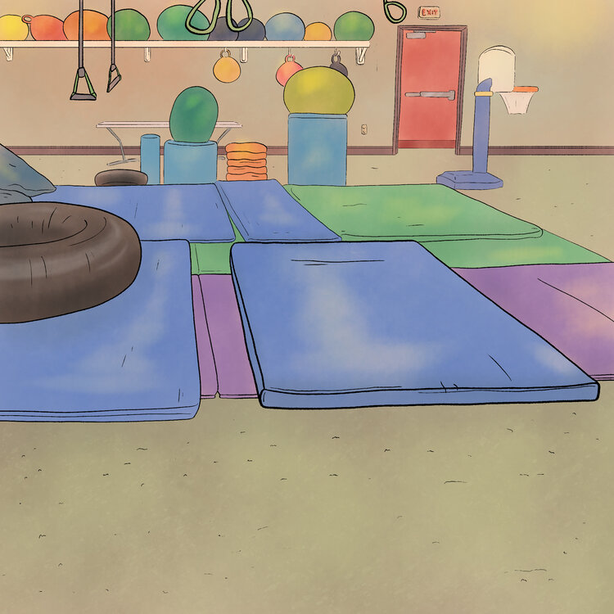
Sara Caudill
The Ohio State University
MFA Candidate, Design
Summer 2021
Previous Work:
Hospital Heroes: Rugby’s Medical Adventure, Children’s Book Illustrator
NASA AFRC,
Summer/Fall 2020 Intern
The Ohio State University,
Graduate Teaching Assistant
Fox TV Animation,
The Simpsons Intern
Fulbright Korea,
English Teaching Assistant
Artist: Sara Caudill

Slide 3
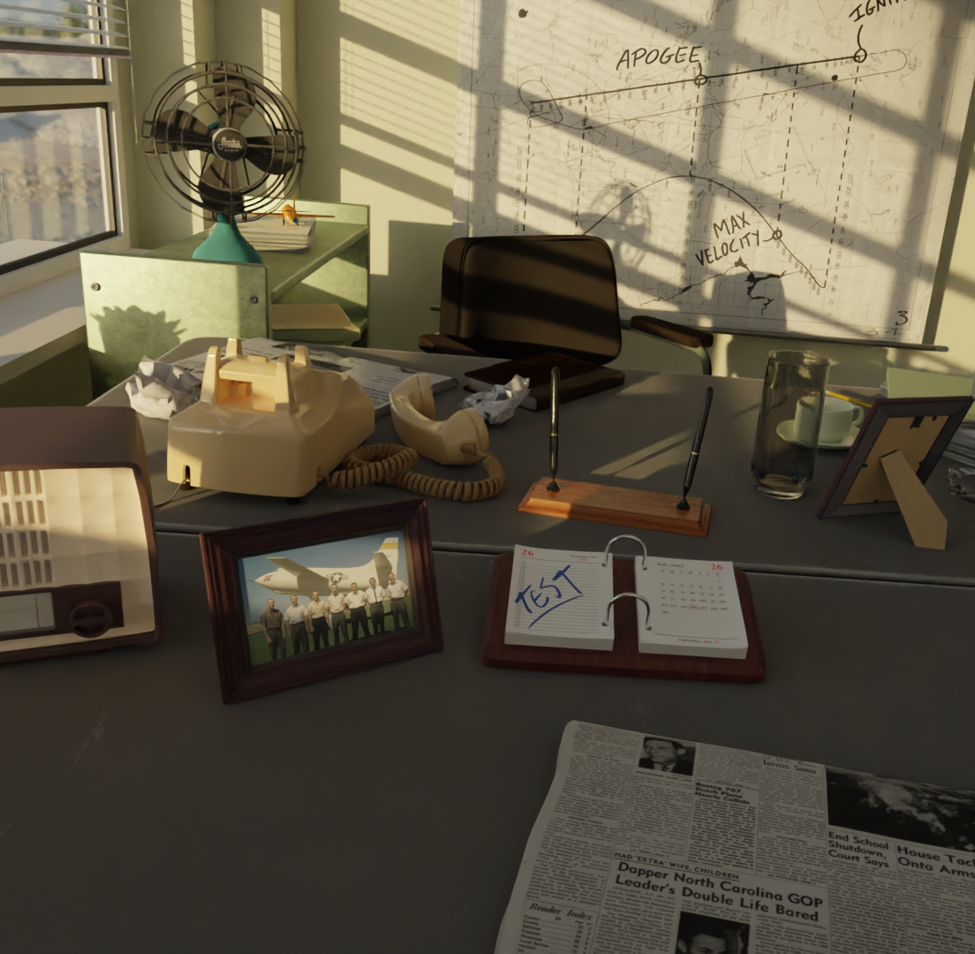
Overview
  Intern-led narrative Virtual Reality (VR) experience intended to demonstrate the AFRC Sim Team’s ability to calculate the dynamics of an aircraft in a story-driven flight simulation
3D Render Artist: Sara Caudill

Slide 4
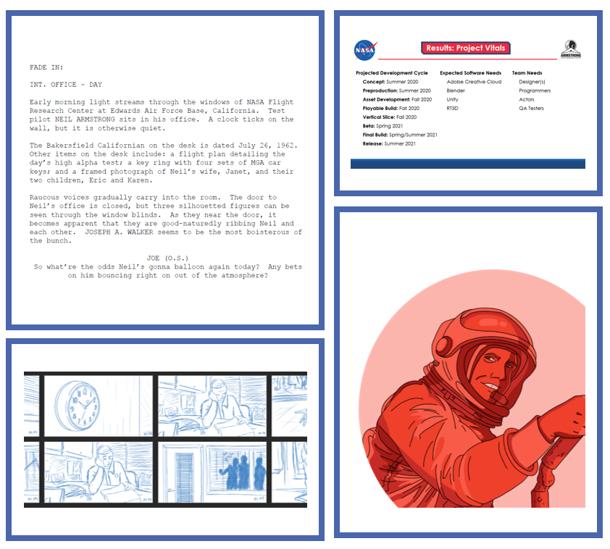
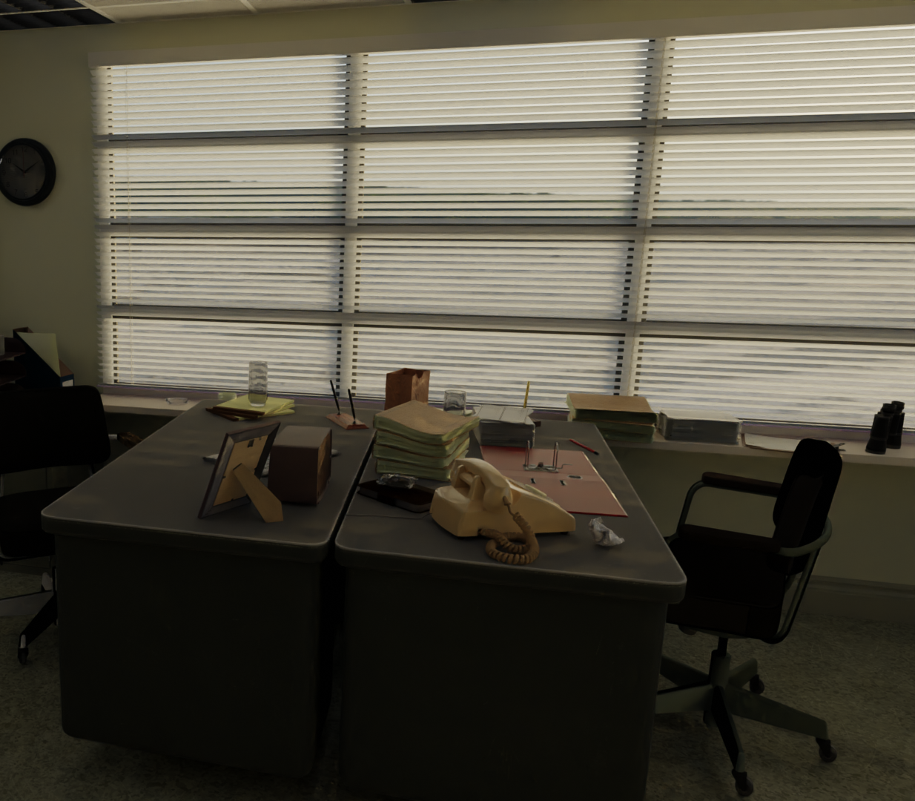
Background
Summer 2020: Game Design Document
Fall 2020: Tech Demonstration and Teaser Trailer
2D/3D Artist: Sara Caudill

Slide 5
Tasks
Project Management
Oversaw production calendar and team meetings
Drafted New Technology Report (NTR) and Request for Information (RFI)
Served as point-of-contact with various stakeholders and SMEs
Environment Design
Used Blender 3D modeling software to prototype EAFB runway
Built environment in Godot with purchased assets
Edited dialogue voiceovers in Adobe Audition for atmosphere and tone
CIF Allocation
Managed proper use of funds received from successful 2020 CIF proposal
Purchased high-quality, fully animatable cockpit, as well as 3D environment and asset models

Slide 6
Project Management
Project manager of growing cross-disciplinary team as Greater Heights shifted from pre-production to production phases
Coordinated meetings with internal and external subject matter experts
Worked with Aamod and team to set short-, mid-, and long-term deliverables

Slide 7
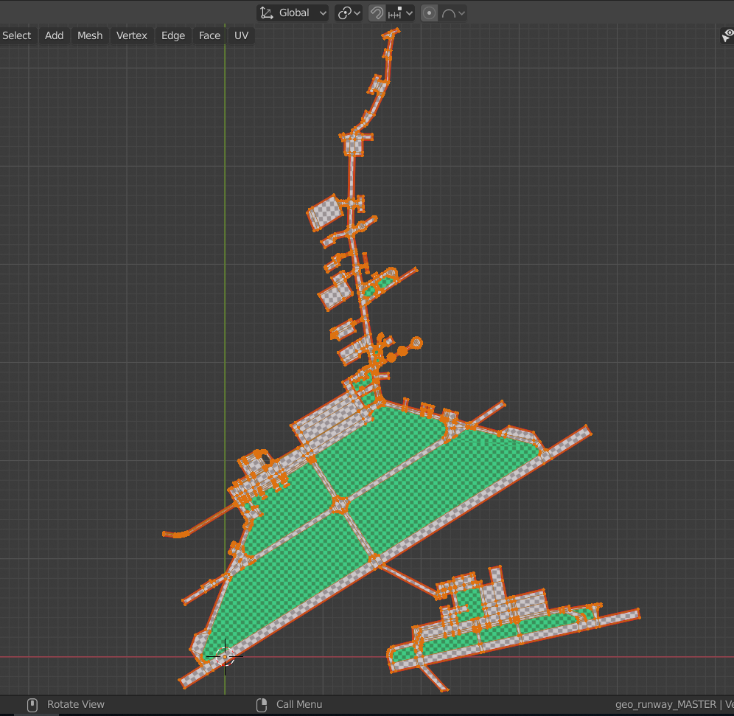
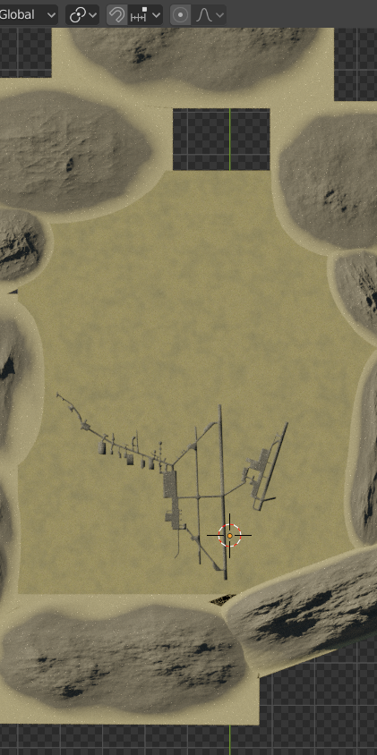
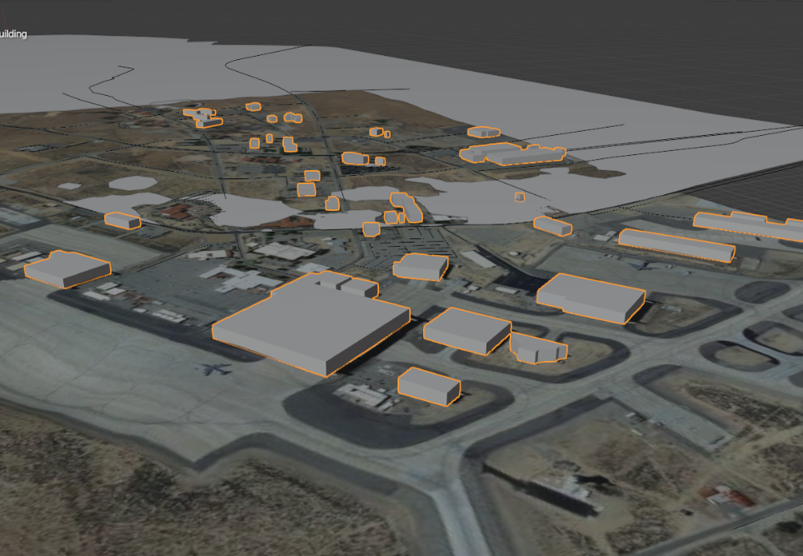
Environment Design
Artist: Sara Caudill

Slide 8
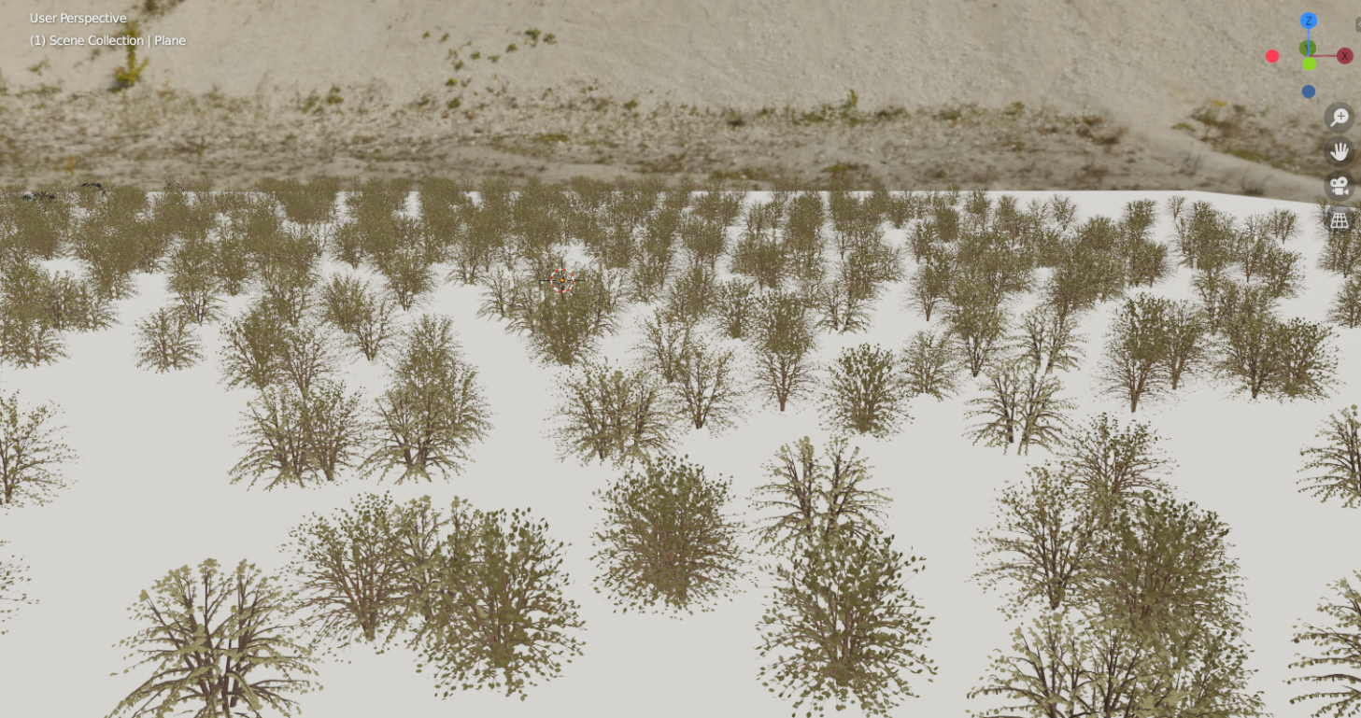
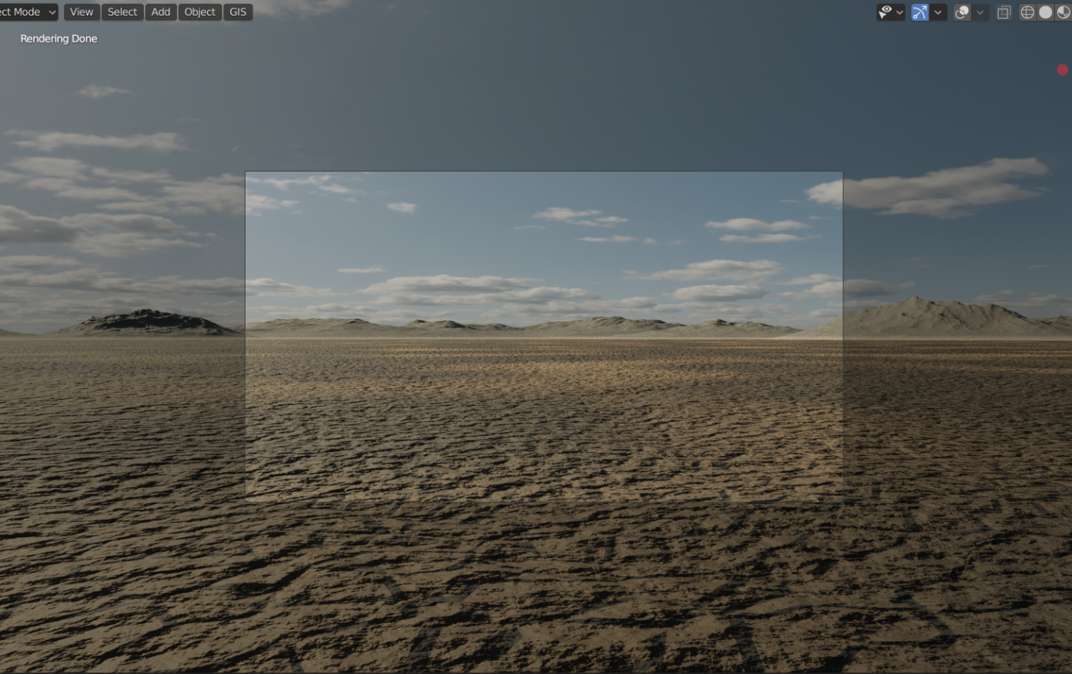
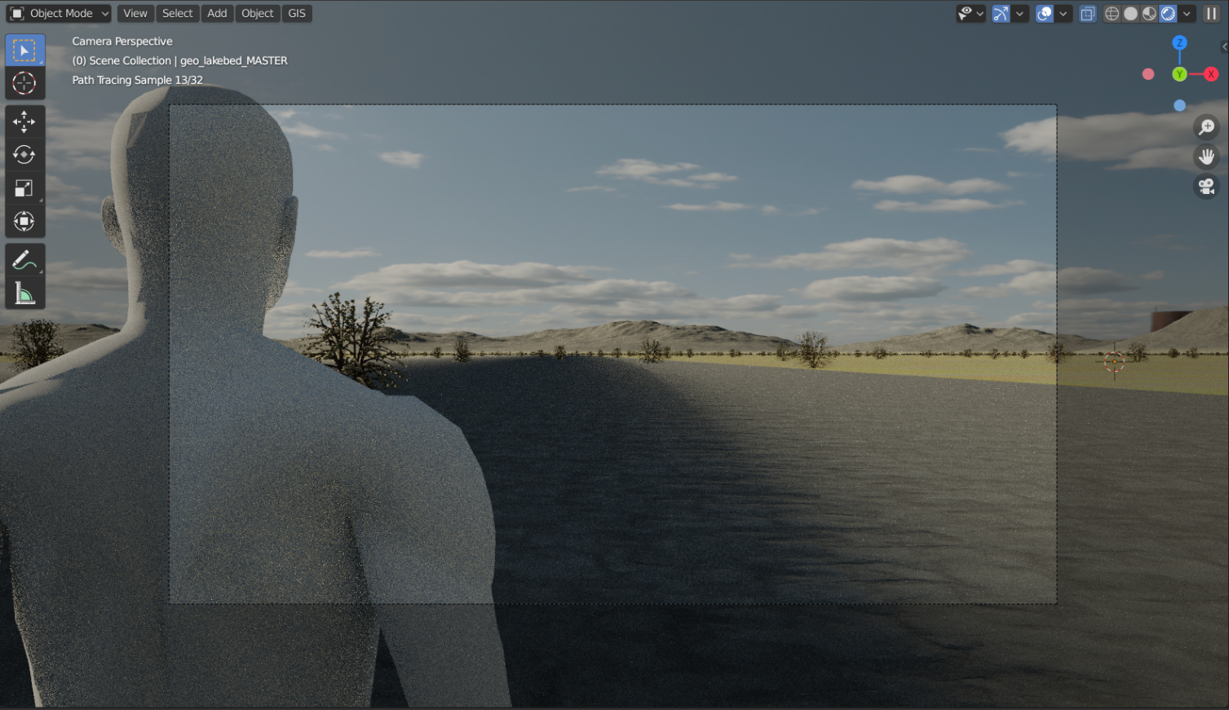
Environment Design, cont.
Artist: Sara Caudill

Slide 9

Environment Design, cont.
Scratch
RAW
Final

Slide 10
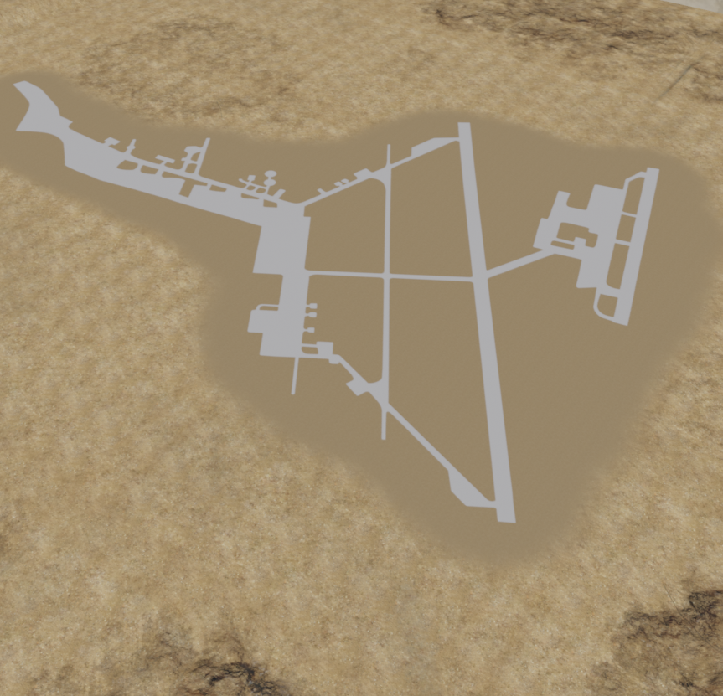
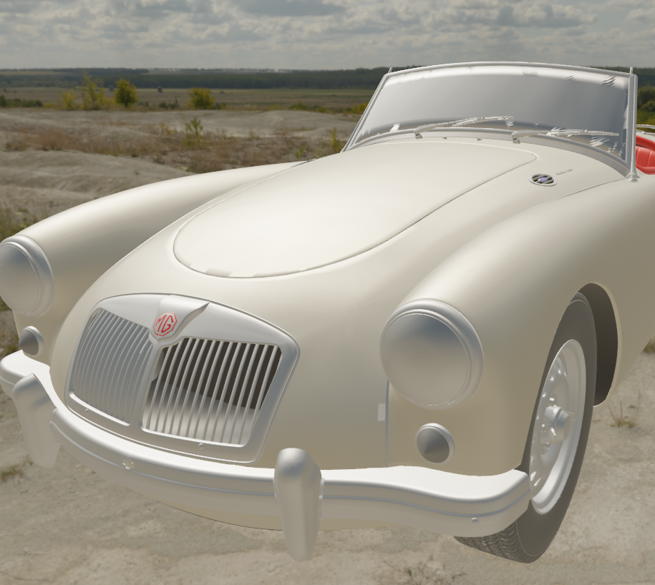
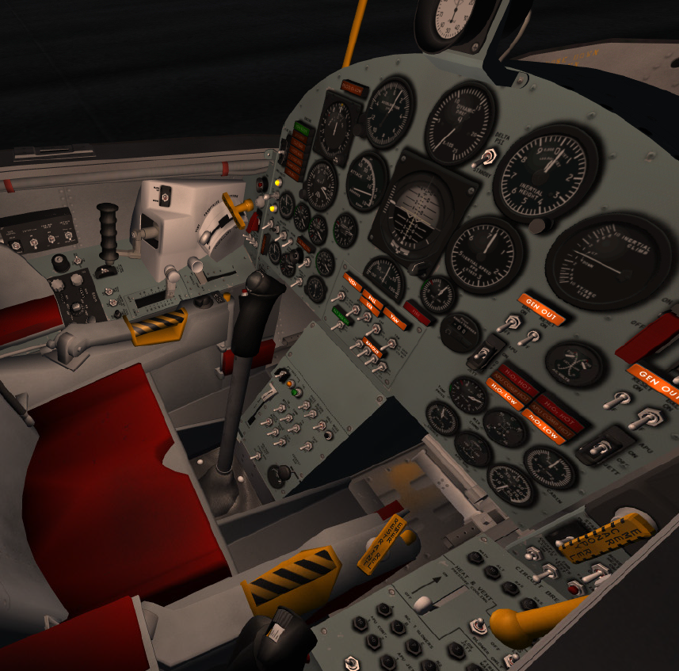
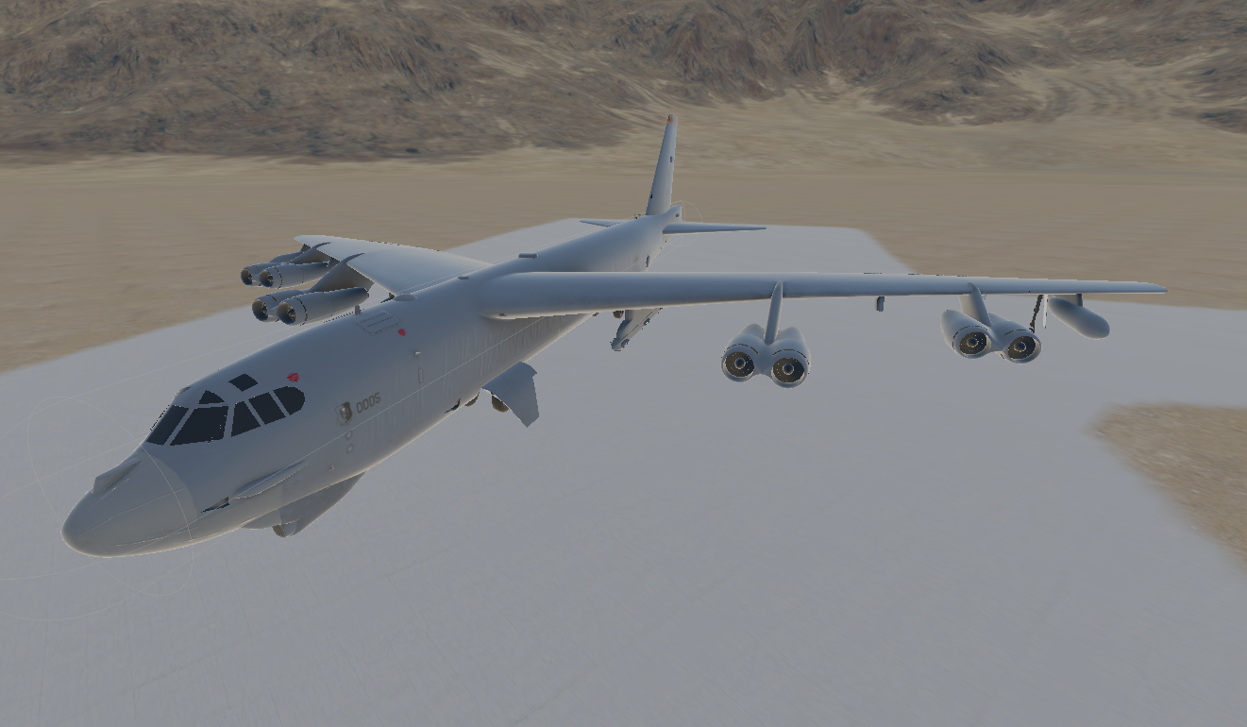
CIF Allocation
Purchased 3D Assets

Slide 11
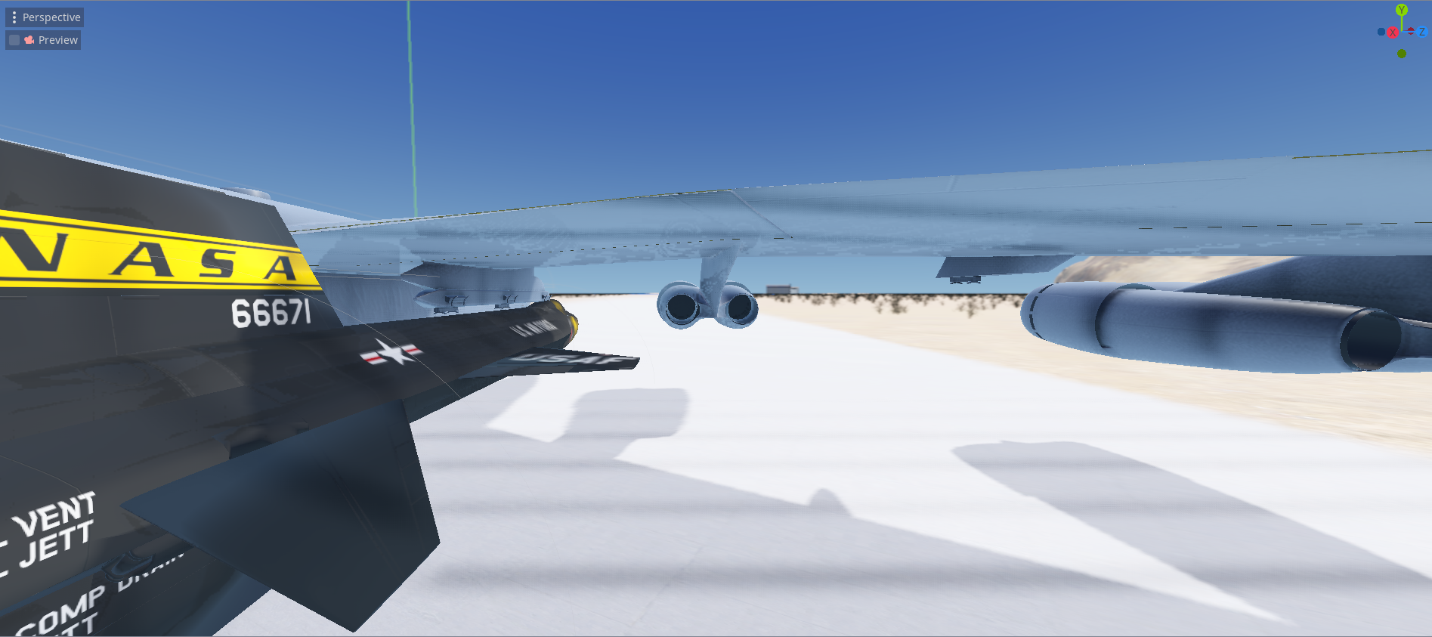
CIF Allocation, cont.
Purchased 3D Assets

Slide 12
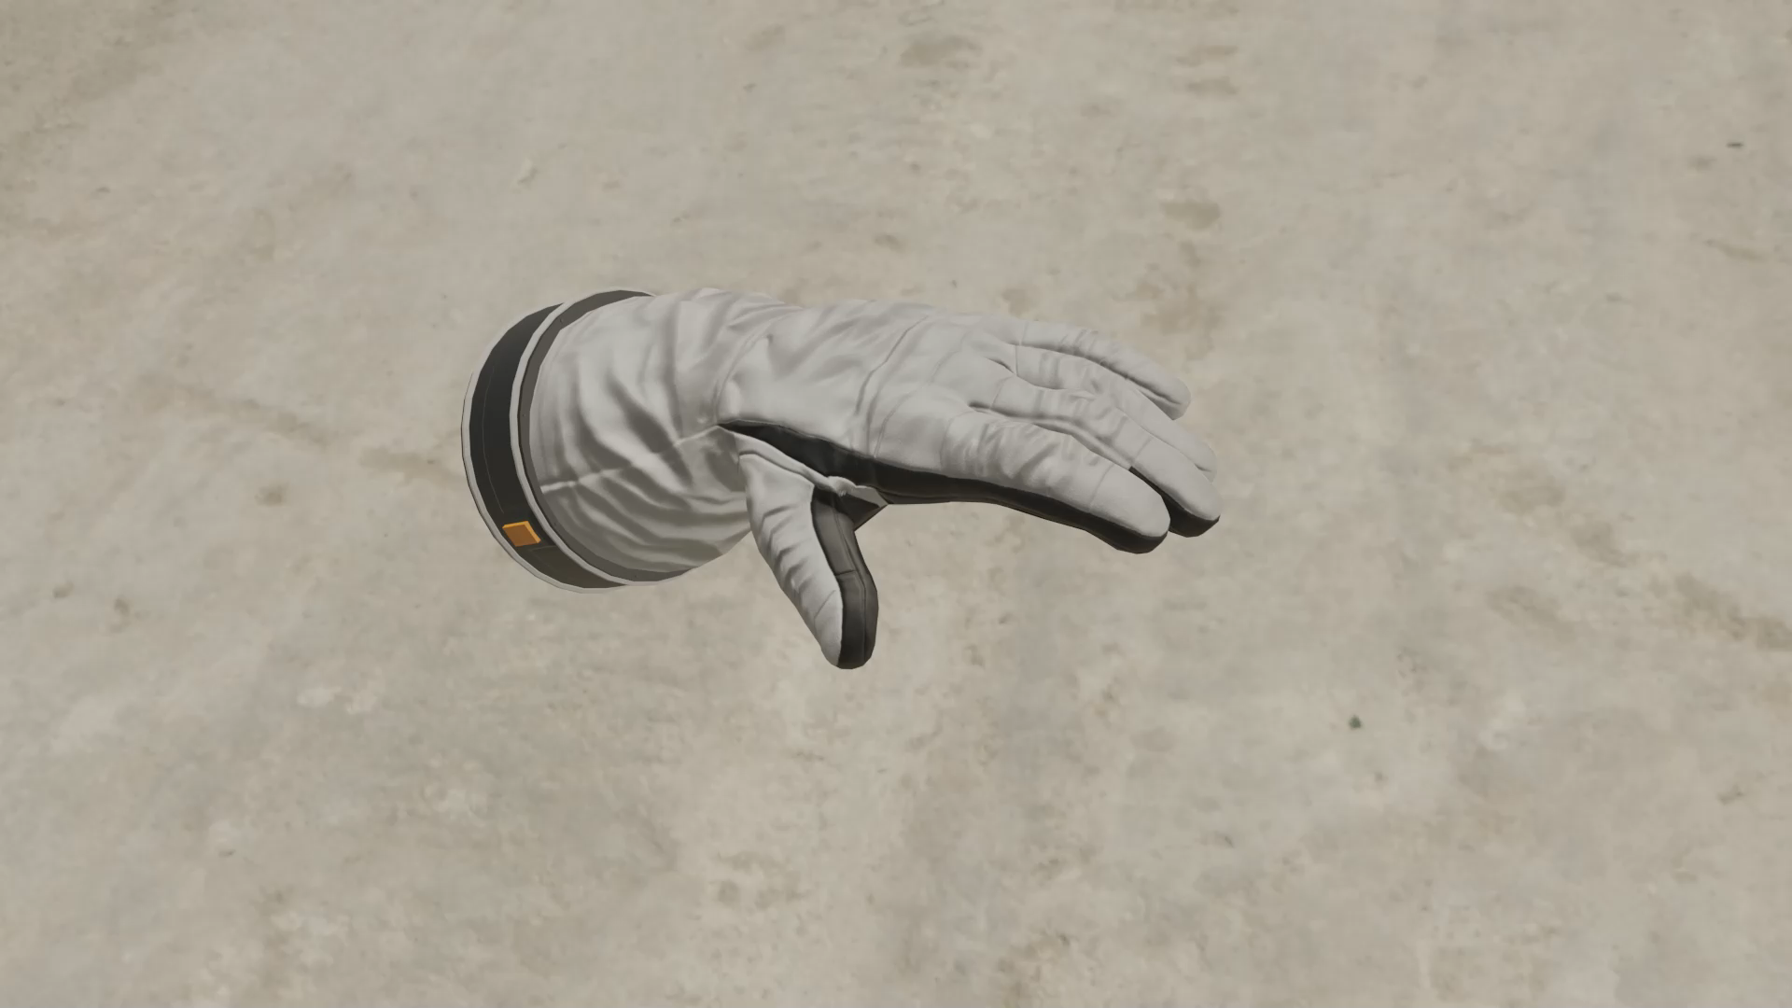
CIF Allocation, cont.
3D Render Artist: Sara Caudill

Slide 13

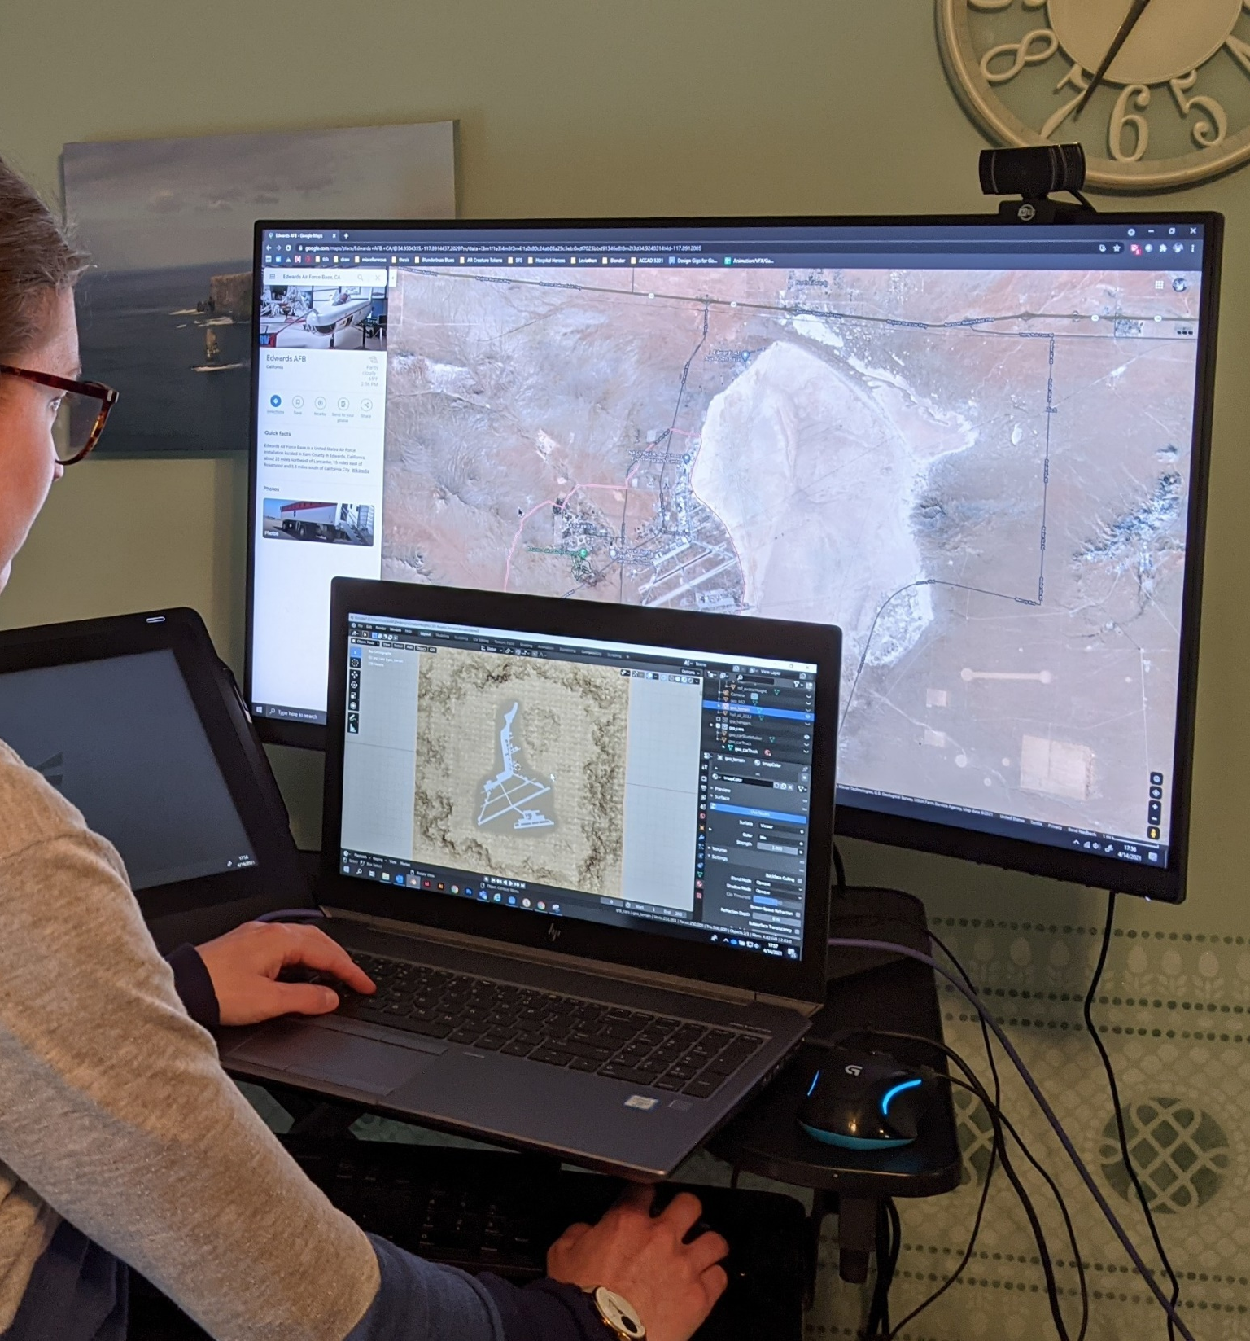
Lessons Learned
Iterate, iterate, iterate—then lock it in.
Don’t hesitate. Explore the new technology. Ask the question.
We’re all still learning.
Pictured: Sara Caudill on her work laptop

Slide 14
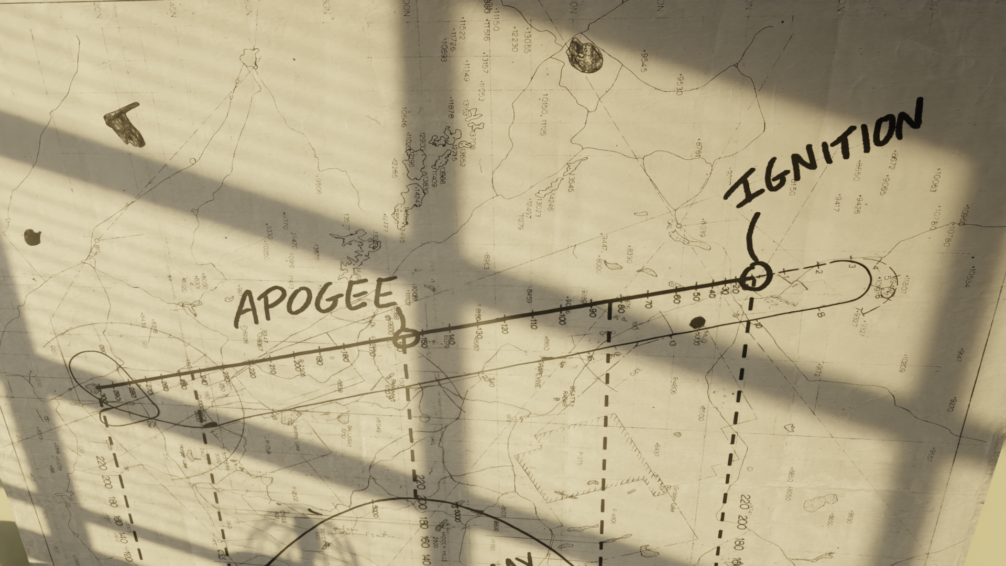
Next Steps
3D Render Artist: Sara Caudill

Slide 15
Acknowledgements
A big thanks to the Sim Team, Aamod Samuel, Kevin Rohrer and the rest of the PAO, Lisa Illowsky, Dave Voracek, the Greater Heights intern team (Neil Malik, Casey Merritt, and Stephen Clarke), and my family who had to hop over the ethernet cable snaking through the hallway each day!

Slide 16
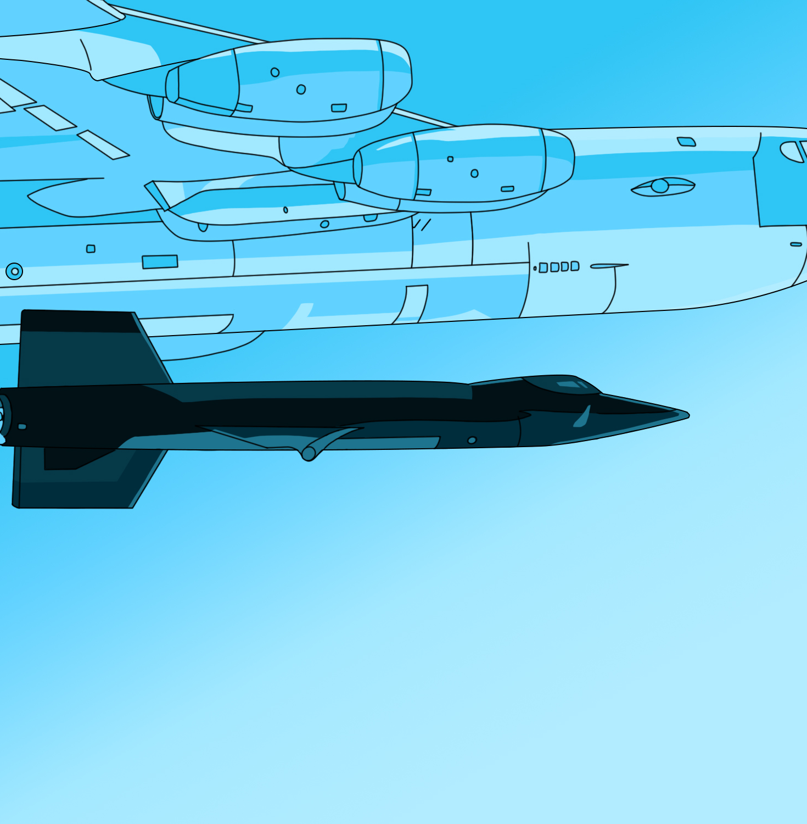
Q&A
Contact:
sara@saracaudill.com
Artist: Sara Caudill

