Slide 1

Developing Autonomous Medical Capabilities for Exploration Spaceflight
Dr. Shean E. Phelps, MD, MPH^{1,2}
Associate Element Scientist
Dr. Ben Easter, MD, MBA^{1,3}
Deputy Element Scientist
Dr. Kris Lehnhardt, MD, FRCP^{1,4}
Element Scientist
(¹NASA ExMC, ²KBR/University of Texas-Medical Branch, ³University of Colorado, ⁴Baylor College of Medicine)
Exploration Medical Capability (ExMC)
NASA Human Research Program (HRP)
Johnson Space Center (JSC), Houston, TX
26 May 2021
“Expanding the Boundaries of Space Medicine & Technology”

Slide 2
BACKGROUND
NASA Human Research Program (HRP)
Human Research Program Elements

Slide 3
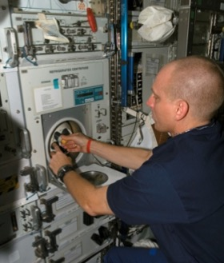
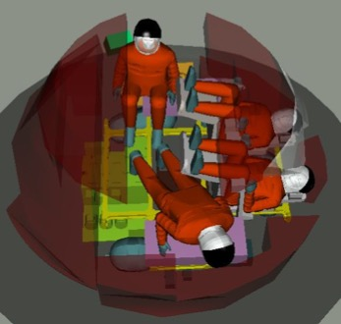
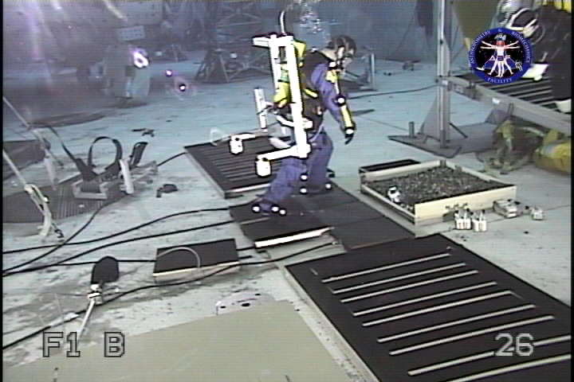
NASA HRP: An Applied Research Program
The Human Research Program (HRP) focuses on applied research
Program goals …
  Perform research necessary to understand & reduce spaceflight human health & performance risks in support of exploration
  Enable development of human spaceflight medical & human performance standards
  Develop & validate technologies that serve to characterize & reduce medical risks associated with human spaceflight
Identify & Reduce Medical Risk
Notes:
Characterize risk to human health & performance in spaceflight
Developed, test, & validate countermeasures for these risks
Integrate these countermeasures into relevant systems, such as a Crew Health & Performance System
Not just publishing papers, but impacting system design
Ultimate goal of keeping crew alive, healthy, happy, & productive in space

Slide 4
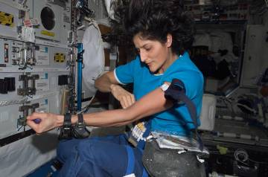

Characteristics of the Human Research Program
Composed of five “Elements”
  Exploration Medical Capability Element
    Medical care for deep-space missions
  Human Factors & Behavioral Performance Element
    Interfaces between humans, vehicles & habitats
    Individual & interpersonal factors
  Human Health Countermeasures Element
    Physiological challenges
  Space Radiation Element
    Biological effects of radiation exposure & mitigating strategies
  Research Operations & Integration Element
    Infrastructure for flight & analog experiments
Translational Research Institute for Space Health (TRISH)
  Cooperative Agreement:
    Baylor College of Medicine, California Institute of Technology & MIT
  Pursue research that complements HRP portfolio
  Focuses on “high risk/high reward” projects

Slide 5
HRP Human Research Roadmap

Slide 6
Outline
Human “Exploration Class” Spaceflight Challenges
Risk Drivers (Medical System Needs)
ExMC Areas of Focus & Risks
Trade Space Definition & Probabilistic Analysis
Autonomy (ExMC perspective)
Technology Examples & Demonstrations
Summary
Questions/Comments

Slide 7
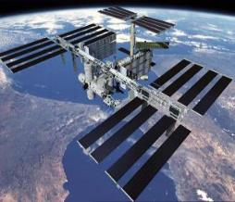
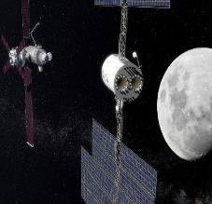
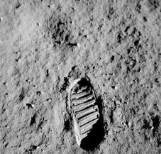
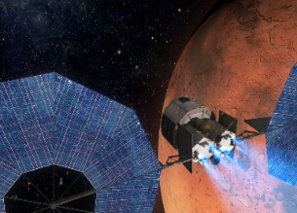

Challenges: Today, Tomorrow, & the Future
ISS
Gateway
Lunar
Mars Transit
Increasing exposure to Hazards
Current State
180 to 360 day mission duration w/ strong consumables resupply
Real-time communications: MCC decision centric
Regular sample return to Earth allows detailed analysis if unknown problems develop
In the event of an emergency, crew to be stabilized & evacuated (generally <1 day to terrestrial care)
Limited on-board medical knowledge/skills/abilities (Earth reliant)
Exploration Class Missions
650 to > 900 day mission duration w/ Zero Consumables Resupply
No Real-time communications: Crew must autonomously address emergencies; MCC = supporting role
Access to Info: Primary enabler for autonomy; No sample return = on-board analytical capabilities
Limited mass, power, volume, & data: Requires vehicle integrated crew health systems
No Evacuation: Sufficient supplies + KSA’s to fully manage medical/ health issues independently required
Notes:
Need to understand briefly the current operational paradigm for providing medical care
ISS only 250 miles above us, minimal communications delay
Flight surgeon sitting in MCC having real-time audio/video convo with crew
Real-time remote guidance for Ultrasound or other medical technologies
close-proximity earth-centred mission, Mission CONTROL
In some ways, over-winter crews in Antarctica are more isolated than the ISS
Let’s contrast that operational model to going to the Moon or Mars
Problem is distance, 250 miles to ISS, 1000x farther to the Moon, 1000x farther to Mars- more time in an unhealthy environment- radiation, partial gravity, isolation with the same humans
That distance creates 3 main problems
Communications- up to 24 min delays one way- real-time guidance/interaction are gone
Evacuation- Orbital mechanics- you can’t come mid-mission, no turning around; whatever happens, you’re there
No resupply- whatever you launch with is what you’ve got (maybe pre-positioning of durable supplies, but only 16% of meds on ISS would last three year shelf life, let alone radiation; food concerns).
The operational models we use today for the ISS & have developed up until now are insufficient to meet the challenges as we go further out from earth.

Slide 8
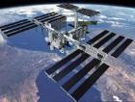
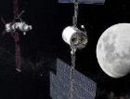

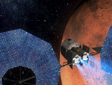
Risk Drivers for Medical System Needs
Mission Duration
&
Hazard Exposure
Resupply &
Evacuation
Capability
On-Board
Decision Making
(comm delay)
On-Board
Capabilities
Influencers
Mission duration & high-level objectives
Distance from Earth
Acceptable mission risk
Time to definitive medical care
Health & performance needs
Level of training for on-board medical provider(s)
Technology developments & medical advances
Crew selection & pre-flight health status
Shorter
Possible
Minimal
Less
Longer
Impossible
Substantial
More

Slide 9
ExMC Mission, Goals & Areas of Focus
Goal: Perform applied research & technology development to inform NASA medical specifications & standards as well as exploration systems engineering requirements
Scientific & Clinical Research to update standards & develop medical system requirements
Medical & Crew Health & Performance Systems Engineering to create & trace medical system requirements & specifications using Model Based Systems Engineering & to develop a suite of trade space analysis tools
Tech Development & Demonstration to validate medical system requirements & inform specifications
Scientific & Clinical Research
Systems Design
Technology Development & Demonstration

Slide 10
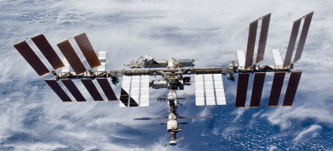
ExMC Risks
In-Flight Medical Conditions
Pharmacy
  Ineffective/Toxic Medications & Pharmacokinetics/Pharmacodynamics
Celestial Dust
Bone Fracture
Renal Stones

Slide 11
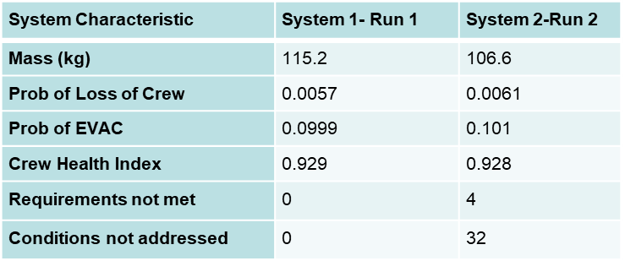
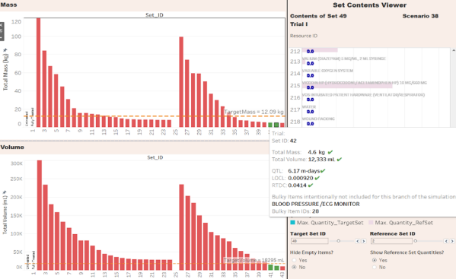
Medical Trade Space Definitions: Probabilistic Risk Analysis
Medical System Questions
What medical events do we expect to happen?
How do mass/volume/power allocations affect risk?
What if spacewalks are added to the mission?
What if the mission duration is extended?
Which imaging technology is most useful? Ultrasound or X-ray?
What is the medical risk of reducing crew's water rations from 3L to 2L daily?
How far from Earth are we?
What’s the communication delay?
Do we really need all this stuff?
42 day cis-lunar mission
Notes:
Evidence-based approach that ties the LxC of conditions to the capabilities needed to the specific resources
Difficult to characterize because medical data is incomplete & fragmented; doctors can’t push our system to failure to better define how successful a treatment is
Invest in evidence collection to answer the type of trade questions described here

Slide 12
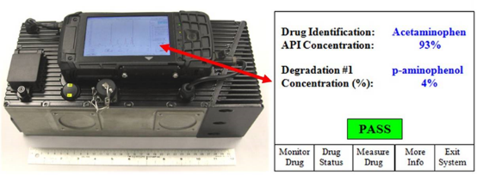
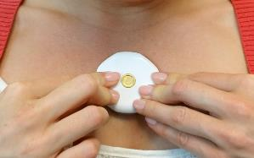
Autonomy: Medical Capabilities for Long Duration Space Flight
As the need for on-board decision making & on-board medical capabilities increases for exploration missions, autonomy (for NASA) means progressive Earth independence
New paradigm when compared with medical operations in low Earth orbit
Examples of autonomous medical capabilities
In-situ, real-time analysis (versus sample collection & return to Earth for analysis)
Enhanced in-mission medical procedure support
Advanced computing tools to support on-board diagnosis & clinical decision-making
Efficient & novel uses of on-board resources to minimize re-supply needs

Slide 13
Technology examples
-In-situ Analysis, Imaging, Medical Procedure Support, On-board clinical decision-making support

Slide 14
In-situ analysis
Laboratory & Pharmaceutical

Slide 15
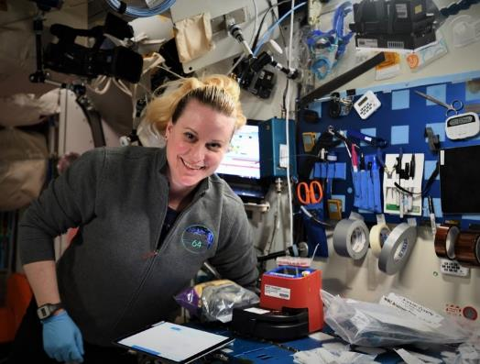
HemoCue® Technology Demonstration
ISS on-board testing is currently in-process
Doctors on Earth commonly use a white blood cell count to aid in their diagnosis of sick or injured patients
This technology has the ability to rapidly provide total & differentiated white blood cell counts in the spaceflight environment with Earth lab-accurate results
Uses include diagnosing illness & monitor conditions such as a bacterial/viral infection or radiation exposure, track the response to treatment, & assess the severity of an illness in-mission
Successful integration of an on-board medical capability for blood analysis could provide an important tool for meeting the medical diagnostic needs of exploration missions beyond low Earth orbit.

Slide 16
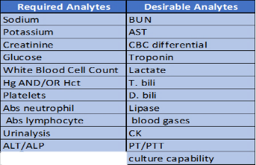
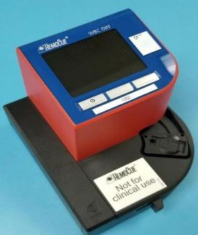
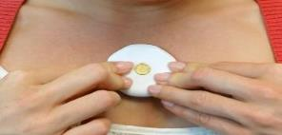
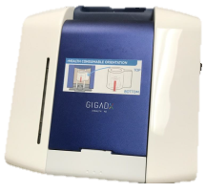
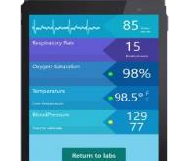
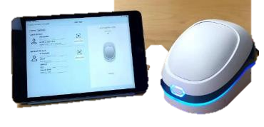
ISS Tech Demos: rHEALTH ONE® & HemoCue®
Integrated blood analyzer & vital signs sensors: ISS technology demonstrations using COTS process to validate spaceflight performance
  HemoCue® White Blood Cell count & 5-part differential
  rHEALTH ONE® Integrated blood analyzer & vital signs sensor, 2-channel laser flow cytometry of hemoglobin; nano-strips measure other analyte concentrations (next gen = rHEALTH AWESOME®)
    Cytometry measures blood cells, light level measures hemoglobin & nano-strips measure other analyte concentrations

Slide 17
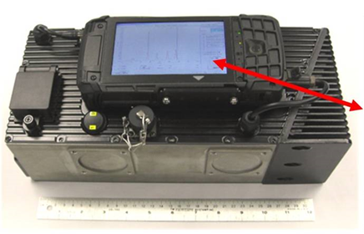
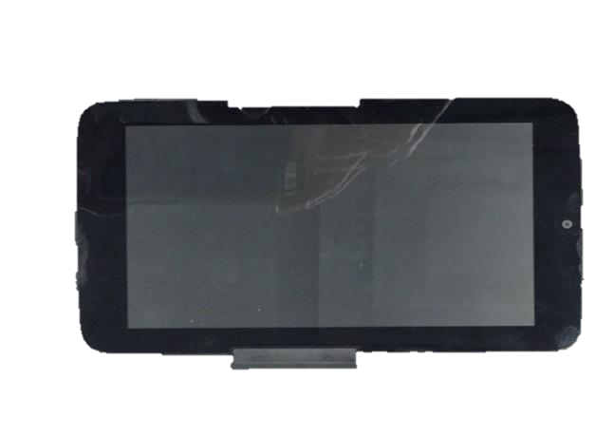
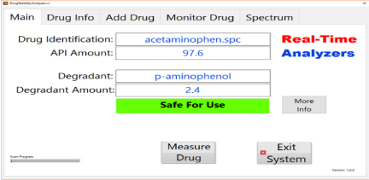
Real-Time Medication Stability Assessment
Potential future technology demonstration could include Raman spectrometer & automated indexing mechanism to align pharmaceuticals for analysis
Capability could be integrated into future exploration medical systems to increase confidence in medication effectiveness after long-duration exposure to the spaceflight environment

Slide 18
IMAGING
Clinical & Research

Slide 19
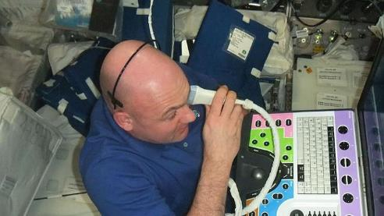
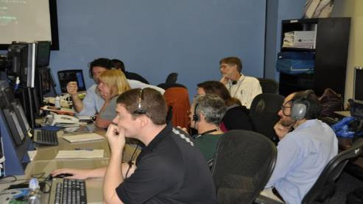
Imaging in the Exploration Environment
Why imaging?
  Of the 100 conditions that we scope medical system for:
    44 amenable to Ultrasound
    27 amenable to X-Ray
  Possibly therapeutic (renal stone propulsion trial)
Current Capability
  US: on ISS
    Minimal pre-flight training
    Real-time guidance from ground
  XR: none

Slide 20
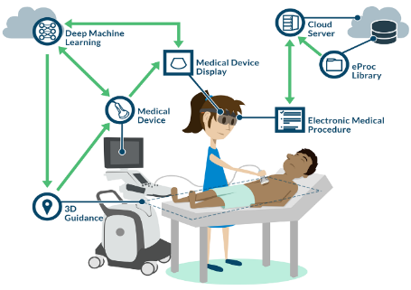
Imaging Challenges
Ultrasound
  Operational Challenges
    How to obtain images?
      Significant advanced training & Real-time guidance
      AR/VR
      COMfORT/AMOS
    Image Interpretation
      Store & forward w/ AI or Machine Learning
X-Ray
  Engineering Challenges
    Additional radiation
    Detector can be exposed by space radiation
    Mass, power & vibration
  Operational Challenges
    High-quality images & Image interpretation

Slide 21
Medical procedure support
Software

Slide 22
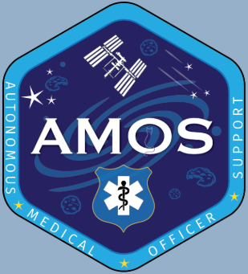
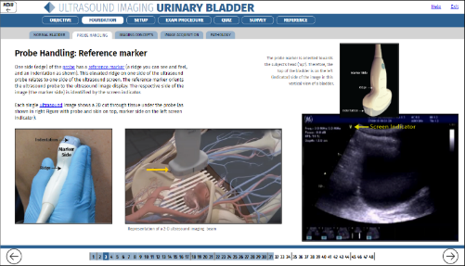
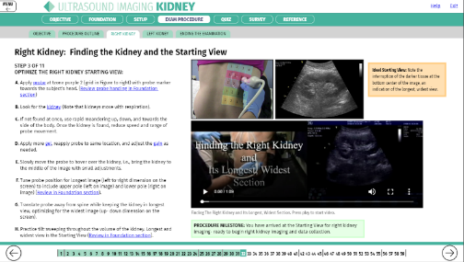
Autonomous Medical Officer Support (AMOS) Software
Description:
Software tool that can fulfill three functions:
  Prefight training
  Onboard just-in-time (JIT) or refresher training
  Guidance for autonomous medical procedures
Intuitive menu-driven, human-centered, modular design
Current modules include kidney & urinary bladder ultrasound
Platform technology - extensible to other non-medical subject areas
Purposes:
Enhance telemedicine capabilities
Enable autonomous procedure performance
Streamline training & skill retention
ISS technology demonstration completed – Spring 2020

Slide 23
On-board clinical decision-making support
Clinical Decision Support (CDS) Project

Slide 24
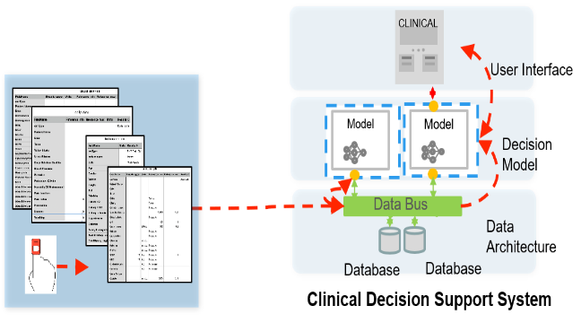
Clinical Decision Support (CDS) Project
  For exploration missions, computational & data resources will play an important role in maintaining crew health, wellness, & performance (where the crew will need to be more self-reliant)
  CDS objectives include:
  Develop potential requirements for an in-vehicle integrated crew health & performance (CHP) data management & clinical decision support system
  Enhance on-board applications of health & performance knowledge & information to enable the crew to make complex clinical decisions that would otherwise be made by Earth-based support personnel

Slide 25
Technology Demonstrations
Novel uses of on-board resources

Slide 26
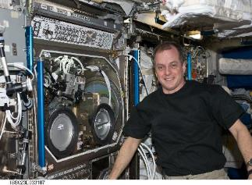
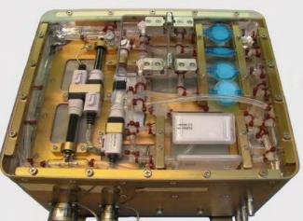
ExMC/GRC Projects ELA Portfolio
Intravenous Fluid Generation (IVGEN)
Developed & delivered a compact water purification system producing sterile water for injection from potable water on-board ISS
Needs:
  Produce sterile water in sufficient quantities as needed for medical operations
  Mass limitations & access to refrigeration limit the type & volume of IV fluids that can be carried aboard a spacecraft
  Solution must require significantly less volume & mass than flying IV fluids from Earth
ISS Tech Demonstration—Expedition 23
  Utilizing in situ potable water, demonstrated
    Purification & bubble removal
    Sterilization
    Microgravity mixing
    Compliance with medical standards
Work beginning now to:
  Miniaturize capability
  Integrate with life support systems

Slide 27

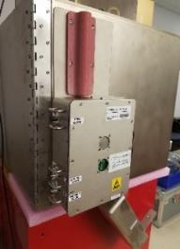
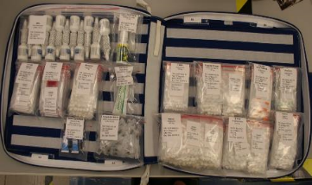
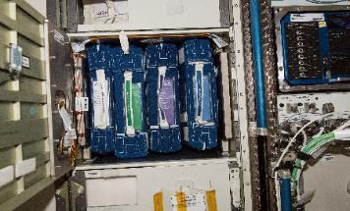
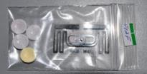
ExMC/GRC Projects ELA Portfolio
Medical Consumables Tracking (MCT)
Medical Consumables Tracking (MCT) – track pharmaceuticals using RFID technology
  Develop a RFID-based system that inventories hundreds of medical items in a locker setting (near-field) & transmit time stamped usage date securely (anonymity & encryption) to ground
  Designed a low-profile near-field antenna that can read high tag density applications (~500 tags)
  Successfully operated on ISS, surpassing designated operational life
Forward Work:
  Make the flown & engineering model H/W & RFID tags available for use in ground analog missions
  Incorporate requirements for this capability in future systems

Slide 28
Summary
The NASA Human Research Program has been working on autonomous medical capabilities for over a decade
Many necessary steps in order to gain acceptance & buy-in from all stakeholders:
  Ground development & testing
  Creation of new approaches to medical protocols & procedures
  Deployment into analog environments
  Technology demonstrations on ISS, in lunar orbit, & on the lunar surface
  Transition to operations
Increased effort now to integrate these progressively Earth independent capabilities into future medical & vehicle systems for the Moon & Mars

Slide 29
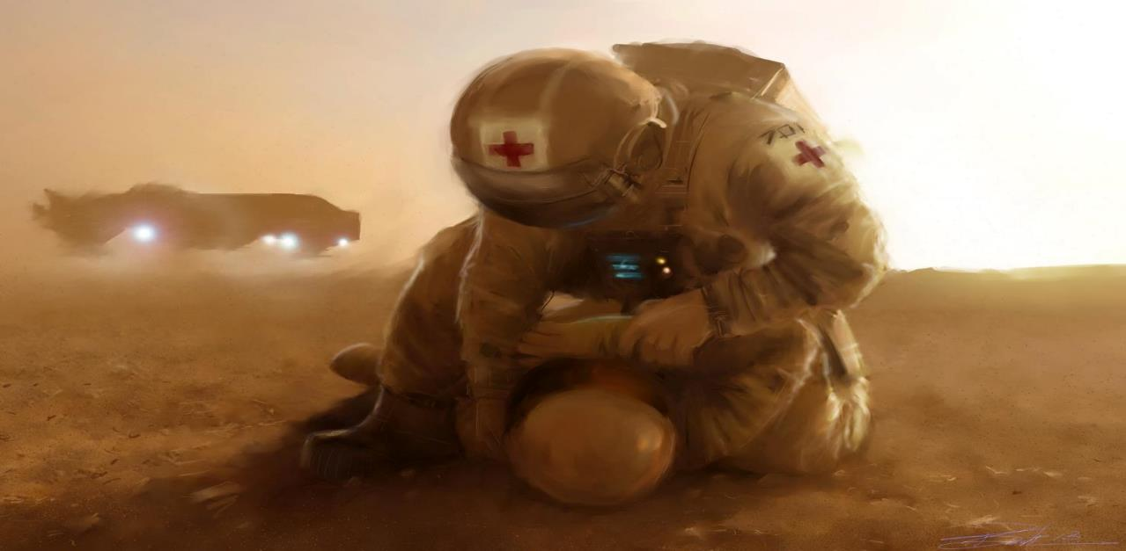
QUESTIONS/COMMENTS

