Slide 1
Space Crop Production
Gioia Massa
NASA, Kennedy Space Center, FL, USA
Feeding Mars - Mars Innovation Forum

Slide 2
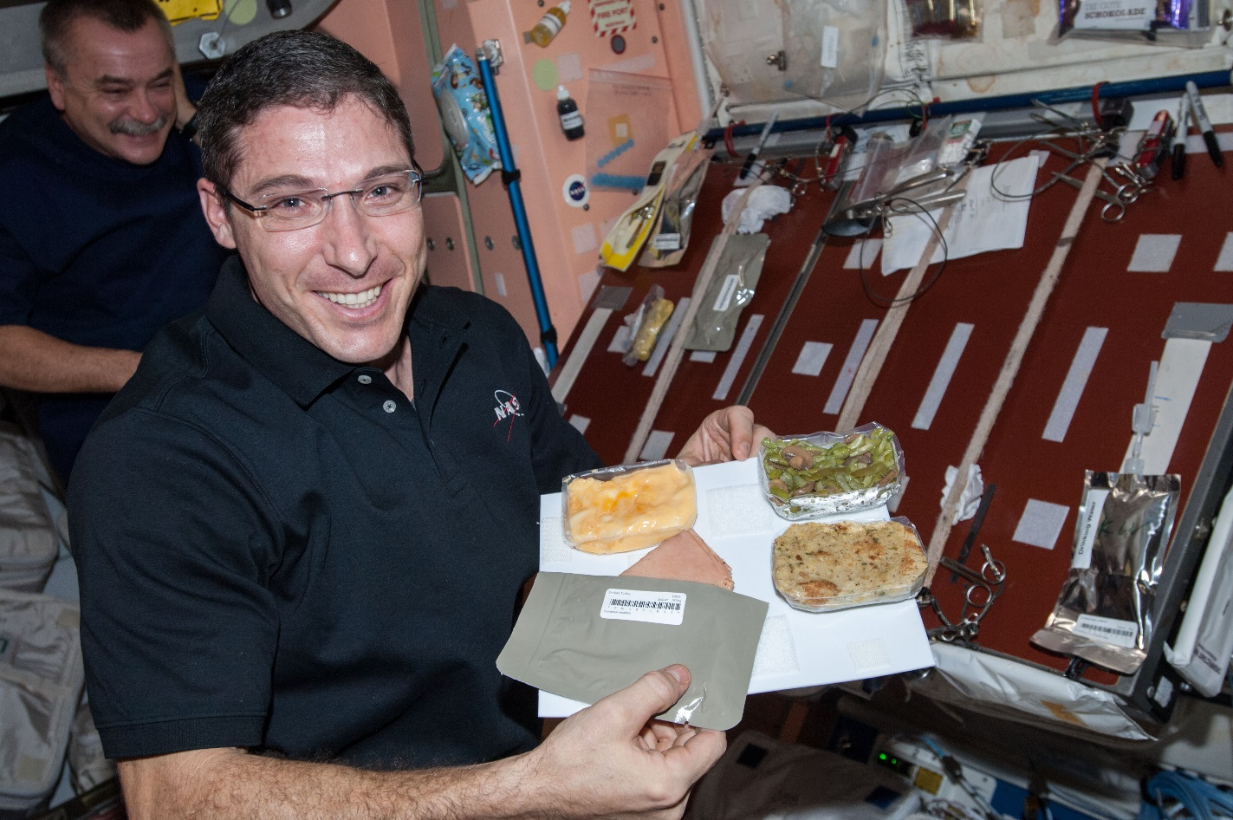
Why plants?
Food
Psychological well being
Atmosphere
Water

Slide 3
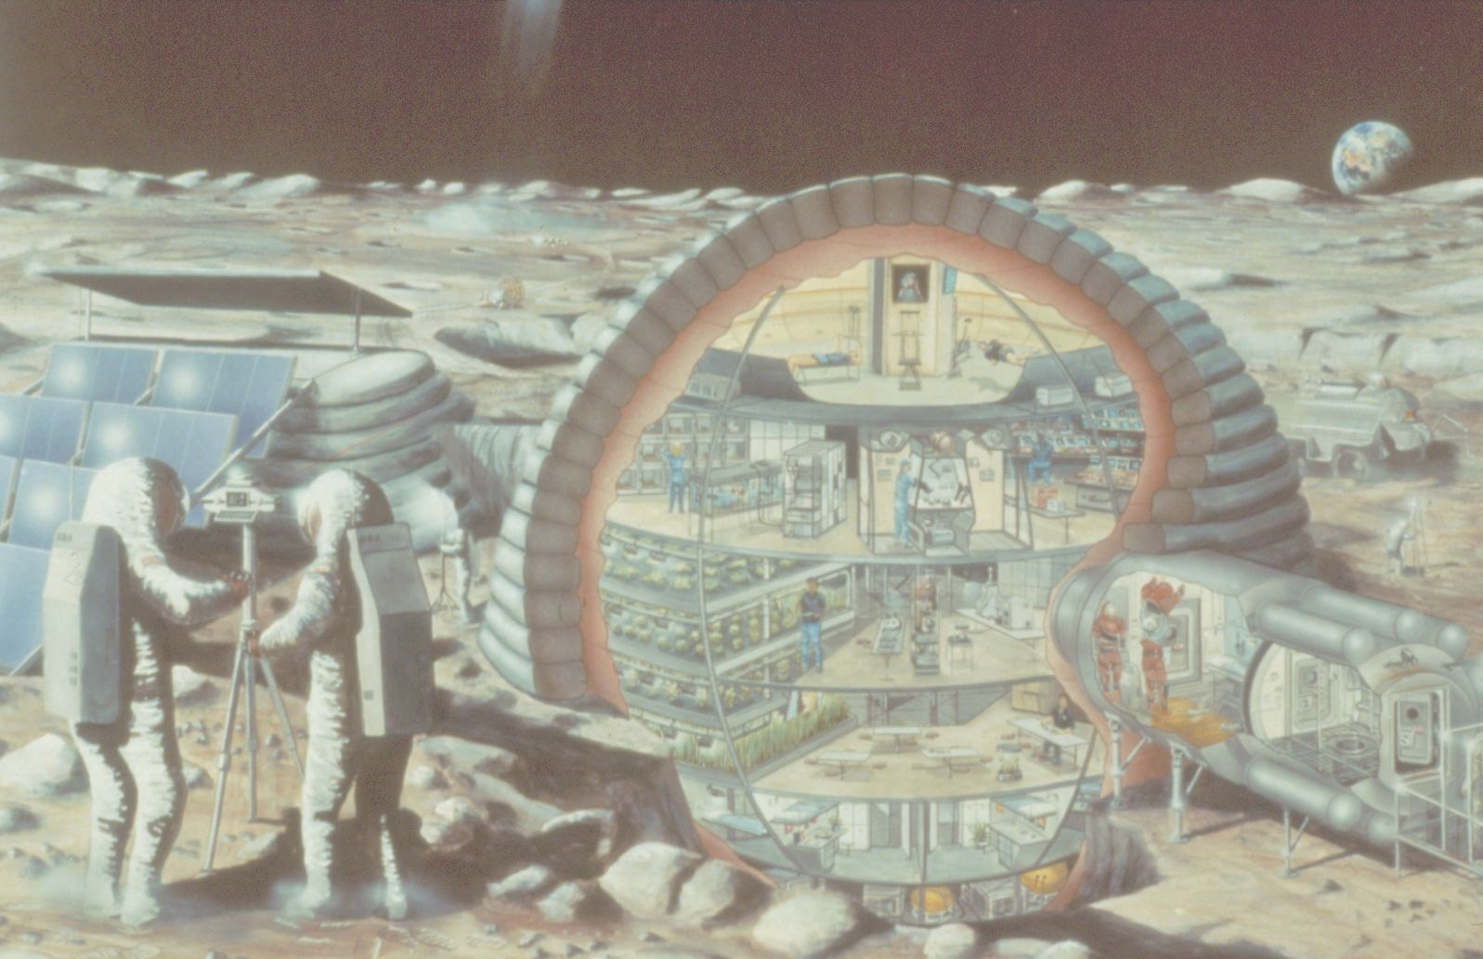

Slide 4
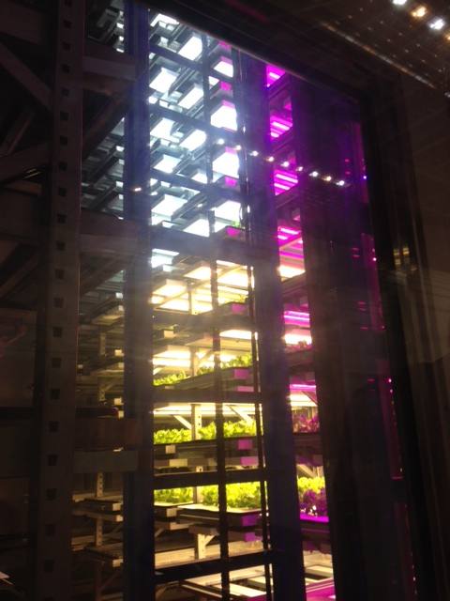
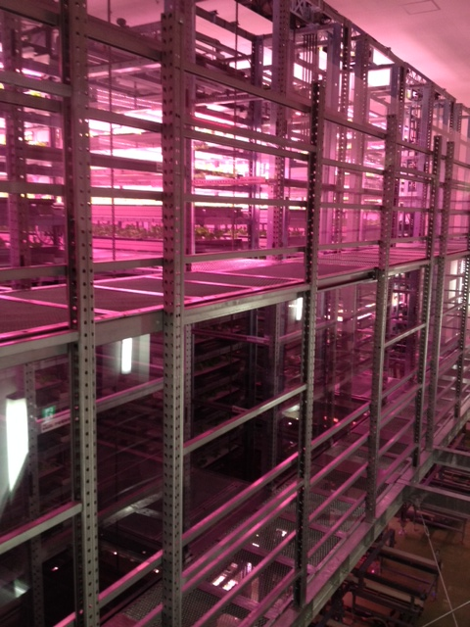
Plant Factories
Photos of Osaka Prefecture University training facility courtesy of Ray Wheeler

Slide 5
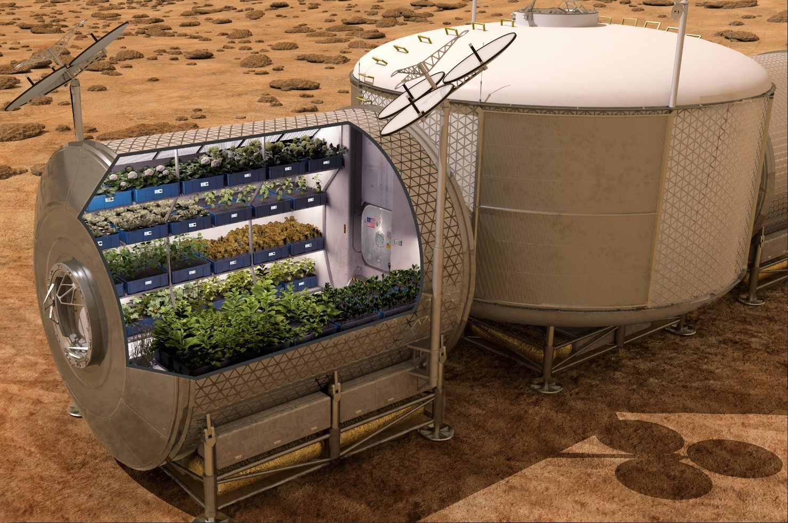

Slide 6
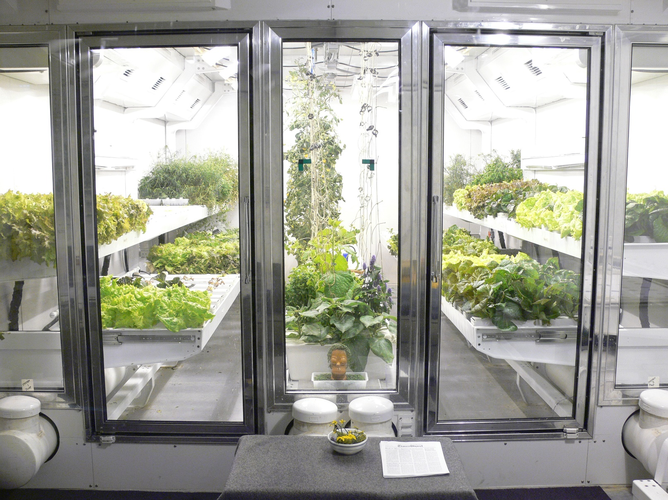
South Pole Greenhouse
Photo courtesy of Lane Patterson

Slide 7
The Space Crop Production Vision
Ensure Food System Security on Long Duration Missions Beyond LEO
Near-Term Goal
Nutrient Supplementation of Prepackaged Food
Long-Term Goal
Caloric Replacement to Facilitate Earth Independence
Notes:
Ralph
Ensure Food System Security on Long Duration Missions Beyond Low Earth Orbit (LEO)
Food and nutrition are the first line of defense for crew health and performance
Provide safe, nutritious and acceptable fresh food
Add variety to crew diet
Enhance morale
* Food security is the condition in which crew have continuous access to sufficient safe and nutritious food which meets both their dietary needs and food preferences in order to maintain peak health and performance.
Nutrient Supplementation of the Prepackaged Food System - Needed for: Deep Space Transport
Fresh produce supplements vitamins (B₁, K, C) and bioactive compounds that degrade in the stored food system on multi-year exploration missions
“Pick-and-Eat” crops that require no processing and minimal preparation will provide variety, customization, and psychological appeal
Enable testing and demonstration of dependable crop production before reliance on system.
Limiting factors are vehicle resources mass, power, volume, water, air, crew time
Caloric Replacement to Facilitate Earth Independence - Needed for: Long duration Surface missions on the Moon and Mars
Reduce up-mass associated with pre-packaged food
In addition to “pick and eat” crops, include staple crops that require processing and preparation
Bioregenerative capability will be required for long duration surface missions

Slide 8









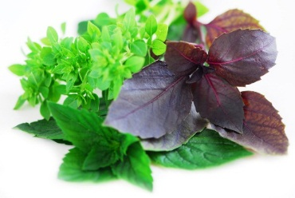


Space Crop Production Candidates
Salad
Leafy Greens
Tomato
Pepper
Radish
Strawberry
Green Onion
Pea
Carrot
Lettuce, Chinese cabbage, Swiss chard, Mizuna, Spinach
Staple Crops
White Potato
Sweet Potato
Rice
Wheat
Dried Bean
Soybean
Peanut
MINIMAL PREPARATION / COOKING
SIGNIFICANT PREPARATION / COOKING
CONSUMED FRESH WITHOUT PROCESSING
Herbs
Basil
Mint
Chives
Dill

Slide 9
Space Crop Production Challenges
Deep Space
Water
Recycling
Radiation
Pressure
Micrometeorites
Surface
Microgravity
Fluid movement
No convection
Dust
Partial gravity
Plant Size
High CO₂
Food Safety / Microbiome
Nutrient output
Sustainability
Abiotic stresses
Vehicle resources
Crew time
Waste
Productivity
Stress tolerance
Environmental optimization
Crop scheduling
Crop

Slide 10


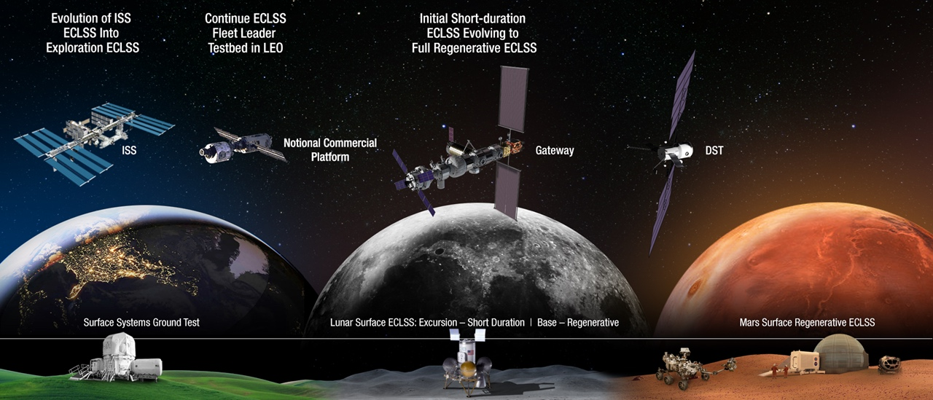
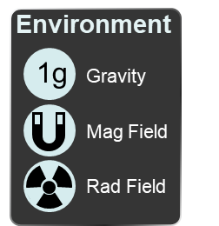



Space Crop Production Roadmap For Exploration
MARS TRANSIT (Crop Production)
GATEWAY (Plant Research)
Operational µg Food Production capability for pick and eat crops to supplement crew diet
ISS (Plant Research and H/W Technology)
Proving Ground to study the effect of deep space radiation on pick and eat crops in µg
Identify challenges and solutions for growing pick and eat crops in µg to support crew nutrition
Scale: One to Two EXPRESS Racks (8-16 Lockers)
Scale: Single Locker
Scale: Single Locker to EXPRESS Rack (8 Lockers)
LUNAR SURFACE (Research/Production)
Ground (Plant Research and H/W Technology)
Develop and deploy operational partial gravity systems for both nutritional support and caloric replacement as both a source of food for long duration lunar missions and as a demonstration for Mars
MARTIAN SURFACE (Production)
Develop space crop production concepts and strategies in support of destinations along the exploration roadmap
Leverage Lunar Surface experience in Food Production systems to extend Earth Independence for Mars missions
Scale: Single Locker to Module
Scale: Single Locker to Module
Scale: Single Locker to Module

Slide 11
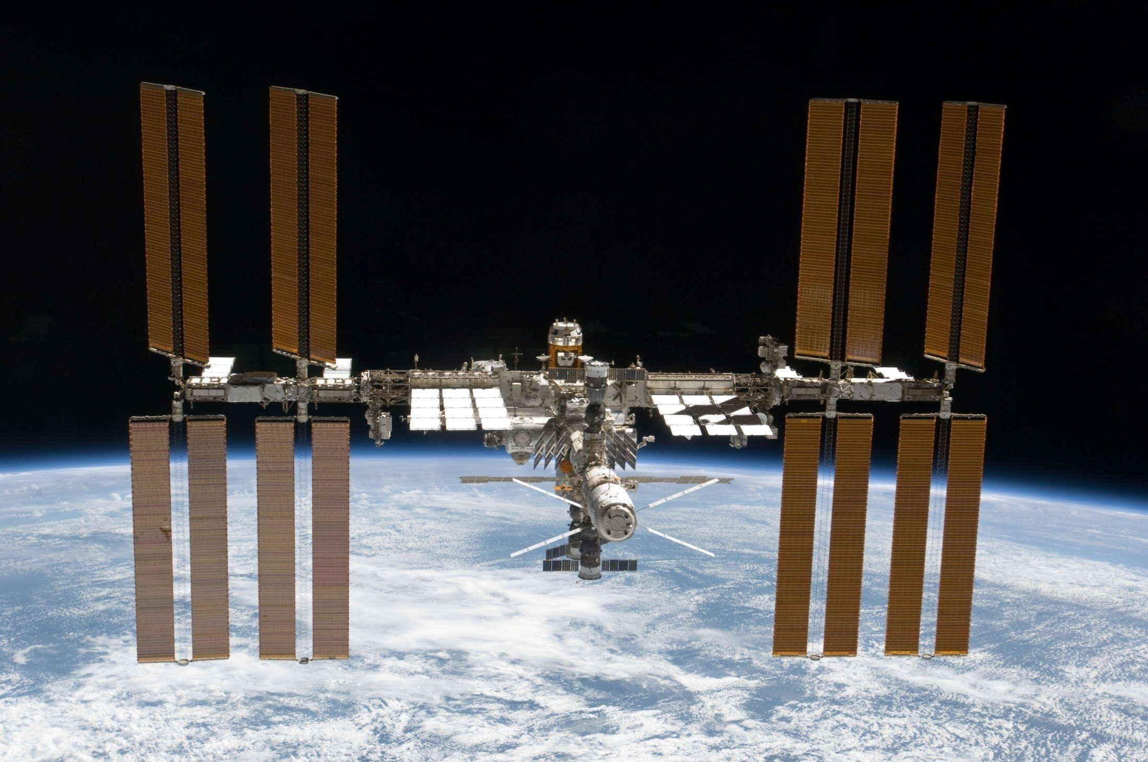
The International Space Station

Slide 12
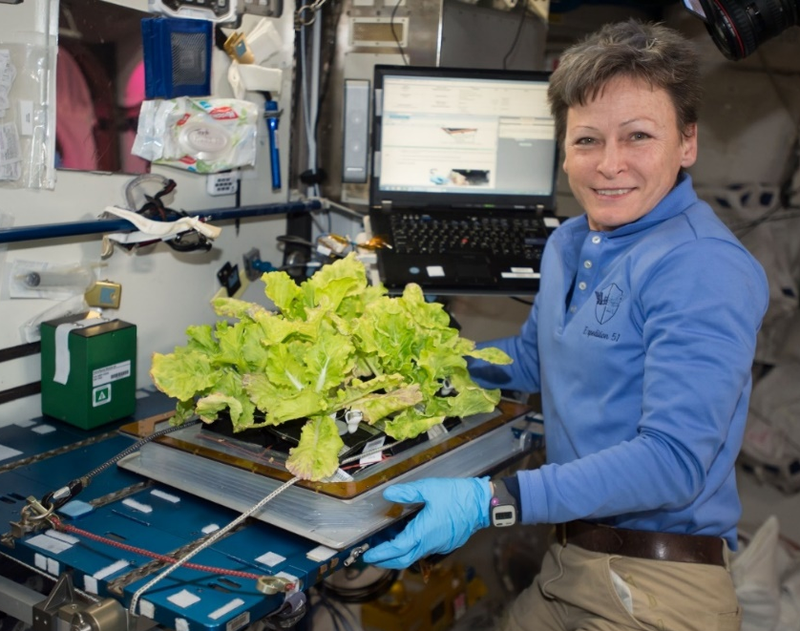
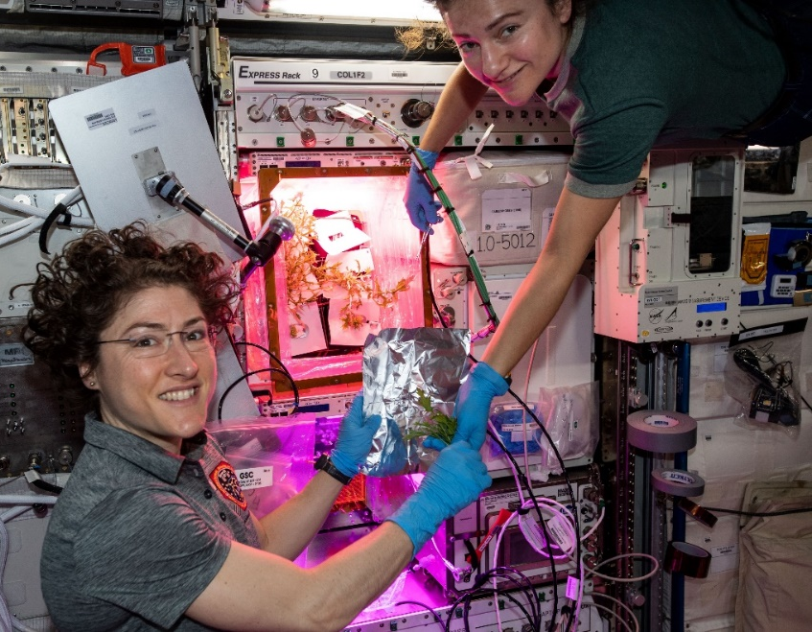

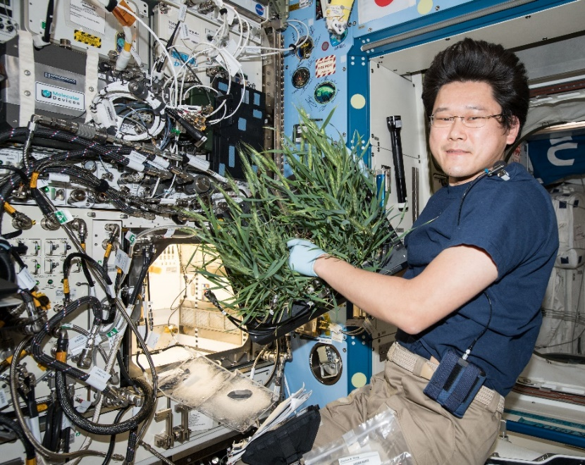
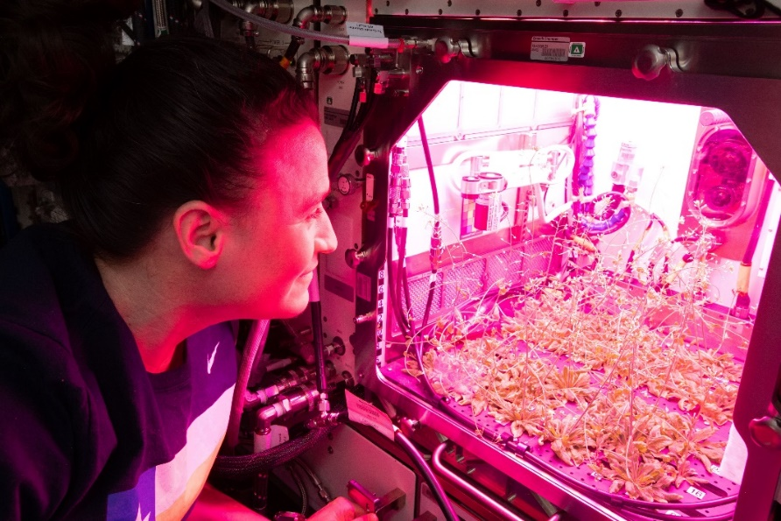

Current NASA Large Plant Research Capabilities On ISS
Notes:
Veggie and the Advanced Plant Habitat

Slide 13
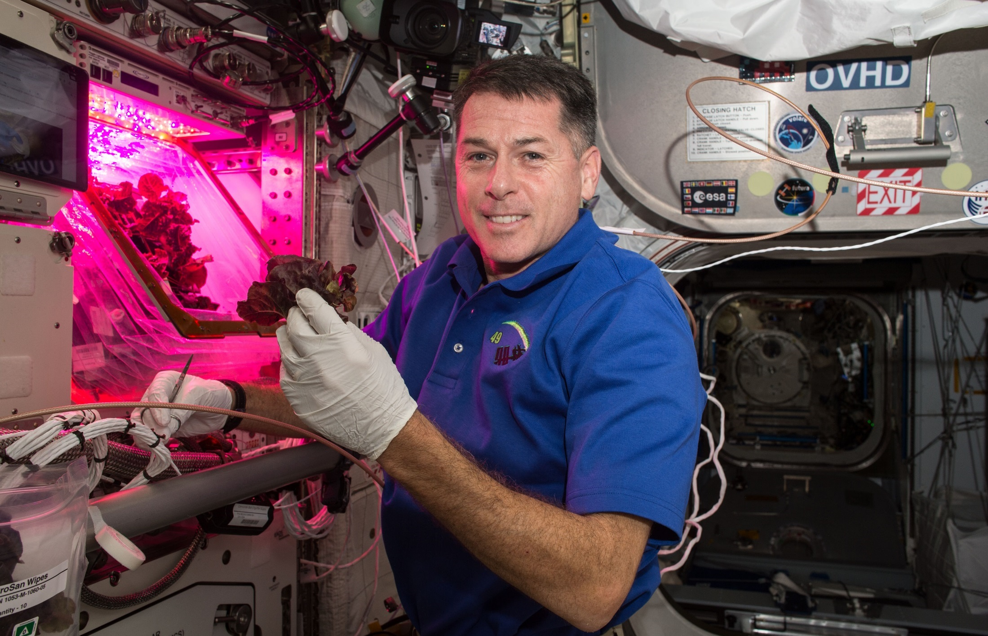
Red Lettuce Cut-and-Come-Again

Slide 14
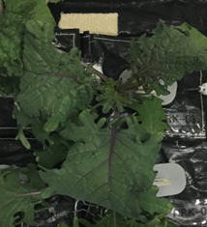
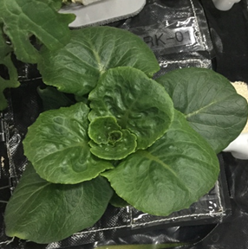
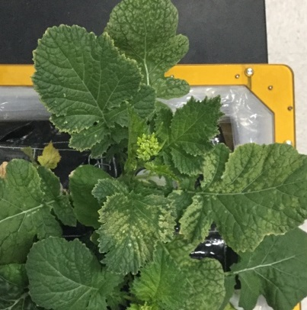
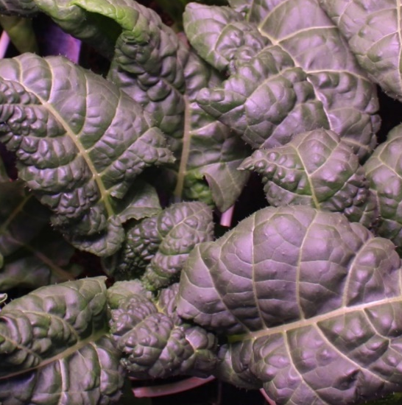
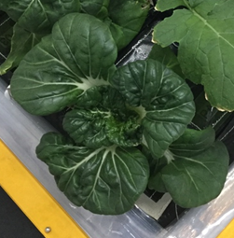
VEG-03 New Crops on Orbit
Red Russian Kale
*Dragoon Lettuce
Wasabi Mustard
*Extra Dwarf Pak Choy
Amara Mustard
Grown in different combinations with Amara Mustard and Extra Dwarf Pak Choi just harvested on ISS!
*= Student Selected Crops!

Slide 15
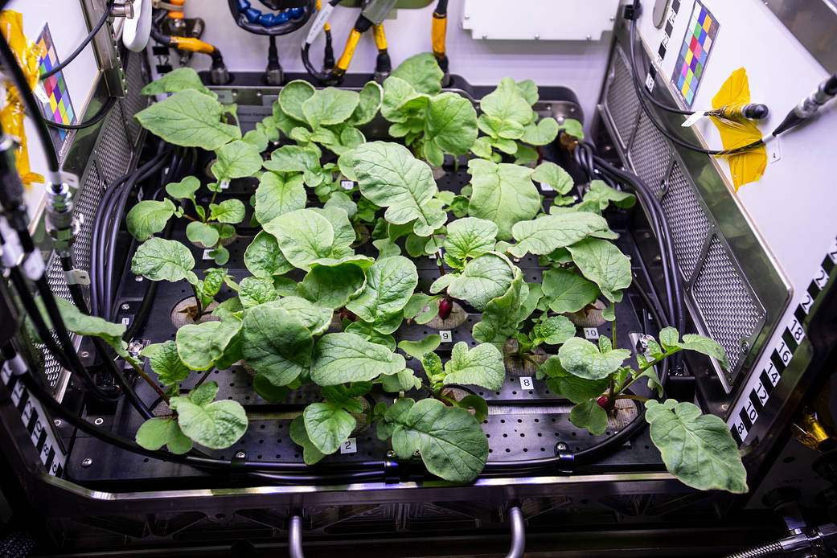
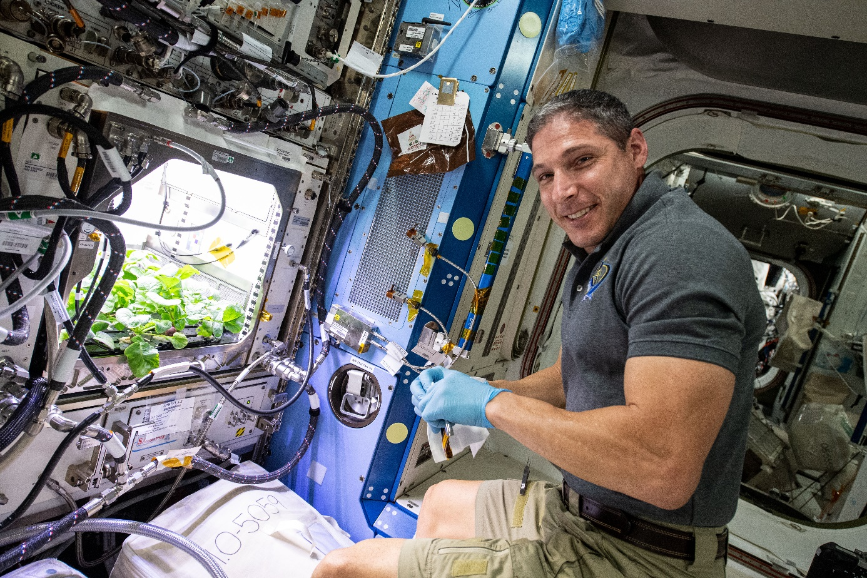
Recent ISS Crop Research
PH-02 Radish Experiment
PI Karl Hasenstein – University of Louisiana, Lafayette

Slide 16
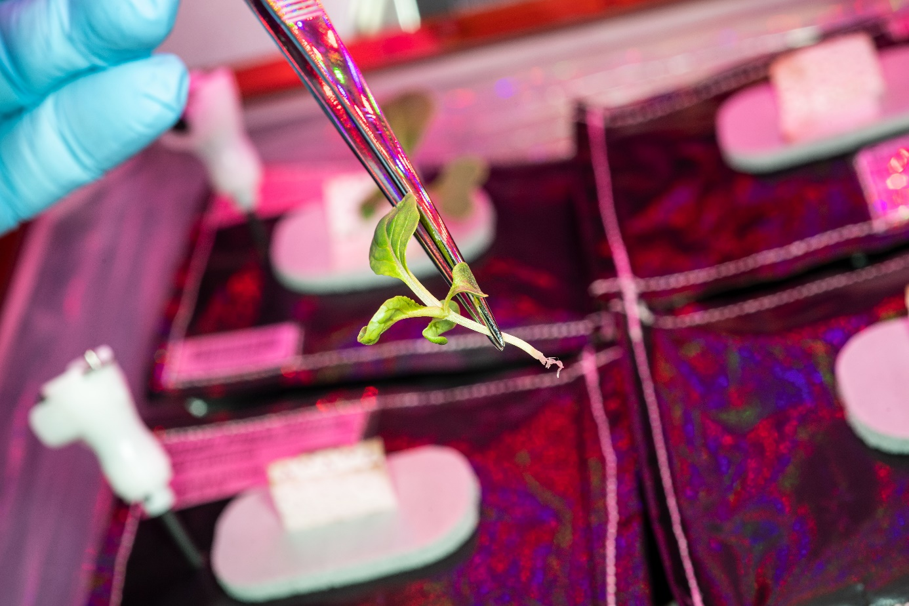
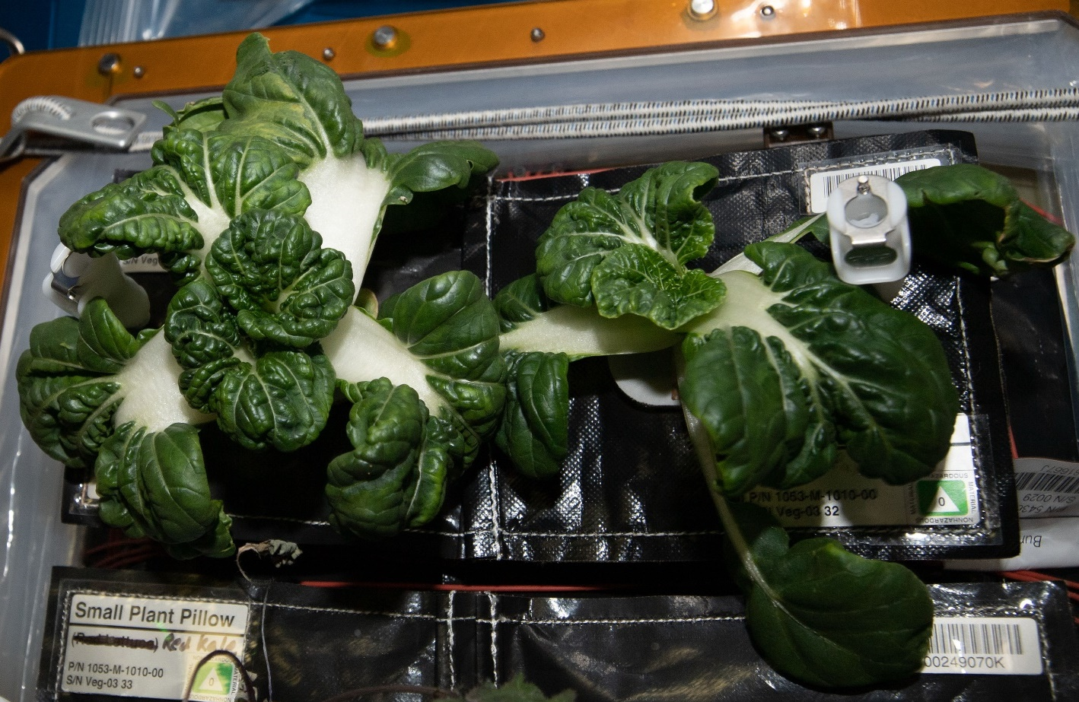
Recent ISS Crop Research
Transplanting 10 Days after initiation
Original
Transplant
Harvest at 29 days
Successful transplanting of ‘Extra Dwarf’ Pak Choi in VEG-03 I

Slide 17
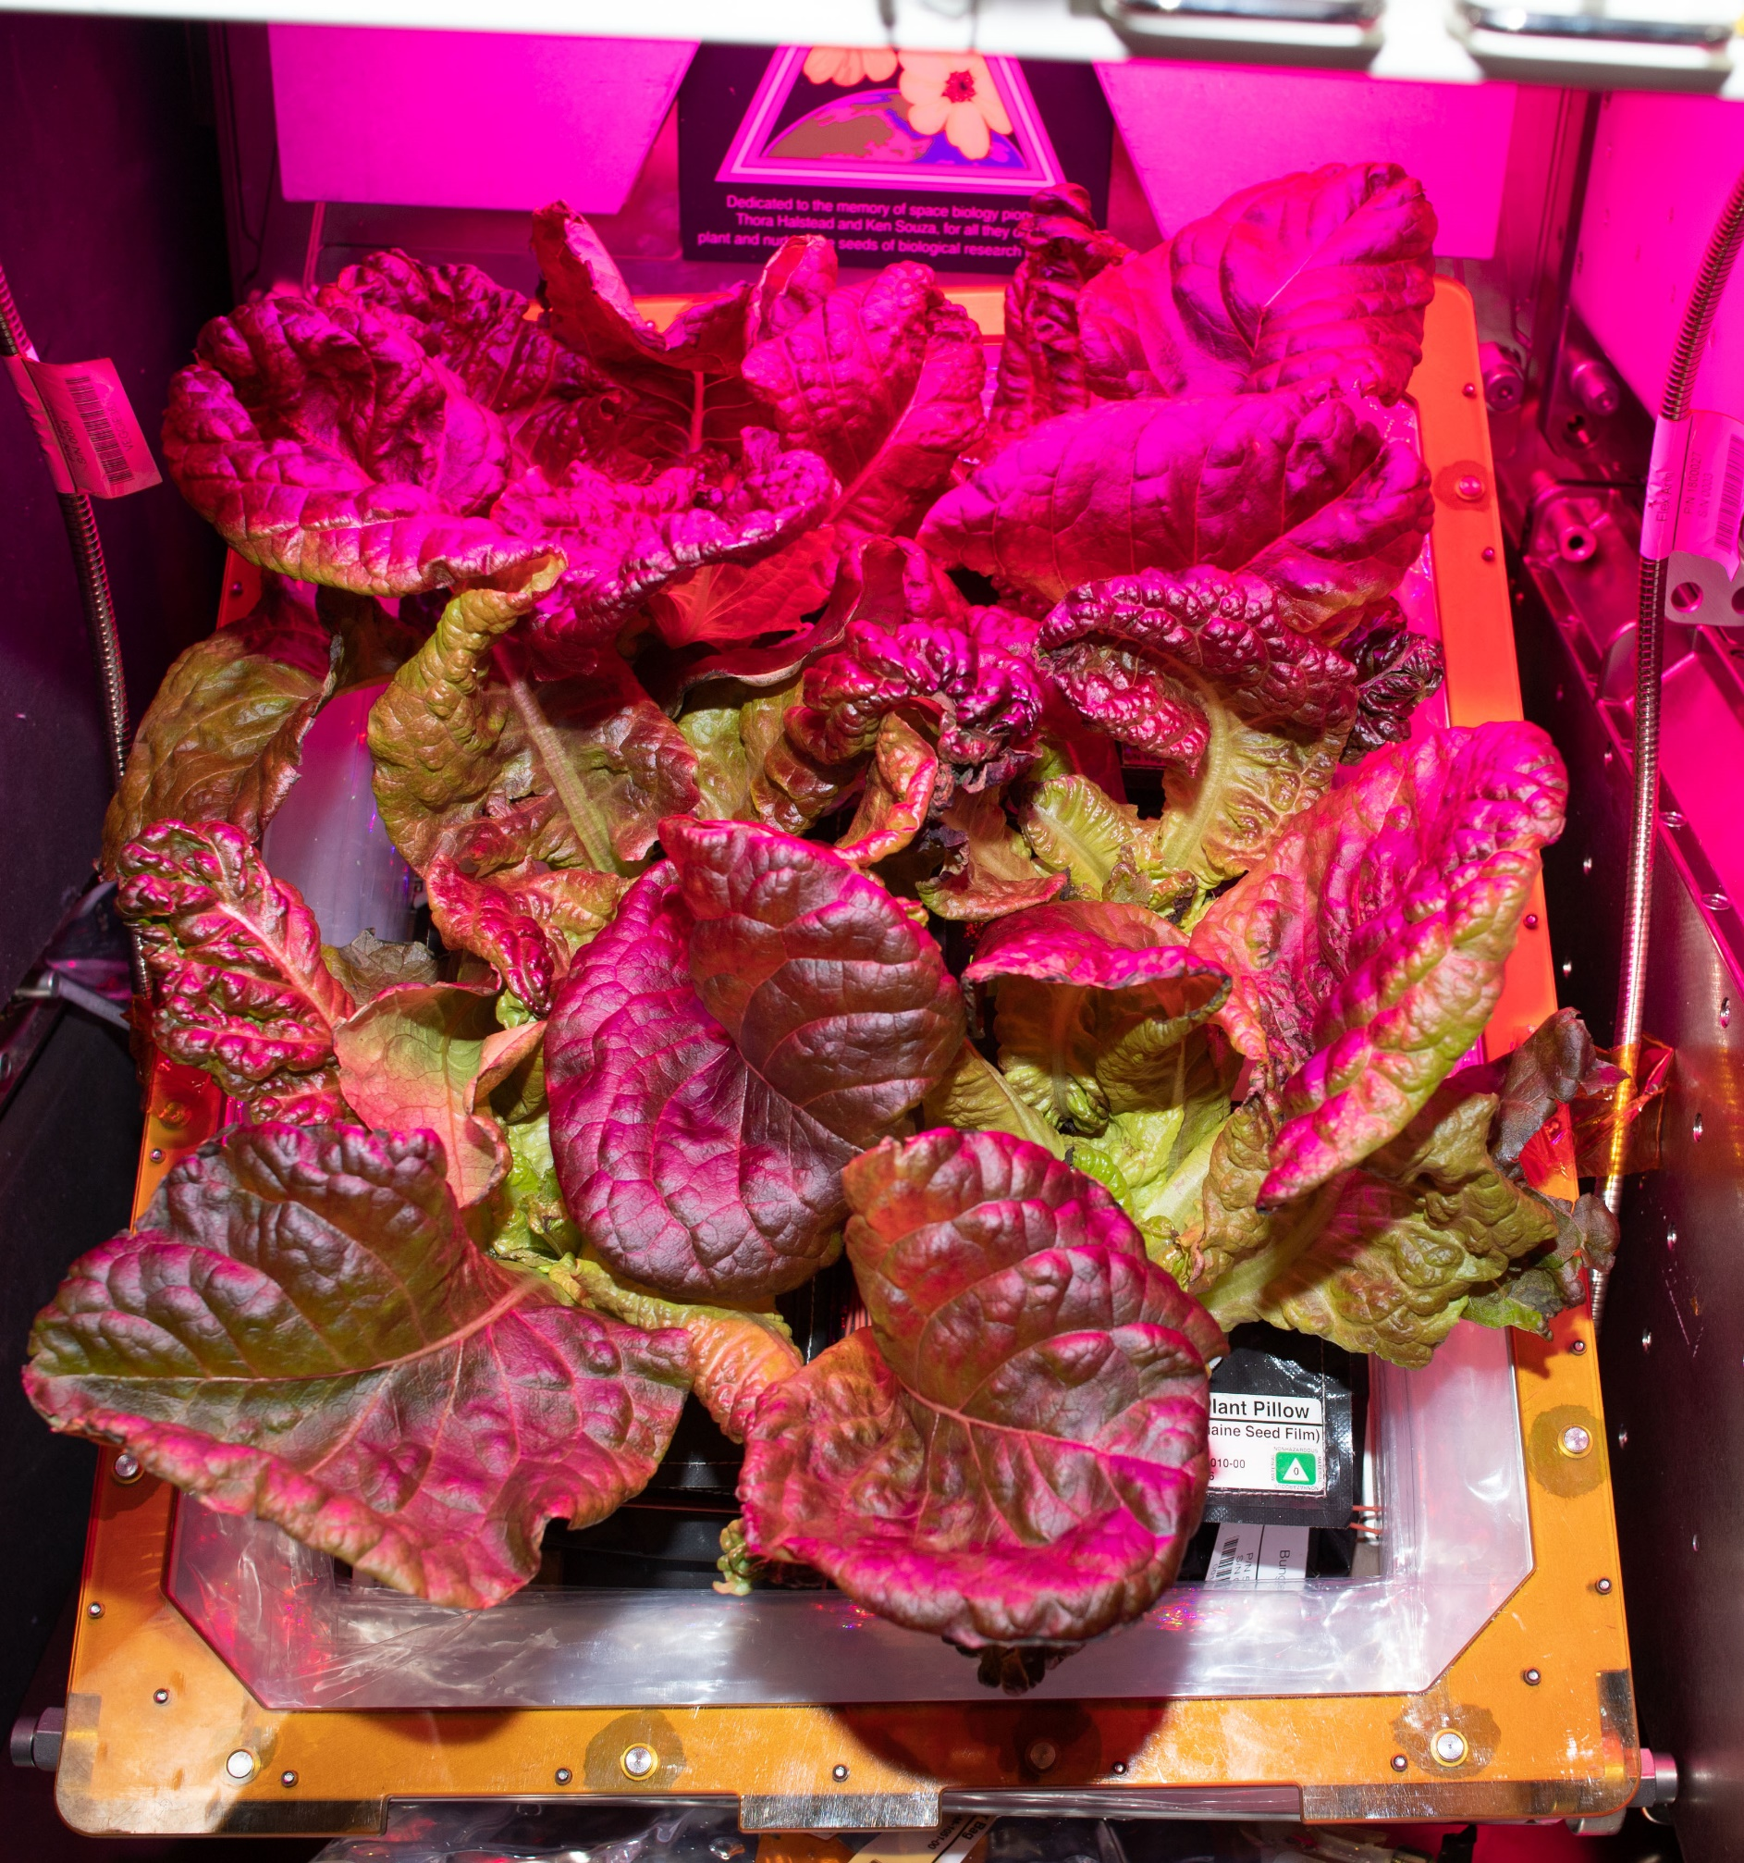
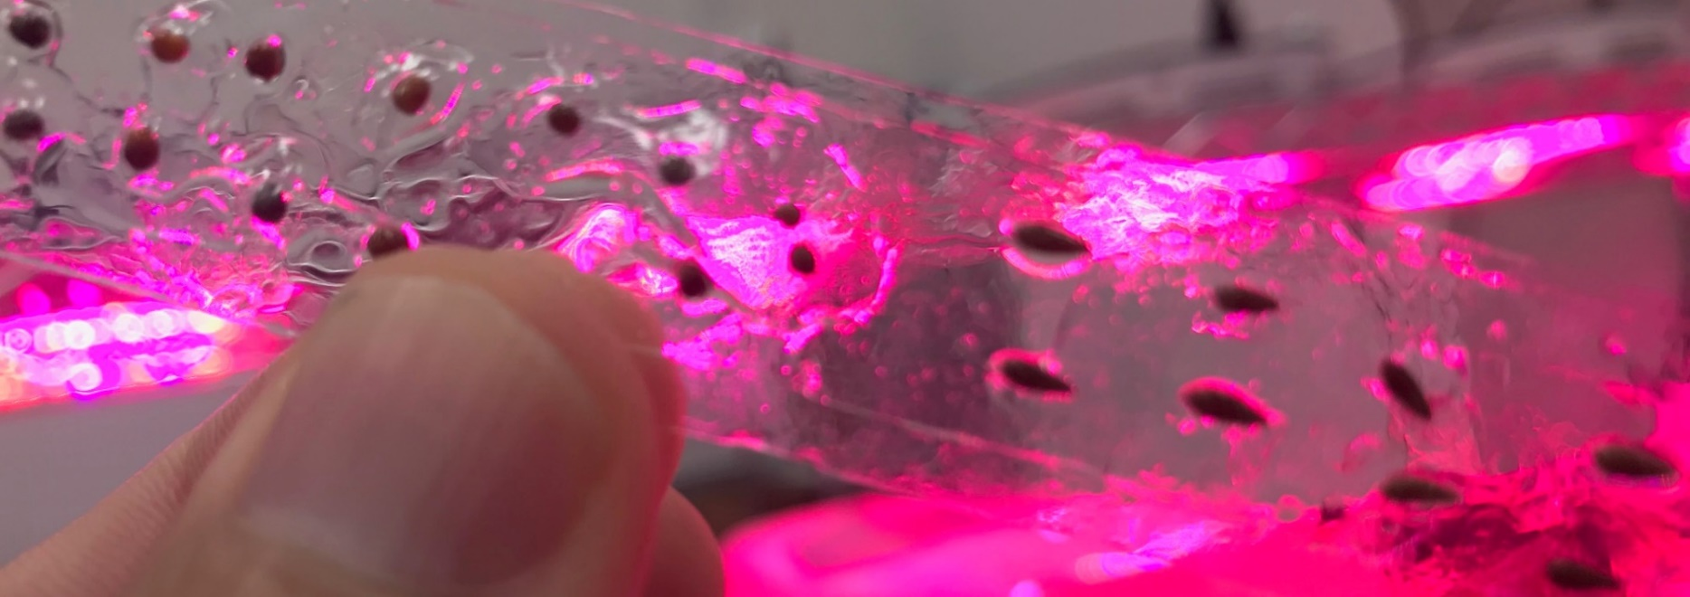
Recent ISS Crop Research
Seed Film technology tested successfully in VEG-03 J

Slide 18
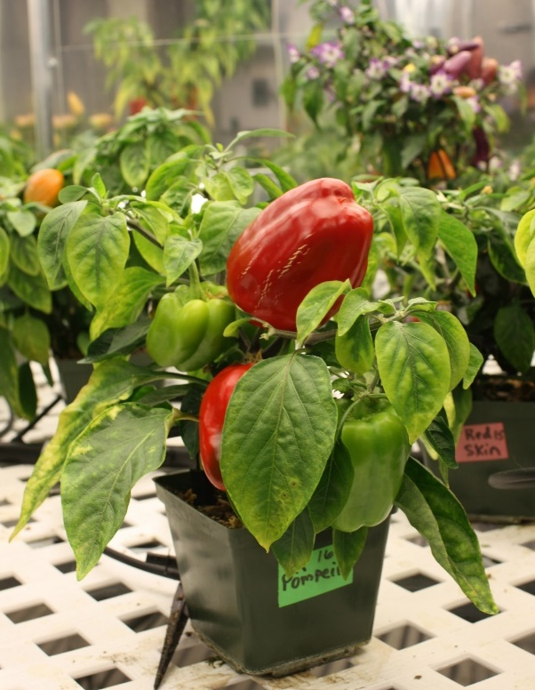
Selection Factors for Space Plants
Targeted breeding areas could fall into several categories:
Plant Growth and Development
Plant Physiology
Produce Nutrition
Produce Organoleptic Acceptability
Postharvest

Slide 19
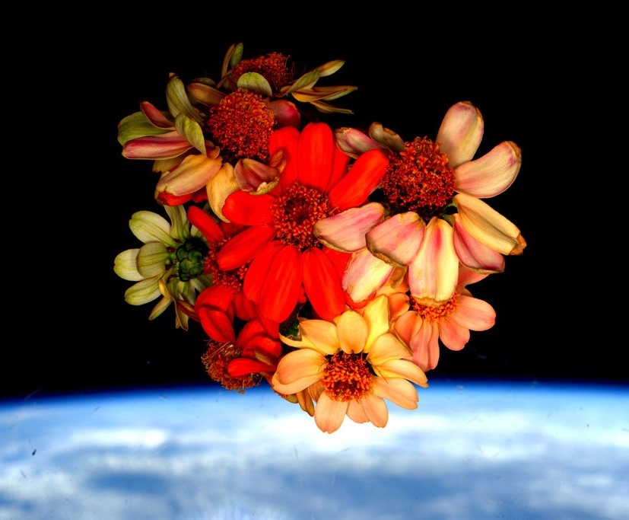
Thank you!

Slide 20
Plant Growth and Development
Compact size (low height and volume)
High yield
High edible/inedible biomass ratio (harvest index)
Reliable germination
Rapid growth to first yield
Uniform growth and development between individuals
Propagules with long shelf stability (seeds, cuttings)
Sustained production capability over long duration (e.g. repetitive fruiting, or cut-and-recut leafy production)
Low debris formation (leaves, flowers, pollen, seeds, etc., remain attached)
Custom microbiome of plant protective and growth promoting microorganisms

Slide 21
Plant Physiology
Stress tolerance (esp. water stress)
Ability to grow well under conditions of:
  Elevated CO₂
  Low relative humidity
  Uniform temperature of 20-23°C
  Narrow spectrum electric lights
  Short photoperiods (to save lighting energy)
  Tolerance of broad environment range
  Tolerance of reduce pressure
No dormancy requirements
Low or pleasing aroma
Low release of volatile organics
High sodium tolerance (e.g. urine recycling)
Preference for ammonia nitrogen sources (e.g. urine recycling)

Slide 22
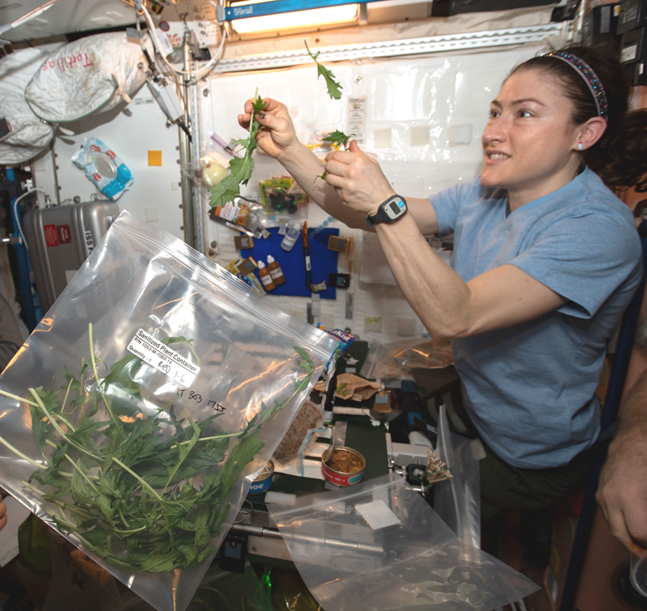
Produce Nutrition
High normal levels of antioxidants
High normal levels of beneficial phytonutrients (e.g. lutein, zeaxanthin, lycopene, phenolics, anthocyanins)
For fresh produce to supplement a packaged diet:
  High normal levels of Potassium and Magnesium
  Low normal levels of Iron
  High normal levels of Vitamins, especially C, B₁, and K
Low levels of antinutrients

Slide 23
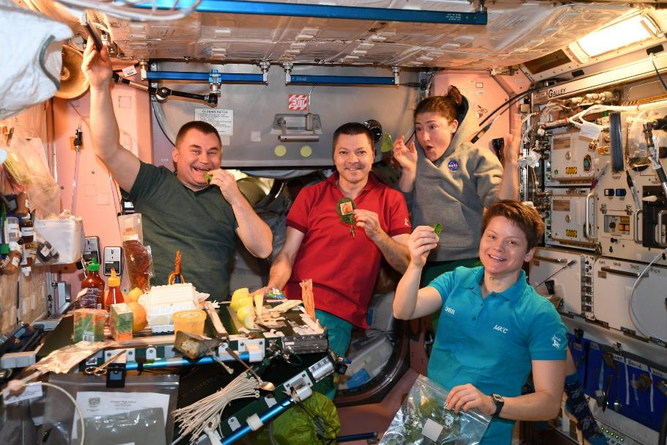
Produce Organoleptic Acceptability
Postharvest
Excellent flavor
Intense flavors
Good texture
Good appearance, color, aroma
Good produce shelf life or storage on the plant
Reduced processing – e.g. seeds easy to remove from seed coats
Easy composting/digestion of inedible plant material for nutrient reclamation (and possibly less structure in micro/partial g)
Use of inedible waste as resources for other food system components (e.g. fish, edible fungus, cellular ag feedstocks)
Other useful materials produced from inedible waste (e.g. life support, shielding, building, fuel)

