Slide 1
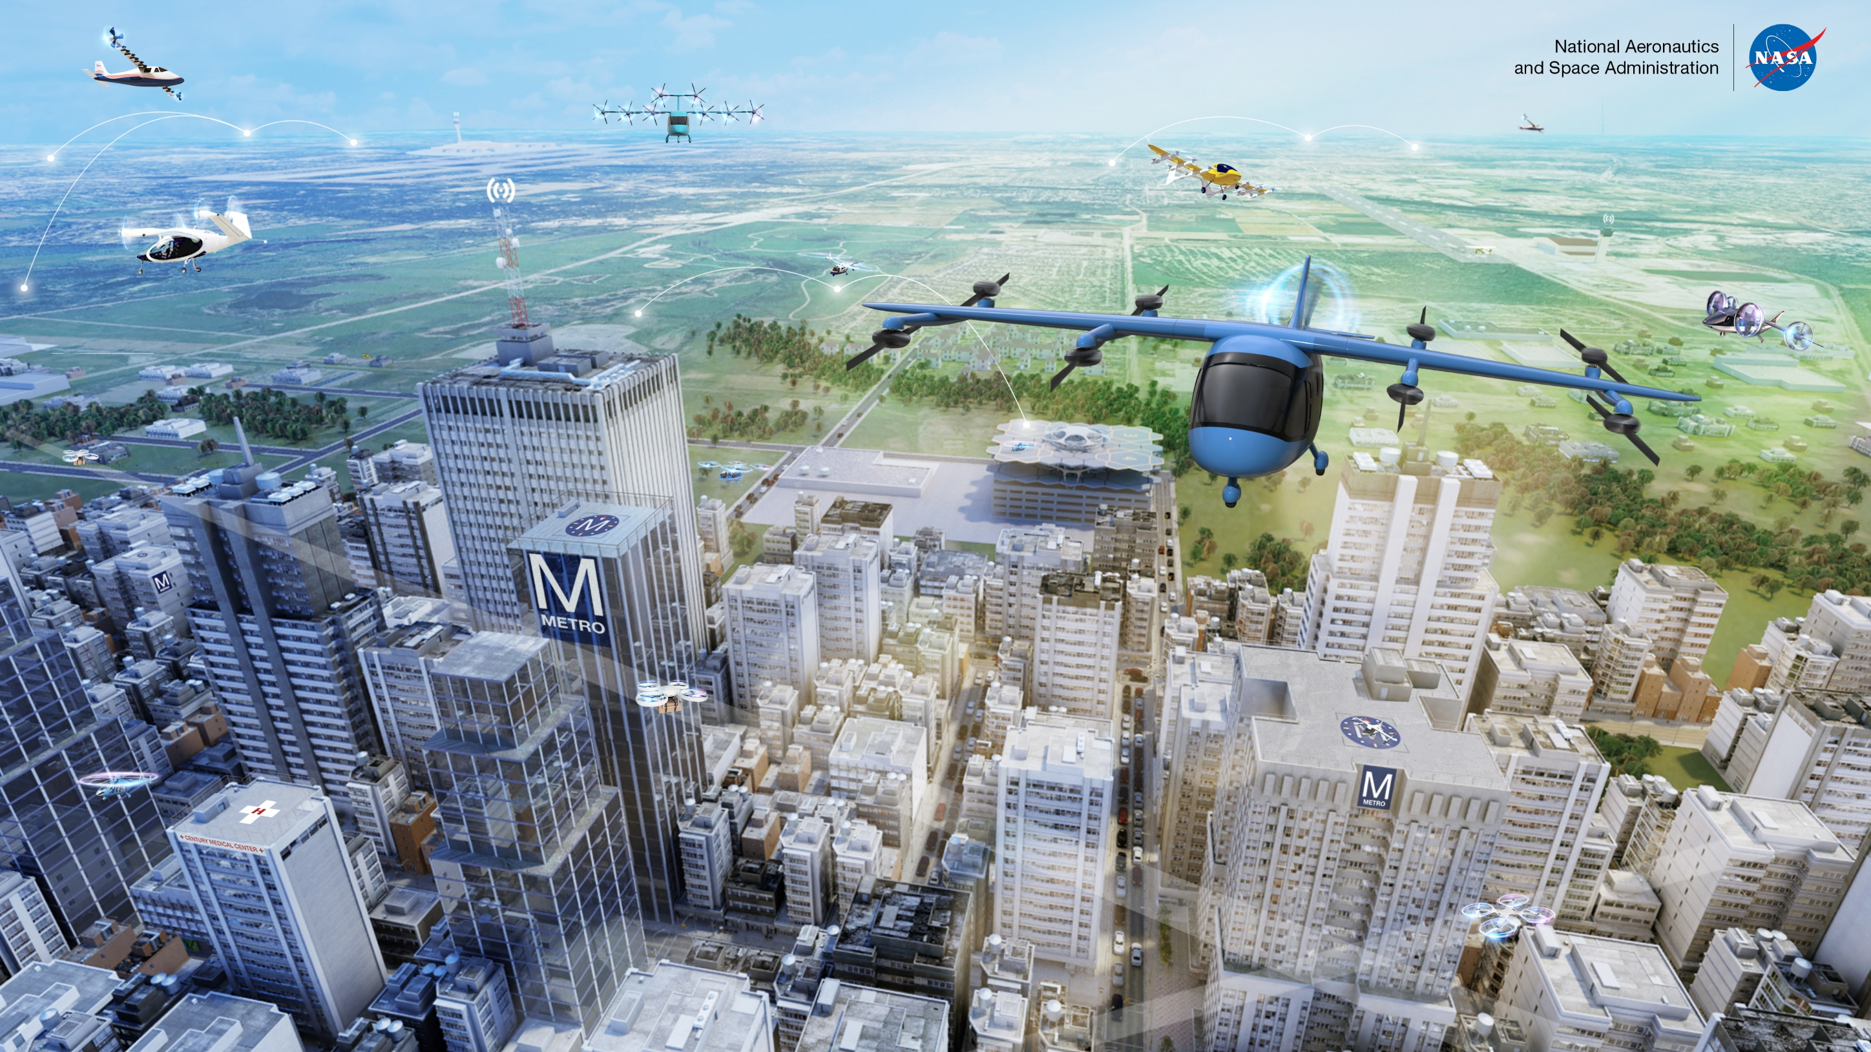
NASA Advanced Air Mobility (AAM) Mission Status
May 20, 2021

Slide 2
Key Aspects of NASA AAM Approach
Find early wins, and be agile as the Advanced Air Mobility (AAM) industry matures
Develop safe systems architectures and requirements for progressively automated AAM
Leverage NASA Subject Matter Experts and facilities to perform robust R&D portfolio execution and Tech Transfer results to standards and policy organizations
Develop Robust Ecosystem Partnerships including the NASA/FAA AAM Executive Board, AAM Ecosystem Working Groups, and industry leaders
Leverage AAM National Campaign Series to progressively develop and test integrated technologies and concepts in relevant operational environments
Notes:
Achieving “systems and architecture requirements” will require enabling activities such as 1) the AAM National Campaign Series 2) a robust Ecosystem Partnership model and 3) NASA ARMD Portfolio Execution.

Slide 3

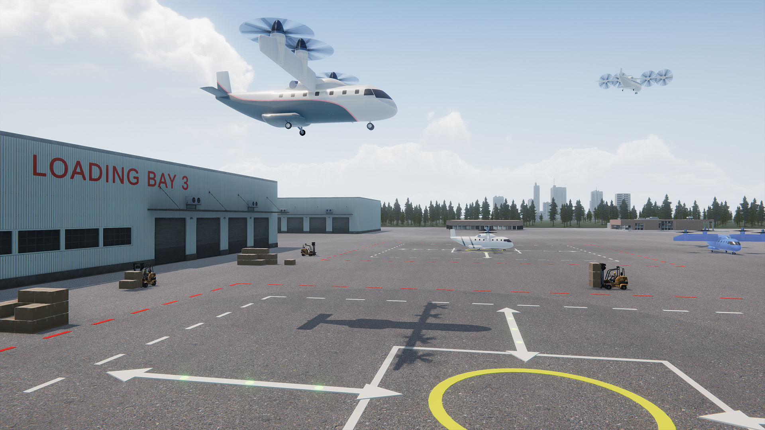
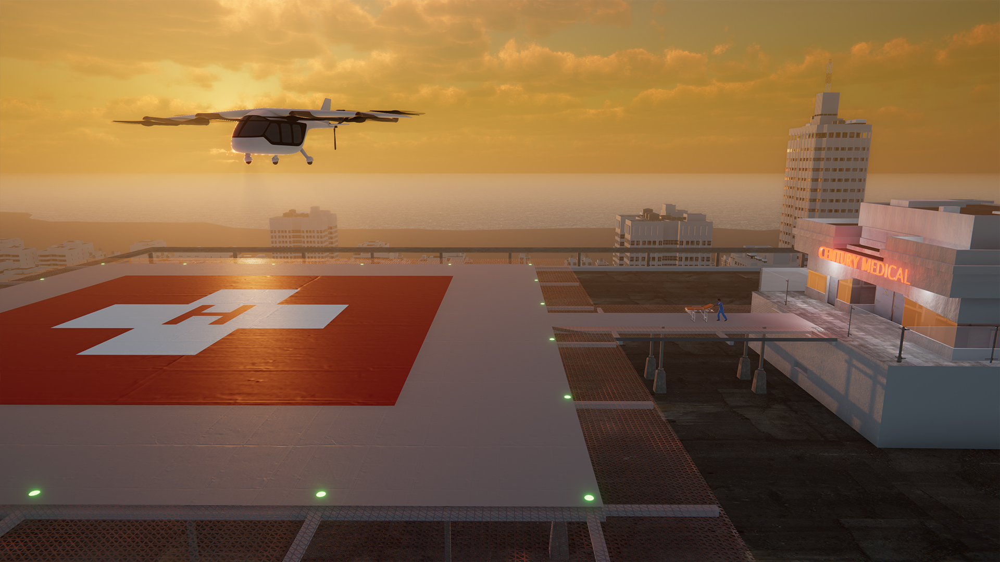
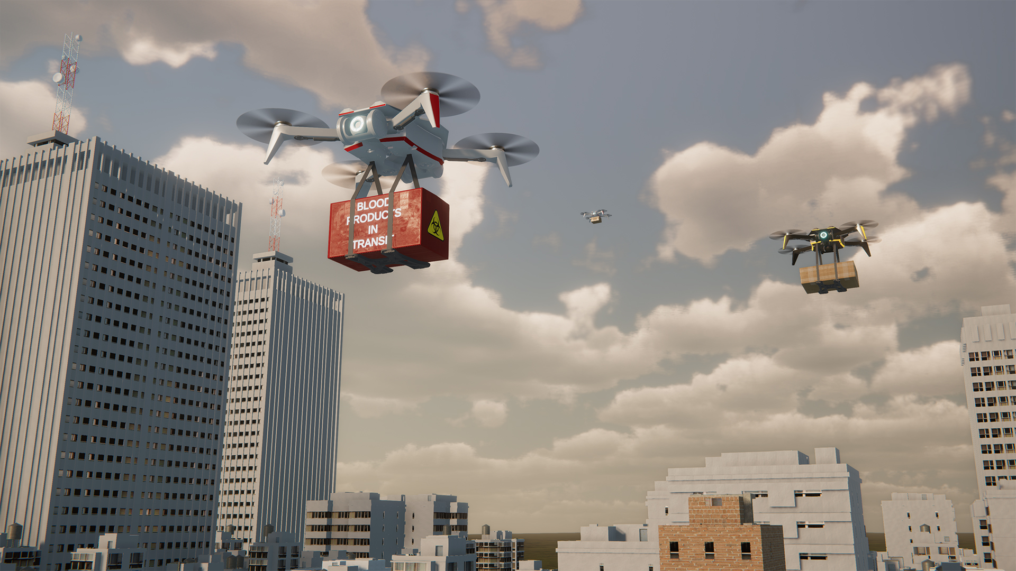
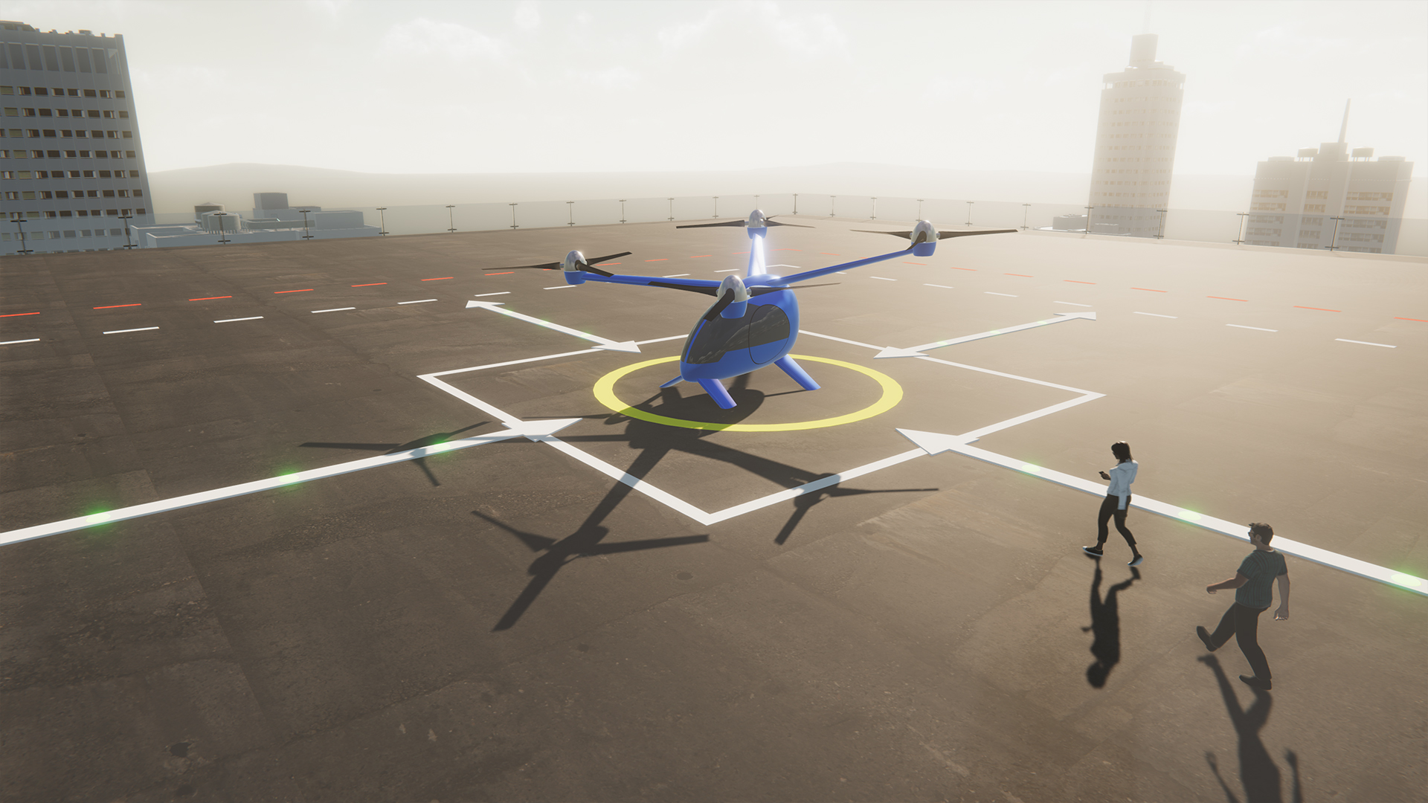
Advanced Air Mobility (AAM)
REGIONAL PASSENGER AND CARGO
TRANSPORT
PUBLIC GOOD
ENTERPRISE / CONSUMER GOODS AND SERVICES
PASSENGER TRANSPORT
Advanced Air Mobility
Safe, sustainable, affordable, and accessible aviation for transformational local and intraregional missions
Local mission < ~75nmi, and intraregional mission < ~500nmi

Slide 4
Industry proposed UAM timeline¹ and milestones
#
  UML-#
  Overarching
  Vehicles
  Airspace
  Community
  Industry Operational Capability ("unlock”)
  CY2020
  CY2021
  CY2022
  CY2023
  CY2024
  CY2025
  CY2026
  CY2027
  CY2028
  CY2029
  CY2030
Initial UAM CONOPS development
High Capacity UAM Ports
3
Integration of
Automated Systems
1
4
3
Integrated system-wide safety tools & methods
1
Secured Systems Architectures
3
Piloted aircraft cert. basis
Conforming prototypes
1
2
Automated Flight and Contingency Management
4
1st Type Cert awarded
Advanced urban capable aircraft
3
Initial pilot training & licensing
2
Scaled vehicle production
4
Initial operational approvals
2
2
Separation Standards
3
Low volume airspace operations
Procedures for high capacity corridors
3
CNSI Architectures
3
Deployment of UAM Airspace Architectures and 3rd Party Services
Automated airspace operations with 3rd party services
4
3
3
Multi-Modal Integration
4
Early adopter locations
1
Local regulations enacted
Initial Infrastructure Deployment
3
Operational safety demonstrations
1
Initial commercial operations
2
High-capacity corridors in early adopter cities
3
Scalable weather-tolerant urban ops
4
  1 Based on a range of publicly available industry projections; not a consensus view; aggressive

Slide 5
Industry proposed UAM timeline¹ with uncertainty
  Industry proposed case¹
  Baseline case
  Conservative case
  2019
  2021
  2023
  2025
  2027
  2029
  2031
  2033
  2035
  2037
  2039
  2041
  2043
  2045
  Key Questions
UML-1
  A few key questions
  Does the UML progression represent the UAM industry? AAM?
  Are technologies and standards similar (enough) across many use cases?
  What are realistic timelines for the industry to emerge?
  How do timelines and benefits across use-cases vary?
  Discuss how advanced air mobility mission use-cases and timelines might emerge
  The short timeline delta in UML-1 indicates that these milestones are expected to pose little risk to the community timeline
UML-2
  The growing uncertainty in UML-2 is driven primarily by timeline risk in the TC process and the resulting delays to commercial operations
UML-3
`
  Risk to the UML-3 timeline is driven by multiple long duration activities, but the activities could happen concurrent to UML-2
UML-4
  Risk for UML-4 is driven primarily by the introduction of scale and autonomy, which entail long lead times and substantial risk
  1 Based on a range of industry projections; not a consensus view

Slide 6
Back-up

Slide 7
AAM Mission Status update
Focus Area | Status
Ecosystem Partnership Strategy | NASA/FAA AAM Executive Board NASA AAM Ecosystem Working Groups International NC and R&D Announcement of Collaborative Opportunity (ACO)
Book of Requirements and Guidelines (BoRG) | Conops development with FAA MBSE Implementation of “Book of Requirements and Guidelines (BoRG)” Integrated Mission Plan Development
National Campaign | Integrated Dry-Run Flight Test Complete Proving Ground, operational scenarios, test plans, and data collection ready for NC-1
R&D Project Accomplishments | AAM – Automated Flight and Contingency Management, and HDV validations frameworks progressing ATM-X UAM Airspace Architecture Developments delivered to National Campaign RVLT - Gen 1 Noise Assessment of Fleet Operations and Gen 2 Noise Power Distance database complete Safety- In-time Aviation Safety Management system integration across automation and vehicle architectures

Slide 8
UAM Maturity Levels (UML)
UAM Framework and Barriers
Vehicles
Airspace
Community
UML-1
Late-Stage Certification Testing and Operational Demonstrations in Limited Environments
UML-2
Low Density and Complexity Commercial Operations with Assistive Automation
UML-3
UML-4
UML-5
UML-6
Low Density, Medium Complexity Operations with Comprehensive Safety Assurance Automation
Medium Density and Complexity Operations with Collaborative and Responsible Automated Systems
High Density and Complexity Operations with Highly-Integrated Automated Networks
Ubiquitous UAM Operations with System-Wide Automated Optimization
Type certified aircraft; initial Part 135 operation approvals; limited markets with favorable weather and regulation; small UAM network serving urban periphery; UAM routes supporting self-managed operations through controlled airspace
Operations include urban core; operational validation of advanced airspace operations and management including 3rd party provided ATM, CNSI, C^2, and automation for scalable, weather-tolerant operations; few high-capacity vertiports; noise compatible with urban soundscape; model-local regulations
100s of simultaneous operations; expanded networks including closely-spaced high throughput vertiports; many federated ATM services available, simplified vehicle operations for credit; low-visibility operations
1,000s of simultaneous operations; large-scale, highly-distributed networks; high-density federated ATM; autonomous aircraft and remote, M:N fleet management; high-weather tolerance including icing; high-volume manufacturing
10,000s of simultaneous operations (capacity limited by physical infrastructure); ad hoc landing sites; noise compatible with suburban/rural operations; private ownership & operation models enabled; societal expectation
Aircraft certification testing and operational evaluations with conforming prototypes; procedural and technology innovation supporting future airspace operations (e.g. UTM-inspired); community/market demonstrations and data collection
INITIAL STATE
INTERMEDIATE STATE
MATURE STATE

Slide 9
Industry proposed AAM timeline¹ and milestones
#
  UML-#
  Overarching
  Vehicles
  Airspace
  Community
  Industry Operational Capability ("unlock”)
  CY2020
  CY2021
  CY2022
  CY2023
  CY2024
  CY2025
  CY2026
  CY2027
  CY2028
  CY2029
  CY2030
Initial UAM CONOPS development
High Capacity UAM Ports
3
Integration of
Automated Systems
1
4
3
Integrated system-wide safety tools & methods
1
Secured Systems Architectures
3
Piloted UAM aircraft cert. basis
Conforming prototypes
1
2
Automated Flight and Contingency Management
4
1st Type Cert awarded
Advanced urban capable aircraft
3
Initial pilot training & licensing
2
Scaled vehicle production
4
Initial operational approvals
2
2
Separation Standards
3
Low volume airspace operations
Procedures for high capacity corridors
3
CNSI Architectures
3
UAM Airspace Architectures and 3rd Party Services
3
Automated airspace operations with 3rd party services
4
3
Multi-Modal Integration
4
Early adopter locations
1
Local regulations enacted
Initial Infrastructure Deployment
3
Operational safety demonstrations
1
Initial commercial operations
2
High-capacity corridors in early adopter cities
3
Scalable weather-tolerant urban ops
4
  1 Based on a range of publicly available industry projections; not a consensus view; aggressive

