Slide 1
A Unified Approach for Computational Aeroelasticity
Dr. Walter A. Silva
Aeroelasticity Branch
NASA Langley Research Center
24 June – 15 July, 2021
AIAA Online Short Course

Slide 2
Acknowledgements
Excerpts from AIAA Short Course on Aeroelasticity
Prof. Cesnik
Prof. Strganac

Slide 3
Outline
Mathematical Preliminaries
Unsteady Aerodynamics
Structural Analysis
Aeroelasticity (AE)
Aeroservoelasticity (ASE)
Reduced-Order Models
Case Studies
Discussion

Slide 4
A-6F Wind-Tunnel Model Flutter
(YouTube)
https://www.airspacemag.com/videos/a-6-wing-flutter-tests_1/

Slide 5
KTH Wind-Tunnel Model Flutter
No hyperlink; separate video

Slide 6
Mathematical Preliminaries

Slide 7
Classification of Systems

Slide 8
Excerpts from References
Autonomous Second-Order Nonlinear Systems:
“…we shall restrict our attention to second-order autonomous
systems…where time does not enter explicitly into the
equation of motion. This, of course, precludes time-
dependent forcing functions.”
Unit-Step and Unit-Impulse Functions:
“Whereas the unit-step function is well defined, the unit-
impulse function, mathematically speaking, is not.”
What do these statements mean? Do we understand how
these concepts apply to real-world systems?

Slide 9


Mathematical Foundations
System Classifications
Time Invariant
Time Varying
Linear
Nonlinear
Linear
Nonlinear
Zero
Memory
y = mx
2
Saturation,
Deadband
as f(t)
y=x
Saturation,
Deadband
y = m(t)x
Van der Pol,
Duffing and
N-S Eqs
Mathieu
Memory
•
x = A(t)x +
B(t)u
Notes:
12/18/98
57

Slide 10

Linear vs. Nonlinear
Superposition (Valid for Linear Systems)
x(t)
y(t)
a_{n}
y(t)
a_{n}
Linear System
Linear System
x_{n}(t)
x_{n}(t)
…
…
a₁
a₁
Linear System
x₁(t)
x₁(t)
Equivalent
If S(a₁x₁ + a₂x₂+…) = S(a₁x₁) + S(a₂x₂) + … => Linear

Slide 11
Linear vs. Nonlinear
Superposition fails for Nonlinear Systems
y(t) = x²(t)
Input: x(t) = cos(w₀t)
Output: y(t) = 1/2 + 1/2 cos(2w₀t)
Bias New frequency!!
Check:
(ax₁ + bx₂)² = a²x₁² + 2abx₁x₂ + b²x₂²
≠ (ax₁)² + (bx₂)²

Slide 12
Linear vs. Nonlinear
Linear systems cannot create new frequencies
that are not present in the input!
Linear
System
y(t)
u(t)
If
u(t) = A₁*sin((2π f₁)*t + ø₁)
Then
y(t) = A₂*sin((2π f₁)*t + ø₂)
Amplitudes and phases could be different but not frequency

Slide 13
Linear vs. Nonlinear
Nonlinear systems can create new frequencies
that are not present in the input!
Nonlinear
System
y(t)
u(t)
If
u(t) = A₁*sin((2π f₁)*t + ø₁)
Then
y(t) = A₂*sin((2π f₁)*t + ø₂) + A₃*sin((2π f₂)*t + ø₃) + …
Yields harmonics (integer multiple of f₁) and subharmonics
(fractional multiple of f₁)

Slide 14
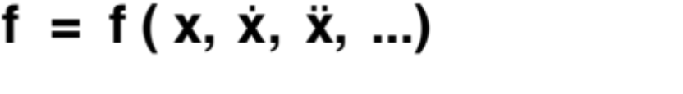
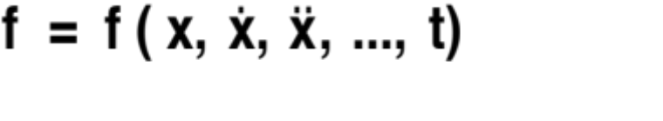
Time-Invariant vs. Time-Varying
Confusion exists in literature
Time-invariant DOES NOT mean steady response
Time-invariant system (shift invariant)
Time-varying system
Linear and nonlinear systems can be EITHER time-
invariant or time-varying
Notes:
12/18/98
58

Slide 15


Time-Invariant vs. Time-Varying
Time Invariant --> y(u(t₁)) = y(u(t₂)) (Shift Invariant)
Time Varying --> y(u(t₁)) ≠ y(u(t₂))
y
y
t
t
t₁
t₂
y
y
t
t
t₁
t₂
Notes:
12/18/98
59

Slide 16
Time-Invariant vs. Time-Varying
Examples
Time-Invariant
  Mass-Spring System (water bucket on spring)
  Airplane (Why? How?)
  Pendulum
  Others?
Time-Varying
  Rocket (Why?)
  “Leaky” Mass-Spring System (leaking bucket)
  Others?
Notes:
12/18/98
59

Slide 17
Stationary vs. Nonstationary
Stationary
  Statistical properties do not change with time
Nonstationary
  Statistical properties DO change with time
Notes:
12/18/98
59

Slide 18
Memory vs. Memoryless
Memory
  Future outputs influenced by past inputs and
  outputs
  Derivative and/or integral terms
Memoryless
  Present output independent of past history
x
y
x
y
y = 2x
2
4
6
6
2
4

Slide 19
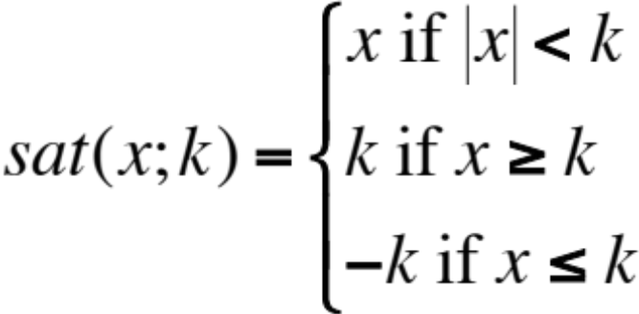
Memory vs. Memoryless
Examples
Memory
  Mass-Spring System (Why?)
  Pendulum
  Any Ordinary Differential Equation
  Any Integral Equation
Memoryless
  Saturation function

Slide 20
Deterministic vs. Stochastic
Deterministic
  Given input always yields the same output
  Repeatable
  Examples?
Stochastic
  Given input yields family of potential outputs
  Based on Probability Distribution Function
  Examples?

Slide 21
Classify These Systems
L/NL
TI/TV
M/ML
D/St
•
x = A(t)x + B(t)u
•
x = Ax + Nxu + Bu
••
•
x + μ(x² - 1)x + x = 0
saturation
••
•
Mx + Cx + Kx = F(t)
••
•
Mx + Cx + K₁x + K₂x³ = F(t)
Navier-Stokes eqs
Class Example

Slide 22
Convolution

Slide 23
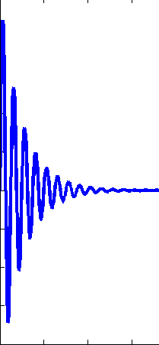
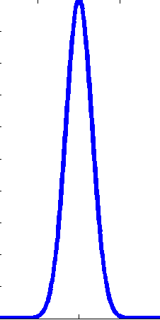


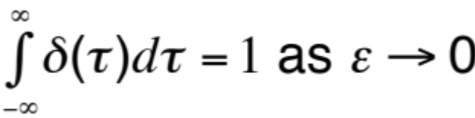
Linear Time-Invariant (LTI)
Continuous-Time
Impulse Response, h(t)
h(t)
CT-LTI
t
Fundamental mathematical function
Application to discrete-time systems not
consistent amongst references and texts

Slide 24
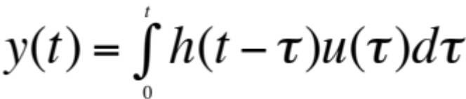
Linear Time-Invariant (LTI)
Continuous-Time
So what is convolution? Why use it?
Arbitrary motion
u(t)
LTI
y(t)
Convolution -->

Slide 25

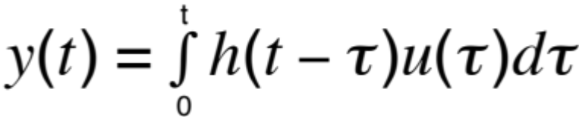

Linear Time-Invariant (LTI)
Continuous-Time
u(t)
Convolution
t
u(t
) • h(t)
0
+
t
u(t
) • h(t)
1
•
t
•
•
y
(t
)

Slide 26
Linear Time-Invariant (LTI)
Continuous-Time
Convolution
How is it presented in texts?
If convoluting f and g (f*g), the flip one of the functions, say f, multiply with each other and “slide”
Why? What does this mean?
What are your memories of convolution?

Slide 27

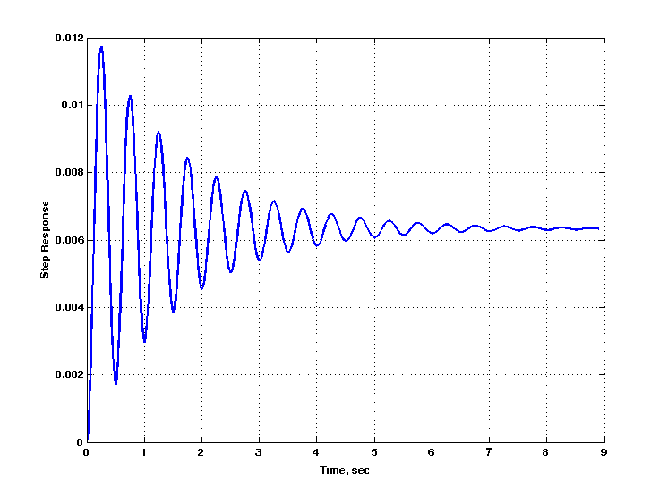
Linear Time-Invariant (LTI)
Continuous-Time
Step Response, S(t)
S(t)
CT-LTI
t
0
Fundamental mathematical function
Often easier to apply to physical systems than
impulse (Dirac)

Slide 28
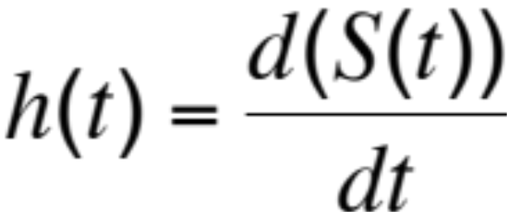
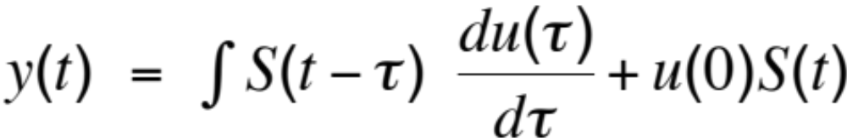
Linear Time-Invariant (LTI)
Continuous-Time
Impulse Response = Derivative(Step Response)
Convolution using Step Response (S(t))

Slide 29
Linear Time-Invariant (LTI)
Discrete-Time
Digital Signal Processing (DSP)
Continuous-time signals→continuous time (CT), variable
Discrete-time signals→both time and amplitude discrete
Why DSP?
Easier implementation (computer)
Better control (no CT devices susceptible to heat, etc)
Digital signals sometimes result of sampling of CT signals;
sometimes just part of a digital process

Slide 30
Linear Time-Invariant (LTI)
Discrete-Time
Sequence of Numbers
x = {x[n]}, n is integer
x[n] = x_{a}(nT), -∞ < n < ∞
Where x_{a} is CT signal, T is sampling period,
(1/T) is sampling frequency
Signal ONLY defined at sample points; not defined
in between.

Slide 31
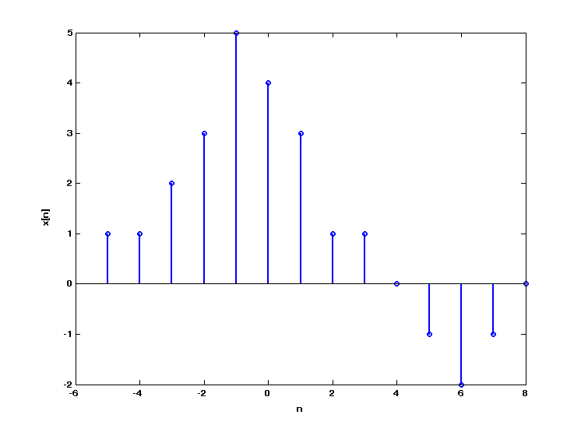
Linear Time-Invariant (LTI)
Discrete-Time
x[0]
x[1]

Slide 32
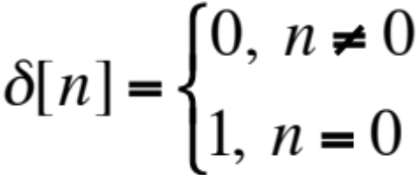
Linear Time-Invariant (LTI)
Discrete-Time
Important and Fundamental Sequences
Unit Sample Sequence
Discrete-time (DT) impulse
1
…
0
DT impulse does not suffer from mathematical abstractions found in Dirac delta function (CT)!!

Slide 33
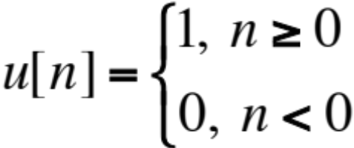
Linear Time-Invariant (LTI)
Discrete-Time
Important and Fundamental Sequences
Unit Step Sequence
Discrete-time (DT) step
1
…
0 1 2 3

Slide 34
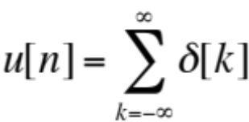
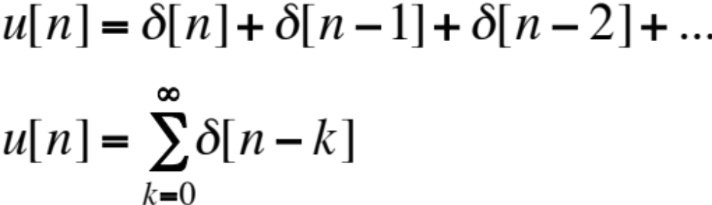
Linear Time-Invariant (LTI)
Discrete-Time
Important and Fundamental Sequences
NOTE: or
With x[n-1] advancing forward, x[n+1] going backward,

Slide 35

Linear Time-Invariant (LTI)
Discrete-Time
Important and Fundamental Sequences
Also, u[n]
…
0 1 2 3
u[n-1]
…
0 1 2 3 4

Slide 36
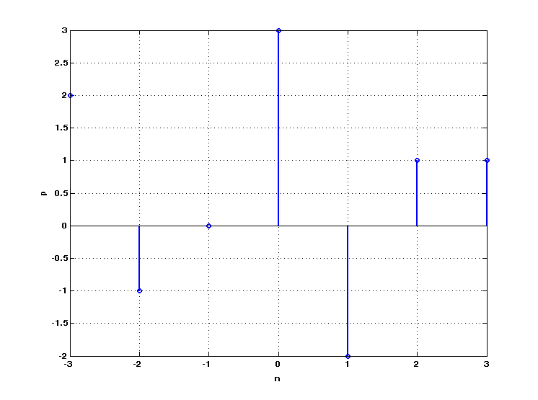
Linear Time-Invariant (LTI)
Discrete-Time
Important Concept
Any sequence can be represented as a sum of
scaled and shifted unit sample responses.
For example,

Slide 37
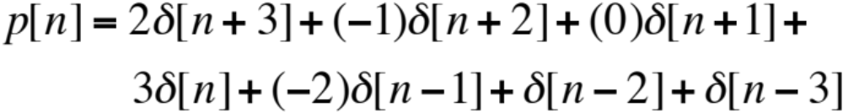
Linear Time-Invariant (LTI)
Discrete-Time

Slide 38
Linear Time-Invariant (LTI)
Discrete-Time
So, what is the response of a system to this input, p[n]?
Is system linear? If so, we can treat each term as if it is a separate input.
Is system TI? If so, the response due to each unit sample input is the same only shifted (before the scaling).
So, what is the response of a system to the first term?

Slide 39


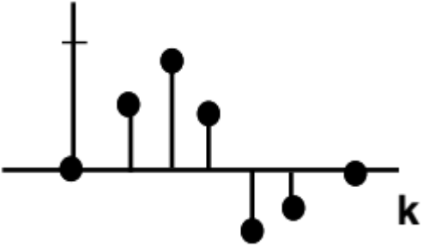

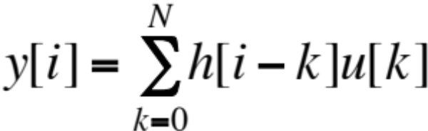
Linear Time-Invariant (LTI)
Discrete-Time
Unit sample input
DT-LTI
Unit Sample
Response
for all time
DISCRETE-TIME
CONVOLUTION

Slide 40




Linear Time-Invariant (LTI)
Discrete-Time
DT-LTI
Linear
DT-LTI
Time Invariant
DT-LTI

Slide 41
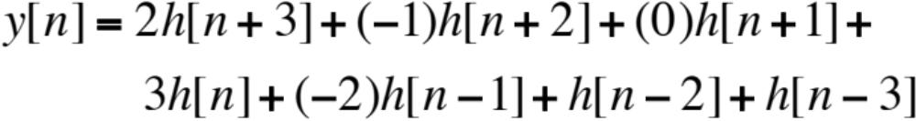
Linear Time-Invariant (LTI)
Discrete-Time
So response to input p[n]
is
This is convolution!

Slide 42
Linear Time-Invariant (LTI)
Discrete Convolution
u(t)
2
DT-LTI
y(t) = ?
1
2
1
h(k)*2
+
h(k)*1
+
…
Total sum = y(t)

Slide 43
Linear Time-Invariant (LTI)
Discrete Convolution (2nd method)
u(t)
2
y(t) = ?
1
DT-LTI
U(t)
y(1) = U(1)*h(1)
Shift U(t) to right,
y(2) = U(1)*h(2)+
U(2)*h(1)
Shift U(t) to right,
…
2
1

Slide 44

Linear Time-Invariant (LTI)
Step Response in Discrete-Time
Discrete-time differentiation = Difference
-
…
…
0
0
0

Slide 45
Excerpts from References
Autonomous Second-Order Nonlinear Systems:
“…we shall restrict our attention to second-order autonomous systems…where time does not enter explicitly into the
equation of motion. This, of course, precludes time-dependent
forcing functions.”
Unit-Step and Unit-Impulse Functions:
“Whereas the unit-step function is well defined, the unit-impulse function, mathematically speaking, is not.”
Now we understand what these concepts mean so we can begin
to understand how they apply to systems!

Slide 46
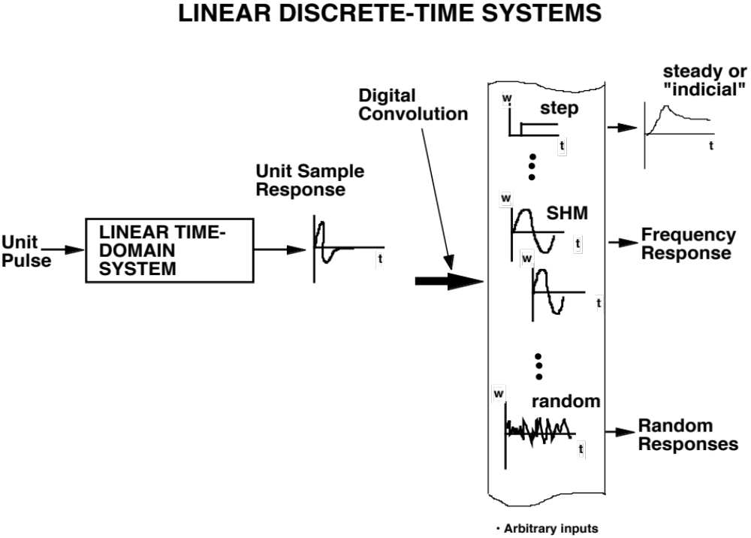

Slide 47
Linear Time-Varying (LTV)
Discrete and Continuous
What is the benefit of time-invariance for convolution?
How does this change for time-varying systems?
Is convolution possible for time-varying systems?

Slide 48
Transforms

Slide 49
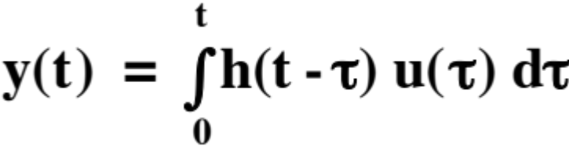
Linear Time-Invariant (LTI)
Continuous - Transforms
Transform Operation
(Fourier,Laplace)
Y(w) = H(w) X(w)
Convolution in time = Multiplication in frequency
Deconvolution in time = ?
Note: If H(w) exists --> h(t) must exist !!

Slide 50
Laplace Transform
Named for great French mathematician Pierre Simon de
Laplace
• Like all transforms, converts one form of a signal
into a different form
• Transforms from time domain to s-domain (or s-plane) and
back

Slide 51



Laplace Transform (cont’d)
S-plane is the complex plane, real numbers along the x-axis ( ) and imaginary numbers along the y-axis ( )
Can use the complex variable to define locations on s-plane
Laplace transform analyzes signals in terms of sinusoids and exponentials

Slide 52
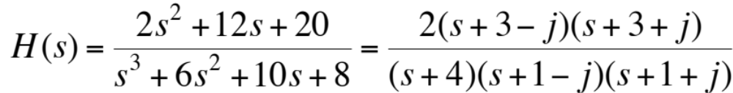
Laplace Transform (cont’d)
• Example
• zeros: -3 + j, -3 - j
poles : -4, -1 + j, -1 - j

Slide 53
Laplace Transform (cont’d)
• Can plot the zeros and the poles in the s-plane
Imaginary
1
-4
-1
Real
-1
STABLE
UNSTABLE

Slide 54

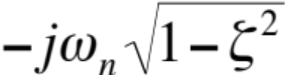




Laplace Transform (cont’d)
• The s-plane
Imaginary
Real
STABLE
UNSTABLE

Slide 55
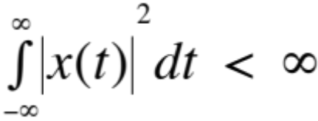
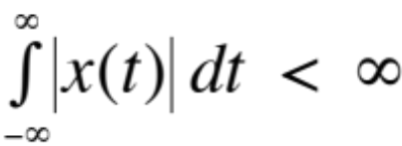
Fourier Transform
Fourier transform of x(t) will exist if x(t) has finite energy
Additionally, should follow Dirichlet conditions:
  x(t) has finite number of discontinuities
  x(t) has finite number of minima and maxima
  x(t) is absolutely integrable

Slide 56
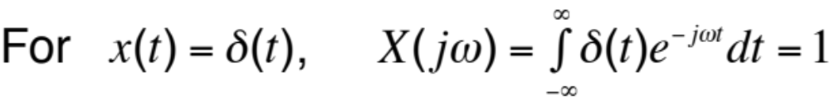

Fourier Transform
White
Spectrum
F. T.
0
t
0
What does this mean?
• White light → equal amounts of energy over spectrum

Slide 57
Fourier Transform
0
t
0
F. T.
0
t
0
0
t
0

Slide 58
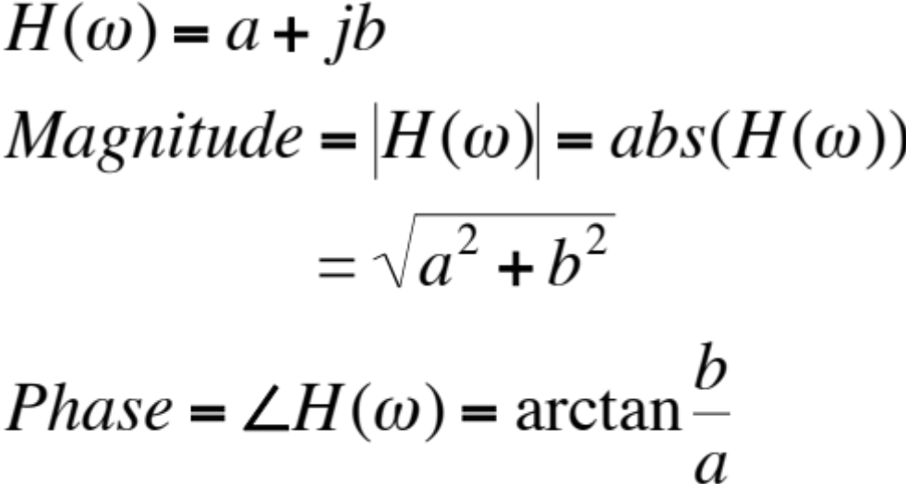
Fourier Transform
Computation of Fourier transform takes a real signal in time and generates a complex number in frequency
The complex number can be visualized in two ways: as real and imaginary components vs. frequency or as magnitude and phase vs. frequency
Recall

Slide 59
Continuous - Transforms
Transform Operation
(Fourier,Laplace)
Y(w) = H(w) U(w)
Convolution in time = Multiplication in frequency
Deconvolution in time = ?
H(w) = Frequency Response Function

Slide 60
Continuous - Transforms
y=h*u
u(t)
h(t)
y(t)
F.T.
F.T.
Inverse F.T.
U(w)
H(w)
Y(w) = H(w) U(w)
Multiplication of two complex numbers

Slide 61
Discrete-Time
Fourier Transform

Slide 62
Fourier Transform: Discrete-Time
Cooley and Tukey publish landmark paper, 1965
Dramatic efficiency in solving a discrete version of the
Fourier transform
Taking advantage of symmetry and periodicity
Known as the Fast Fourier Transform (FFT)
Has enabled the real-time computation of frequency analysis

Slide 63
Fourier Transform: Discrete-Time
Standard Fourier transform involves many mathematical
operations per computation
Number of operations is a function of the square of the
size of the data, or N²
If N = 2¹⁰ = 1024, then N² = 2²⁰ = 1,048,576
The number of operations for the FFT is N(log₂N)
For N = 2¹⁰, N(log₂N) = 10,240!!!
FFT algorithm implemented in hardware, software
One of the most important algorithms ever created

Slide 64
Discrete Transform
N
y(i)
=
h
(
k
)
u
(
∑
i
−
k
)
k
=
0
Z-transform
Y(z) = H(z) U(z)
Discrete-time equivalent of Laplace transform

Slide 65
Z-Transform
Laplace transform is used for continuous-time systems (differential equations)
Laplace transform → s-domain, s-plane
Z-transform is used for discrete-time systems (difference equations)
Z-transform → z-plane
Goal for both methods is to identify the poles (roots) and zeros of the system

Slide 66


Z-Transform
S-plane arranged in a rectangular coordinate system (real vs. imaginary)
For Laplace transform, the complex variable is defined as
Z-plane arranged in a polar (circular) format (will see why later)
For Z-transform, a complex variable in polar notation is defined as

Slide 67


Discrete Transform
S-Plane to Z-Plane
3
2
6
4
1
0.0
5
2
4
1
6
3
5
S-Plane
Z-Plane

Slide 68
Discrete-Time Frequency Analysis

Slide 69
Frequency Analysis
Continuous-time systems can have infinite frequency range
Sampling of a continuous-time system results in a discrete-
time system
Different sampling rates (sampling frequency, time step) will
result in different discrete-time systems from the same
continuous-time system
Important to understand discrete-time sampling concepts in
order to understand system dynamics

Slide 70
Frequency Analysis
Sampling
Time step (dt) is time (seconds) between samples
- for dt=0.01 secs, each sample occurs at 0.01 seconds
Sampling frequency is the inverse of time step fs = 1/dt
- for dt=0.01 secs, fs = 100 samples /sec
- samples/sec = Hertz
Selection of time step (or sampling frequency) must be
based on frequency content of system or signal of interest
Must understand sampling, aliasing, and Nyquist frequency

Slide 71
Frequency Analysis
Sampling
Extremely Important Equation
Given Nyquist condition, the highest frequency that a particular sampling frequency can resolve is
fs > 2f → f = fs/2 (Nyquist frequency) → fn = fs/2 = 1/(2*dt)
What is the frequency resolution of a given time step?
Df = 1/(N*dt) where N = length of signal (no. of time steps)
Frequency resolution improves as N increases
Frequency resolution improves as dt increases

Slide 72
Influence Functions, Green’s Functions

Slide 73
Linear Time-Invariant Systems
Influence Functions, Green’s Functions
What are the deflections x₁, x₂, and x₃
where the forces are being applied?
Kx = F, K=stiffness matrix
If K is not known, excite one force at a
time to get each column of K matrix
f₁
f₂
f₃
4 2 3
2 1 2
3 2 4
1
0
0
4
2
3
And so on…
=
Influence coefficient matrix = Static “Impulse response”

Slide 74


Linear Time-Invariant Systems
Influence Functions, Green’s Functions
To solve an Ordinary Differential Equation (ODE)
Replace F(t) with a Dirac delta function,
What is the reason for this substitution?
What is the system? Input? Output?

Slide 75
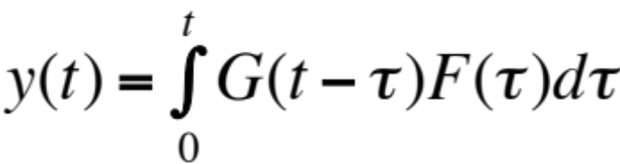
Linear Time-Invariant Systems
Influence Functions, Green’s Functions
Solution to this equation
is G(t) = Impulse Response
So, what is the solution of original ODE?
For zero initial conditions,

Slide 76
Linear Time-Invariant Systems
Influence Functions, Green’s Functions
This concept is the basis for many methods commonly used in engineering:
  Aerodynamic Influence Coefficients (AICs)
  Structural Influence Coefficients (SICs)
  Kernel Function
These are all the same concept

Slide 77
State-Space Modeling

Slide 78
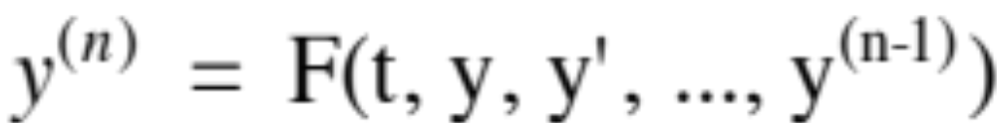
State-Space Models
An n^{th}-order differential equation
can be converted to a system of n first-order
differential equations by assigning

Slide 79
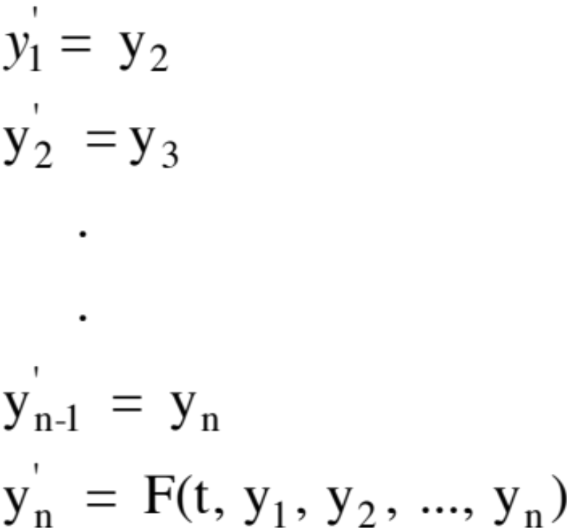
State-Space Models (cont’d)
Resulting in the following set of equations
This is known as state-space form

Slide 80
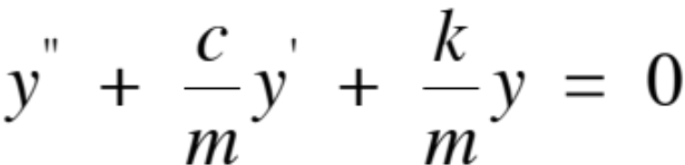
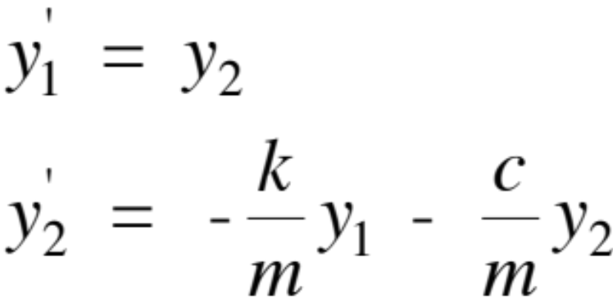
State-Space Models (cont’d)
Here’s an example for a mass-spring system
define

Slide 81
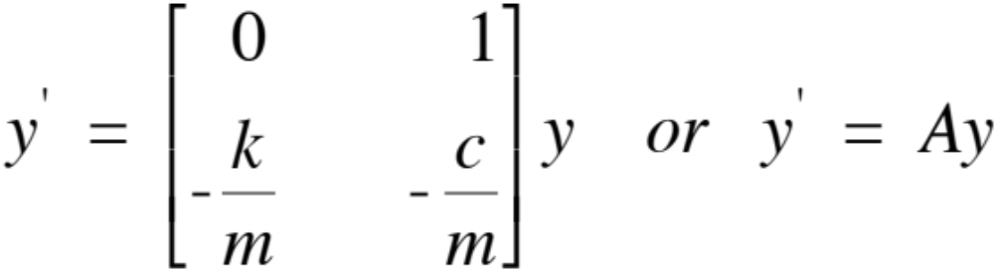
State-Space Models (cont’d)
Setting y^{T} = [y₁ y₂], in matrix form,

Slide 82

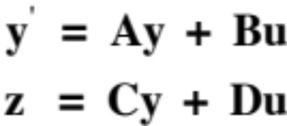
State-Space Models (cont’d)
If you have inputs to the system
and specific outputs
Outputs related to
the states of system
Outputs not related
to states of system
(direct feedthrough)

Slide 83
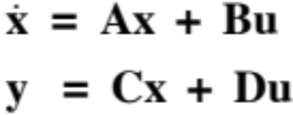
State-Space Models (cont’d)
The traditional model is defined as
With system stability defined by performing
eigenvalue analysis of A matrix (stability matrix)
Modern control theories, optimization, simulation,
and even nonlinear system theories are based on
this model

Slide 84
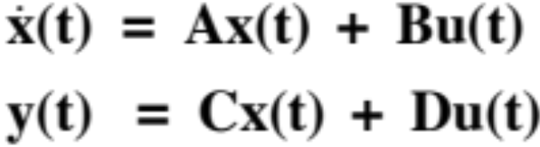

State-Space Models (cont’d)
The impulse response for this system
is defined as
A goal of system identification is to identify the
system quadruple (A,B,C,D) for a given system;
Can be achieved IF impulse response is known,
directly or indirectly.

Slide 85


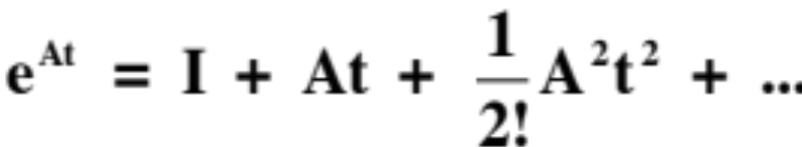
State-Space Models (cont’d)
Solution of this system of equations involves the state transition matrix,
defined as the solution of
which is

Slide 86
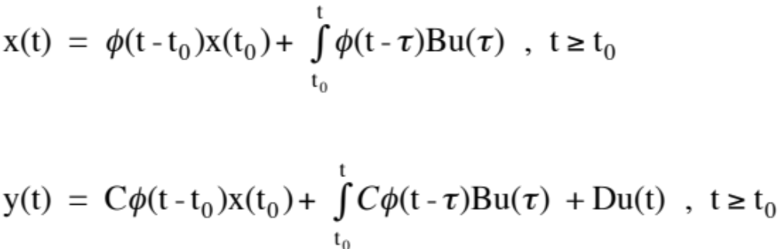
State-Space Models (cont’d)
Solving the differential equation,
What is this?

Slide 87
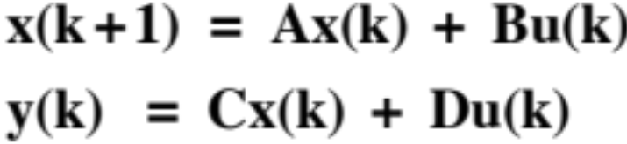

State-Space Models (cont’d)
Discrete-Time
The discrete-time version is
with impulse (pulse) response as
Each value of the discrete-time pulse response
is known as a Markov parameter. The information
Contained by the Markov parameters is central
To the theory of system identification (state-space
Realization).

Slide 88
System Identification

Slide 89
System Identification
Basic premise of system identification is to define a mathematical model of a system when only the input and output (sometimes only output) are known
There are several theories available in the time domain and the frequency domain
Predominantly, the majority of the theories are for linear systems
Nonlinear system identification is a more challenging problem

Slide 90
System Identification
?
Inputs
Outputs
Class Discussion
Given what we have learned thus far, how
would you proceed to identify this system?
What questions should be asked?
Define procedures to help answer questions

Slide 91
System Identification
Types of Identification
Parametric
  the structure or format of the equation of a
  system is known but its parameters are unknown
Nonparametric
  there is no assumed mathematical structure for the system

Slide 92

System Identification
Examples of Identification
Parametric
Nonparametric
Inputs
Outputs

Slide 93

System Identification
Some Terminology
White-Box Model
Light-Gray-Box Model
Dark-Gray-Box Model Generic with parameters
Black-Box-Model Generic
Inputs
Outputs

Slide 94
System Identification
Time Domain Methods
  Often based on impulse response
  Impulse response terms known as Markov parameters
  Include use of correlation methods
  Can generate ARMA (auto-regressive moving average) and state-space models
Inputs
State-Space Model (A,B,C,D)
Outputs

Slide 95
System Identification
Frequency Domain Methods
  Often based on filter methods
  Fourier methods usually incorporated
  Can generate frequency response functions
Inputs
Frequency Responses
Outputs

Slide 96
System Identification
Input Excitations
Time Domain
Frequency Domain
White
noise
Impulse (pulse)
Sinusoid
Colored
noise
Random

Slide 97
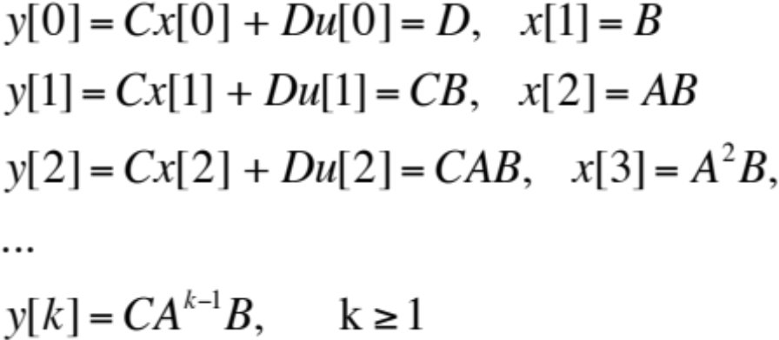
Discrete-Time Markov Parameters
The values of a discrete unit-pulse response of a state-space system are known as the Markov parameters
For SISO (Single-Input, Single-Output),
Essential for system ID/system realization
If Markov parameters known, can compute A, B, C, D matrices
For MIMO systems, Markov parameters are matrices; (i,j) entries
PULSE algorithm extracts Markov parameters from input/output data
“On Markov Parameters in System Identification”, NASA TM 104156

Slide 98
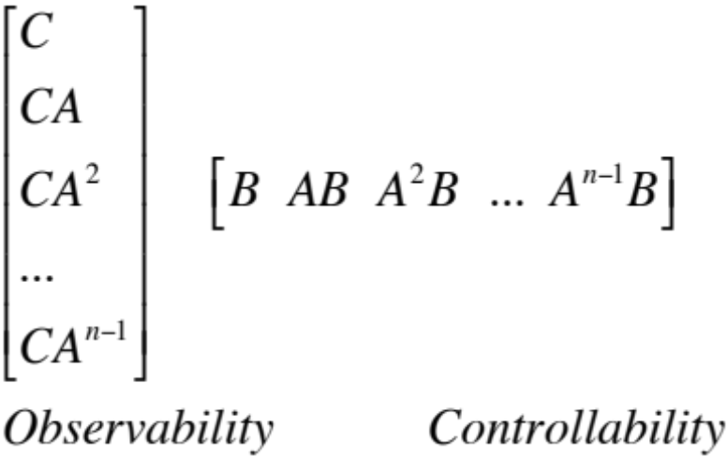
State-Space Realization (Ho-Kalman)
Given Markov parameters, find system dimension and quadruple (A,B,C,D) up to transformation (not unique)
Possibly first state-space realization methods (Ho-Kalman)
Related to multiplication of Observability and Controllability matrices:
B. L. Ho, R. E. Kalman, “Effective Construction of Linear State Variable Models from Input/Output Functions”, Regelungstechnik, vol. 14, No. 12, pp. 545-8, 1966.

Slide 99
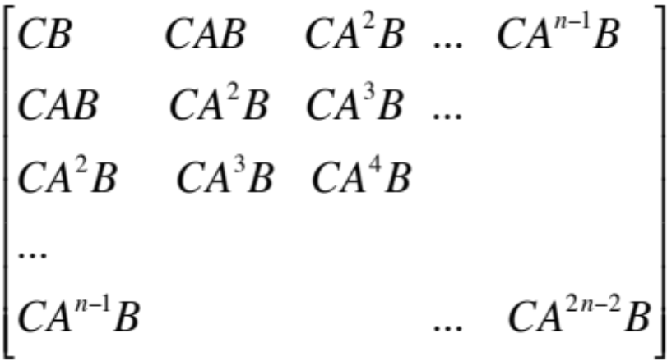
State-Space Realization (Ho-Kalman)
Result is a Hankel matrix, constant skew diagonals (upside down
Toeplitz matrix)
Values on the skew diagonals are the Markov parameters of the
system minus zero term (D) and values greater than index
To use Ho-Kalman, first form Hankel matrix H; factor H into its ‘O’ and
‘C’ components; use ‘O’ and ‘C’ to find A, B, and C
Rank(H)=n, keep adding data until rank does not increase

Slide 100
Nonlinear Systems

Slide 101
Nonlinear Systems Brief History
1600s – 1700s Newton’s Physics, Calculus
1800s Planetary motion analysis, Chaos
Early 1900s Presence of nonlinearity in
engineering devices
Lorentz’ equations
1970s Turbulence and chaos
1980s Fractals

Slide 102
Nonlinear Systems - Complexity
Real world is nonlinear, varying from single DOF
to multiple DOF to continuous
  1 DOF: Logistic equation (predator-prey)
  2 DOF: Pendulum, Limit Cycles
  n DOF: Structures, Electronics
  continuous: Earthquakes, Turbulent Fluids,
  Nonlinear Waves (shocks)
Linear systems are a very special, limited subgroup,
the result of a simplification (linearization) of a more
complex nonlinear system

Slide 103
Linear vs. Nonlinear
A linear system either
  Moves toward its equilibrium point
  OR blows up
A nonlinear system exhibits
  Greater complexity (responds to various equilibrium points)
  Exact (closed-form) solutions rarely available

Slide 104
Linear vs. Nonlinear
Multiple
Equil.
Point
Linear
Nonlinear
Single
Equil.
Point
ICs
t
t
stable
“stable”
t
t
unstable
Finite escape time
Goes to ∞ as t goes to ∞
Goes to ∞ in finite time

Slide 105
Nonlinear Systems
In addition to
  Finite escape time
  Multiple equilibrium points (equilibria)
  Limit cycles (will discuss)
Can also have
  Subharmonic, or harmonic oscillations
  Chaos (randomness from a deterministic system)

Slide 106
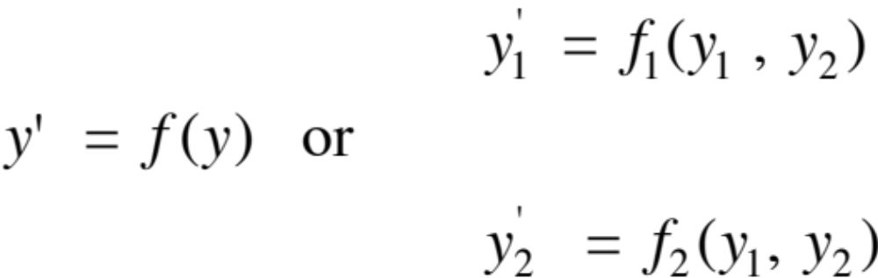
Nonlinear Systems (Time Domain)
Regardless of complexity, state-space form provides a
powerful, convenient, and consistent mathematical format for modeling and analyzing nonlinear systems:

Slide 107

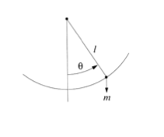
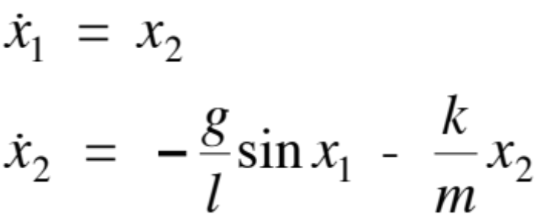
Nonlinear Systems (Time Domain)
Pendulum
Cast into state-space form,

Slide 108
Nonlinear Systems (Time Domain)
Equilibrium points (Fixed points) are a distinctive property of
nonlinear systems
A nonlinear system usually has multiple equilibrium points; a
linear system has one and only one equilibrium point
Knowing the number and type of equilibrium points of a
nonlinear system provides insight into the complex
dynamics of the system
An equilibrium point is a point in the solution space of the
system where the system is at rest

Slide 109
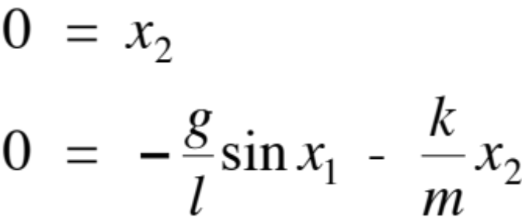

Nonlinear Systems (Time Domain)
To find equilibrium points, set derivatives to zero:
So equilibrium points are
But what are the different types
of equilibrium points?

Slide 110
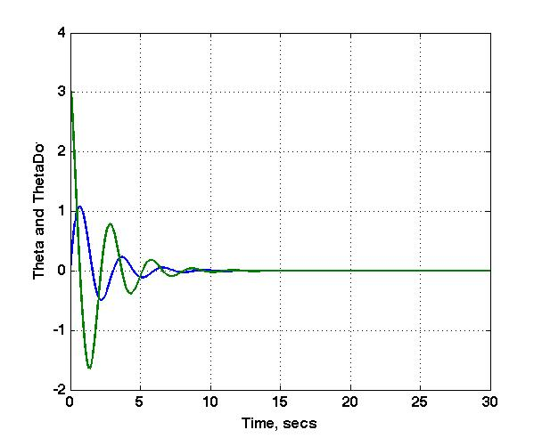
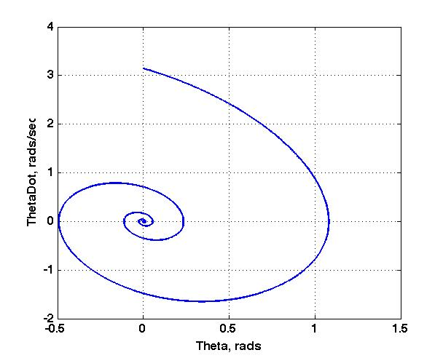
Nonlinear Systems (Time Domain)
Equilibrium Points
View in Time
View in Phase Plane
Start with IC
Time

Slide 111
Unsteady Aerodynamics

Slide 112
Background
Objective : find aerodynamic loads (forces & moments) associated with motion
  vibratory motion of the structure -- flutter and vehicle response
  motion of the flow field -- turbulence and gust response
  rotary motion of the vehicle -- rotorcraft and cascade flows (turbomachines)
  aircraft maneuvers & active control
Difficulties
  flowfield nonlinearities
    viscous flow -- drag due to friction, flow separation, & stall
    compressibility -- shock formation & oscillating shocks
  3 - dimensional flows -- aspect ratio, wing sweep, wing / body interference
  stores, nacelles, and other appendages

Slide 113
Background
Early (Classical) Developments
- 2D, flat plate, incompressible flow (linear equations)
- Quasisteady approximation
- Wagner’s function (step response in angle of attack)
- Kussner’s function (response to sharp-edged gust)
- Theodorsen’s function (sinusoidal airfoil response)
- Sear’s function (sinusoidal gust response)
- Analytically derived (no computers!)
Complex Geometries and Compressible Flow
- Analytical derivation of classical responses difficult
- Requires more complex aerodynamic equations
- Need computers to solve complex equations for complex
geometries
Notes:
12/18/98
54

Slide 114
Background
Assumptions for linear methods
  boundary layer ignored, attached flow assumed (inviscid)
  irrotational & isentropic (permits potential formulations) -- no shocks
  sinusoidal (harmonic) motion of structure and flow -- 1st-order effects
  superposition (linear) -- camber + thickness + oscillating flat plate
Nonlinear methods
  Assumptions vary depending on equation level
  Equation hierarchy defines complexity and related assumptions

Slide 115



Quasisteady aerodynamics
AOA consists of V_{y} , V_{α} , and α_{o} contributions
An upwash, V_{y} , increases the AOA
Angular velocity about the elastic axis
leads to an AOA that varies along the wing.
Upwash, V_{α} , at the 3/4 c is used.
Thus
Instantaneous response at condition; no history

Slide 116



Model Comparison (Lift) & Reduced Frequency Influence
k = 0 . 1
k = 1 . 0

Slide 117
Classic Aerodynamic Functions
 | Airfoil Motion | Gust
Step | Wagner’s Function (angle of attack or impulsive velocity) | Kussner’s Function (sharp-edged gust)
Sinusoidal | Theodorsen’s Function | Sear’s Function

Slide 118

Wagner’s Function
Quasisteady
Wagner’s
Semichords Traveled
Time-domain response in lift due to a step change in angle of attack. Defines the lag between the motion of the airfoil and the associated aerodynamic response (lift).
The quasi-steady approach assumes no lag -- immediate response

Slide 119


Wagner’s Function
$Φ\left(τ\right)$ = 1 $\int_{0}^{∞}{{\left\{{\left(K_{0}−K_{1}\right)}^{2}+π^{2}{\left(I_{0}+I_{1}\right)}^{2}\right\}}^{−1}e^{−xτ}x^{−2}dx}$
I₀, I₁: modified Bessel functions of the first kind
K₀, K₁: modified Bessel functions of the second kind
and
Lift: $L=2πbρUwΦ\left(τ\right)$
where b = semichord, ρ = density, U = freestream velocity, w = downwash (motion)
And $τ= \frac{U_{t}}{b}$ is a nondimensional quantity proportional to time known as the distance travelled in semichords

Slide 120

Wagner’s Function
What is this?

Slide 121



Reduced Frequency
Fundamental parameter in unsteady aerodynamics
Frequency parameter
Number of oscillations undergone by airfoil during time airflow travels across the chord of the airfoil
Typically use reduced frequency
Similarity of propagation

Slide 122



Theodorsen’s Method
Quasisteady flow (as previously derived) :
Unsteady Potential Flow (Theodorsen’s Theory ~ 1930s)
which introduces “noncirculatory” contributions
Theodorsen’s Function is C(k) = F(k) + iG(k) where k is the reduced frequency, k = bω / V

Slide 123
Theodorsen’s Function
NACA Report 629

Slide 124
Aerodynamic Modeling
Actual flows are:
  three dimensional
  viscous
  compressible
  nonlinear
For most applications, a significant simplification on the flow representation can be reached.

Slide 125



Aerodynamic Modeling
Viscous, Inviscid Flows
  Viscous flow: mass diffusion, viscosity (friction), and thermal conduction phenomena are present.
  Inviscid flow:
  Examples of viscous flows: high angle of attack; blunt bodies
Flow outside boundary layer is inviscid
Thin boundary layer—viscous flow

Slide 126

Aerodynamic Modeling
Compressible, Incompressible Flows
  Incompressible: density is constant (low speed flows)
  Mach number is a good indicator of compressibility
    M < 0.3 incompressible (approximate)
    M > 0.3 compressible (approximate)

Slide 127
Aerodynamic Modeling
Mach Number Regimes
  By definition, the flow is locally:
    Subsonic, if M < 1
    Sonic, if M = 1
    Supersonic, if M > 1
  Four different flow regimes using Mach # as the indicator:
    Subsonic
    Transonic
    Supersonic
    Hypersonic

Slide 128


Aerodynamic Modeling
Subsonic Flow (M < 1 everywhere)
  Usual simplifications: incompressible, irrotational, linearized.
  Disturbances propagate both down and upstream.

Slide 129







Aerodynamic Modeling
Transonic Flow (mixed regions of M < 1 and M > 1)
  Assumptions: nonlinear, compressible
  Shock waves move due to oscillations of airfoil and oscillations in the flow
  Defined by geometry, NOT freestream Mach number!
Trailing edge shock
Bow shock

Slide 130

Aerodynamic Modeling
Supersonic Flow (M > 1 everywhere)
  Assumptions: compressible, linearized
  Disturbances propagates downstream inside Mach cone.
Sharp nosed edge
Shock wave
Expansion wave

Slide 131

Aerodynamic Modeling
Hypersonic Flow (high supersonic speeds)
  Assumptions: nonlinear, viscous
  Stronger shocks; thin shock layer interacts with viscous boundary layer
  High layer temperatures—chemical reactions occur
  Typically for M > 5
Shock wave
Thin, hot shock layer with viscous interactions and chemical reactions

Slide 132


Strip Theory
3-D extension of the 2-D theory
  2-D solutions assume that the loads at each spanwise station of a wing depend only on the motion of that station.
  The wing is divided into a number of strips and the aerodynamic loads on each strip is calculated on the basis of the 2-D coefficients evaluated at the centerline of the strip.
chords parallel to the flow

Slide 133
Strip Theory
3-D extension of the 2-D theory (cont.)
  Effective primarily for unswept wings with high aspect ratios.
  Strip theory can be adjusted to account for compressibility (Prandtl-Glauert correction) or aspect ratio effects.
  Theodorsen function C(k) is used for the unsteady circulatory loads.
  Each strip has at least two degrees-of-freedom (DOF),i.e., pitch and plunge (three DOF if control surface is present).

Slide 134


Linear Frequency-Domain Methods
Numerical method to solve the 3-D potential flow.
Break-up lifting surface into boxes.
Assumption:
x
Evaluate upwash at 3/4 box chord
Boxes arranged in strips parallel to freestream velocity

Slide 135


Doublet Lattice Method
Discretized problem reduces to:
and can be set up in matrix form:
    Very popular method (e.g., MSC/NASTRAN, ASTROS, etc.)
    Linearized potential flow—subsonic flow applications
    Undisturbed flow is uniform and is either steady or gusting harmonically
    Similar in concept to Finite Element Model (FEM) in structural applications
Notes:

Slide 136
Practical Considerations
Practical considerations (from MSC/NASTRAN implementation):
  Aspect ratio of the boxes should be ~1 (range 1/3 to 3 is acceptable).
  Chord length of the boxes < 0.08 U/f, where U=uniform flow velocity, f=greatest frequency of interest (Hz), i.e., 12 boxes per minimum wavelength.
  No less than four boxes per chord.
  Boxes should be concentrated near wing edges and hinge lines or any other places where downwash is discontinous and pressures have large gradients.

Slide 137

Unsteady Aerodynamics

Slide 138
Nonlinear Unsteady Aerodynamics
Navier-Stokes Eqns
unstable
Euler Eqns
q
Full Potential
stable
transonic flutter “dip”
Transonic Small Dist.
1.0
Linearized TSD
Mach no.
Classical
TSD (hi freq)
Lifting Surface
(Linear, sub-,
and supersonic)
Typically will need “some”
nonlinear aero to determine
transonic flutter “dip”.
Notes:
12/18/98
61

Slide 139
Aerodynamic Equation Hierarchy
Navier-Stokes (NS) Equations
Direct Numerical
Simulation (DNS)
Large Eddy
Simulation (LES)
Reynolds-averaged
Navier-Stokes (RANS)
Thin-Layer
Approximation

Slide 140
Aerodynamic Equation Hierarchy
Navier-Stokes (NS) Equations
Direct Numerical
Simulation (DNS)
The full and exact solution of the NS equations
without any turbulence model approximations
Huge computational requirements ~ flow past
airfoil requires exaflop (10¹⁸ flops)
Turbulence contains wide spectrum of vortices
of equal physical importance -- limited to simple
geometries and low Reynolds numbers

Slide 141
Aerodynamic Equation Hierarchy
Navier-Stokes (NS) Equations
DNS
Large Eddy
Simulation (LES)
LES
Next level of simplification from DNS
Focus is on the large energy-containing scales
Smaller scales approximated with subgrid models
Much less computational requirements than DNS

Slide 142
Aerodynamic Equation Hierarchy
Navier-Stokes (NS) Equations
Stationary turbulent effects are
time averaged
Time averaging creates more
unknowns than equations (closure)
Turbulence models provide closure
FUN3D
Reynolds-averaged
Navier-Stokes (RANS)

Slide 143
Aerodynamic Equation Hierarchy
Navier-Stokes (NS) Equations
Only those derivatives in the direction
normal to the wall are retained in the
shear stress and heat flux terms
CFL3D
Reynolds-Averaged
Navier-Stokes (RANS)
Thin-Layer
Approximation

Slide 144





Navier-Stokes Equations
Most generic flow representation, may be considerably computationally intensive for unsteady calculations.
Thin-layer approximation: valid only for high Re—very large turbulent eddy viscosities invalidate the model.
Equations in vector form:
where:
As before in Euler Equations
Shear stresses in flow

Slide 145


Example of Different CFD Results
Ref.: Bennett, R. M., and Edwards, J. W., “An Overview of Recent Developments of Computational Aeroelasticity,” 29th AIAA Fluid Dynamic Conference, Albuquerque, New Mexico, June 15–18, 1998.
Flutter speed index
Frequency ratio
“Comparison of experimental and calculated flutter results for the AGARD Wing 445.6 tested in air.”

Slide 146
Aerodynamic Equation Hierarchy
“Rules of Thumb”
Linear
Inviscid w/
flat plate
Nonlinear
Inviscid w/
thickness
Accuracy usually
not improved
(w/ experiment)
Accuracy usually
is improved
(w/ experiment)
+
Viscous
effects
Bottom Line: Thickness and viscosity tend to have
compensating effects, which is why Linear Methods
have proven so effective!!

Slide 147
Aerodynamic Equation Hierarchy
“Rules of Thumb”
Nonlinear
Inviscid w/
thickness
Shocks tend to be stronger and farther aft than experiment
Computed transonic flutter boundaries tend to be “very deep” (AFW/CAP-TSD analyses)
Reduce shock strength from inviscid result, moving shock forward (boundary layer)
Viscous
effects
Bottom of flutter dip is raised (softened) from inviscid result

Slide 148
Aerodynamic Equation Hierarchy
“Rules of Thumb”
Unsteady shock dynamics
Lower frequency structural motions
Flow has more time to react to motions
Shock excursion over larger portion of wing chord
Larger excursion implies greater variation in pressures
which implies greater nonlinear integrated effect (forces)
Higher frequency structural motions
Flow has less time to react to motions
Shock excursion over smaller portion of wing chord
Smaller excursion implies less variation in pressures
which implies less nonlinear integrated effect (forces)

Slide 149
Structural Analysis

Slide 150
Finite Element Method
Very powerful method for analyzing arbitrary structures.
The de facto industry standard.
Extensive literature available on this topic.
Several commercially available packages
  MSC/NASTRAN
  ANSYS
  I-DEAS
  ADINA
  ABAQUS
  Etc.

Slide 151


Finite Element Method
Basic idea: the problem is solved by breaking down the domain in subdomains and by assuming a shape for the solution (Rayleigh-Ritz approximation) within each subdomain (finite element). In the limit of the subdomain refinement, the solution should converge to the exact solution.
subdomain
domain
boundary

Slide 152
Finite Element Method
Different “subdomain” formulations (type of elements):
  1-D elements: rods, bars, strings
  2-D elements: plate, shells, shear element; triangular, quadrilateral, variable number of nodes
  3-D elements: solid (brick) elements; tetrahedron, hexahedron

Slide 153
Finite Element Method
Four main steps in the method:
  Element formulation (in applications, choice from an existing library of elements)
    Type and order of shape functions
    Element shape
    Nodal degrees of freedom
  Assembling process: global DOF. from element DOF
  Solution
    Linear/nonlinear system solvers
    Linear: assumes small perturbation -> constant stiffness matrix
    Eigensolver: modes and frequencies
    Interface with aerodynamics/aeroelasticity
  Pre- and Post-processing

Slide 154

Normal Modes Method
The Normal Equations are an expression of the Modal Method.
Modes are eigenfuctions/eigenvectors of the mass-spring system.
Linear assumption (small perturbation) in effect.
Note: “Normal” usually with respect to the mass matrix/distribution.

Slide 155




Normal Modes Method
Example for a cantilever beam
First Mode
Second Mode
Third Mode
Beam Length

Slide 156

Overview - ‘reduced order model’
The motion of the wing may be represented by a superposition of ‘modes’ . . .
  Flexure : y (span, time) = [ F ] {q_{y}}
  Torsion : a (span, time) = [ F ] {q_{a}}
velocities and accelerations of flexure and torsion may be represented by this expansion of modes

Slide 157

KTH Model Mode Shape 2

Slide 158

KTH Model Mode Shape 6

Slide 159

KTH Model Mode Shape 7

Slide 160
Nonlinear Structural Dynamics
Issues
  Large perturbations
  Stiffness matrix not constant across entire motion
  Material nonlinearity
  Follower forces
  Others
Options
  Nonlinear Normal Modes
  Directly coupled solution to FEM
  Local linearization at each condition of interest

Slide 161
Aeroelasticity

Slide 162

Aeroelasticity
RIGID BODY
Thermal
Control
Notes:
1

Slide 163


Historical Point of Interest
  Airplane designs had aeroelastic problems from Day One !
  Samuel Langley's monoplane launched (days before the Wright Flyer) from a houseboat in the Potomac River suffered a structural failure -- possibly aeroelastic divergence
Notes:
6

Slide 164
Some types of aeroelastic phenomena
STATIC (involves the interaction of aerodynamic and elastic forces)
  DIVERGENCE -- deformation - dependent aerodynamic forces exceed the elastic restoring capability of the structure
  CONTROL SURFACE REVERSAL -- control loss or reversal of expected response due to structural deformation (stiffness) of the primary surface
  LIFT EFFECTIVENESS ----change in magnitude and distribution of aerodynamic loads due to the structural stiffness of the aerodynamic surface
DYNAMIC (involves the interaction of aerodynamic and elastic and inertial forces)
  FLUTTER -- an oscillatory instability where one ”mode of motion” is driven to resonance by a second mode. Both modes have coalesced to the same frequency (includes ‘bending-torsion’, propeller whirl, and panel flutter)
  ‘BUZZ’ and ‘BUFFET’ -- high frequency instabilities caused by flow separations, wakes from forward structures, shock wave oscillations
  ‘DYNAMIC RESPONSE’ due to gusts, turbulence, and other such atmospheric disturbances that affect aircraft performance

Slide 165








Aeroelastic divergence -- a static instability in which the elastic restoring forces are exceeded by the deformation-dependent aerodynamic forces. It does not depend on ‘strength’ (e.g., yield or ultimate loads); it does depend on ‘stiffness’ (e.g., [K], EI, … )
To illustrate, consider the following example . . .
where
q = dynamic pressure K = stiffness e = eccentricity = aerodynamics
With substitution for the aerodynamic loads . . .
Solving for the deformation of the structure, θ :
Observe that
If “q” is the free variable, then divergence is defined as
$$C_{L_{α}}$$
Notes:
1

Slide 166

FLUTTER is caused by the interaction of aerodynamic, inertial, and elastic forces
Flutter is easily illustrated by examining the behavior of a wing section limited to two degrees of freedom -- pitch and plunge.
The equations of motion are found by summing forces and moments
Notes:
10

Slide 167
Aeroelastic Analysis
Fidelity of the structural model is key to aeroelastic analysis
  A finite element model (FEM) is essential
  A “dynamically similar” model could be used
  Measured modes may be a source for a structural model
Aeroelastic analysis software products:
  NASTRAN
  Zona Technology
  NASA
  “home grown”

Slide 168
Aeroelastic Analysis
Aeroelastic stability analysis is performed for
  All altitudes of interest
  Mach numbers within the flight envelope
  Symmetric and antisymmetric modes
The analyst’s concern must include
  The transonic regime
  Examination of all participating modes of vibration
Two general solution categories:
  Classical methods for linear, frequency-domain unsteady aero
  Time-domain methods for nonlinear, CFD-based unsteady aero

Slide 169



FLUTTER
⎛
m
mr
••
⎞
y
⎞
⎛
K
0
⎞
⎛
y
⎞
⎛
−
L
⎛
y
⎞
⎜
⎟
+
=
⎜
⎟
⎜
⎟
••
⎜
⎟
⎜
⎟
mr
I
α
0
K
α
M
⎝
⎠
⎝
⎠
⎝
⎠
α
⎝
⎠
⎝
⎠
Mass Matrix
Stiffness Matrix
Unsteady Aero
Time domain solutions:
Response to a disturbance (initial condition) is examined.
All structures have some level of structural damping [c] that can be added to equations.
+
Notes:
11

Slide 170
Classical Solution Methods
In general, the equations of motion for the aero(servo)elastic system are:
Many methods are used:
  Velocity “root - locus” plots
  Theodorsen’s method
  the “V-g” method (a.k.a. American method)
  the “p-k” method (aka British method)
We solve the “general” aeroelastic set of equations, however we must consider
  relationship between “circular” frequency and reduced frequency (k)
  harmonic motion is assumed (aero in frequency domain)
  relationship between Mach number, velocity, altitude, flow conditions
  eigenvalues are complex -- frequency and damping are found
  for “separated” equations, the solution must agree
  the presence and form of damping
  Flutter Determinant, solved iteratively (usually)

Slide 171


FLUTTER
Frequency domain solutions (roots) may reveal . . .
  flutter as a coalescence of aeroelastic frequencies of 2 or more modes
  or, aeroelastic divergence as a “zero frequency” mode
Notes:
14

Slide 172

FLUTTER - The V-g (Velocity-damping) chart is a popular way to present frequency domain solutions
A V-g Diagram is constructed for each altitude and Mach no., the V-g diagram shows damping for increasing freestream velocity.
Critical modes may be sensitive to damping, the path (somewhat) indicates the nature and severity of the instability.
Aerodynamic loads affect both frequency & damping, but some modes are insensitive to aerodynamics.
The number of roots depends upon the number of DOF in the system or modes of vibration used in the solution.
Notes:
16

Slide 173

Time-Domain Solution Methods
Generalized
Coordinates
Q - Dynamic
Pressure
Q
Monolithic
CFD code
GAFs
Modeshapes from FEM splined to CFD grid for use in CFD code
Linear Structure represented by state-space modal equations of motion
Nonlinear Aerodynamics represented by flow solution (Euler, NS)
Linear Structure outputs structural states
Structural states are combined with modeshapes into physical space to define grid deformation, input to Nonlinear Aerodynamics
Nonlinear aero computes pressure distribution at each time step
Pressure distribution projected (dot product) onto each mode (Generalized Aerodynamic Forces, GAFs)

Slide 174


Time-Domain Solution Methods
Modal Space
N modes
2N states
${Gaf}_{i}=\int{C_{p}}φ_{i}$dS
Generalized
Coordinates
Q
GAFs
Project Pressures
Onto each Mode
Physical Space
$$d\left(x,y,z,t\right)=\sum{φ(x,y)ψ(t)}$$
Pressures/Forces
Grid deformation

Slide 175

Time-Domain/Freq Solution Methods
Time Domain
Frequency Domain
${Gaf}_{i}=\int{C_{p}}φ_{i}$dS
Influence Function
Response of N modes
to N modes
NxN GAFs
N modes
N GAFs
Example: AGARD 445.6 Wing
4 modes
4 Time-domain GAFs
16 Freq-domain GAFs

Slide 176
Time-Domain Solution Methods
Generalized
Coordinates
Q - Dynamic
Pressure
Q
Monolithic
CFD code
GAFs
Classical Solution Methods yield ‘nmode x nmode’ GAFs!!
Time-Domain Solution Methods yield ‘nmode’ GAFs!!
Black Box -> New Q, new solution -> $$$
A change in structural damping requires a new solution
Outputs are time signals of generalized coordinates/GAFs -> no insight regarding aeroelastic mechanisms (as found in V-g-f or root locus plots)

Slide 177

Aeroelastic Analysis & Test Process

Slide 178
Computational Aeroelasticity
Coupling Methods
There are three primary approaches for coupling CFD/CSD:
  Intimately-Coupled (or Unified) Analysis: governing equations have to be reformulated
  Tightly (or Closely) Coupled Analysis: interaction between CFD and CSD codes occurs at every time step
  Loosely-Coupled Analysis: occasional interactions between CFD and CSD codes

Slide 179
Aeroservoelasticity

Slide 180
Introduction (Background)
ASE : Multidisciplinary interaction of:
  The aircraft’s flexible structure
  The steady and unsteady aerodynamics
  The active control systems
ASE Interactions
  Adverse effects on vehicle stability and performance
  Favorably modify the aeroelastic response characteristics
  (HiLDA video)
Viable design option for:
  Minimum weight
  Optimized performance
  Multimission requirements

Slide 181


Slide 182

ASE Design Benefits

Slide 183
Point of Interest
Traditional approach
  Design rigid-body control system
  Design/investigate flexible-body control system
  Frequency separation allows separate designs to be combined later
High Speed Civil Transport (large, flexible)
  Closely-coupled rigid-body and flexible modes
  Traditional approach not effective
  New design paradigm
  Long fuselage leads to lags in response
  Several ASE issues (SMC, RQ, GLA,…)

Slide 184


AE/ASE Typical Plots
MODELING
PERFORMANCE
ROBUSTNESS
I
R
Mode Shapes
Stability
Nyquist Plot
PSD
M
ω
ω
φ
ω
Aero Paneling
Statistical Response
Bode Plot
I
σ
k
t
R
ω
k
Deterministic
Response
S-Plane Approx
Singular Values
Notes:
12/18/98
16

Slide 185

Equations of Motion
Structure
Controls
Aerodynamics
• Can combine structure and controls into state-space form for
use with modern control theory (optimal control, stability)
• Classical linear aerodynamics defined as discrete, tabular
functions of frequency; not in time domain, therefore, cannot
include in structure-control state-space formulation
• Use rational function approximations to solve problem

Slide 186

Aerodynamic “Fits”
Imaginary
Aero = f(w)
Doublet lattice
Kernel function
Aero(S) = f(S)
Real

Slide 187

P-Transform Latest technique; see references by J. Dykman, Boeing-Long Beach
Notes:
12/18/98
17

Slide 188

Equations of Motion

Slide 189
Gust Modeling
Two basic models of “turbulence”
  Dryden spectrum - for wind-tunnels
  Von Karman spectrum - for atmospheric flight
Based on spectra (frequency content)
Think of as additional filter that will affect the overall response of the vehicle
Measurement/quantification of turbulence an important and active effort

Slide 190
Comments on EOMs
Final product is system quadruple (A,B,C,D) matrices
Quadruple is math model of structure, aerodynamics, and controls (including sensors and actuators)
Stability is determined by eigenvalue analysis of A matrix
Quadruple suitable for any control system design concept
Quadruple suitable for initial simulation

Slide 191
Math Model Development
Mode Shapes
Aero/Structural
Interface
Aerodynamic
S-Plane
Approximation
Unsteady Aero
Generalized Masses
Modal Frequencies
Structural Damping
Frequency
Domain Model
Open-Loop
Frequency Domain
Model
Open-Loop State-
Space Model
Actuator and
Turbulence Models
Closed-Loop State-
Space Model
Design Methods
Closed-Loop Frequency
Domain Model
Analysis Methods
Transfer Matrix
Control Law
State-Space
Control Law

Slide 192


State-Space Model
W_{g}
B_{wg}
B_{u}
C
A
C_{c}
B_{c}
A_{c}
Notes:
12/18/98
15

Slide 193

Dynamic Pressure Root Locus Plot
Notes:
12/18/98
27

Slide 194
Dynamic Pressure Root Locus Plot
Will want to see something like...
Flutter at
Q psf
Flutter at
1.2Q psf
Flutter suppression
System (FSS) Off
Flutter suppression
System (FSS) On
…without aggravating higher frequency mechanisms
and within hardware performance limits

Slide 195

Discipline Integration Example – X-59
https://www.youtube.com/watch?v=DPd0OHrmCBc
Demonstrate low-boom overland flight

Slide 196
X-59 Aeroelastic Modeling, Testing, and Validation
Tight Collaboration with
Lockheed-Martin (LM)
Independent verifications
  Computational
    FEM
    Loads
    Linear aero
    CFD aero
    Reduced-Order
    Models
    AE/ASE
    Thermal
  Experimental
    Proof Test (stiffness)
    Ground Vibration Test (structural dynamics)
    Structural Coupling
    Test (Control System)
  Active participation in all
  analyses and tests
Structure
Unsteady Aero
AeroElasticity (AE)
Flutter
Static/Dynamic
Deformation
Loads
Low-Boom Flight Demonstrator (LBFD)
AE/ASE Concerns
Long, slender fuselage
Thin wings
Large engine (mass)
Lift distribution (statically unstable)
Finite Element Model (FEM) accuracy
of critical importance
Structure
Unsteady Aero
Control System
AeroServoElasticity (ASE)
Flight Dynamic/ASE Stability
High sensitivity identified
Loads

Slide 197



X-59 Aeroelastic Modeling, Testing, and Validation
Transonic Aero
Static Shape
Low-Boom Flight Demonstrator (LBFD)
AE/ASE Concerns
Long, slender fuselage
Thin wings
Large engine (mass)
Lift distribution (statically unstable)
Finite Element Model (FEM) accuracy
of critical importance
Proof Test Preparations
Image credit:Lockheed-Martin

Slide 198




X-59 AeroServoElastic (ASE) Analyses
ASE
Stability
Sensitivity
Studies
Unstable
Margin
Flight
Condition
1
Stable
ASE sensitivity to weight -> fuselage mode -> ASE
Close collaboration with Flight Dynamics
Unstable
Weight variations:
5%, 10%, 18%
Flight
Condition
2
Margin
FEM
Stable
Image credit:Lockheed-Martin

Slide 199
Reduced-Order Modeling

Slide 200
Background
The development of Reduced-Order Models (ROMs) is a very active area of research
A ROM seeks to extract the essence of a complex system in order to create a simpler, more efficient, representation
There exist various types of ROMs for various applications (Structures, Aero, Controls, etc.)
Can consider linear unsteady aero methods as ROMs
Can consider CFD turbulence models as ROMs

Slide 201
Background
Two major categories: POD and System ID
POD: Proper Orthogonal Decomposition
Separation of variables for any data set
Decomposing into “dominant” spatial and temporal components
Can use spatial and temporal components to re-create related physics
Similarities with Principal Component Analysis (PCA) and Independent Component Analysis (ICA)
Sometimes referred to as “Modal Decomposition” in reference to Fluid Dynamics
Large number of references available

Slide 202
Background
System ID: System Identification
System ID seeks to create a mathematical representation of a “black box” using very specific types of inputs and the resultant outputs
Remainder of Tutorial will focus on AEROM, a system ID software for unsteady aerodynamics and aeroelasticity

Slide 203
Introduction
The AEROM software, developed at NASA Langley Research Center, continues to be developed, distributed, and applied to various configurations
The software is a “wrapper” that can be easily applied to any time-accurate CFD code (nonintrusive to source code)
The software has been successfully used with the structured CFL3D and the unstructured FUN3D flow solvers
Capabilities include error minimization and rapid generation of aeroelastic root locus plots
Some history and applications of AEROM follow

Slide 204




Initial Developments
Two Different Worlds
V-g-f plots
CFD grids
ASE Models
Aeroelastic transients
Root locus plots
Nonlinear Aeroelastic CFD Solutions
Improved physics
Expensive, time consuming
Difficulty integrating into vehicle
design processes
Linear Aeroelastic/ASE Methods
Easy to generate
Rapid, multiple solutions
Well integrated into vehicle
design processes

Slide 205
Initial Developments
Two Different Worlds
COMBINE?
V-g-f plots
CFD grids
ASE Models
Aeroelastic transients
Root locus plots
Nonlinear Aeroelastic CFD Solutions
Improved physics
Expensive, time consuming
Difficulty integrating into vehicle
design processes
Linear Aeroelastic/ASE Methods
Easy to generate
Rapid, multiple solutions
Well integrated into vehicle
design processes

Slide 206
Initial Developments
Two Different Worlds
COMBINE?
V-g-f plots
Volterra
Theory
CFD grids
ASE Models
Aeroelastic transients
Root locus plots
Nonlinear Aeroelastic CFD Solutions
Improved physics
Expensive, time consuming
Difficulty integrating into vehicle
design processes
Linear Aeroelastic/ASE Methods
Easy to generate
Rapid, multiple solutions
Well integrated into vehicle
design processes

Slide 207
Volterra Theory of Nonlinear Systems
y
h
+
∫
(
t
)
=
h
(
t
-
τ
)
u
(
τ
)
d
τ
+
0
1
0
t
t
∫
∫
h
(
t
-
τ
,
t
-
τ
)
u
(
τ
)
u
(
τ
)
d
τ
d
τ
+
.
.
.
+
2
1
2
1
2
1
2
0
0
t
t
∫
∫
.
.
.
h
(
t
-
τ
,
.
.
.
,
t
-
τ
)
u
(
τ
)
.
.
.
u
(
τ
)
d
τ
.
.
.
d
τ
+
.
.
.
n
1
n
1
n
1
n
0
0
Multidimensional convolutions with multidimensional kernels
Kernels are IMPULSE RESPONSE FUNCTIONS
Question: Does an aerodynamic impulse response exist?
Initial Answer: No, or unclear, according to some texts
Fung: “Whereas the unit-step function is well defined, the unit-impulse function, mathematically speaking, is not.” (??), pg 275

Slide 208


Conceptual Breakthrough
Classical Unsteady Aerodynamics
Origins
Impulse Response
Convolution
circa 1930s
continuous time
linear
Dirac delta function
abstract/undefined
confusion
ignored/dismissed
recognized efficiency
continuous time
linear
step response ONLY
Valid for ODEs, PDEs;
Green’s function
Clearly, this function cannot be used within a CFD analysis.
BUT, frequency-domain GAFs exist, therefore, by Fourier principle, the
inverse Fourier transform of GAFs (impulse responses) must exist!

Slide 209

Conceptual Breakthrough
Digital Signal Processing (DSP)
circa 1960s
discrete time
linear, nonlinear
unit sample
simple, well-defined
extremely useful
easy to apply
digital efficiency
linear, nonlinear
Impulse OR step
cornerstone of DSP
Unit sample input
∑ δ(k) = 1, k=discrete time
δ[k]
Output due to this input known as Unit Sample
Response
No abstract/complicated theory
Practical, directly applicable to any discrete-time
system

Slide 210

Eigensystem Realization Algorithm (ERA)
Discrete-Time State-Space Realization Theory
  Developed at NASA LaRC by colleague Dr. Jer-nan Juang et al.
  Multi-input/Multi-output (MIMO ), MATLAB-based, interactive
  Based on SVD of Hankel matrix of Impulse Responses (Unit Sample Responses)
  Applied extensively and successfully to experimental modal identification
  First application to the development of unsteady aerodynamic state-
  space models (2001)
Linearized
x - states of the system
y - outputs (4 modes-->4 outputs)
u - inputs (4 modes-->4 inputs)
A,B,C,D - system matrices
Impulse (Sample) Responses = Ce^{At}B + D
Given 1st-order Volterra kernel (h(k)), compute A, B, C, and D matrices

Slide 211
Traditional Approach for Obtaining Unsteady Aerodynamics in State-Space Form
Frequency Domain
Aeroelastic
Analysis
Doublet
Lattice
OR
GAFs
Rational
Function
Approx.
FFT
Time Domain
CFD
(Flutter,
ASE Sim)
State-Space
Unsteady
Aerodynamics
GAFs
Aeroelastic
Analysis

Slide 212
New Approach for Obtaining Unsteady Aerodynamics in State-Space Form Using ERA
Frequency Domain
Aeroelastic
Analysis
Doublet
Lattice
GAFs
OR
Rational
Function
Approx.
FFT
Time Domain
CFD
(Flutter,
ASE Sim)
GAF
Imp
Resp
ERA
State-Space
Unsteady
Aerodynamics
Aeroelastic
Analysis

Slide 213

Time-Domain GAFs
Aerodynamic Impulse Responses Do Exist!
AGARD 445.6 Wing
M=0.9
An FFT of these
Functions yields…

Slide 214

Frequency-Domain GAFs
FFT of Impulse Responses (comparison w/ linear solution)

Slide 215

FUN3D Code
Unstructured-grid flow
solver
Langley-developed code
Aeroelastic capability
Multiple turbulence
models

Slide 216



ROM Development Process
Unsteady Aerodynamic State-Space ROM
Walsh Functions
Structural state-space ROM

Slide 217

ROM Development Process
Aeroelastic Simulation ROM

Slide 218

ROM Development Process
Error Minimization (Unsteady Aerodynamics)
Low
Error
?
Yes
Continue
No
ERA
PULSE

Slide 219
ROM Development Process
Aeroelastic Root Locus Plot Using Aeroelastic Simulation ROM
Modeled as a closed-loop
system with gain (dynamic
pressure) in MATLAB
Eigenvalues
Z-Plane
Root Locus
Frequency vs
Damping Ratio
Root Locus
S-Plane
Root Locus

Slide 220
Applications
Supersonic Low-Boom Configuration
KTH Full-Span Generic Fighter Wind-Tunnel Model
AGARD 445.6 Aeroelastic Wing
S&C Flight Dynamics, Aero Damping
X-59 Low-Boom Flight Demonstrator (LBFD)

Slide 221



Supersonic Low-Boom Configuration
Lockheed-Martin concept
Detailed, sized FEM
Grids for aeroelastic response and sonic boom propagation

Slide 222


Supersonic Low-Boom Configuration
Comparison of ROM and
FUN3D Mode 4 aeroelastic
transients at M=1.7, Q=2.0 psi
Aeroelastic root locus plot with varying dynamic
pressure, indicating multiple aeroelastic flutter
mechanisms

Slide 223



KTH Full-Span Generic Fighter Wind-Tunnel Model
Generic full-span fighter
Designed and fabricated by KTH
Tested in TDT (summer 2016)
CFD models in free air and inside
a CFD model of the TDT

Slide 224


KTH Full-Span Generic Fighter Wind-Tunnel Model – TDT Model
Comparison of ROM and
FUN3D Mode 3 aeroelastic
transients at M=0.9, Q=1744 Pa
Aeroelastic root locus plot with varying dynamic pressure, indicating aeroelastic flutter mechanism between modes 5 and 6

Slide 225


AGARD 445.6 Wing
Data acquired in the TDT in the 1960s, NASA reports by Dr. E. C. Yates, Jr.
45º sweep, 4% thick (very thin) airfoil data acquired at 0º AOA
Very thin airfoil -> narrow transonic range (starts at M=0.98)
Used significantly (overused? misused?) for CFD code comparisons
Measured flutter data often misrepresented in literature as “highly nonlinear” flutter boundary, ”transonic flutter dip”

Slide 226


AGARD 445.6 Wing
M=1.141
M=1.141, Q=30 psf
Inviscid results indicate an unstable third mode, clearly visible in ROM root locus plot but not clearly visible in aeroelastic transients plot (red)
Because a root locus plot is the result as time approaches infinity, viewing only
transients from CFD code can be misleading
Viscous results indicate a stabilization of the third mode

Slide 227

System ID for MIMO Systems for S&C
Simultaneous Inputs, Single CFD Solution
Computational Fluid Dynamics
(Kestrel or FUN3D)
System/Observer/Controller Identification Toolbox
(SOCIT)

Slide 228

Pitch Moment Damping
Walsh Functions vs. Harmonic Motion and Reference
SciTech 2018,
Aviation 2018,
Shelton, Silva
228

Slide 229


FUN3D/AEROM Transonic Analyses: X-59
Mode 44 FUN3D/ROM Comparisons
ROM
FUN3D
BOTH
Time Steps
M=1.05
Imag
Aeroelastic Root
Locus Plot
44 modes,
2% struct damping
(from single CFD
solution-AEROM)
Real

Slide 230
Concluding Remarks
The Short Course is concluded.
Thank you for your time and participation!
Any questions or comments?
Sincerely,
Walt Silva

