Slide 1
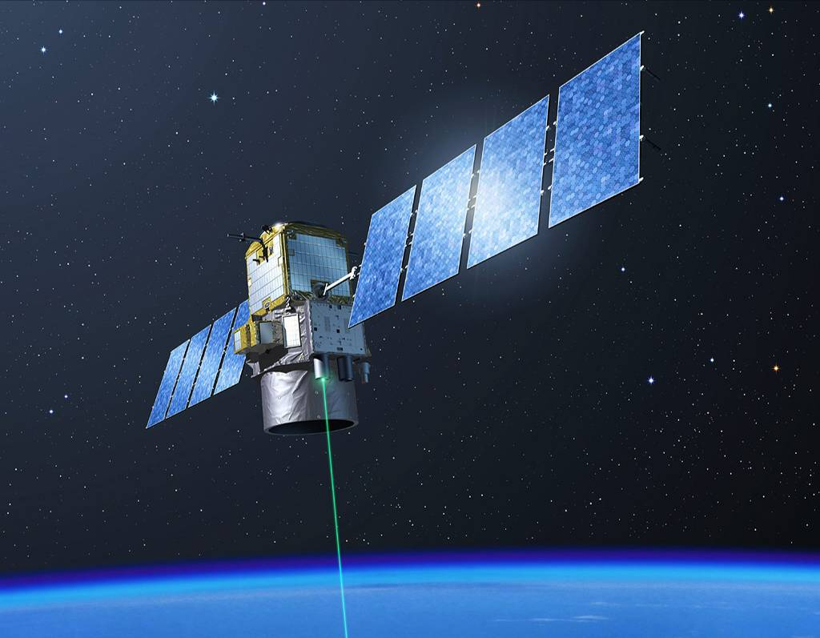
CALIPSO Science Highlights
Dave Winker¹, Jason Tackett¹, Mark Vaughan¹, Zhaoyan Liu¹, Jay Kar², Roman Kowch², and Chieko Kittaka
NASA LaRC, Hampton, Virginia
NASA LaRC/SAIC, Hampton, VA
MOWG, 19 May 2021

Slide 2
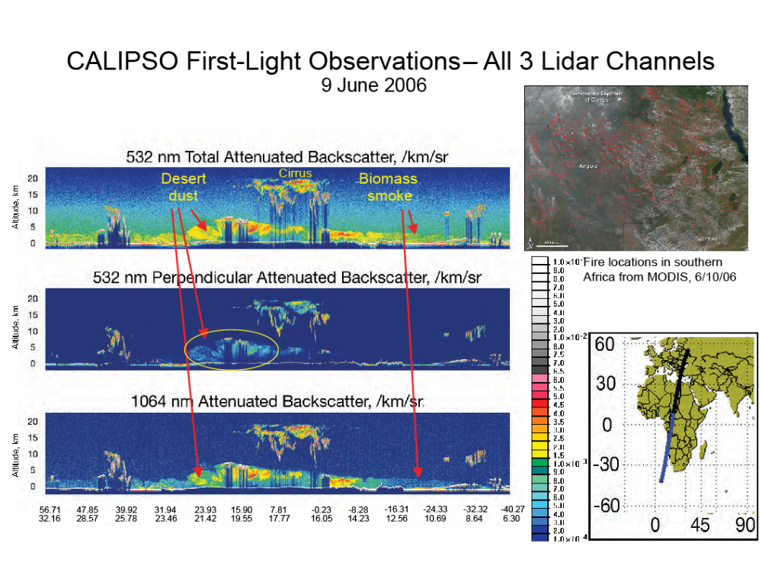
CALIOP First Light Observations
June 9, 2006
Notes:
2
This figure shows calibrated Level 1 data from all three lidar channels: 532 nm total and perpendicular attenuated backscatter, and 1064 nm total attenuated backscatter (ie: not corrected for attenuation). The units of the color bar are /km/sr. The image shows a nighttime transect from northern Africa south to the Atlantic Ocean.
High cirrus, probably produced by tropical convective systems, is seen in the center of the image. The backscatter signal from the cirrus is similar at both wavelengths, characteristic of the relatively large cirrus particles. The cirrus is also strongly depolarizing and produces a significant perpendicular (ie: cross-polarized) signal. To the south of the cirrus (right) is a smoke layer originating from biomass fires in southern Africa, which are widespread during this time of year (see MODIS fire map). Unlike the cirrus, this aerosol is weakly scattering at 1064 nm and non-depolarizing, which is the signature expected for smoke.
The aerosol to the north of the cirrus (to the left) is primarily dust. Dust particles are also relatively large and depolarizing so produce strong 1064 nm and perpendicular signals. To the north of the dust is some other type of aerosol of unknown (at this time) origin. While the aerosol appears to be fairly uniform from roughly 20 N -40 N in the 532 nm total backscatter channel, it can be seen that the aerosol north of about 25 N is non-depolarizing and more weakly scattering at 1064 nm. This signature indicates the aerosol north of 25 N is composed of liquid droplets which are smaller than the dust particles found just to the south. This could be aerosol of urban origin.

Slide 3
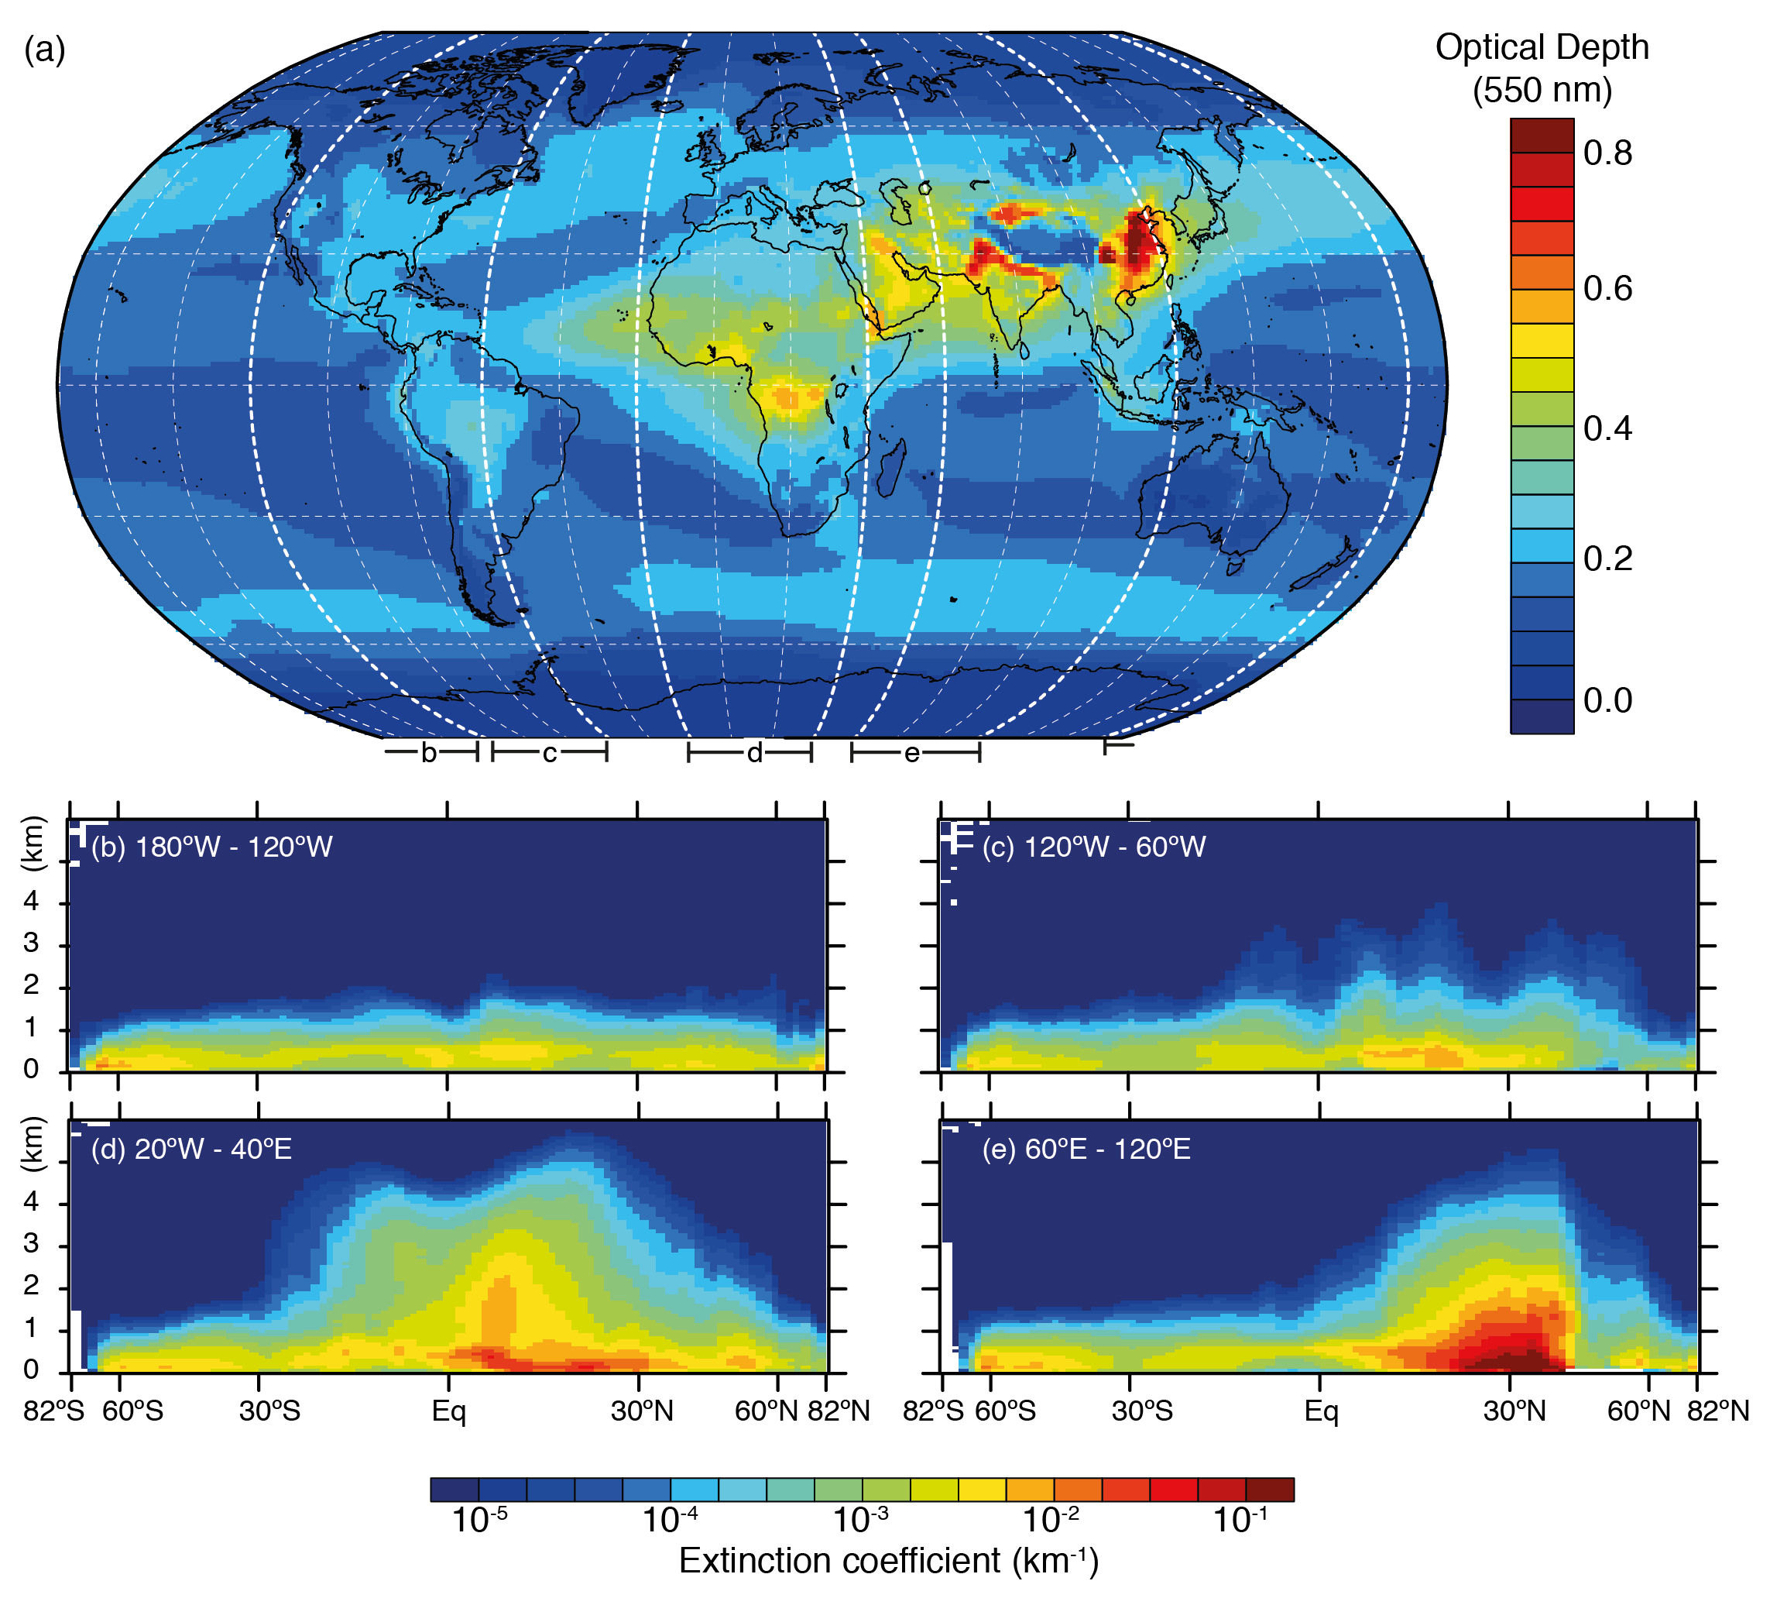
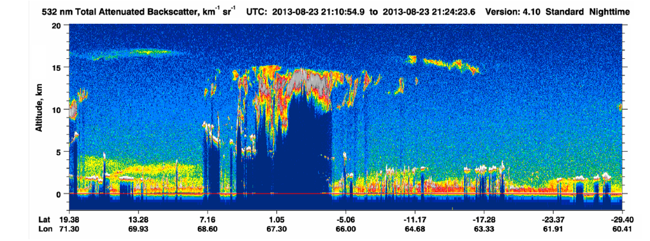
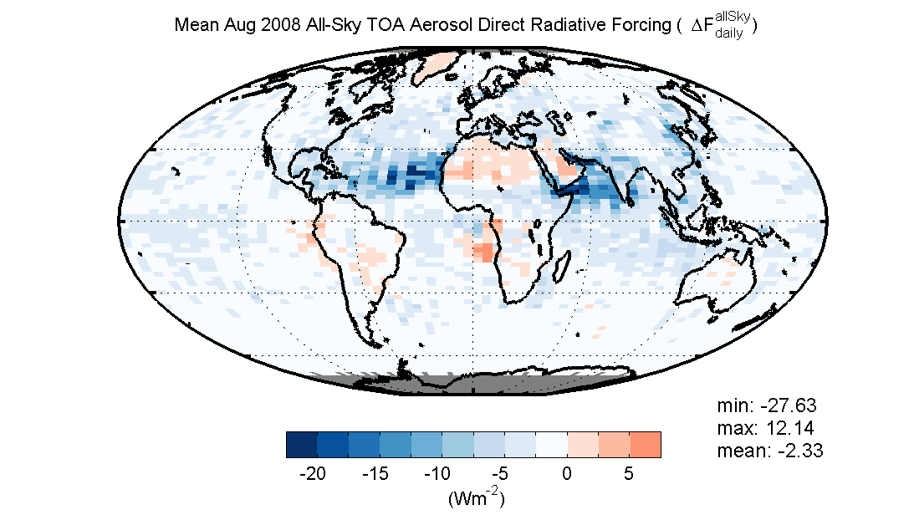
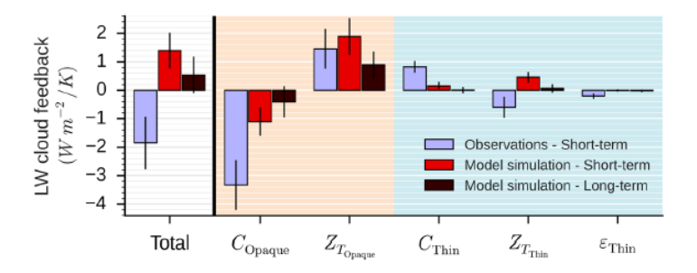
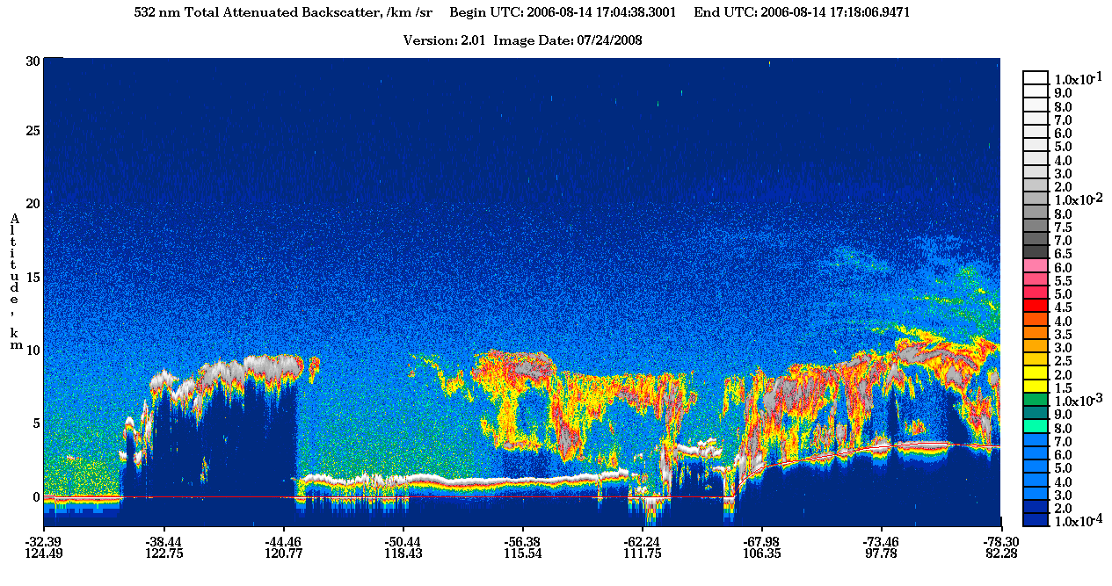
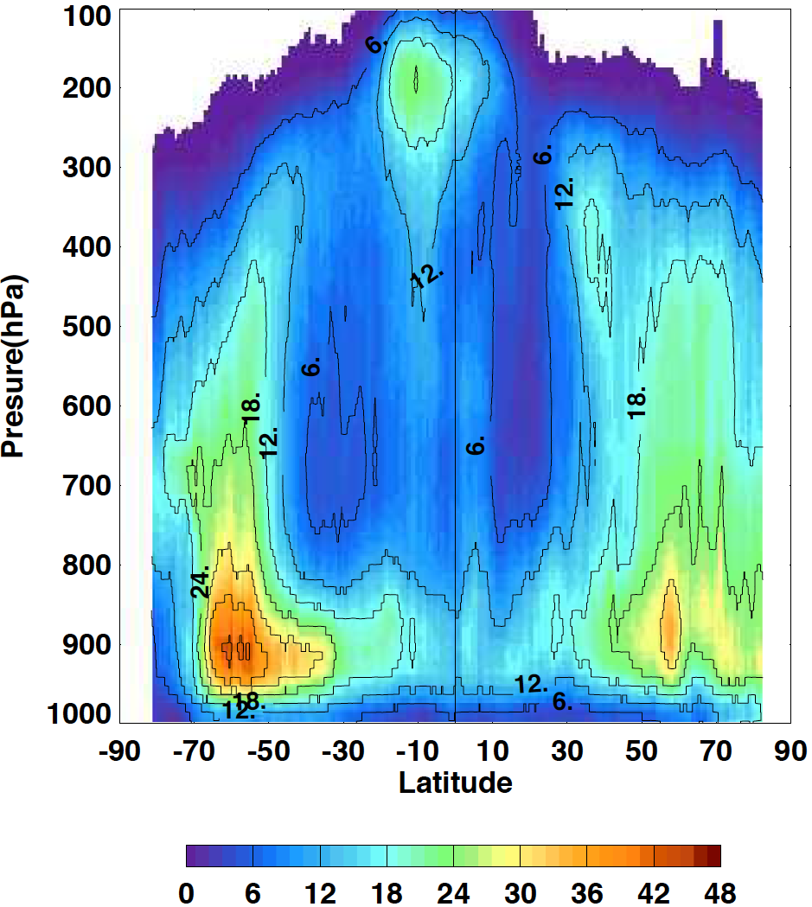
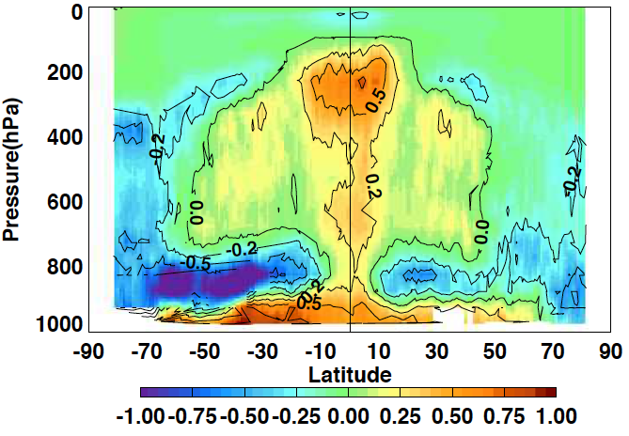
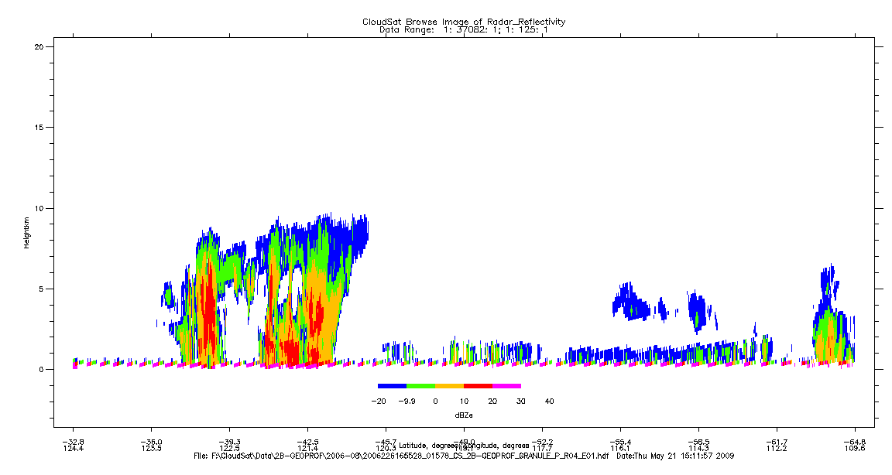
Science Highlights
Vertically-resolved aerosol climatology
(IPCC AR5)
All-sky aerosol radiative effects
LW Cloud Radiative Feedbacks
(Vaillant de Guelis et al., 2019)
Cloud Climatology &
Radiative Heating Profiles
(Kato et al, 2019)

Slide 4
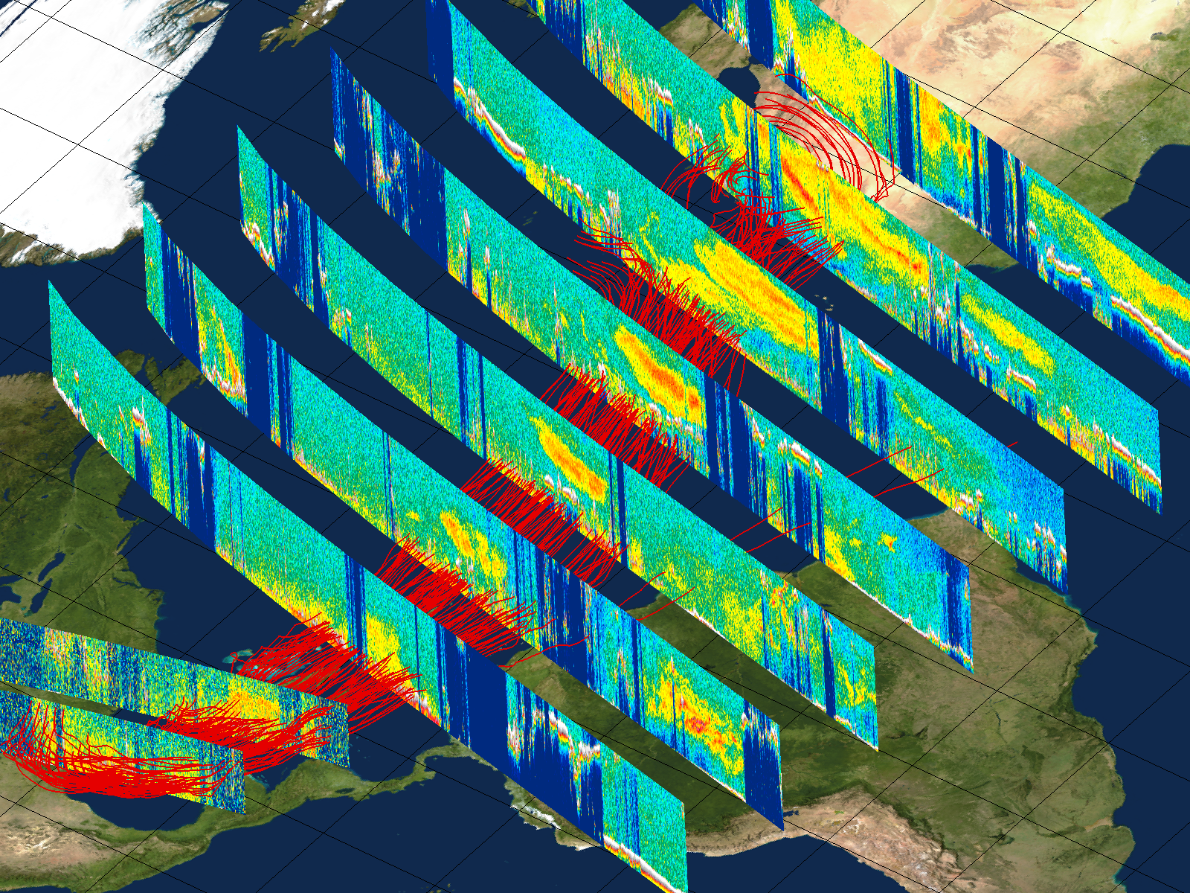
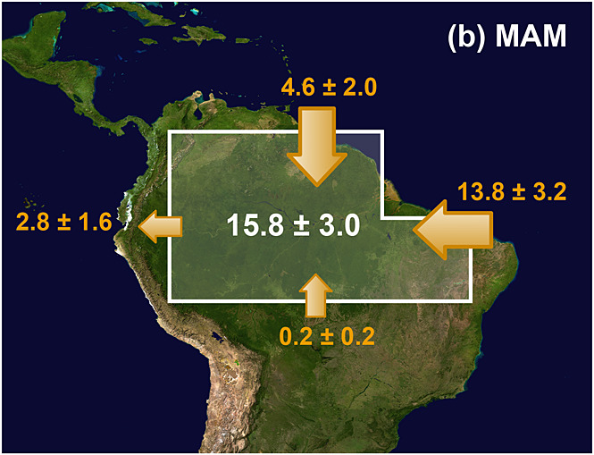
Sahara Dust Transport
Sahara dust outbreak, August 2007
Sahara dust contains phosphorus and represents a significant source of nutrients to the Amazon basin
Aug 17
Aug 18
Aug 19
Aug 20
Aug 21
Aug 25
Aug 22
5 km
Aug 28
3 km
Aug 23
Liu et al. JGR 2008
Estimated mean mass fluxes into the Amazon Basin (2007-2013) and net dust deposition (Tg)
CALIPSO extinction profiles can be converted to dust mass concentration and combined with reanalysis winds to estimate dust mass flux through latitudinal curtains
(Hongbin Yu et al. GRL 2015)

Slide 5
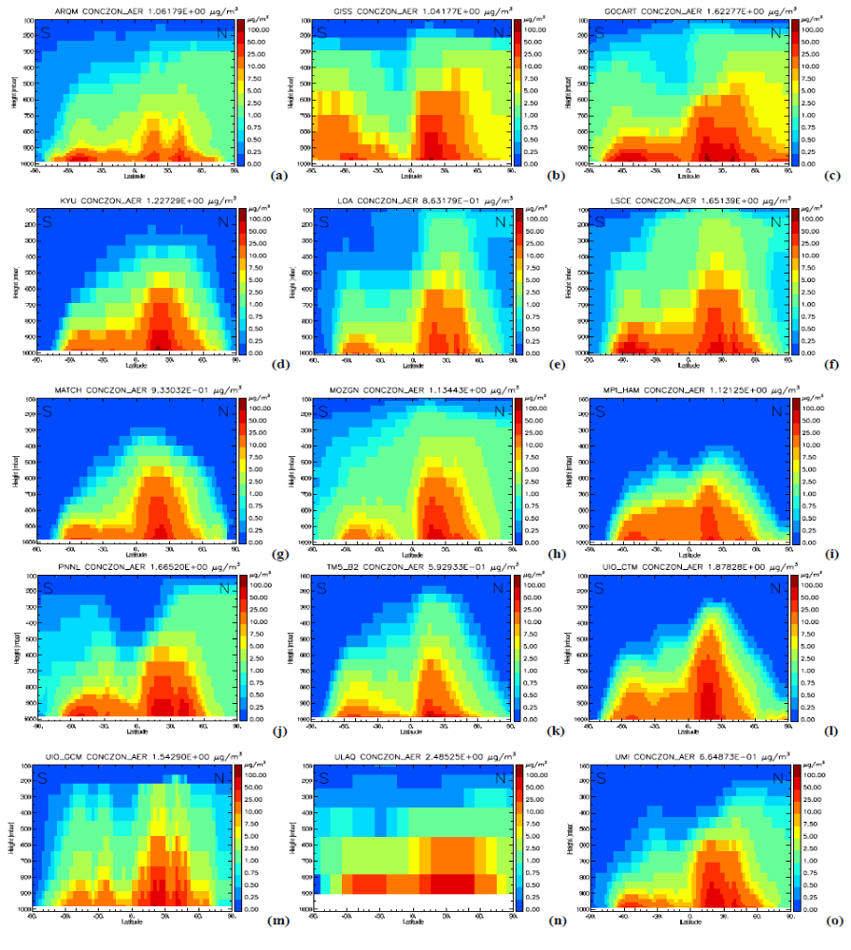
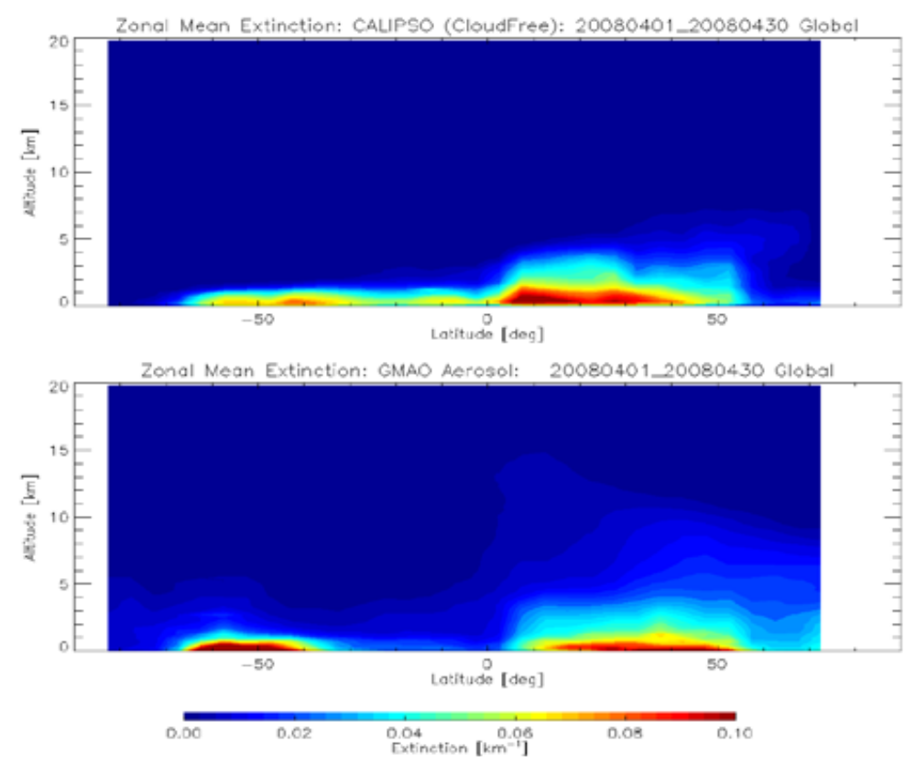
Prior to CALIOP, aerosol vertical distribution was not observations
circa 2006: annual zonal mean aerosol mass concentration from 15 different global models
Models were found to exhibit large diversity in horizontal transport and exaggerated aerosol loading in the upper troposphere
Clear-sky zonal mean aerosol extinction, April 2008
CALIPSO
GMAO-GOCART
(Textor et al ACP 2006)

Slide 6
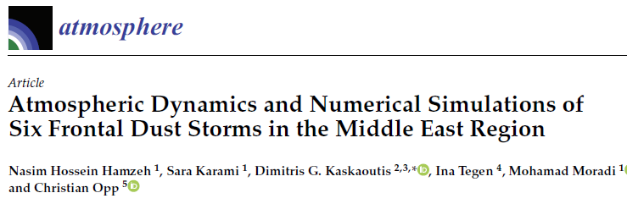
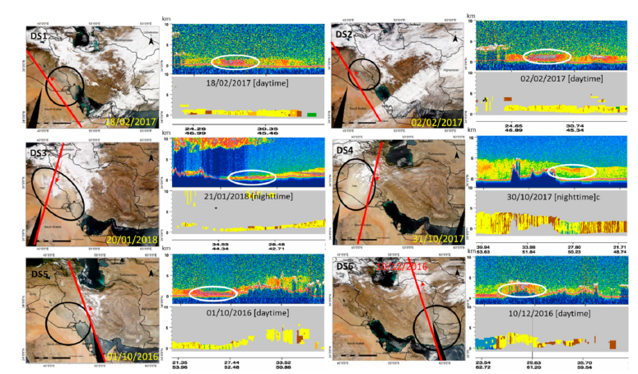
Dust storms are natural hazards which affect the formation of hurricanes, monsoon circulations, and human health.
CALIOP and MODIS are used to examine atmospheric dynamics which trigger wintertime dust storms in the Middle East
Findings: the mechanisms triggering winter dust storms are different from spring and summer: winter storms tend to be very shallow (< 2 km) while spring and summer storms are much deeper (> 5 km).
(Hamzeh et al., Atmosphere, 2021)
None of the models could accurately simulate the distribution and magnitude of dust. Problems were due to the parameterization of dust mobilization and the models’ ability to represent the local meteorology in complex terrain, especially the strong near-surface winds triggering the storms

Slide 7
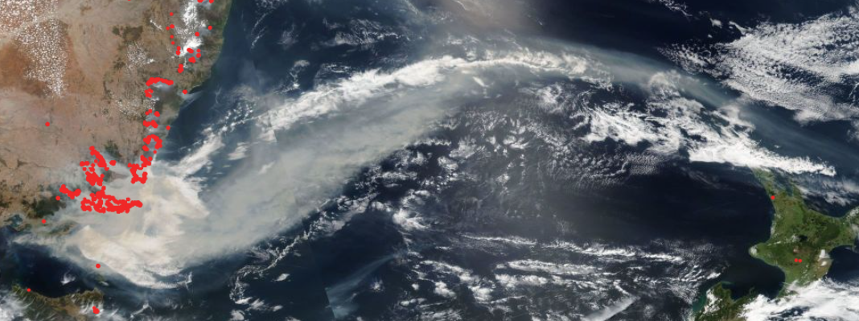
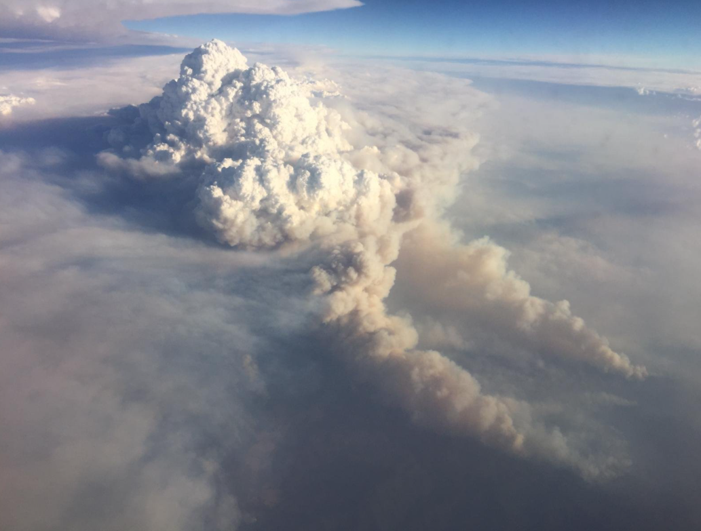
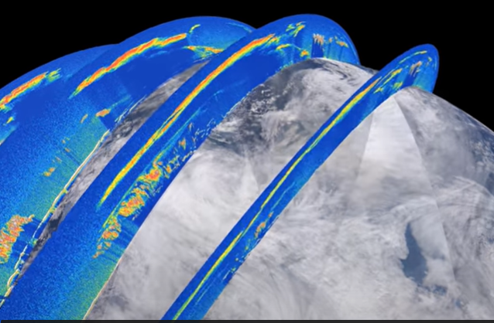
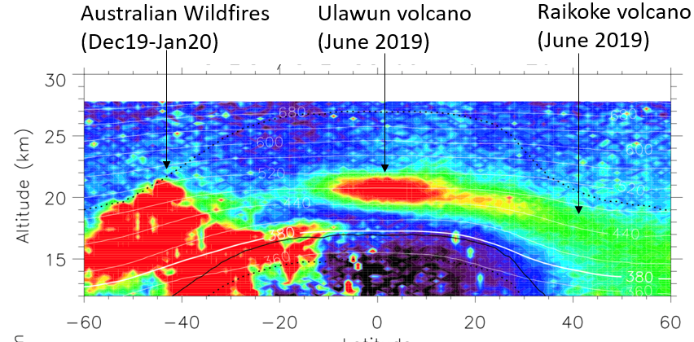
CALIOP tracks Australian smoke plume 1000’s km downwind
CALIOP profiles averaged over 3-12 Jan 2020
Australian bush fires in January 2020 initiated pyrocumulus, which injected smoke into the upper troposphere
(Visualization by Roman Kowch, LaRC/SAIC)
(courtesy Jean-Paul Vernier, LaRC/SAIC)

Slide 8
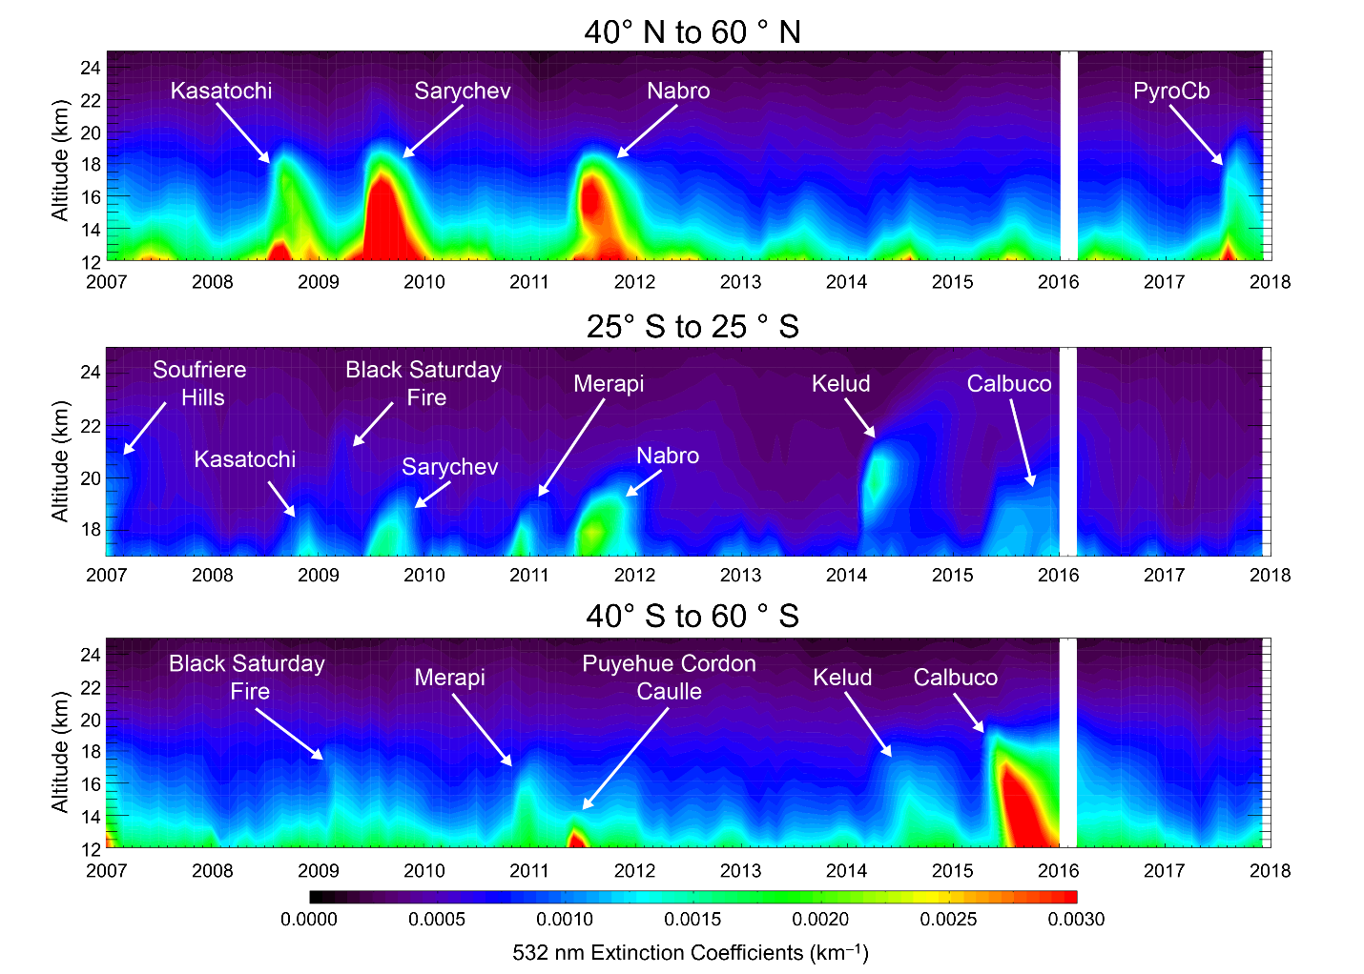
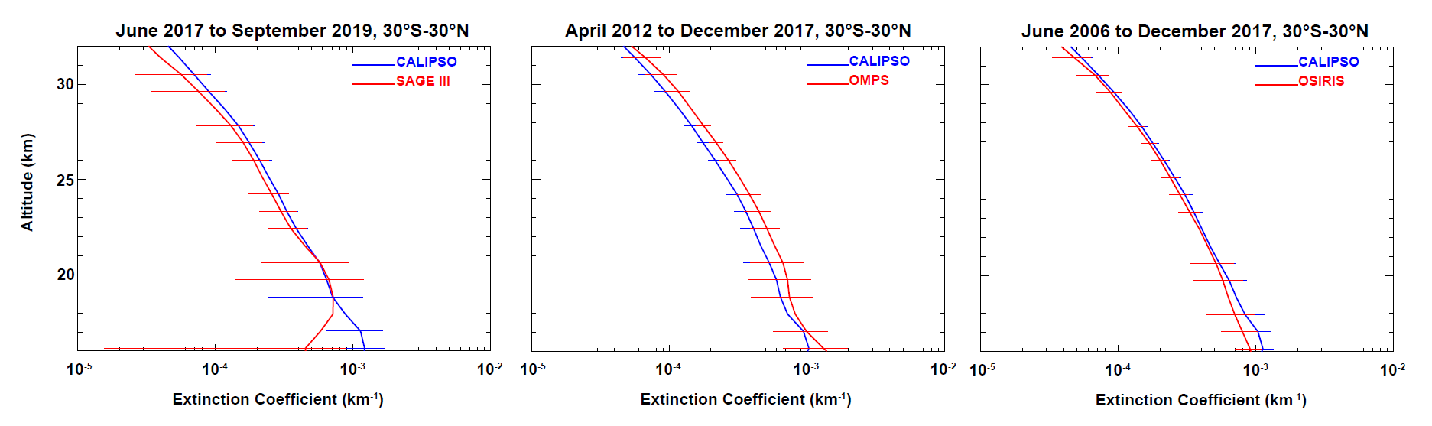
Stratospheric Aerosols
CALIOP nighttime 532 nm stratospheric profiles are averaged on a 5° by 20° lat-long grid
Aerosol extinction profiles are retrieved and reported as monthly means on a 3D global grid with 900 m vertical spacing
CALIOP
SAGE II
CALIOP
OMPS
CALIOP
OSIRIS
Zonally averaged CALIOP extinction coefficient profiles for data acquired between 30°N and 30°S compared to data from SAGE III-ISS, OMPS, and OSIRIS (Kar et al. 2019)
Time-height cross sections of CALIOP stratospheric aerosol extinction, Jan 2007 to Dec 2017 (Kar et al., 2019)

Slide 9

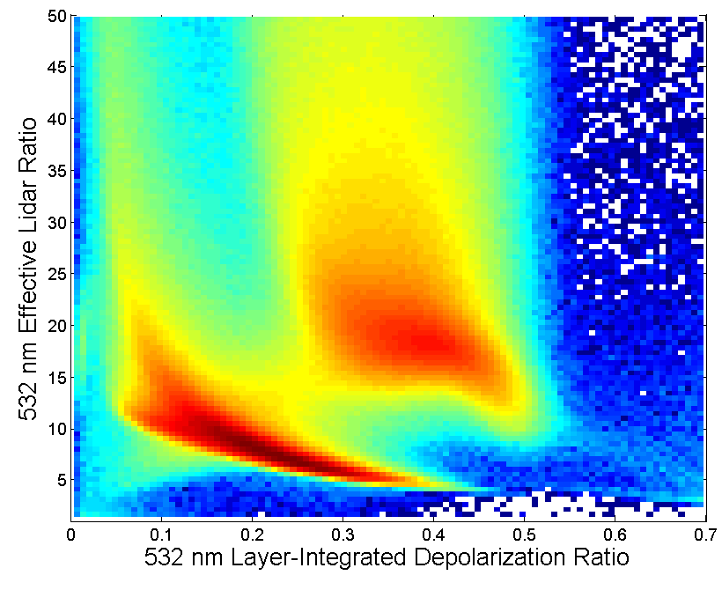
CALIOP: vertically resolved cloud ice-water phase
1/IAB
ice
water
layer depolarization
Notes:
CALIPSO/CloudSat: How these new datasets are being used and what we’re learning

Slide 10
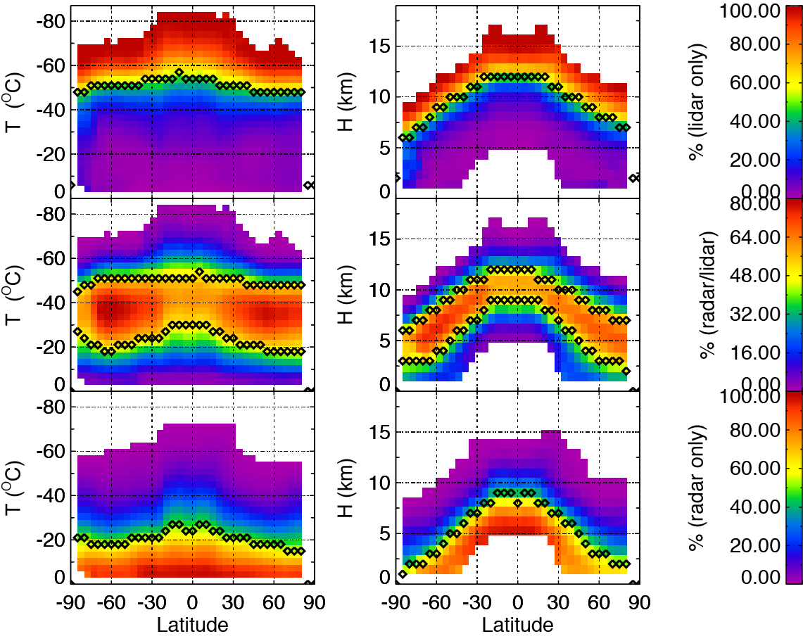
Complementarity of Lidar and Cloud Profiling Radar
Observations over the Indian Ocean and Antarctica
Probability of cloud detection as a function of temperature
CALIPSO
lidar-only
lidar+radar
CloudSat
radar-only
(Heymsfield et al 2014)
Notes:
10

Slide 11
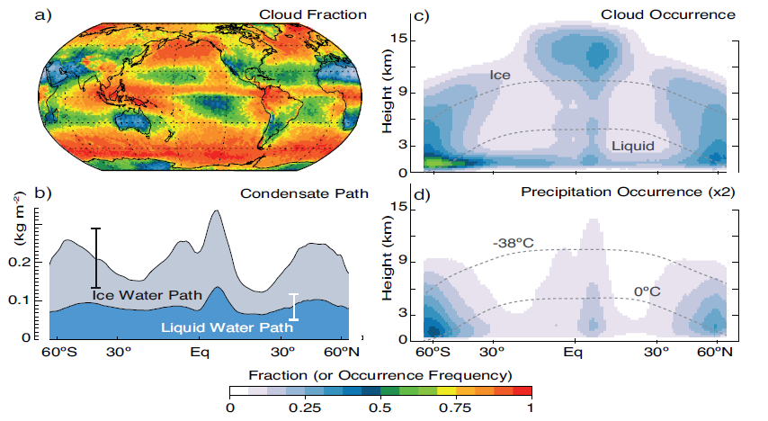
“An improved ability to quantify vertical profiles of cloud occurrence and water content”
CloudSat/CALIPSO 2B-GEOPROF-LIDAR dataset
liquid water path : microwave radiometer data
ice water path: CloudSat 2C-ICE
c, d) 2B-GEOPROF-LIDAR data set.
(Fig 7.5, IPCC AR5)

Slide 12
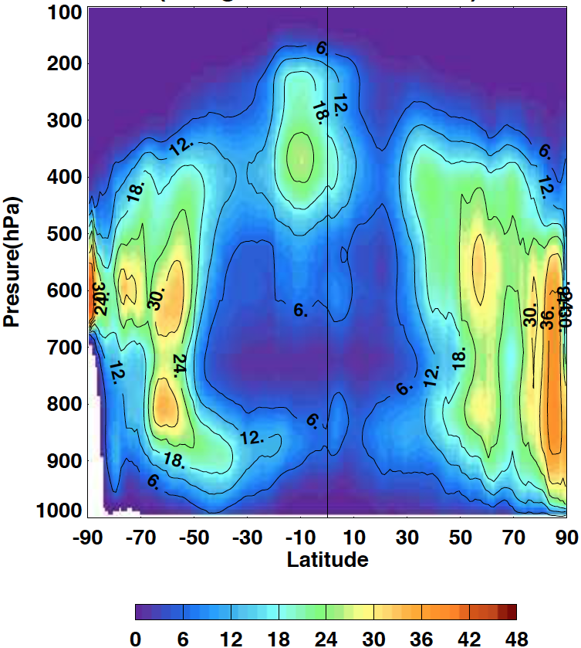
Passive sensors confounded by cloud multi-layering
CALIOP-CloudSat MODIS + GEO
Vertical Cloud Fraction
(Kato et al, 2019)

Slide 13
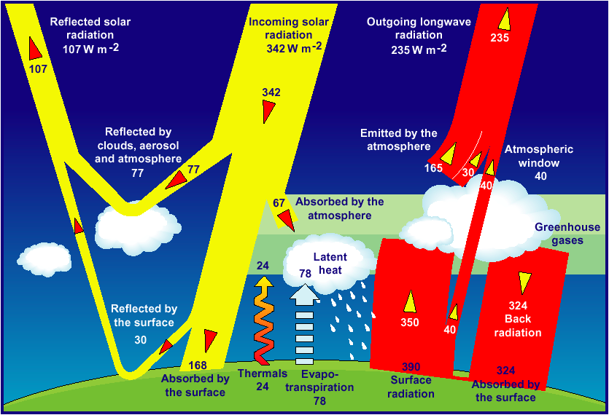
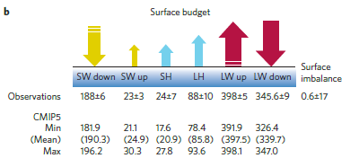
Closure of the surface radiation budget
IPCC AR5: “The net downward flux of radiation at the surface … has been estimated more accurately through radiation budget measurements and cloud profiling (Kato et al. 2011). Based on these observations the global mean surface downward longwave flux is about 10 W/m² larger than the average in climate models …”
(Stephens et al., Nat GeoSci, 2012)

Slide 14
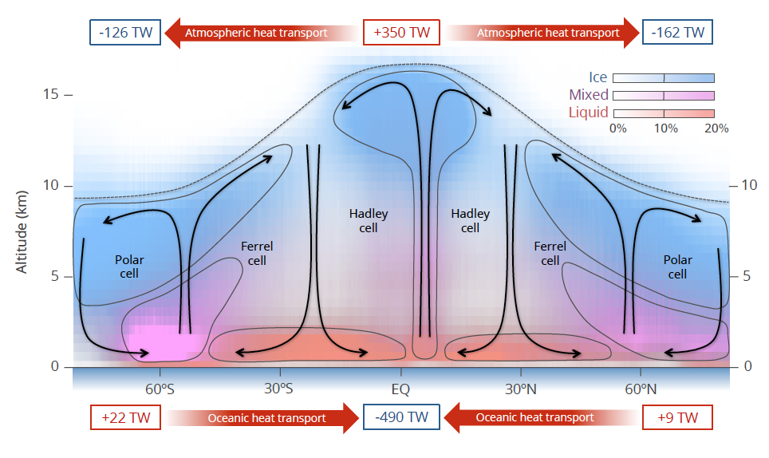
Importance of Cloud Ice-Water Phase Highlighted
Probability of cloud detection as a function of temperature
CALIPSO-CloudSat: Distribution of Cloud Phase
lidar-only
lidar+radar
radar-only
(Heymsfield et al 2014)
Matus and L’Ecuyer, JGR, (2017)
Notes:
Zonal mean cloud fraction cross-section color-coded according to phase uniquely determined by combined CloudSat and CALIPSO observations.
Liquid clouds in red, ice clouds in blue, and mixed-phase clouds in pink.
The values in the boxes at the top and bottom summarize the annual mean implications of mixed-phase clouds for atmospheric and oceanic heat transport, respectively.
Annually, mixed-phase clouds lead to a 350 terraWatts of atmospheric heating in the tropics and a cooling of between 120 and 160 TW at the poles relative to clear sky conditions. This implies that mixed-phase clouds enhance the flow of energy from equator to pole in the atmosphere.
The opposite is true at the surface where clouds cool the tropics and warm the poles reducing the equator-to-pole heat transport by oceans relative to clear sky conditions.

Slide 15
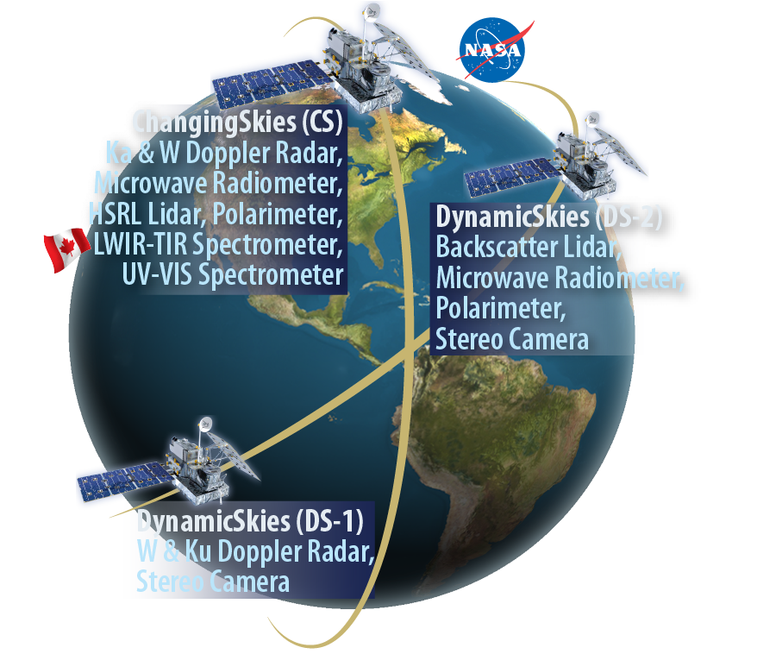
Next Step: AtmOS
Inclined Orbit
• W-, Ku-band Doppler radar
• Microwave radiometer (118-880 GHz)
• 532 and 1064 nm backscatter lidar
• Polarimeter (1130 km swath, 1 km resolution)
• Time-differenced stereo camera measurements
Polar Orbit
• W-, Ka-band Doppler radar
• Microwave radiometer (118-880 GHz)
• 532 nm HSRL, 1064 nm backscatter lidar
• Polarimeter (550 km swath, 0.5 km resolution)
• Spectrometers (LWUV, VIS, NIR, SWIR, LWIR, FIR)
Polar Orbit
Inclined Orbit
Inclined Orbit
1st launch: inclined orbit ~2028
2nd launch: polar orbit ~2029
15

