Slide 1
Orion MPCV Nonlinear Dynamics Uncertainty
Adam Johnson¹, Paul Bremner³
Matt Griebel¹, Brent Erickson¹, Joel Sills²
¹Quartus Engineering Incorporated
²NASA Engineering and Safety Center
³AeroHydroPLUS

Slide 2
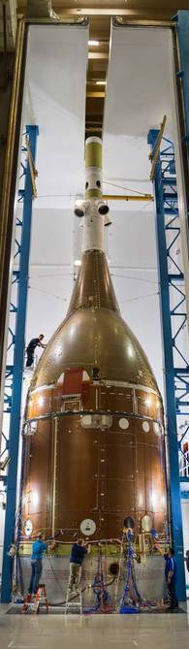
Background
Vibration testing of the Orion Multi-Purpose Crew Vehicle (MPCV) Configuration 4 (C4) Structural Test Article (STA) was performed in the reverberant acoustic chamber at Lockheed Martin
  C4 = “full stack” launch configuration
  Fixed base with varying stinger shakers
Significant nonlinear behavior and response deviation from pre-test FEA predictions
  Frequency and damping variations
  Nonlinear FRF shapes
MPCV Nonlinearities determined to be stick-slip in nature, sourced to multiple key joints
  See “SCLV-2019_Quartus_E-STA_NL_Correlation.pptx"
  and “SCLV_2021_MPCV_Nonlinear_Correlation_and_QSMA.pptx

Slide 3


Nonlinear Correlation Motivation
Performed nonlinear model correlation to…
  Further elucidate the source and type of nonlinearities present in MPCV joints
  Capture MPCV nonlinear dynamics in a single model
  Develop a method to quantify uncertainty introduced when linearizing a nonlinear system
Coupled Loads Analysis (CLA) typically performed using a linear FEA model
  Current technique for nonlinear MPCV is to develop 2 separate linearizations:
    FEM correlated to a High Level Loading (HLL)
    FEM correlated to a Low Level Loading (LLL)
Focus of this presentation
Illustration of Linearization Uncertainty
Linear models become inaccurate when used at non-corresponding load levels
Note: Even at corresponding load levels, linear response cannot capture variations in response magnitude due to slipping joints
$$F$$
Low-level loads (LLL) Linear FEM
High Level Loads (HLL) Linear FEM
Nonlinear (NL) Model
$$x$$

Slide 4
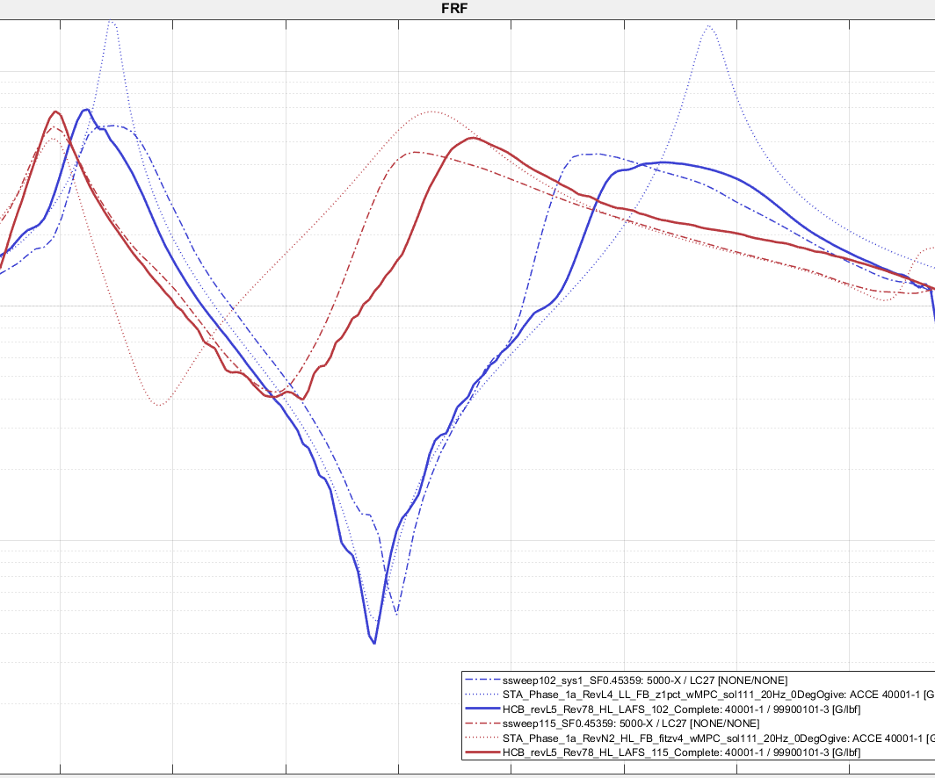
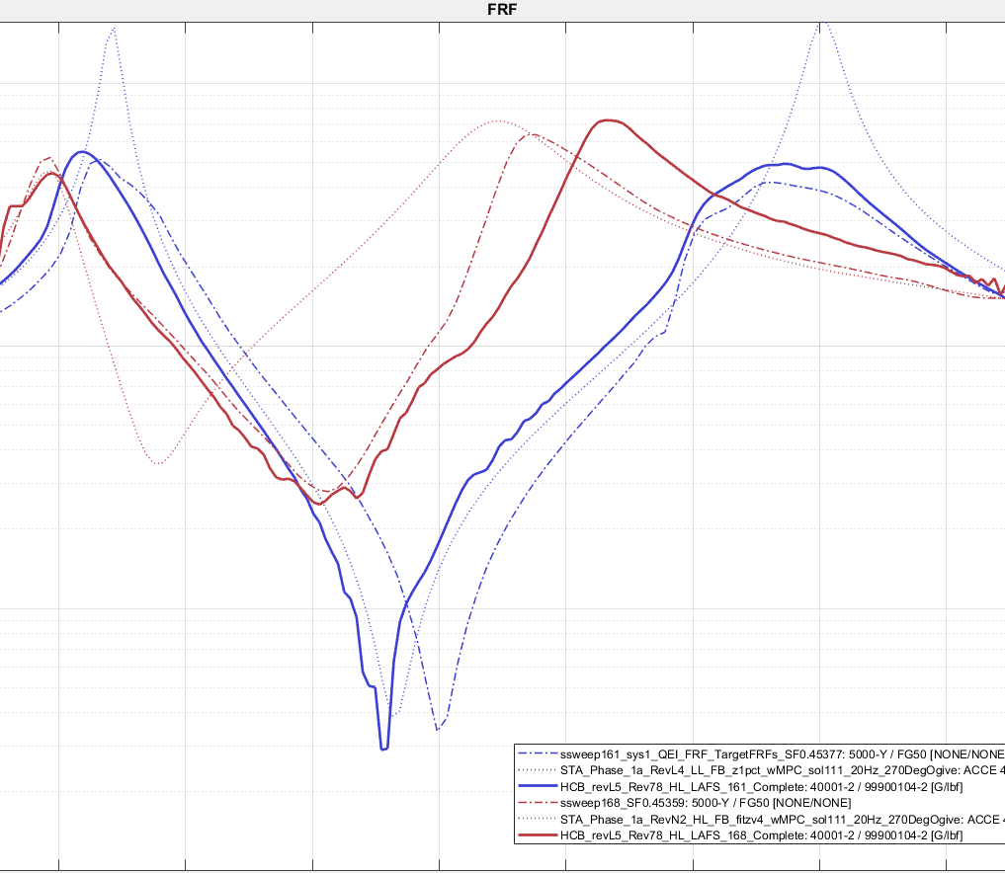
C4 Nonlinear Correlation Example
Example FRF comparison below illustrates C4 nonlinear model correlation
  Single model captures response to LLL loading as well as transition to HLL loading
  Linear correlation cannot capture FRF shape
Z Bending
Y Bending
Magnitude
Magnitude
LL Test
LL Linear FEM
NL FEM, LL Input
HL Test
HL Linear FEM
Frequency
NL FEM, HL Input
Frequency

Slide 5
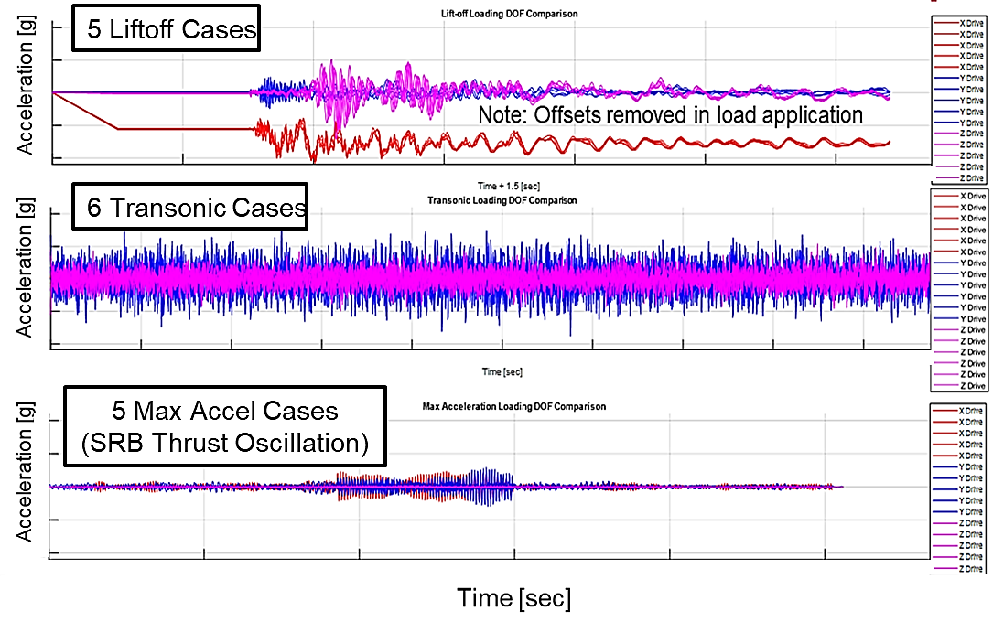
Comparative CLA Study
Performed a comparative CLA study to quantify Linearization Uncertainty
  Developed flight-like NL “Truth” model from C4 correlation and LM flight FEM
  CLA transient loads applied to all three models as base shake (MSA-SA interface)
Models used in Comparative CLA study
CLA Load Case Inputs (MSA-SA Base Shake)
Developed from C4 correlated nonlinear joint properties
NL
“Truth” Model
LM LL Linearization
(1% damping)
LM HL Linearization
(1% damping)
*Flight Cycle CLA FEM*

Slide 6
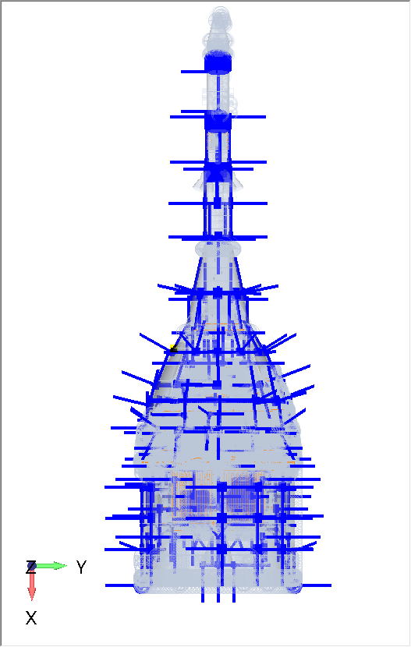
Response Locations
Response Recovery Locations Overlay
Recovering grid response at 343 evenly distributed response locations
  Best immediately available response sample at the time
Known limitations of response sample
  Includes secondary structure that may not be of interest to stakeholders
  Does not include assessment of forces, stresses or strains

Slide 7
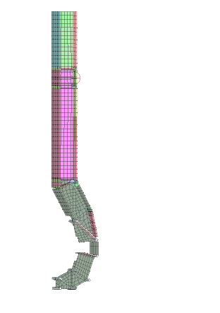
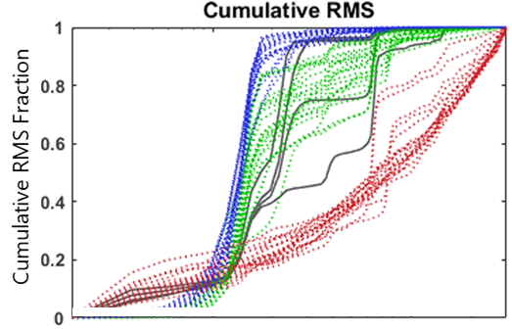
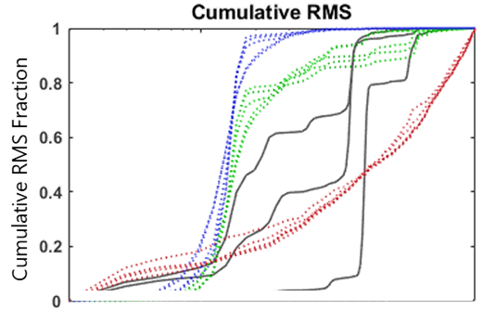
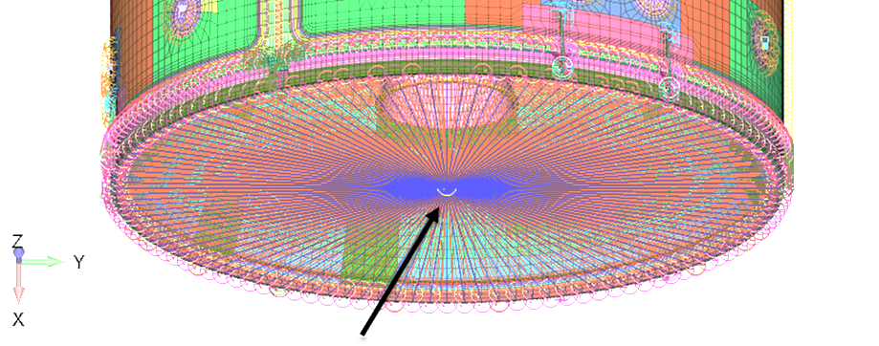
Response Metric Selection
Determined that velocity grid response is best proxy for structural loads and strains
  Acceleration contains large amount of localized high-frequency vibration
  Displacement under-represents vibration from second and third bending modes
Longeron Output from NL Model (Transonic)
MSA-SA IF Output from NL Model (Transonic)
Dsp/Veloc/Accel
Dsp/
Veloc/
Accel
Strain
Force
Frequency [Hz]
Frequency [Hz]

Slide 8
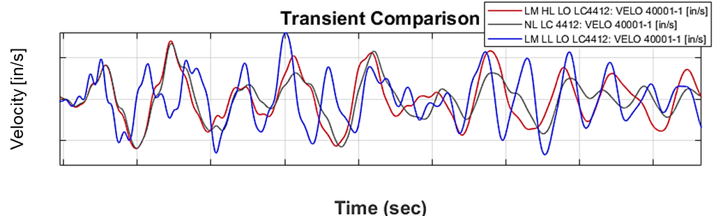
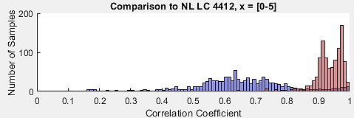
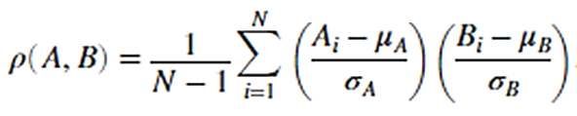
CLA Response Comparison Checks
How well are the linearizations approximating nonlinear flight transient response?
Summarized comparison for each load case using Pearson correlation coefficients
  1 => perfect match between transients
  0 => transients have no linear relationship
  Does not compare response magnitudes
Liftoff Time History Comparison (LAS-Z)
Example Time History Correlation Coefficients
Liftoff LC 4412
LM HL CLA Model
LM LL CLA Model

Slide 9
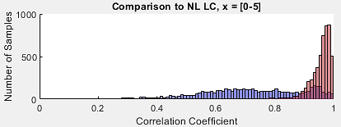
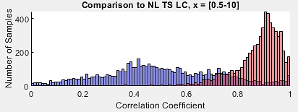
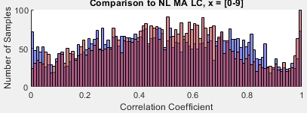
CLA Response Comparison Checks
Correlation to NL Response
(Correlation coefficients for all responses and load cases)
HLL linearization is a reasonable approximation for high-level flight loading
  Liftoff and Transonic
Need to compare response magnitudes (see next slide)
LM HL CLA Model
HL linearization is best match to NL response
Liftoff
LM LL CLA Model
[0-10]
HL linearization is best match to NL response
Transonic
Neither linearization performs well
Max Accel. / Thrust Osc.

Slide 10
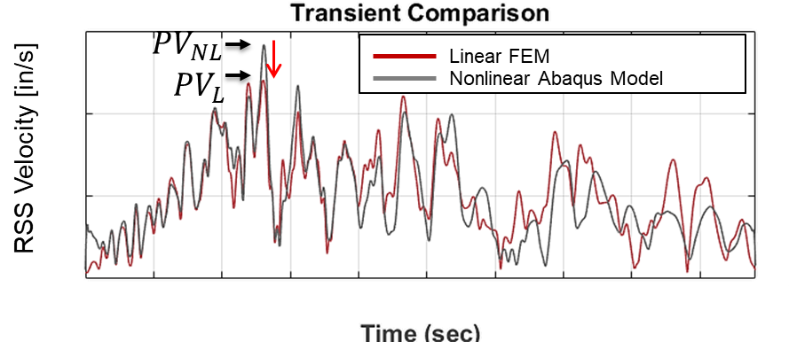
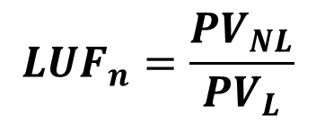
Response Magnitude Uncertainty Parameter
Linearization Uncertainty Factor (LUF) calculated at each response location for each load case:
  Combine XYZ by computing root sum squared (RSS) time history
  Find Peak Value (PV) of NL and linear FEM RSS time history
  LUF is NL PV normalized by linear FEM PV
LUFs can be combined into probability distributions over all locations and a set of load cases (see next slide…)
Linearization Uncertainty Factor (LUF)
RSS Time Histories
$$LUF_{n}=\frac{{PV}_{NL}}{{PV}_{L}}$$
LUF>1 → Linear Model is Under-Predicting
LUF<1 → Linear Model is Over-Predicting

Slide 11
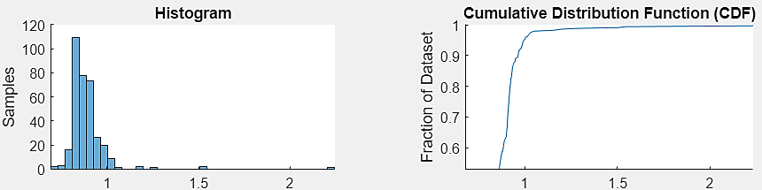
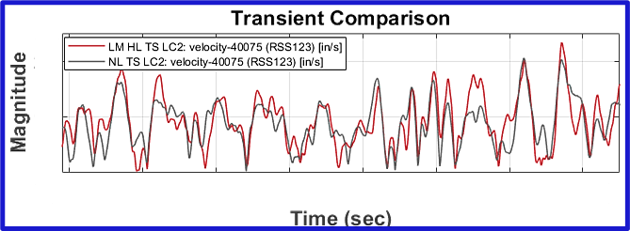
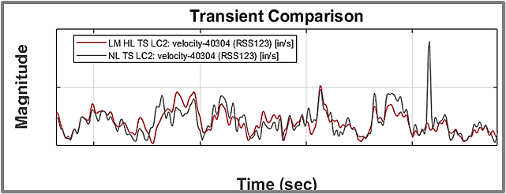
Trends in LUF Probability Distributions
Mean LUF <1 driven by conservative 1% damping in the linear model
Highest 1% of LUFs driven by localized nonlinear transient “spikes”
  Would likely be less pronounced in strains or integrated structural loads
Example LUF Probability Distribution
Transonic Load Case
Linear model cannot capture localized nonlinear transient spikes
Mean < 1
P99 >> 1
HLL Linear FEM
HLL Linear FEM
Nonlinear Model
Nonlinear Model

Slide 12
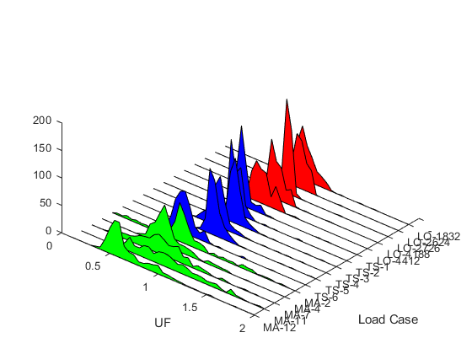
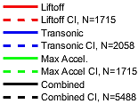

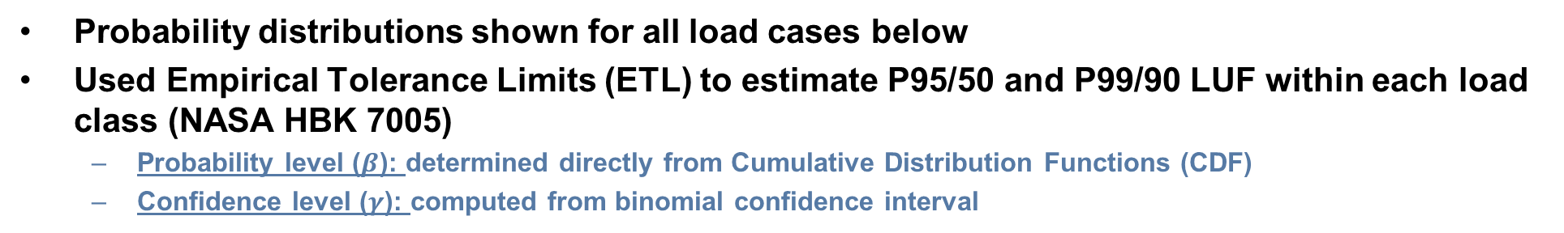
Maximum Expected UFs
Probability distributions shown for all load cases below
Used Empirical Tolerance Limits (ETL) to estimate P95/50 and P99/90 LUF within each load class (NASA HBK 7005)
  Probability level ($β$): determined directly from Cumulative Distribution Functions (CDF)
  Confidence level ($γ$): computed from binomial confidence interval
CDFs and Associated 90% Confidence Bounds
UF Probability Distributions
Liftoff
P99
Transonic
$β$
P95
Max Accel
Load Cases
UF Over Response Locations
Note: Examples Shown for LM HL FEM

Slide 13
UF Summary – Velocities
LUF statistics shown below for HLL linear CLA model
Applying P95 or P99 LUFs as a multiplicative factor existing estimate of P95/50 responses would be highly conservative
  Need to account for response reduction from mean LUF <1.0
  Linearization uncertainty is an independent source of uncertainty (with respect to loads uncertainty, model uncertainty, etc…)
LUF mean and standard deviation should be correctly statistically combined with other sources of uncertainty to obtain the correct RSS-d uncertainty factor for P95/50 loads
  Details on the following slide…
P95 and P99 LUF should not be directly applied to existing estimate of P95/50 responses (see next 2 slides)

Slide 14
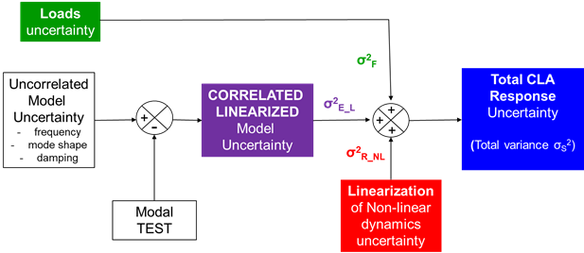
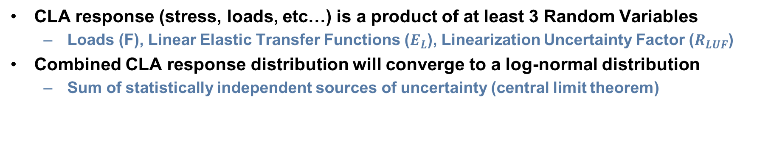


Total CLA Uncertainty [1 of 2]
CLA response (stress, loads, etc…) is a product of at least 3 Random Variables
  Loads (F), Linear Elastic Transfer Functions ($E_{L}$), Linearization Uncertainty Factor ($R_{LUF}$)
Combined CLA response distribution will converge to a log-normal distribution
  Sum of statistically independent sources of uncertainty (central limit theorem)
CLA Response as a Product of 3 Random Variables
$$P\left(S\right) \sim P(F.E_{L}.R_{LUF})$$
Log transform…
$$P\left(L_{S}\right) \sim P(L_{F}+L_{E_{L}}+L_{R_{LUF}})$$

Slide 15
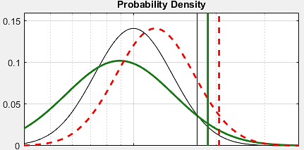
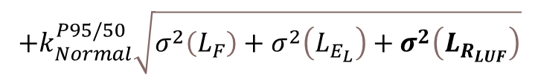
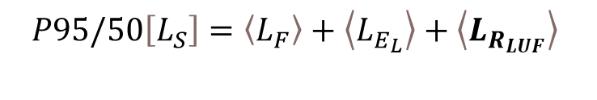
Total CLA Uncertainty [2 of 2]
Statistically combining LUFs with CLA response distribution results in modest increase from linear CLA P95/50 estimate
  Incorporates mean LUF < 1.0 (slight reduction)
  Linearization uncertainty RSS-d with other sources of CLA uncertainty
Applying P95/50 LUF as scale factor to existing linear CLA P95/50 estimates exceeds true P95/50 (overly conservative)
CLA Response Distribution (Illustration)
Mean LUF < 1.0
$$P95/50\left[L_{S}\right]=\left\langle L_{F}\right\rangle +\left\langle L_{E_{L}}\right\rangle +\left\langle L_{R_{LUF}}\right\rangle$$
Linear CLA Response
P95/50 Estimates
$$+k_{Normal}^{P95/50}\sqrt{σ^{2}\left(L_{F}\right)+σ^{2}\left(L_{E_{L}}\right)+σ^{2}\left(L_{R_{LUF}}\right)}$$
… Statistically Combined with LUFs
… Scaled by P95/50 LUF
CLA Uncertainty Margin
CLA Response
(Units are Arbitrary)

Slide 16
Considerations for Future Work
Future work should analyze targeted set of CLA outputs of interest
  Likely strains or integrated loads
  This analysis used grid point velocities over entire vehicle as a proxy
Shock Response Spectrum could offer a more rigorous approach
  This analysis used time history peak value which give less insight into the dynamic sources of uncertainty

Slide 17
BACKUP

Slide 18
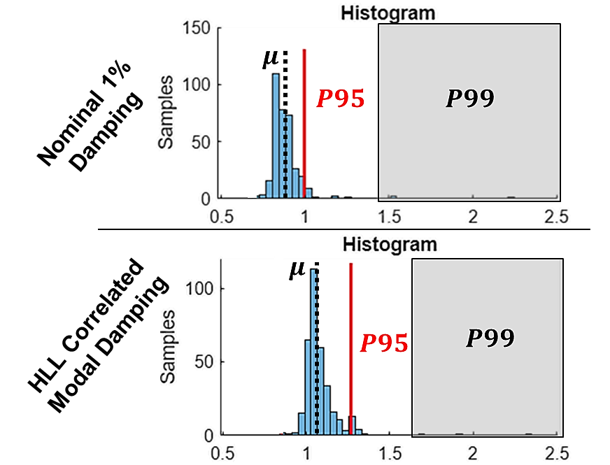
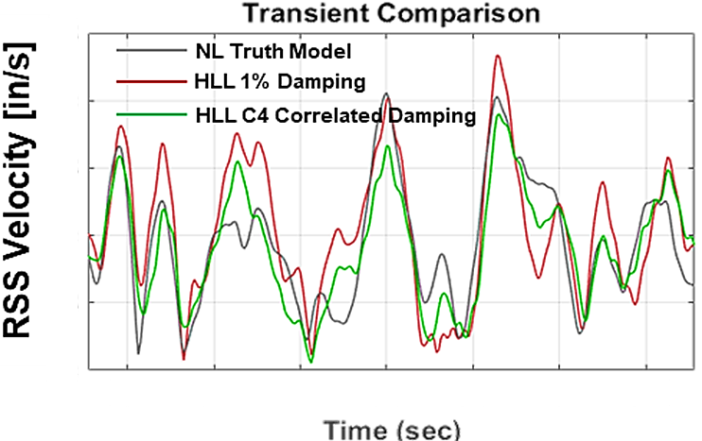
LUF Sensitivity to Damping
Example LUF Probability Distributions
Transonic Load Case
LUFs are sensitive to linear FEM damping assumptions
  Conservative 1% damping reduces necessary LUF

Slide 19
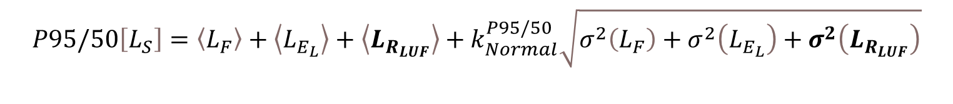
Total CLA Uncertainty
Maximum predicted CLA response can be calculated by considering all sources of uncertainty
  Combine LUF standard deviation with other independent sources of uncertainty using RSS
  Mean LUF < 1.0 will appropriately reduce max expected response
Max Predicted CLA Response Using Normal Tolerance Factors
(Log-transformed)
CLA Uncertainty Margin
$$P95/50\left[L_{S}\right]=\left\langle L_{F}\right\rangle +\left\langle L_{E_{L}}\right\rangle +\left\langle L_{R_{LUF}}\right\rangle +k_{Normal}^{P95/50}\sqrt{σ^{2}\left(L_{F}\right)+σ^{2}\left(L_{E_{L}}\right)+σ^{2}\left(L_{R_{LUF}}\right)}$$
Mean LUF < 1.0

