Slide 1

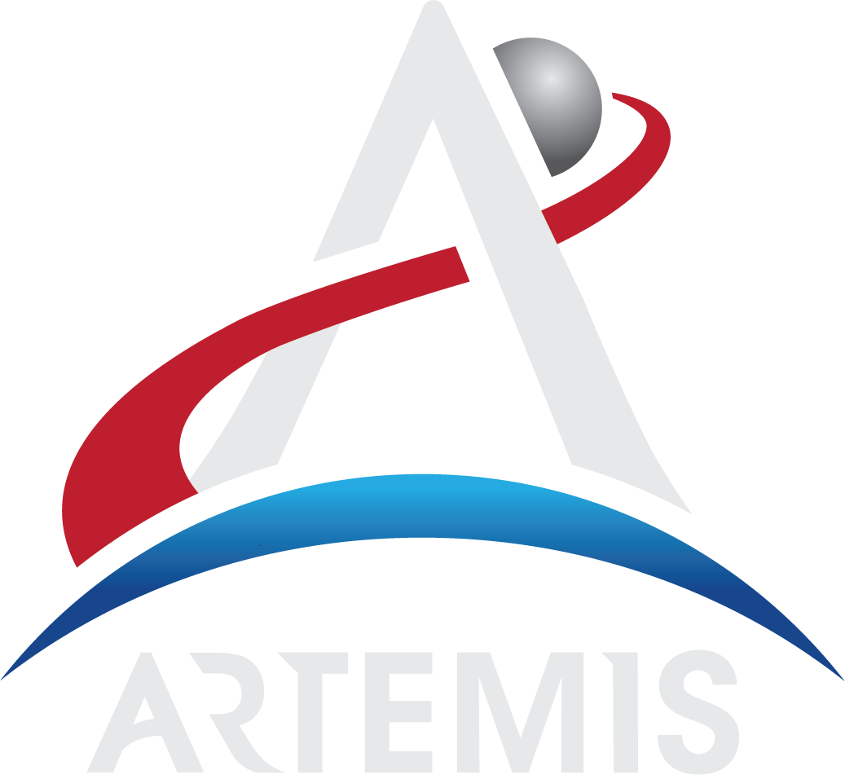
NASA Overview
Lili Villarreal
NASA Kennedy Space Center

Slide 2



National Aeronautics and Space Administration (NASA)
  Federal Agency responsible for aeronautics and aerospace research and the U.S. human space program
    It’s considered a large agency (those with +10K people)
    NASA employs about 20 thousand civil servants and about 60 thousand contractors
  Federal Annual Budget ~ $23 Billion.
  The entire federal budget is about $4.8 Trillion
  NASA is barely ½ a percent of the entire budget of the federal government
  NASA’s percentage of the federal budget during the Apollo program was 4%.
Notes:
Very large +75K, consistently rated best federal agency to work

Slide 3
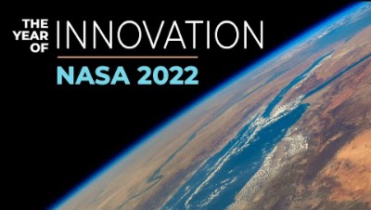

Slide 4
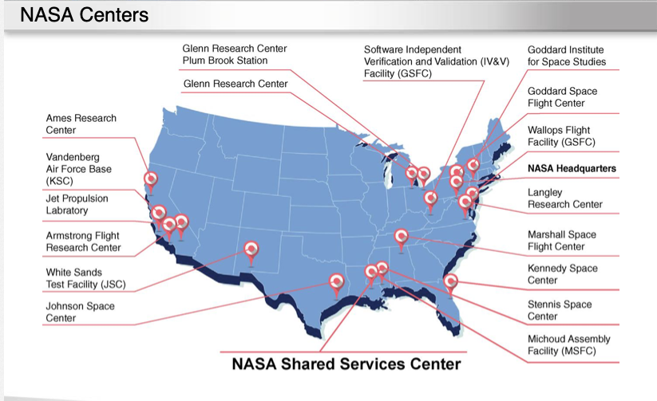

Slide 5
Kennedy Space Center
Kennedy Space Center (KSC) is a multi-user spaceport that supports NASA programs and commercial companies with access to space.
KSC is the home of 3 NASA Programs:
  Commercial Crew Program (CCP)
  Launch Services Program (LSP)
  Exploration Ground Systems (EGS)

Slide 6
Exploration Ground Systems
The purpose of the EGS program is to assemble, test and launch the Space Launch System (SLS) which will send the Orion spacecraft to deep space for Human Exploration of the moon and beyond.
This exploration project is called Artemis
  Fun fact – in mythology Apollo was the brother of Artemis
We will be sending the first female to the moon!
First Artemis mission is scheduled to launch soon!

Slide 7
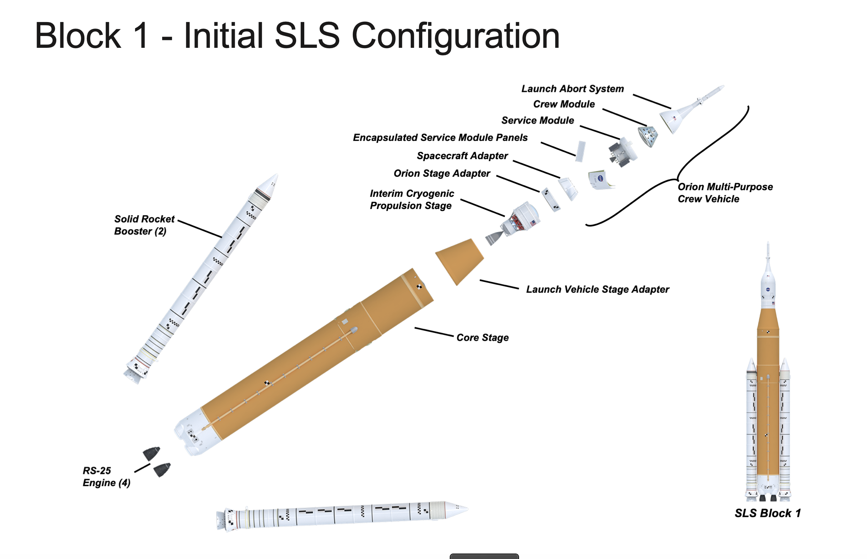
Space Launch System Rocket

Slide 8
Path to Artemis 1
PA-1 (Pad Abort -1)
  May 2010 NASA tested the launch abort system in White Sands to simulate a pad abort
EFT-1 (Exploration Flight Test -1)
  December 2014 NASA Launched the Orion vehicle from Cape Canaveral Air Force Base on a Delta IV Heavy to test the Orion systems on orbit and test the landing systems. EGS recovered the vehicle in the pacific ocean off the coast of California
AA-1 (Ascent Abort-1)
  July 2019 NASA launched a fully active launch abort system on a demo Orion vehicle from a Northrop Grumman provided booster to simulate an ascent abort
Green Run Testing
  Comprehensive test to run the RS-25 engines through the full eight-minute run they will experience during the launch of SLS.

Slide 9
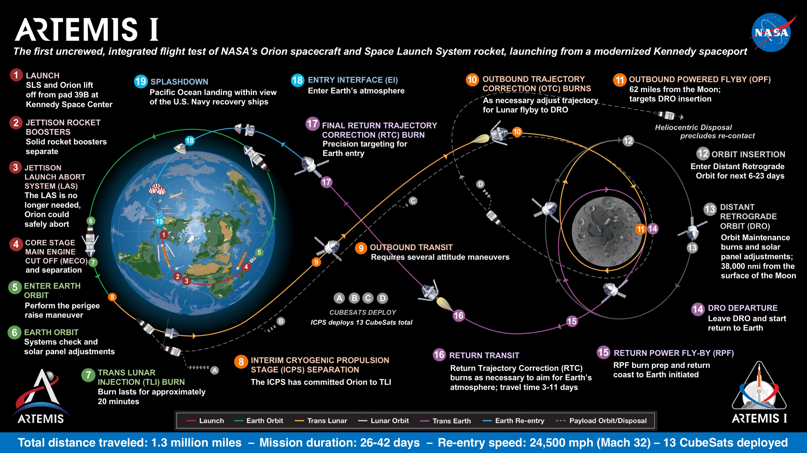

Slide 10
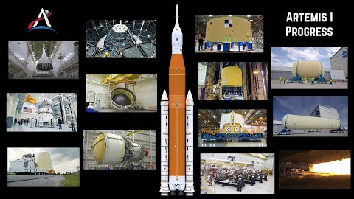
Artemis 1

Slide 11
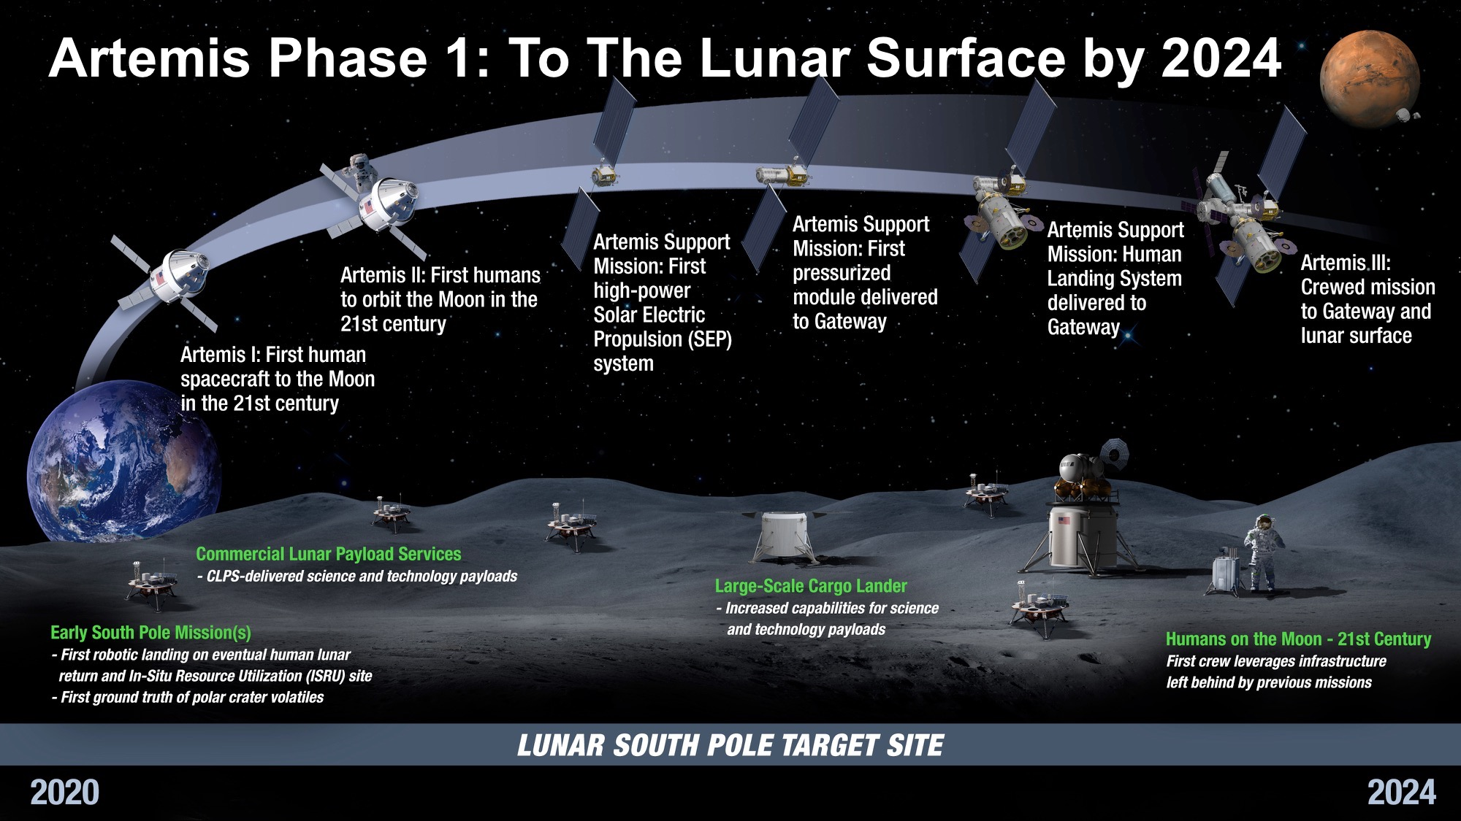
2022
2024
2021

Slide 12
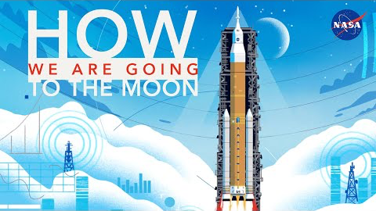

Slide 13
Why Explore?
Space Exploration has already led to more than 1300 technologies such as GPS, heart defibrillators, smoke detectors and satellite radio. As we continue to explore, we will develop even more technologies to benefit life on Earth
Space Exploration engages and inspires the public and encourages students to pursue studies in challenging, high-tech fields
Space Exploration stimulates the economy by creating new jobs, new markets and new technologies
Space Exploration satisfies our curiosity, advances our knowledge, and answers our fundamental questions about the history of the Earth, the solar system and the universe
Going to the Moon and Mars will be a stunning achievement and an enduring legacy to future generations of our desire to explore, learn and progress. The moon will provide a place to test new technologies and develop resources for future missions to Mars and beyond
Exploring space allows us to learn how to survive in other planets in our solar system

Slide 14
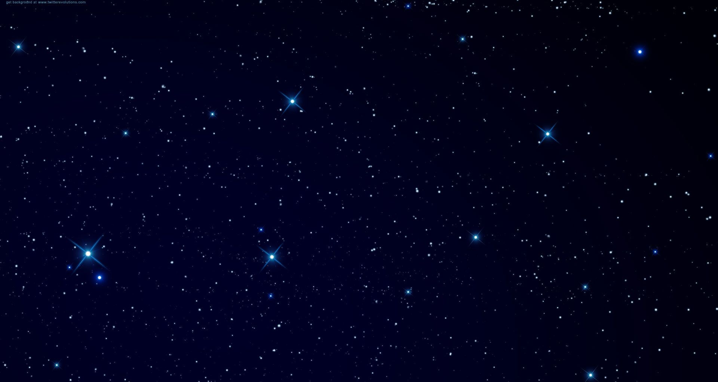
Final remarks –
  Follow your dreams and work Hard!
  Perpetual Optimism is a force multiplier!
Interested in working at NASA??
  Apply for an internship
  www.intern.nasa.gov
Want to see the space station fly by where you live?
  www.spotthestation.nasa.gov
QUESTIONS?

Slide 15
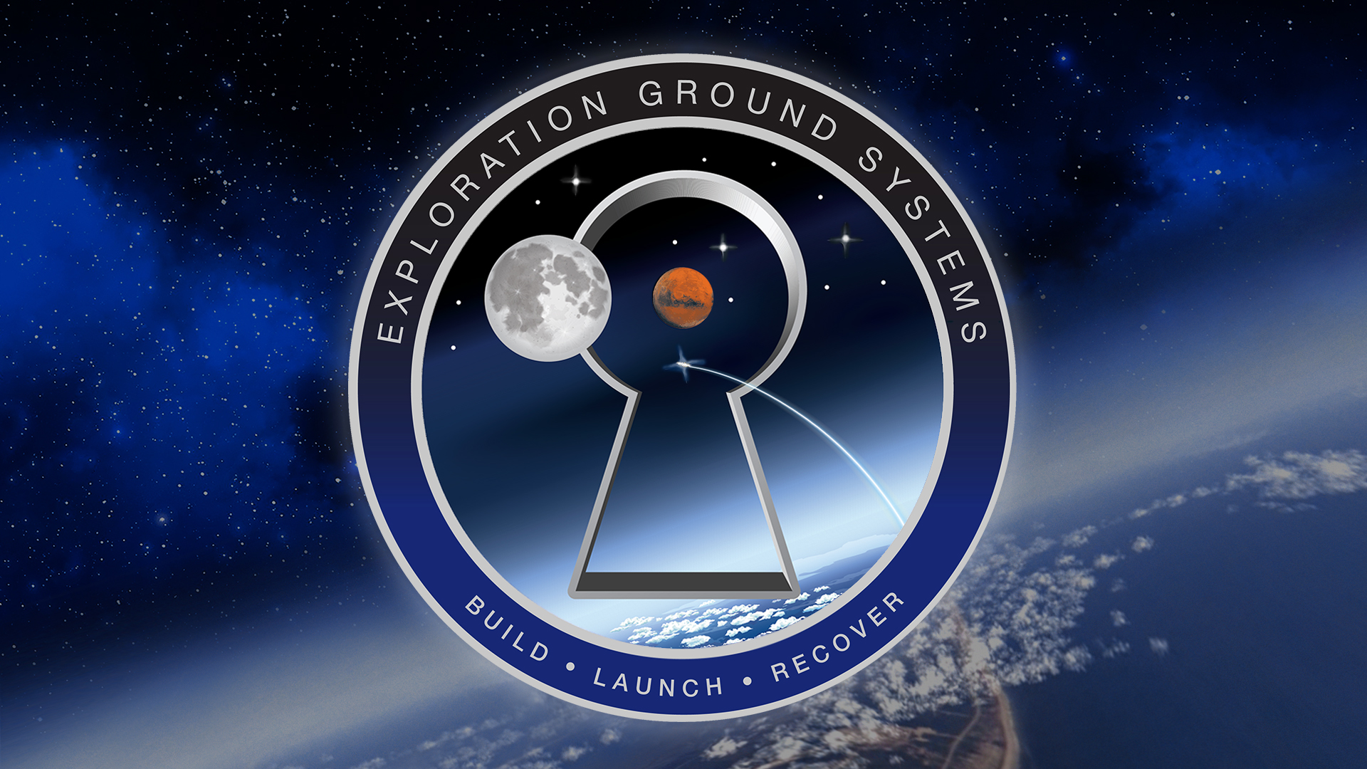

Slide 16
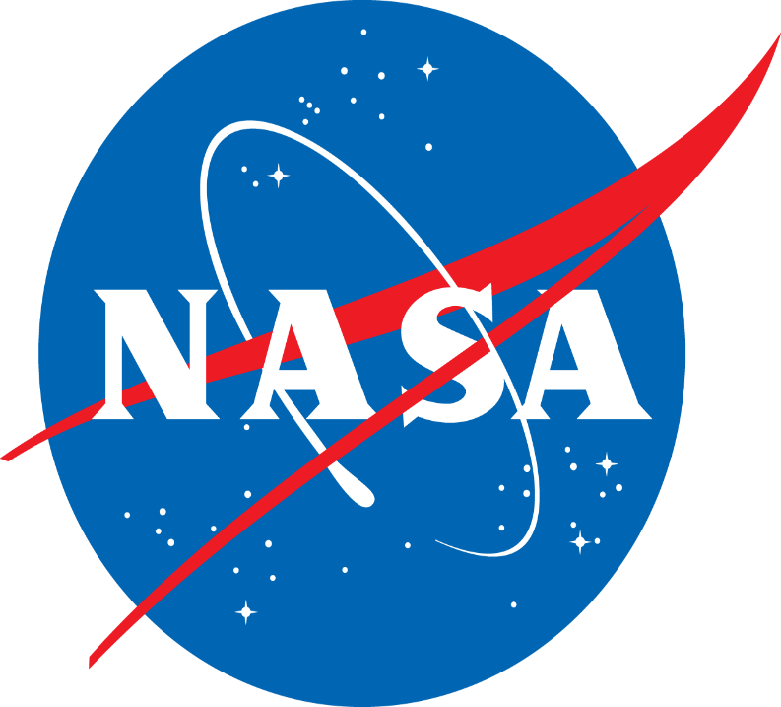
www.nasa.gov/egs

