Slide 1
Breakout Session 1
Qualified Material Process and Material Property Suite for Additive Manufacturing
Bring Your Questions!
Sam Cordner
MSFC Materials Engineer
Doug Wells
MSFC Structural Materials Engineer,
Technical Specialist – Damage Tolerance
Public Use - Quality Leadership Forum 2021 - 27 May 2021

Slide 2
AM Certification: Governing Principles
Understanding and Appreciation of the AM process
Integration across disciplines and throughout the process
Discipline to define and follow the plan
Control what you do :: Evaluate what you get

Slide 3
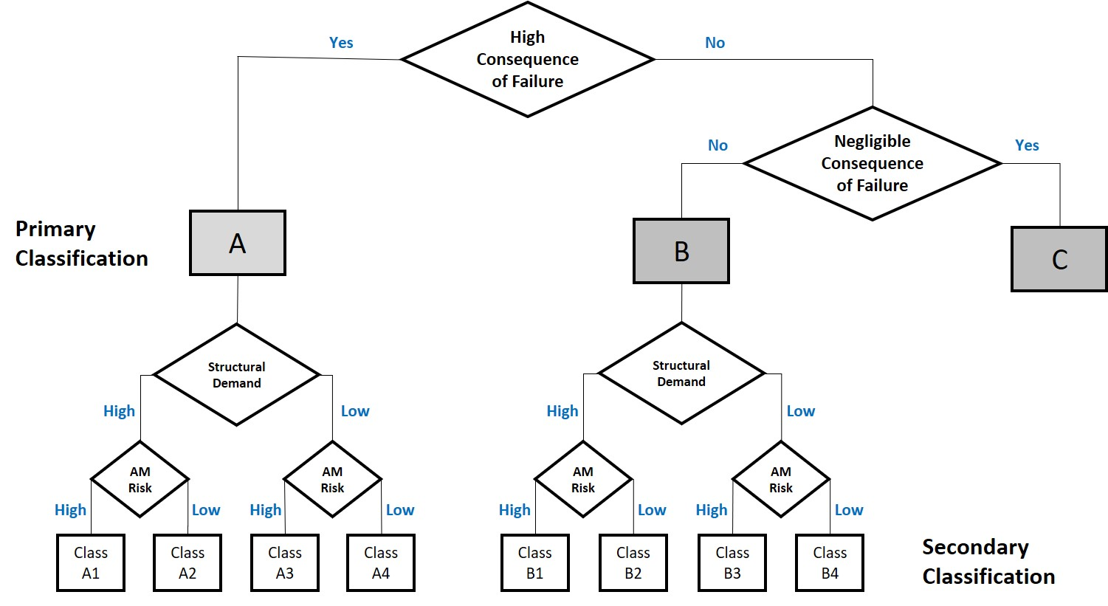
Classification

Slide 4

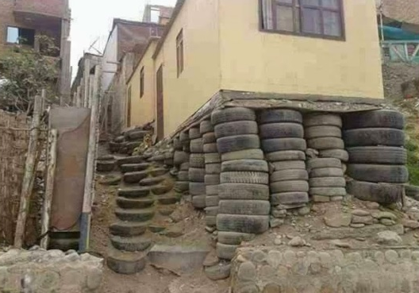
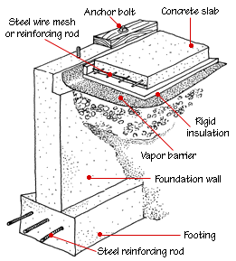

Building a Foundation
Planning for AM certification does NOT start with a part
AM Control Plan should define how the foundation for certification is structured and how it operates
Equipment and Facility Controls
Personnel Training
Process/Machine Qualification
Material Properties
Statistical Process Controls

Slide 5
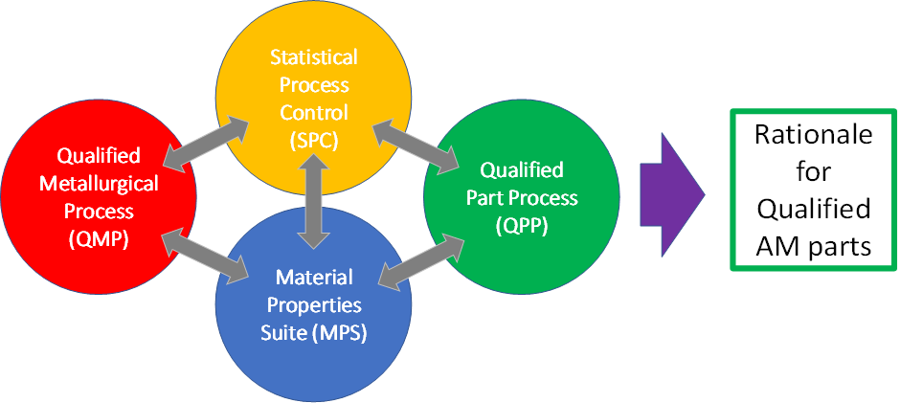
Qualified Material Process (QMP)
Begins as a Candidate QMP
Defines aspects of the basic, part agnostic, fixed AM process:
Feedstock
Fusion Process
Thermal Process
Enabling Concept
Machine qualification and re-qualification, monitored by…
Process control metrics, SPC, all feeding into…
Design values
Feedstock
Specification
NASA-STD-6033
Definition of
Material Process
ECP
Qualification Maintenance Calibration
AM Process
Post-AM Process
Qual. of Material Process
Training Plan
Training
Machine 1
QMP-A, B or C
Foundational Process Controls
Machine 2
Machine 3
Machine “n”
Sub-QMP-A, B or C
Sub-QMP-A, B or C
Sub-QMP-A, B or C
Registration
(A or B)
MPS
Data
PCRD
Data
SPC Criteria
Design
Properties
Design Process
PPP

Slide 6
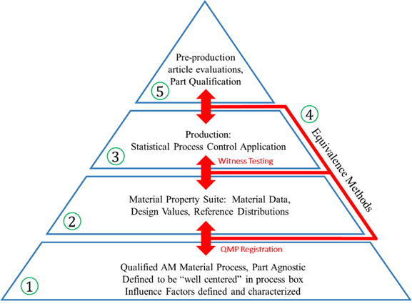
The QMP becomes the Foundation!

Slide 7
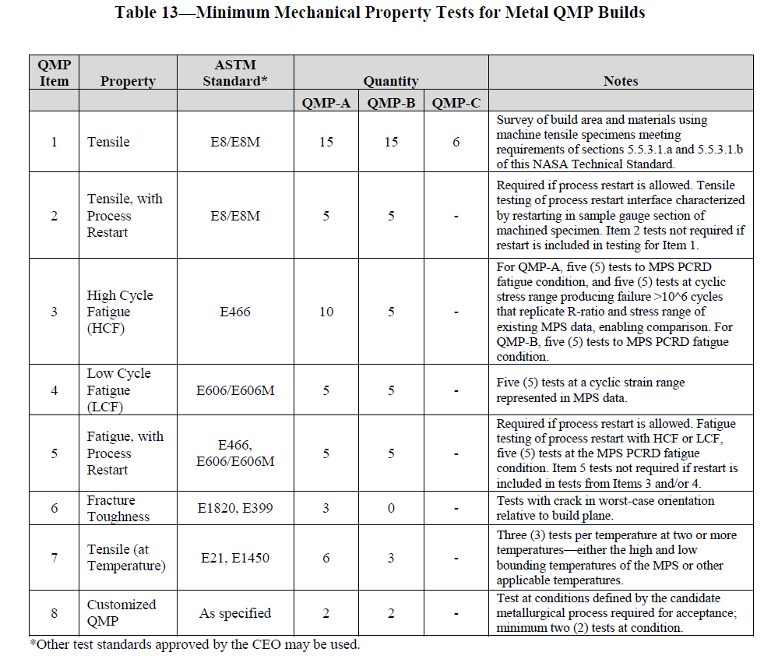
QMP Tables

Slide 8
Material Properties
The Material Property Suite (MPS) consists of four inter-related entities:
Data Repository
Design Values
Process Control Reference Distribution (PCRD)
SPC acceptance criteria for witness testing

Slide 9
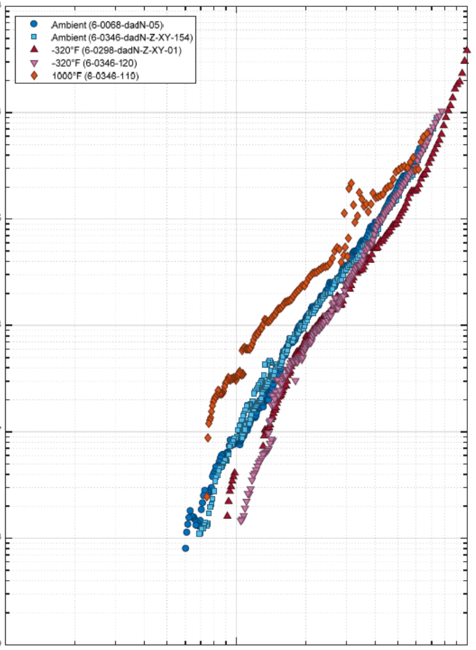
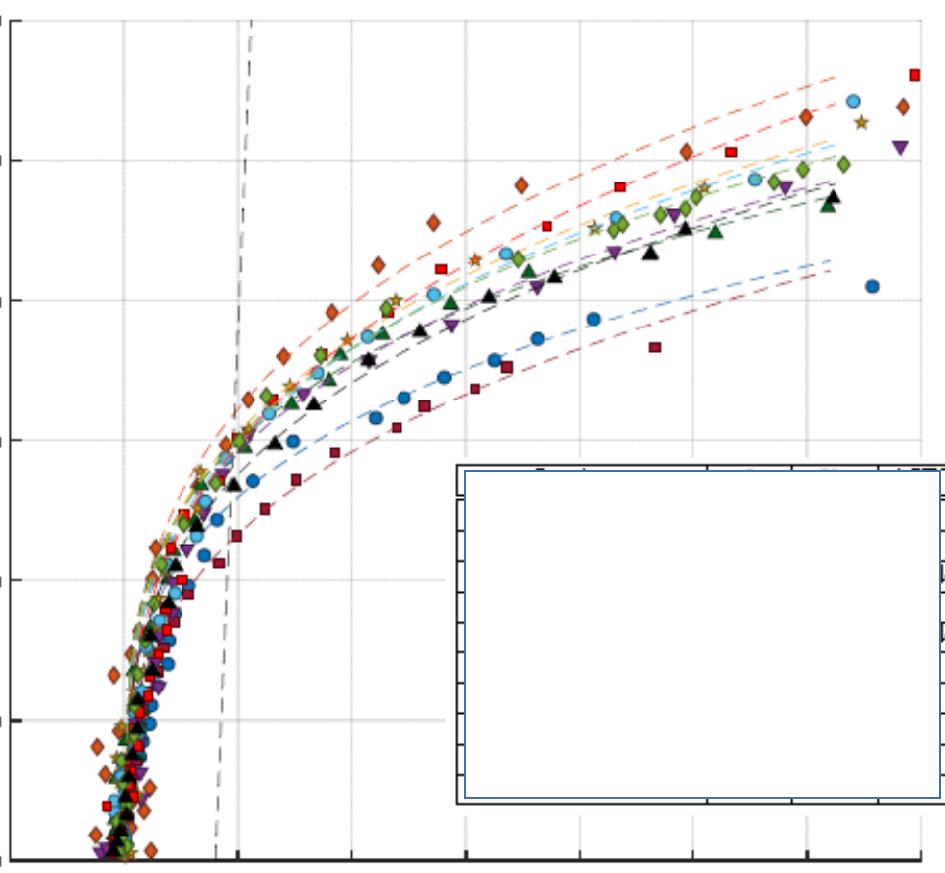
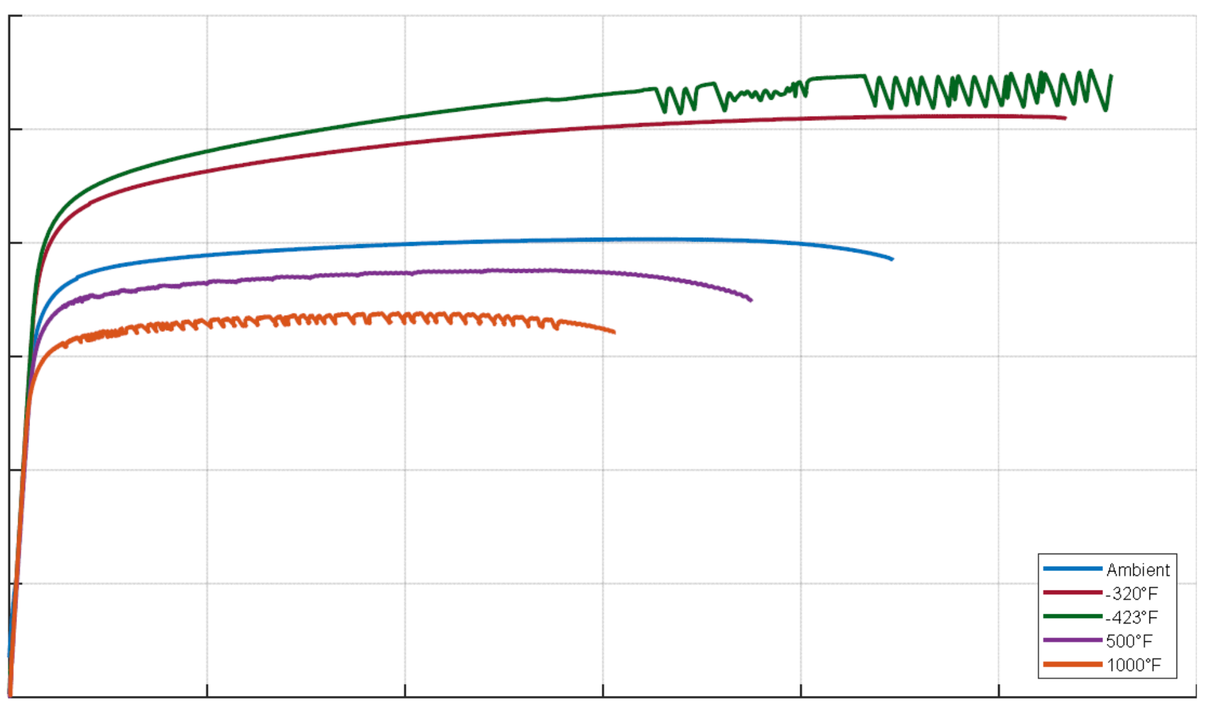
Material Properties
Material properties and design values in additive manufacturing require modifications to the approach typical of traditional metallic materials, with requirements more similar to that used in composites CMH-17
Important distinctions arise due to the sensitive nature of the process and individualistic aspect of AM machines. Each machine is a foundry!
Traditional supplier roles and responsibilities shift with the AM machine making the final material product form and part. (Casting analogy)
AM Process Vendor is responsible for material integrity

Slide 10
Material Properties – Data Repository
Includes data from
Qualification testing
Material Characterization
Pre-production Article Evaluations
Contains all data needed for
Setting Design Values
Property equivalence evaluations and QMP Registration
Setting the Process Control Reference Distribution
Grouping of data
Group data by
QMP = Material/process/heat treat
“Combinable” conditions for design

Slide 11
Material Properties – Design Values
Design Values
Statistically substantiated
Applicable sources of variability included
Utilizes all appropriate data sources in Repository
May include additional margin for safety
DV
μ
Design
Values

Slide 12
Material Properties – PCRD
Process Control Reference Distribution
Statistically describes nominal witness behavior of a machine
Utilizes all appropriate sources of witness coupon data in Repository
Used to set acceptance criteria for witness tests
σ
μ
PCRD

Slide 13

Material Properties – SPC
Statistical process controls are important in sustaining certification rationale
Statistical equivalency evaluations substantiate design values and process stability build-to-build
Process qualification
Witness testing
Integration to existing material data sets
Pre-production article evaluations
Equivalency of material performance is an anchor to the structural integrity rationale for additively manufactured parts
The dark and scary place most manufacturers are NOT used to operating….

Slide 14
Material Properties Suite
Statistical Process Control
Acceptance Criteria
Derived from PCRD
Acceptance criteria for
witness tests
SPC Acceptance Criteria for Witness Testing
σ
DV
μ
μ
Design
Values
PCRD

Slide 15
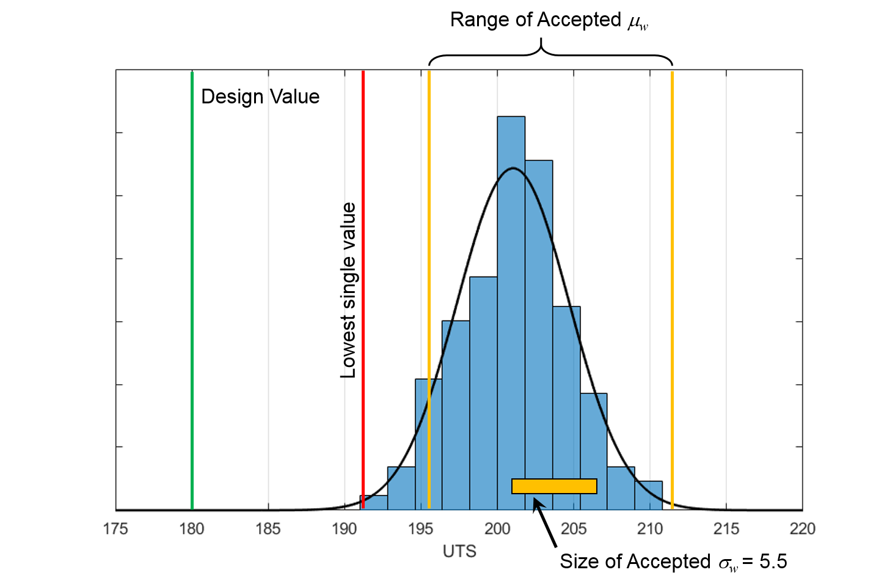
Material Properties Suite – PCRD and SPC Criteria
Witness test acceptance is not intended to be based upon design values or “specification minimums”
Acceptance is based on witness tests reflecting properties in the MPS used to develop design values
Suggested approach
Acceptance range on mean value
Acceptance range on variability (e.g., standard deviation)
Limit on lowest single value

Slide 16
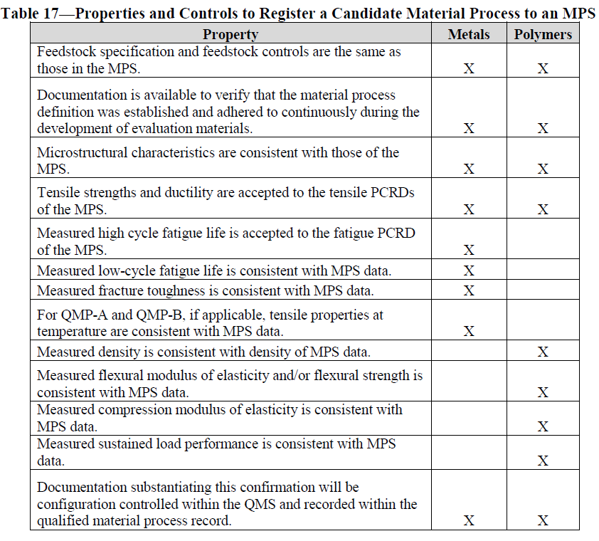
Registering a QMP to an MPS

Slide 17
Bootstrapping a QMP and MPS
When new AM processes are first established, an MPS may not yet exist to conduct the registration process. In such cases, the material test data generated to produce the QMP are also used to generate the initial MPS (i.e., bootstrapping), and the QMP is registered to the new MPS by default.
Additional data generated from the QMP are used to populate preliminary MPS PCRDs and other material properties to enable registration of additional QMPs.

Slide 18
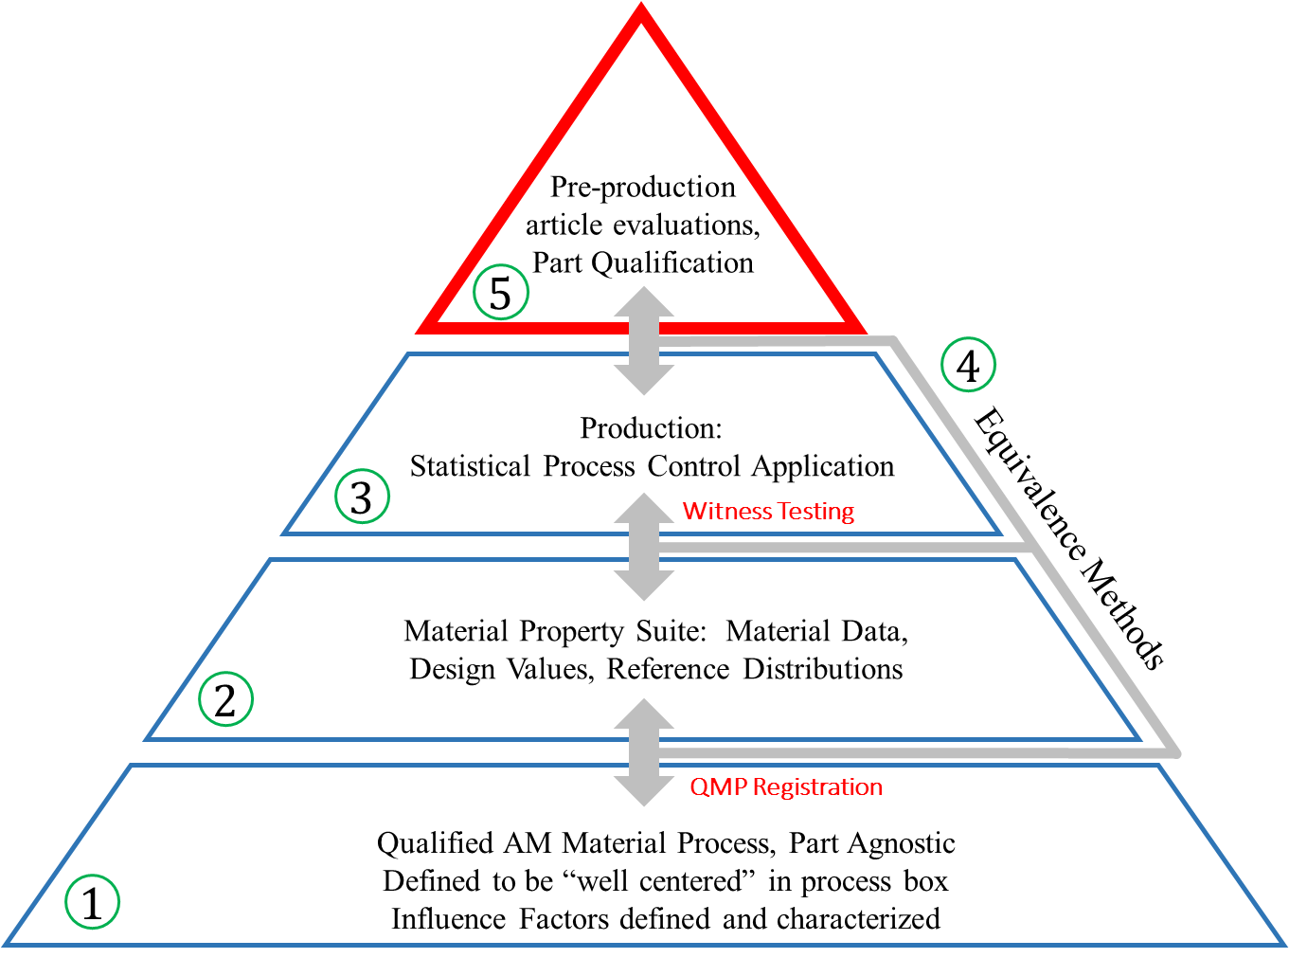
Foundation Complete!!
A basis to begin designing AM parts with certification intent is feasible once the foundation is laid.
Foundation is now ready to support AM part development in an environment with suitable rigor to establish certification.

Slide 19
Conclusions
QMP’s define the material state for one machine
MPS define the overall material property. It can be broken up in different ways depending on needs
QMP and MPS are the foundations for material control and material design values
Control what you do::Evaluate what you get

Slide 20
Back Up Slides

Slide 21
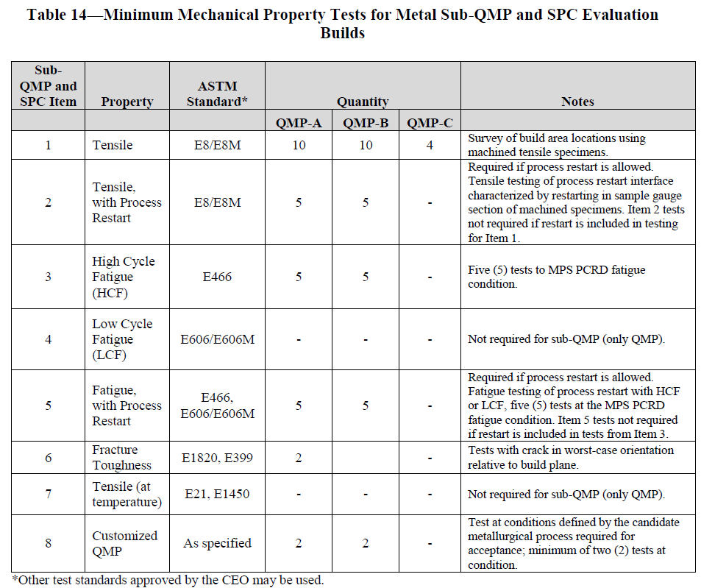
Table 14

Slide 22
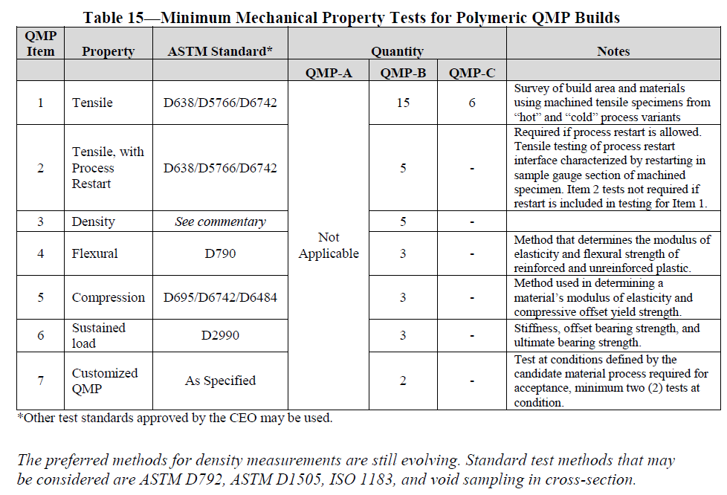
Table 15

Slide 23
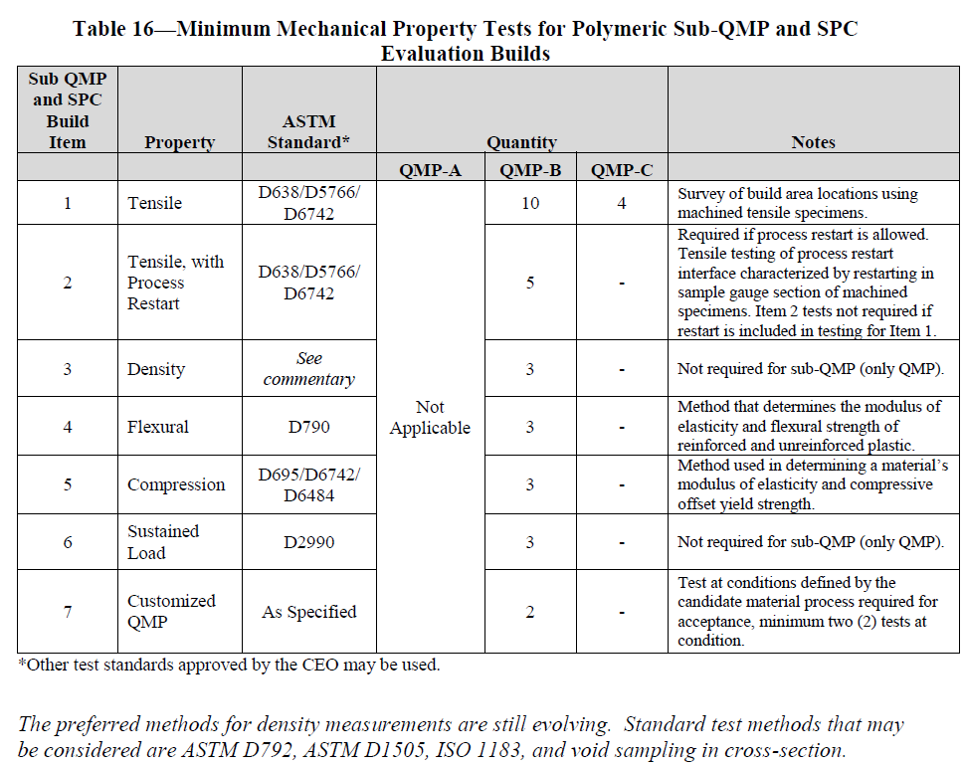
Table 16

Slide 24
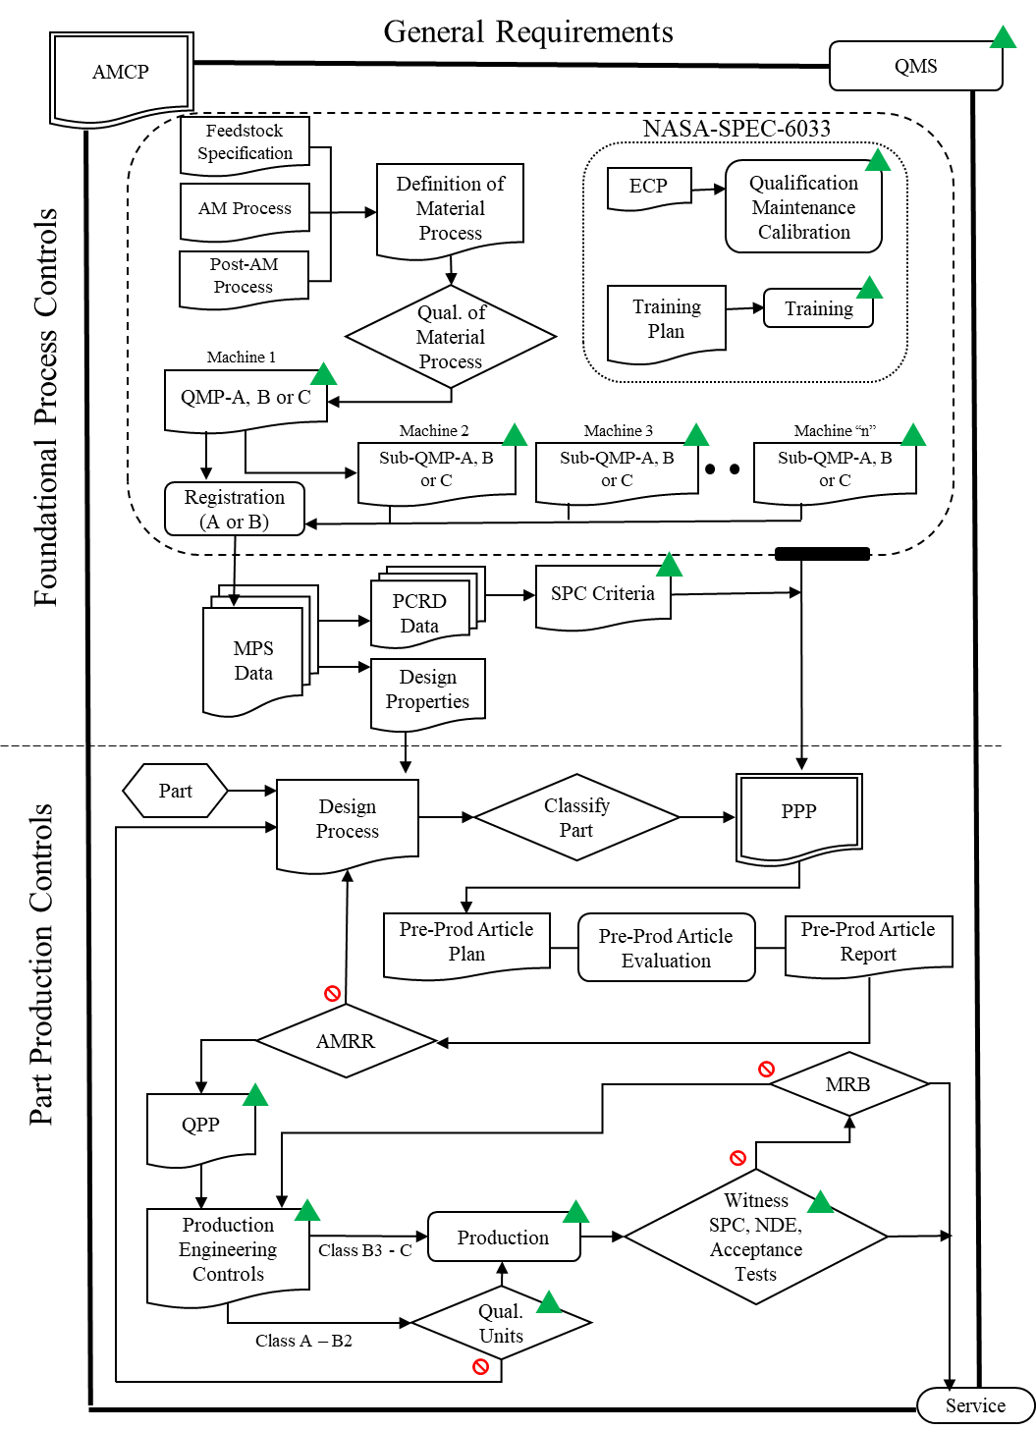
Summary of Methodology

Slide 25
Applicability
Adaptive technologies—where process parameters change based on active feedback during the manufacturing process—are not allowed without a tailored, point-design methodology.
e.g. Electron beam powder bed fusion (E-PBF)

Slide 26
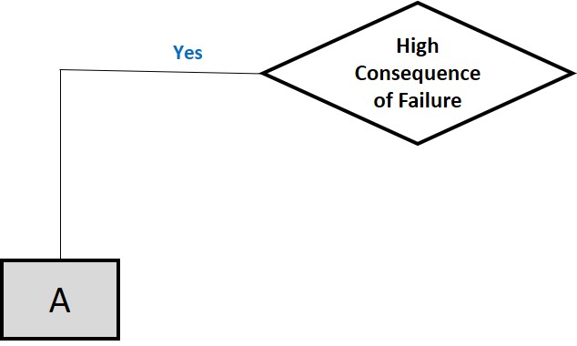
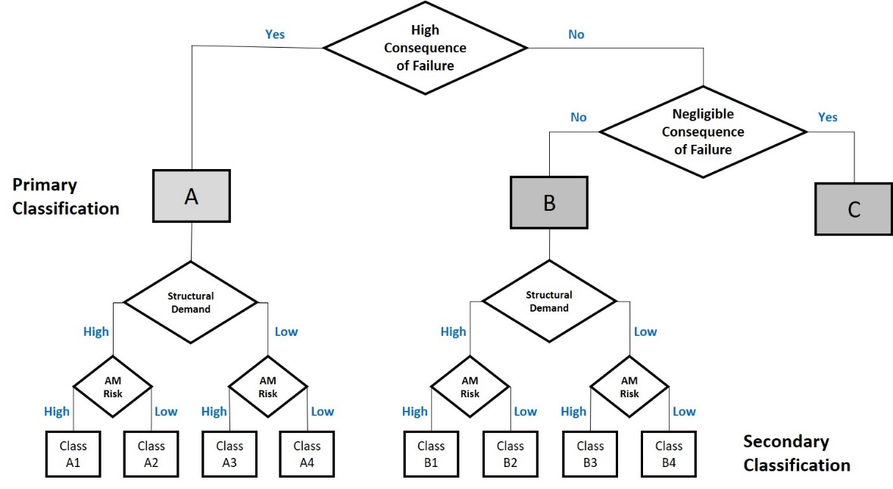
High Consequence of Failure
A part shall be designated as Class A, High Consequence of Failure, if failure of the part leads to a catastrophic hazard or the part is defined as Mission Critical Hardware by the Program Office.
Class A parts shall not:
Be made from polymeric materials
Be fasteners
Contain printed threads.

Slide 27
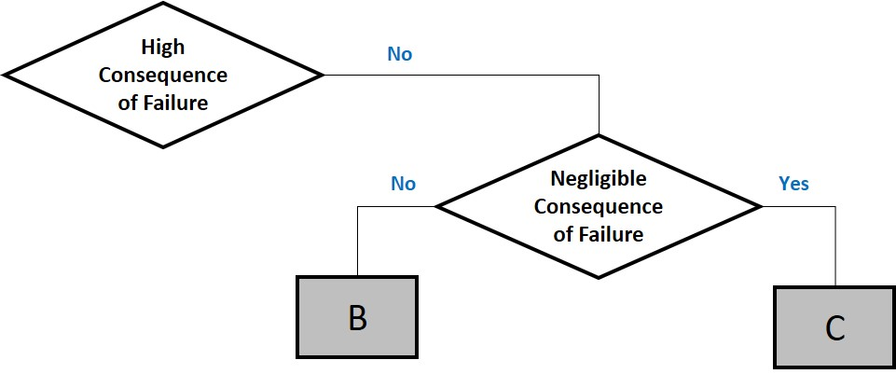
Negligible Consequence of Failure
Parts not designated Class A or Class C shall be designated as Class B.
Class B parts shall not:
Be fasteners
Contain printed threads.

Slide 28
Negligible Consequence of Failure
A part shall be designated as Class C, Negligible Consequence of Failure, provided that ALL of the following criteria (see the next slide) are satisfied:
Failure of part does not lead to any form of hazardous or unsafe condition.
Failure of part does not eliminate a critical redundancy.
Part does not serve as primary or secondary containment.
Part does not serve as redundant structures for fail-safe criteria per NASA-STD-5019.
Part is not designated “Non-Hazardous Leak Before Burst” per NASA-STD-5019.
Failure of part does not cause debris or contamination concerns per NASA-STD-6016 .
Part meets requirements for off-gassing, flammability, and compatibility requirements as described in NASA-STD-6016.
Failure of part causes only minor inconvenience to crew or operations.
Failure of part does not alter structural margins or related evaluations on other hardware.
Failure of part does not adversely affect other systems or operations.
Failure of part does not affect minimum mission operations.

Slide 29
Exempt Parts
A part shall be designated as Exempt provided that all of the following criteria are satisfied, and it meets all criteria for Class C, which exempts it from all other requirements in this NASA Technical Standard:
The part does not require any form of structural assessment.
The part does not permanently interface to, or attach to, the launch vehicle, spacecraft, habitable module, or any subsystems thereof.
Except for use in habitable crew spaces, the part does not provide any functionality or serve any purpose to the launch vehicle, spacecraft, or any subsystems thereof.

Slide 30
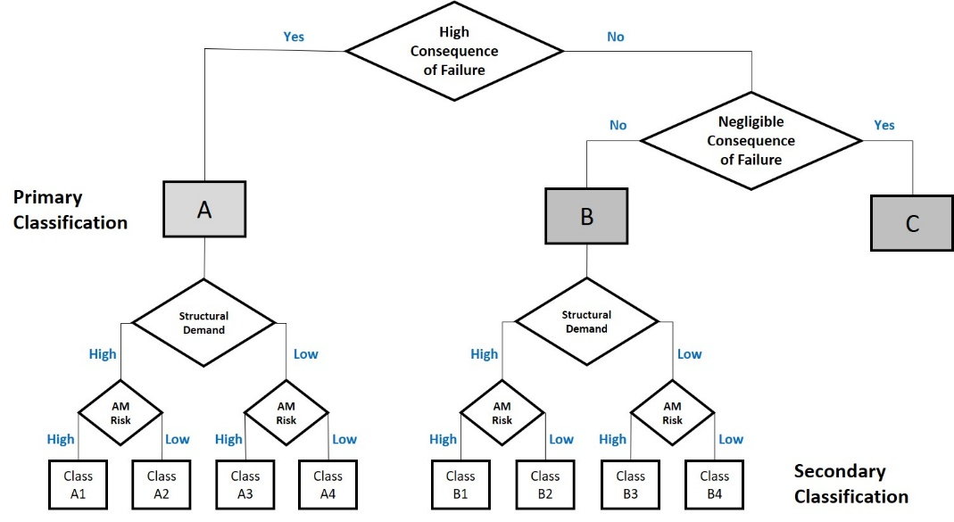
Secondary Classification
Secondary classification is for Class A and B parts only and is used to determine appropriate levels of process control
A
B
High
Structural Demand
Low
High
Structural Demand
Low
High
AM Risk
Low
High
AM Risk
Low
High
AM Risk
Low
High
AM Risk
Low
Class
A1
Class
A2
Class
A3
Class
A4
Class
B1
Class
B2
Class
B3
Class
B4

Slide 31
Structural Demand - Metals
Material Property | Criteria for Low Structural Demand
Loads environment | Defined or bounded loads environment
Environmental degradation | Only due to temperature
Ultimate strength | Minimum margin* ≥ 0.3
Yield strength | Minimum margin* ≥ 0.2
Point strain | Local plastic strain < 0.005
High cycle fatigue, improved surfaces | Cyclic stress range (including any required factors) ≤ 80% of applicable fatigue limit
High cycle fatigue, as-built surfaces | Cyclic stress range (including any required factors) ≤ 60% of applicable fatigue limit
Low cycle fatigue | No predicted cyclic plastic strain
Fracture mechanics life | 20x life factor
Creep strain | No predicted creep strain
*Margin = [σ_{design}/(σ_{operation} * safety factor)] – 1
High
Structural Demand
Low
High
AM Risk
Low
High
AM Risk
Low
Class
A1
Class
A2
Class
A3
Class
A4

Slide 32
Structural Demand - Polymers
Analysis Input/Material Property | Criteria for Low Structural Demand
All Materials
Loads Environment | Defined or bounded loads environment
Environmental Degradation | Only due to temperature and moisture, if specific environmental performance data exist. Design environment temperature does not cross the Tg.
Fatigue | Cyclic stress range (including any required factors) ≤ 50% of applicable fatigue limit
Sustained stress/creep strain | No sustained stress† and no predicted creep strain
Material with elongation at failure ≥ 3% in application environment
Ultimate strength | Minimum margin* ≥ 0.5
Yield strength‡ | Minimum margin* ≥ 0.3
Material with elongation at failure < 3% in application environment
Ultimate strength# | Minimum margin* ≥ 2.0
High
Structural Demand
Low
High
AM Risk
Low
High
AM Risk
Low
Class
A1
Class
A2
Class
A3
Class
A4
†Includes assembly stress (tight snap fit connections, shrink fits, fastener preloads) and operational stress
‡Yield strength defined by secant modulus to specified strain, by specified offset strain, or as otherwise defined by structural assessment requirements
#Ultimate strength assessed against local maximum principal stress at stress concentrations (brittle material design rules) for low ductility materials
*Margin = [σ_{design}/(σ_{operation} * safety factor)] – 1

Slide 33
AM Risk
Additive Manufacturing Risk determination will be unique to each material and type of process
High
Structural Demand
Low
 | Metallic |  | Polymer
 | L-PBF | DED | L-PBF | Score For
Additive Manufacturing Risk |  |  |  | Yes | No | Score
All surfaces and volumes can be reliably inspected, or the design permits adequate proof testing based on stress state? | X | X | X | 0 | 5
As-built surface can be fully removed on all fatigue-critical surfaces? | X | X |  | 0 | 3
Surfaces interfacing with support structures are fully accessible and the as-built surface removed? | X | X | X | 0 | 3
Structural walls or protrusions are the equivalent of ≥ 8 trace, (e.g., melt pool, bead, scan path) widths in cross section? | X |  | X | 0 | 2
Structural walls or protrusions are the equivalent of ≥ 2 trace, (e.g., melt pool, bead, scan path) widths in cross section? |  | X |  | 0 | 2
Critical regions of the part do not require support structure? | X | X | X | 0 | 2
High
AM Risk
Low
High
AM Risk
Low
Class
A1
Class
A2
Class
A3
Class
A4
AM risk = HIGH, if cumulative AM Risk score >=5

