Slide 1
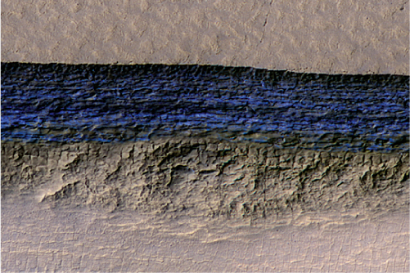
Mars Water Well Performance: Experimental Heat Transfer Results Supporting Simulations
Stephen Hoffman, Ph.D.
  Aerospace Corp.
James Lever, Ph.D.
U.S. Army Corps of Engineers / Cold Regions Research and Engineering Laboratory
Alida Andrews
  Aerospace Corp.
Kevin Watts
  NASA/Johnson Space Center
Image from Dundas, et al.
Science vol. 359, pp. 199–201 (2018)

Slide 2
What Is Motivating This Experiment?
Using local resources for future human missions to Mars means reduced transportation requirements from Earth and a larger source of materials than might otherwise be available
Of the many resources available on Mars, perhaps the most valuable is water
One facet of NASA’s current Mars Exploration Program is a search for the locations and quantities of water in various forms.
  Subsurface liquid water aquafers
  Surface and subsurface water ice and icy soils
  Hydrated minerals
  “Average regolith”
Access to massive quantities of water could change surface mission concepts of operation and drive site selection
A “Rodriguez Well” is one well-established technique for acquiring water from ice here on Earth
A computer simulation developed by the U.S. Army Cold Regions Research and Engineering Laboratory (CRREL) is used to estimate Rodriguez Well performance
This simulation incorporates empirical terms for heat transfer based on terrestrial environmental conditions – terms specific to Mars are needed

Slide 3



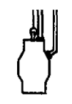

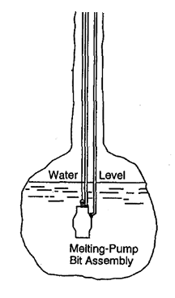

Subsurface Water Well Development: Rodwell Approach
Hot water in
Cold water out
Hot
Water
Water Storage & Transfer Tank
Hot
Water
Heat Source
Phase 1: Drill through overburden into top of ice.
Phase 2: Melt into ice. Begin forming water pool.
Phase 3: Steady state operation.

Slide 4
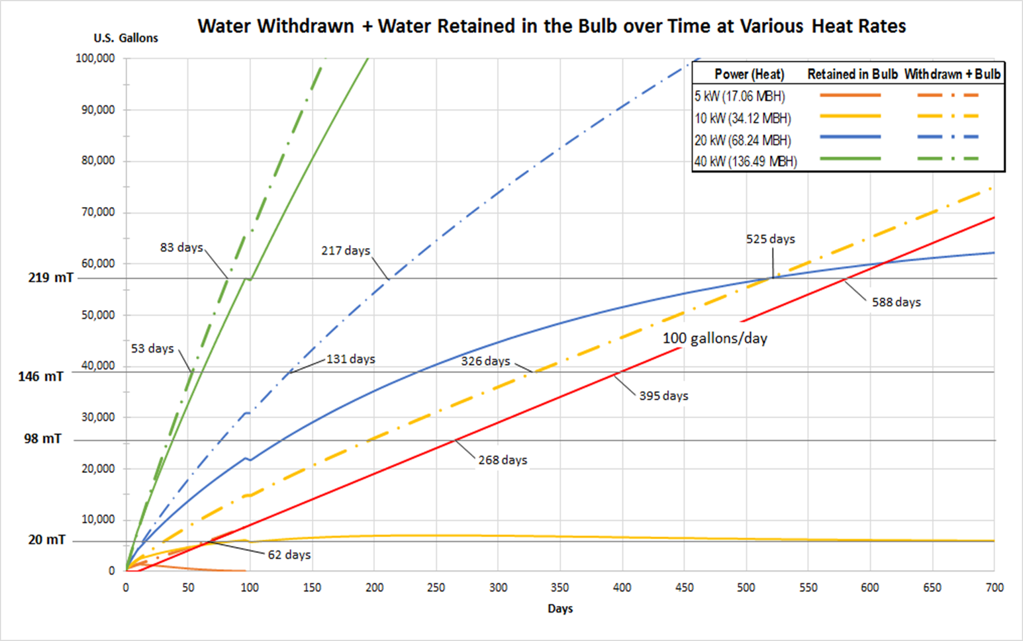
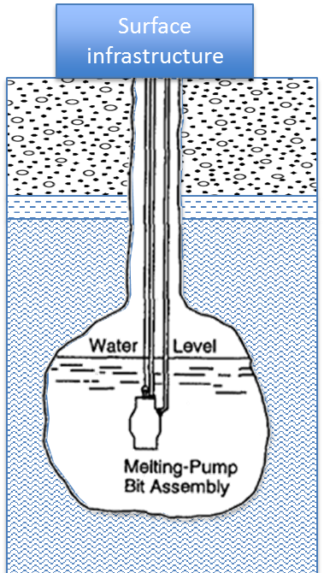
Predicted Time Needed to Withdraw Water at a 100 gal/day Rate
Note: assumes -80° C ice

Slide 5
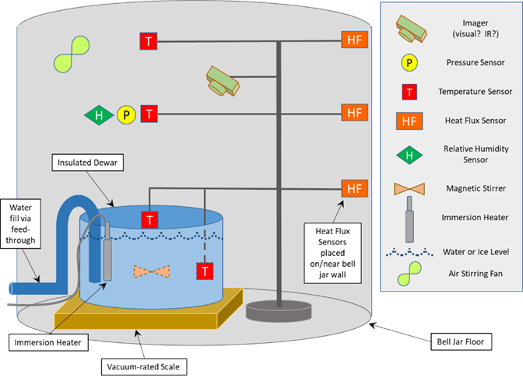
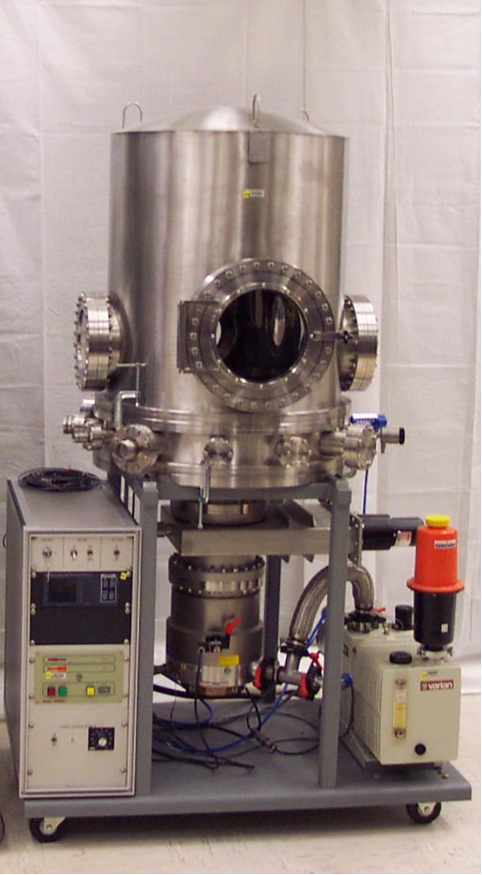
Experiment Equipment and Layout
Twelve test points – combinations of
  Two dewar diameters (4.5 and 6.0 in)
  Six chamber pressure (1000 – 8 mb)
  Two chamber temperatures (-20 C and -40 C)
Evaporative loss measured using a load cell
Total heat transfer measured via immersion heater power
JSC 2-foot bell jar

Slide 6
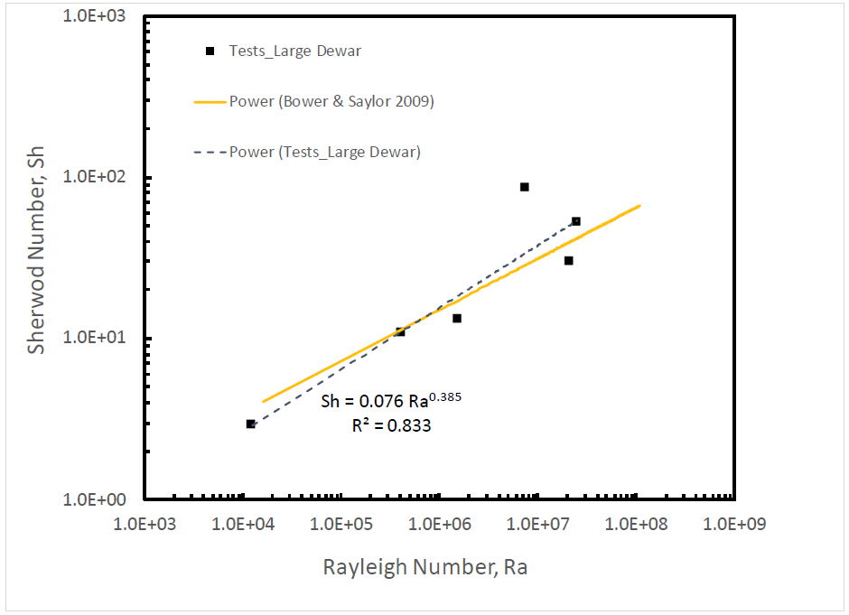
Sherwood–Rayleigh Relation for Water Undergoing Natural
Convection-Driven Evaporation

Slide 7
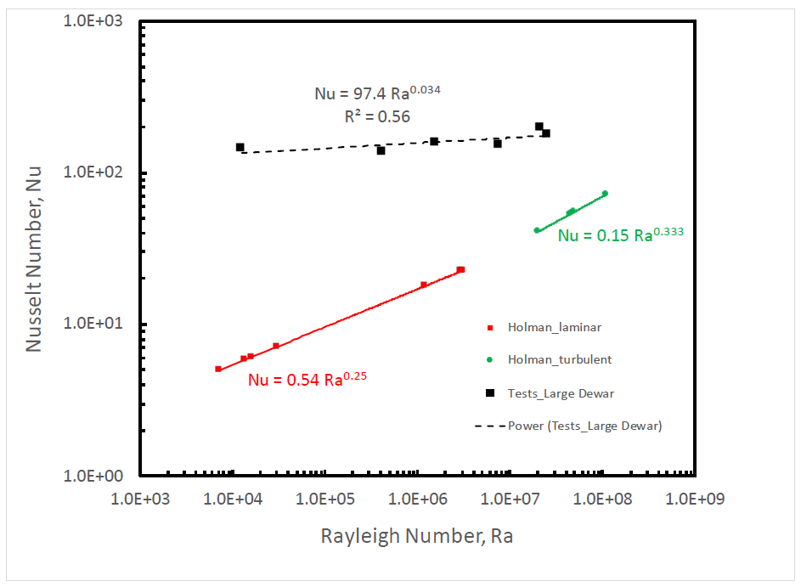
Convective Heat Loss from Water to a Gas

Slide 8
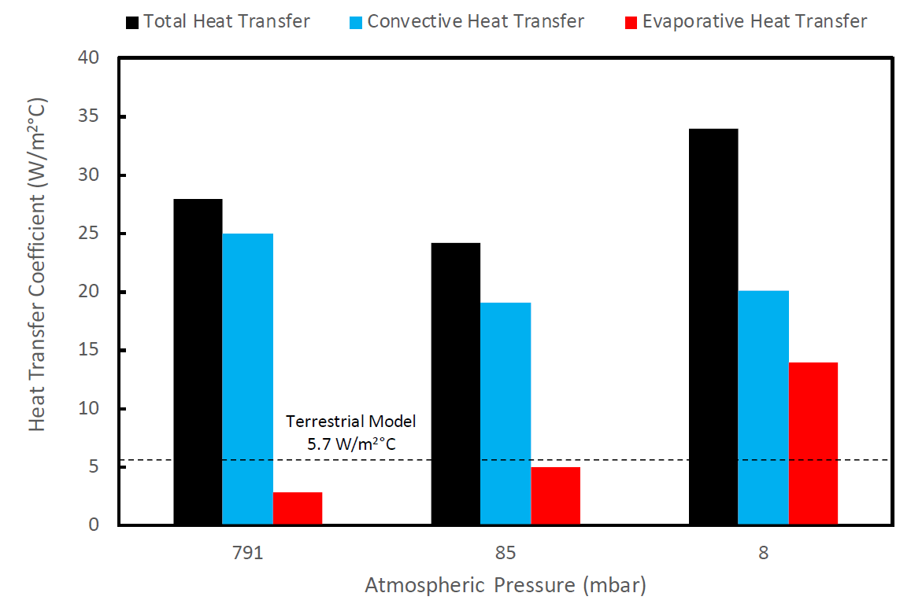
Components of Heat Transfer, Water to CO2 at T = -45°C

Slide 9
Summary
Water will likely be an important resource for future human missions to Mars
Recent discoveries of exposed ice sheets on Mars supports the theory that extensive buried ice sheets exist at mid latitude locations
The Rodriguez Well technique offers one means for extracting significant quantities of water from these ice sheets
  Extensive history of use in terrestrial applications
Recent experiments at the NASA Johnson Space Center indicate these wells can be formed under ambient surface conditions on Mars
  Water pools can be sustained with water held near freezing conditions
    This approach is used in terrestrial Rodwells
  Water pools under these Martian conditions found to exhibit structural characteristics similar to terrestrial Rodwells
    For example: ice shelf formation
  Evaporation follows power law trends observed for terrestrial water pools at Earth ambient conditions
Total heat loss rates will be used to adapt CRREL simulation models for use in predicting Martian Rodwell performance

Slide 10
Backup

Slide 11
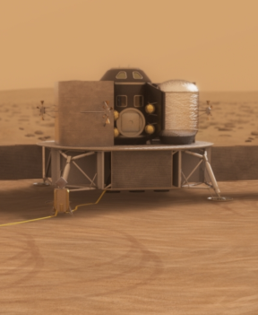
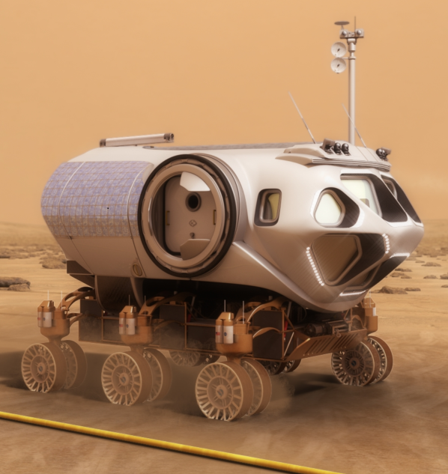

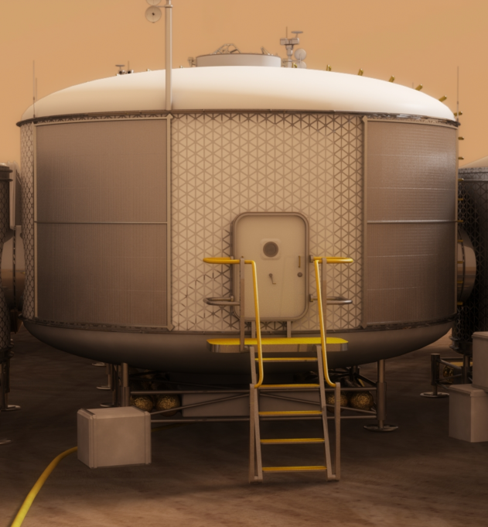
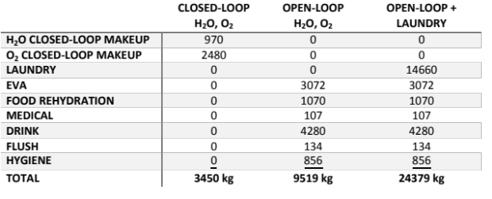
How Would a Human Mars Mission Use Abundant Water?
20 tons of water (plus CO₂) provides ascent fuel and oxidizer for one MAV
Subsystem | Mass (kg)
 | MDM Payload | Mars Liftoff
Crew Cabin | 3,427 | 4,122
Structures | 881 | 881
Power | 377 | 377
Avionics | 407 | 407
Thermal | 542 | 542
ECLS | 502 | 502
Cargo | 422 | 1,117
Non-Prop. Fluids | 295 | 295
1st Stage | 9,913 | 31,432
Dry Mass | 3,605 | 3,605
LO2 | 0 | 21,519
LCH4 | 6,308 | 6,308
2nd Stage | 5,006 | 13,245
Dry Mass | 2,566 | 2,566
LO2 | 0 | 8,239
LCH4 | 2,440 | 2,440
TOTALS | 18,345 | 48,799
23 tons of water provides rover reactants for robust surface mobility
Power
Martian Water: 2H₂O
O2:CH₄ 3.4:1
4H₂O (crew metabolic)
Electrolysis:
4H₂O + power = 4H₂ + 2O₂
2O₂
3O₂
Fuel Cell:
3O₂ + 6H₂ = 6H₂O + power
Power
O₂:CH₄ 4:1
O₂:CH₄ 3:1
6H₂
2H₂O
Martian Atmosphere: CO₂
2H₂O
4H₂
Sabatier:
CO₂ + 4H₂ = CH₄ + 2H₂O + heat
CH₄
2CH₄
Methane Reformer:
2CH₄ + 2H₂O + heat + catalyst = 6H₂ + 2CO
2CO
Production Plant NET Reaction:
2H₂O + CO₂ + power = 2O₂ + CH₄ + heat
Rover NET Reaction:
2CH₄ + 3O₂ + heat + catalyst = 2CO + 4H₂O + power
H₂O
O₂
25 tons of water provides robust open-loop life support for a crew of 4 for 500 days
A total of 68 tons of water supports one crew of 4 during a 500 day mission

Slide 12
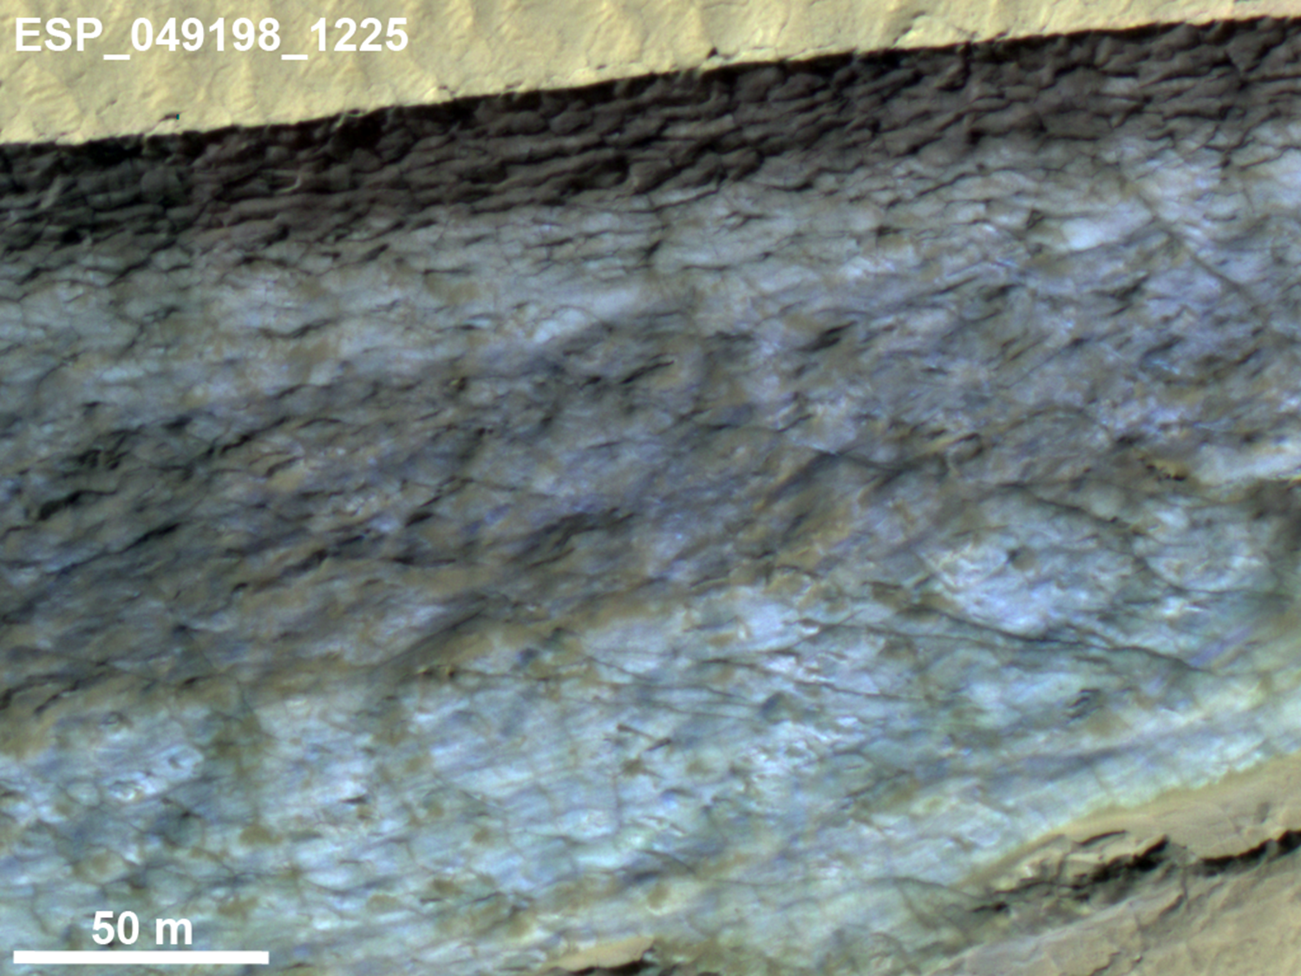

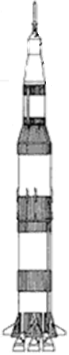
How Much Water Ice Could Be In These Formations?
0
50
68 tons of water
Enough to support one crew of 4 during a 500 day mission
Depth in meters
100
150
C. M. Dundas et al., Exposed massive ground ice in the Martian mid-latitudes, Science vol. 359, pp. 199–201 (2018)

Slide 13
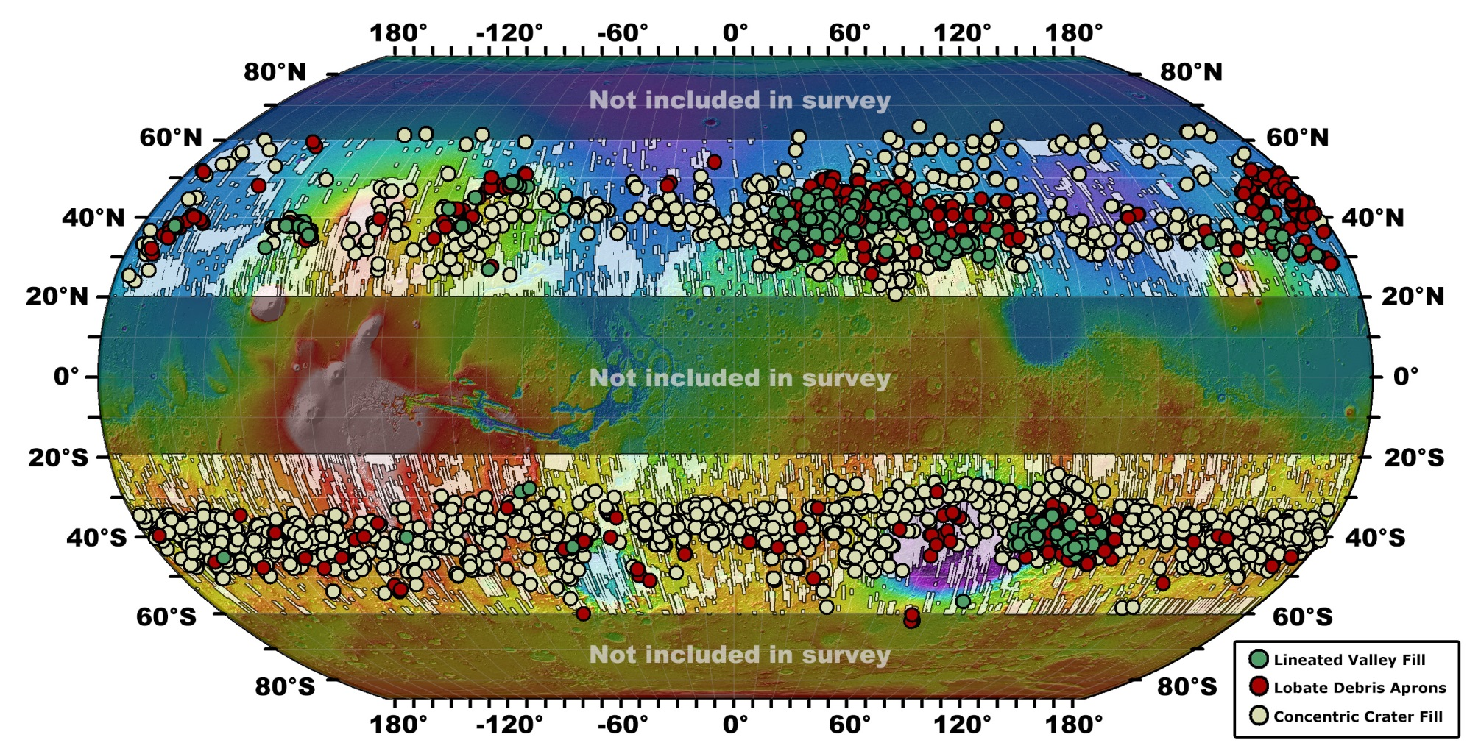
Where are these Scarps Located?
Seven of the scarps “… are located in the southern hemisphere, and the eighth location is a cluster of scarps in Milankovič Crater in the northern hemisphere.”
PHX
~55 N
~55 N
8
V2
V1
Pathfinder
Mars 2020/
Perseverance
InSight
MER/
Spirit
MER/Opportunity
MSL/Curiosity
~55 S
7
2
1
~55 S
5
3
6
4
Lander / Rover
0
Ice Scarp

Slide 14
Test Points: Liquid Water at ~1°C
Test Number | Dewar Size | Air Temp (deg C) | Air Pressure (mbar) | Rayleigh Number
1 | 4.5 in (11.4 cm) | -40 | 8 | 4.6E+03
2 | 4.5 in (11.4 cm) | -40 | 240 | 1.0E+06
3 | 4.5 in (11.4 cm) | -40 | 1000 | 1.7E+07
4 | 4.5 in (11.4 cm) | -20 | 8 | 2.5E+03
5 | 4.5 in (11.4 cm) | -20 | 370 | 1.0E+06
6 | 4.5 in (11.4 cm) | -20 | 1000 | 7.0E+06
7 | 6.0 in (15.2 cm) | -40 | 8 | 2.5E+04
8 | 6.0 in (15.2 cm) | -40 | 95 | 9.9E+05
9 | 6.0 in (15.2 cm) | -40 | 1000 | 9.1E+07
10 | 6.0 in (15.2 cm) | -20 | 8 | 1.3E+04
11 | 6.0 in (15.2 cm) | -20 | 250 | 2.6E+06
12 | 6.0 in (15.2 cm) | -20 | 1000 | 3.8E+07
Green values – in range of published data. Red numbers – outside range of published data

Slide 15
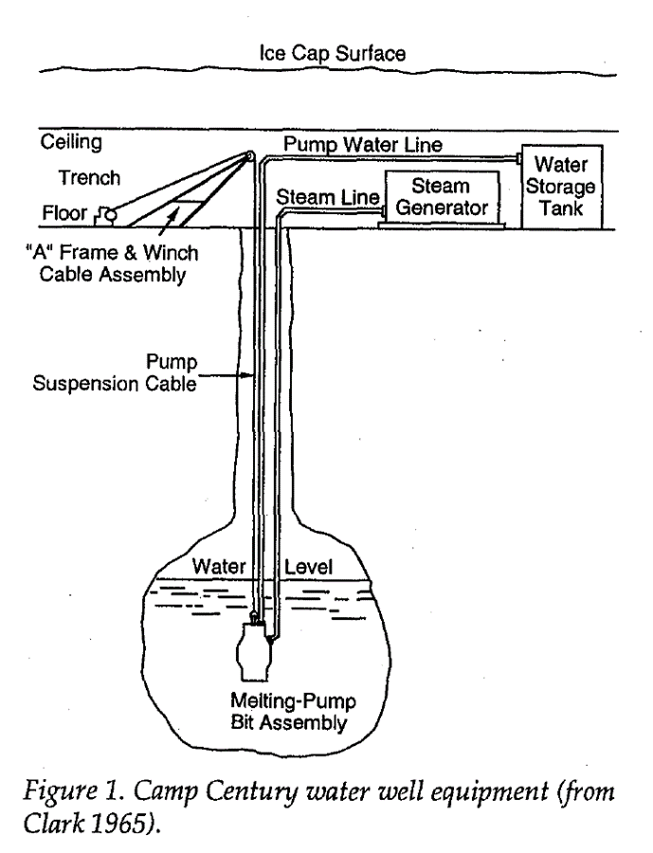
Terrestrial Polar Operations: The Rodriguez Well*
In situ water reservoirs were first designed and built by the U.S. Army Cold Regions Research and Engineering Laboratory (USACRREL) in the early 1960s for several U.S. Army camps located in Greenland (Schmitt and Rodriguez 1960; Russell 1965).
  commonly referred to as Rodriguez Wells or Rodwells
Snow or ice is melted and stored in place at some depth below the surface of the ice cap, eliminating the need for mechanical handling of snow and for fabricated storage tanks
Water wells or Rodwells have been used at:
  Camp Fistclench (Greenland, 1957)
  Camp Century (Greenland, 1959 and 1960)
  Camp Tuto (Greenland, 1960)
  South Pole Station (Antarctica, 1972-73 and 1995-present; currently using third Rodwell)
  IceCube drilling operation (2004 – 2011; seasonal only)
*Lunardini, V.J. and J. Rand (1995). Thermal Design of an Antarctic Water Well. CRREL Special Report 95-10.

Slide 16
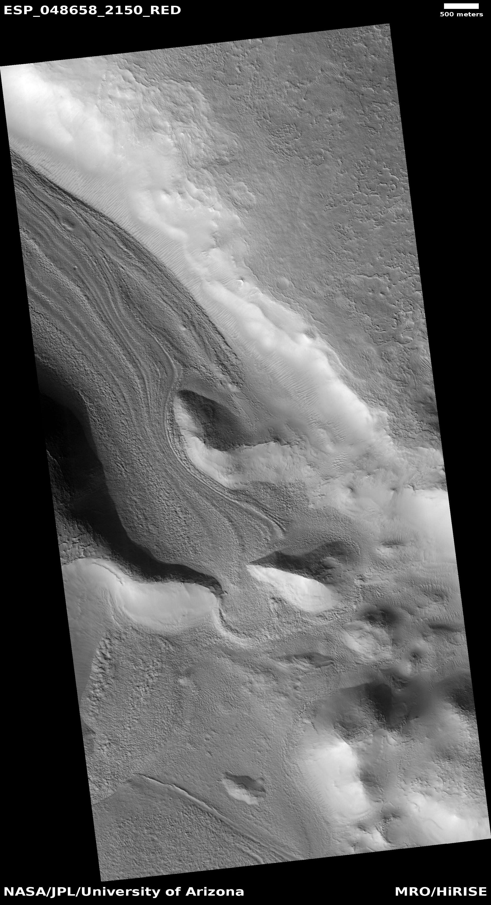
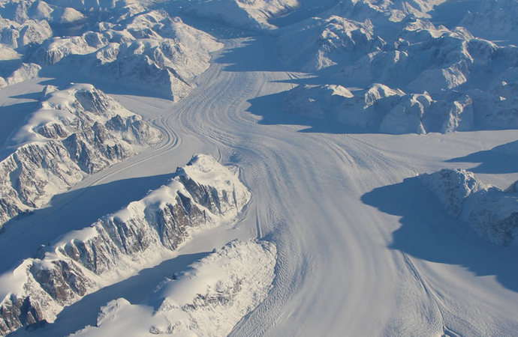
What is Lineated Valley Fill?
Lineated Valley Fill is a feature seen on the floors of some channels on Mars, exhibiting ridges and grooves that seem to flow around obstacles. These features bear a strong visual resemblance to some terrestrial glaciers.
The Heimdal Glacier in southern Greenland. Credit: NASA/John Sonntag

Slide 17
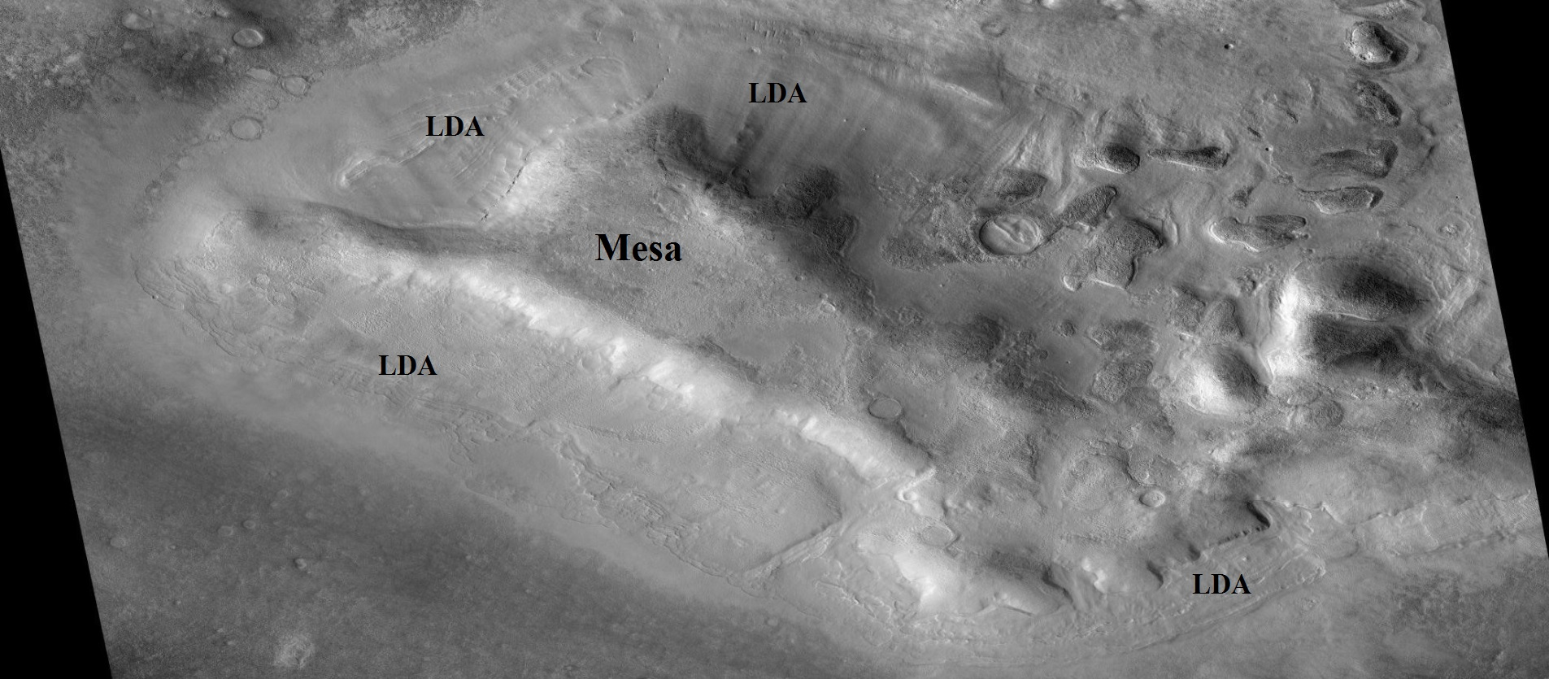
What are Lobate Debris Aprons?
Lobate debris aprons (LDAs) are geological features on Mars, consisting of piles of rock debris below cliffs. These features, first seen by the Viking Orbiters, are typically found at the base of cliffs or escarpments. They have a convex topography and a gentle slope, suggesting flow away from the steep source cliff.

Slide 18
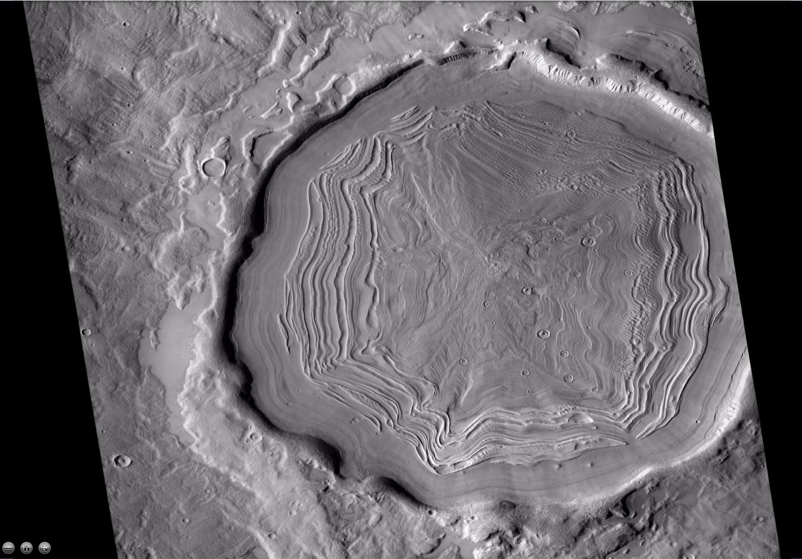
What is Concentric Crater Fill?
Concentric crater fill is a terrain feature where the floor of a crater is mostly covered with a large number of parallel ridges.
Modeling suggests that concentric crater fill developed over many cycles in which snow is deposited, then moved into the crater. Once inside the crater, shade and dust preserved the snow. The snow was gradually compressed into ice. The many concentric lines are created by many cycles of snow
accumulation, at a time when the Mars environment could support snowfall.

Slide 19
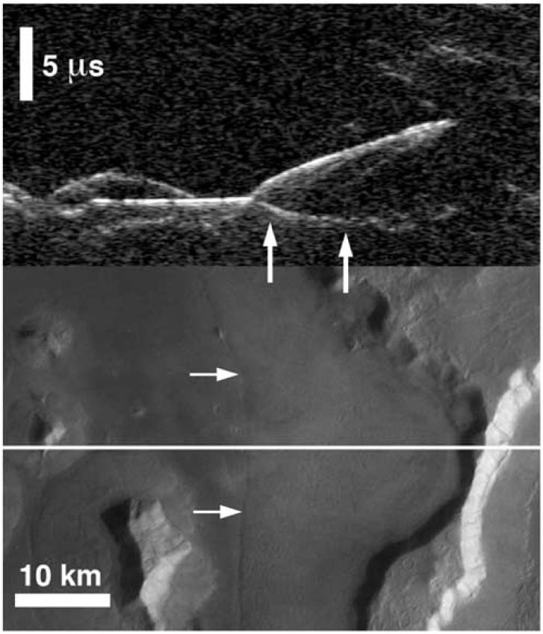
What is the Radar Evidence for Debris Covered Water Ice?
While searching for subsurface aquafers, the MARSIS (Mars Advanced Radar for Subsurface and Ionosphere Sounding; on Mars Express) and SHARAD (SHAllow RADar; on Mars Reconnaissance Orbiter - MRO) radars gathered data indicating these terrain features could be debris covered ice.
Debris Layer
(bright radar reflection)
Vertical Radar Sounding Along Ground Track
Possible Ice Layer
(poor radar reflection)
Bedrock Layer
(bright radar reflection)
Margin of Lobate Debris Apron
Spacecraft Ground Track
Margin of Lobate Debris Apron
Lobate Debris Apron
Radar evidence for ice in lobate debris aprons in the mid-northern latitudes of Mars
Jeffery J. Plaut, Ali Safaeinili, John W. Holt, Roger J. Phillips, James W. Head III, Roberto Seu, Nathaniel E. Putzig, and Alessandro Frigeri
Geophysical Research Letters Volume 36, L02203, 2009.

Slide 20
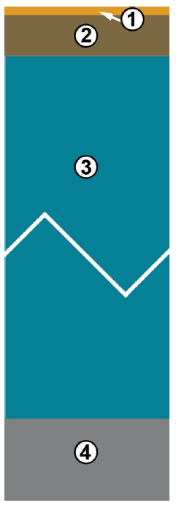
Debris Protects This Ice, But How Thick Is It?
Conceptual stratigraphy of the materials exposed in the scarps.*
Upper dry lithic layer (dust, rocks, regolith), with a thickness of about 10 centimeters at these locations [i.e., ~50 deg. Latitude; based on models]; this is too thin to be well-expressed in the scarps. The basal contact is likely to be sharp, as observed by Phoenix.
Ice-rich soil (ice filling the pores of lithic material). The thickness may be variable spatially and is ≤1–2 m in places. This could be locally absent if the uppermost massive ice is covered by mass-wasted debris; however, such a layer is possible based on the difference between the depth to visible ice and the predicted depth to the top of the ice table. If such a layer exists, vertical variations in ice content due to ice modification processes are possible.
Massive ice with low lithic content (≤ a few vol%). This is likely to be greater than 100 m thick but may be variable; it constitutes the bulk of the material exposed in the scarps. This unit contains some vertical structure (e.g. layers with variation in lithic fraction) and lateral heterogeneity (e.g., lens with less ice at Scarp 2). It may be locally covered by a surface lag deposit, especially on the lower parts of the scarps.
Basal unit (bedrock or underlying regolith materials); this may contain some ice in pore space.
*C. M. Dundas et al., Exposed massive ground ice in the Martian mid-latitudes, Science vol. 359, pp. 199–201 (2018)

Slide 21
Conceptual System and Notional Conops
Conduct a local site survey to identify the specific location for the Rodwell
  Identify the thinnest debris depth
  Determine the firn layer depth (if any) and identify cracks, voids, etc.
Drill through the debris layer
  Use mechanical drill
  Case the hole to prevent debris from collapsing into the hole and to allow some TBD pressurization of the reservoir
Drill into ice layer
  Drill down to a depth sufficient for ice to support the overlying debris layer and bypass any firn, cracks, voids, etc.
  Several technology options exist for this step; further evaluation/tests are needed to select “best” option
    Mechanical, electro-thermal, hot water, hybrid
Melt ice and store water in subsurface reservoir
  Power needed to melt ice and water extraction rate are coupled and both are tied to the specific use scenario
Options exist to cease operations between crews or to keep Rodwell in continuous operation
  Dependent on surface mission scenario and overall campaign – future work required
Option to store water above ground or use the Rodwell reservoir for storage
  Future work required

Slide 22
Observations from the 100 gal/day Withdrawal Case
The power values on the previous chart are ONLY for melting ice and maintaining a liquid pool of water in the subsurface cavity; additional power will be needed to pump water out of this cavity and to run other surface infrastructure elements.
The withdrawal rate and input power are highly coupled
  A different withdrawal rate will result in a different shape to these results
For this 100 gal/day withdrawal rate
  For power levels above approximately 10 kW, liquid water is being created at a much faster rate than it is being withdrawn, resulting in very large subsurface water pools that will not be used
  A power level of approximately 10 kW generates liquid water at about the rate at which it is being withdrawn
    The water pool remains at approximately a constant volume
    The water pool will gradually sink to lower levels, which will drive the amount of power needed to pump water from these deeper levels
  For power levels below approximately 10 kW, water is being withdrawn faster than it is being melted and the well eventually “collapses”
    At a power level of approximately 5 kW, the 20 mT projected need for a single crew’s MAV could be withdrawn before the well “collapses” but little additional water would be made

Slide 23
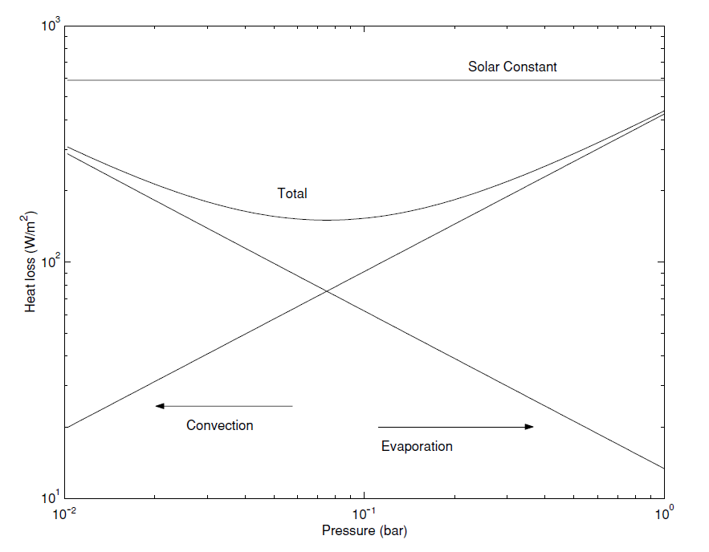
Example of Relevant Experimental Results
Convective heat transfer between a 273 K surface (water) and a 200 K atmosphere compared to evaporative cooling. The right-hand boundary reflects terrestrial conditions; the left reflects Martian conditions. For equivalent conditions, total heat loss is actually less on Mars than on Earth. (Hecht, “Metastability of Liquid Water on Mars”)

Slide 24
Differences Between Existing Model and Mars Model
Physical / Chemical Properties
  Atmospheric constant pressure specific heat
  Atmospheric gas constant
Heat transfer
  Air – water heat transfer
    Requires investigation owing to low-pressure conditions on Mars
  Air – ice heat transfer
  Water – ice heat transfer (assumed to be the same on Earth and Mars)
Air pressure effects
  Atmospheric pressure ranges from slightly above the triple point of water to slightly below
Gravity (impacts factors such as buoyancy)
Parameter | Earth |  | Mars
 | (SI/metric) | (SAE) | (SI/metric) | (SAE)
Atmospheric Pressure | 1013 mb | 14.7 psi | 8.0 mb | 0.116 psi
Gas Constant | 287 J/(kg-K) | 53.4 ft-lbf/(lbm-R) | 189 J/(kg/K) | 35.1 ft-lbf/(lbm-R)
Atmospheric Specific Heat | 1.01 kJ/(kg-K) | 0.240 Btu/(lb-R) | 0.834 kJ/(kg-K) | 0.199 Btu/(lb-R)
Heat Transfer – Water to Air | 5.67 W/(m²-K) | 1.00 Btu/(h-ft²-R) | 4.11 W/(m²-K) | 0.725 Btu/(h-ft²-R)
Heat Transfer – Ice to Air | 5.67 W/(m²-K) | 1.00 Btu/(h-ft²-R) | 4.11 W/(m²-K) | 0.725 Btu/(h-ft²-R)
Baseline value used in CRREL Rodwell simulation

Slide 25
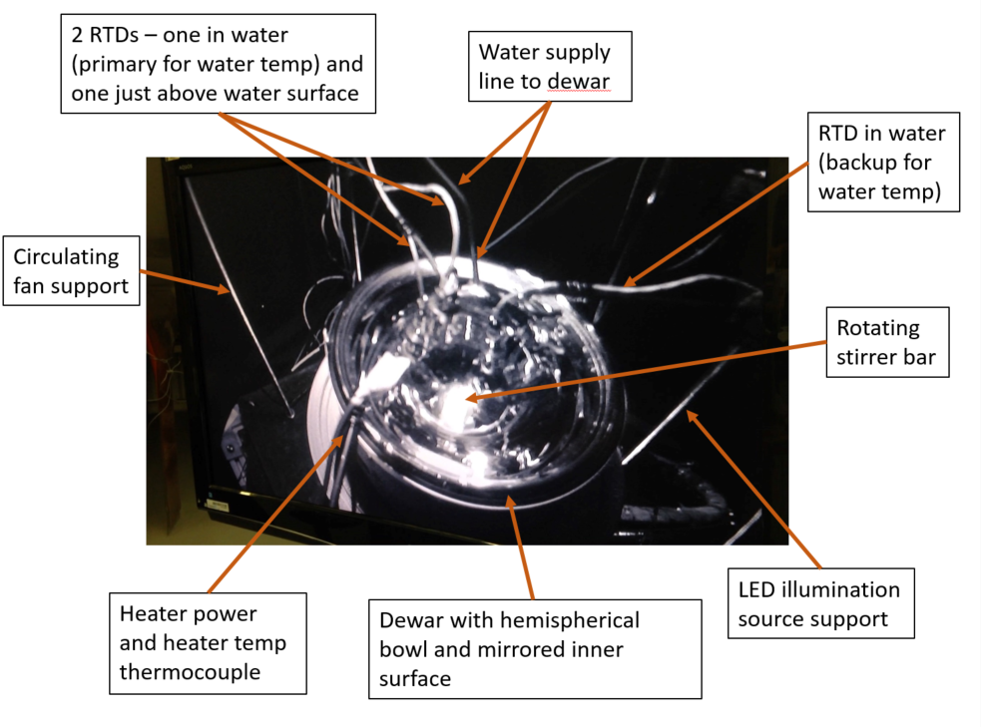
Key Items Appearing in Video

Slide 26
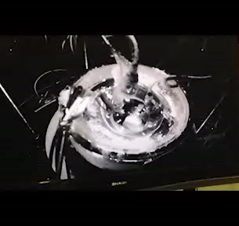
Short video
Test conditions:
Chamber pressure = 8 mb (6 torr)
Chamber temperature = -20 C
Chamber gas = CO₂

Slide 27
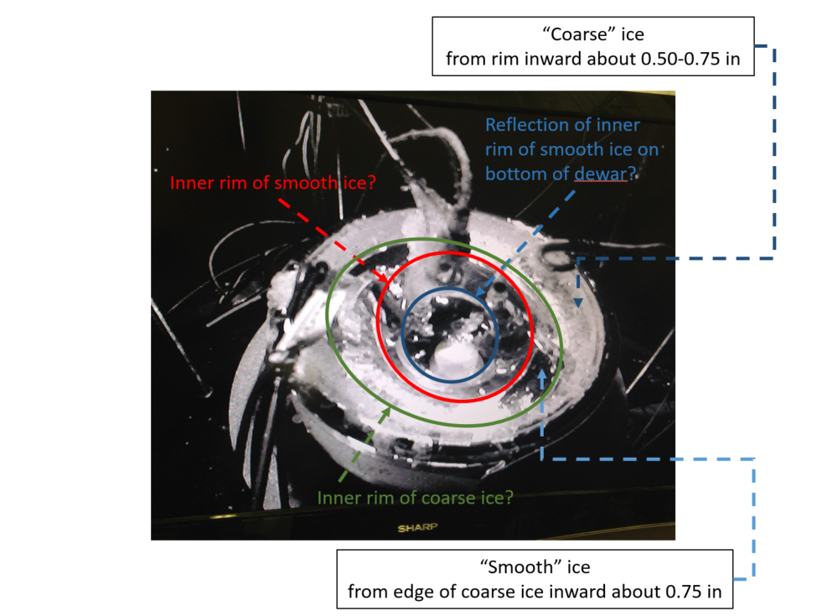
Ice and Water Formation Visible in Video

