Slide 1

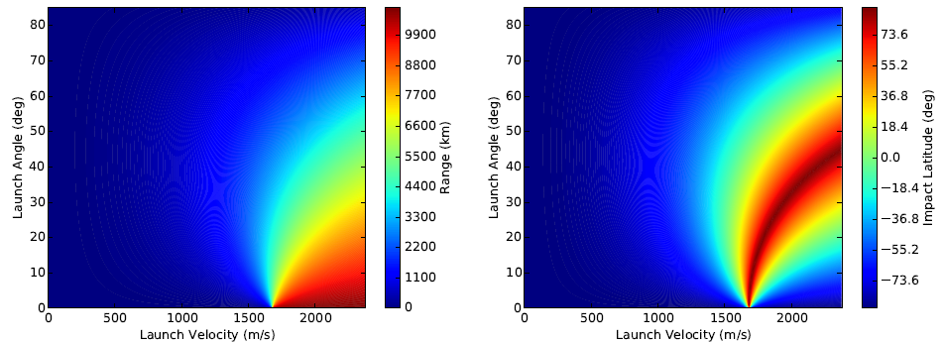
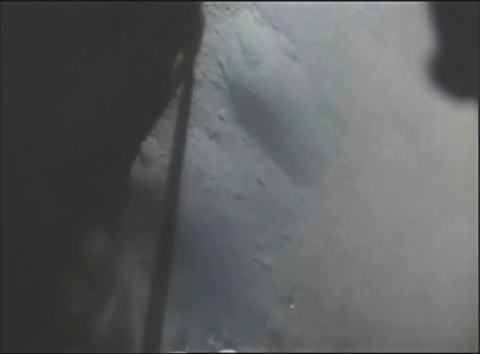
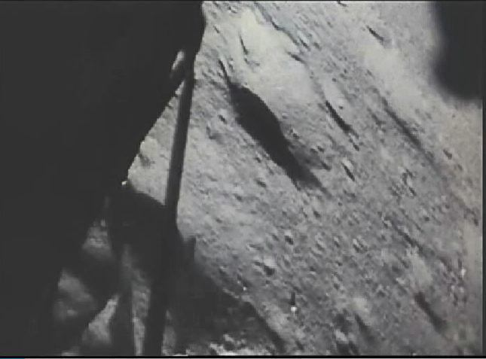
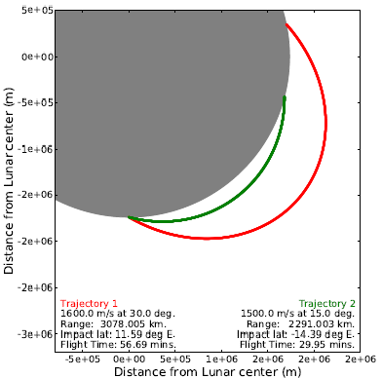
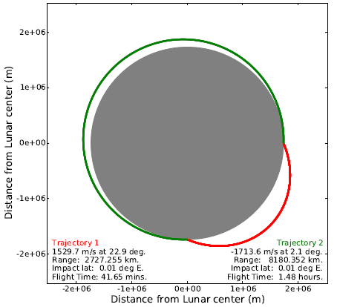
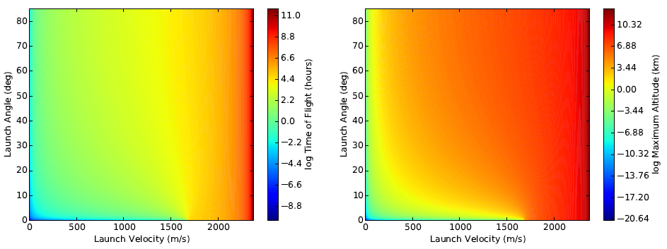
Lunar Regolith Trajectories as a Result of Plume Surface Interactions
Daniel Batcheldor¹, James Mantovani², & Matthew Wittal²
¹Southeastern Universities Research Association; ²NASA, UB-E Swamp Works, Kennedy Space Center, FL
Abstract
Methods
Lunar regolith is ejected from the impingement points of descent engine plumes. Such particles pose potential risks to surface operations, sites of scientific and historical interest, and orbiting spacecraft. Consequently, determining the resultant trajectories of these particles is necessary in order to estimate and mitigate risk. Here we present the ranges, impact latitudes, times of flight, and maximum altitudes for particles accelerated by a plume surface interaction at the lunar south pole. Using launch angles determined from observations and simulations, and for velocities <1:6 km/s, particles pose little risk. However, above 1:6 km/s the risks increase, and the results become highly sensitive to the initial angle. In addition, gravitational and non-gravitational processes will introduce perturbations to high-velocity trajectories resulting in a reduction in precision. Therefore, while local topography or artificial berms may mitigate trajectories with low initial angles, it remains important to place tight constraints on the potential launch angles of particles accelerated by plume surface interactions through simulations and experimentation. If these angles are indeed constrained to within a few degrees of the horizon, the risks posed by accelerated regolith particles at any velocity will be minimal.
Particles are given initial velocities from 1 to 2370 m/s and initial angles above the horizon from 0 to 90 degrees. The particles are then on free sub-trajectories determined solely by the lunar gravitational potential. Particles originate at determinable positions on elliptical lunar orbits each with a periapsis either less than or equal to the lunar radius. The details of the trajectories are then determined as follows:
The semi-major axis of each orbit is given by the vis-viva equation.
The ellipticities of the orbits are derived from the orbital angular momenta.
The maximum altitude is therefore the apoapsis of the orbit.
The true anomalies at the lunar radius gives the angular distance between the launch and impact points, i.e., the range and impact latitude.
The time-of-flight is then derived from the mean anomaly and the times since periapsis for the launch and impact points.
This process is then repeated for each velocity and each angle. Figure 2 demonstrates the resultant trajectories for a family of initial conditions. As can be seen, the same impact point can be reached by a clockwise (negative initial velocity) or anticlockwise orbit. However, such results are symmetrical and so only positive velocities (clockwise) are considered moving forward.
Figure 3:. Ranges [left] and latitudes [right] of lunar regolith with initial velocities and angles above the horizon. The largest changes are seen at velocities close to 1.68 km/s.
Figure 4 presents the resultant times-of-flight and maximum altitudes for all initial velocities and angles. These data contain the initial velocities and angles that would reach selected altitudes of interest, like the Lunar Reconnaissance Orbiter (LRO, perilune ~20 km) and the Lunar Gateway (perilune ~3000 km). Video analysis of the Apollo landings [8] and simulations [9,10] limit initial angles to be below 15 degrees. Consequently, to intersect with the orbit of LRO, initial angles below 15 degrees would require velocities of greater than 1 km/s, and intersections with the Lunar Gateway orbit would require velocities greater than 2 km/s.
Figure 1: Still from the Apollo 15 descent video. (Left) Before landing dust accelerated by the engine plume obscures the surface. (Right) After shutting off the descent engine the dust clears.
Introduction
Figure 2: Examples of individual trajectories given an initial velocity and angle above the horizon. [Left] Two different initial conditions resulting in two different impact sites. [Right] Two different initial conditions resulting in the same impact site. One trajectory has a negative initial velocity equivalent to an azimuthal difference of 180 degrees between the two.
Figure 3:. Times-of-flight [left] and maximum altitudes [right] of lunar regolith with initial velocities and angles above the horizon. The color bars are in a logarithmic stretch to highlight the sensitivity of the results to the initial conditions.
The lunar surface is blanketed in impact ejecta (regolith) whose size distribution averages between 60 and 80 microns [1]. Regolith has been detected above the lunar surface [2,3], attributed to natural processes [4,5], and been identified as a potential risk to human exploration of the surface [6]. It also poses a risk to surface systems already in place particularly as a result of plume surface interactions with descent engines [7] (Figure 1). It is therefore important to understand the trajectories of accelerated particulates so that the risk to human exploration, surface systems, and orbital systems can be determined. Here we present the general solution to the impact position (range, latitude), maximum altitude, and time-of-flight for particles originating from the lunar south pole at any velocity and angle, under the assumption of a singular point-mass gravitational potential and a smooth moon. This simplified approach enables the rapid determination of any trajectories that may pose a risk to surface and orbital systems, which trajectories should be mitigated through landing site location and/or construction, and potentially through the landing operations themselves.
Conclusions
Results
The point-mass gravitational potential assumption provides the precision needed to rapidly assess the risks to lunar surface and orbital assets from regolith accelerated by plume surface interactions, particularly below 1:6 km/s. Higher velocities may be less precise due to perturbations from other gravitational and non-gravitational physical processes, and the resultant ranges, impact latitudes, times-of-flight, and maximum altitudes become very sensitive. However, should further investigations demonstrate that velocities rarely exceed
1:6 km/s, and are mainly at low initial angles, then the risks posed to surface and orbital assets will be low. Such risks could be further mitigated through careful choice of landing site and in the design considerations of long-term surface facilities.
Figure 3 presents the resultant impact ranges and latitudes for all initial velocities and angles. The curvatures in the color contours demonstrate multiple solutions. The range continues to increase toward the lunar circumference as the velocity increases and the angles tend to zero. The sensitivity of the range to the initial angle when the velocity is close to 1:68 km/s is shown by the rapid change in color. The transition from two to one angle solutions is also seen at 1:68 km/s. This is also the point at which the initial velocities are high enough, and angles low enough, to give the particles a trajectory that takes them farther than the north pole and into the opposite hemisphere, i.e., the impact latitudes evolve away from 90 degrees. To impact within a few hundred meters of the launch site (e.g., the lander), the initial velocities must be greater than 1:68 km/s and the angles must be very close zero. A small variation results in an impact outside the footprint of any nearby surface systems.
This work was supported by Amentum Services, Inc. under the Kennedy Space Center Laboratory Support Services and Operations Contract – 80KSC017C0012.
References: [1] McKay et al. (1991). [2] Rennilson & Criswell (1974). [3] Glenar et al (2011). [4] Horányi et al. (2015). [5] Stubbs et al. (2006). [6] Stubbs et al. (2007). [7] Immer et al. (2011a). [8] Immer (2011b). [9] Lane & Metzger (2015). [10] Liever et al. (2012).

