Slide 1
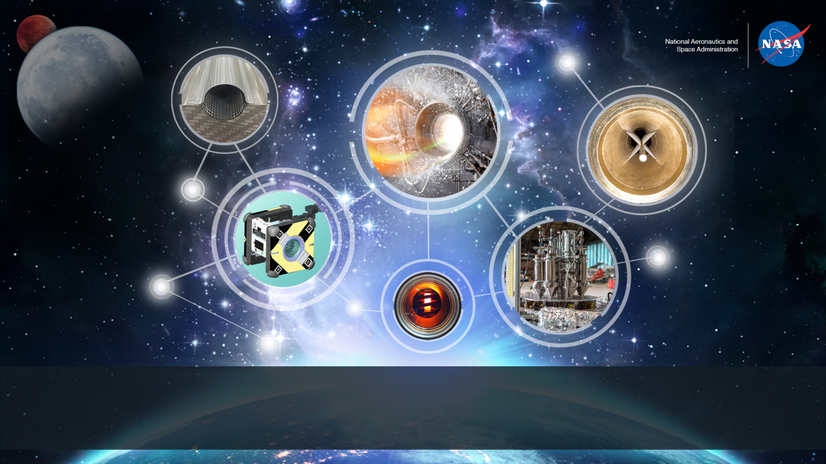
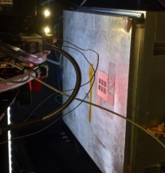
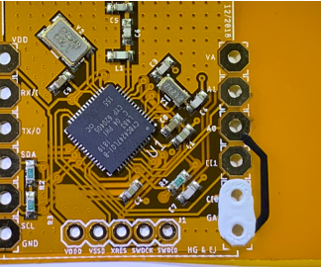
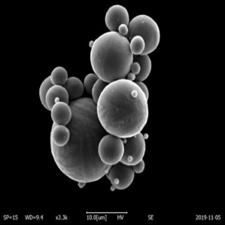
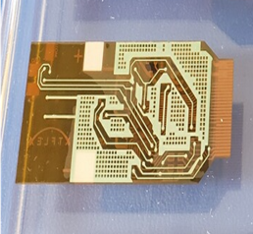
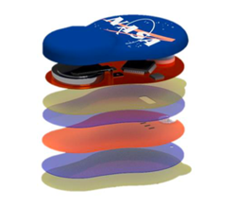
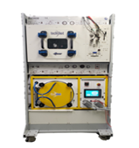
Development of Flexible Energy Storage Device for Wearable Electronics Using Polymer-based Composites
Curtis Hill, Jennifer Jones, MSFC ESSCA Jacobs
Z.-Y. Cheng, Jindong Wei, Zhen-Yu Ko, Auburn University Materials Research & Education Center

Slide 2

Outline
Introduction to the On Demand Manufacturing of Electronics Project.
Mechanism of Dielectric Materials.
Mechanism of a Coupling Agent.
Polymer-Silane All-Organic Composite
  Sample Preparation and Characterization.
  Experimental Results and Discussion.
Polymer- Ceramic Composite
  Sample Preparation and Characterization.
  Experimental Results and Discussion.
Conclusion and Future Studies.

Slide 3
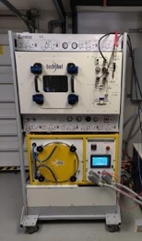
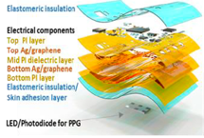
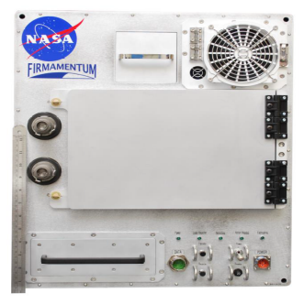
Background on In Space Manufacturing:
On Demand Manufacturing of Electronics
In Space Manufacturing portfolio provides a solution towards sustainable, flexible missions through on-demand fabrication, replacement, and recycling capabilities to support critical systems.
On Demand Manufacturing of Mechanical Parts (ODMM): Reduce logistics requirements for long-duration missions by developing 3D metal manufacturing technologies for ISS demonstration.
On Demand Manufacturing of Electronics (ODME): Development of printed electronics, sensors, and power devices for microgravity print demonstration on ISS. The planned tech demo will be a wireless wearable sensor device for crew health monitoring.
Recycling & Reuse Technology (RnR): Development of materials and recycling technologies with the goal of repurposing waste products such as packaging material and defective components.
ODME:
Multilayer thin film printed device (left);
Wireless wearable crew health sensor (right)
Techshot Multi-material fabrication laboratory (FabLab) ODMM
ISS Refabricator Demo with Tethers Unlimited, Inc.
©Jacobs 2019

Slide 4

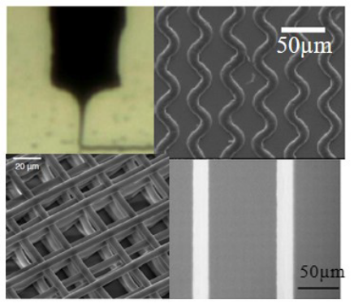
On-Demand Manufacturing of Electronics (ODME) Overview
On-Demand Printed Electronics Capability Development:
Development of Thin Film Deposition Capability in Microgravity
  The objective of the Thin Film Deposition Technology development is to evaluate alternate thin film deposition systems for the best system to print printed electronics and sensors in microgravity.
  A threshold value of a 300 microns resolution (minimum printable feature size) was chosen because this is the solution with the minimum complexity required to fabricate electronic devices in microgravity. The Project Goal is to demonstrate fabrication processes with 100 micron or better resolution. Current State-of-the-Art (SOA) of printed resolution of electronic materials is between 30 and 50 microns for analogous ground-based processes.
Development of Multilayer Technology for Microgravity
  The objective of the Multilayer Technology development is to develop materials, processes, and equipment modifications as necessary for the stacking of circuitry layers of printed electronics. This will enable a much wider range of potential applications and printed electronic capability.
  A threshold fabrication ability of a single layer printed “board” was chosen because this is the solution with the minimum complexity required to fabricate electronic devices in microgravity. The Project Goal is to demonstrate the fabrication of multi-layered electronic devices in microgravity.
Development of Validation and Verification In-Situ Capability for Flight Demo
  The objective of the Validation & Verification development is to develop test procedures, software, and hardware to effectively test function and operation of the ODME printed flight demo on ISS.
  The development of In-situ Verification is a two-year project to develop and evaluate optimum methods, hardware, and integration to the 3D printer operation, in order to effectively validate the operation of flexible hybrid electronics sensors and devices.
Electrohydrodynamic inkjet deposition for microgravity
Multilayer thin film printed device

Slide 5
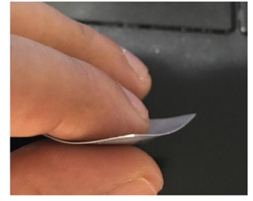
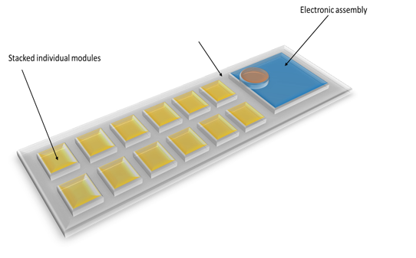
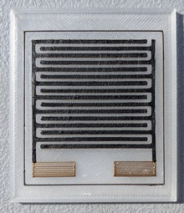
On-Demand Manufacturing of Electronics (ODME) Overview
ODME development of printed power & energy storage devices
Energy harvesting from WiFi
Biofuel Cell for harvesting of energy from human sweat
Flexible, printed supercapacitor for energy storage
Flexible, printed thermoelectric for power generation
Printed supercapacitor

Slide 6

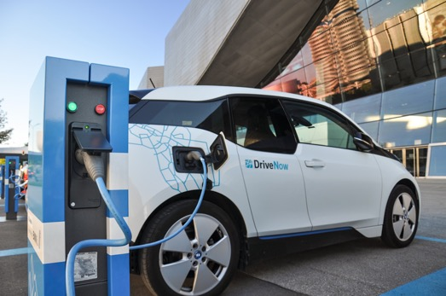
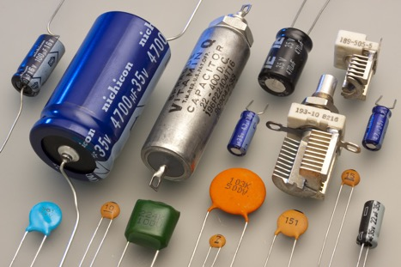
The Need for Flexible Energy Storage
High energy storage, rapid release, and small density
Low density, high dielectric constant, low loss factor, and a high dielectric breakdown strength
Polymer-Based Dielectric Composite

Slide 7
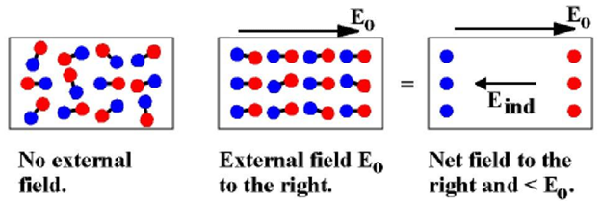
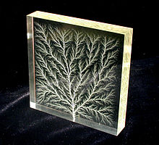
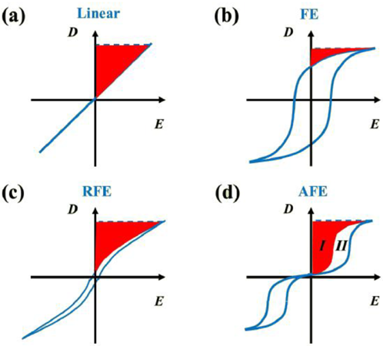
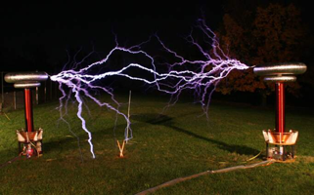
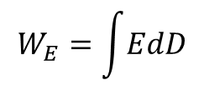

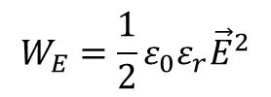
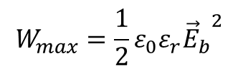
Mechanism of Dielectric Materials
For linear dielectric material:
$$\vec{D}=ε\vec{E}=ε_{0}ε_{r}\vec{E}$$
$$W_{E}=\frac{1}{2}ε_{0}ε_{r}{\vec{E}}^{2}$$
$$W_{max}=\frac{1}{2}ε_{0}ε_{r}{{\vec{E}}_{b}}^{2}$$
$$W_{E}=\int{EdD}$$
Polarization process of a dielectric material
The relationship between electric displacement, external electric field and energy storage density.
What causes dielectric breakdown?
Electronic Breakdown:
  Intrinsic Breakdown
  Electron avalanche breakdown
  Field emission breakdown
  Free volume breakdown
Thermal Breakdown:
  Steady state thermal breakdown
  Impulse thermal Breakdown
Electromechanical Breakdown
Discharge Breakdown
Discharge Energy Density
Loss Energy Density
The relationship between electric displacement, external electric field and energy storage density for (a) linear dielectrics material, (b) ferroelectrics, (c) relaxor ferroelectrics, and (d) antiferroelectric.
Notes:
In this slide, $ε_{0}$is the dielectric constant for vacuum, $ε_{r}$ is the relative dielectric constant; $\vec{E}$ is the electric field; $W_{E}$ is the energy density at $\vec{E}$; $W_{max}$ is the maximum energy density; ${\vec{E}}_{b}$ is the breakdown strength for the material.
This slide showed if we want to make a dielectric material with higher energy density, the higher dielectric constant and a higher dielectric breakdown strength are needed.
4 main mechanisms can be used to illustrate the dielectric breakdown process. However, which mechanism plays a main role in one specific dielectric breakdown process was difficult to determine.
For polymer-based dielectric material, the relationship between free volume and dielectric breakdown process has been studied a lot. The result was used to illustrate the temperature dependence of dielectric breakdown strength and worked very well.

Slide 8
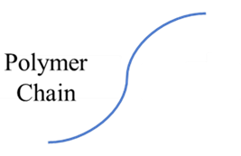
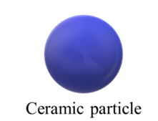
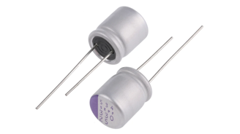
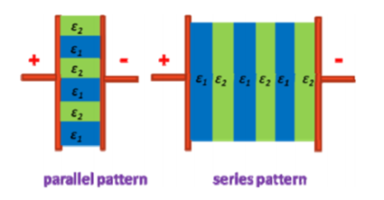
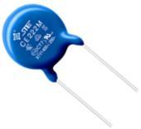
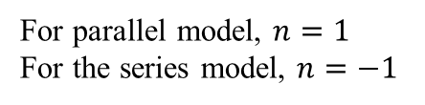


Mechanism of Dielectric Materials:
Dielectric Composite
For polymer-based dielectric material:
With increasing concentration of inorganic filler in polymer matrix:
The dielectric breakdown strength ($E_{b}$) will decrease:
Easy to Prepare
High E_{b}
Low Cost
Flexible
Low Dielectric Constant ε_{r}
High Temperature Dependence
less wettability
Less adhesion
Naturally hydrophilic
Naturally hydrophobic
Induce some free spaces (i.e., micro/nano-sized spaces/hole) to the interface!
For Ceramic-based dielectric material:
Ultra High Dielectric Constant (ε_{r})
Low Temperature Dependence
Low E_{b}
Hard to Prepare
High Cost
Brittle
The dielectric constant ($ε_{r}$) will increase:
$$ε_{eff}^{n}=φ_{1}ε_{1}^{n}+φ_{2}ε_{2}^{n}$$
For parallel model, $n=1$
For the series model, $n=−1$
The schematic for parallel and series models
(Zhang, L. I. N., & Cheng, Z-Y. Development of polymer-based 0–3 composites with high dielectric constant.)
Notes:
The reason for making a polymer-ceramic composite material:
The polymer-based dielectric material has a high dielectric breakdown strength but a low dielectric constant. The ceramic-based dielectric material has a high dielectric constant but a low dielectric breakdown strength. We want to combine the advantage from the polymer and ceramic dielectric material.
The less wettability and adhesion between the polymer matrix and inorganic filler are mainly caused by inorganic filler’s naturally hydrophilic, and the polymer matrix has naturally hydrophobic. The difference between the hydrophilic surface and the hydrophobic surface induces some free spaces (i.e., micro/nano-sized spaces/hole) to the interface between the polymer matrix and inorganic filler. It is well known the Eb of a polymer decreases with the increase of free space in the polymer because it has a very low dielectric constant and can act as a free path for charge carriers.

Slide 9
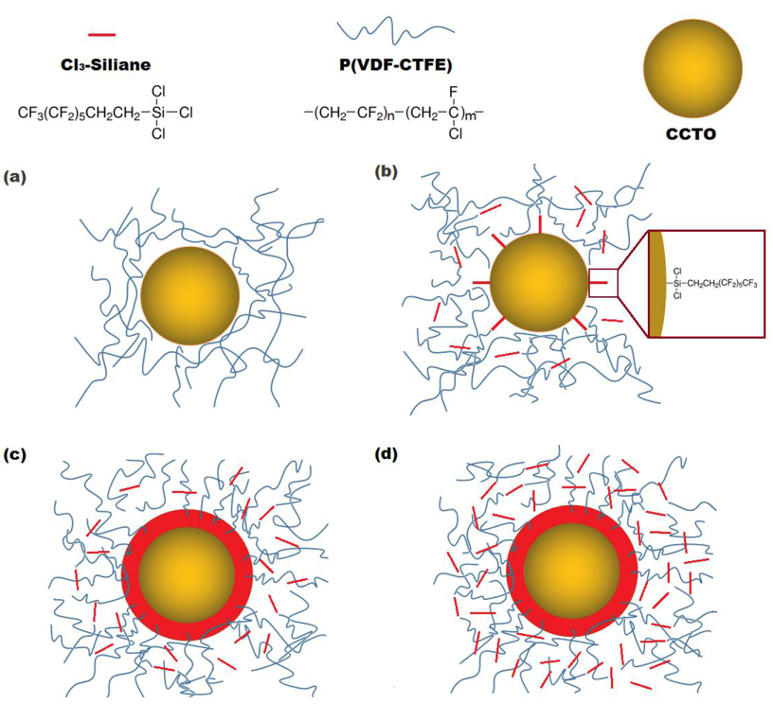

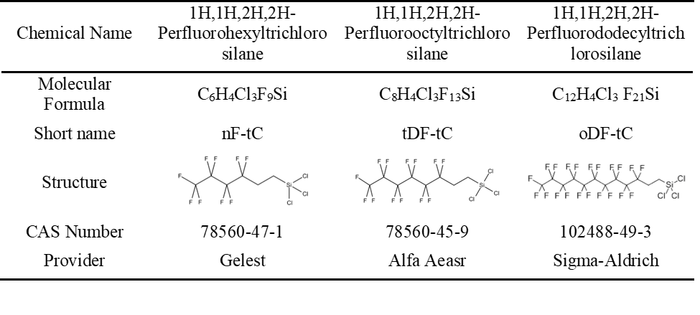
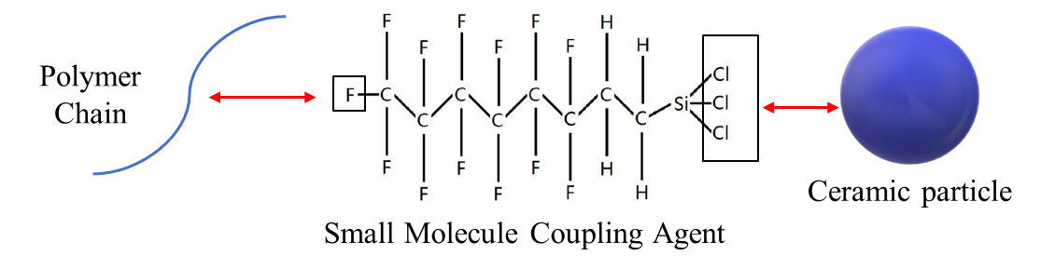
The Mechanism of Coupling Agent
Basic information of coupling agents used in the research
Schematic microstructure of the composites of CCTO, P(VDF-CTFE), and Cl₃-silane: a) no Cl₃-silane; b) the ratio of Cl₃-silane to CCTO is lower than the critical ratio; c) the ratio of Cl₃-silane to CCTO is the critical ratio; d) the ratio of Cl₃-silane to CCTO is high.
(Tong, Y., Zhang, L., Bass, P., Rolin, T. D., & Cheng, Z-Y. Influence of silane coupling agent on microstructure and properties of CCTO-P (VDF-CTFE) composites. )
Notes:
According to some recent research, the silane coupling agent can be used to modify the nanoparticle’s hydrophilic surface.
The SCA has two functional group, one can react with the inorganic filler, another one can interact with polymer chain.
According to the previous research, the silane coupling agent can escape from the interface to the polymer matrix even at a very low concentration.
The influence of coupling agent in a composite on the dielectric properties is very complicated and it should be studied.

Slide 10




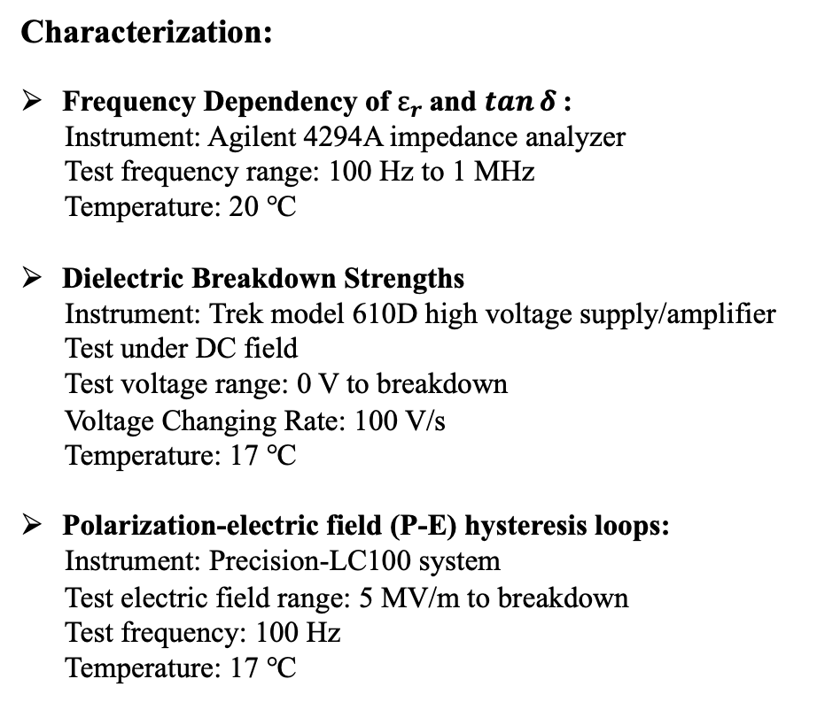
Sample Preparation and Characterization: Polymer-Coupling Agent All-Organic Composite
Sample Preparation:
Characterization:
Frequency Dependency of $ε_{r}$and $\tan{δ}$:
Instrument: Agilent 4294A impedance analyzer
Test frequency range: 100 Hz to 1 MHz
Temperature: 20 ℃
Dielectric Breakdown Strengths
Instrument: Trek model 610D high voltage supply/amplifier
Test under DC field
Test voltage range: 0 V to breakdown
Voltage Changing Rate: 100 V/s
Temperature: 17 ℃
Polarization-electric field (P-E) hysteresis loops:
Instrument: Precision-LC100 system
Test electric field range: 5 MV/m to breakdown
Test frequency: 100 Hz
Temperature: 17 ℃
Dissolve P(VDF-HFP) as the Matrix
Dissolve Coupling Agent into a Solution
Mix P(VDF-HFP) Matrix Solution and Coupling Agent Solution
70℃ Solution Casting for 12 Hours
160℃ Quench for 15 Minutes
Gold Sputter coating
Flowchart of fabrication process (Solution casting)
Notes:
The normal solution casting was used to prepare the thin film samples.

Slide 11
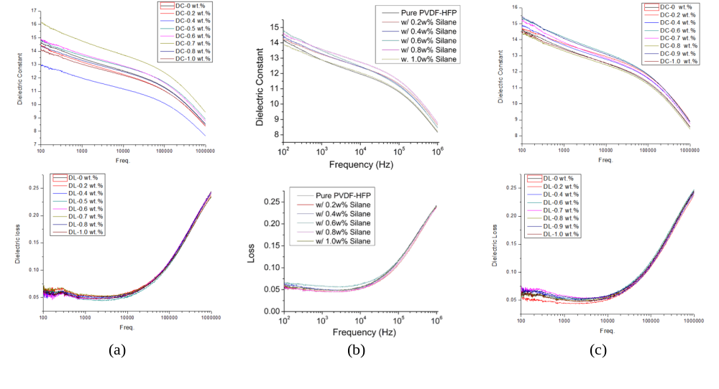
Sample Characterization:
Polymer-Coupling Agent All-Organic Composite
nF-tC
tDF-tC
oDF-tC
Frequency dependency of dielectric constant and loss with different amount of
(a) nF-tC (b) tDF-tC and (c) oDF-tC with P(VDF-HFP)

Slide 12
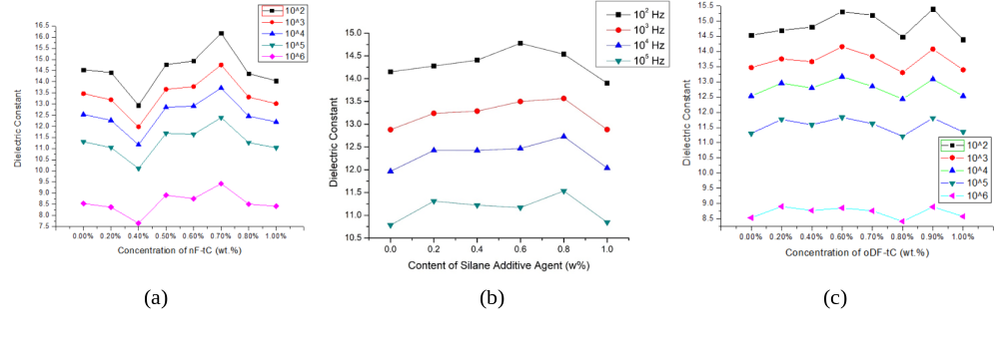
Experimental Results and Discussion:
Polymer-Coupling Agent All-Organic Composite
The improvement of the dielectric constant:
nF-tC
tDF-tC
oDF-tC
The dielectric constant and loss with different amount of
(a) nF-tC (b)tDF-tC and (c)oDF-tC with P(VDF-HFP) at certain frequency
Notes:
The red arrow showed the concentration point for maximum dielectric constant.
The silane molecules has a functional group that can interact with the polymer chain. The existence of this functional group provides a better interaction among polymer chains. One more thing should be mentioned in this part, the thickness measurement’s error does have some influences on the result of dielectric constant, and we already tried our best to avoid it. However, the error’s influences should not be neglected.
We still investigating the reason why the third figure has 2 peak.

Slide 13
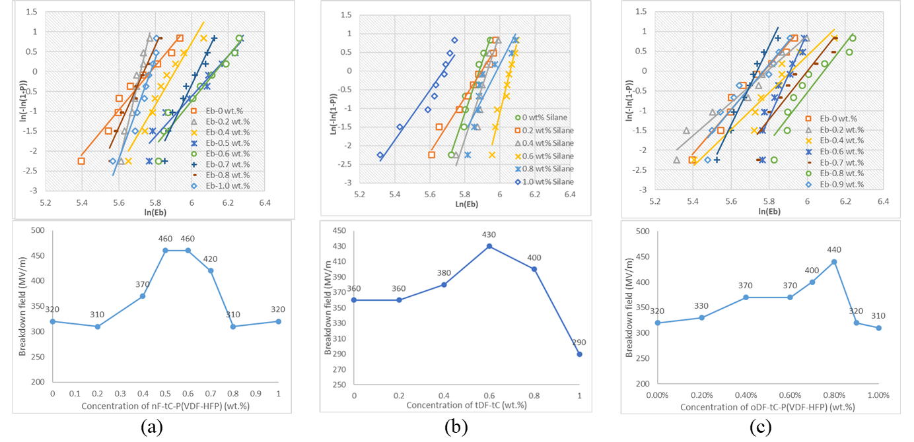
Experimental Results and Discussion:
Polymer-Coupling Agent All-Organic Composite
The improvement of dielectric breakdown strength:
nF-tC
tDF-tC
oDF-tC
Weibull distrubtion plot and dielectric breakdown strength of the P(VDF-HFP) with different amount of (a) nF-tC (b)tDF-tC and (c)oDF-tC
Notes:
The red arrow showed the concentration point for maximum dielectric breakdown strength.
Similar to the dielectric constant, with the increasing concentration of Silane Coupling Agent, the dielectric breakdown strength increased at first, and then decreased. The improvement of dielectric breakdown strength may be caused by the small silane molecule that occupied the free volume.

Slide 14
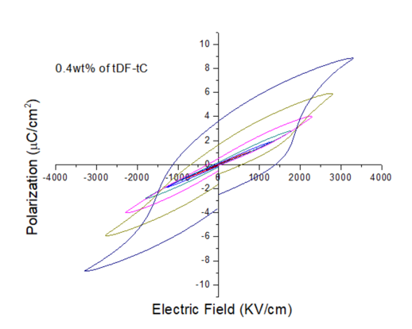
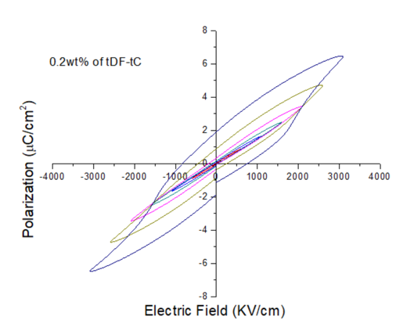
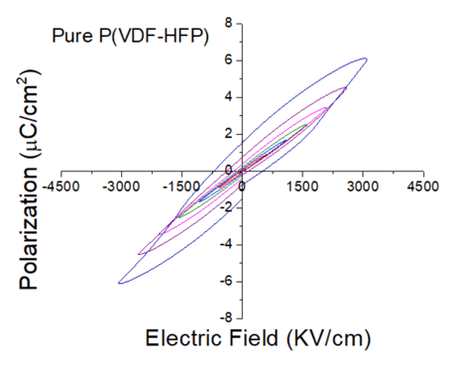
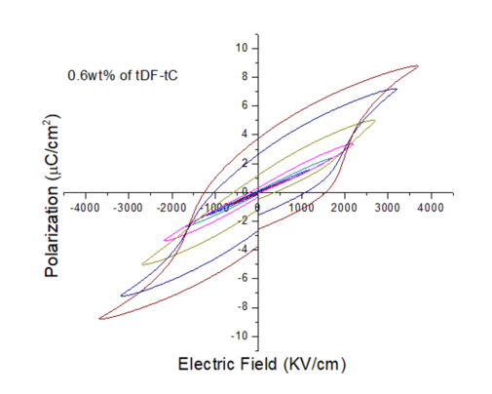
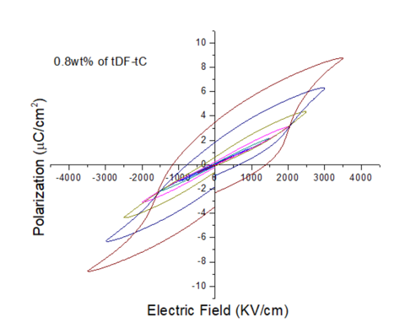
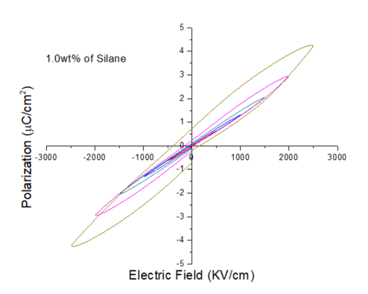
Experimental Results and Discussion:
Polymer-Coupling Agent All-Organic Composite
(a)
(b)
(c)
(d)
(e)
(f)
P-E hysteresis loops of P(VDF-HFP) at 100 Hz with different amount of coupling agent (tDF-tC) (a)Pure P(VDF-HFP), (b)0.2 wt.% tDF-tC in P(VDF-HFP), (c)0.4 wt.% tDF-tC in P(VDF-HFP), (d)0.6 wt.% tDF-tC in P(VDF-HFP), (e)0.8 wt.% tDF-tC in P(VDF-HFP), and (f) 1.0 wt.% tDF-tC in P(VDF-HFP)
Notes:
For P(VDF-HFP)-tDF-tC (silane with 6 carbon) sample, both DC and AC test can achieve the maximum electric field strength when the concentration of tDF-tC at 0.6 wt.%.

Slide 15
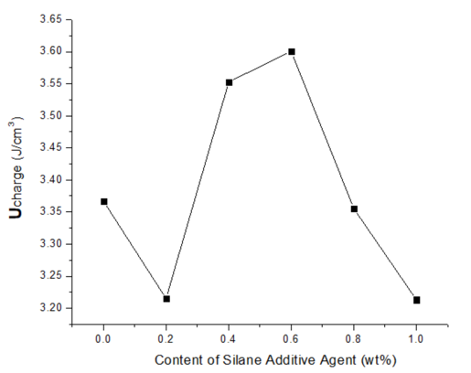
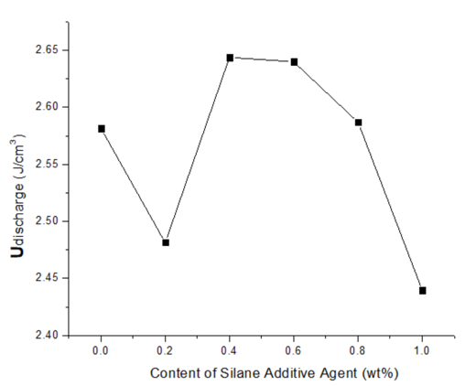
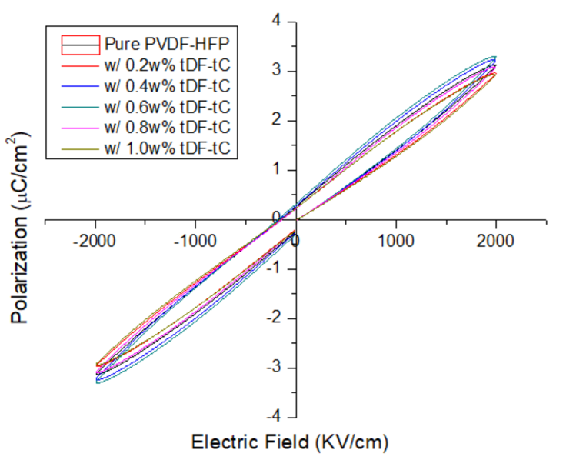
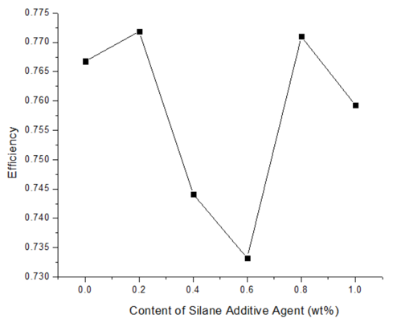
Experimental Results and Discussion:
Polymer-Coupling Agent All-Organic Composite
The improvement of energy storage density:
(a)
(b)
(c)
P-E hysteresis loops under 100 Hz of P(VDF-HFP) with different amount of tDF-tC under 2000 kV/cm
Results for (a) charge (b)discharge energy density and (c) the efficiency with different amount of tDF-tC under 2000 kV/cm
Notes:
The red arrow showed the concentration point for maximum charge/discharge energy density and the efficiency.
The improvement of energy storage density under same electric field was mainly caused by the improvement of dielectric constant. The dielectric constant is proportional to the polarization.

Slide 16
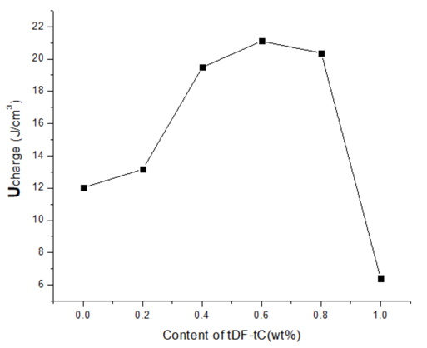
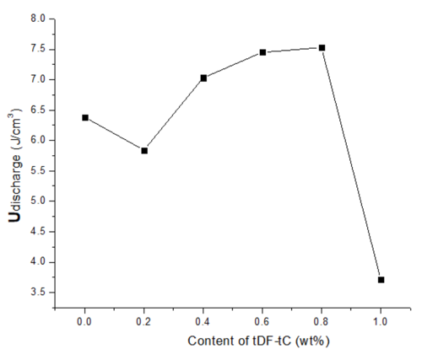
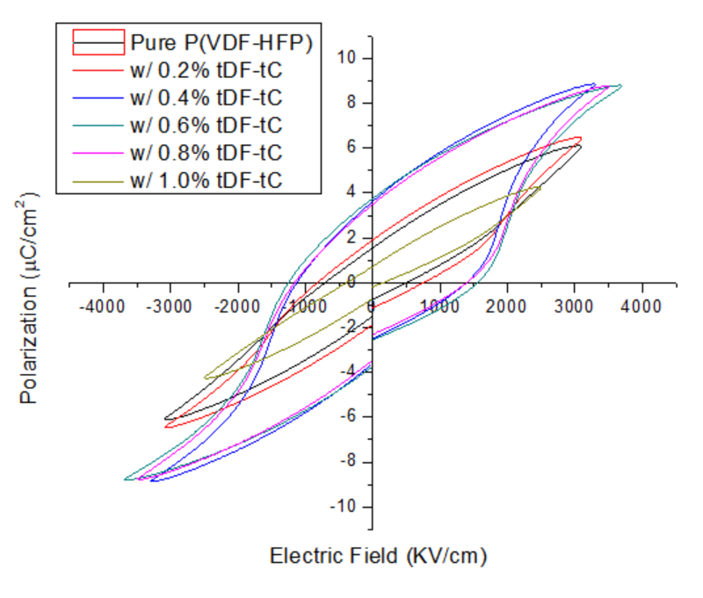
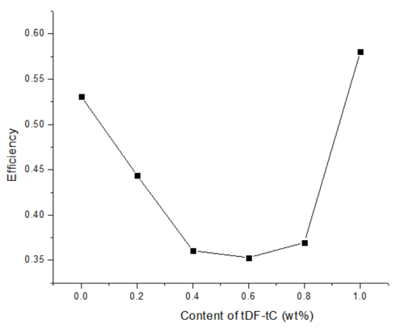
Experimental Results and Discussion:
Polymer-Coupling Agent All-Organic Composite
The improvement of energy storage density:
(b)
(a)
(c)
P-E hysteresis loops under 100 Hz of P(VDF-HFP) with different amount of tDF-tC under under maximum electric field
Results for (a) charge (b)discharge energy density and (c) the efficiency with different amount of tDF-tC under maximum electric field
Notes:
The red arrow showed the concentration point for maximum charge/discharge energy density and the efficiency.
The improvement of energy storage density under maximum electric field was mainly caused by the improvement of dielectric breakdown field. With higher dielectric breakdown field, the charge energy density increased. However, a lower discharge and efficiency might be obtained because of the energy loss during the discharging process.

Slide 17



Experimental Results and Discussion:
Polymer-Coupling Agent All-Organic Composite
(a)
(b)
(c)
The electric field dependence of (a) Charge and (b)discharge energy density and (c) The Efficiency with different amount of tDF-tC
Notes:
This slide showed adding coupling agent to the polymer matrix would improve the energy density.
The improvement of dielectric breakdown strength may be caused by the small silane molecule that occupied the free volume. When the free volume is occupied by air or vacuum, the free volume could act as a free path for charge carriers and a charge concentration point, finally, the free volume “hole” becomes a breakdown initiation point. Therefore, with more “empty” free volume in the material, lower dielectric breakdown strength was obtained. What is more, that is the reason why the polymer material’s dielectric breakdown strength showed a significant temperature dependence near the glass transition temperature.
However, when the concentration of silane is higher than a critical concentration, the silane coupling agent has become the major source of free volume, the free volume fraction increase. Therefore, the dielectric breakdown strength decreased with the increase of silane concentration after a certain concentration point.

Slide 18

Sample Preparation and Characterization:
Polymer-Ceramic Composite
Sample Preparation:
Dissolve P(VDF-HFP) as the Matrix
Make BTO-DMF Suspension
Characterization:
Frequency Dependency of $ε_{r}$and $\tan{δ}$:
Instrument: Agilent 4294A impedance analyzer
Test frequency range: 100 Hz to 1 MHz
Temperature: 20 ℃
Polarization-electric field (P-E) hysteresis loops:
Instrument: Precision-LC100 system
Test electric field range: 5 MV/m to breakdown
Test frequency: 10 Hz
Temperature: 17 ℃
Mix P(VDF-HFP) Matrix Solution and Ceramic Suspension
1 hr. Ultrasonic Treatment and 1 hr. Magnetic String, Repeat 24 times.
70℃ Spin Coating for 12 Hours
160℃ Quench for 15 Minutes
Gold Sputter coating
Flowchart of fabrication process (Spin coating)
Notes:
The spin coating method was used to prepared the thin film samples.

Slide 19








Experimental Results and Discussion:
Polymer-Ceramic Composite
The improvement of dielectric constant:
(a)
(b)
(a)
(b)
(c)
(d)
(c)
(d)
The Frequency dependency [(a), (b)], and concentration dependency[(c), (d)] of dielectric constant [(a),(c)], and loss [(b) and (d)]with different amount of milled BTO (From 0 wt.% to 30 wt.% )
The Frequency dependency [(a), (b)], and concentration dependency[(c), (d)] of dielectric constant [(a),(c)], and loss [(b) and (d)]with different amount of milled BTO (From 0 wt.% to 4 wt.% )
Notes:
Overall, both the dielectric constant and dielectric loss would increase with the increase of BTO concentration.
However, for the low concentration part (right part), the 2 wt.% sample showed a small peak in dielectric constant and a lower dielectric loss at relative high frequency. We are still investigating the reason behind this phenomena, but we believe it should have a similar mechanism with the polymer-silane all organic composite we mentioned earlier.

Slide 20





Experimental Results and Discussion:
Polymer-Ceramic Composite
The improvement of energy storage density:
(a)
(a)
(b)
(b)
(c)
P-E hysteresis loops under 10 Hz of P(VDF-HFP) with different amount of BTO (From 0 wt.% to 30 wt.% ) under (a) 50MV/m and (b) maximum electric field before breakdown
Results for (a) Charge and discharge energy density and (b) The Efficiency, and (c) Maximum electric field applied on the sample with different amount of BTO (From 0 wt.% to 30 wt.% ) under 500 kV/cm (50 MV/m)
Notes:
For high filler concentration composite, the charging and discharging energy storage density increased with the increase of concentration of BTO, the improvement was caused by the improvement of dielectric constant.
The dielectric breakdown strength decreased with the increase of concentration of BTO.

Slide 21





Experimental Results and Discussion:
Polymer-Ceramic Composite
The improvement of energy storage density:
(a)
(a)
(b)
(b)
(c)
P-E hysteresis loops under 10 Hz of P(VDF-HFP) with different amount of BTO (From 0 wt.% to 4 wt.% ) under (a) 50MV/m and (b) maximum electric field before breakdown
Results for (a) Charge and discharge energy density and (b) The Efficiency, and (c) Maximum electric field applied on the sample with different amount of BTO (From 0 wt.% to 4 wt.% ) under 500 kV/cm (50 MV/m)
Notes:
The red arrow showed the concentration point for 0.2 wt.% of BTO.
Based on the figure, 0.2 wt.% of BTO point shows some wired phenomenon including a lower charging/discharging energy density, high energy releasing efficiency and a higher breakdown strength. Similar with the dielectric constant, we are still investigating the reason behind this phenomena, but we believe it should have a similar mechanism with the polymer-silane all organic composite we mentioned earlier.

Slide 22


Experimental Results and Discussion:
Polymer-Ceramic Composite
(a)
(b)
The electric field dependence of (a) Charge and discharge energy density and (b) The Efficiency of P(VDF-HFP) with 2 wt.% of BTO

Slide 23
Conclusions
This study shows a novel way to improve a polymer’s dielectric breakdown strength by adding a silane coupling agent. All three silane coupling agents which were used in this study have a significant influence on the dielectric property and dielectric breakdown strength.
For the fabrication of a polymer-based composite, this research also showed the importance of precisely controlling the amount of silane molecules in the polymer matrix.
In this study, the polymer we studied is P(VDF-HFP), and this polymer itself has a large number of dipoles and high electronegativity Carbon-Fluoride bonds. It is not clear if a similar structure in the silane coupling agent and the polymer chain has an antagonism and synergy effect.
For the polymer-based composite, with the increasing amount of the ceramic filler, both the dielectric constant and loss will increase, and the dielectric breakdown strength will decrease. Adding coupling agents may be a promising way to improve polymer-based composite dielectric breakdown strength.

Slide 24
Future work
Some linear dielectric polymers (like PMMA) will be studied for the Polymer-Silane Coupling Agent system.
The Silane Coupling Agent’s influence on Polymer-Ceramic composites will be studied .
Our samples will be more thoroughly characterized by evaluation of temperature dependence of dielectric property, and with DSC, DMA, SEM, and XRD.
The mechanical properties of materials made of the polymer-coupling agent all-organic composite and polymer-ceramic composite will be tested.

Slide 25
Thanks for your attention!
Any questions?

