Slide 1


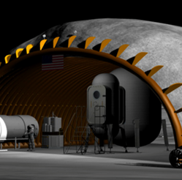
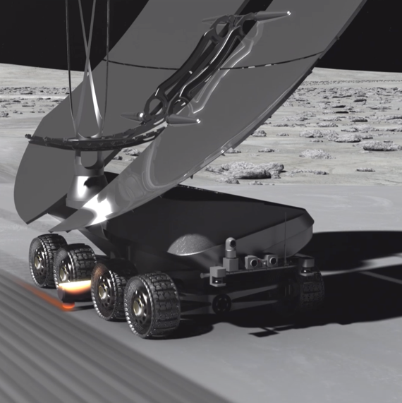

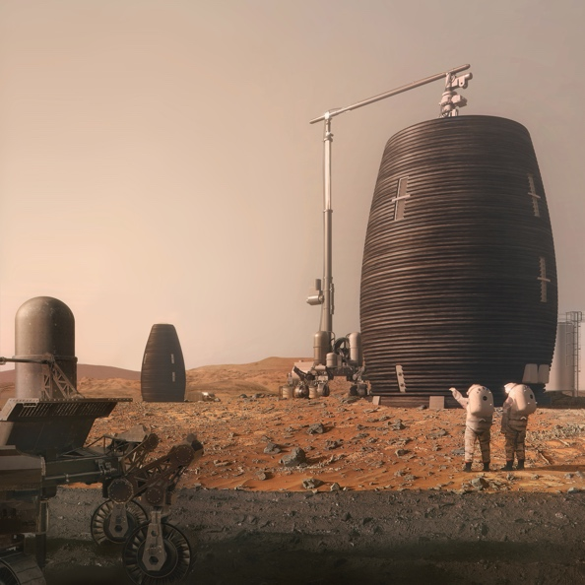
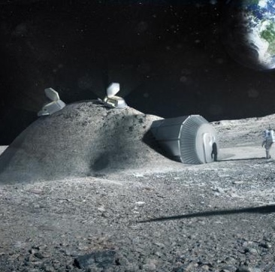
Image credits: NASA
Lunar Safe Haven Seedling Study
Overview of Study Progress for PTMSS/SRR
Melanie Grande, Dr. Bob Moses | Lunar Safe Haven Seedling Study | 06.11.2021
Notes:
Seedling Study Overview…..2 mins
Level Zero Requirements…..3 mins
Decision Analysis Structure…..5 mins
Concept Design Options…..5 mins
TOTAL = 15 mins

Slide 2

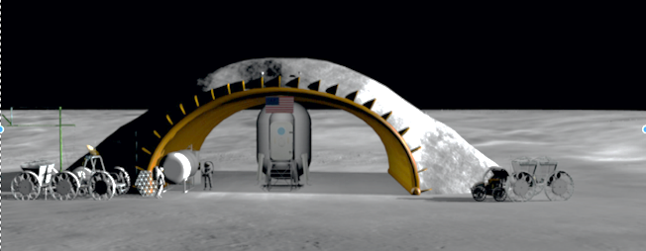
Lunar Safe Haven (LSH) Seedling Study - Overview
Background
In order to enable sustainable presence (~10 years) on the Moon, we must provide better protection for crew and surface systems from radiation, thermal extremes, and micrometeoroids (MM)
The Lunar Safe Haven Seedling Study has examined NASA activities in site preparation, excavation, regolith transfer, surface construction/assembly/deployment, autonomy, robotic servicing/repair, advanced manufacturing, and in situ resource utilization (ISRU) for identifying the best approaches for implementing a safe haven shelter
With recent technology advancements in these content areas, it is “reasonably achievable” to provide significant protection from the harsh lunar environment using ISRU and autonomous robotics
STMD and HEOMD have declared a large number of capability gaps (such as TX6 06-38 Radiation Shielding, TX12 12-07 Construction of Unpressurized Structure for Protection) that map to the content areas of the LSH Study, and which LSH team is capable of contributing to for gap closure
Approach
Multi-center team (LaRC, MSFC, and KSC) working on a one-year (FY21) effort sponsored by STMD Game Changing Developments
Data has been collected from other NASA projects, OGA’s, industry, and academia on concept options and state of technology maturity
Image credits: NASA

Slide 3
Level Zero Requirements
Level Zero Requirements were developed by the LSH team to be synergistic with the NASA Artemis Plan and guide the trade study from a high level
The LZRs cover several key principles, including:
  Protection is needed for crew and surface systems from radiation, micrometeoroid strikes, and the thermal environment on the lunar surface
  ISRU-based design is needed due to large amount of mass and volume needed for protection
  Construction/assembly of a shelter needs to leverage as much as possible existing or near-term planned systems to support the activity in the late 2020s/early 2030s
  NASA’s Artemis program will set other requirements such as available landers, integration with habitat systems, and technology demonstration missions

Slide 4
Decision Analysis Approach
Decision Statement:
  What system(s) should be manifested in the Artemis campaign as part of a continuous mitigation strategy that will protect crew and systems on the lunar surface from the harsh lunar environment (e.g. radiation, thermal extremes, and micrometeoroids) during sustained missions?
Identification of Objectives:
Definition: Defines what the stakeholders hope to achieve in meeting the goal
Method: Group generation and down selection
Attribute Selection:
Definition: Measure that enables trade-offs between achieving relatively more or less on a given objective
Method: Focus groups breakout with subsequent group review. Attributes mapped to crosscutting objectives

Slide 5
List of objectives
Environmental
A1. Minimize radiation exposure to crew.
A2. Maximize energy absorption capability of the shelter from impacts for crew and other exploration systems, including impacts from micrometeoroids, the movements of external assets (e.g., mobility systems), and any resulting ejecta.
A3. Minimize accumulation of dust (fine and coarse) on LSHC establishment and operations systems.
Operational
B1. Maximize use of indigenous materials in construction and operation.
B2. Minimize need for crew involvement during establishment and sustained operations of the LSHC.
B3. Maximize evolvability of the LSH establishment and operations concept.
B4. Balance resiliency and robustness of LSH concept as a whole.
B5. Maximizes available storage for exploration systems, science equipment, consumables, and contingency spares.
Programmatic
C1. Minimize investment costs.
C2. Maximize Mars extensibility.

Slide 6
Current List of LSH Attributes
Some Attributes are cross-cutting because they are directly/indirectly relevant to multiple Objectives! For this activity/presentation, individual Objective POCs are managing the Attribute definitions.
LSH Attributes | Mapped Objectives (Draft)
Effective dose to crew from background | A1
Acute dose to crew during SPEs | A1
Shielding Extensibility and Flexibility | A1, B3
Micrometeoroid (MM) Impact Protection Probability | A2, B4
Sensitivity of Damage Detection | A2, B4
Protection against impact from external assets | A2, B4
Architectural Dust Mitigation | A3
Lunar Surface System Mass Reduction | B1, A1, A2, B3
Risk Reduction of an ISRU-based Design | B1, B4
Maintenance Need | B2
Training Need | B2
Degree of Autonomy | B2, B4
Crew Situational Awareness | B2
Spatial Involvement | B2
LSH Attributes cont’d | Mapped Objectives (Draft)
Evolvability Composite Score | B3, A1, B1
Fault/Degradation Identification | B4, A2, A3, B1
Resiliency | B4, A2, A3, B1
Complexity | B4, A2, A3, B1
Long Term Utility | B5, B3
Space Management | B5
Vertical Utilization | B5
Environmental Controllability | B5
Total Architecture System Investment | All objectives (in particular, C1)
Technology Maturation Investment | All objectives (in particular, C1)
Regolith as a Shielding Material | C2, A1, B1
Autonomous Emplacement | C2, B2, B4
Scalability for Mars | C2

Slide 7
Attributes – Objective A1
0, 2, 4 are available intermediate values
Objective A1: Minimize radiation exposure to crew.
POC: Erin Hayward
Decision Attributes
Measurement Guidance
1. Effective background dose to crew
  Galactic Cosmic Rays (GCRs) are a constant background source of high energy particles that are difficult to shield from. Additionally, interactions with GCRs in regolith and shielding materials create secondary particles.
  Career dose limits for crew are currently based on 95% confidence interval of <3% REID (risk of exposure induced death). REID is calculated from particle flux spectra at various locations in the body and accounts for crew age/gender; effective dose is a proxy for REID that is simpler to calculate to compare relative benefits of different shielding concepts.
  The LSHC should minimize the contribution to career dose from background radiation, enabling longer stays on the moon, and more trips into space per
  astronaut.
For more developed concepts, a modeling tool such as OLTARIS can be used to estimate crew effective dose (inputs: ray trace of CAD model and design reference environment). For early-stage concept comparison, shielding effectiveness can be judged on slab geometry models with material composition and thickness as inputs.
Consider:
How much incoming primary radiation does LSHC block?
How much in situ generated radiation (neutrons in regolith) does LSHC prevent from being created?
How much secondary scatter radiation does the shelter concept generate simply by existing?
Units: Sv (Sieverts), on a yearly basis.
2. Acute dose to crew during SPEs
  Solar particle events (SPEs) are intense events that can cause acute radiation symptoms if crew is not protected. The LSHC should minimize the dose to crew during these events.
  A “storm shelter” design may be appropriate, where the entire structure is not required to provide this level of shielding.
As in #1, calculate dose using a modeling tool such as OLTARIS. The design reference environment is based on the proton spectra from the October 1989 event series. SC: Total gray equivalent to crew blood forming organs (BFO) must be less than 250 mGy-Eq.
Units: Gy-Eq (Gray Equivalent), on a per event basis. Gy-Eq considers the ability of different particles to cause deterministic effects, like acute radiation syndrome.
Notes:
Quantitative example!

Slide 8
Attributes – Objective C2 Mars Extensibility
0, 2, 4 are available intermediate values
Objective C2: Mars Extensibility of the Lunar Safe Haven Concept
POC: Bob Moses
Decision Attributes
Measurement Guidance
1. Regolith as a Shielding Material
  Using “as is”, lunar and Mars regolith provide similar shielding properties
  Elements within Lunar and Mars regolith are substantially different in terms of grain, toxicity, types of materials
  Processing to extract specific “concentrate” can be quite different depending on the selected elements sought (for additive construction and manufacturing)
This attribute should be ranked on a scale from 0 to 5, for example:
5 – Strong Extensibility if used “as is”
3 – Moderate alignment if “water from regolith” is preferred
1 – Limited alignment if high-Z materials are to be removed from regolith
2. Autonomous Emplacement
Comms Latency between Earth and Mars is far greater than between Earth and its Moon
Teleoperations and supervised autonomy of surface equipment is similar if conducted by crew in orbit above respective surface
This attribute should be ranked on a scale from 0 to 5, for example:
5 – Strong Extensibility if “Mars latency can be rehearsed on the Moon”
3 – Moderate alignment if “supervised autonomy from orbit is preferred”
1 – Limited alignment if Mars concepts of operations are not factored into lunar architecture, especially during technology downselect or upgrades
3. Scalability for Mars
EDL capabilities for Landing on the Moon are different than landing on Mars
Some power systems on the Moon do not translate well to use on Mars
Abundance of resources are quite different with Mars offering more opportunities
Environments are different
Concepts of operations may vary depending on whether the Moon or on Mars
This attribute should be ranked on a scale from 0 to 5, for example:
5 – Strong Extensibility is possible if Mars cases are weighted equal to lunar scenarios during Pre-Phase A decisions
3 – Moderate alignment is possible if capability and technology gaps are identified early
1 – Limited alignment is consequential if interdependencies illustrated in the concept of operations are not factored holistically into all mission phases
Notes:
Qualitative example!

Slide 9
Concept Generation using Morphological Matrices
During brainstorming, the LSH team created three morphological matrices for each system group with a large number of alternatives
  System groups: Shelter Physical Design, Establishment Systems, Sustained Operations Systems
Narrowed down the possible combinations to 17 concept alternatives
Each concept will be evaluated based on identified decision attributes to quantify how well each concept satisfies the main objectives
  Ultimately 1-2 concepts will be down-selected based on attribute scores
Morphological Matrix using Function Decomposition method:
  One function per row
  Brainstorm to put one alternative for “means to achieve the function” per column
Morphological Matrix – Establishment Systems
Transport LSH systems | Idea 1 | Idea 2 | Idea 3
Survey the location | Idea 1 | Idea 2 | Idea 3 | Idea 4
Emplace, assemble, and/or construct the LSHC shelter | Idea 1 | Idea 2
…

Slide 10
Shelter Morphology – Key Alternatives to Trade
Function/Parameter
Shielding Material
Main Structure Material
Shelter Shape
Inner Structure from Earth
NOTE 1:
Several additional alternatives were generated during brainstorming, but the alternatives shown here represent an initial down-select by the team. A limited number of alternatives can be evaluated during the one-year study.
Regolith
Level with Grade
Regolith + Binder
Inner Structure from Repurposed Lander
Rectangular Top-view
Alternatives
Whipple + Regolith
Inflatable
Half Cylinder Plan-view
Water/Ice
Regolith-derived
Open on Both Ends
Material Processing
Main Structure Construction
Dust Mitigation
NOTE 2:
Alternatives under each function must be selected in combination with alternatives that are feasible under other functions. Not all combinations are feasible.
None (Bulk “as is”) vs. Sorted/Separated
Deployable/Assembly
Stabilized/bound regolith
Cement/bricks (non-hydrated mixture)
Deployable/Inflate
Interior & Some Exterior Pads
Some sintering
3D Print in Place
Electrostatic neutralization
Shielding Construction
Shelter Size
Thermal Management
Bag / Transfer / Crane and/or Bulldoze
Accommodates Habitat
Regolith Insulation
3D Print
Includes Garage & Stowage
Sunshades

Slide 11
Establishment Systems Morphology – Key Alternatives to Trade
Transport Systems
LSH Site Preparation
Emplace, Assemble, Construct Shelter
Utilities Access
Use Existing Infrastructure
RASSOR for excavation
LSMS for regolith transfer, construction, cargo transfer
Power
Self-Contained
LSMS for regolith transfer
LTV copy to assemble or other construction
Communications
(Cooperative/Auton.) Mobile Agents
Compactor/ Roller to rough compact
Regolith 3D printing system
Dust Mitigation
LSH Site Location Determination
LTV copy to assemble or other construction
Robotics to deploy/assemble parts from Earth
Thermal Control
Auton. With Ground Beacons + Satellite
Auton. Vs Crew Assisted
Auton. Vs Crew Assisted
Crew Assisted
LSH Site Survey
Imaging from Orbit
Mobile Soil Assays
Crew Assisted

Slide 12
Sustained Operations Systems Morphology – Key Alternatives to Trade
Maintain Successful Nominal Ops
Power Distribution
Thermal Management
Sensor network monitored via automation
Rovers drive to power source when needed
Regolith Insulation
LTV 2 copy with sensors and imaging equipment
Recharging wireless to avoid dust contamination
Sunshades
Crew performs diagnostics and inspections
Power stowage onboard, batteries
Manage Waste & Trash
Comm. & Data
Stage, sort, separate waste for reuse
Network communication connected to Artemis base
Convert waste to manufacturing feedstocks
Dust Management
Monitor Lunar Environment
Dependent on systems used
Continuous sensor array to monitor conditions
Plasma Dust Lofting
Piezoelectric technique

Slide 13
Summary of Alternatives
17 total generated concepts
Alternative 1.1-1.6 - Change Shelter Protection Material
  Example: regolith, regolith and binder, Whipple shield design, etc.
Alternative 2.1-2.3 – Change Shelter Structure Material
  Example: Inner metal structure, inflatable beams, regolith, etc.
Alternative 3.1-3.2 – Change Shelter Size and Dimensions
  Example: Accommodates all crew, multiple shelters, etc.
Alternative 4.1-4.2 – Change Equipment Used
  Example: LSMS, LTV 2 copy, backhoe, etc.
Alternative 5.1-5.2 – Change How to Maintain Successful Operation of the LSH
  Example: Combination of crew inspection with sensors, crew performs diagnostics, etc.
Alternative 6.1-6.2 – Change Degree of Autonomy
  Example: fully autonomous, semi-autonomous navigation, etc.

Slide 14




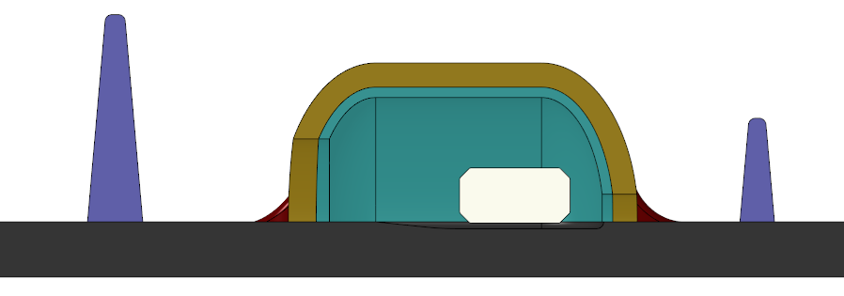

Sample Conceptual Design of Lunar Safe Haven
Physical Shelter Design
Autonomy for Construction and Maintenance
Notional
Large entrance Radiation Block
Rigidized Regolith Layer
Bulk Loose Regolith Layer
Beacon Placement Locations at Lunar Pad Construction Worksite
Habitat
Habitat
Various levels of autonomy balance human-in-the-loop with fully autonomous solutions that determine task planning, best path, etc.
Establishment Systems
2
Rocks from cleared sites form base
Vertical Element
Construction
3
Berms
Shielding
Vertical Element
Construction
Connections to External Services
1
Excavate & trenching (previously shown)
2
2
Structural (vertical element) construction (not shown – requires other systems currently not shown)
1
3
Transfer bulk regolith & bury support (“roof”) structure
Notes:
Autonomy options:
Example = Systems that do the deploying/placing/establishment of the Location Determination Reference Systems
Fully autonomous solution that determines best location for beacons and places them.
(3) + autonomously provide decision support and offer possibilities to be selected by humans.
Scripted/selected locations and actions, determined by humans, and robotic agent autonomously places the sensor/object.

Slide 15
Conclusion
The Lunar Safe Haven concept represents a game-changing idea to protect crew and systems on the lunar surface over long durations
The LSH team has been performing a trade study that leverages recent technology development to make high levels of protection reasonably achievable
Next steps:
  Continued refinement of the LSH concepts
  Evaluation using the Decision Attributes
  Down-select “top” concepts and define path forward for technology development needs

Slide 16
Back-Up

Slide 17
Level Zero Requirements (1/2)
The Lunar Safe Haven Concept (LSHC) shall shield crew, electronics (such as computers providing command and control of autonomous systems), and other exploration and habitation systems that require radiation shielding as defined by HEOMD for at least 10 (TBR) years without exceeding the proxy dose limits for crew and electronics. [Functional]
The LSHC shall protect crew, electronics, and other exploration and habitation systems that require protection as defined by HEOMD from the hazards of the lunar environment—including but not limited to micrometeoroid impacts, thermal loads, seismic activity, electrical charging, dust, vacuum, and the sun—for at least 10 (TBR) years. [Functional]
The LSHC shall protect crew, electronics, and other exploration and habitation systems that require protection as defined by HEOMD from the impacts and damage from other external assets that could cause collisions or ejecta for at least 10 (TBR) years. [Functional]
The LSHC shall not negatively impact the crew performance, habitability, and safety requirements derived from NASA-3001 for crew—as defined in HSI requirements documents of the lunar exploration systems to be used by HEOMD—and for proximal EVA. [Technical]
Note: 10 years operational duration will include any maintenance/repair.

Slide 18
Level Zero Requirements (2/2)
The LSHC shall not negatively impact functionality nor negatively impact deployment and placement of heritage exploration habitation systems selected by HEOMD that require protection and shielding. [Technical]
The LSH concept shall utilize in situ resources, including both natural and repurposed resources. [Technical]
The LSH concept shall identify and define the surface equipment concepts necessary to emplace, assemble, and/or construct the safe haven shelter. [Programmatic]
The technologies included in the LSH concept shall be ready to be deployed and operational on the lunar surface by 2030 (TBR), according to HEOMD. [Programmatic]
The Lunar Safe Haven shall be compatible with NASA's lunar lander systems to be selected by HEOMD. [Programmatic]
Note: L-0 Req. #5 was written with the intent to rule out any concepts that would expose habitats directly to regolith, such as by burying.

Slide 19
Functional Decomposition – Shelter (As of 2/23)
The Lunar Safe Haven Concept (LSHC) will consist collectively of: (A) a shelter, (B) systems to establish the shelter (whether via emplacement, assembly, construction, and/or manufacturing), and (C) systems to perform and maintain general operations of the shelter.
(A) The functions of the LSHC shelter must be to:
  Store the crew and some amount of electronics and other exploration and habitation systems, including:
    Allow shipping and receiving (in and out)
  Protect from radiation for at least 10 years without exceeding the proxy dose limits for crew and electronics, including: [Mapped to L-0 Req. 1]
    Protect the crew
    Protect some amount of electronics and other exploration systems
  Protect from the hazards of the lunar environment—including but not limited to micrometeoroid impacts, thermal loads, seismic activity, electrical charging, dust, vacuum, and the sun—for at least 10 (TBR) years, including: [Mapped to L-0 Req. 2]
    Protect the crew
    Protect some amount of electronics and other exploration systems
  Protect from the impacts and damage from other external assets that could cause collisions or ejecta for at least 10 (TBR) years, including: [Mapped to L-0 Req. 3]
    Protect the crew
    Protect some amount of electronics and other exploration systems
In addition, options for the shelter might include:
  Provide a protected area for servicing systems
  Manage/remove lunar dust for individual LSHC systems (not Artemis systems inside the shelter), including:
    Coarsely remove dust
    Finely remove dust

Slide 20
Functional Decomposition – Establishment Systems (As of 2/23)
According to Level Zero Requirement 7, the LSHC shall identify the concepts needed to emplace, assemble, and/or construct the LSHC shelter on the lunar surface. Collectively, the systems that will be identified in the emplacement/assembly/construction trade space will be known as the “LSHC establishment systems”. The list below represents the functions of the establishment systems that might be included—but are not required—to satisfy Level Zero Requirement 7.
(B) The functions of the LSHC establishment systems might be to:
  Transport LSH systems from lander off-loading site to the establishment site
  Deploy Location Determination Reference Systems, including:
    Reverse-Ephemeris Satellite Suite
    Ground Beacons
  Survey the installment location, including:
    Image and characterize the site (topography, geology)
    Perform resource assessment, mapping, and analysis
    Identify mining locations
    Identify shelter location
  Prepare the site for installment of the LSHC shelter, including:
    Remove rocks
    Grade (level) the site
      Excavate high areas (and trench for subsurface structures)
      Dump regolith in depressions to create a level site and rough grade at the site
    Rough compact the site and stabilize the surface of the compacted area
    Verify compaction and grading
    Transfer bulk regolith
    Stockpile construction feedstock
  Continued:
  Emplace, assemble, and/or construct the LSHC shelter, including:
    Deploy the LSHC systems
    Accept construction materials at the installment site
    Process construction materials
    Construct shelter structure
    Install equipment
  Verify and validate the establishment of the LSHC shelter, and confirm operational readiness
  Receive distributed power from the Artemis surface power source, including:
    Connect to and accept power from the surface power source
    Do power conditioning appropriate for a given system
    Distribute the received power to LSHC systems
  Communicate and provide sufficient command and data handling with other surface systems, including:
    Manage algorithms for autonomy
    Distribute commands among agents
    Send and receive data to/from LSHC and other Artemis systems
    Connect to and accept internet from the Artemis Base Camp elements
  Manage/remove lunar dust for individual LSHC systems (not Artemis systems inside the shelter), including:
    Coarsely remove dust
    Finely remove dust
  Manage thermal control for individual LSHC systems (not Artemis systems inside the shelter)
Some functions are subsequently broken down into lower-level functions

Slide 21
Functional Decomposition – Operations Systems (As of 2/23)
According to Level Zero Requirements 1-3, the LSHC shelter shall operate for at least 10 years. Collectively, the systems that will be identified in the maintenance/repair trade space will be known as the “LSHC operations systems”. The list below represents the functions of the operations systems that might be included—but are not required—to satisfy the Level Zero Requirements 1-3.
(C) The functions of the LSHC sustained operations systems might be to:
  Maintain successful operation of the LSHC, including:
    Provide continuous health monitoring and fault identification the LSHC operations
    Provide appropriate audits to verify operational readiness during LSHC operations
    Identify anomalies during the emplacement/assembly/construction
    Fix anomalies during the emplacement/assembly/construction
    Inspect and verify that the emplacement/assembly/construction has completed successfully
    Inspect and identify anomalies during operations lasting up to TBD years
    Fix anomalies during operations
    Perform repairs of systems
    Support tool changes during repairs and operations
  Manage waste and trash, including waste from construction, maintenance, and operations (i.e., logistics wrappers and general trash).
  Monitor the lunar environment to provide information on space weather conditions, radiation, seismic activity, and other conditions relevant to protection of crew and surface systems.
  Continued:
  Receive distributed power from the Artemis surface power source
    Connect to and accept power from the surface power source
    Do power conditioning appropriate for a given system
    Distribute the received power to LSHC systems
  Communicate and provide sufficient command and data handling with other surface systems
    Manage algorithms for autonomy
    Distribute commands among agents
    Send and receive data to/from LSHC and other Artemis systems
    Connect to and accept internet from the Artemis Base Camp elements
  Manage/remove lunar dust for individual LSHC systems (not Artemis systems inside the shelter), including:
    Coarsely remove dust
    Finely remove dust
  Manage thermal control for individual LSHC systems (not Artemis systems inside the shelter)
#4-7 are the same functions as for establishment systems

Slide 22
Sample LSH Concepts – Physical Shelter Design
A concept combination is made up of at least one alternative in each row, and it includes a design (selection) for the physical shelter + establishment systems + sustained operations systems.
Parameters - SHELTER | Alternative 1 | Alternative 2 | Alternative 3
1. Shelter protection | Regolith, bulk covering | Layered polyethylene and regolith
2. Shelter structure | Inner metal structure delivered from Earth |  | Inflatable beams/form work, which could be empty or filled with water or gas, e.g. Vectran
3. Shelter size/dimensions | Accommodates all crew because big enough just for Surface Habitat (SH)
4. Shelter shape
4A. grade level | level with the grade
4B. plan profile (i.e. from aerial view) | rectangular
4C. section profile (i.e. view normal from the ground) | dome (circular, parabolic, or egg), for example: Quonset hut half cylinder, vertical arch, or geodesic dome
4D. means of ingress/egress | two open sides
4E. number of stories | single story
5. Dust management within (or under the footprint of) the shelter | Stabilized regolith (binder/epoxy mixed in) to develop floors and pathways under footprint of shelter
6. Thermal management/ protection | Thick enough regolith shielding causes controlled/ constant thermal environment Low CTE materials for shelter structure Sunshades (e.g. at door/openings)
Green cells = fixed variables
White cells = will vary between Alternatives

Slide 23
Sample LSH Concepts – Establishment Systems
Functions - ESTABLISHMENT SYSTEMS | Alternative 1 (continued) | Alternative 4 | Alternative 5
1. Transport LSH systems from lander off-loading site to establishment site | Crane with appropriate implements, such as LSMS on wheels, which can pick up cargo and transport it
1*. Degree of Autonomy | Completely autonomous
2. Prepare the site for installment of the shelter
2A. Remove rocks; Grade (level) the site; Build foundation (if needed) | RASSOR, an excavation robot used to clear area of rocks and level the site | LTV 2 (copy) with an attachment of a hoe/claw | Backhoe
2B. Rough compact the site and stabilize the surface of the compacted area | Compactor/Roller (has a smooth wheel roller to compact shallow layers of soil) | LTV 2 (copy) with an attachment of a Compactor/Roller (has a smooth wheel roller to compact shallow layers of soil)
2C. Verify compaction and grading | Verification sensors and imaging equipment built in to the Establishment rovers
2D. Transfer bulk regolith; Stockpile construction feedstock | Crane with appropriate implements, such as LSMS on wheels | LTV 2 (copy) with an attachment of a loader + dump truck-style container | Dump Truck + Loader
2*. Degree of Autonomy | Completely autonomous
3. Emplace, assemble, and/or construct the shelter
5A. Deploy the LSHC systems | Deployment of structure delivered from Earth
5B. Accept construction materials at the installment site | Dedicated area to pile up regolith
5C. Process construction materials | Use bulk regolith, remove large rocks (no additional processing? TBR)
5D. Construct/ assemble shelter structure and protection | Multiple assembly/construction agents | LTV 2 (copy) with robotic arms to do assembly, plugging stuff in, moving things around
5*. Degree of Autonomy | Completely autonomous
4. Receive distributed power from the Artemis surface power source | Rovers drive over to the surface power source when needed Wireless charging Onboard batteries for power storage
5. Manage/remove lunar dust for individual LSHC systems (not Artemis systems inside the shelter) | Combination of surface coatings to resist dust/abrasion and electrodynamic dust shield

Slide 24





Concept of Operations : WBS 4.3 – Site Preparation
Site preparation
  Rock removal
  Grading
  Stabilization/compaction
  Verify compaction
Site Preparation Examples Include:
Obstacle/Rock Clearing
Bad Material Removal
Establish Rough Grade
Grade Fill and Cut Ops
Compaction
Establish Control Points
Primary Implements of Interest for Site Prep:
  Rock Removal
  Dozer Blade
  Load Haul Dump (LHD) Excavator
  Compactor
  Regolith Stabilization
  Use Un-Pressurized Rover (UPR) for mobility (>1,000 kg cargo)
Comm. for line of sight from lander
Take rocks to future berm location
Changing Topography and Geological Information for each grid location are continuously updated in the Digital Village
2
Excavate
3
Sub-Surface
Fill
3
Fill
2
3
4
1
4
Desired Site Topography
0
Install control points and continuously assess desired states
1
Deploy Un-pressurized Rover (UPR) with implements for rock removal, load, haul, dump, grade, stabilize surface
2
Excavate high areas, load, haul (trench for subsurface structures, if desired)
3
Dump regolith in depressions, to create a level site and rough grade the site
4
Rough compact the site and stabilize the surface of the compacted area
5
Stockpile construction feedstock pile and stage required construction equipment

Slide 25
Concept of Operations : WBS 4.5 – Vertical Construction
Emplacement of shielding material overtop LSH (sub)structure
Connection of (external) services as needed (such as power, communications, ECLSS, …)
V&V and other check out of the structure and monitoring systems
Vertical Construction Elements include:
Blast Protection
Radiation Shielding (Nuclear Reactor and Space Radiation)
Unpressurized Hangars
Pressurized Habitats
Sun Shades for Thermal Control
Solar Power Farm
Primary systems/functions of Interest:
  Specialized Construction Implements/Systems
  Verification of structure
  Use Un-Pressurized Rover (UPR) for mobility (>1,000 kg cargo)
  Additional Power if making bricks / pavers / sintering / molten regolith printing
2
Rocks from cleared sites form base
Vertical Element
Construction
3
Berms
Shielding
Vertical Element
Construction
Connections to External Services
Changing Topography and Geological Information for each grid location are continuously updated in the Digital Village
2
1
1
Excavate & trenching (previously shown)
2
Structural (vertical element) construction (not shown – requires other systems currently not shown)
3
Transfer bulk regolith & bury support (“roof”) structure

Slide 26
Autonomy Parameters by Category
Establishment Systems
  E1B. Self-contained Transportation / Additional equipment
  E2A. The location determination reference systems
  E2B. Systems that do the deploying/placing/establishment of the Location Determination Reference Systems
  E3B. Perform resource assessment, mapping, and analysis; Identify mining locations; Identify shelter locations
  E4D. Transfer bulk regolith; Stockpile construction feedstock
  E5D. Construct/ assemble shelter structure and protection
Sustained Operations Systems
  S1. Maintain successful operation of the LSHC
Notes:
Slide: 30 s
Previous: 1 m 30 s
Total: 2 m
Blue = parameters to be presented due to time

Slide 27
E1B. Self-contained Transportation
Vehicle chooses when to transport cargo.
  Non-human external trigger.
Human operator chooses when to transport, but vehicle is self-aware and has knowledge where to go.
Human chooses waypoints for vehicle.
Manual or tele-operation.
Sensor scanning and self-awareness
Waypoints
Notes:
Slide: 2 m
Previous: 2 m
Total: 4 m
Highlight purpose and meaning of each level and some of the considerations.
Notes:
(1) higher investment cost
(2) minimal crew involvement

Slide 28
E2B. Systems that do the deploying/placing/establishment of the Location Determination Reference Systems
Fully autonomous solution that determines best location for beacons and places them.
(3) + autonomously provide decision support and offer possibilities to be selected by humans.
Scripted/selected locations and actions, determined by humans, and robotic agent autonomously places the sensor/object.
Related parameters E1B
Beacon Placement Locations at Lunar Pad Construction Worksite
Notes:
Slide: 2 m
Previous: 4 m 30 s
Total: 6 m 30 s
Notes:
Emplaced beacons are intended to be temporary and not permanently emplaced
Does not require detailed construction processes/operations
Decision only (No action)
Builds off of navigation (cargo) transportation functions/means (1B)

