Slide 1
Integrative Fit Assessments for
Multi-Component Stack-up of xEMU
Presenter: Kristine Davis
Authors: Kristine Davis, Richard Rhodes, Sudhakar Rajulu, Yaritza Hernandez, Elizabeth Benson, Sarah Jarvis,
Garima Gupta, and K. Han Kim

Slide 2
Agenda
Background
Methods
  Hardware
  Subjects
  Procedures
  Analysis
Results
Conclusion

Slide 3
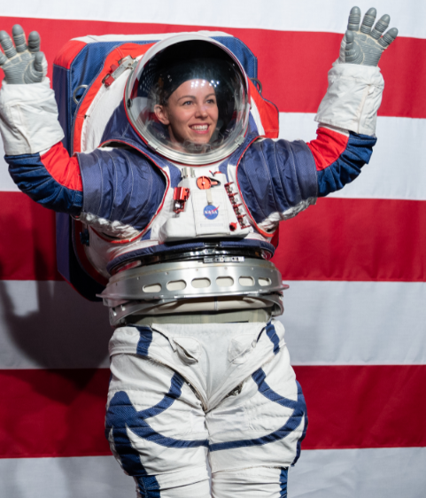
Background
Exploration Extravehicular Mobility Unit (xEMU) is NASA’s spacesuit that will support the Artemis missions
  Focus on improved mobility of Pressure Garment System (PGS)
JSC completed study in 2020 focused on fleet sizing of the xEMU Waist, Brief, Hip (WBH) Assembly
  Optimized the size/shape of brief
  Recommended adding an additional size to accommodate subjects with longer Vertical Trunk Diameters (VTD)
This study follows-up on those results to verify the stack-up of the hardware when connected to the Hard Upper Torso (HUT)
HUT Side BSC
Waist Bearing
Flexion/Extension Ring & Bladder
Brief
Waist Brief Hip Assembly
Hip Bearing
Hips
Leg Bearing

Slide 4
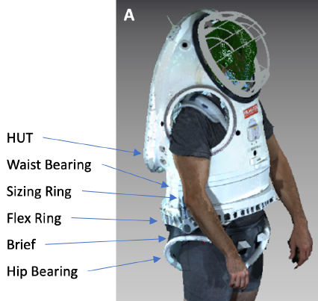
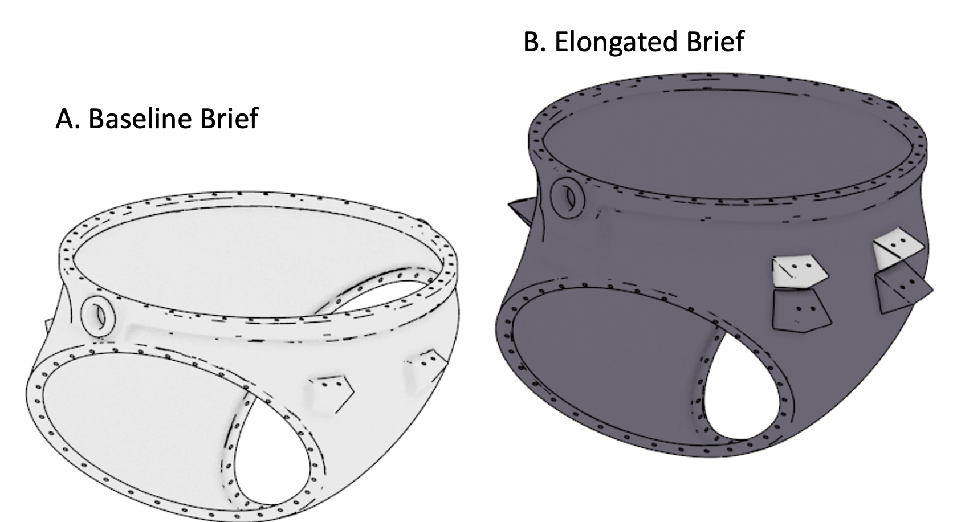
Hardware
3-D printed suit hardware was used to simulate the stack-up worn by a subject
Components:
  HUT
  Waist Bearing
  Flex Ring with Pivot connecting to the brief which allowed for movement similar to the suit hardware
  Two brief sizes (baseline and elongated)
    Elongated brief is approximately 2 inches taller
  Sizing Rings
    4 sizes: 0.75”, 1.5” 2.25” and 3” height
  Hip Bearings

Slide 5
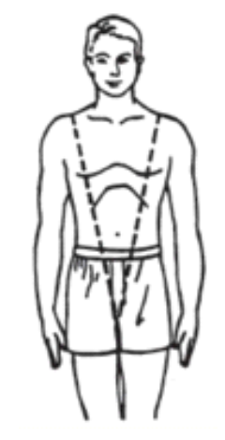
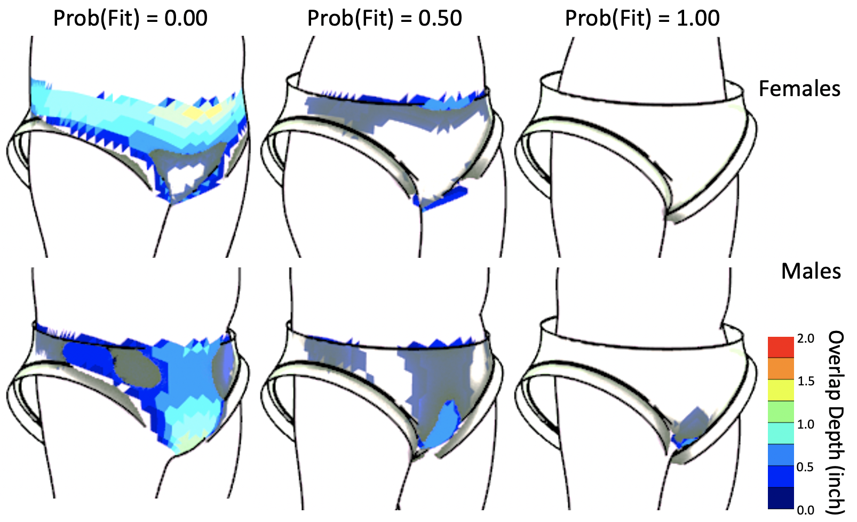
Subjects
Eleven volunteers total participated in human in the loop tests
  4 females and 7 males
VTD was measured for each subject
  Specifically, the vertical distance from the crotch to the mid-shoulder landmark using a caliper
Fit probability was estimated with subject’s 3D body scan overlaid with CAD of the suit
  Prediction was validated with corresponding subjects wearing the 3D printed mock-up suit
  Details in Davis et al. ICES paper (2020)
VTD

Slide 6
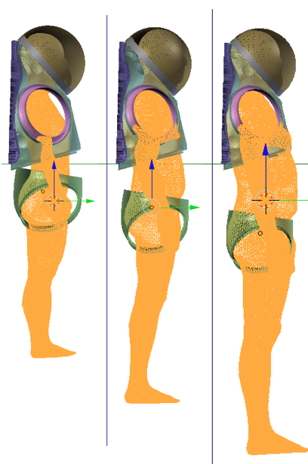
Procedures
Pre-test:
  Subject was asked to don mock-up suit stack-up while wearing provided formfitting clothing
    Commercial off-the-shelf (COTS) items. Not intended to mimic liquid cooling and ventilation garment (LCVG) or comfort layer
  Subject donned 3D printed stack-up by entering through hatch opening. Then shoulder straps were used to position the HUT and optimize the subject’s indexing by centering their shoulder in the scye ring and head in the helmet
  Initial sizing ring combination was preliminary determined by model prediction based on 3D body scan
    All subjects started with the baseline brief before moving to the elongated brief
      Sizing ring selection changed dependent on which brief was used

Slide 7
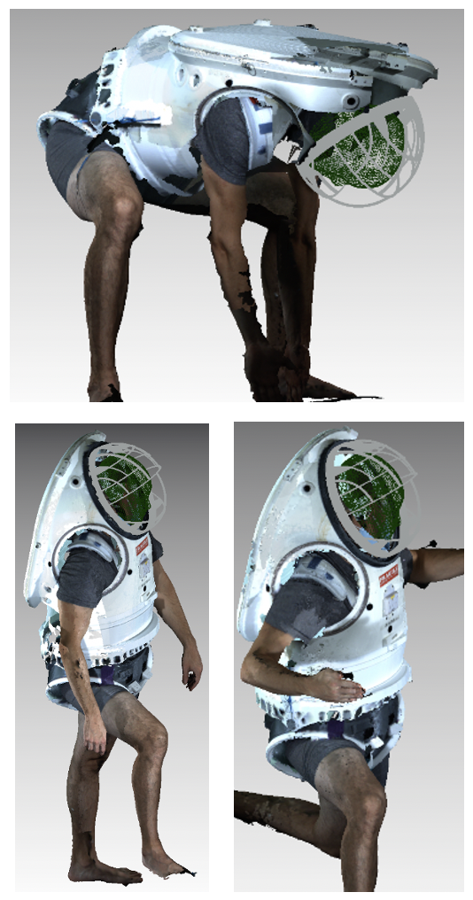
Procedures
During test:
  Once indexed into 3D printed suit, the hatch was closed and subjects performed functional movements such as squats, kneeling, and walking to access the fit. Then they performed functional postures such as maximum forward and backward leans.
    Sizing rings were either removed or added according to subject’s request to optimize fit
  After completion of assessment in each brief, subject provided verbal report of perceived fit, comfort and suit maneuverability
  Test was repeated with an LCVG, maximum absorbency garment (MAG), and drink bag using the preferred brief type (baseline or elongated)

Slide 8
Analysis
Sizing ring heights were treated as a dependent variable and a statistical analysis was performed to assess the influences from the independent variables (example: subject’s gender, VTD and brief type)
  Analysis of covariance (ANCOVA) identified the statistically significant factors determining the sizing ring height selections
  With the identified factors, a statistical regression model was built to predict the height of the sizing rings needed for the projected crew population
Choice between baseline and elongated brief was also analyzed for the underlying covariation with VTD
  Logistic regression model was built to predict the probability of preferring an elongated as opposed to a baseline brief
  Brief preference model estimated the approximate proportion of the population who are likely to need an elongated versus baseline brief

Slide 9
Results
Average selected height for the stack of sizing rings is summarized in Table 1.
  ANCOVA indicated that the selected sizing ring height significantly covaries with the subject’s VTD (F=38.082, p < 0.05) and brief type (F=19.482, p < 0.05) as main effects.
    Subjects with a larger VTD tended to select a taller sizing ring height
    Baseline brief condition was associated with taller sizing rings than elongated brief
  Neither the subject’s gender nor any interaction effects are statistically significant.
Table 1. Descriptive statistics of the subjects. Units are in inches.
 |  |  | Females | Males
VTD |  |  | 24.715 (1.192) | 27.351 (1.971)
Selected Sizing Ring Height | Baseline Brief |  | 1.125 (1.299) | 4.250 (1.768)
 | Elongated Brief |  | 0.375 (0.750) | 2.036 (1.661)

Slide 10
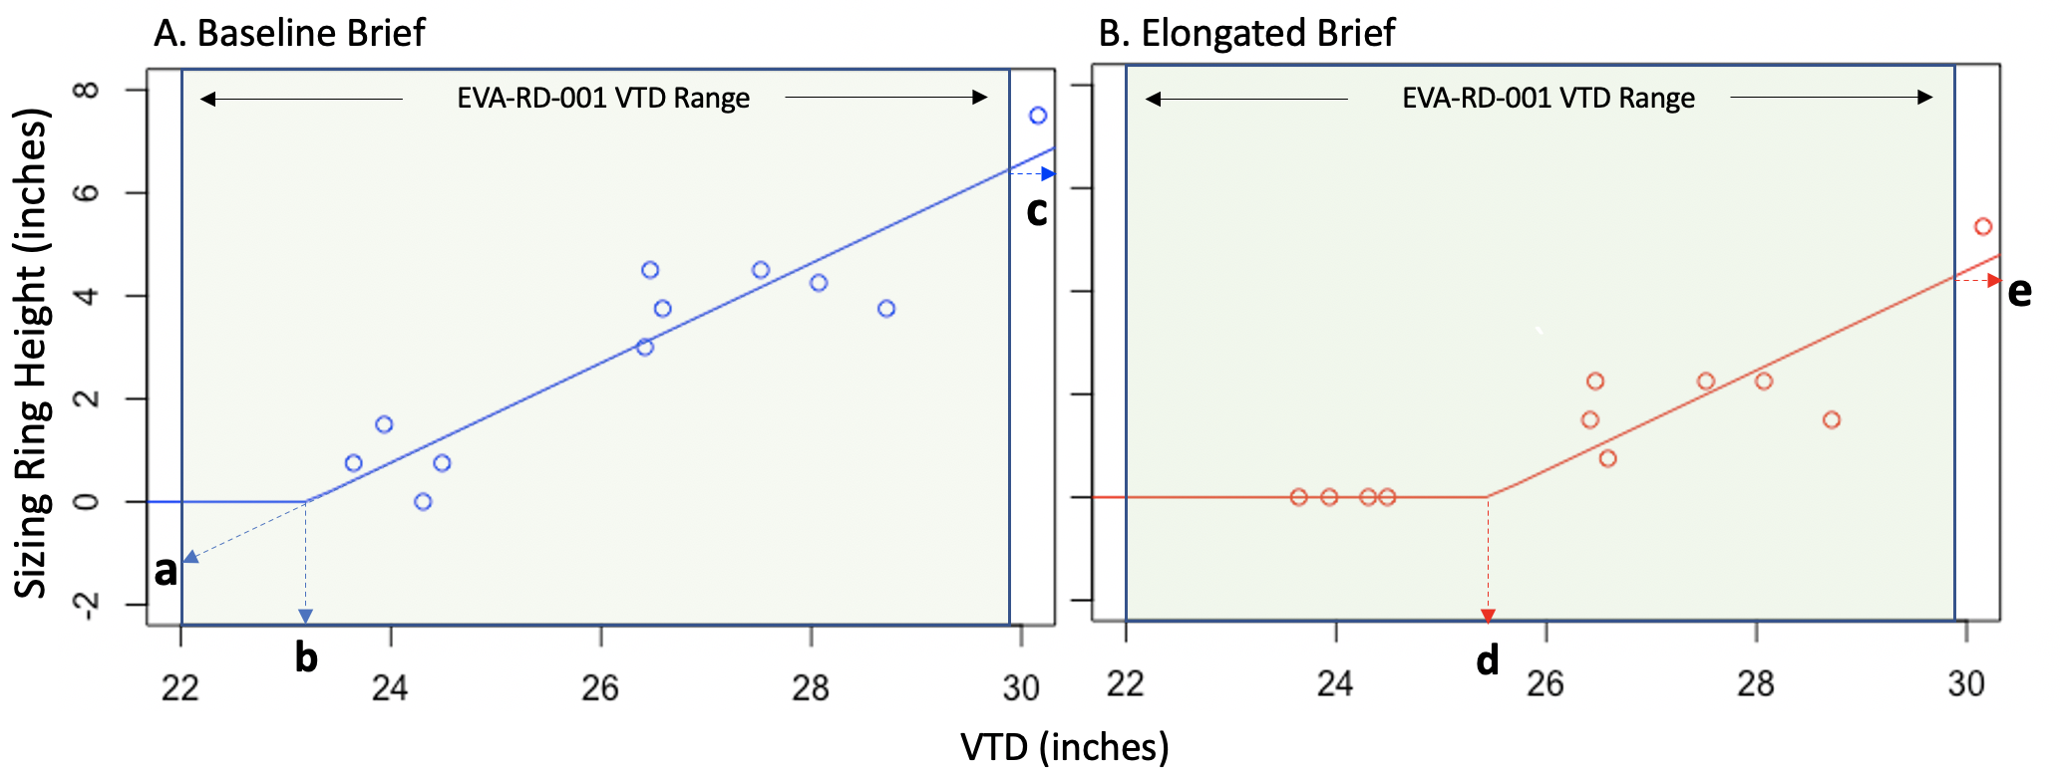
Results
Prediction model onto hypothetical crew population with minimum to maximum VTD (22.0 - 29.9 inches)
Persons with VTD ≤ 23.2” (baseline brief) or 25.5” (elongated brief) may not need sizing rings (point b and d)
Persons with a smallest VTD (22”) may have a negative gap -1.2” (point a)
Persons with a largest VTD (29.9”) may need 6.4” (baseline; point c) or 4.3” (elongated, point e) sizing rings

Slide 11
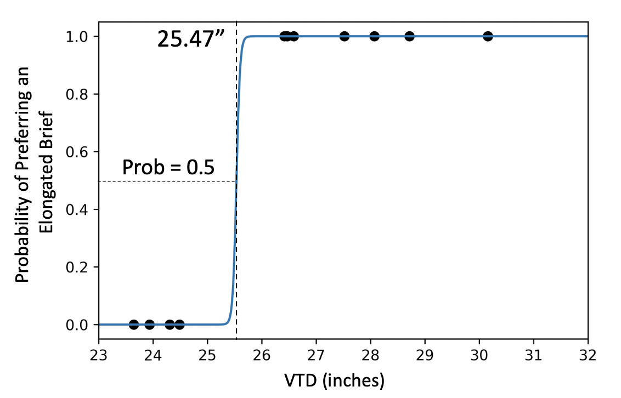
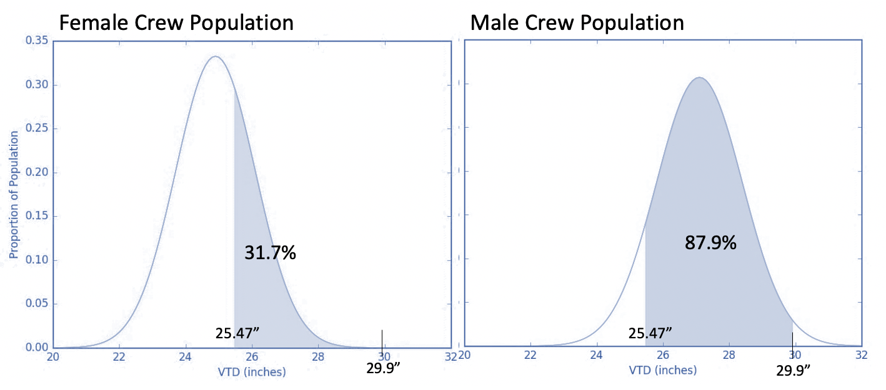
Results
When asked to report preferred brief type, four subjects selected baseline brief and seven subjects selected the elongated brief
  Model predicted that the persons with VTD ≥ 25.47-inch threshold will prefer an elongated brief
  The 25.47” threshold value can be translated that 31.7% female and 87.9% male crew populations are expected to select an elongated brief

Slide 12
Results
User
feedback
Subject | Gender | VTD inch (percentile) | Preferred Brief | Comment
1 | F | 23.6 (14.5) | Baseline | The elongated brief feels to be lower than desired, thus some postures like raising the thigh or hip flexion were more difficult to perform.
2 | M | 30.2 Above max | Elongated | All motions were performed in both briefs but had a more upright posture with the elongated brief for motions like squats and kneels. Also elongated brief allowed for more comfortable bending
3 | M | 26.6 (34.7) | Elongated | Overall, all functional motions can be performed in both briefs
4 | M | 26.5 (31.1) | Elongated | The higher pivot point was immediately noticed upon wearing the elongated brief and felt to help to maintain a better center of gravity when bending the torso. However, the baseline brief required more attentive control of the upper body to prevent weight shifting.
5 | M | 27.5 (63.3) | Elongated | Felt overall more upright with the elongated brief especially when kneeling. More hip clearance was perceived as well.
6 | F | 26.4 (91.0) | Elongated | Performed all functional movement well in both briefs, overall preferred the elongated brief due to the increase flexion however both where acceptable.
7 | M | 28.7 (89.9) | Elongated | Can perform functional movements easier with elongated brief
8 | F | 24.3 (31.3) | Baseline | Was not able to perform some of the functional movements with elongated brief since pivot point was too high
9 | M | 28.1 (87.3) | Elongated | Performed all functional movement well in both briefs, overall preferred the elongated brief due to the increase flexion
10 | F | 24.5 (37.3) | Baseline | Length of stack up was ideal with baseline brief and too long with elongated brief
11 | M | 23.9 Below min | Baseline | Elongated brief feels bulky and cumbersome. The pivot point is located too high near the abdomen

Slide 13
Conclusion
Anthropometry measurements were found to be significantly correlated with the selected height of the sizing ring combination
  Individual selection of the sizing rings should be interpreted in the context of the discrete sizing ring height options available to the subjects. Patterns may change if the discrete interval of sizing ring heights available changes
    This study considered 0.75” sizing ring intervals
Benefits can be seen by using both baseline and elongated brief for crew population
  Baseline brief allows the gap between the subject and the brief inner surface to be minimized as compared to the elongated brief (1.175” vs. 3.347”)
  Elongated brief allows for less sizing rings to be used
  Usability and comfort is improved with elongated brief for wearers with long VTD

Slide 14
Thank you! Q&A
Sarah Jarvis, Yaritza Hernandez and Han Kim

