Slide 1
HLPW-4: CRM-HL
Fixed RANS TFG
Nashat Ahmad (R-008)
NASA Langley Research Center

Slide 2
Code Description
FUN3D (Fully Unstructured Navier-Stokes 3D)
  Uses unstructured grids
  Node-centered finite volume scheme
  Second-order accurate
  Computation of viscous fluxes on tetrahedral meshes is based on the Green-Gauss theorem and on nontetrahedral grids, an edge-derivative augmentation is employed to avoid odd-even decoupling
  Time integration toward a steady state is based on a backward-Euler scheme with local time-stepping to accelerate convergence
  https://fun3d.larc.nasa.gov
Several SA variants
  SA, SA-neg, SA-neg-RC, SA-neg-QCR2000, SA-neg-RC-QCR2000
  https://turbmodels.larc.nasa.gov/

Slide 3
Runs Description
Started from freestream
No initial first-order iterations
Steady-state
Simulations are “free-air” using committee provided free-air grids
Simulations are fully-turbulent
SA turbulence model used
Roe solver with no flux limiting

Slide 4
Case 1a: Flaps Deflection Study
Reference Conditions
Grid (Prism-Tet)
Parameter | Value
M | 0.2
Re | 5.49 million
T_{ref} | 521 °R
α | 7.05° (wall corrected)
Grid Level | Nodes
D2.2(40/37) D2.2(37/34) D2.2(43/40) | 202,542,838 200,227,380 199,821,858
Three different flap settings: 40/37 (nominal), 37/34, and 43/40

Slide 5
Case 1a: Forces and Moments
Configuration | C_{L} | C_{D} | C_{m,y}
40/37 | 0.1741393E+01 | 0.1822673E+00 | -0.3471430E+00
37/34 | 0.1684169E+01 | 0.1711244E+00 | -0.3327001E+00
43/40 | 0.1690239E+01 | 0.1851852E+00 | -0.3182826E+00

Slide 6
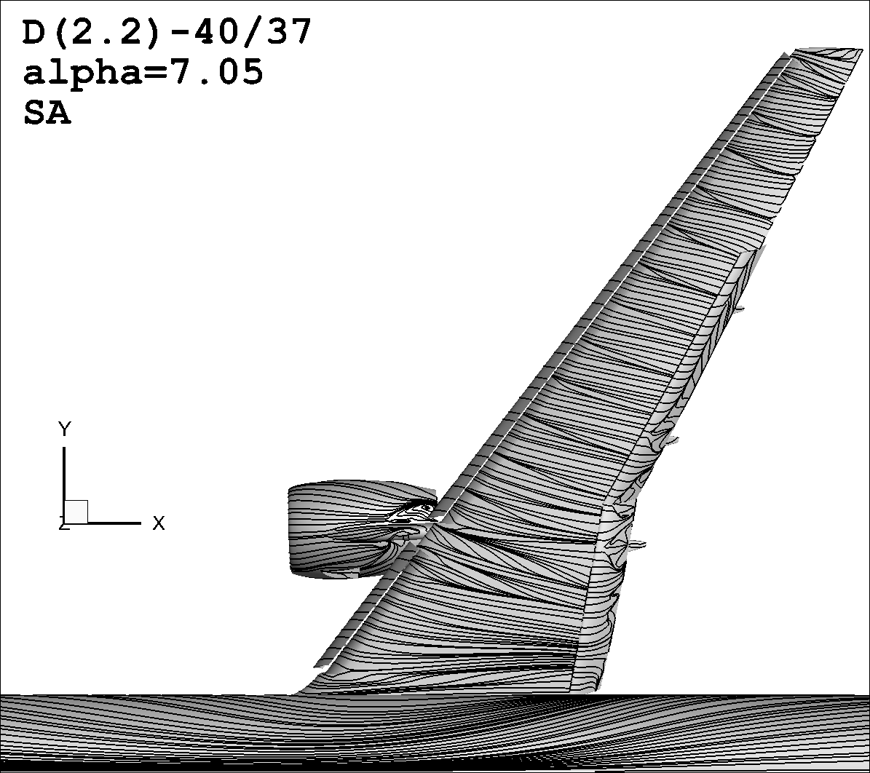


Streamlines (View 1)
D2.2(40/37)
alpha=7.05°
SA
D2.2(37/34)
alpha=7.05°
SA
D2.2(43/40)
alpha=7.05°
SA

Slide 7
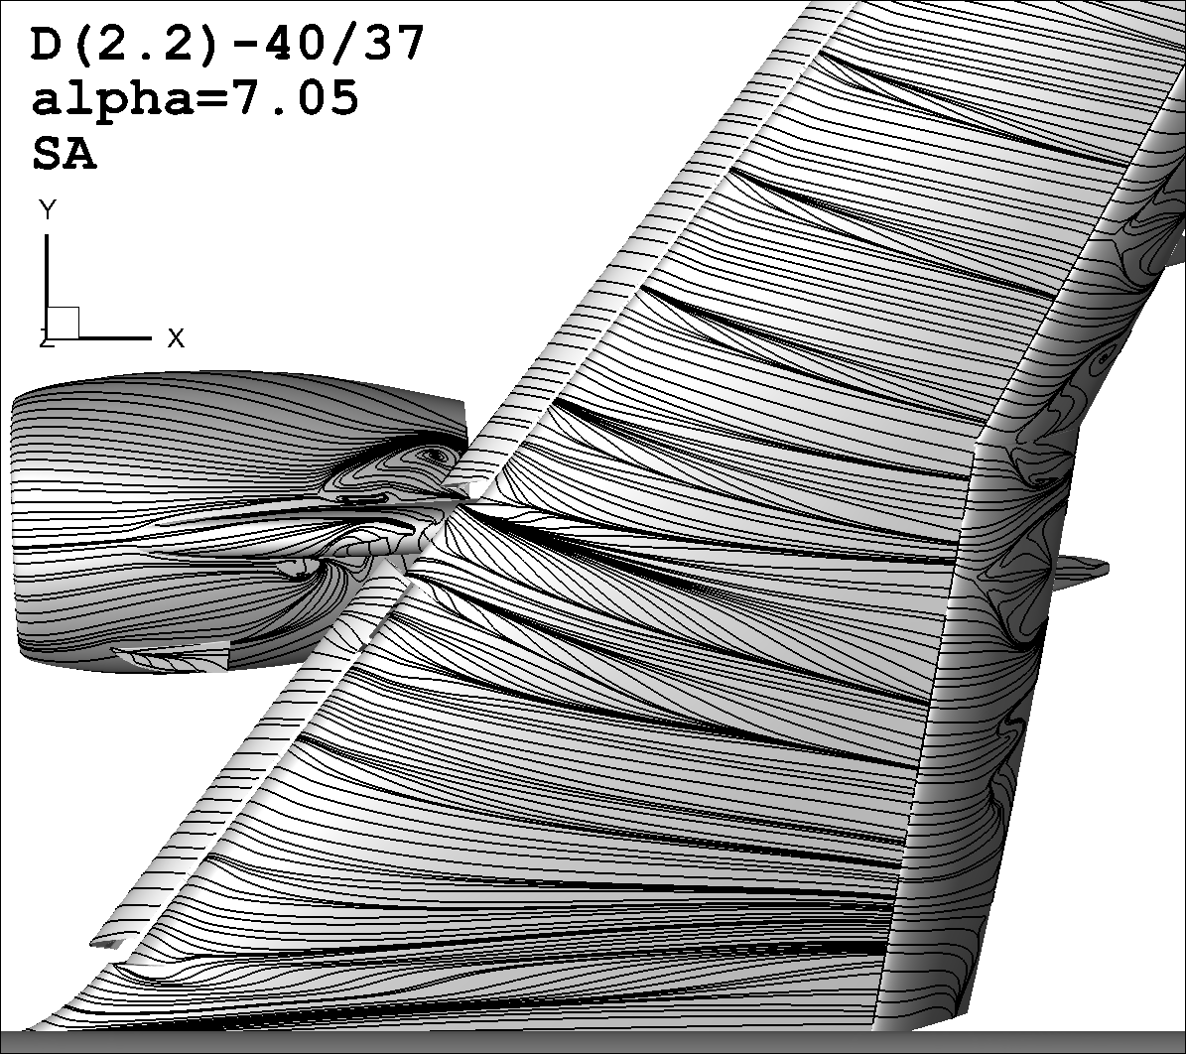
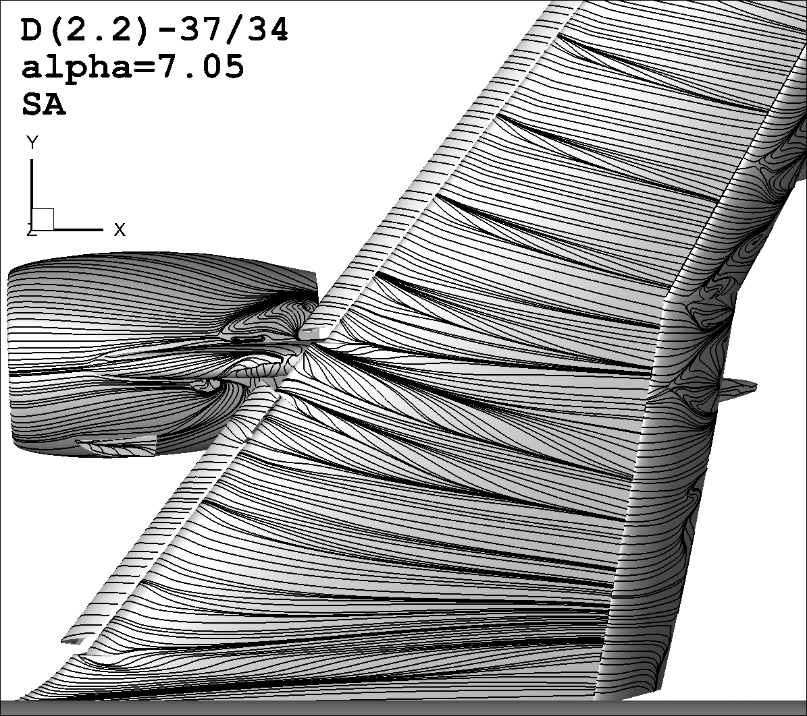

Streamlines (View 2)
D2.2(40/37)
alpha=7.05°
SA
D2.2(43/40)
alpha=7.05°
SA

Slide 8
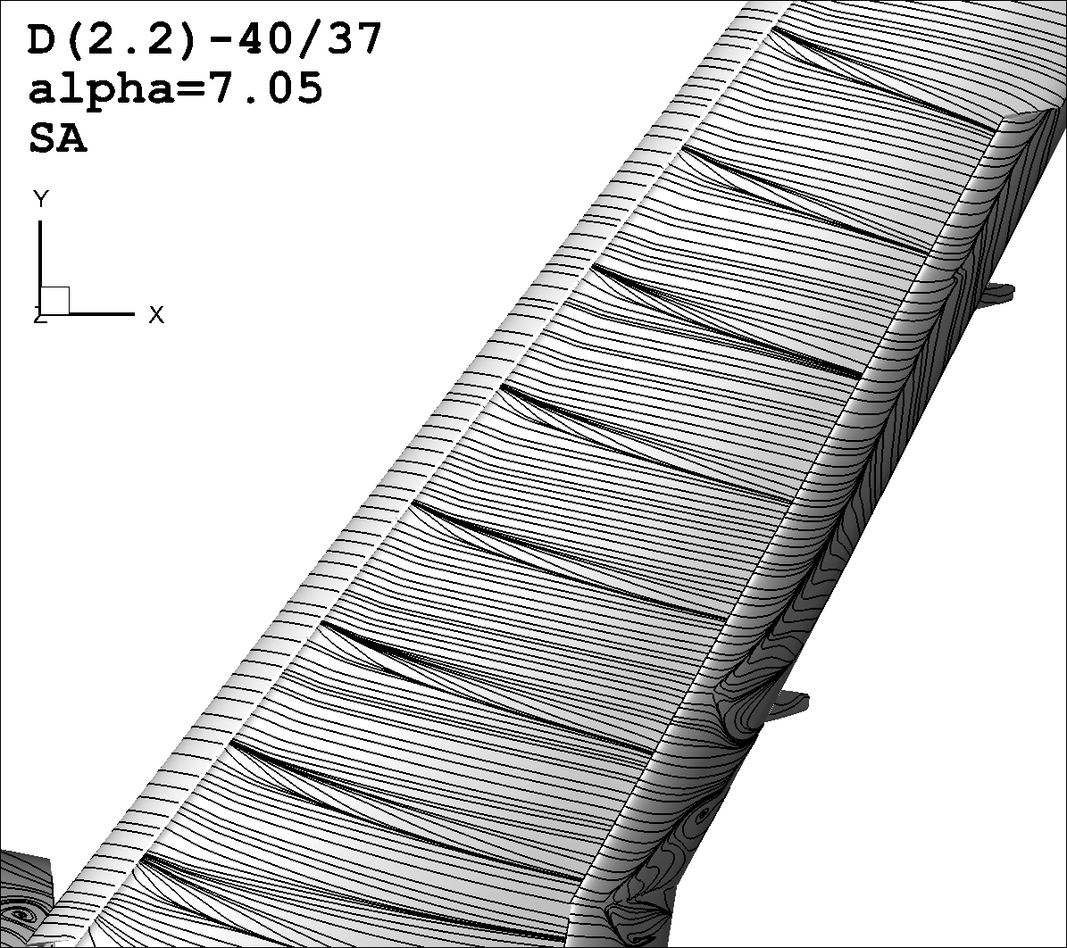
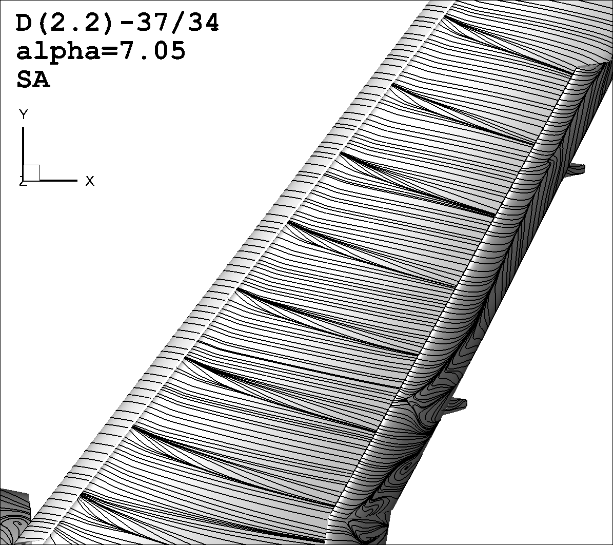

Streamlines (View 3)
D2.2(40/37)
alpha=7.05°
SA
D2.2(37/34)
alpha=7.05°
SA
D2.2(43/40)
alpha=7.05°
SA

Slide 9
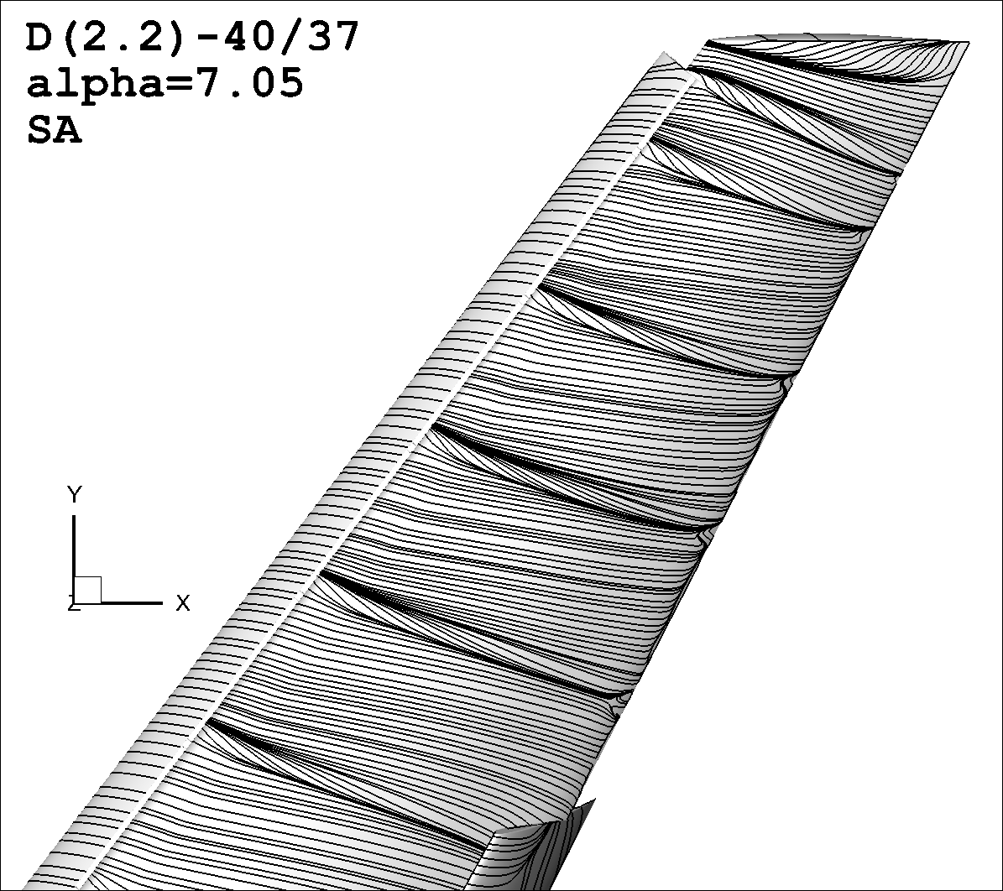

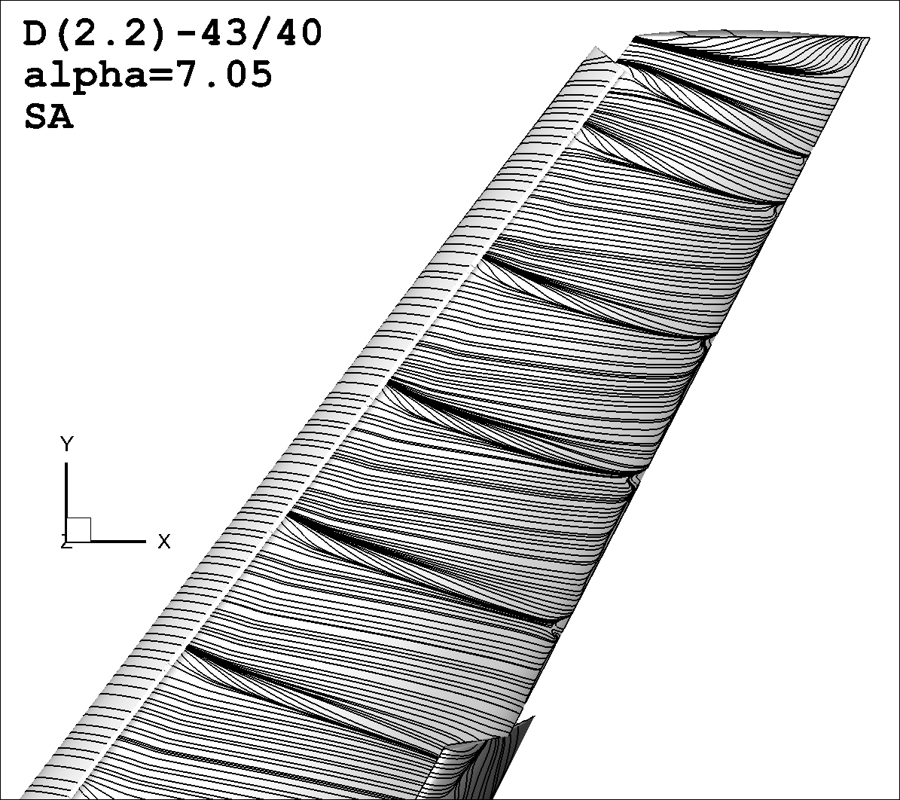
Streamlines (View 4)
D2.2(40/37)
alpha=7.05°
SA
D2.2(37/34)
alpha=7.05°
SA
D2.2(43/40)
alpha=7.05°
SA

Slide 10
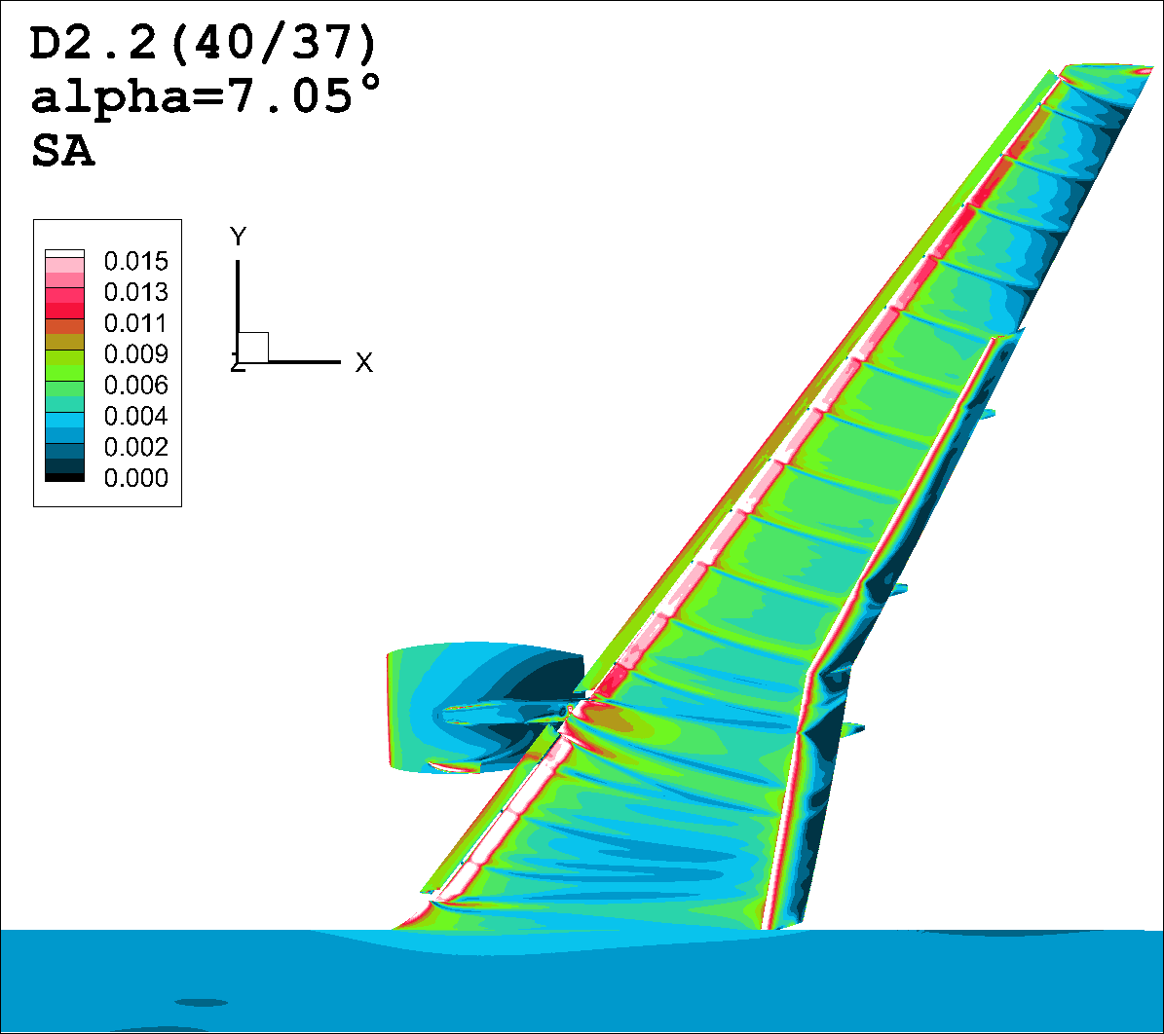
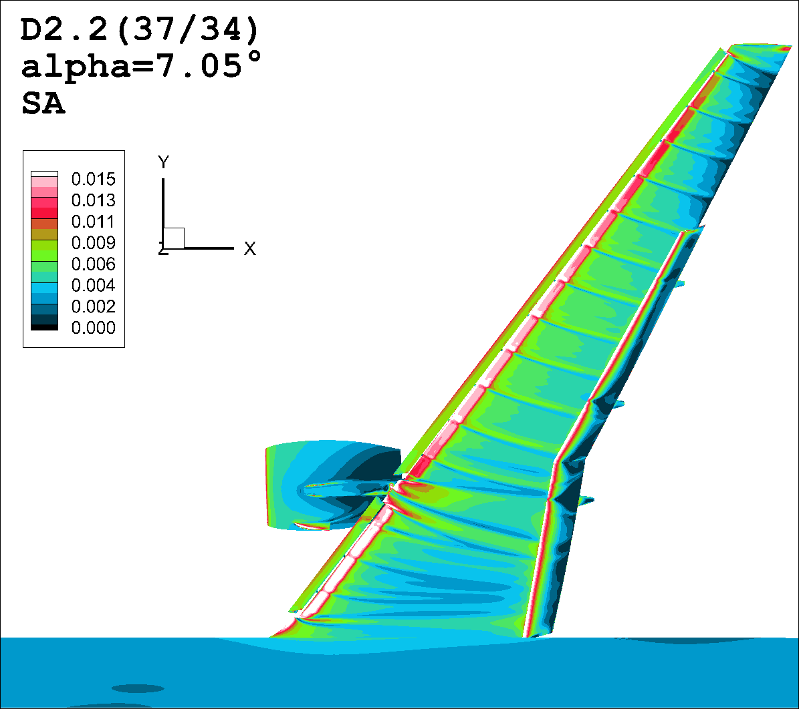
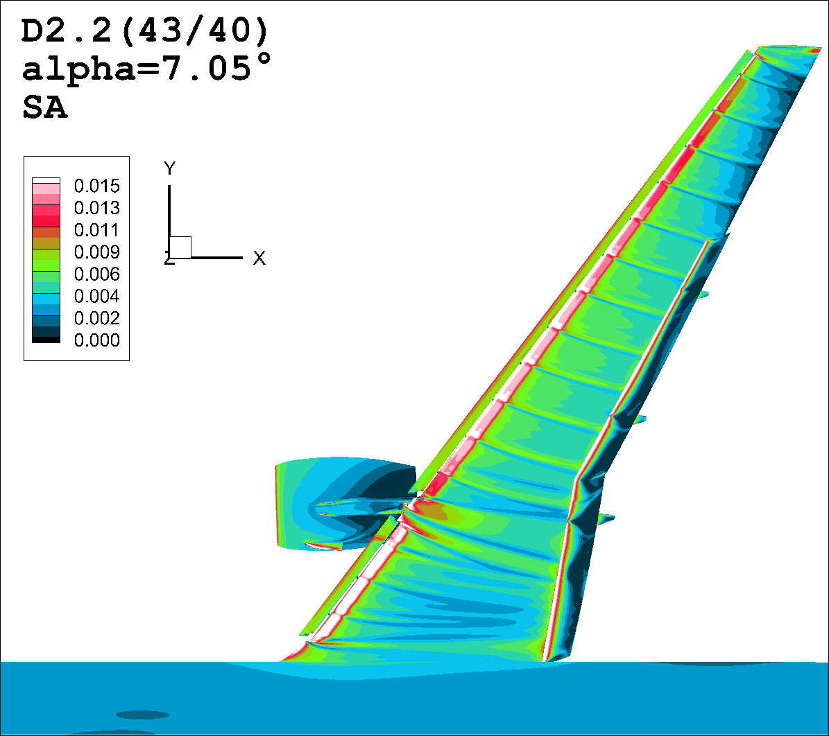
Skin Friction (View 1)

Slide 11
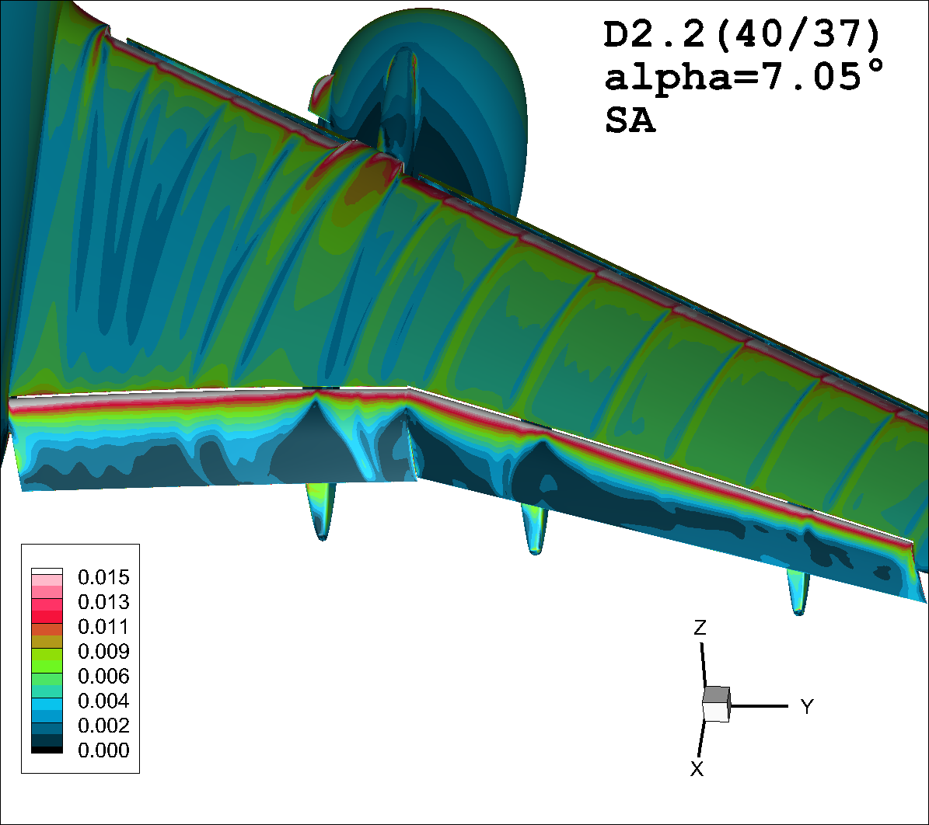
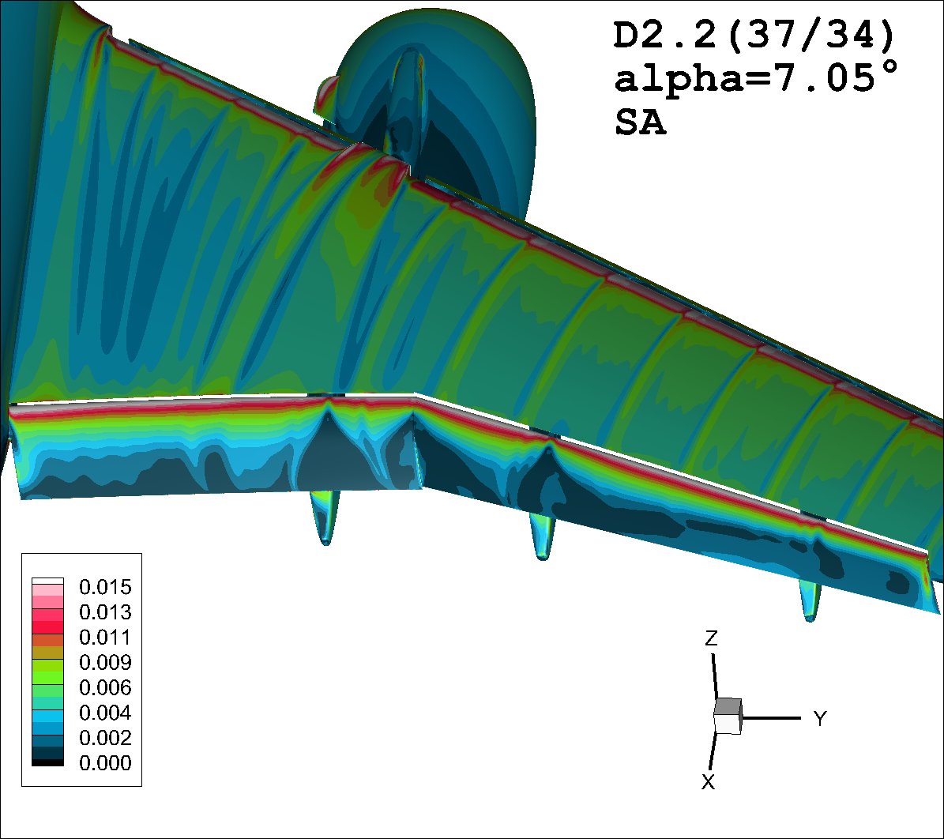
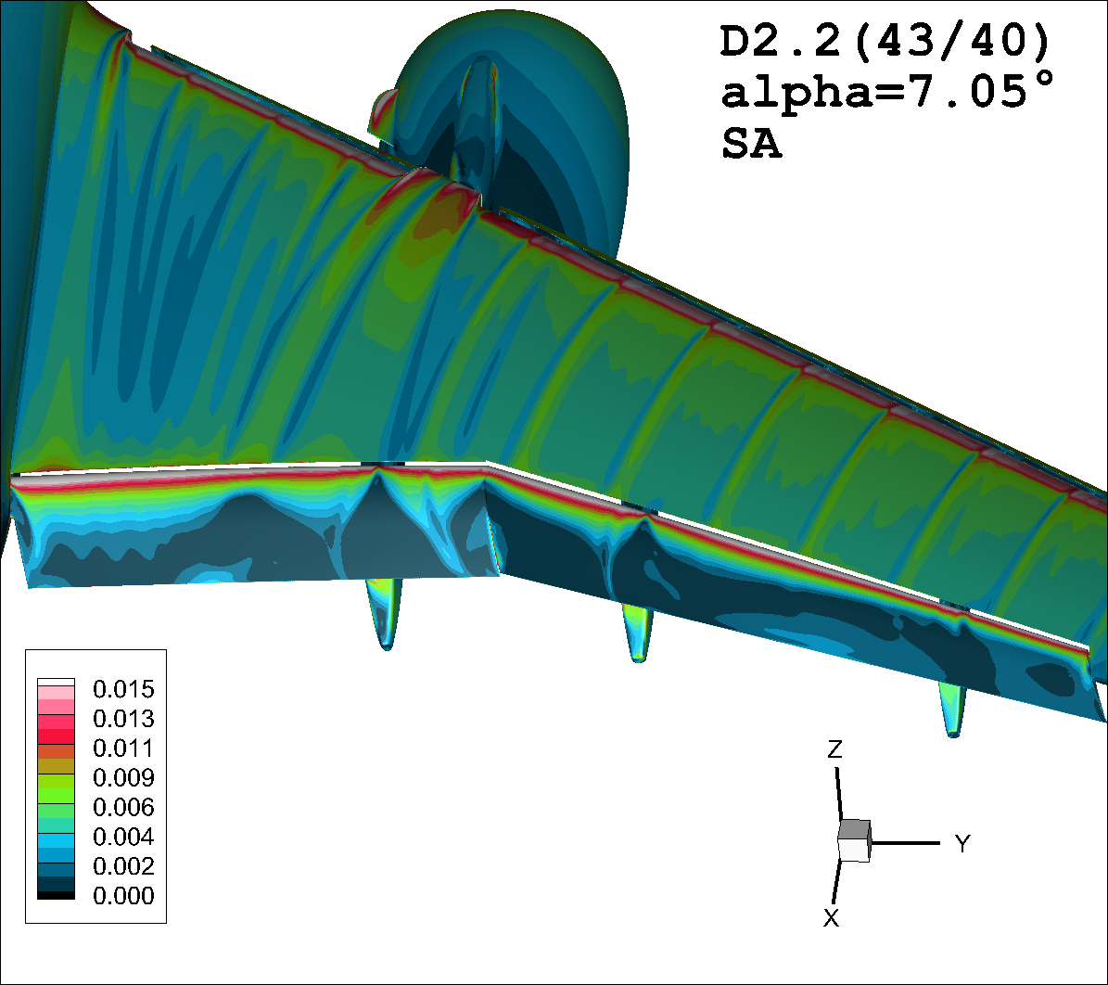
Skin Friction (View 5)

Slide 12
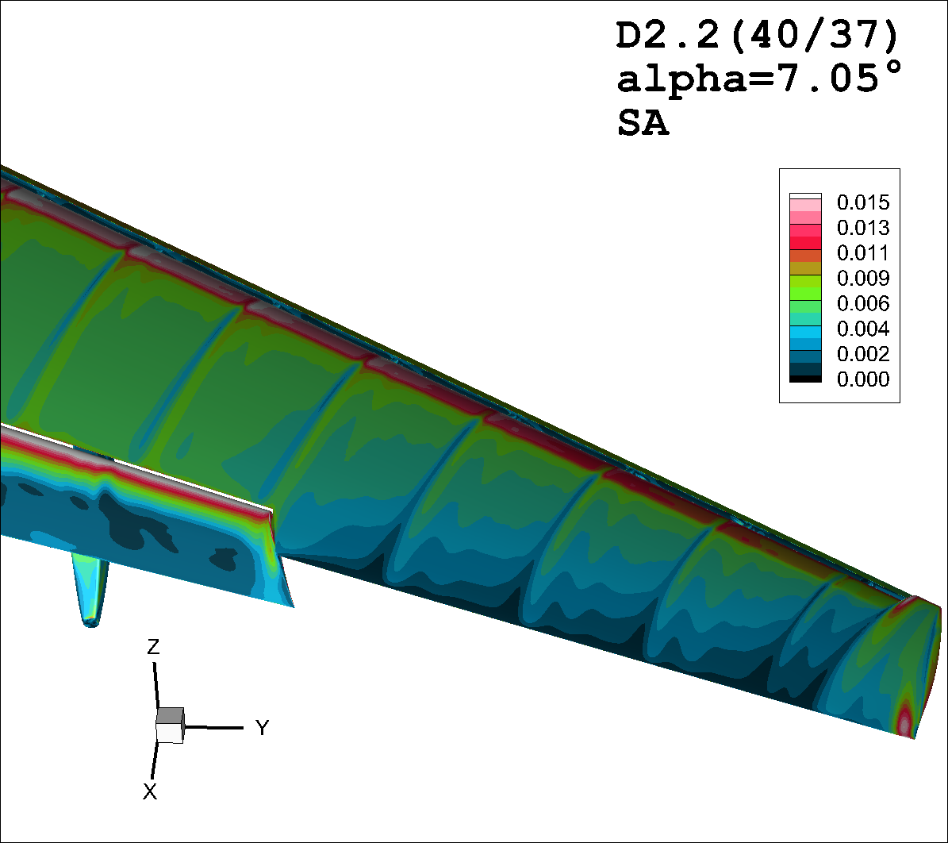
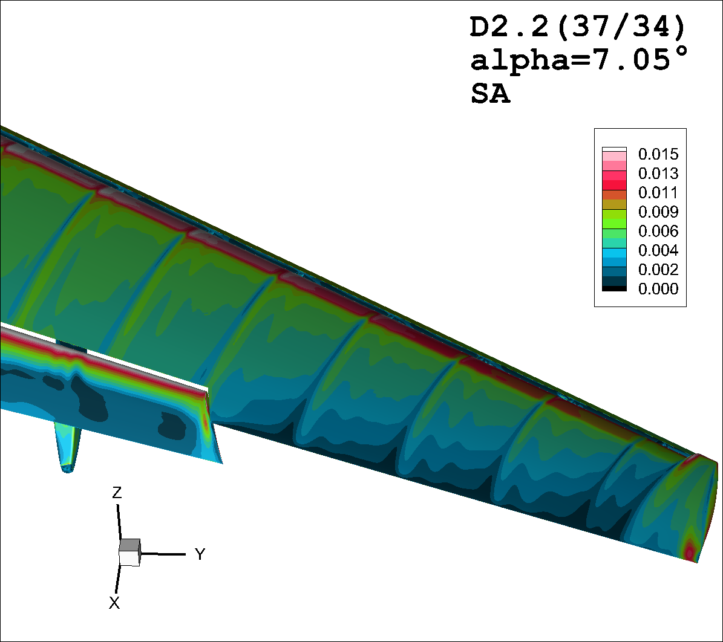
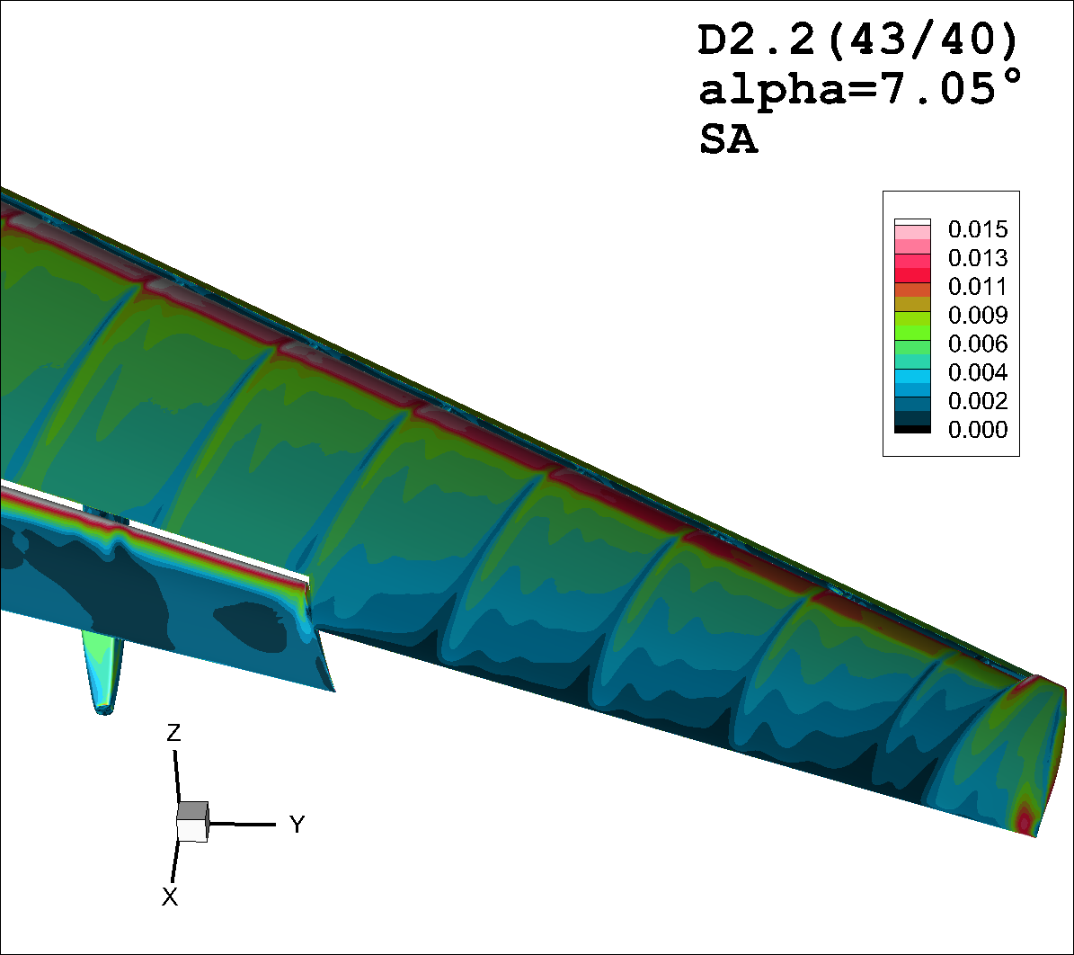
Skin Friction (View 6)

Slide 13
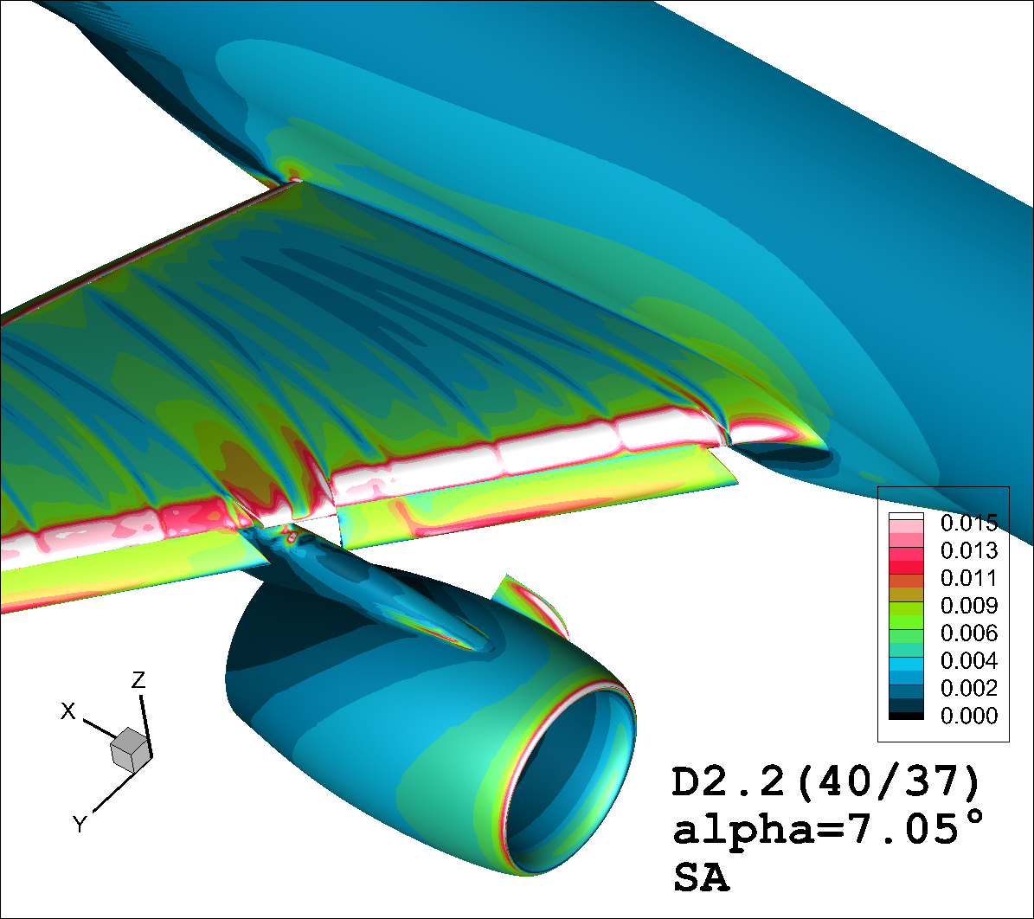


Skin Friction (View 7)

Slide 14
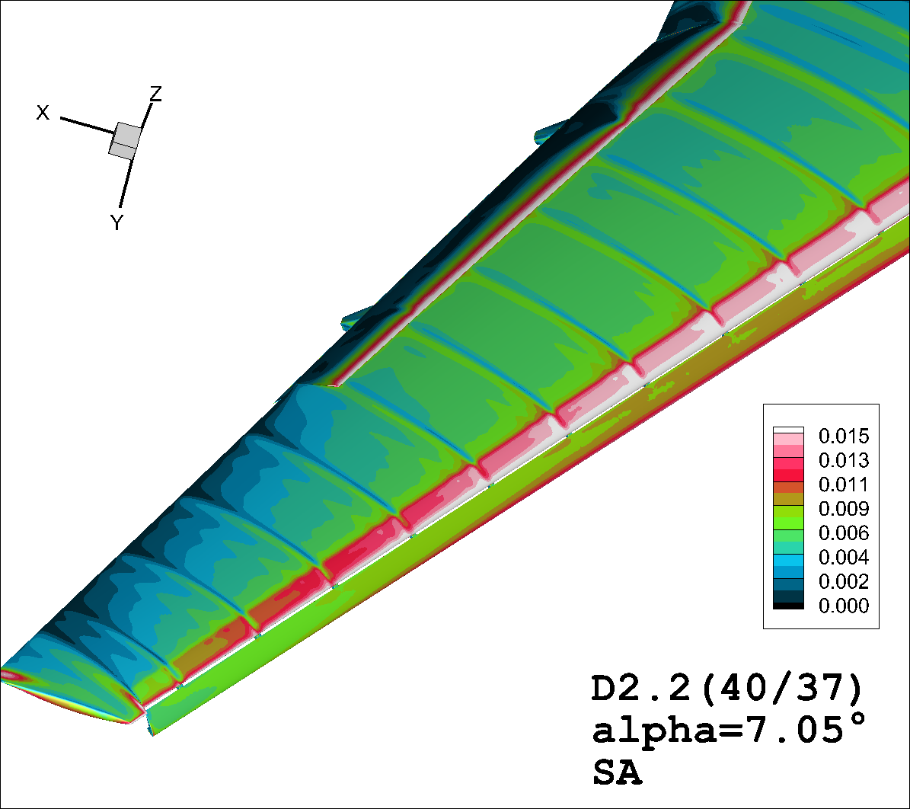

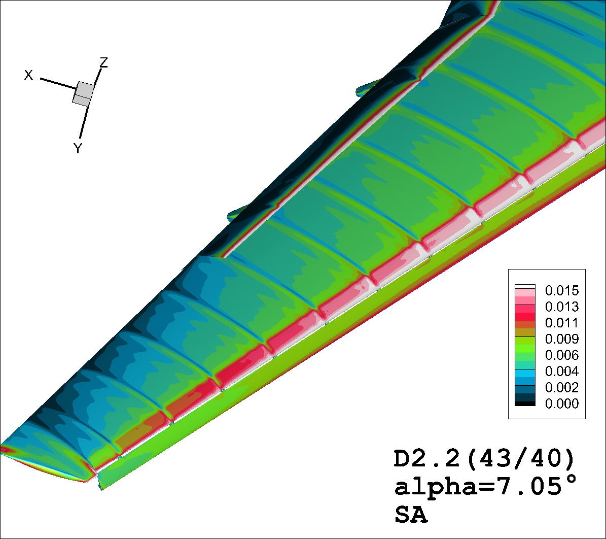
Skin Friction (View 8)

Slide 15
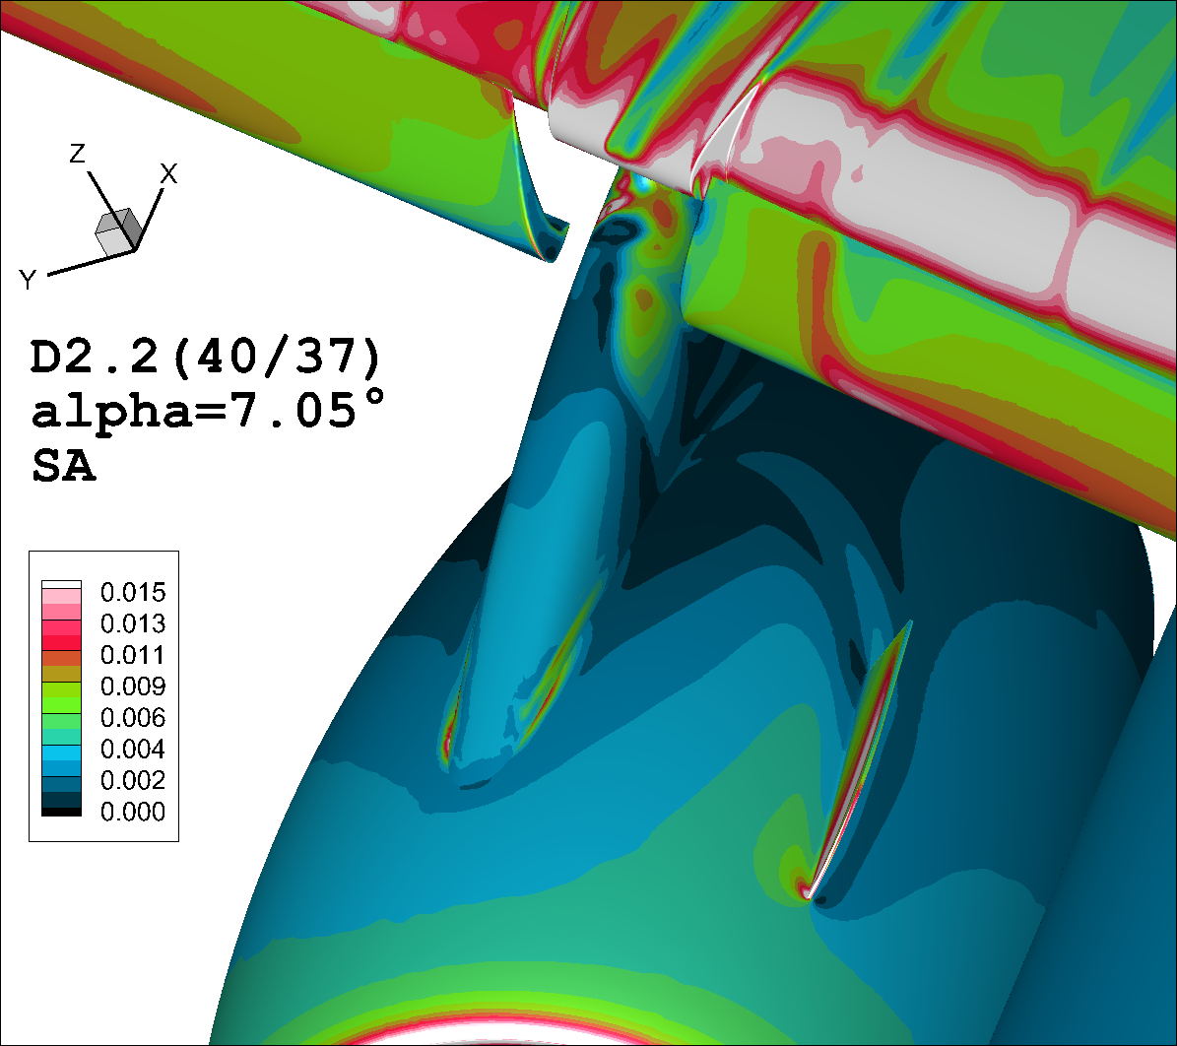
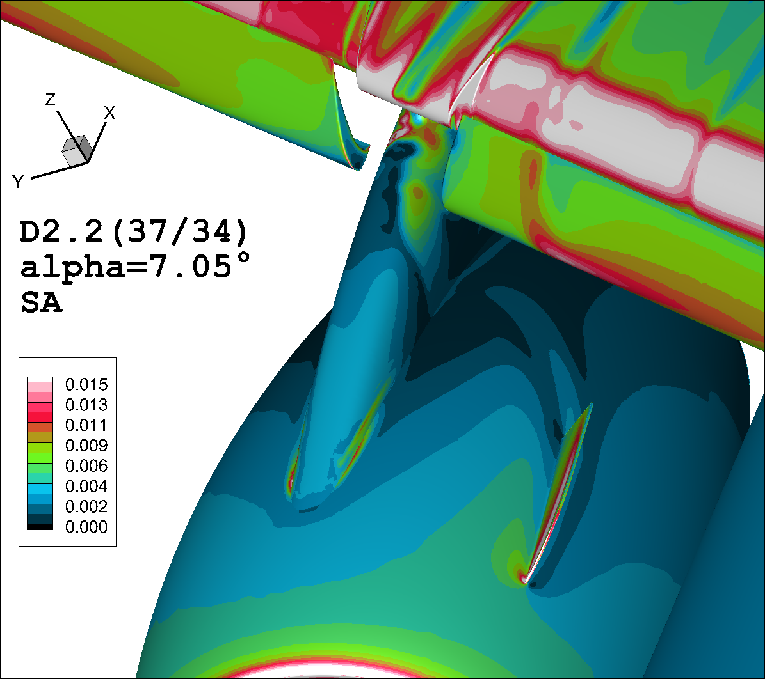

Skin Friction (View 9)

Slide 16
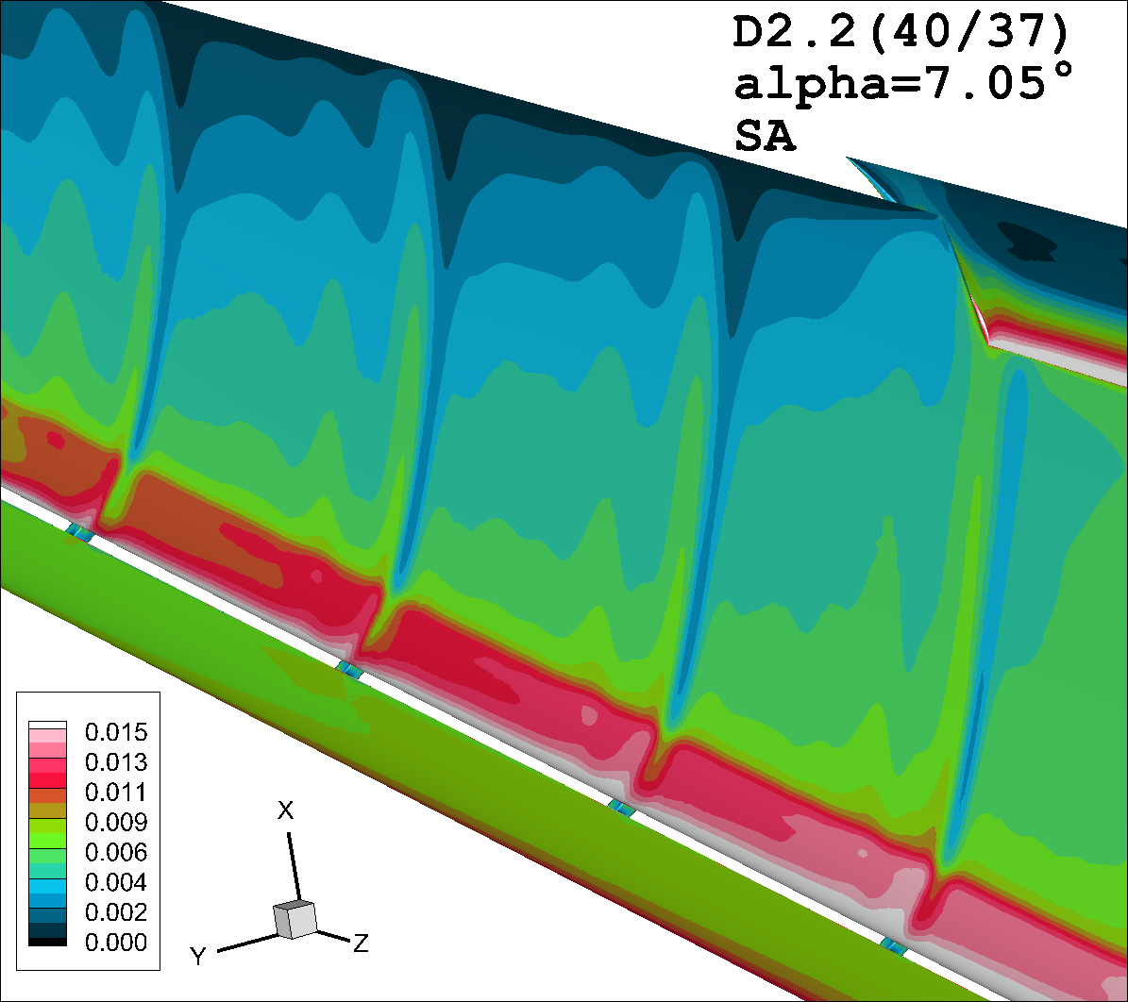
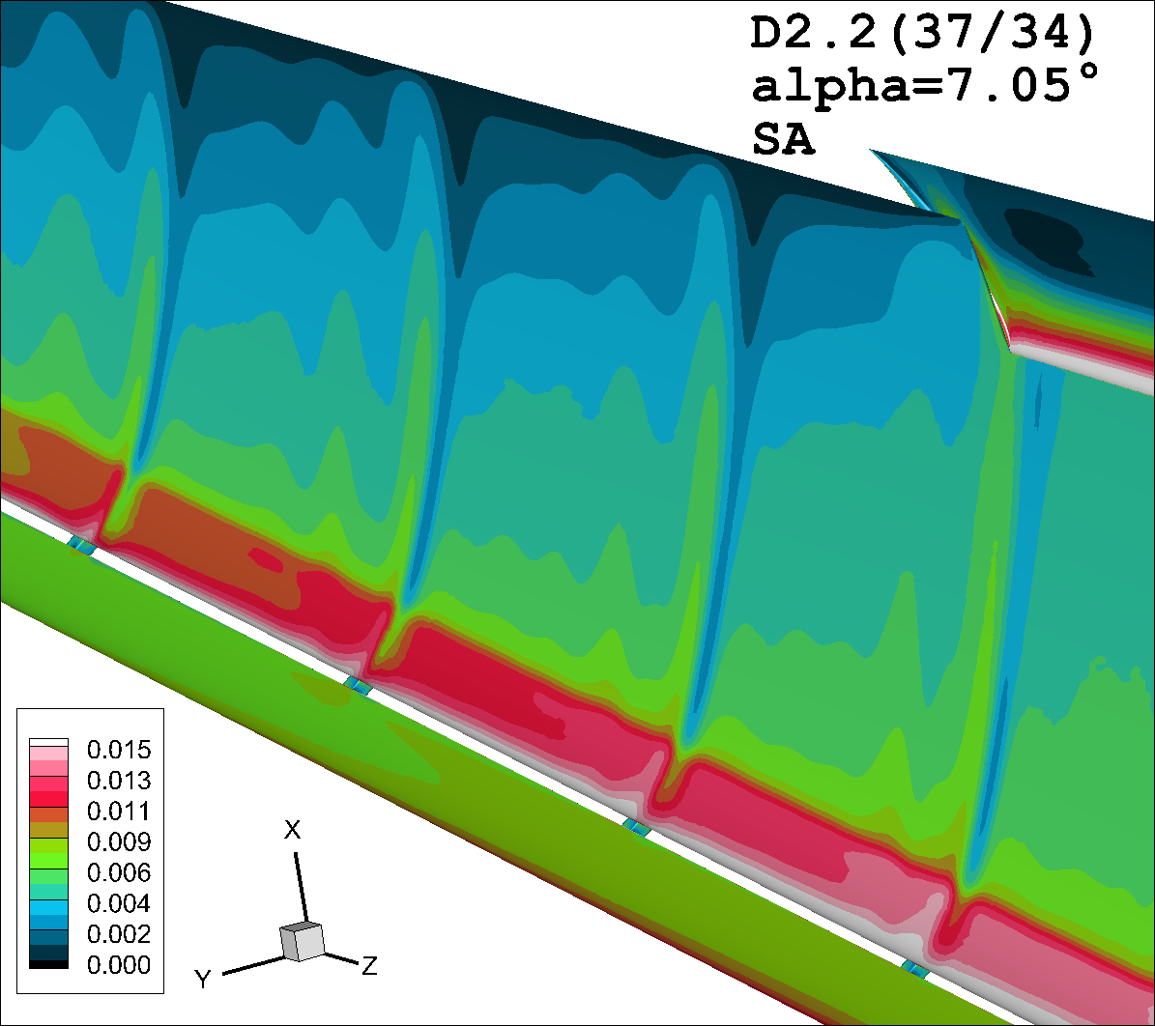

Skin Friction (View 10)

Slide 17
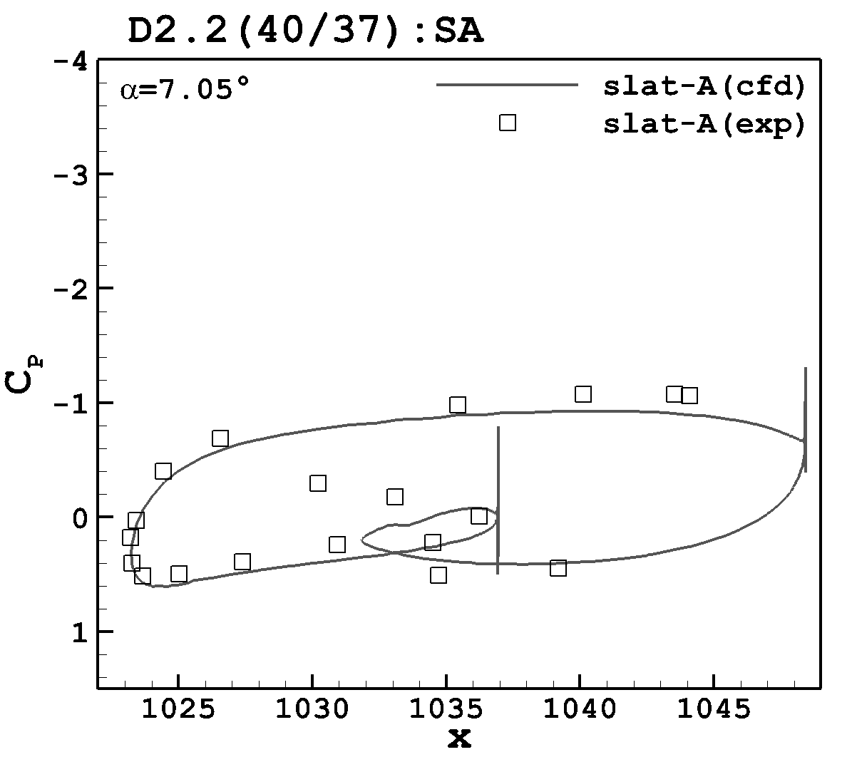
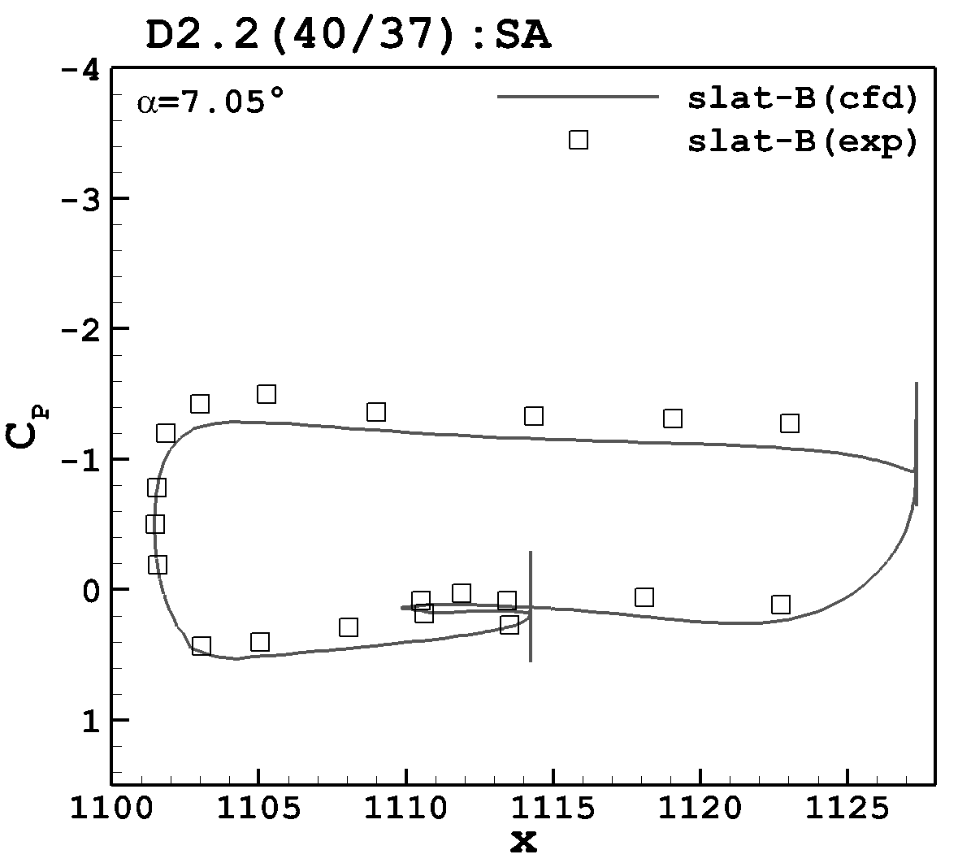
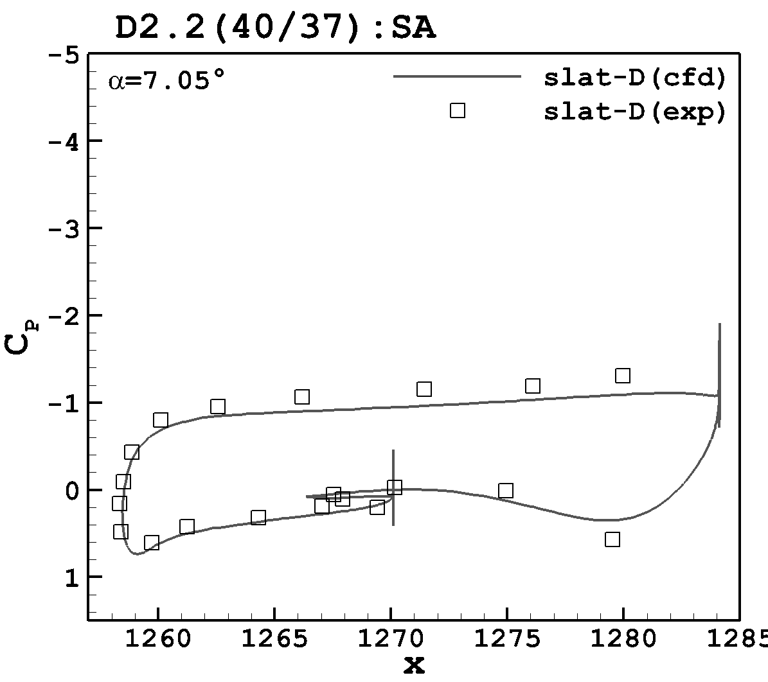
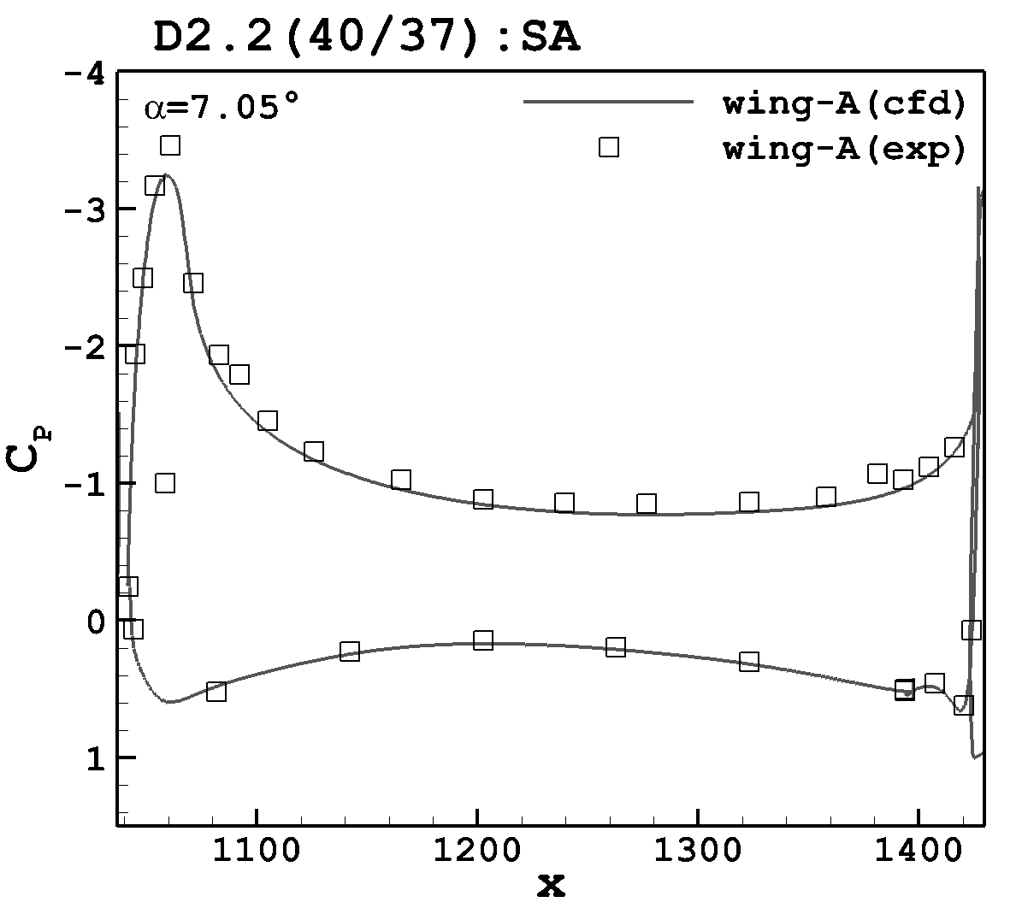
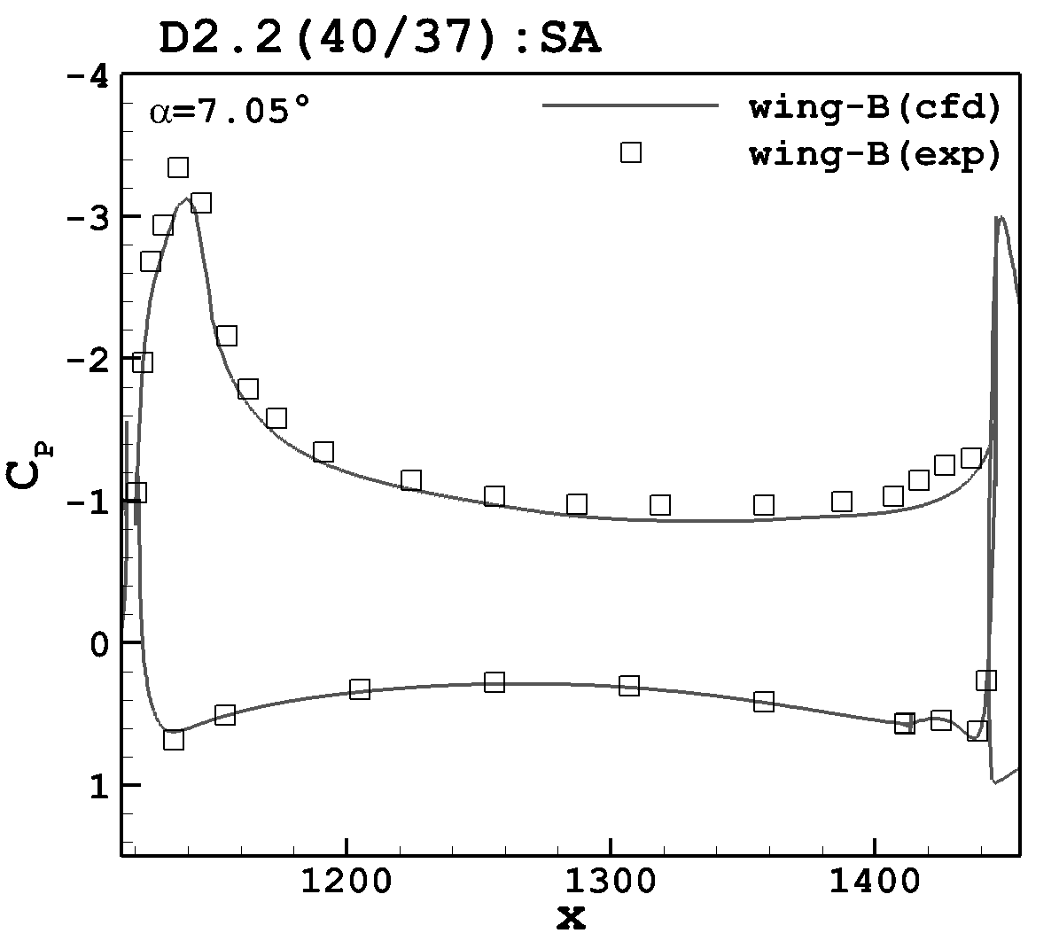
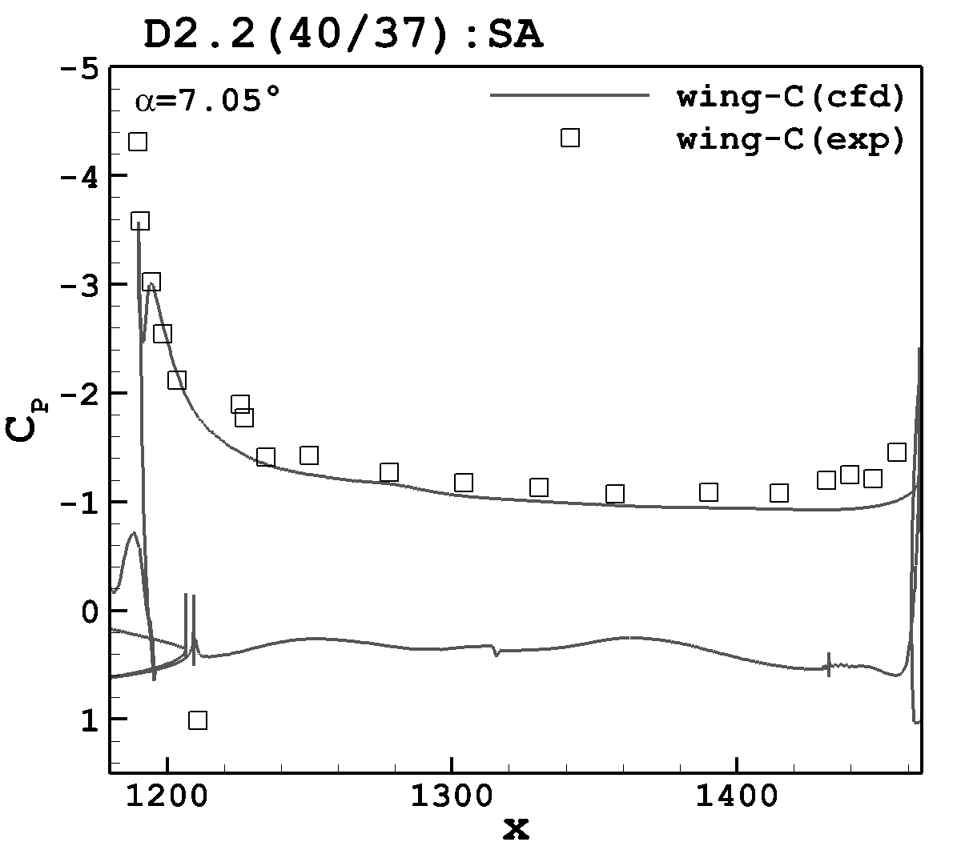
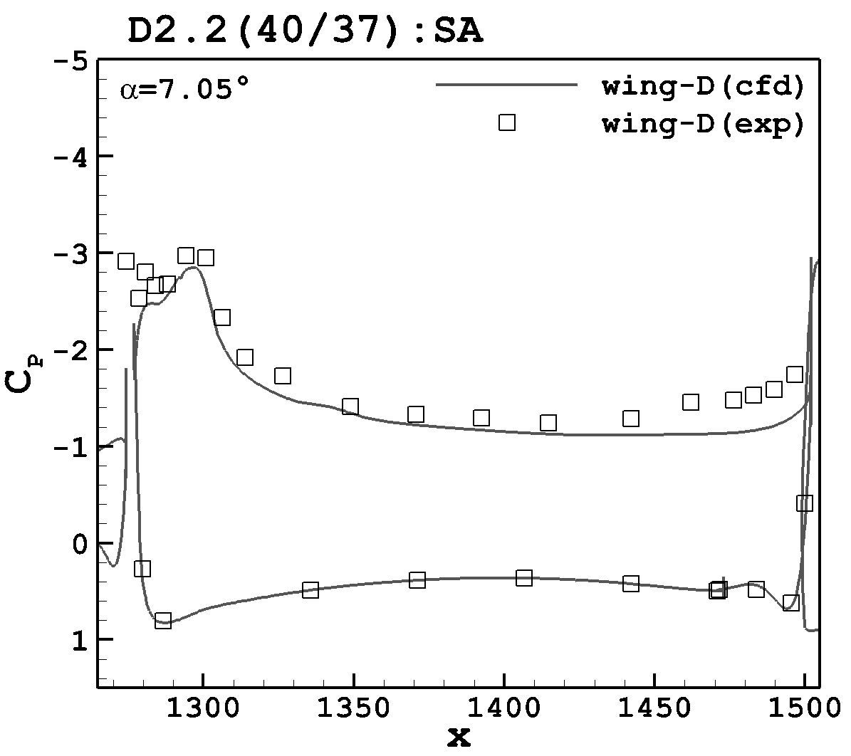
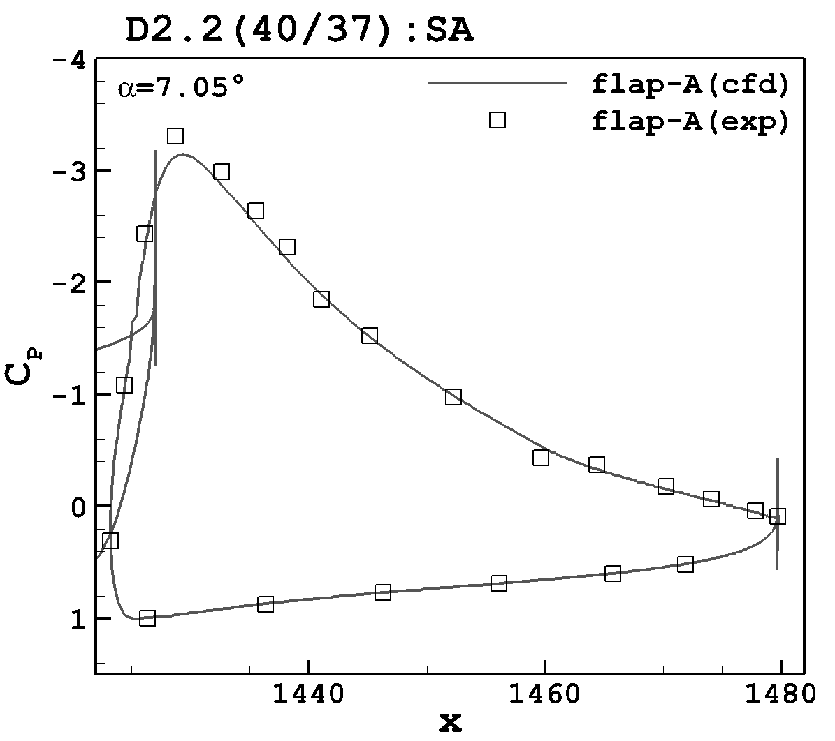
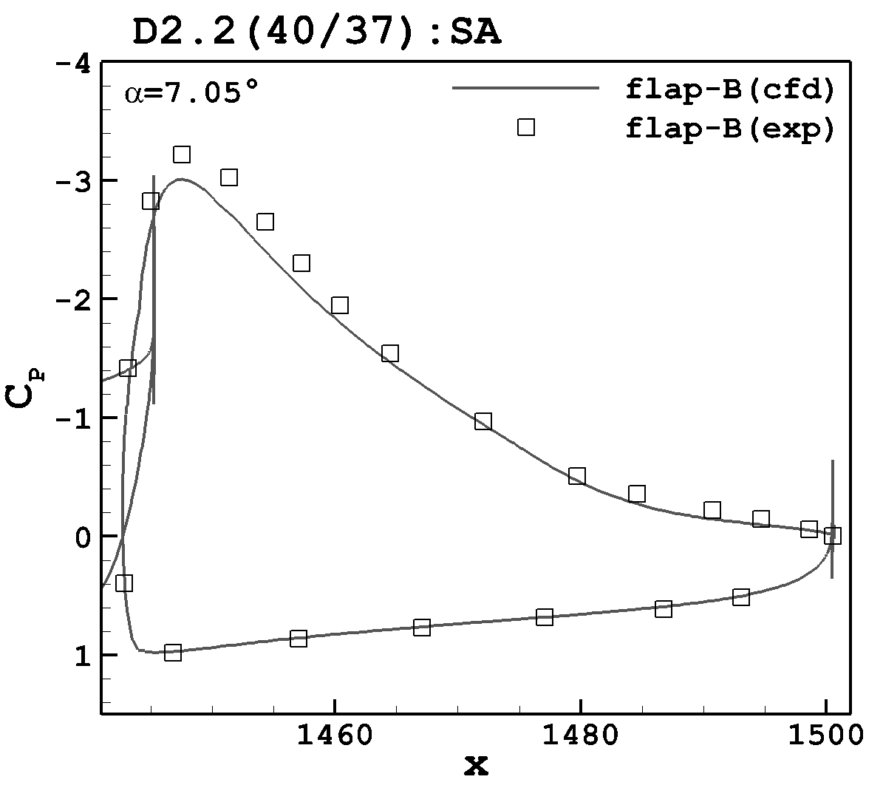
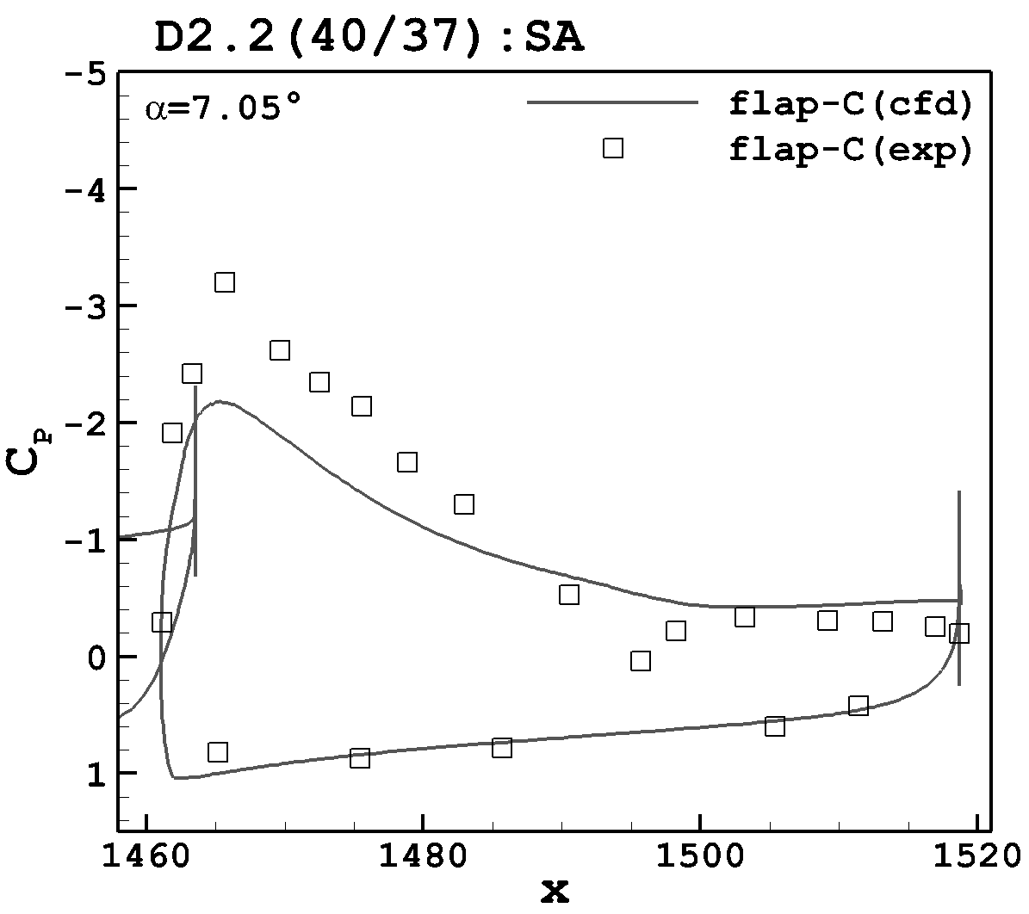
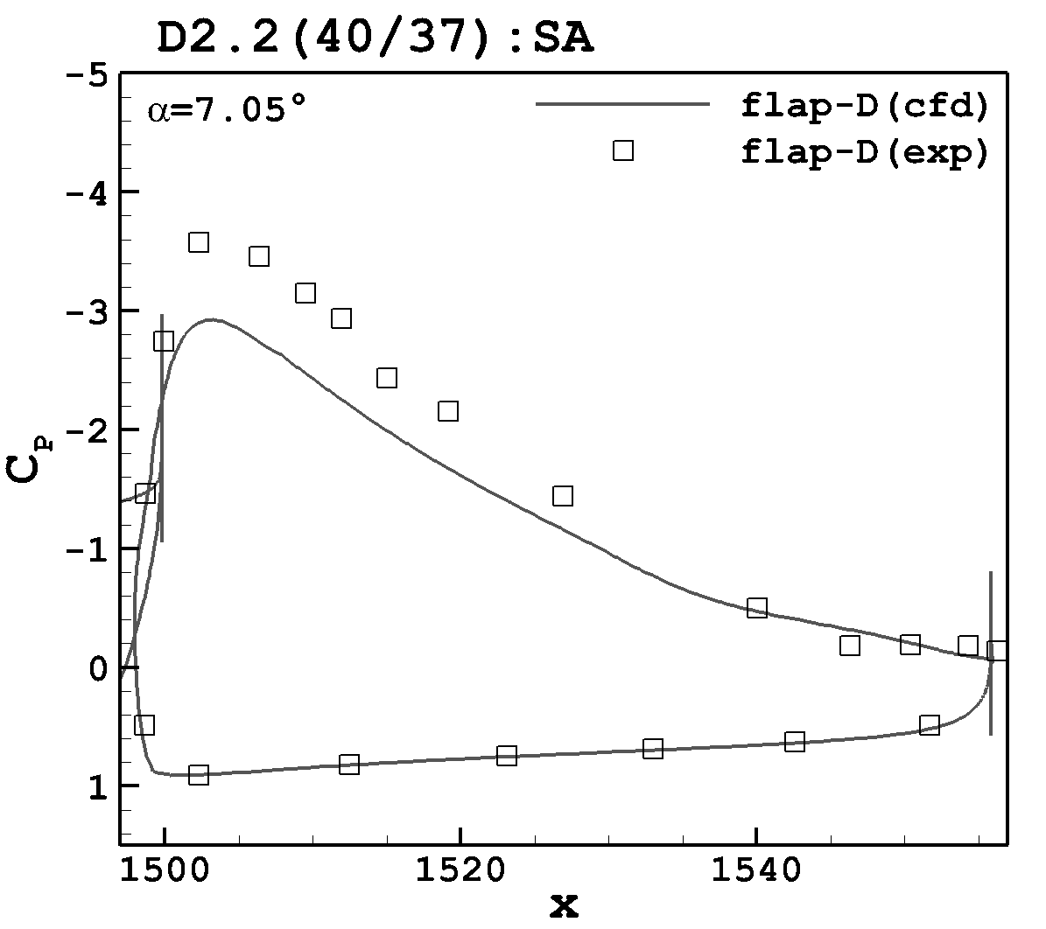
Pressure Coefficient (flaps:40/37; α = 7.05°; SA)

Slide 18
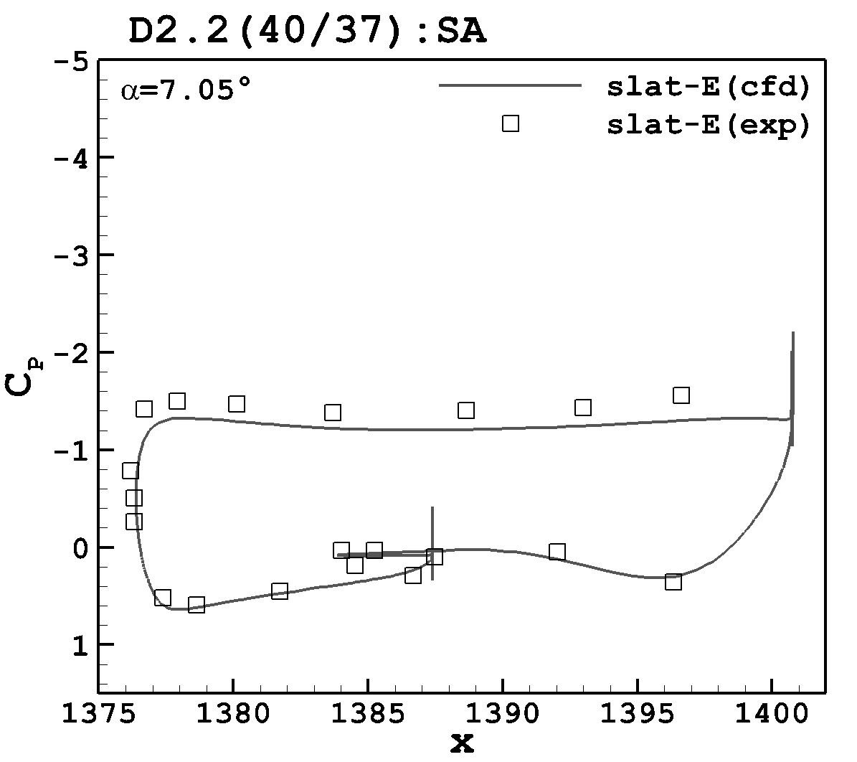
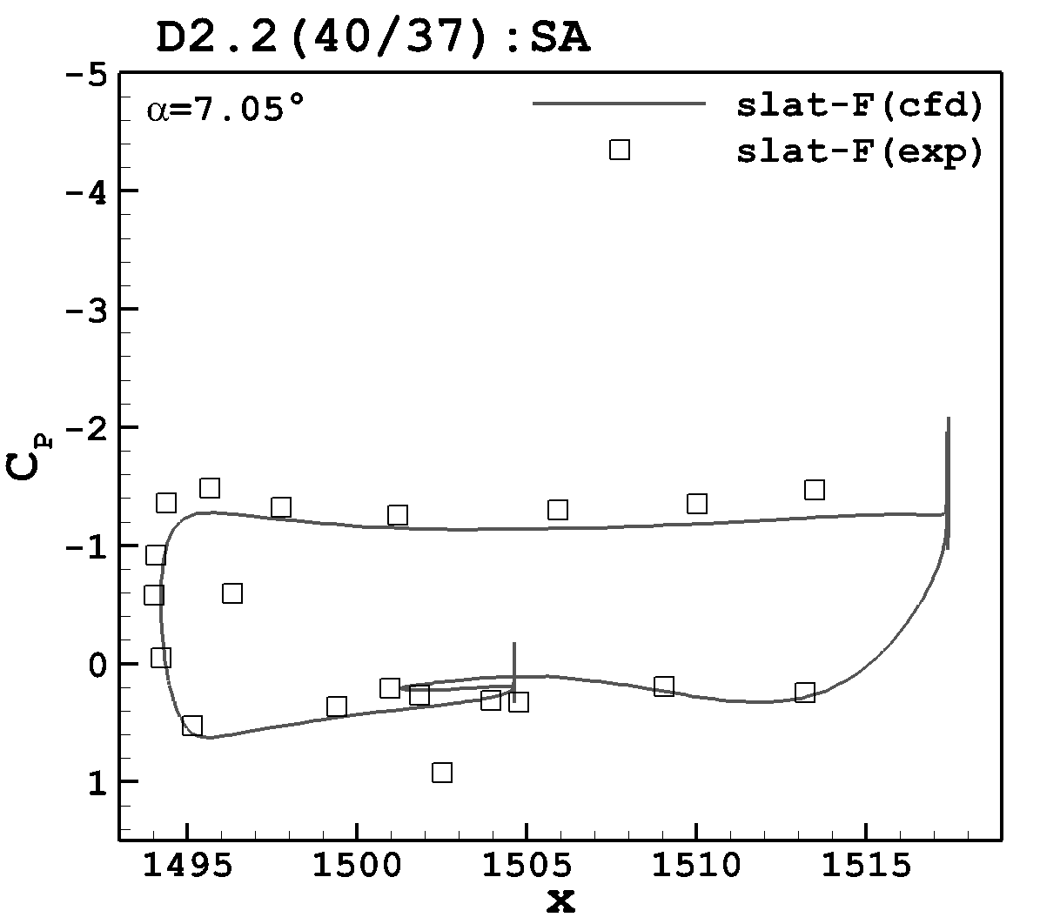
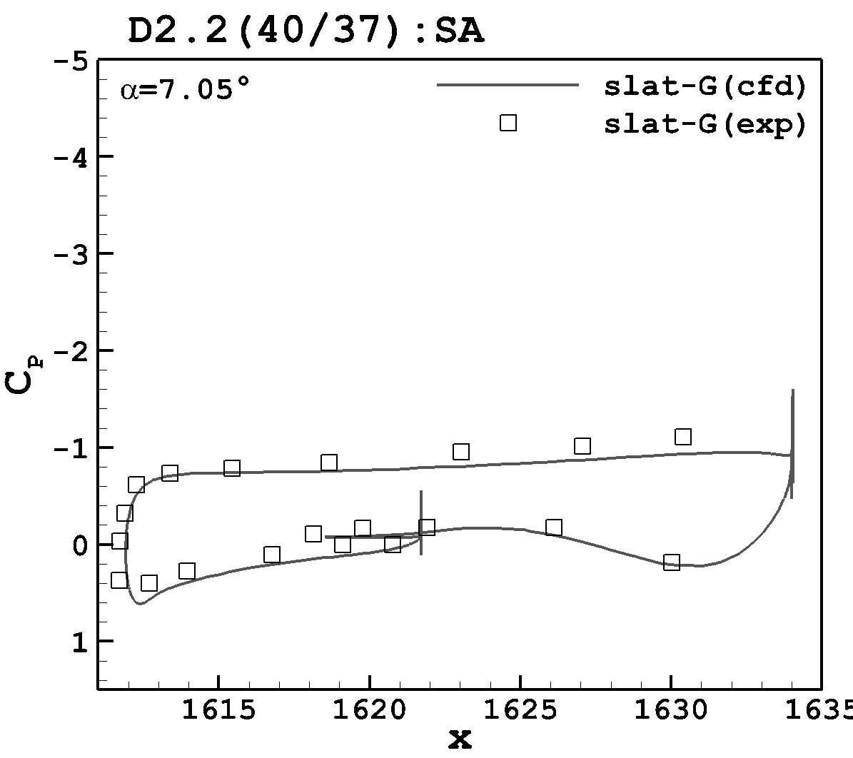
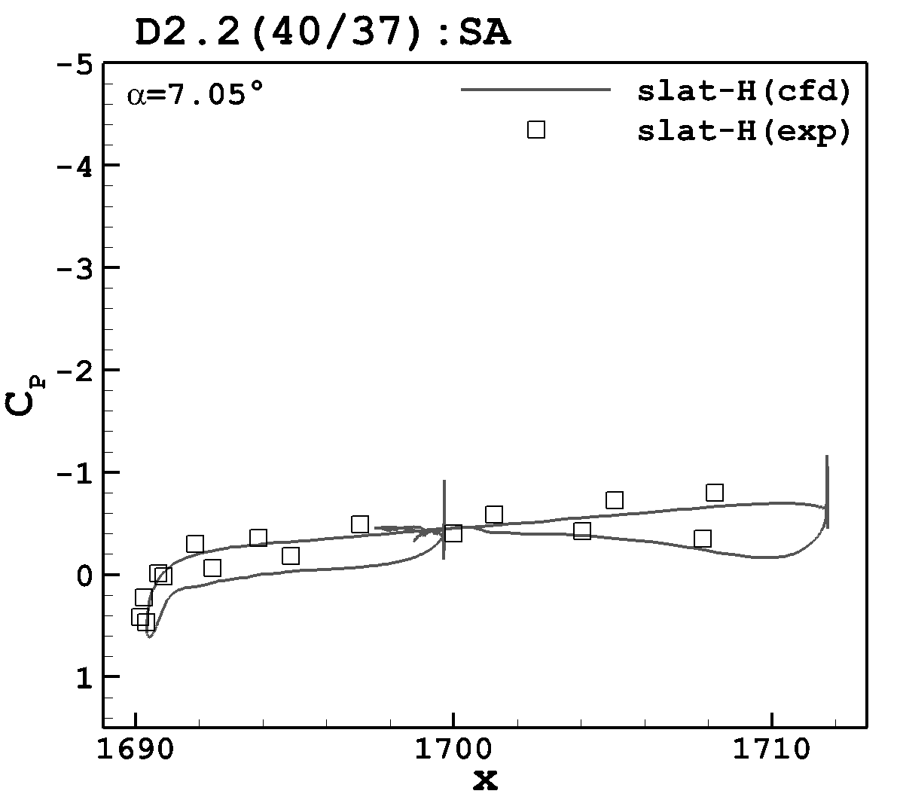
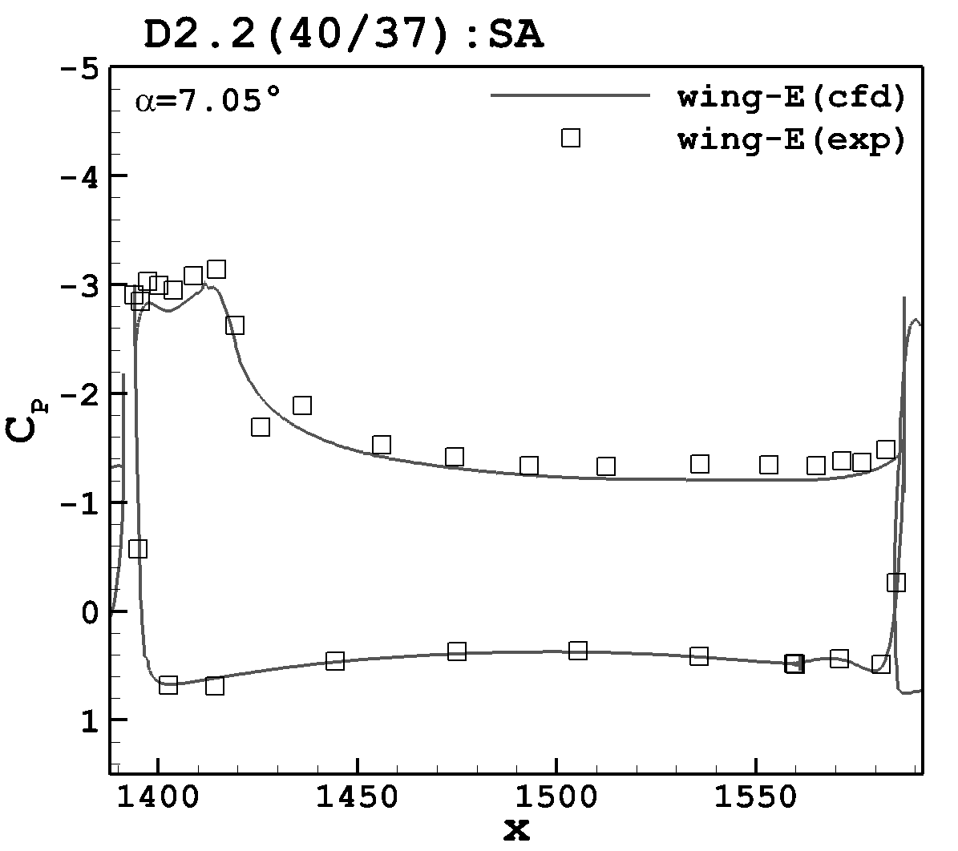
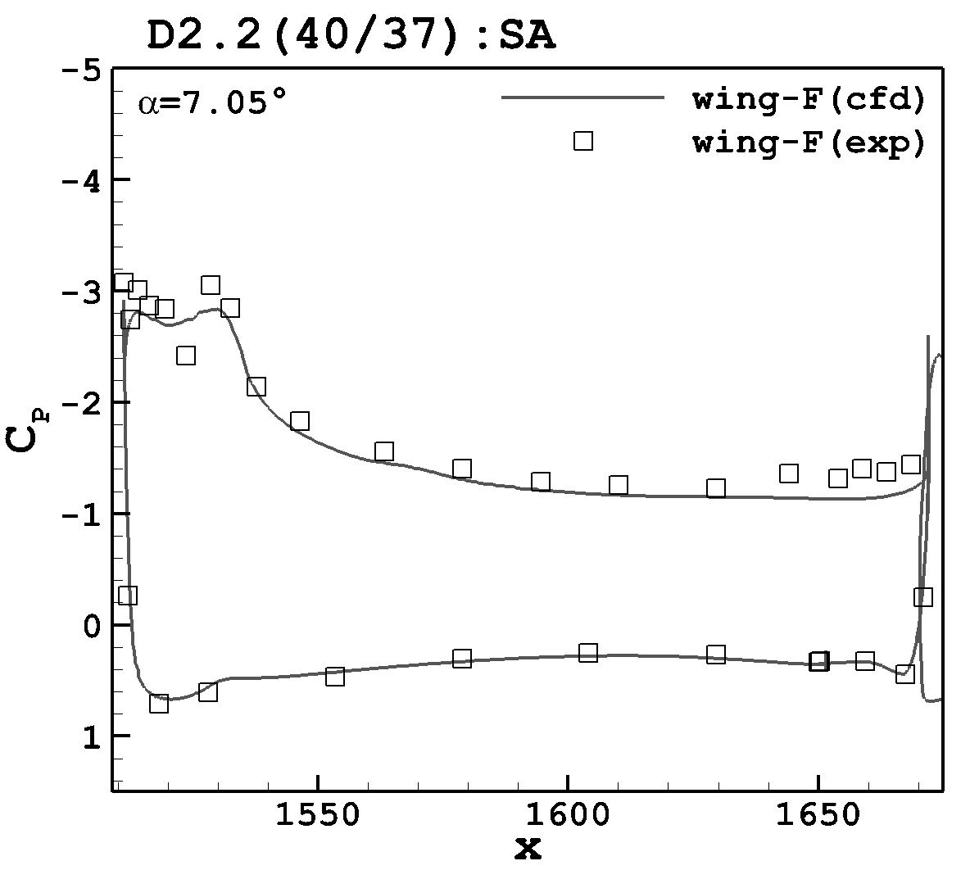
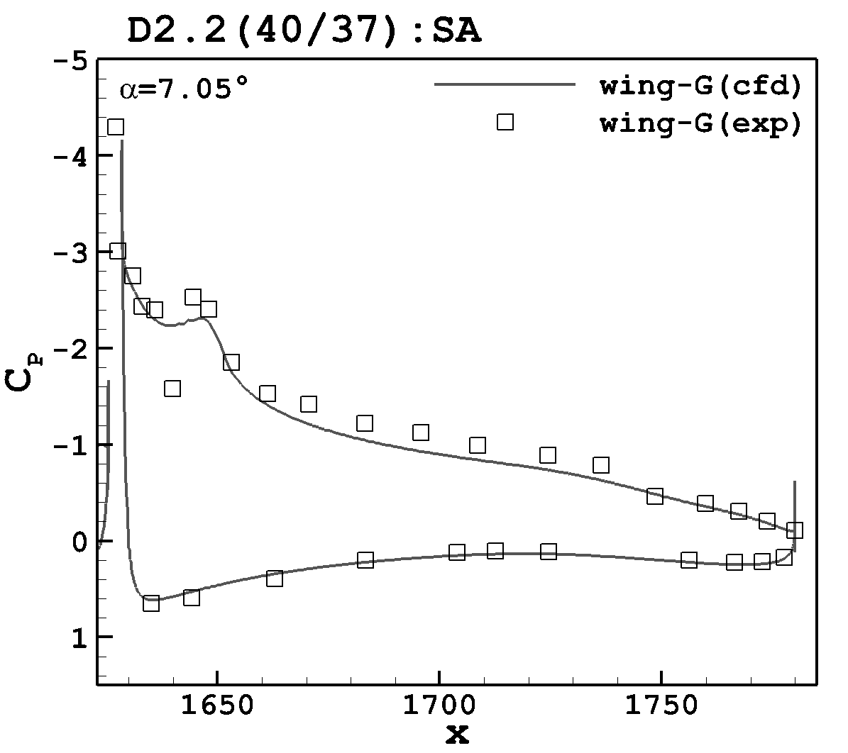
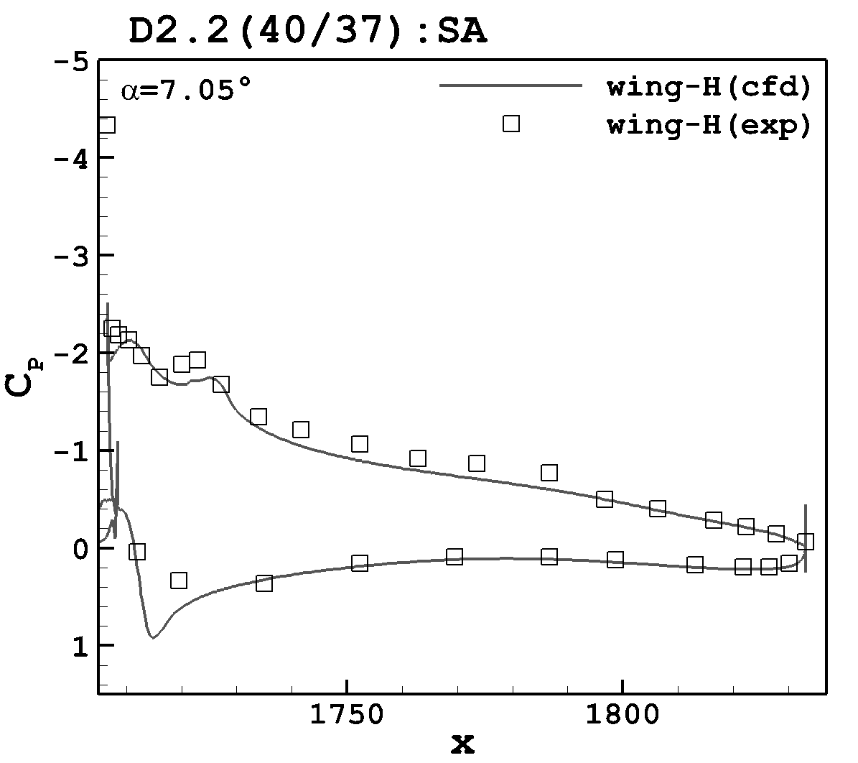
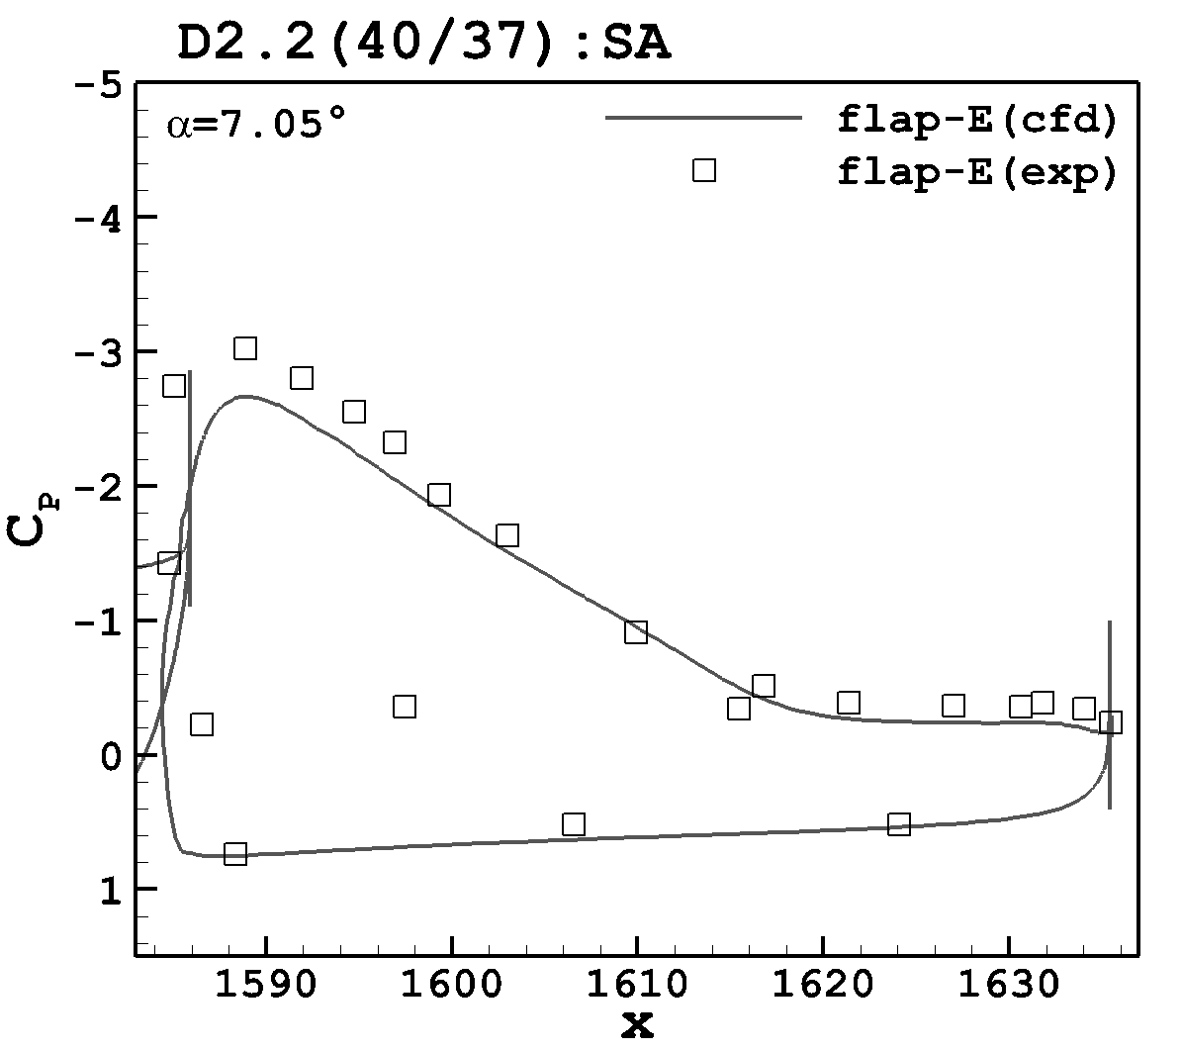
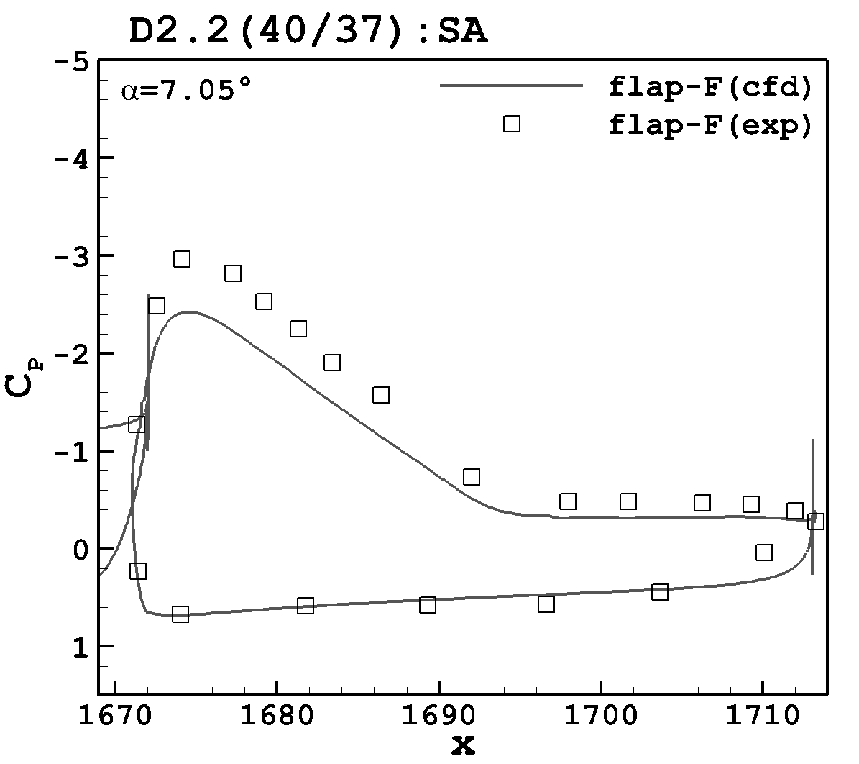
Pressure Coefficient (flaps:40/37; α = 7.05°; SA)

Slide 19
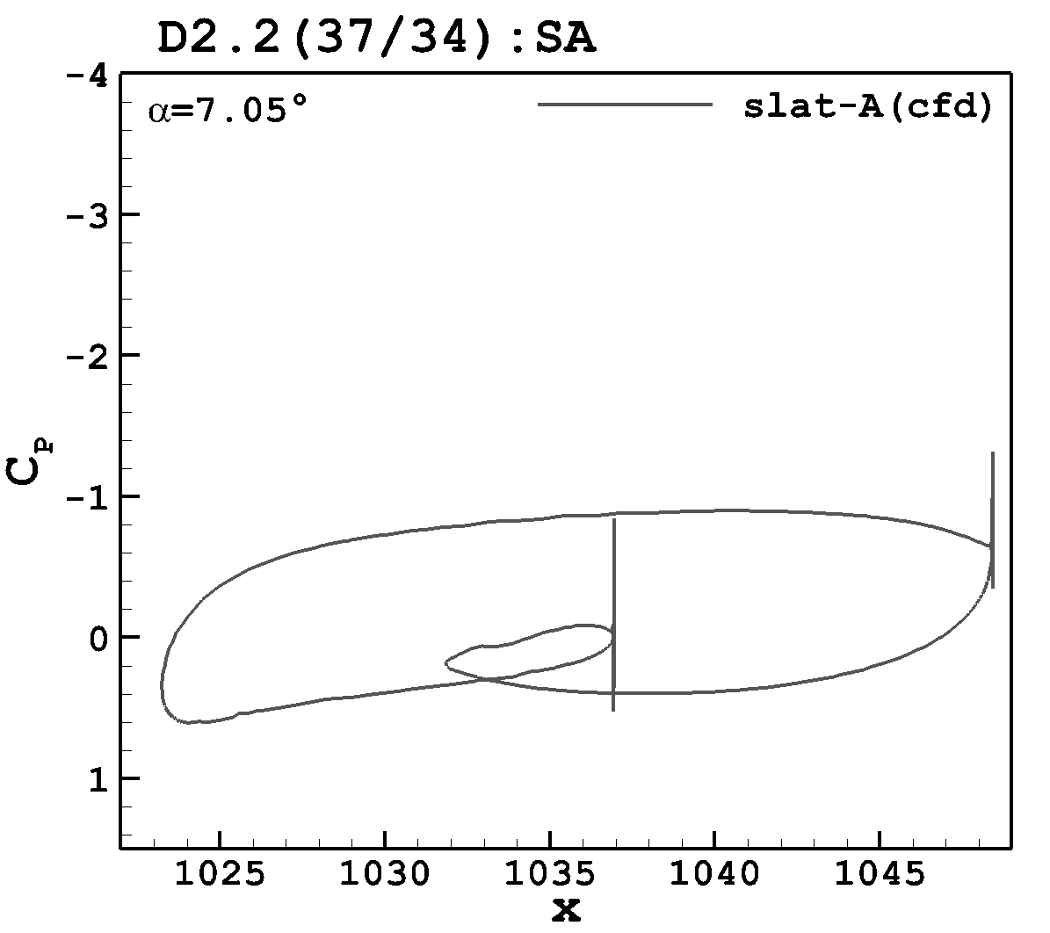
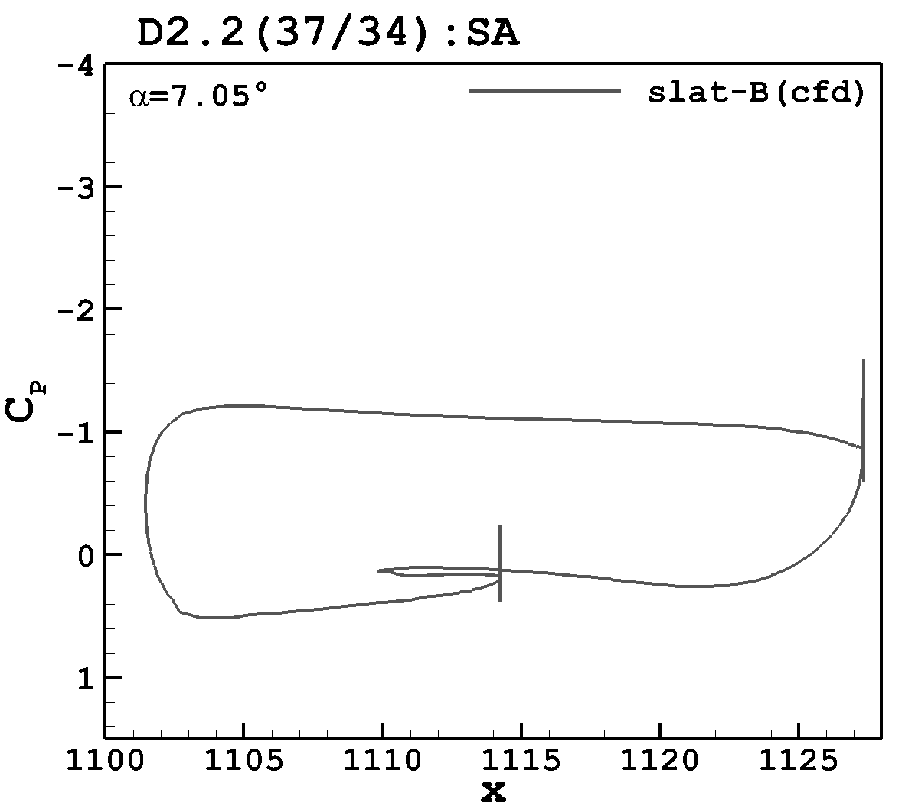
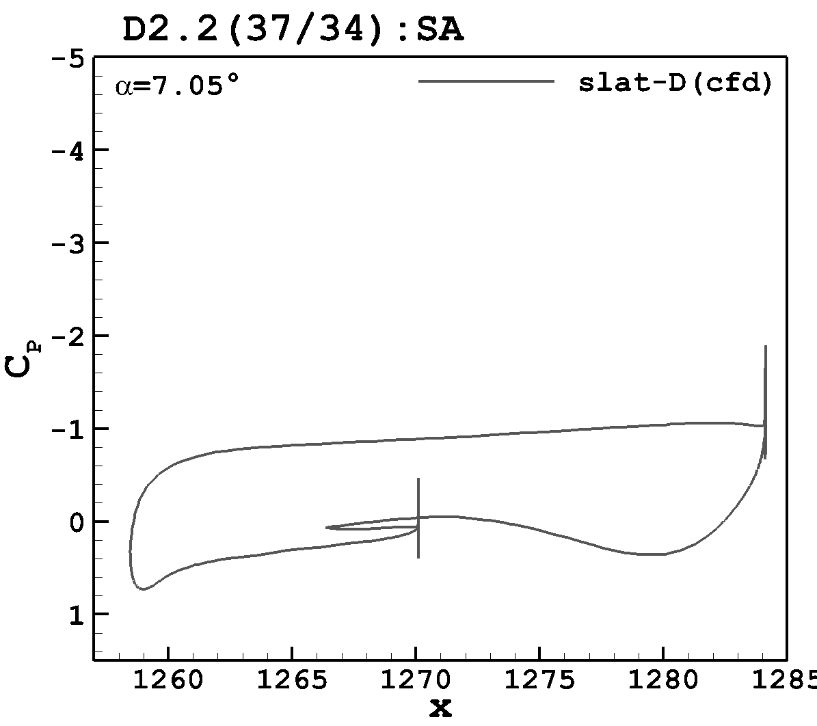
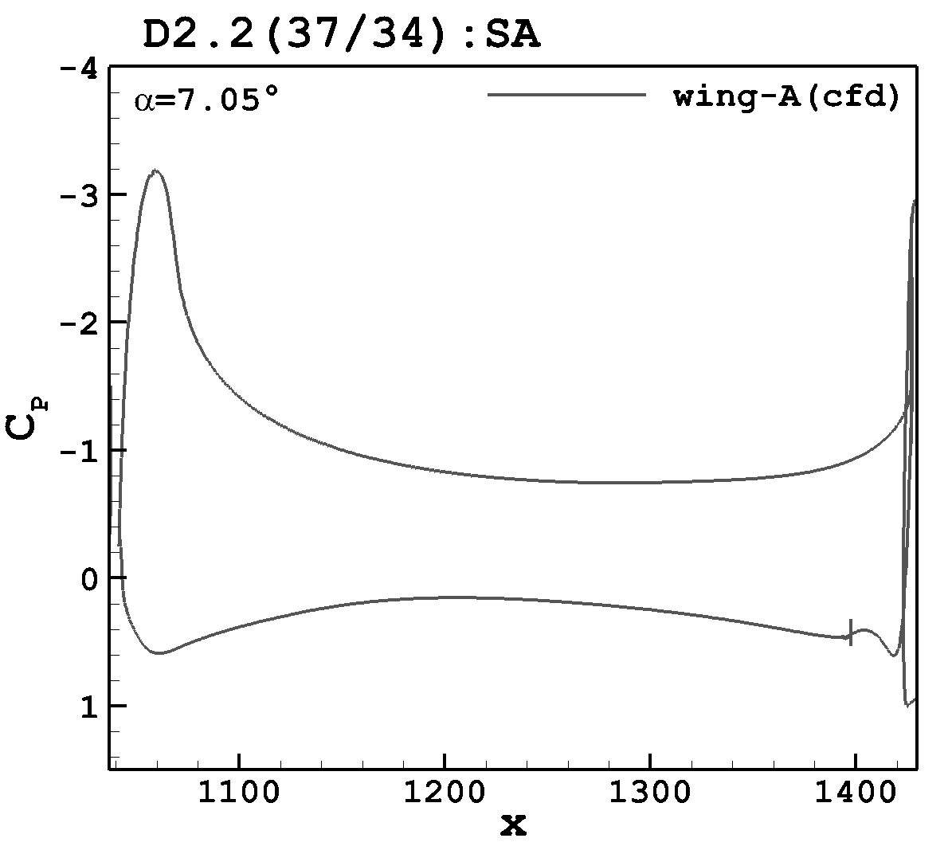
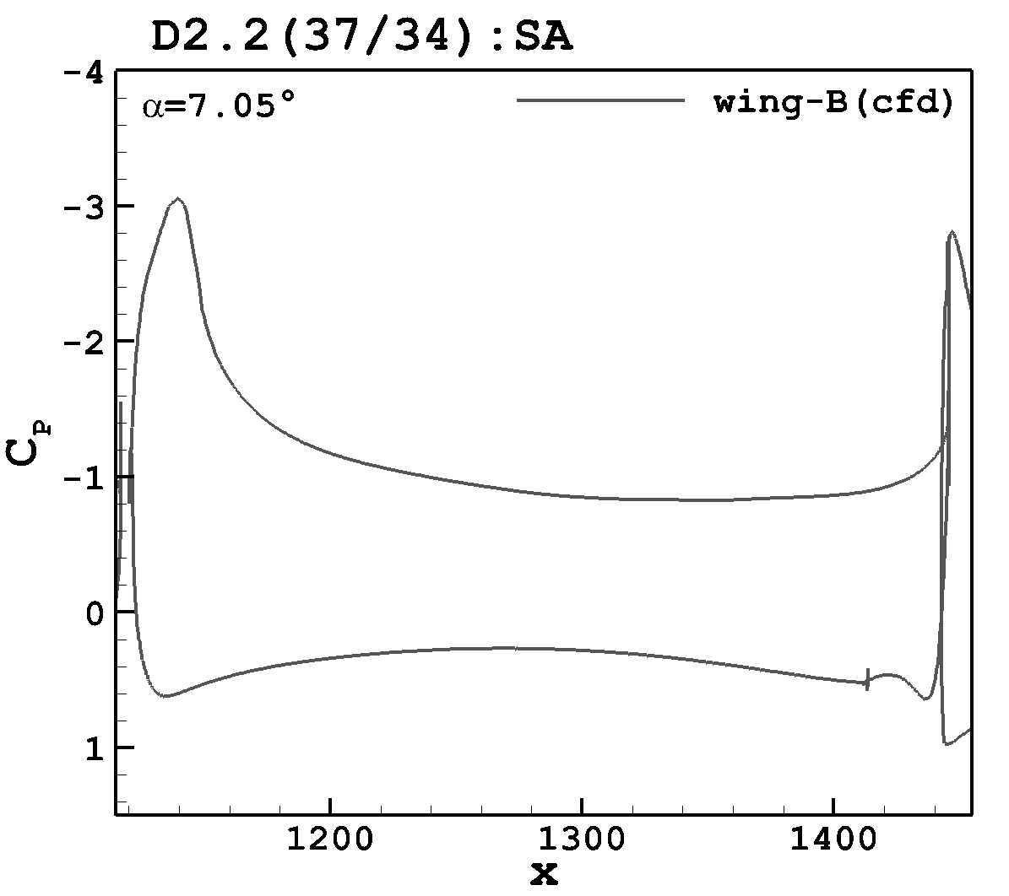
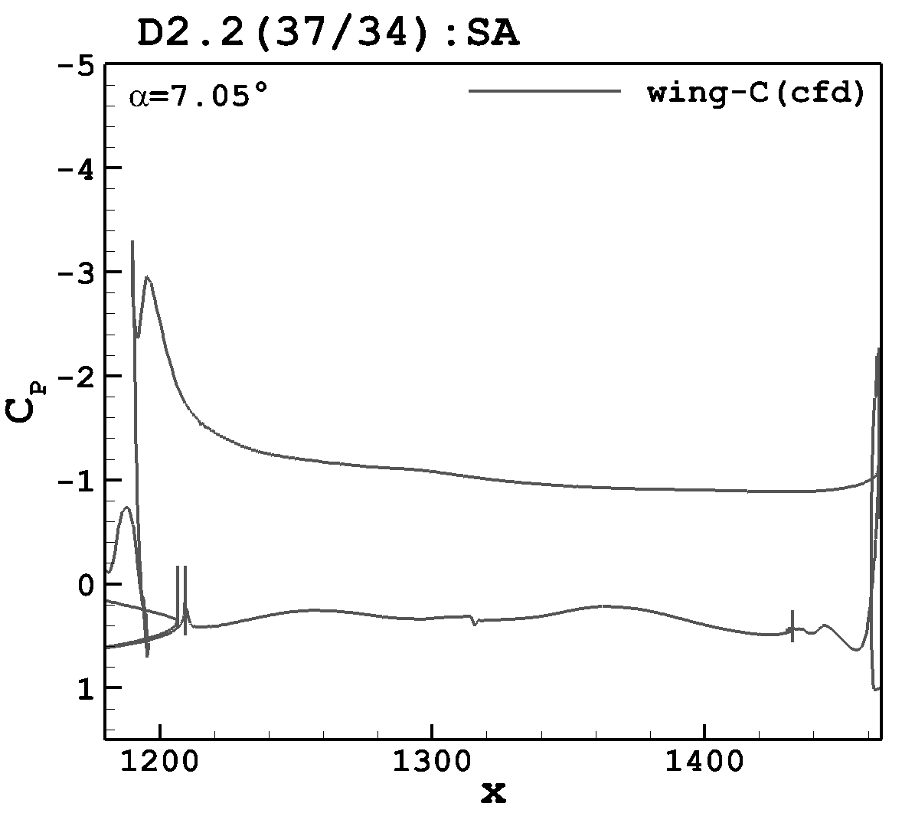





Pressure Coefficient (flaps:37/34; α = 7.05°; SA)

Slide 20










Pressure Coefficient (flaps:37/34; α = 7.05°; SA)

Slide 21











Pressure Coefficient (flaps:43/40; α = 7.05°; SA)

Slide 22










Pressure Coefficient (flaps:43/40; α = 7.05°; SA)

Slide 23
Case 2: C_{L,max} Study
Reference Conditions
Grids (Prism-Tet)
Parameter | Value
M | 0.2
Re | 5.49 million
T_{ref} | 521 °R
α | 2.78°, 7.05°, 11.29°, 14.46°, 17.05°, 19.57°, 20.55°, 21.47° (wall corrected)
Grid Level | Nodes
A1.2(40/37) | 11,943,153
B1.2(40/37) | 31,660,032
C1.2(40/37) | 91,112,700
D2.2(40/37) | 202,542,838

Slide 24








A1.2(40/37) Grid (SA – Roe) Convergence/C_{L}

Slide 25








C1.2(40/37) Grid (SA – Roe) Convergence/C_{L}

Slide 26







D2.2(40/37) Grid (SA – Roe) Convergence/C_{L}

Slide 27



A1.2, C1.2 & D2.2 Grids (SA – Roe) Forces/Moments

Slide 28






Streamlines (View 1)
D2.2(40/37)
alpha=2.78°
SA
D2.2(40/37)
alpha=7.05°
SA
D2.2(40/37)
alpha=11.29°
SA
D2.2(40/37)
alpha=17.05°
SA
D2.2(40/37)
alpha=19.57°
SA
D2.2(40/37)
alpha=20.55°
SA
D2.2(40/37)
alpha=21.47°
SA

Slide 29







Streamlines (View 2)
D2.2(40/37)
alpha=2.78°
SA
D2.2(40/37)
alpha=7.05°
SA
D2.2(40/37)
alpha=11.29°
SA
D2.2(40/37)
alpha=17.05°
SA
D2.2(40/37)
alpha=19.57°
SA
D2.2(40/37)
alpha=20.55°
SA
D2.2(40/37)
alpha=21.47°
SA

Slide 30







Streamlines (View 3)
D2.2(40/37)
alpha=2.78°
SA
D2.2(40/37)
alpha=7.05°
SA
D2.2(40/37)
alpha=11.29°
SA
D2.2(40/37)
alpha=17.05°
SA
D2.2(40/37)
alpha=19.57°
SA
D2.2(40/37)
alpha=20.55°
SA
D2.2(40/37)
alpha=21.47°
SA

Slide 31







Streamlines (View 4)
D2.2(40/37)
alpha=2.78°
SA
D2.2(40/37)
alpha=7.05°
SA
D2.2(40/37)
alpha=11.29°
SA
D2.2(40/37)
alpha=17.05°
SA
D2.2(40/37)
alpha=19.57°
SA
D2.2(40/37)
alpha=20.55°
SA
D2.2(40/37)
alpha=21.47°
SA

Slide 32





Skin Frictions (View 1)

Slide 33
Skin Friction (View 5)

Slide 34







Skin Friction (View 6)

Slide 35







Skin Friction (View 7)

Slide 36







Skin Friction (View 8)

Slide 37







Skin Friction (View 9)

Slide 38







Skin Friction (View 10)

