Slide 1
Suits and Crew Deconditioning
Affording Mars VIII Workshop
1 June 2021
This document has been reviewed for Proprietary, SBU, and Export Control (ITAR/EAR) and has been determined to be non-sensitive. It has been released to the public via the NASA Scientific and Technical Information (STI) Process (Document ID 20210016331).

Slide 2
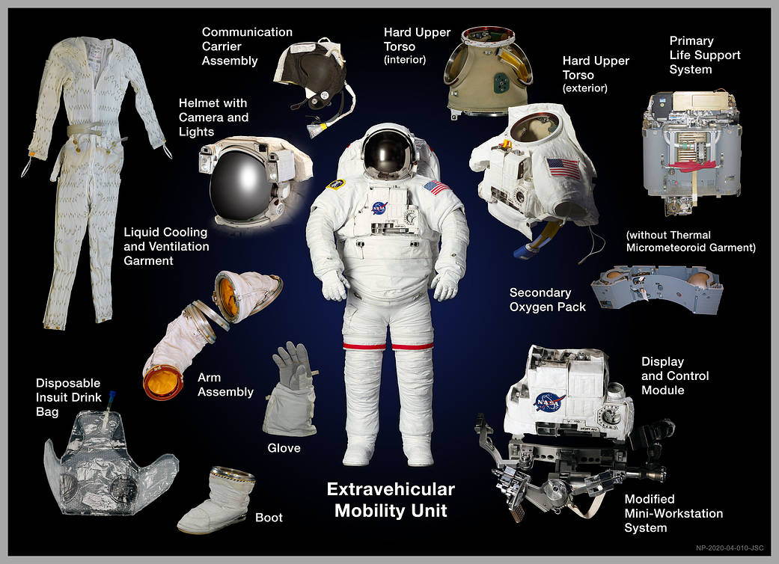
Current ISS Operational Suit Design (EMU) Components
This document has been approved for public release (Document ID 20210016331) and does not contain any export-controlled information.

Slide 3
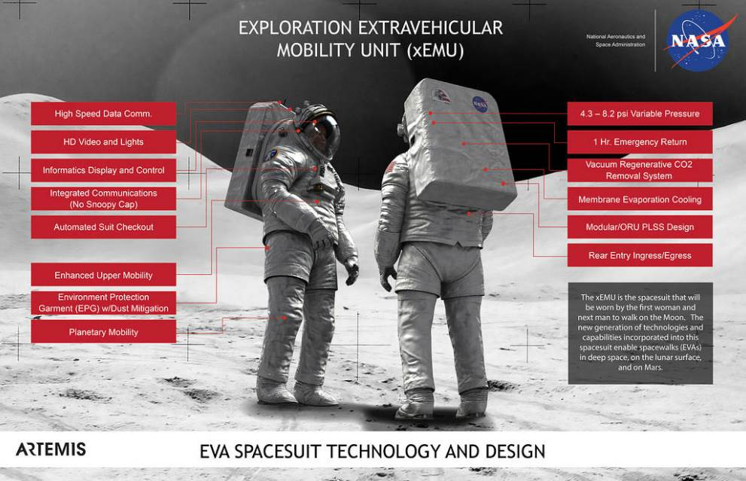
In Development Exploration EVA Suit Design (xEMU) Enhancements
This document has been approved for public release (Document ID 20210016331) and does not contain any export-controlled information.

Slide 4
Crew Deconditioning Overview
Physiological Adaptation
Cardiovascular Deconditioning
Declined Aerobic (Cardiopulmonary /Cardiorespiratory) Capacity
Bone Density Loss
Muscle Mass Loss
Ocular Distortion
Spinal Elongation
General Fluid Shifting
Impacts
Decreased crew performance
Increased crew injury risk
All of these coupled with nominal psychological affects due to long duration space flight, isolation, and communication latency associated with Mars missions compound the psychological affects of decreased physical capability and increase the overall impacts to the crew’s cognitive capacity
Reference 2020 Crew Health & Performance EVA Roadmap
https://www.nasa.gov/sites/default/files/atoms/files/tp-20205007604.pdf
This document has been approved for public release (Document ID 20210016331) and does not contain any export-controlled information.

Slide 5
Approach to Suit Development
A Suit Specific Approach
A suit specific approach to suit development is driven by two guiding principles in priority order:
Provide life support systems to sustain the life of the crewmember
Provide as much mobility and dexterity for functional performance as possible without impacting number one
A System Approach
A system approach to suit development considers the following elements:
In addition to suits being a comprehensive protective system, suits can also serve as a proactive functional enabler within the overall architecture
Suits can serve as a subsystem of the overall crew health and performance system
Facilitates collaboration and synergy in solving suit challenges as well as crew performance challenges
Enables adaptive functional application to spur environmental adaptation and stimulate crew health for return
Includes effective utilization of all elements of the xEVA System (i.e.: tools, support team)
This document has been approved for public release (Document ID 20210016331) and does not contain any export-controlled information.

Slide 6
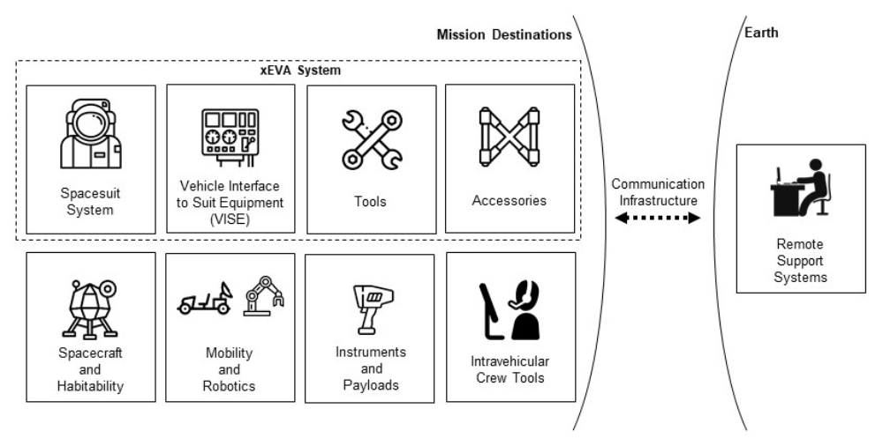
xEVA System Elements (reference EVA-EXP-0042 xEVA System ConOps)
https://www.nasa.gov/suitup/reference
This document has been approved for public release (Document ID 20210016331) and does not contain any export-controlled information.

Slide 7
System Approach & Crew Deconditioning Mitigation Discussion Primer
Crew Deconditioning Challenges & Questions to Consider
[NOTE: assumption is that in-transit mitigation options are not being discussed and the crew IS deconditioned upon arrival at the surface of Mars]
How can a suit system help to overcome orthostatic intolerance?
  Potentially incorporate compression garments into the suit design?
  How does the potential solution create additional limitations/impacts (i.e.: decreased mobility, decreased thermal management effectivity)?
How can a suit system help to overcome decreased aerobic capacity?
  Potentially increasing suit system capability to compensate for anticipated increase in metabolic loading and consumable depletion?
  How does the potential solution create additional limitations/impacts due to increased mass?
How can a suit system help to overcome increased injury risk due to bone density & muscle mass loss while also improving crew performance?
  Potential incorporation of an exoskeleton to reduce loading on crewmember?
  Potential implementation of umbilical operations vs. back mounted life support system?
  How does the potential solution create additional limitations/impacts (i.e. decreased mobility, increase system mass impacts on transportation systems)?
This document has been approved for public release (Document ID 20210016331) and does not contain any export-controlled information.

Slide 8
System Approach & Crew Deconditioning Mitigation Discussion Primer
Crew Deconditioning Challenges & Questions to Consider
[NOTE: assumption is that in-transit mitigation options are not being discussed and the crew IS deconditioned upon arrival at the surface of Mars]
How can a suit system accommodate fluid shifts and changing anthropometrics while enabling proper fit for performance and injury prevention?
  Potential inclusion of compression garments to facilitate fluid balancing?
  Potential mechanical counterpressure suit system instead of pressure garment system?
  How does the potential solution create additional limitations (i.e. mobility, timelines due to technology development needs)?
How can a suit system help to overcome potential decreased cognitive capacity and the potential compounding effects from decreased ground support?
  Potential inclusion of informatics systems and autonomous system monitoring to reduce cognitive load?
  How does the potential solution create additional limitations or adapt to changes in crew physiology (i.e.: intensify cognitive loading instead of alleviating it, compounding visual changes)?
This document has been approved for public release (Document ID 20210016331) and does not contain any export-controlled information.

Slide 9
System Approach & Crew Deconditioning Mitigation Discussion Primer
Suit Development Challenges to Consider
Optimization of suit system capability vs. crew mass loading
Enhancing reliability while reducing suit system complexity
Implementing highly effective suit characteristics while also facilitating multi-environmental usability (micro-gravity and partial gravity scenarios; vacuum and partial atmosphere scenarios) to minimize the need for multiple suits and impacts to transportation architectures
Questions to Consider Across the Board
Can you or how do you modulate implementation of the many potential solutions to facilitate crew development and reconditioning instead of fostering a dependency that further diminishes the crew’s capability outside of the suit system?
Is there a solution that would improve crew health & performance that further facilitates the crew’s transition back to Earth?
Just because the suit can serve a function, is it the most effective/efficient to do so or is it better to utilize other systems?
Reference 2020 EVA Gap List
https://www.nasa.gov/sites/default/files/atoms/files/2020_eva_gap_list.pdf
This document has been approved for public release (Document ID 20210016331) and does not contain any export-controlled information.

Slide 10
Conclusion
The suit system is a key element in any human space exploration mission
There is a delicate balance between suit capability and crewmember capability
The further we explore beyond Earth, the more reliable a suit system must be in ever-increasing uncertain environments
The suit system can help solve other crew health & performance needs
A systematic, methodical, and collaborative approach must be taken to fully understand the trade-offs involved in the myriad of implementation options available
Even with a system approach to suit development:
  The more complex the overall system architecture, the more intentional we must be to prioritize key capability
  The number of system variables will grow requiring a clear prioritization rubric for identifying and ensuring critical capability
  The demand and pressure to provide increasing capability while reducing overhead (mass, cost, volume, schedule) will grow exponentially as access to mission destinations evolve
This document has been approved for public release (Document ID 20210016331) and does not contain any export-controlled information.

