Slide 1


AVIONIC SYSTEMS DIVISION
Human Systems Integration: Capturing the Human Element in Technology Development
Presented to the INCOSE TGCC
George Salazar, P.E.,ESEP ,LSM-IEEE NASA/JSC
M. Natalia Russi-Vigoya, PhD, AHFP KBR/ JSC
Notes:
Presenting on Two areas in human systems—HSI and HRL

Slide 2
Overview
  Purpose:
  Provide a high-level awareness of the Human Systems Integration(HSI) process and the human readiness complement of technology readiness level(TRL) to manage and maximizing system performance.
Topics:
  What is Human Systems Integration (HSI)?
  Expected benefits of HSI
  HSI in the development process
  Human Readiness Level (HRL) Metrics
  Closing Remarks

Slide 3
Overview
Topics:
  What is Human Systems Integration (HSI)?
  Expected Benefits of HSI
  Human Systems Integration (HSI) In the Development Process
  Human Readiness Level Metrics
  Closing Remarks

Slide 4
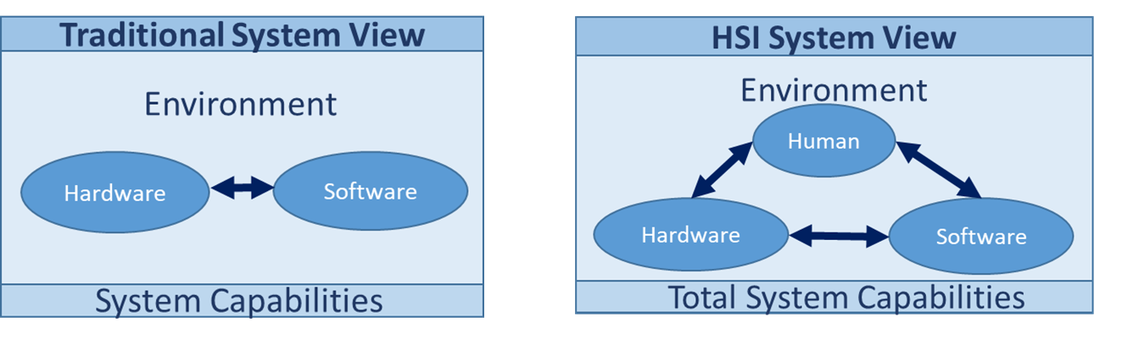

What is Human Systems Integration (HSI)?
HSI is defined as the interdisciplinary technical and management processes as part of the systems engineering process for integrating human considerations within and across all system elements to enhance human system design, reduce life-cycle ownership cost, and optimize total system performance
  Human treated equally with H/W and S/W
  Designing systems with human capabilities and limitations in mind

Slide 5
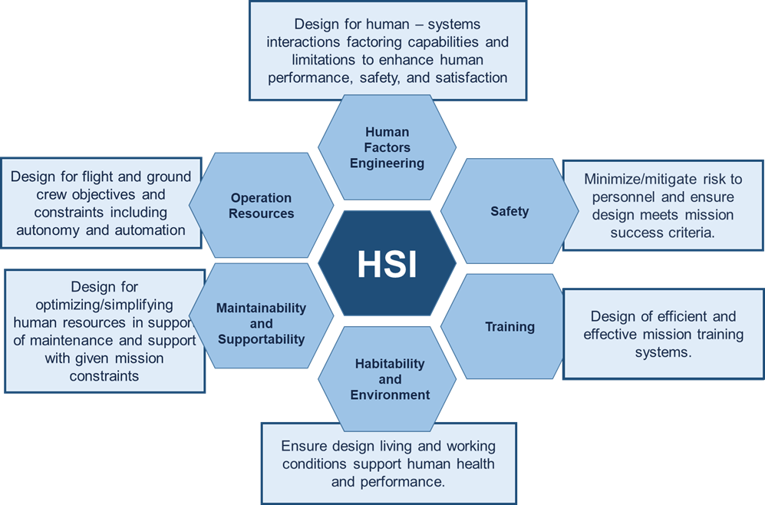
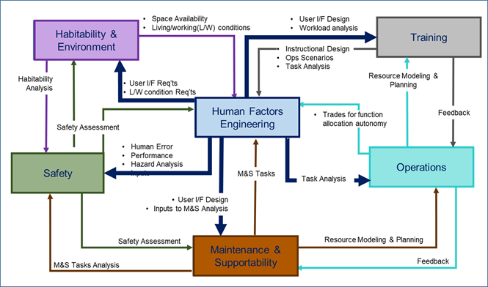
NASA Human Systems Integration (HSI) Domains
Domains Interactions (Notional)
NASA Domains
5
Notes:
Human element focus in system development.
Enhance human system design, reduce life-cycle ownership cost, and optimize total system performance

Slide 6
Next…
Topics:
  What is Human Systems Integration (HSI)?
  Expected Benefits of HSI
  Human Systems Integration (HSI) In the Development Process
  Human Readiness Level Metrics
  Closing Remarks

Slide 7
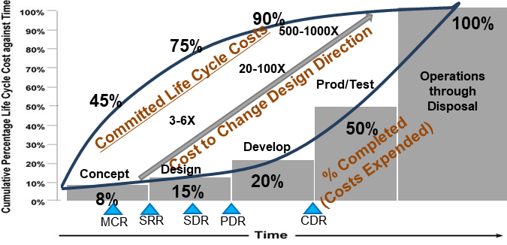
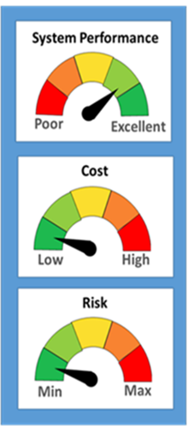
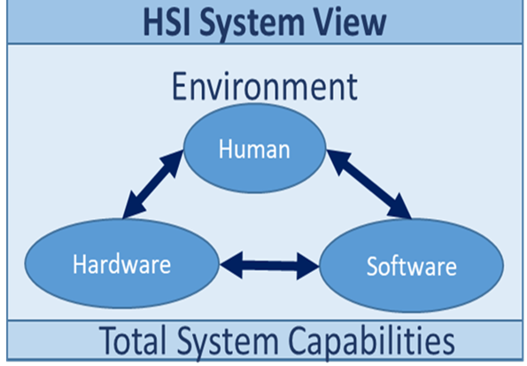
Cost Reduction and System Performance
Minimize cost escalation in complex system development
  Hardware and software has enormous capabilities with more internal and external interactions
  Artificial Intelligence in system decision‐making adds further complexity
Reduce risks such as late rework and increased operating costs
Maximize total system performance, safety, and operations by considering the human throughout the system development life-cycle
Committed Life Cycle Cost against Time (Credit: INCOSE SE HdBk V.3.1)

Slide 8
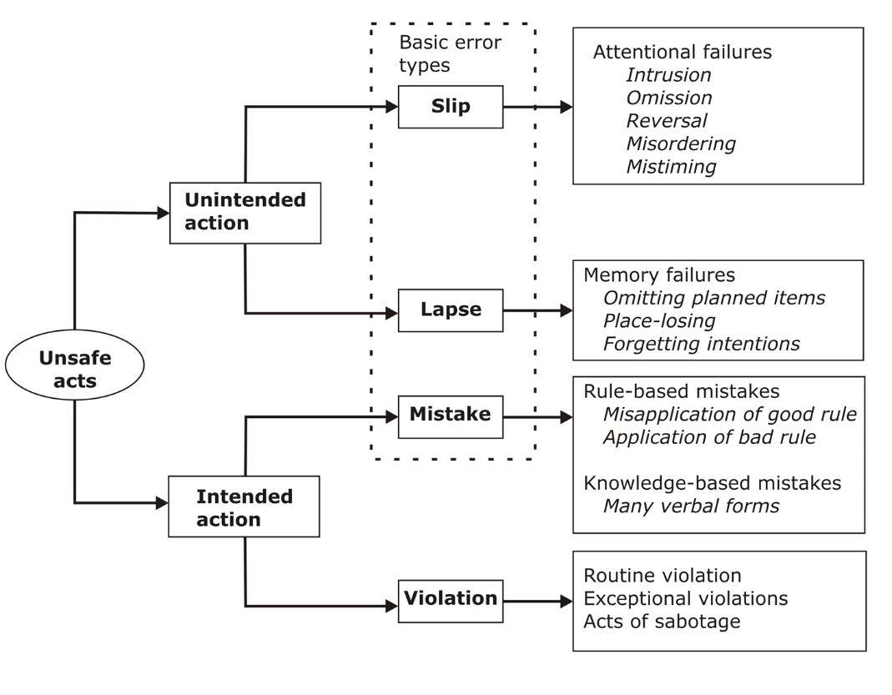
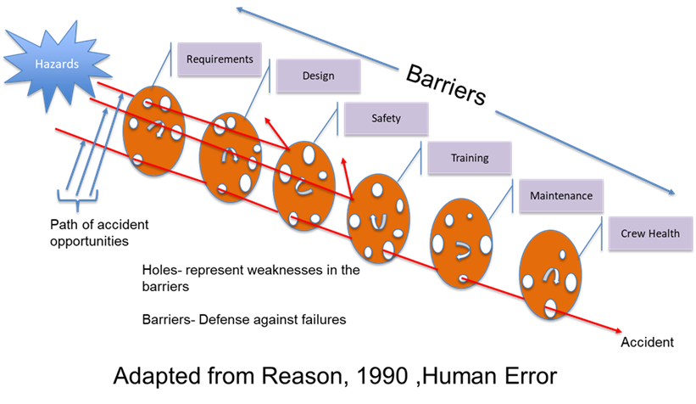
Human Error and Hazard Mitigation
Requirements
Design
Safety
Training
Maintenance
Crew
(Adapted from Reason, 1990)
(Karmaker, and Chowdhury, 1991)

Slide 9
Myth --HFE and HSI Are the Same?
Human Factoring Engineering
Human Systems Integration
HSI
Safety
Operations
HFE
Training
Habitability
Maintenance & Sustainment
Task
Design
Match Machine
To task
Machine
Design
HFE
Match Task
To Human
Match machine
To Human
Human
Main Goal:
Improve performance, enhance safety, and increase user satisfaction
Main Goal:
Ensure the human elements of the total system are effectively integrated with hardware and software elements

Slide 10
Observations In Applying HSI
Few project managers understand the importance of HSI
Most systems engineers understand integrating all systems to ensure system success
  Not fully appreciate is the human + system engineer for optimal performance
Most designers understand H/W and S/W - not humans!
  Think about your engineering studies
HSI practitioners must be engaged early in development as the practitioner does not have the option to “redesign” the human to fit the system
Challenge in coordinating across HSI “domains” with SE to understand each other’s languages, metrics, and concerns-important for communications and compromise

Slide 11
Next …
Topics:
  What is Human Systems Integration (HSI)?
  Expected Benefits of HSI
  Human Systems Integration (HSI) In the Development Process
  Human Readiness Level Metrics
  Closing Remarks

Slide 12
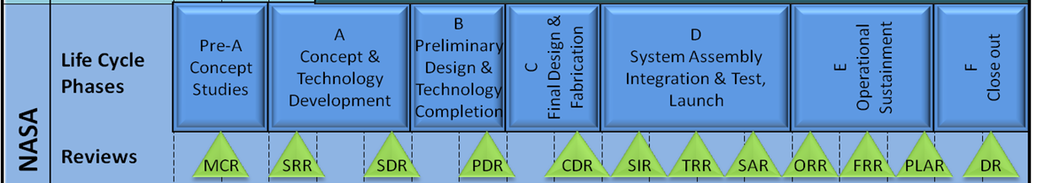
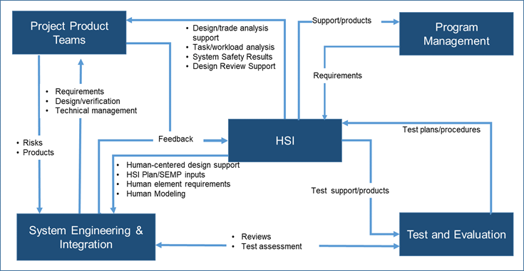
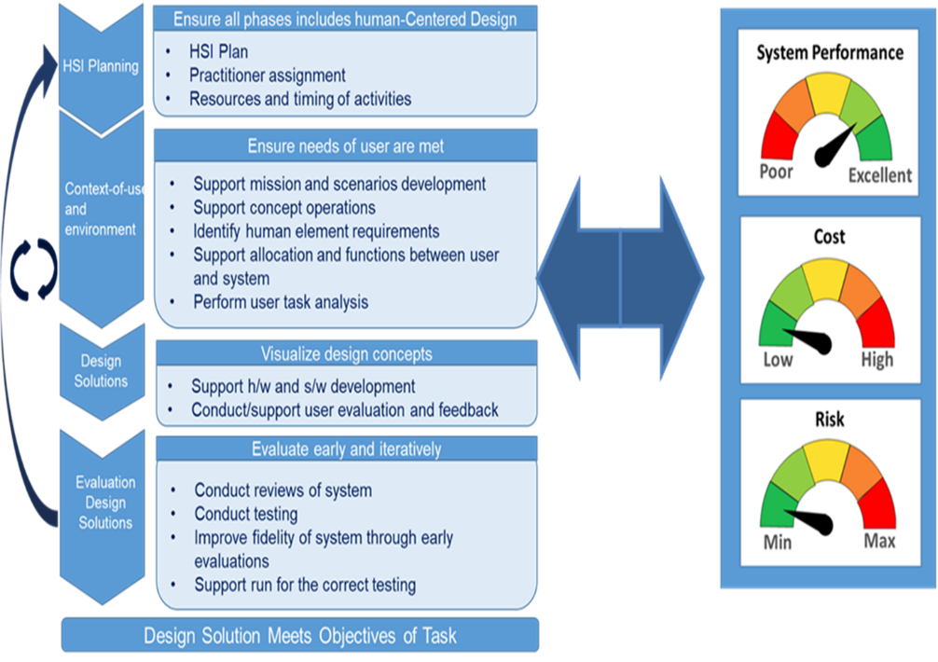
Systems Engineering/HSI Activity Interaction
Total system (human, hardware, software, and environment) optimization happens in an integrated fashion and not components that have been independently optimized
12

Slide 13

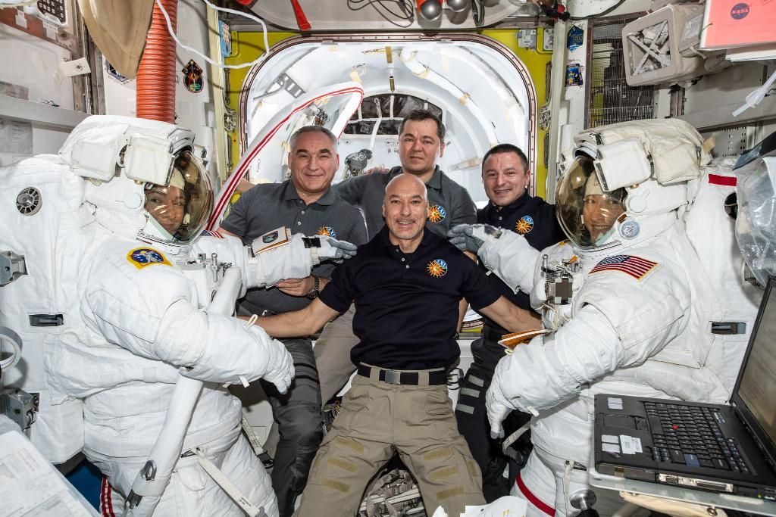
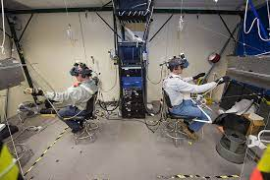
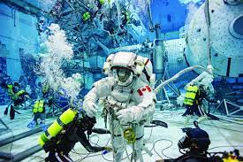
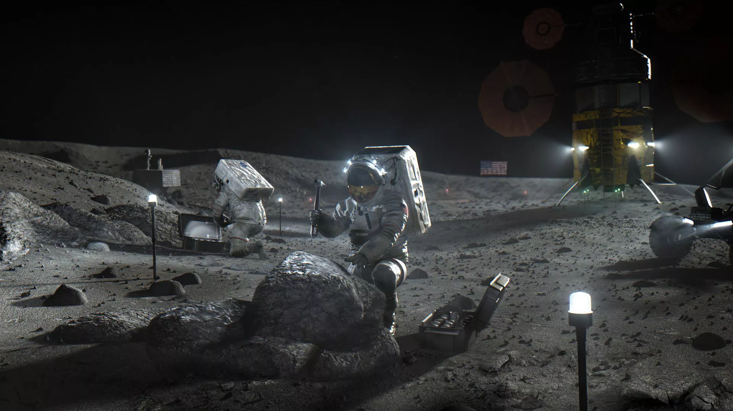
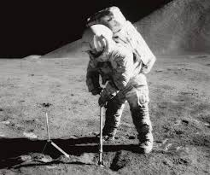

What is it that we are trying to Achieve with Systems Engineering and HSI?
Skills
Abilities
Experience
Can this astronaut
As part of this group
With this training
With no errors
Perform these tasks
Under these conditions
The aim is not to train the astronaut to work a machine that is designed to achieve a goal: Rather, the aim is to design the machine to support the astronaut who is responsible to achieve the goal.
Adapted from:Dr. Holly A.H. Handley:Human System Engineering Community Initiatives: From Human View to Human Readiness Level,3-2020

Slide 14
Next …
Topics:
  What is Human Systems Integration (HSI)?
  Expected Benefits of HSI
  Human Systems Integration (HSI) In the Development Process
  Human Readiness Level Metrics
  Closing Remarks

Slide 15
Performance Metrics in System Development
Traditional performance metrics in system development catered to the hardware/software
  Technical performance measures tools that show how well a system is satisfying its requirements or meeting its goals-providing insight into program risk
    Weight
    Power
    Memory
    Throughput
    For new technology—Technology Readiness Level
    What about the human?
    User research will have different goals at the different stages of design (e.g., exploratory research will seek to identify mental models and natural interactions, higher fidelity prototypes may need to identify performance metrics (e.g., accuracy, time on task, task completion, ease of use, satisfaction, situation awareness, etc.)
    System/product/services human readiness needs to be done from the early stages of design to ensure that the technology level is meeting the user expectations requirements
  What is needed is a metrics to measure human system readiness for use of the technology being developed
    Human Readiness Level (HRL) as an ANSI standard
    It complements the Technology Readiness Level (TRL)
    Provides a simple way of determining the readiness of the technology for the human

Slide 16
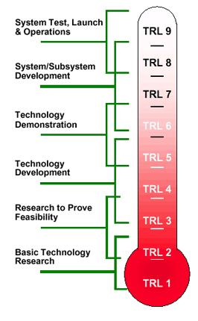
Quick Overview of Technology Readiness Level
Formal metrics that support assessments of a particular technology towards maturity
Advantages
  Facilitates the communication and shared understanding of technology status within and among diverse organizations
  Definitions embedded in the TRL scale actively promote testing and verification to assess maturity
  Gauge progress throughout development and plan anticipated levels of effort remaining to achieve a desired level of maturity
  Manage program schedule and cost risks with a strategy designed to prevent integrating technologies into the system before they are technically mature
Disadvantages
  Does not address interaction/integration readiness of different technologies with various TRLs
  No direct measure of risk, cost, or the feasibility of deployment
  TRL only for the environment intended
  Inability to capture the human-related aspects of technology development and its critical role in the readiness of a technology for operational use
Credit:NASA

Slide 17
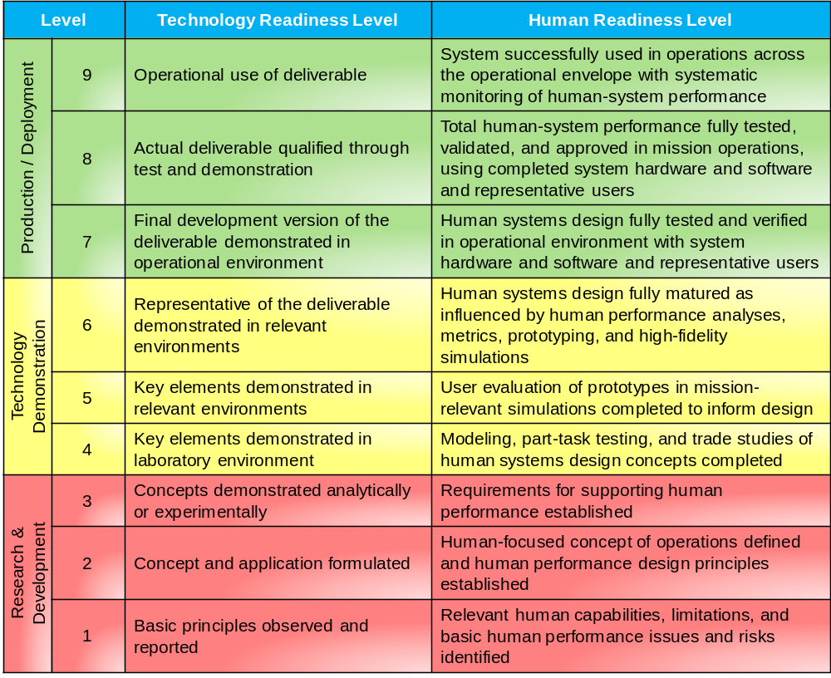
Proposed HRL Scale
Complement and supplement TRL scale
(Flight proven)
Support decisions regarding time and resource investments
Identify human issues early in lifecycle to keep design change and cost down
Increasing Maturity
(PDR requirement)
Provide leading indicators with evidence-based measures of human readiness & human error reduction
Provide a single number to communicate readiness of a technology for human use for high-level decision makers

Slide 18
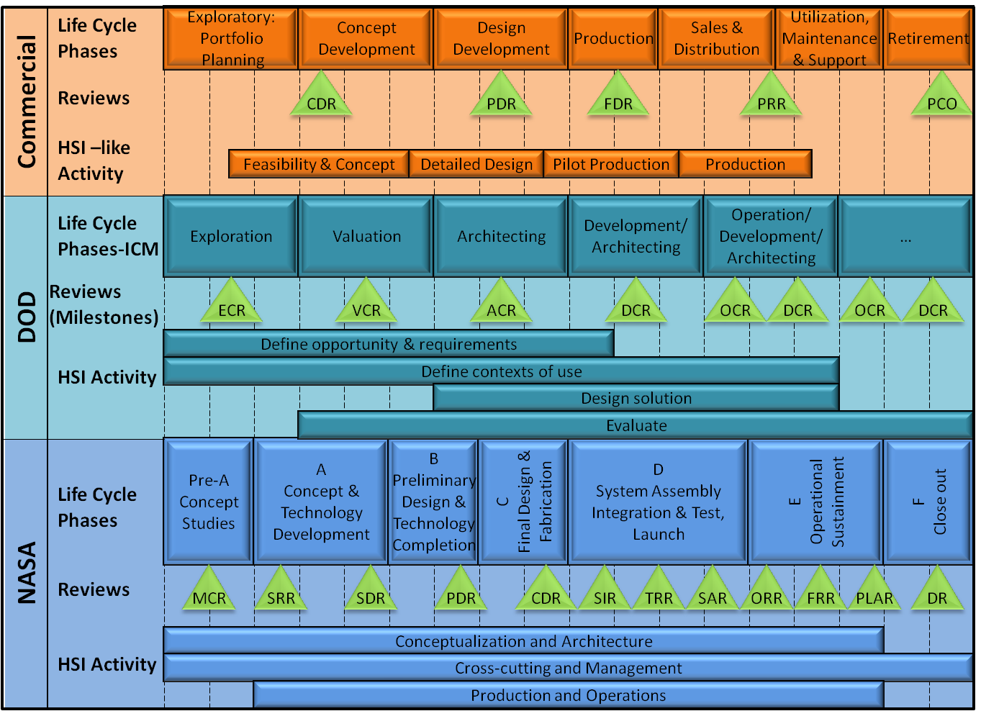
Human Readiness Level (HRL) In the NASA Lifecycle
HRL metrics provides an organization and program management with a simple number indicating the state of integration within the system with respect to humans and technology
  Risks when HRL lags TRL
Like TRL, HRL provides a common understanding of human readiness to support management decisions about development, funding, risks, and life-cycle phases transition
HRL scale looks at leading indicators(evidence-based measures of usability readiness) rather than lagging indicators of human readiness (human error in fielded systems)
TRL 1-3
TRL 4/5
TRL 6
TRL 7
TRL 8
TRL 9
HRL 1-3
HRL 4/5
HRL 6
HRL 7
HRL 8
HRL 9
Notional Mapping of HRL/TRL to NASA Human Spaceflight Lifecycle
HRL soon to become an ANSI standard-ANSI/HFES 400-2021 in the fall of 2021

Slide 19
Overview
Topics:
  What is Human Systems Integration (HSI)?
  Expected Benefits of HSI
  Human Systems Integration (HSI) In the Development Process
  Human Readiness Level Metrics
  Closing Remarks

Slide 20
Closing Remarks
Maximizes total system performance, safety, and operations by considering the human in the system’s design, engineering, and operational environments.
Reduce total ownership cost though the use of HSI.
HRL provides a high-level status of technology ready for the human.
HRLs assesses the degree that HSI requirements have been addressed.

Slide 21
Questions?

Slide 22
Backup

Slide 23
Brief History of Human Engineering Processes at NASA
1965- MSFC‐STD‐391, Human Factors Engineering Program establish minimum human factors requirements to promote the maximum effectiveness and reliability of humans as a system component.
1966-MSFC‐STD‐267A, Human Engineering Design Criteria contained human engineering design principles and practices to be used by engineers in designing equipment for the satisfactory performance of operator, maintenance, and control personnel.
2008- NPR 8705.2B, Human‐Rating Requirements for Space Systems emphasis on the process of achieving human rating of space systems
2010-Human Integration Design Handbook for Human Space Flight, further enhancing NASA’s focus on human‐centered design (HCD)
2013-NPR 7123.1B, NASA Systems Engineering Processes and Requirements, included the first formal definition of HSI in NASA documentation.
2014- NASA/TP‐2014‐218556, Human Integration Design Processes (HIDP) captured NASA human engineering and HSI lessons learned to supplement standards and requirements
2015-NASA‐STD‐3001, NASA Space Flight Human‐System Standard, Volume 2: Human Factors, Habitability, and Environmental Health added requirement for HCD-significant step forward in capturing and documenting NASA’s approach to HSI.
2015-NASA HSI Practitioner’s Guide (HSIPG) was initial HSI guide provided much‐needed guidance on HSI team responsibilities, activities, and products, along with guidance on writing an HSI Plan (HSIP).

