Slide 1
Overview of the CCSDS Optical Communications Interoperability Standards
June 2021
Bernard Edwards / NASA (CCSDS Optical Communications Working Group Chair)
Notes:
1
1
1

Slide 2
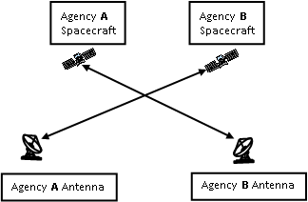
Optical Communications
International Standardization
Sharing optical communication ground stations or relay satellites among the international space agencies would allow the agencies to share the cost of the communications infrastructure.
  For example, due to cloud blockage, it is critical to have multiple ground stations in use during space-to-ground optical operations to provide high availability.
International cross support is being worked within the Interagency Operations Advisory Group (IOAG) and the Consultative Committee for Space Data Systems (CCSDS).
The goal is to develop optical communications cross support by various agencies as we have today in traditional Radio Frequency (RF) communications.
Traditional International
RF Cross Support

Slide 3
CCSDS Optical Communications
Working Group
Scope:
  Physical, coding, and synchronization layer recommendations for the interoperability of flight and ground optical communications terminals
  Recommendations for characterizing the atmosphere channel and for the concept of operations for space-to-ground links
Published Books:
  Blue Book: Optical Communications Physical Layer
    Covers the High Photon Efficiency Recommendations
  Blue Book: Optical Communications Coding and Synchronization
    Covers High Photon Efficiency
  Green Book: Atmospheric Characterization For Optical Communication Systems
  ESA/DLR Orange Book: Optical High Data Rate Communications – 1064 nm
Books awaiting official publication:
  Revision 1 of the Blue Book on Optical Communications Physical Layer
    Will add Optical On / Off Keying Recommendations
  Magenta Book: Atmospheric Characterization and Forecasting for Optical Link Operations
  NASA/CNES/JAXA/NICT Orange Book: Optical High Data Rate Communications – 1550 nm

Slide 4
Future Work of the Optical Communications Working Group
Optical On / Off Keying (O3K) Coding and Synchronization Recommendations
Inclusion of the ITU Generic Framing Procedure (GFP) in the appropriate CCSDS Books
Adding Ranging and Time Transfer to High Photon Efficiency

Slide 5

CCSDS International Optical Communication Standards in Development
TBIRD Demo
GEO
MOON
Lagrange
1 AU
100
Gbps
Next Gen IOC
10
Gbps
(1/R² Loss)
DSOC design 20 cm 6 W Tx
Commercial
LEO
Crosslinks
Or Direct-to-Earth Using OOK
To Commercial OGS
100X
More Loss so PSK
LOP-G
1,000,000X
More Loss so PPM, Large OGS
1
Gbps
100X
More Loss
so PPM
1 Gbps @
1 AU SCaN
Goal
DSOC
Psyche
Gen 2 DSOC
100
Mbps
LCRD
EDRS
JDRS
O2O
10
Mbps
CCSDS
Optical On-Off
Keying
CCSDS
High Data
Throughput
CCSDS
High Photon
Efficiency
NEAR-EARTH
SATS
MOON
MARS
SATURN
URANUS
NEPTUNE
LEO SATS
Lagrange
MERCURY
JUPITER
PLUTO
VENUS
Km
10²
10³
10⁴
Km
10⁵
10⁶
10⁷
10⁸
10⁹
10¹⁰
light second
light minute
light hour
Range of Communication Link (km)

Slide 6
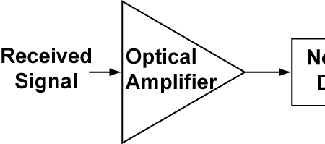
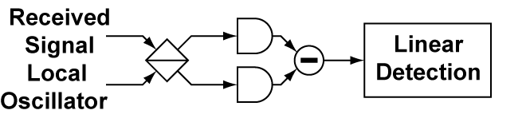
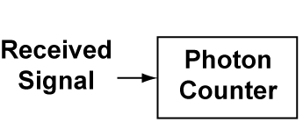
Detection Sensitivity
in Optical Communications
10
Optically
Preamplified
CCSDS
Optical On-Off
Keying
Power
Detection
ASE noise limited
Received
Signal
Local
Oscillator
CCSDS
High Data
Throughput
Coherent
Photons per bit
1
LO shot noise limited
Photon
Counting
CCSDS
High Photon
Efficiency PPM
Quantum
Limit
“noiseless”
0.1
Unknown architecture

Slide 7
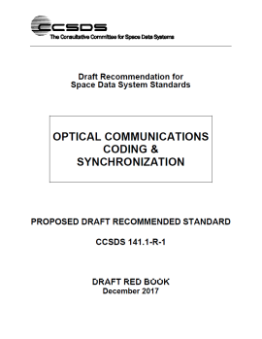
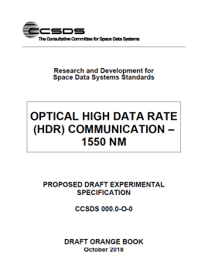
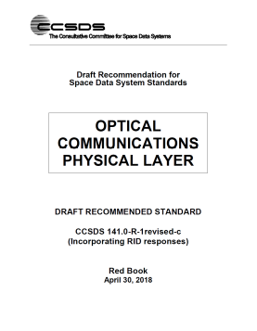
CCSDS Optical Signaling Today
Optical coding and sync layers accept fixed-length frames rate-matched to optical channel
CCSDS Transfer Frames
HPE
O3K
HDR
Free-Space Optical Channel

Slide 8
Frame Transfer Services Provided by Current
Optical Communications Recommendations
TM
AOS
Fixed Length USLP
Variable Length USLP
Ethernet / Other
Fixed-length transfer frames
Not supported
Optical Coding and Sync
Optical Physical Layer
Optical communications signaling recommendations would be more widely applicable if they accepted variable-rate variable-length frames at the input to the coding and sync layer

Slide 9
Add Generic Framing Procedure (GFP)
Augment existing CCSDS optical coding and sync layers to provide fixed-rate octet transport service in addition to fixed-rate fixed-length frame transport service
Use Generic Framing Procedure (GFP, ITU-T G.7041/Y.1303) to adapt higher-layer frame formats to fixed-rate octet transport service
Rationale:
  Provides necessary means for transporting variable-length variable rate frames
  Widely adopted industry standard for terrestrial optical transport systems (SDH, OTN)
  Supports many common client interfaces and flexible enough to support other custom frame formats (e.g. CCSDS transport frames)
Data Link Layer Frames
Fixed/Variable Rate,
Fixed/Variable Length
Frames
Generic Framing Procedure
Fixed Rate
Octet Stream
Optical Coding and Sync
Optical Physical Layer

Slide 10

A set of standards for space optical communications is being developed by CCSDS to enable interoperability. International standards will allow optical communications terminals built by one agency to use the infrastructure of another.
However, current CCSDS recommendations for optical signaling do not support transport of variable-length variable-rate frames.
  The CCSDS Optical Communications Working Group is investigating the incorporation of Generic Framing Procedure (ITU G.7041) for handling variable-length, variable-rate frame inputs (e.g. USLP, Ethernet) to the optical coding and sync layers.

Slide 11
BACKUP

Slide 12

Field Guide to CCSDS Book Colors
BLUE BOOKS
Recommended Standards
Normative and sufficiently detailed (and pre-tested) so they can be used to directly and independently implement interoperable systems (given that options are specified).
ORANGE BOOKS
Experimental
Normative, but may be very new technology that does not yet have consensus of enough agencies to standardize.
MAGENTA BOOKS
Recommended Practices
Normative, but at a level that is not directly implementable for interoperability. These are Reference Architectures, APIs, operational practices, etc.
YELLOW BOOKS
Administrative
CCSDS Procedures, Proceedings, Test reports, etc.
GREEN BOOKS
Informative Documents
Not normative. These may be foundational for Blue/Magenta books, describing their applicability, overall archtecture, ops concept, etc.
SILVER BOOKS
Historical
Deprecated and retired documents that are kept available to support existing or legacy implementations. Implication is that other agencies may not cross-support.
RED BOOKS
Draft Standards/Practices
Drafts of future Blue/Magenta books that are in agency review. Use caution with these… they can change before release.
PINK BOOKS/SHEETS
Draft Revisions For Review
Draft Revisions to Blue or Magenta books that are circulated for agency review.
Pink Books are reissues of the full book, Pink Sheets are change pages only.

Slide 13
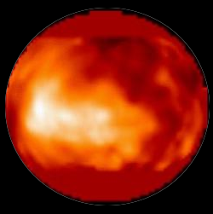
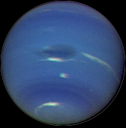


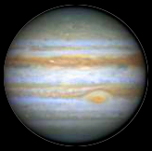



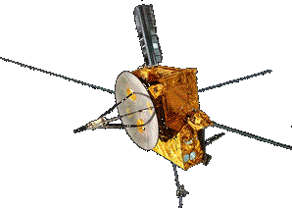

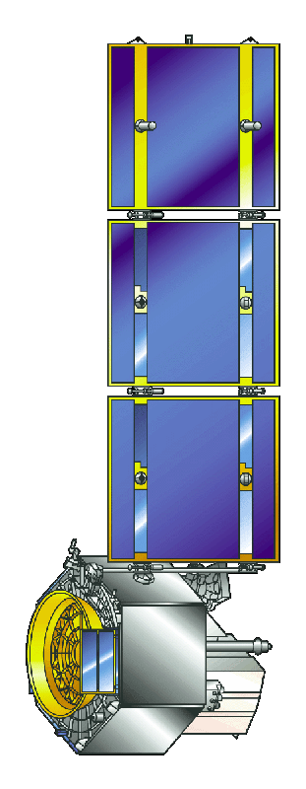



High Photon Efficiency
Optical Communications
Titan
Neptune
Attributes:
Long distance
Photon-starved channel
Direct detection
Serially Concatenated Pulse Position Modulation
Saturn
¸
Uranus
Pluto
Charon
Jupiter
Mars
Venus
13
Sun
Mercury

Slide 14
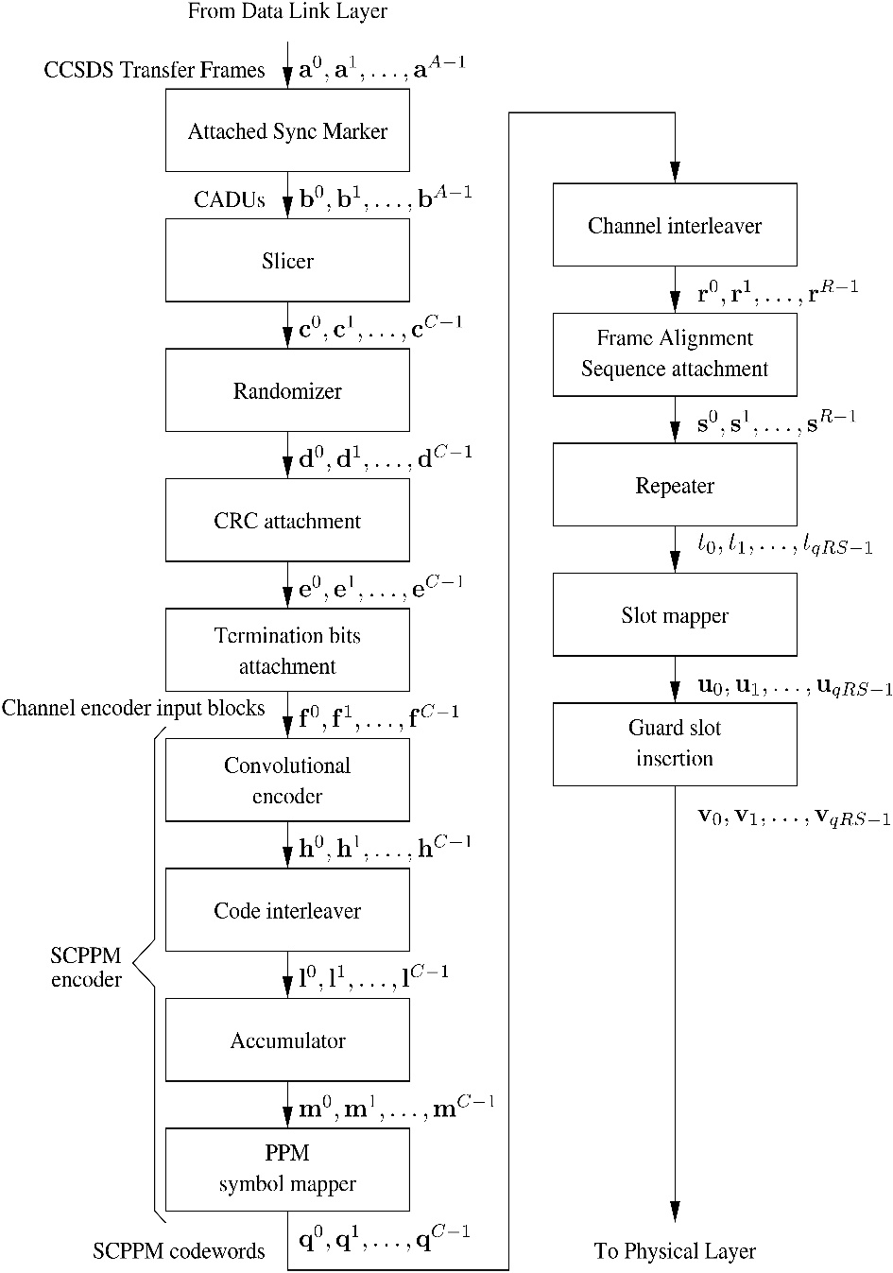
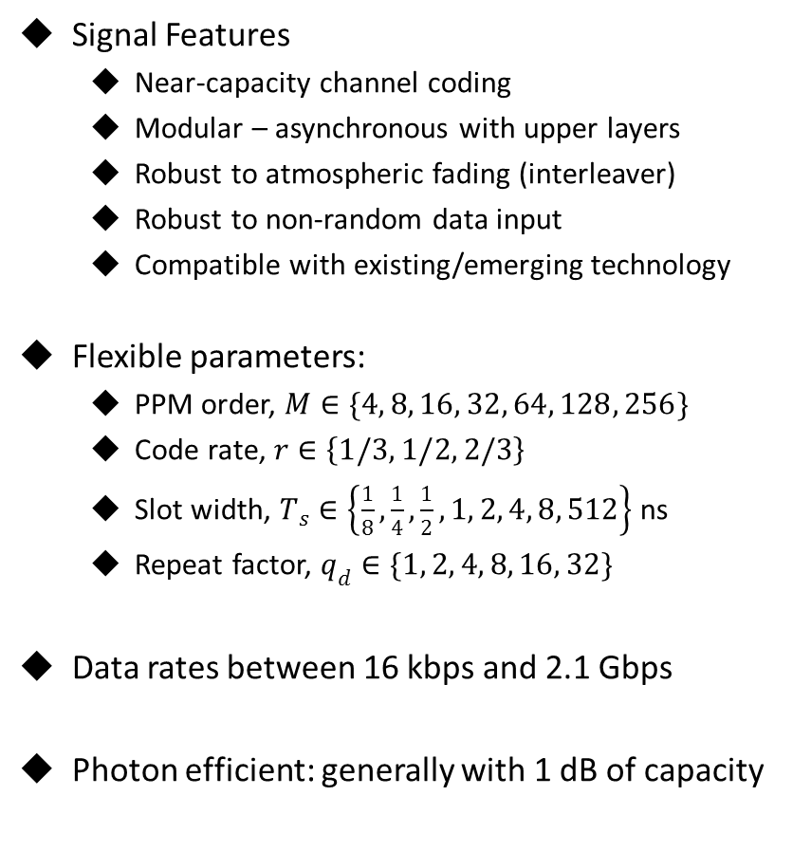
High Photon Efficiency Signaling
For Optical Communications
  Signal Features
  Near-capacity channel coding
  Modular – asynchronous with upper layers
  Robust to atmospheric fading (interleaver)
  Robust to non-random data input
  Compatible with existing/emerging technology
  Flexible parameters:
  PPM order, $M∈\{4, 8, 16, 32, 64, 128, 256\}$
  Code rate, $r∈\left\{1/3, 1/2, 2/3\right\}$
  Slot width, $T_{s}∈\left\{\frac{1}{8},\frac{1}{4},\frac{1}{2}, 1, 2, 4, 8, 512\right\}$ ns
  Repeat factor, $q_{d}∈\{1, 2, 4, 8, 16, 32\}$
Data rates between 16 kbps and 2.1 Gbps
Photon efficient: generally with 1 dB of capacity

Slide 15
High Data Rate Throughput 1064 nm
(ESA/DLR Orange Book)
This book is based on
  European Space Agency missions (EDRS series, Sentinel series)
  German Aerospace Agency (DLR) developments
  TESAT Spacecom LCT terminal (heritage extending back to 1997 for LEO-LEO and a 2nd generation for LEO-GEO links developed since 2006
Key technical features:
  1064 nm wavelength
  BPSK modulation
  1.8 Gbps user data rate
Notes:
JAXA is interested, resources being identified. Possible issues getting resources allocated / schedule.

Slide 16

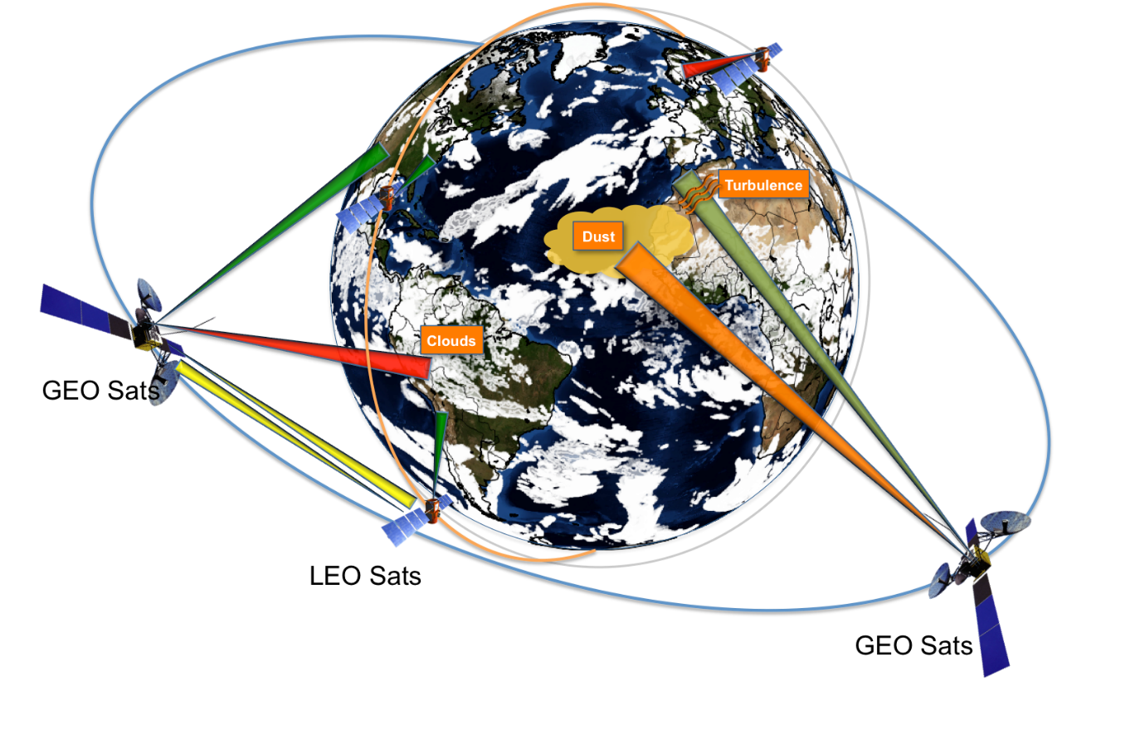
  CCSDS Books will:
  Provide a narrative on atmospherics and explain why it is critical to accurately characterize
  Explain how long-term statistics of atmospherics are used to choose an optimal network of geographically diverse ground sites
  Provide content on the required instruments and parameters to support long-term site characterization and real-time decision making
Clouds are primary source of attenuation
Characterization and prediction of the atmospheric channel are critical to inform
space link handovers, select ground sites, and to maximize system availability

Slide 17

High Data Throughput 1550 nm
Orange Book Link Scenarios
Optical Link
RF Link
Space
Relay
Crosslinks
Users
Space
Optical or RF
Trunks
Optical
Direct-to-Earth
Link
Air
Atmosphere
Ground

Slide 18
High Data Rate Throughput 1550 nm
Architectural Considerations
Space Relay
  Edge-to-Edge FEC– Decoding performed at edge nodes where processing resources are available
    DVB-S2 and other capacity-approaching codes used
  Optical link from user to relay; optical or RF link from relay to ground
    Options for coding + interleaving for atmospheric channels
  Wide range of supported user rates (~10 Mbps to 10+ Gbps)
    Burst mode PSK modulation formats for large range of data rates
  Example missions: JDRS, LCRD
Direct-to-Earth
  High-rate (~> 100 Gbps) link for large volume, short duration data transfer
    Signaling similar to high-rate fiber telecom approaches
  Example missions: large data volume LEO DTE

Slide 19
High Data Throughput 1550 nm
Signaling Overview
CCSDS Transfer Frames
Frame Sync Marker
Attachment
Slicer
FEC:
DVB-S2, RS, or G.975 I.3
Convolutional Channel Interleaver
Q-Repeat
Physical Layer Framing
Randomizer
Modulation:
Burst-Mode PSK@1550nm
To amplifier or
telescope
Notes:
JAXA is interested, resources being identified. Possible issues getting resources allocated / schedule.

Slide 20
High Data Rate Throughput 1550 nm Relay Link Example
User Platform
Optical relay serves as a transparent link-layer bridge between User Platform and Ground Relay
Ground Network
Space Pkt
Ground Relay
Service I/F
Transparent Bridge
AOS Frame
AOS Frame
User Terminal
Relay Platform
Switch
FEC/ILV/ Q-Repeat
FEC/DeILV/ De-Q-Rep.
Relay Terminal 1
Relay Terminal 2
Phy Frame
Phy Frame
Phy Frame
Phy Frame
Random
De-Random
Random
De-Random
Modulation
De-Mod
Modulation
De-Mod
05/10/17
Physical Link
Physical Link
Notes:
JAXA is interested, resources being identified. Possible issues getting resources allocated / schedule.

Slide 21
Example: Using GFP with 1550 nm
HDR Orange Book Recommendations
Variable-Length Variable-Rate Frames
Fixed-Length Fixed-Rate CCSDS Frames
Frame Transport Service
GFP
Attach Sync Marker
Bit Transport Service
Slicer
CRC Attachment
Forward Error Correction
Same approach could be used to transport variable-length/variable-rate frames
over CCSDE HPE or O3K
Channel Interleaver
…

Slide 22
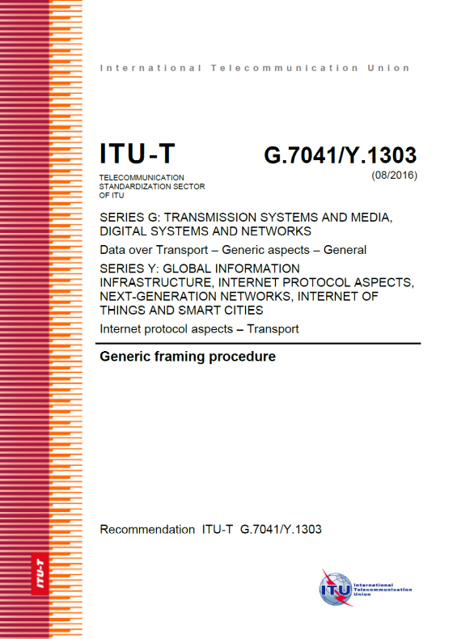
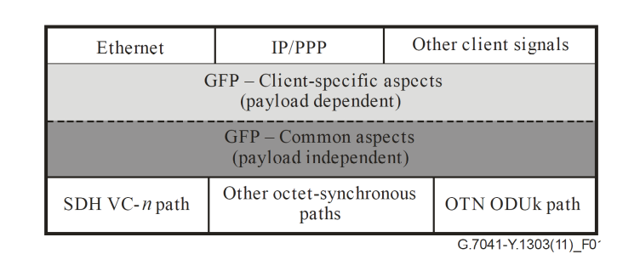
GFP Description

