Slide 1

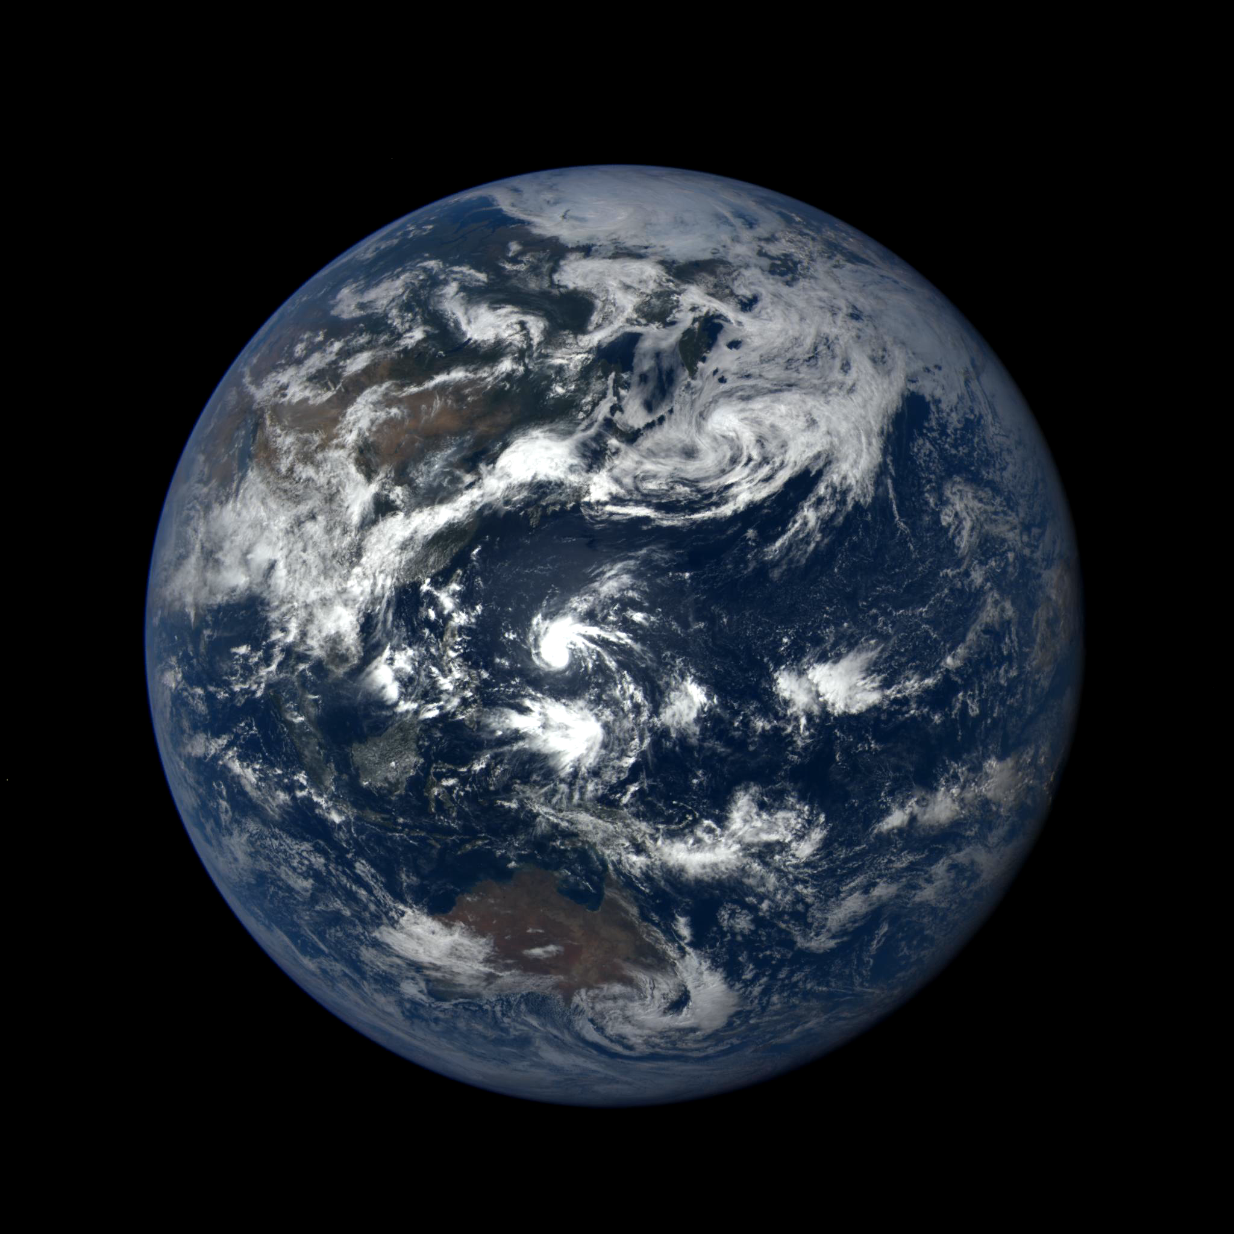

Introduction to Orbits
Aerospace
and Aviation Academy
Presented by:
Steven L. Rickman
NASA Technical Fellow for Passive Thermal
NASA Engineering and Safety Center
June 2021
Video Credit: DSCOVR: EPIC Team

Slide 2
Lesson Contents
Acknowledgements
What is an Orbit?
Why Study Orbits?
Anatomy of an Orbit
Johannes Kepler, Tycho Brahe, and Isaac Newton
Kepler’s First Law
Kepler’s Second Law
Kepler’s Third Law
Thank You, Sir Isaac Newton!
Example: Circular – Geostationary
Perturbed Orbits
Example: Circular – Sun Synchronous
Example: Elliptical – Molniya
Other Orbits
Q & A

Slide 3
Acknowledgements
Information and image sources are cited on each slide.
Unless otherwise credited, animations were developed by the author using Copernicus 4.6.
Microsoft® Clip Art was used in the presentation.
Some content from Bate, R. R., Mueller, D. D., and White, J. E., Fundamentals of Astrodynamics, Dover Publications, New York, 1971.

Slide 4
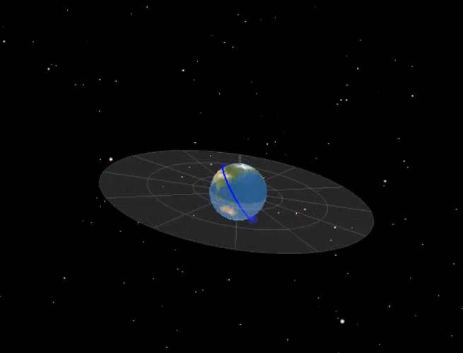
What is an Orbit?
An orbit is “the curved path, usually elliptical, described by a planet, satellite, spaceship, etc.”
Circular Orbit About the Earth
Source: https://www.dictionary.com/browse/orbit

Slide 5
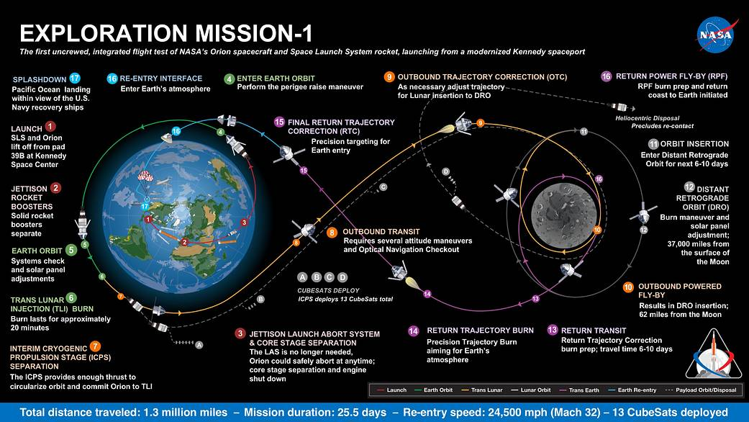
Why Study Orbits?
Orbits are the paths a spacecraft takes in space;
They are used to go from one location in space to another, for example, from the Earth to the Moon, and back.
Orion Exploration Mission – 1 (EM-1)
Source: https://www.nasa.gov/image-feature/exploration-mission-1-map

Slide 6
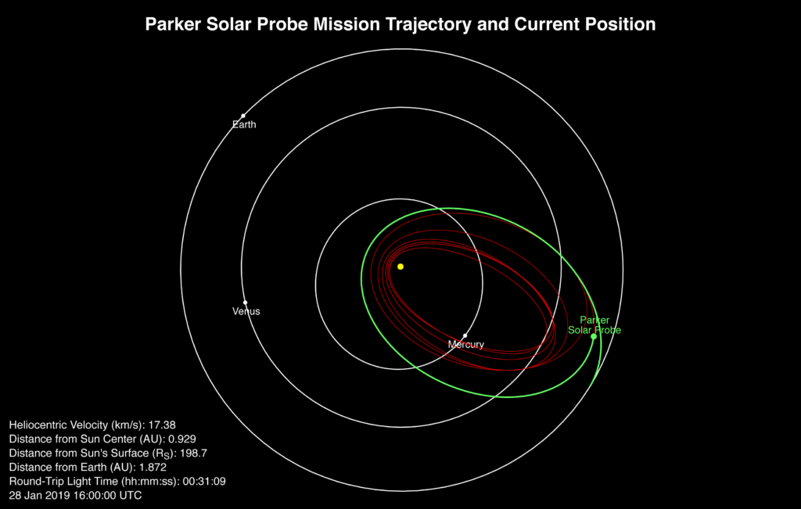
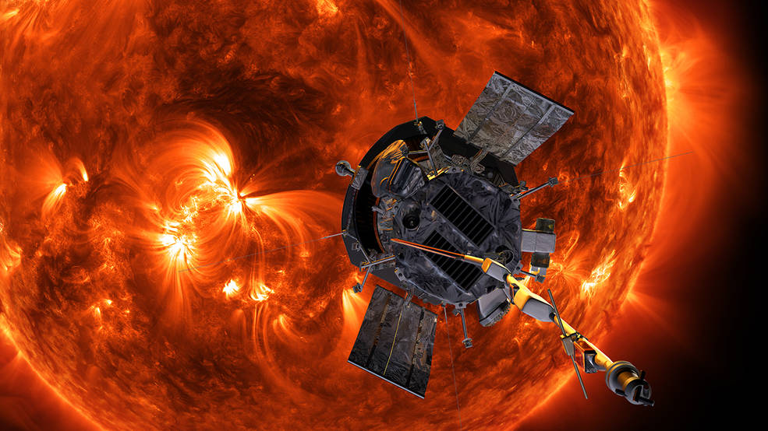
Why Study Orbits?
It is important to understand orbits to determine the environment a spacecraft experiences, how long it takes to travel to the destination, etc.
Parker Solar Probe Trajectory
Parker Solar Probe Spacecraft
Image Credits: https://blogs.nasa.gov/parkersolarprobe/
https://www.nasa.gov/press-release/goddard/2018/scientist-to-discuss-heliophysics-parker-solar-probe

Slide 7




Anatomy of an Orbit
Periapsis -- the location of minimum orbit altitude
Argument of Periapsis -- the angle, measured in the orbit plane, from the ascending node to the periapsis
Semimajor Axis-- half the distance from apoapsis to periapsis
Equator
True Anomaly -- angle from the periapsis location to the spacecraft location
+
Inclination -- the tilt of the orbit plane with respect to the equator
Focus
Eccentricity – is a measure of the shape of an orbit – circular, elliptical, parabolic, or hyperbolic
Ascending Node -- the location where the orbit crosses the equator headed south to north
+
Focus
Apoapsis -- the location of maximum orbit altitude
Right Ascension of the Ascending Node will be discussed in a subsequent section.
Orbit Elements

Slide 8
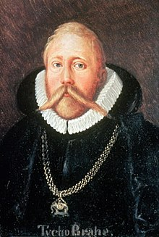

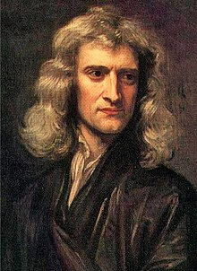
Johannes Kepler, Tycho Brahe, and Isaac Newton
Brahe, 1546-1601
Kepler, 1571-1630
Newton, 1643 (1642 O.S.) - 1727
Image Credits: https://en.wikipedia.org/wiki/Johannes_Kepler
https://en.wikipedia.org/wiki/Tycho_Brahe
https://en.wikipedia.org/wiki/Isaac_Newton

Slide 9
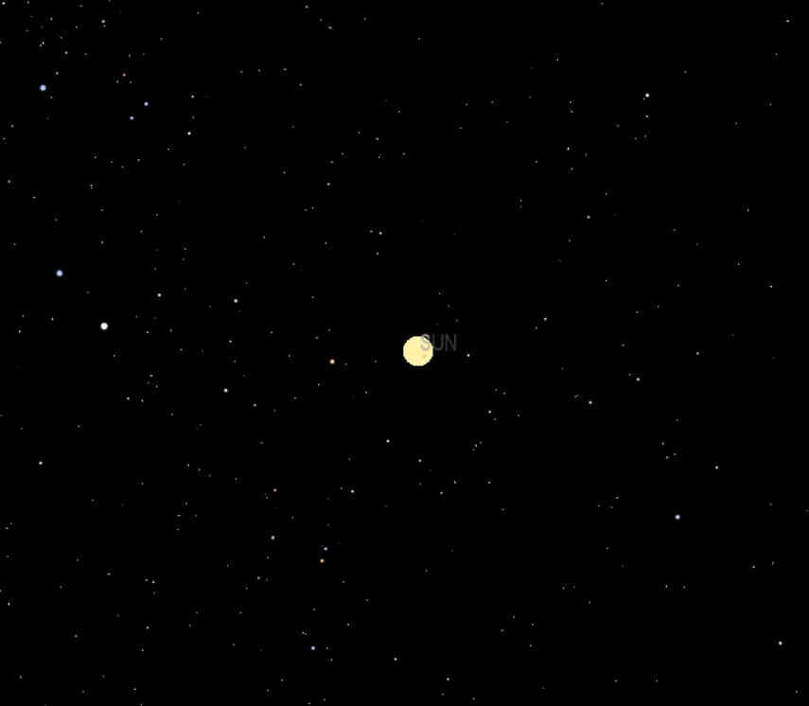
Kepler’s First Law
The orbit of each planet is an ellipse*, with the sun as a focus.
*Actually, other orbit shapes are possible and are described by the “conic sections.”
Orbits of the Inner Planets

Slide 10
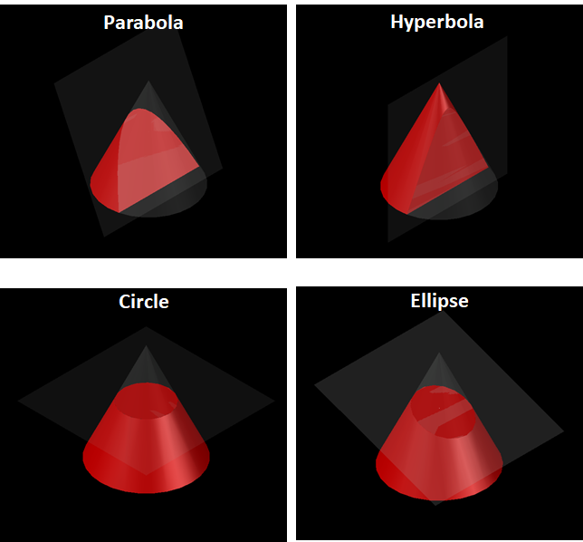
Conic Sections
Take a cone and cut it with a plane at different angles
The shapes appearing at the cutting plane are also the shapes of the orbits.

Slide 11
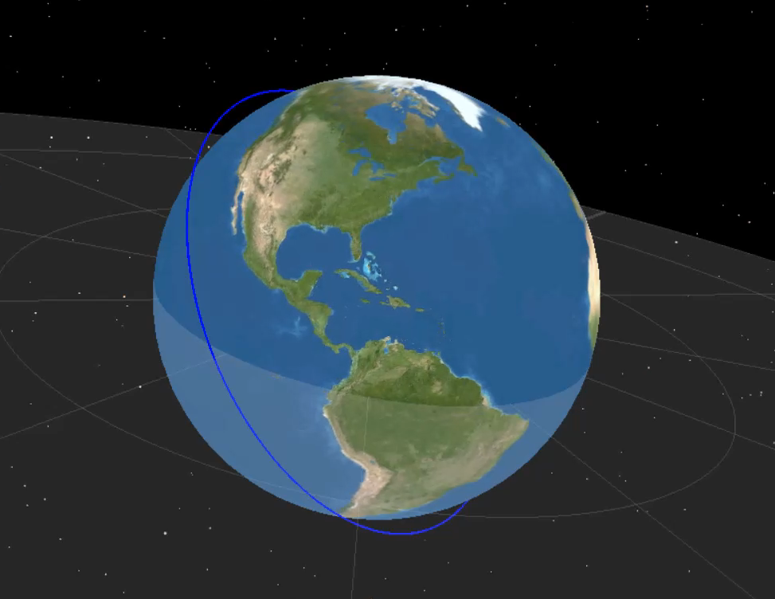
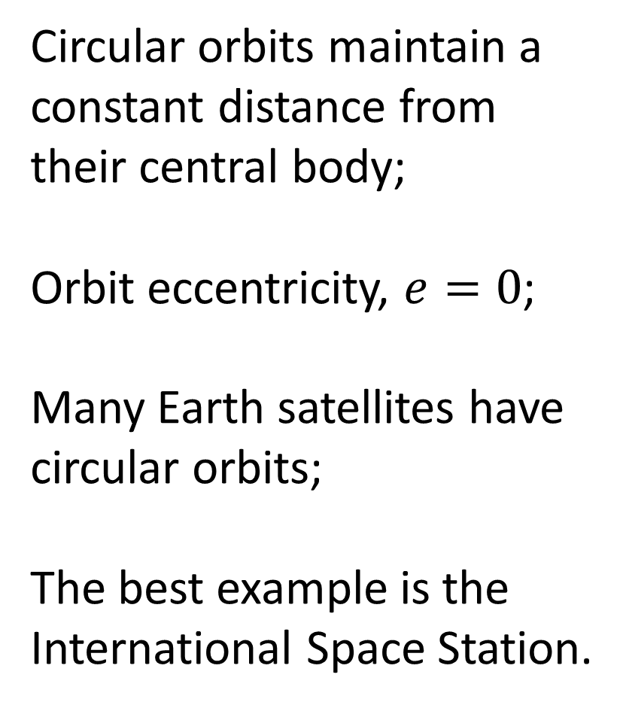
Circular Orbit
Circular orbits maintain a constant distance from their central body;
Orbit eccentricity, $e=0$;
Many Earth satellites have circular orbits;
The best example is the International Space Station.
Example: International Space Station Orbit

Slide 12
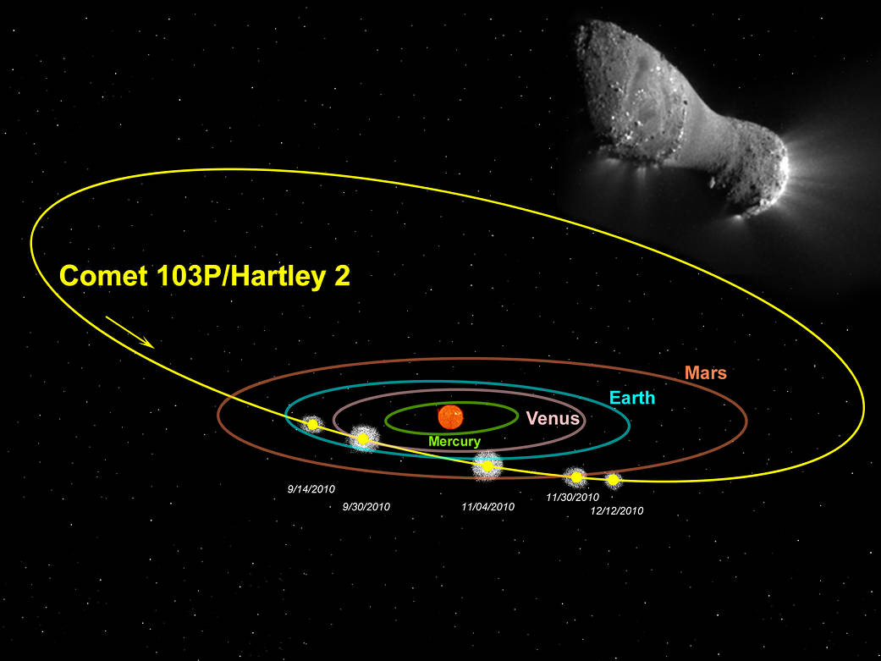
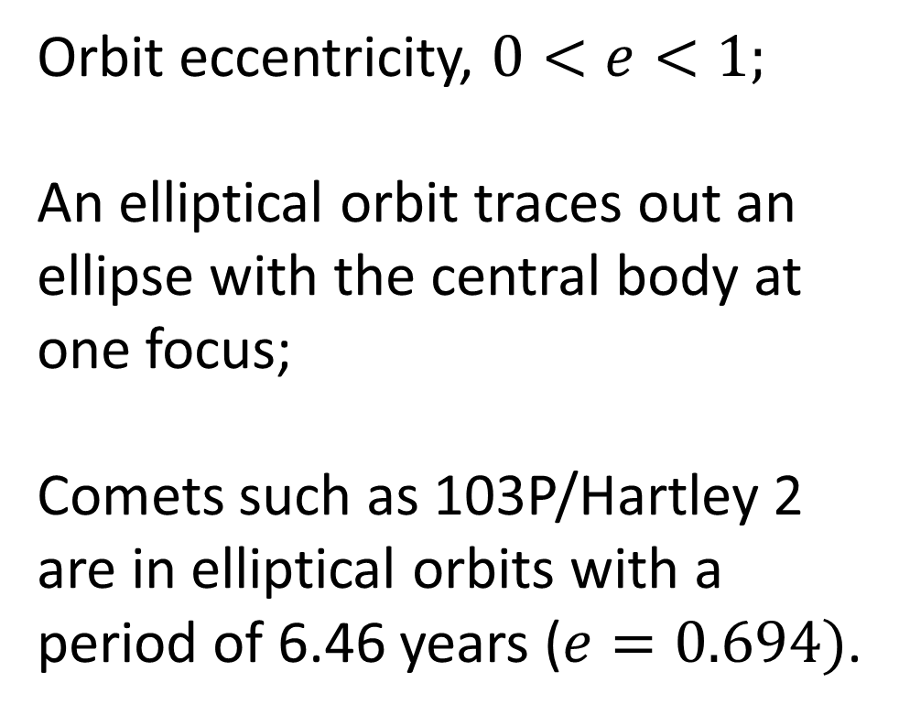
Elliptical Orbit
Orbit eccentricity, $0<e<1;$
An elliptical orbit traces out an ellipse with the central body at one focus;
Comets such as 103P/Hartley 2 are in elliptical orbits with a period of 6.46 years ($e=0.694)$.
Example: Comet Hartley 2 Orbit
Image Credit: NASA/Steele Hill; Inset Image Credit: NASA/JPL-Caltech/UMD

Slide 13
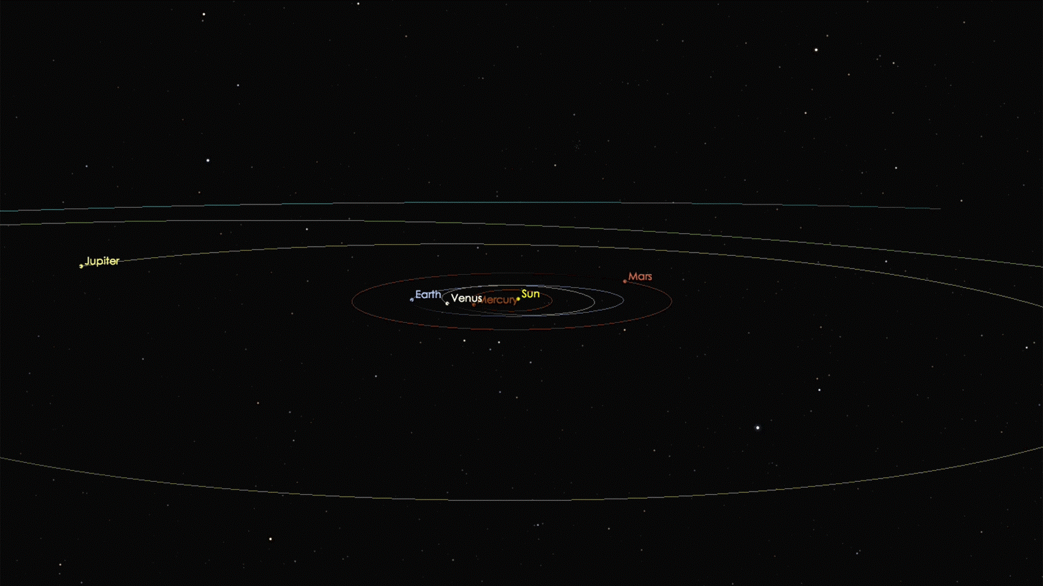
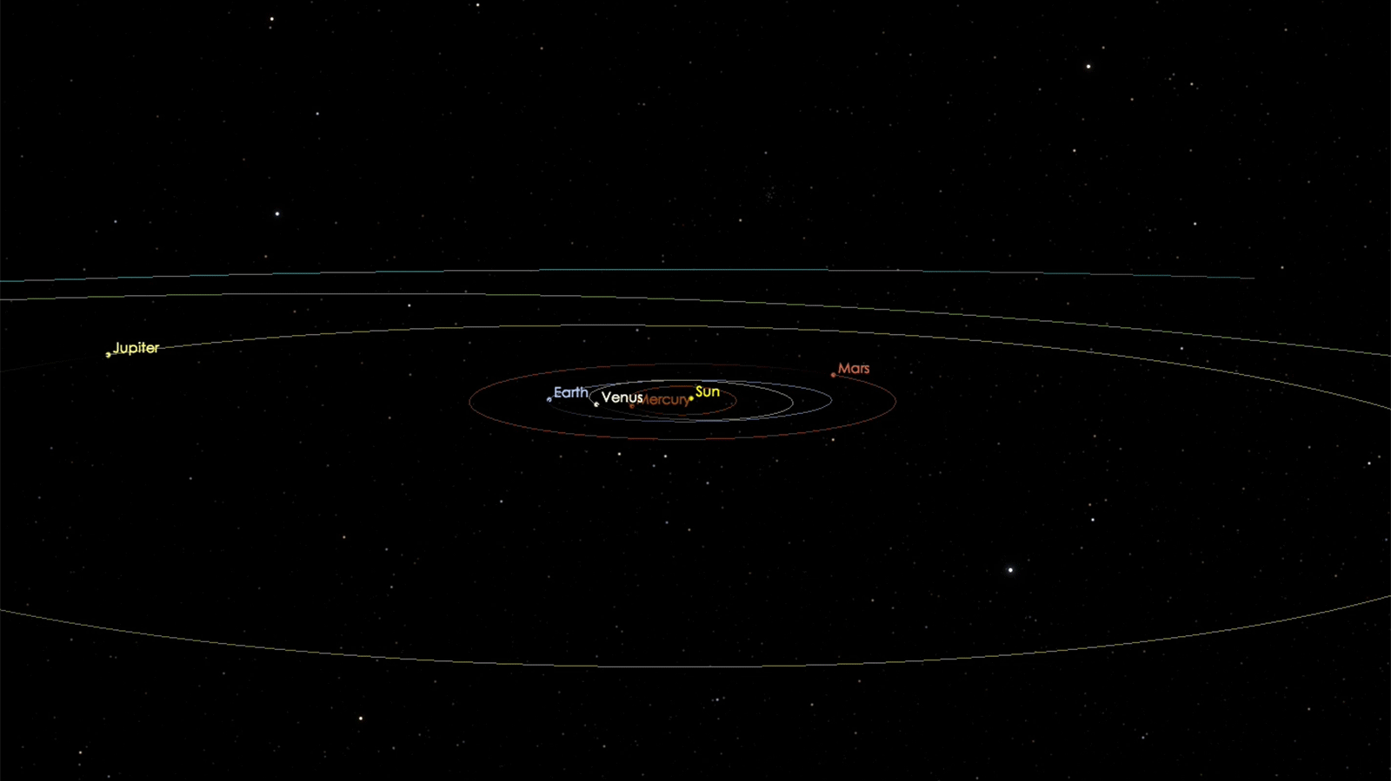
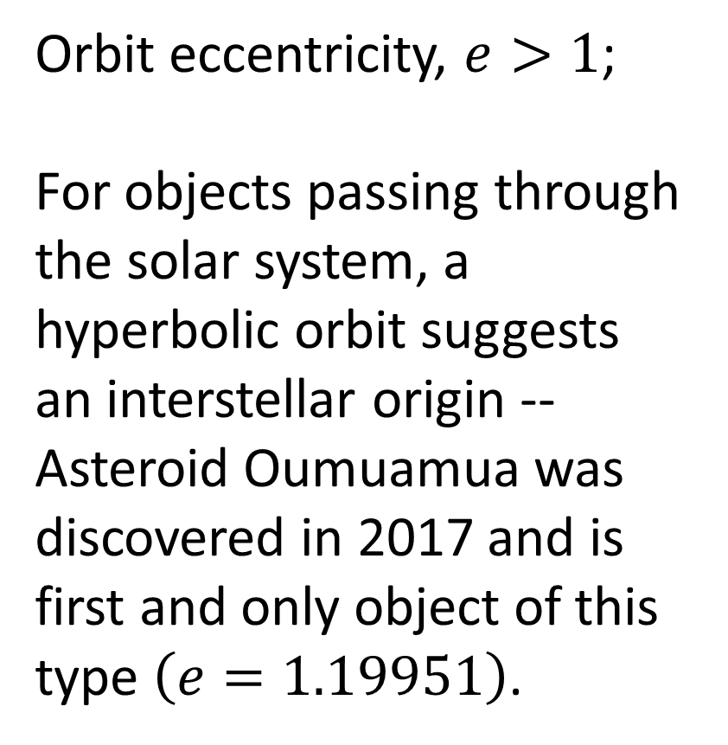
Hyperbolic Orbit
Orbit eccentricity, $e>1$;
For objects passing through the solar system, a hyperbolic orbit suggests an interstellar origin -- Asteroid Oumuamua was discovered in 2017 and is first and only object of this type $\left(e=1.19951\right)$.
Example: Asteroid Oumuamua
Video Credit: https://solarsystem.nasa.gov/asteroids-comets-and-meteors/comets/oumuamua/in-depth/
Source: https://en.wikipedia.org/wiki/%CA%BBOumuamua

Slide 14
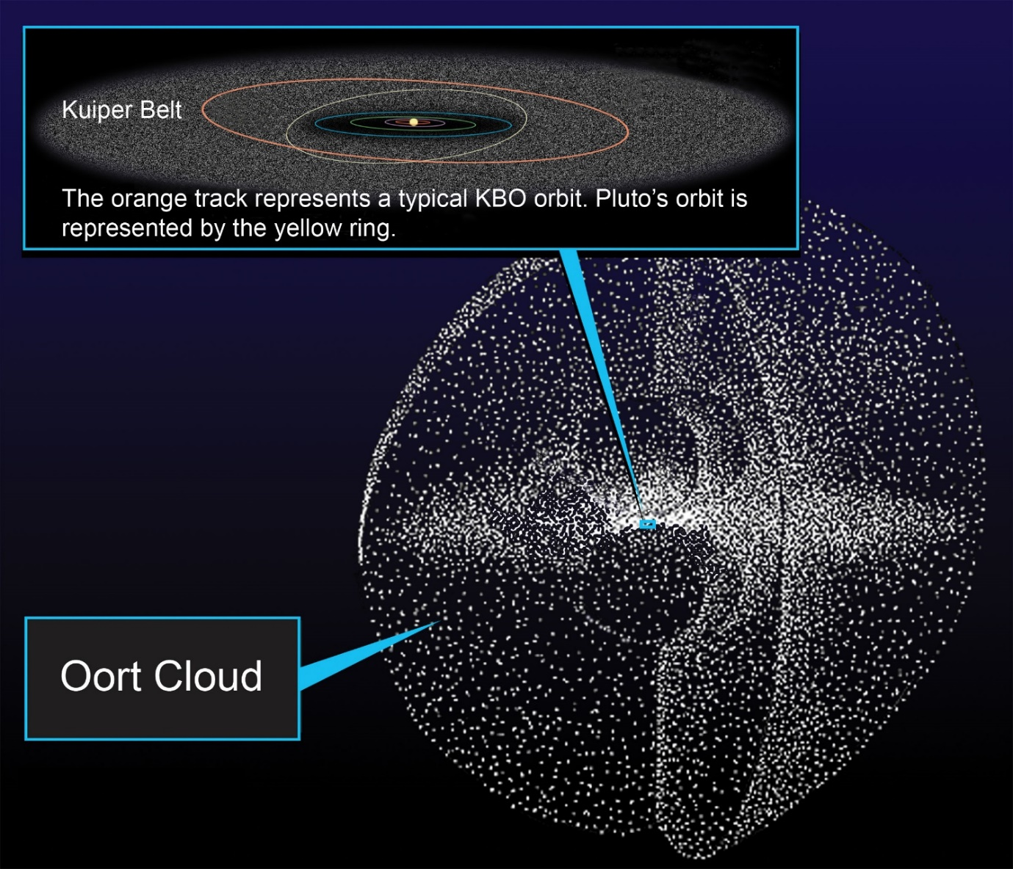
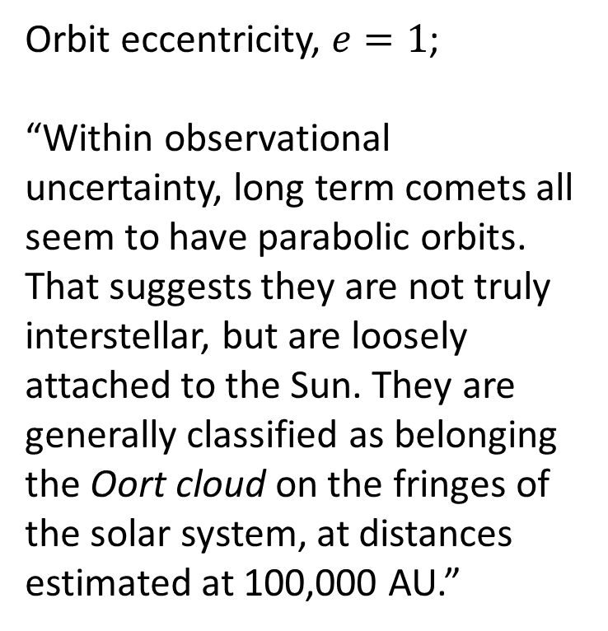
Parabolic Orbit
Orbit eccentricity, $e=1$;
“Within observational uncertainty, long term comets all seem to have parabolic orbits. That suggests they are not truly interstellar, but are loosely attached to the Sun. They are generally classified as belonging the Oort cloud on the fringes of the solar system, at distances estimated at 100,000 AU.”
Source: https://www-spof.gsfc.nasa.gov/stargaze/Scomets.htm
Image Credit: https://solarsystem.nasa.gov/resources/491/oort-cloud/
The Oort Cloud

Slide 15
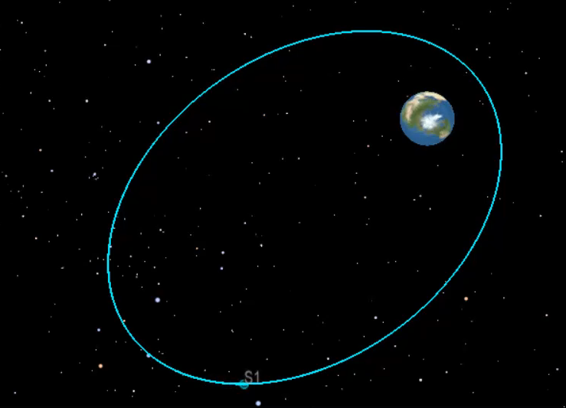





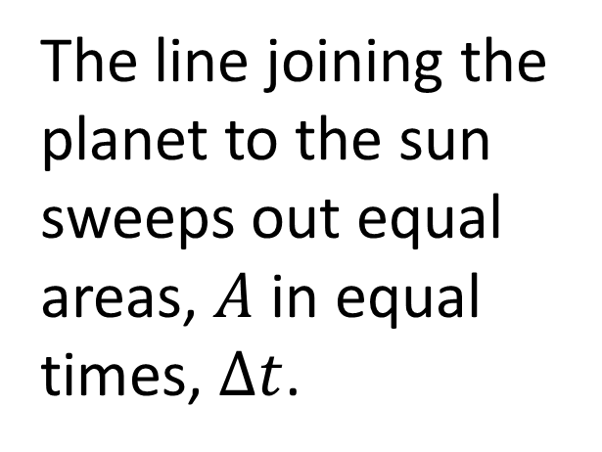

Kepler’s Second Law
The line joining the planet to the sun sweeps out equal areas, $A$ in equal times, $∆t$.
$$∆t_{1}$$
$$A_{1}$$
$$A_{2}$$
$${∆t}_{1}={∆t}_{2}$$
$$A_{1}=A_{2}$$
$$∆t_{2}$$
Demonstration of Constant “Areal” Velocity

Slide 16
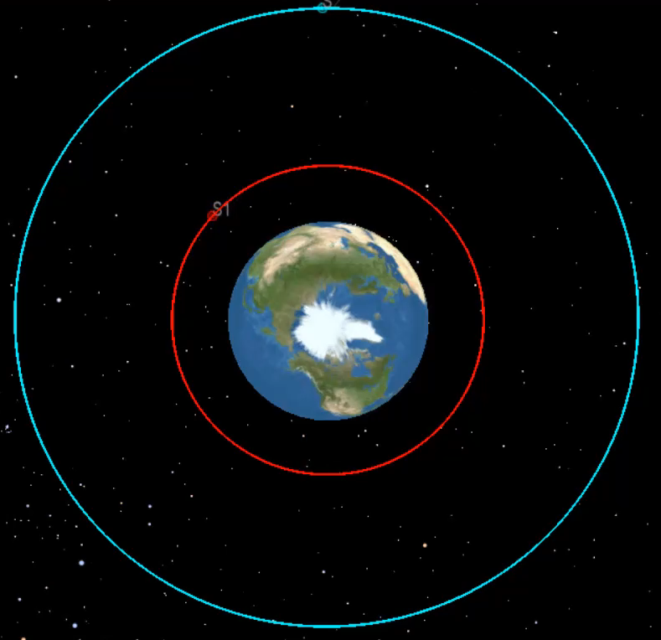


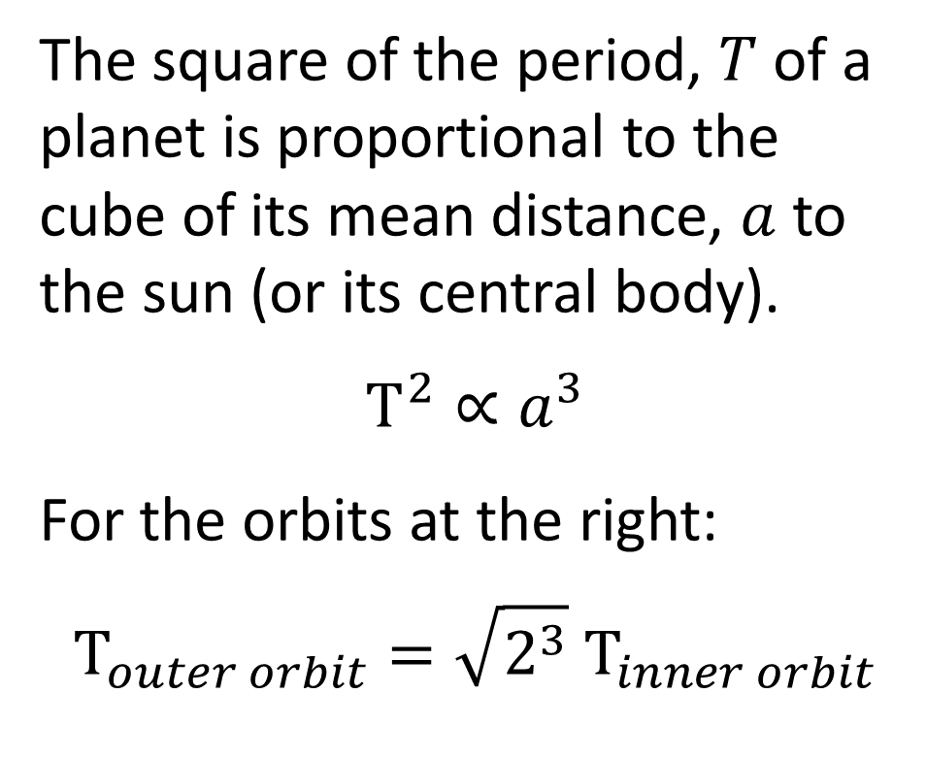
Kepler’s Third Law
The square of the period, $T$ of a planet is proportional to the cube of its mean distance, $a$ to the sun (or its central body).
$$Τ^{2}∝a^{3}$$
For the orbits at the right:
$$Τ_{outer orbit}={\sqrt{2^{3}} Τ}_{inner orbit}$$
$$a$$
$$2a$$
Orbits with Different Semimajor Axes

Slide 17
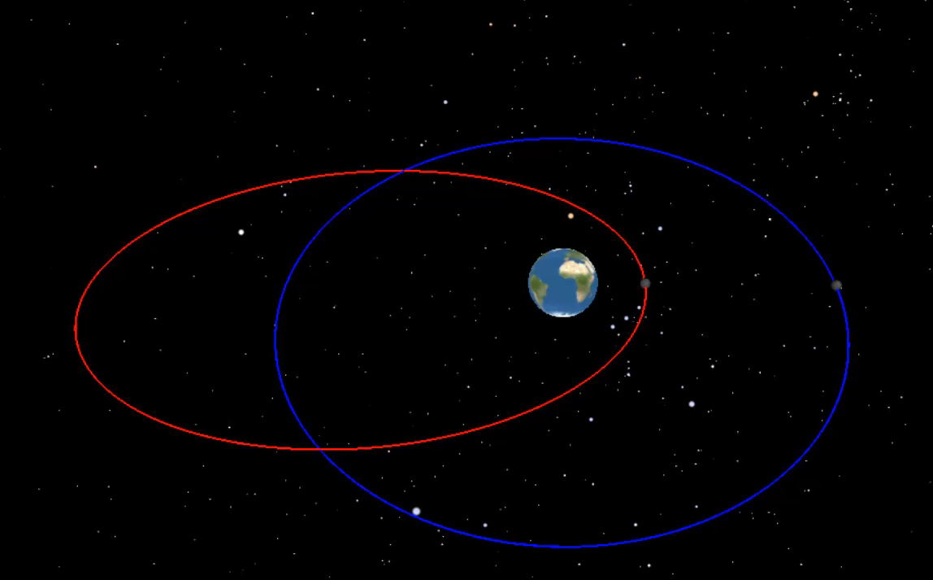



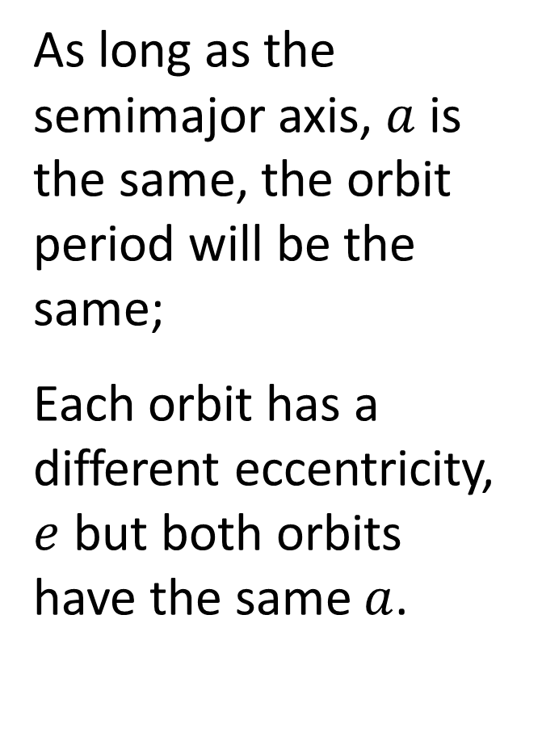

Kepler’s Third Law
As long as the semimajor axis, $a$ is the same, the orbit period will be the same;
Each orbit has a different eccentricity, $e$ but both orbits have the same $a$.
$$e=0.0$$
$$2a$$
$$2a$$
$$e=0.7$$
Two Orbits with the Same Period

Slide 18
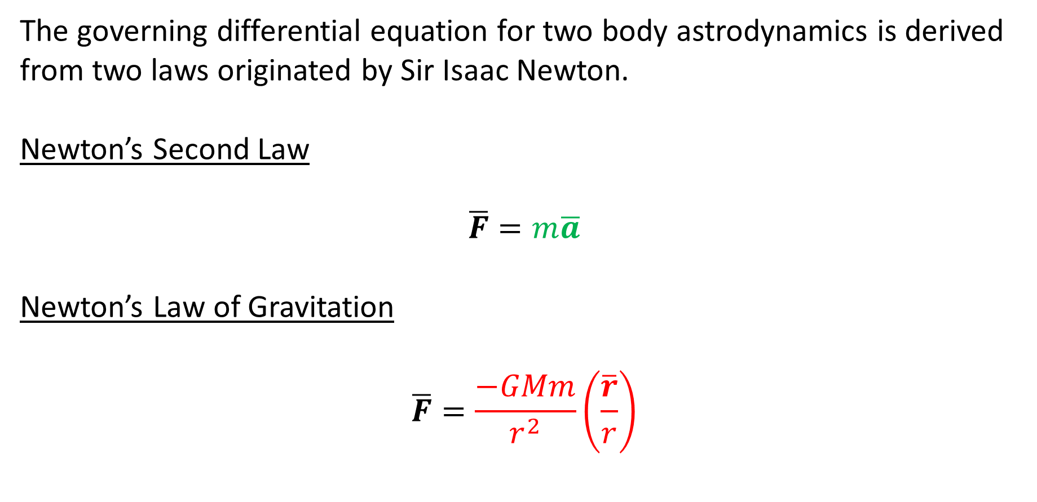
Thank You, Sir Isaac Newton!
The governing differential equation for two body astrodynamics is derived from two laws originated by Sir Isaac Newton.
Newton’s Second Law
$$\overline{F}=m\overline{a}$$
Newton’s Law of Gravitation
$$\overline{F}=\frac{−GMm}{r^{2}}\left(\frac{\overline{r}}{r}\right)$$

Slide 19
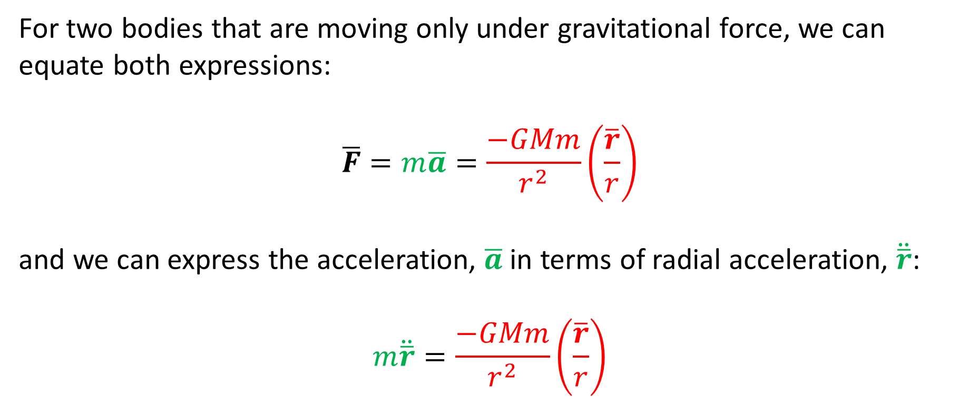
Thank You, Sir Isaac Newton!
For two bodies that are moving only under gravitational force, we can equate both expressions:
$$\overline{F}=m\overline{a}=\frac{−GMm}{r^{2}}\left(\frac{\overline{r}}{r}\right)$$
and we can express the acceleration, $\overline{a}$ in terms of radial acceleration, $\ddot{\overline{r}}$:
$$m\ddot{\overline{r}}=\frac{−GMm}{r^{2}}\left(\frac{\overline{r}}{r}\right)$$

Slide 20
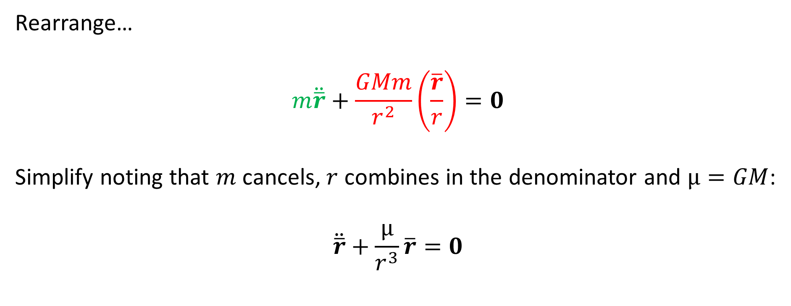
Thank You, Sir Isaac Newton!
Rearrange…
$$m\ddot{\overline{r}}+\frac{GMm}{r^{2}}\left(\frac{\overline{r}}{r}\right)=0$$
Simplify noting that $m$ cancels, $r$ combines in the denominator and $μ=GM$:
$$\ddot{\overline{r}}+\frac{μ}{r^{3}}\overline{r}=0$$

Slide 21


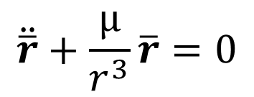
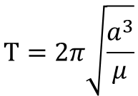


Thank You, Sir Isaac Newton!
There’s A LOT of information to be squeezed out of this equation including…
Conservation of Specific Mechanical Energy
Conservation of Specific Angular Momentum
  Kepler’s 1st Law: Trajectory
  Kepler’s 2nd Law: Constant “Areal” Velocity
  Kepler’s 3rd Law: Orbit Period
$$ℰ=\frac{v^{2}}{2}+\left(c−\frac{μ}{r}\right)$$
$$\overline{h}=\overline{r}×\overline{v}$$
$$\ddot{\overline{r}}+\frac{μ}{r^{3}}\overline{r}=0$$
$$r=\frac{a\left(1−e^{2}\right)}{1+e\cos{ν}}$$
$$\frac{1}{2}r^{2}\dot{θ}=constant$$
$$Τ=2π\sqrt{\frac{a^{3}}{μ}}$$

Slide 22
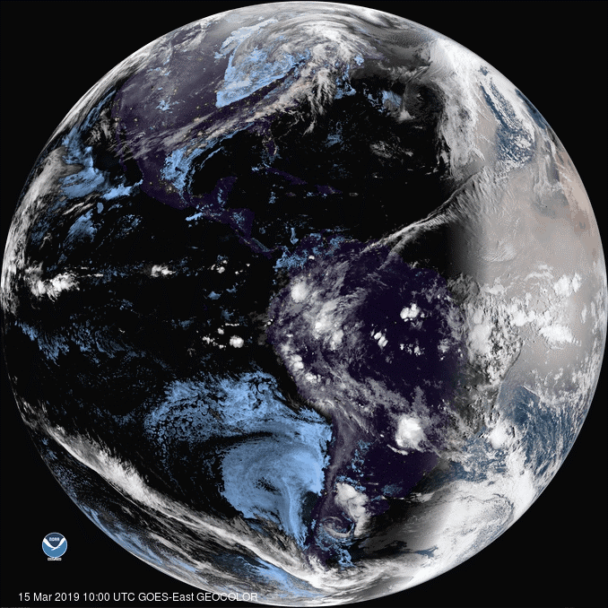
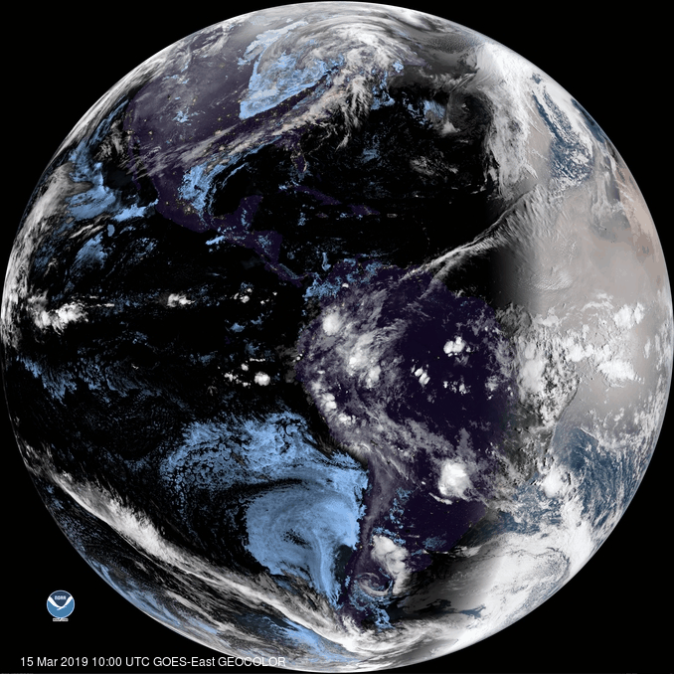
Example: Geostationary Orbit
A geostationary orbit has an orbit period of 24 hours with an orbit inclination of 0 degrees;
In this orbit, the spacecraft appears fixed over a specific location on Earth’s equator;
Geostationary orbits are used for communications satellites and weather satellites.
Earth as Seen from GOES 16
Animation Source: https://www.star.nesdis.noaa.gov/GOES/fulldisk_band.php?sat=G16&band=GEOCOLOR&length=12

Slide 23
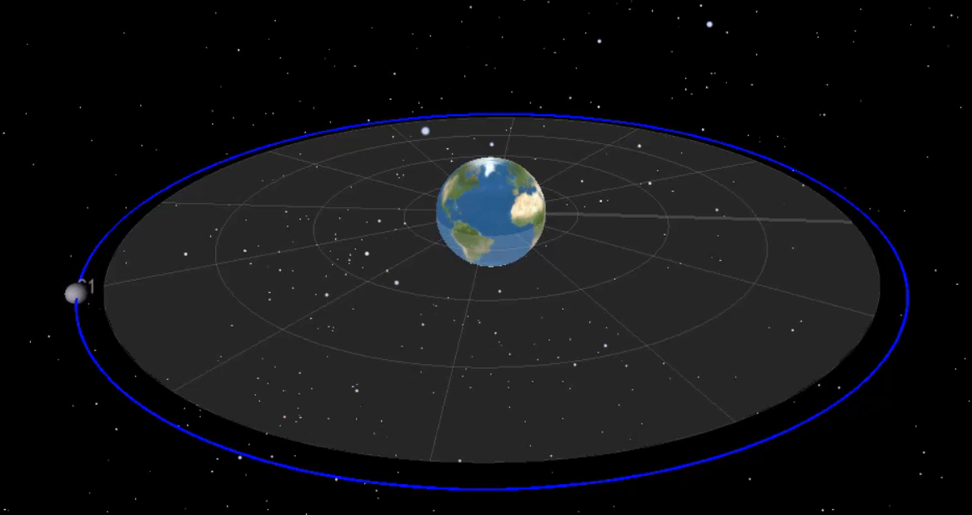

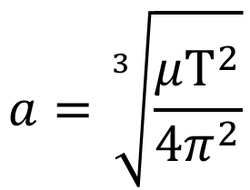
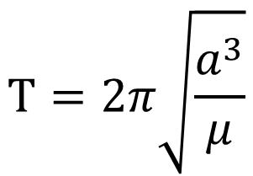

Example: Geostationary Orbit
At what altitude must the satellite be positioned to be geostationary?
$$Τ=2π\sqrt{\frac{a^{3}}{μ}}$$
$$a$$
$$a=\sqrt[3]{\frac{μΤ^{2}}{4π^{2}}}$$
Geostationary Orbit
$$h=a−r_{e}=\sim 35786 km$$

Slide 24
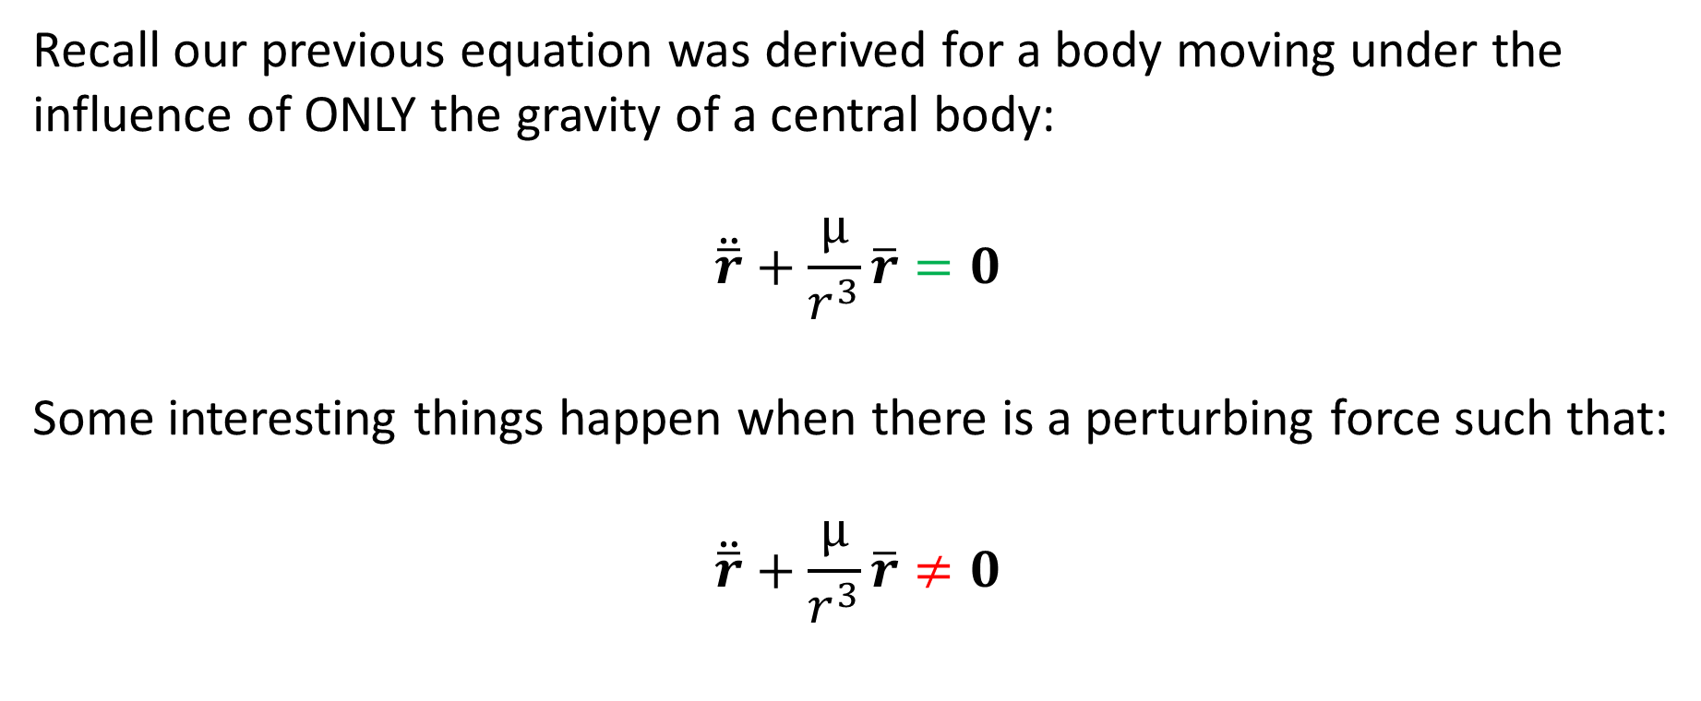
Perturbed Orbits
Recall our previous equation was derived for a body moving under the influence of ONLY the gravity of a central body:
$$\ddot{\overline{r}}+\frac{μ}{r^{3}}\overline{r}=0$$
Some interesting things happen when there is a perturbing force such that:
$$\ddot{\overline{r}}+\frac{μ}{r^{3}}\overline{r}≠0$$

Slide 25
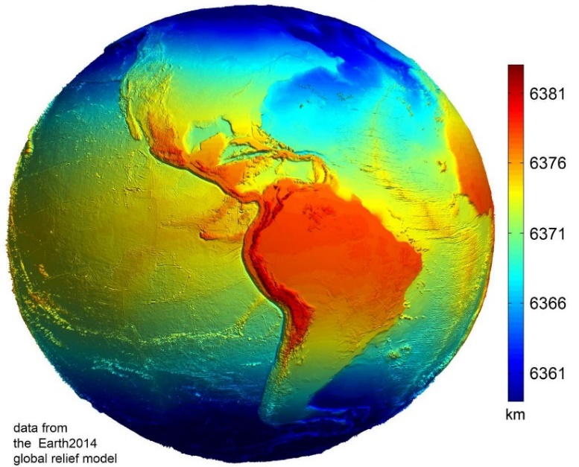
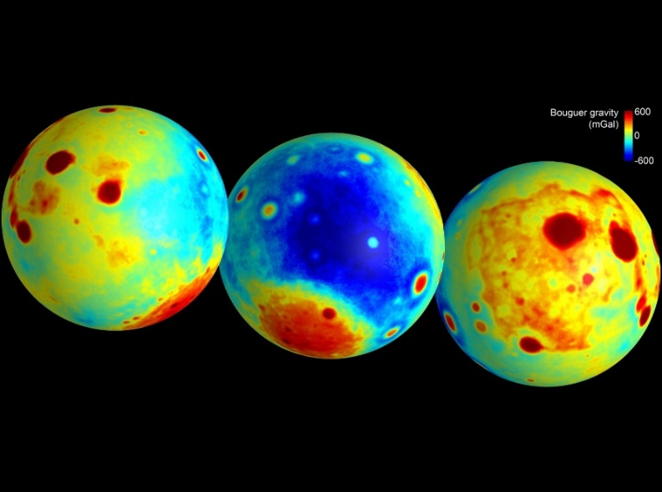
Perturbed Orbits
There are many forces that can perturb an orbit including:
Spherical harmonics
Drag
Radiation pressure
Other celestial bodies
Tides
Mass concentrations
etc.
Equatorial Bulge from Earth 2014 Global Relief Model
Image Credits: Earth 2014 Global Relief Model, C. Hirt, used with permission
http://www.ngs.noaa.gov/PUBS_LIB/Geodesy4Layman/80003051.GIF
Image credit: NASA/JPL-Caltech/CSM
Lunar Gravity Anomalies Measured by NASA’s GRAIL Mission

Slide 26
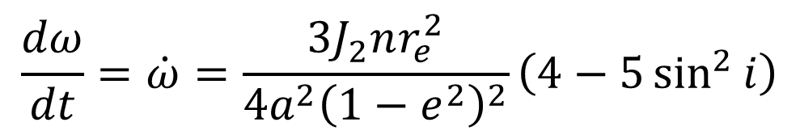
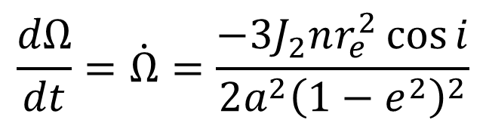

Perturbations
Earth is not a perfect sphere -- it is oblate and has a slight bulge in the equatorial region and this imperfection gives rise to some major orbit perturbations;
Precession of the Ascending Node:
Precession of the Periapsis:
$$\frac{dΩ}{dt}=\dot{Ω}=\frac{−3J_{2}nr_{e}^{2}\cos{i}}{2a^{2}{\left(1−e^{2}\right)}^{2}}$$
$$\frac{dω}{dt}=\dot{ω}=\frac{3J_{2}nr_{e}^{2}}{4a^{2}{\left(1−e^{2}\right)}^{2}}\left(4−5\sin^{2}{i}\right)$$
Note: For Earth, $J_{2}=1.082626683×{10}^{−3}$

Slide 27
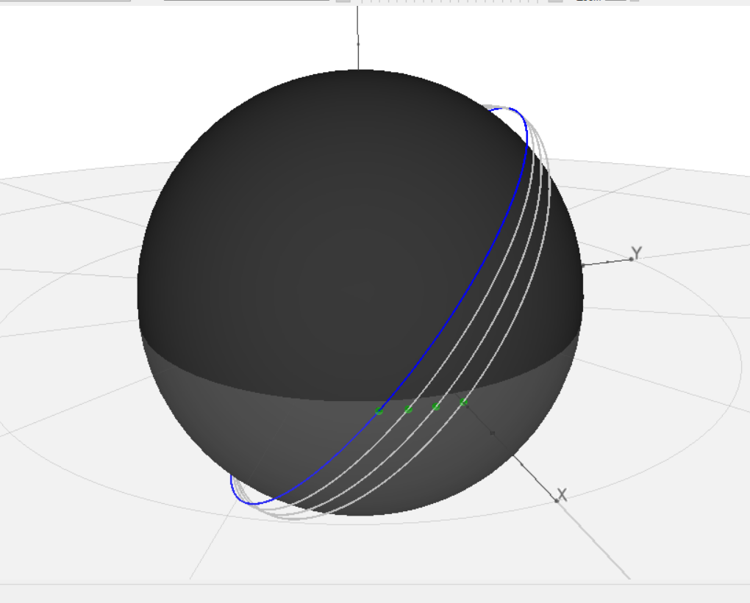
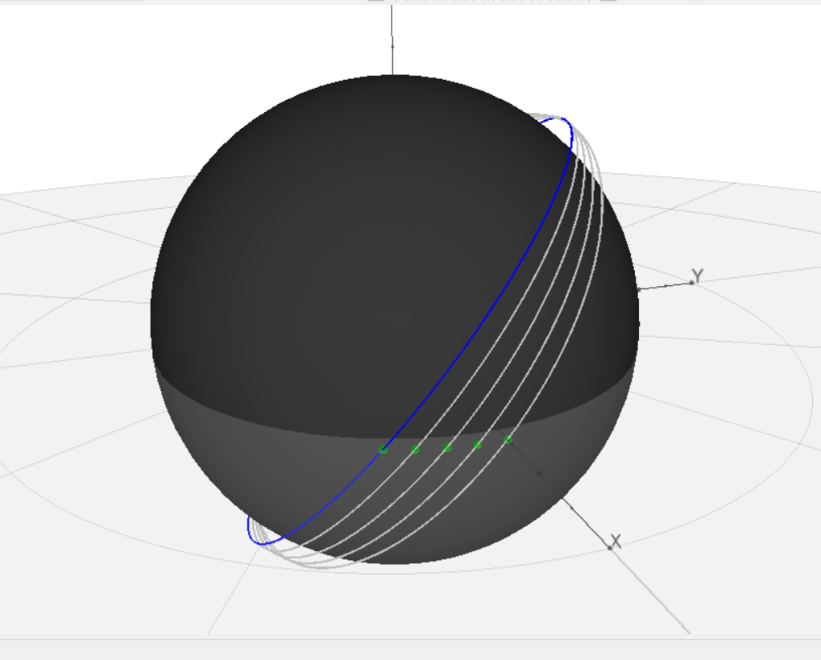



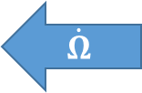
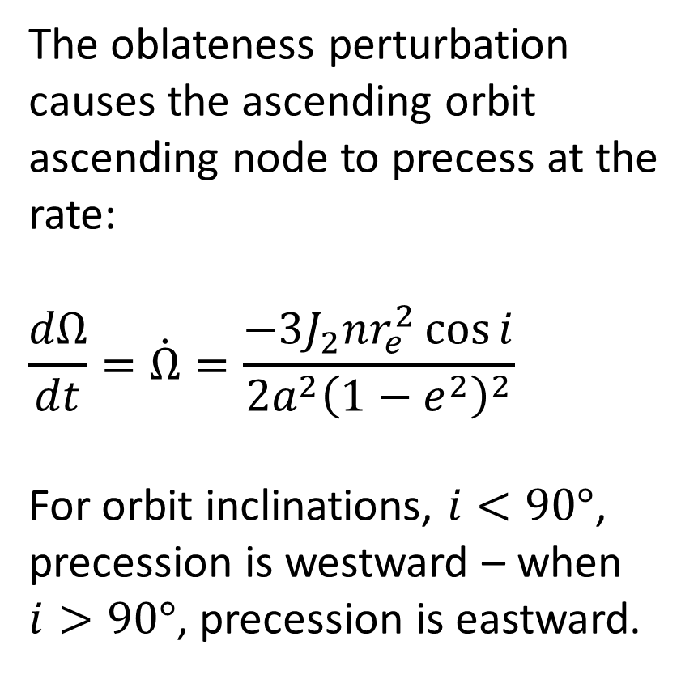
Perturbations: Precession of the Ascending Node
The oblateness perturbation causes the ascending orbit ascending node to precess at the rate:
$$\frac{dΩ}{dt}=\dot{Ω}=\frac{−3J_{2}nr_{e}^{2}\cos{i}}{2a^{2}{\left(1−e^{2}\right)}^{2}}$$
For orbit inclinations, $i<90°$, precession is westward – when $i>90°$, precession is eastward.
$$\dot{Ω}$$
Precession of the Orbit Ascending Node

Slide 28
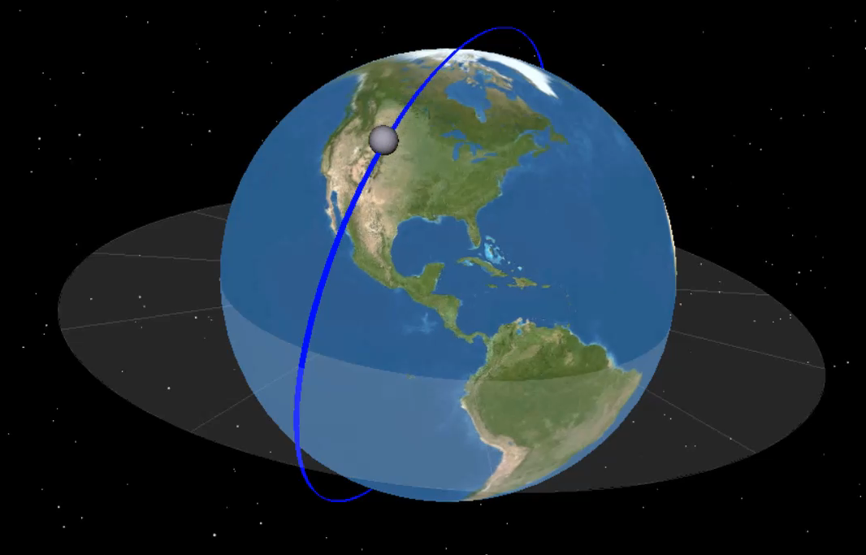
Example: Sun Synchronous Orbit
Sun synchronous orbits are useful for Earth observation spacecraft because they are designed to pass over sunlit portions of the planet at the same “local solar” time – this results in consistent illumination conditions for observations.
Sun Synchronous Orbit

Slide 29
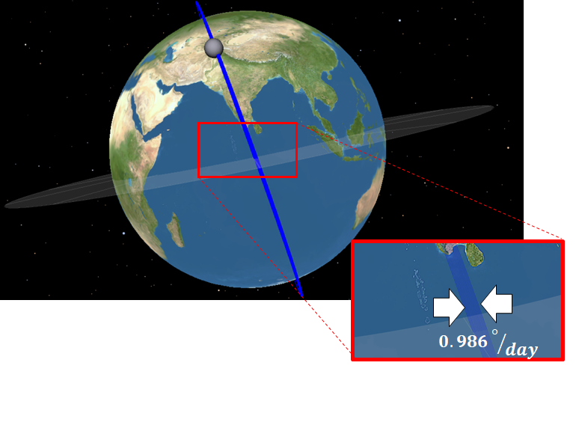
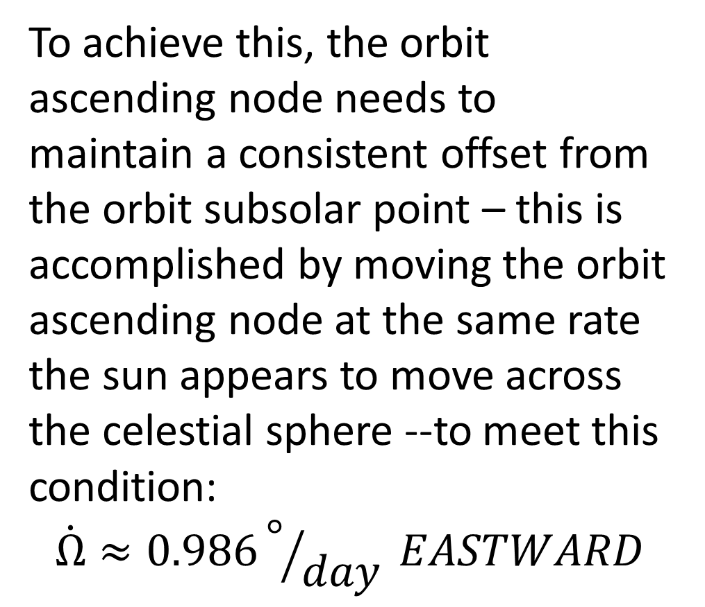
Example: Sun Synchronous Orbit
To achieve this, the orbit ascending node needs to maintain a consistent offset from the orbit subsolar point – this is accomplished by moving the orbit ascending node at the same rate the sun appears to move across the celestial sphere --to meet this condition:
$$\dot{Ω}≈0.986°/{day} EASTWARD$$
Daily Precession of the Ascending Node

Slide 30
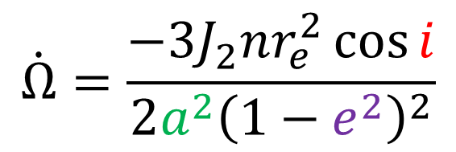
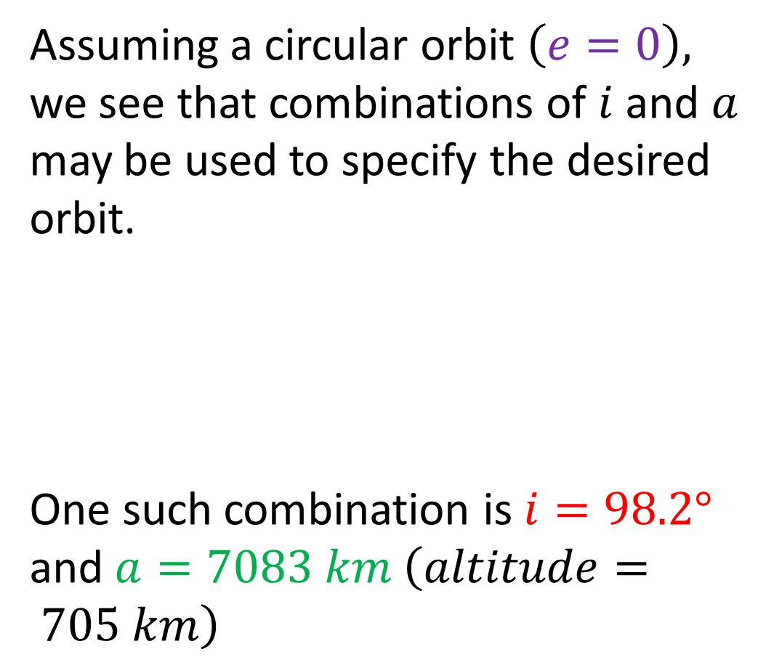

Example: Sun Synchronous Orbit
Assuming a circular orbit $\left(e=0\right),$ we see that combinations of $i$ and $a$ may be used to specify the desired orbit.
One such combination is $i=98.2°$
and $a=7083 km \left(altitude= 705 km\right)$
$$\dot{Ω}=\frac{−3J_{2}nr_{e}^{2}\cos{i}}{2a^{2}{\left(1−e^{2}\right)}^{2}}$$
Daily Precession of the Ascending Node
$$0.986°/{day}$$

Slide 31
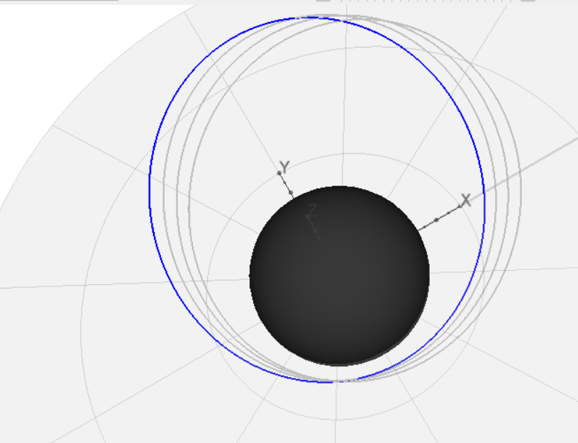
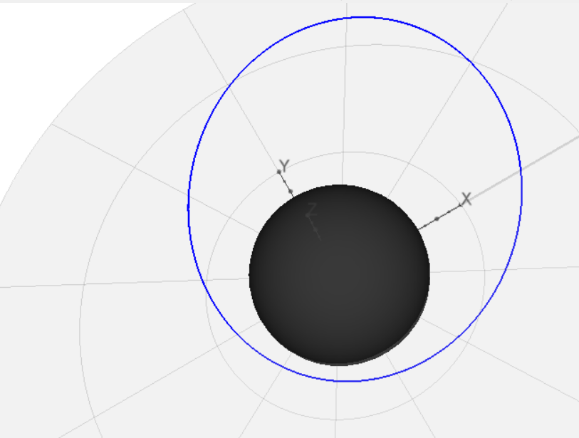





Perturbations: Precession of the Periapsis
The oblateness perturbation also causes the periapsis and apoapsis to precess at the rate:
$$\dot{ω}=\frac{3J_{2}nr_{e}^{2}}{4a^{2}{\left(1−e^{2}\right)}^{2}}\left(4−5\sin^{2}{i}\right)$$
Precession is positive when $\left(4−5\sin^{2}{i}\right)<0$ and negative when $\left(4−5\sin^{2}{i}\right)$ $>0$ .
$$\dot{ω}$$
Precession of the Orbit Periapsis

Slide 32
Example: Molniya Orbit
Communication satellites in geostationary orbits over the equator are of little use to those living at higher latitudes because they appear low in the sky;
A satellite orbiting at a higher inclination is desired;
However, it won’t appear to remain over the same point on the ground;
A Molniya orbit may be used to cause the spacecraft to dwell at nearly the same point for long periods of time.

Slide 33

Example: Molniya Orbit
In order to “lock” the location of the apoapsis and periapsis in place, we desire an orbit where the rate of movement of the periapsis goes to zero:
$$\frac{dω}{dt}=\dot{ω}=\frac{3J_{2}nr_{e}^{2}}{4a^{2}{\left(1−e^{2}\right)}^{2}}\left(4−5\sin^{2}{i}\right)=0$$
We see from the equation that this happens when:
$$\left(4−5\sin^{2}{i}\right)=0$$
This is true when the inclination is$i=63.4°$

Slide 34

Example: Molniya Orbit
The spacecraft spends much of its orbit at high altitude, at high latitude, moving slowly -- appearing nearly stationary when near apoapsis;
Orbit is designed so that apoapsis stays “locked” into the same position over time.
Molniya Type Orbit (Time points in red are 10 minutes apart)

Slide 35

Other Orbits: Gravity Assist Orbit
Spacecraft orbits may be redirected using gravity assist maneuvers where a close fly-by of a planet is be used to change the direction of and orbit and add energy to it.
Image Credit: NASA/JPL/Caltech
https://www.jpl.nasa.gov/images/juno/earthflyby/JunoCruiseTraj_20130815.jpg
Juno Spacecraft Trajectory

Slide 36











Other Orbits: The Restricted Three-Body Problem
When two large masses, $m1$ and $m2$, are orbiting one another, regions in space can serve as gravitational nodes where spacecraft or other celestial bodies can collect – these are called Lagrange points;
$L1$, $L2$ and $L3$ and unstable.
$L4$ and $L5$ are stable.
$$L4$$
$$m2$$
$$m2$$
$$L3$$
$$m1$$
$$m1$$
$$L2$$
$$L1$$
$$L5$$
Dynamics of the Three-Body System

Slide 37


Other Orbits: Three-Body Orbits
In 1772, using three-body assumptions, Joseph-Louis Lagrange believed that, because the L4 and L5 points are stable, asteroids might be trapped near these points;
The first confirmed observation of a Jupiter Trojan was made by Max Wolf in 1906.
Jupiter’s Trojan Asteroids
Animation Credit: CAS/Petr Scheirich. Used with permission.
Source: https://en.wikipedia.org/wiki/Jupiter_trojan

Slide 38

Other Orbits: Three-Body Orbits
Lagrange points are also used for spacecraft;
The James Webb Space Telescope (JWST) will be located at the Earth-Moon L2 point.
JWST Orbit at the Earth-Moon L2 Point
Image Credit: NASA
https://www.nasa.gov/images/content/463480main_lagrange_point_lg_1.jpg

Slide 39

Other Orbits: Three-Body Orbits
The DSCOVR spacecraft is located at the Sun-Earth L1 point.
DSCOVR Spacecraft at the Sun-Earth L1 Point
The Earth-Moon System as Seen from the DSCOVR Spacecraft
Image Credit: NOAA
Video Credit: DSCOVR: EPIC Team

Slide 40
Questions?

