Slide 1
Additive Manufacturing Design, Process and Quality Controls
Doug Wells
MSFC Structural Materials Engineer,
Technical Specialist – Damage Tolerance
Andrew Glendening
GSFC Materials and Processes Assurance
Sam Cordner
MSFC Materials Engineer
Rick Russell
NASA Technical Fellow for Materials
Public Use - Quality Leadership Forum 2021 - 27 May 2021

Slide 2
Outline
Introductory Session
Breakout Sessions
  Qualified Material Process and Material Property Suite for Additive Manufacturing
    Doug Wells - MSFC
    Sam Cordner - MSFC
  Considerations for Quality Audits of Additive Manufacturing Suppliers
    Andrew Glendening – GSFC
    Jeannette Plante – HQ/OSMA
Public Use - Quality Leadership Forum 2021 - 27 May 2021

Slide 3
Introductory Session
No Verbal Q&A Until Breakout Sessions
Please take note of any questions you might have so you can ask them in the breakout sessions
Public Use - Quality Leadership Forum 2021 - 27 May 2021

Slide 4
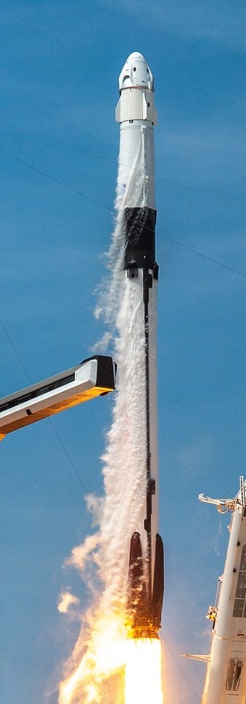
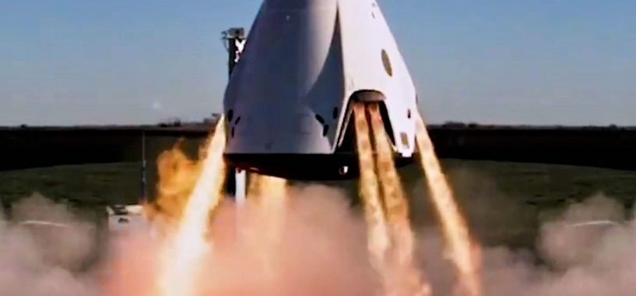

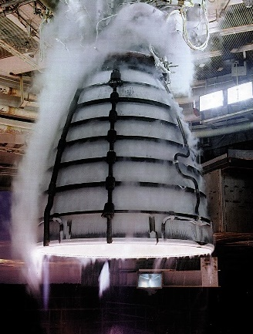
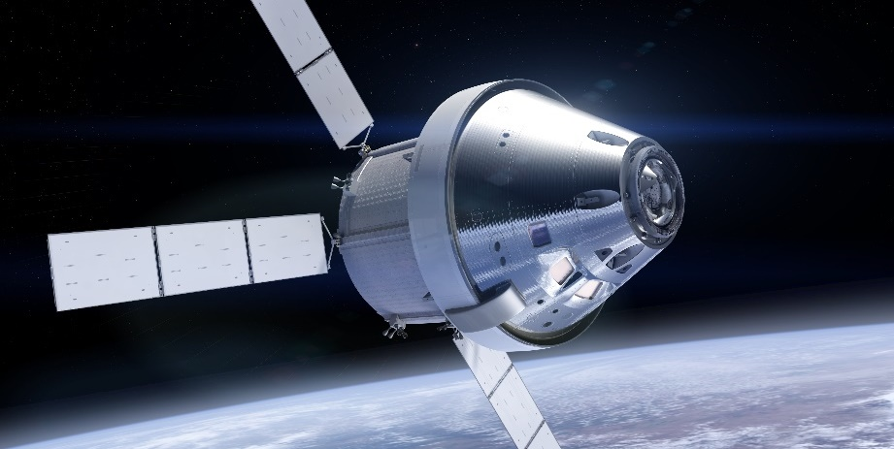
Additive Manufacturing: The Future is Now!!
Public Use - Quality Leadership Forum 2021 - 27 May 2021

Slide 5

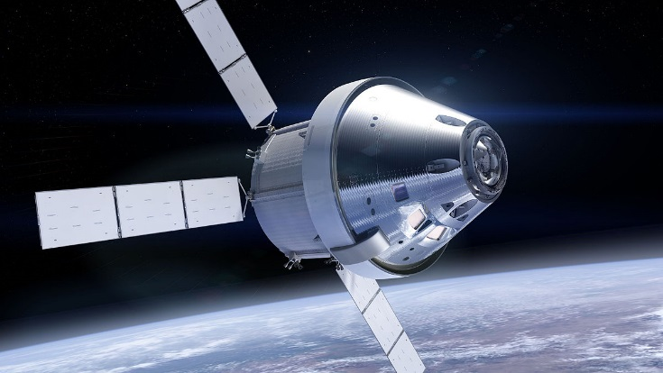
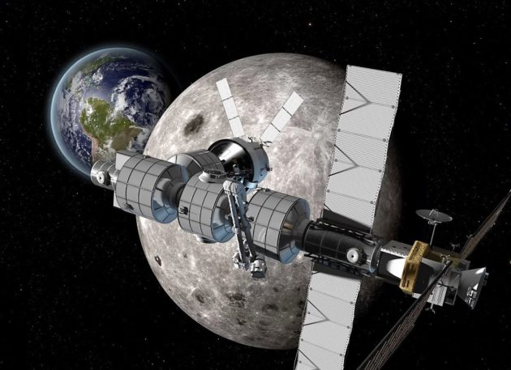

NASA’s motivation for AM Standards
AM parts are already being use for NASA programs in critical applications
Human exploration of space, especially deep space, requires extreme reliability
Low Earth |  | Deep Space
400 km | vs | 400,000 - 400,000,000+ km
15-30 year life | vs | 50 to 100+ years
Replacement Parts | vs | Limited Replacement
Nearby Safe Haven | vs | Largely on your own
Public Use - Quality Leadership Forum 2021 - 27 May 2021

Slide 6

The New Standards – April 2021
NASA-STD-6030
Additive Manufacturing Requirements for Spaceflight Systems
NASA-STD-6033
Additive Manufacturing Requirements for Equipment and Facility Control
NASA-STD-6030
Additive Manufacturing Requirements for Spaceflight Systems
Appendix B
Non-crewed Tailoring Guidelines
Public Use - Quality Leadership Forum 2021 - 27 May 2021

Slide 7
Applicability
 |  |  |  | Class
Category | Technology | Materials Form | A | B | C
Metals | L-PBF | Metal Powder | X | X | X
 | DED | Metal Wire | X | X | X
 | DED | Metal Blown Powder | X | X | X
Polymers | L-PBF | Thermoplastic Powder |  | X | X
 | Vat Photopolymerization | Photopolymeric Thermoset Resin |  |  | X
 | Material Extrusion | Thermoplastic filament |  |  | X
Adaptive technologies, where the heat input can change during the manufacturing process, are not covered by NASA-STD-6030
  e.g., Electron beam powder bed fusion (E-PBF)
Public Use - Quality Leadership Forum 2021 - 27 May 2021

Slide 8
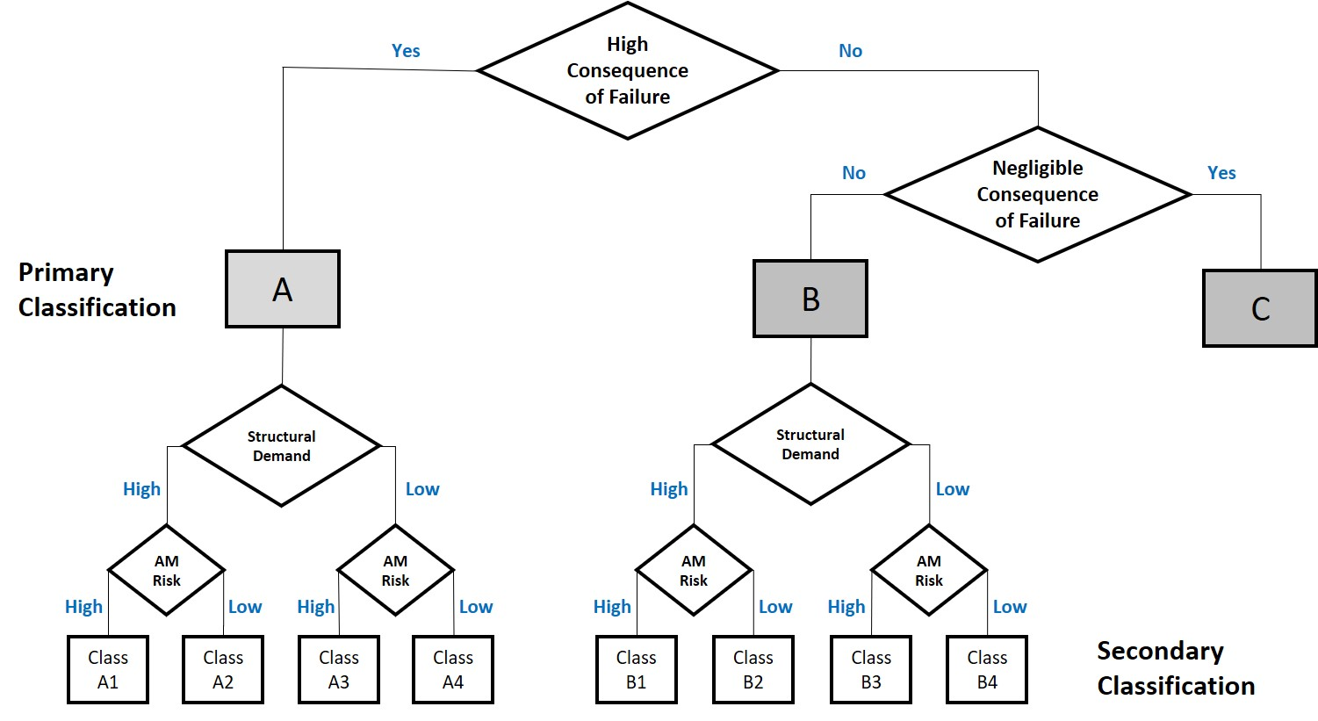
Classification
Public Use - Quality Leadership Forum 2021 - 27 May 2021

Slide 9
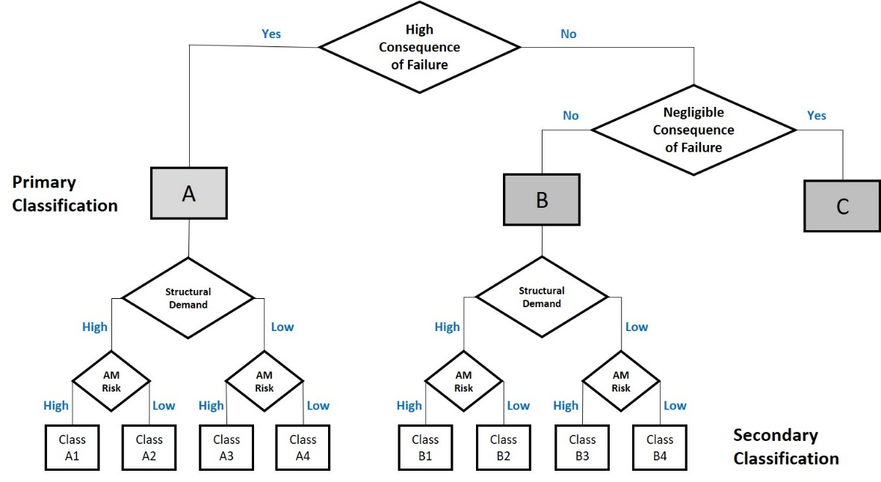
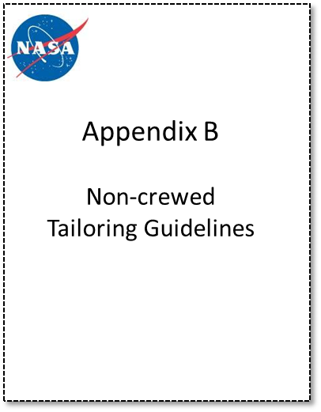
High Consequence of Failure
A part shall be designated as Class A, High Consequence of Failure, if failure of the part leads to a catastrophic, critical, or safety hazard and/or the part is defined as mission critical by the program or project.
Class A parts shall not:
  Be made from polymeric materials
  Be fasteners
  Contain printed threads.
Public Use - Quality Leadership Forum 2021 - 27 May 2021

Slide 10
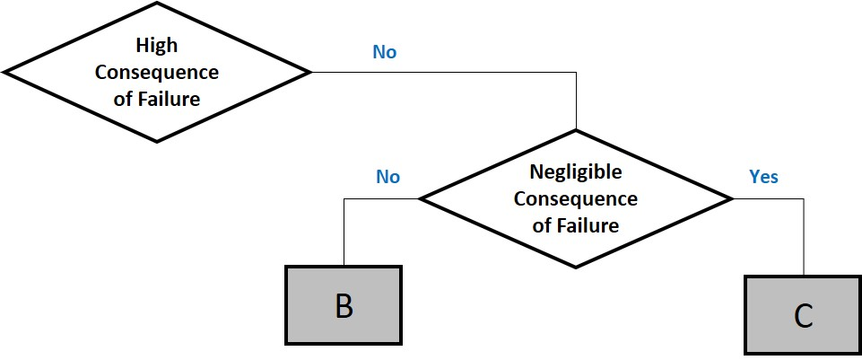
Negligible Consequence of Failure
Parts not designated Class A or Class C shall be designated as Class B.
Class B parts shall not:
  Be fasteners
  Contain printed threads.
Public Use - Quality Leadership Forum 2021 - 27 May 2021

Slide 11
Negligible Consequence of Failure
A part shall be designated as Class C, Negligible Consequence of Failure, provided that ALL of the following criteria are satisfied:
  Failure of part does not lead to any form of hazardous condition.
  Failure of part does not eliminate a critical redundancy.
  Part does not serve as primary or secondary containment.
  Part does not serve as redundant structures for fail-safe criteria per NASA-STD-5019, Fracture Control Requirements for Spaceflight Hardware.
  Part is not designated “Non-Hazardous Leak Before Burst” per NASA-STD-5019.
  Failure of part does not cause debris or contamination concerns, as defined by the Non-Fracture Critical Low-Release Mass classification per NASA-STD-5019, NASA-STD-6016, and/or other project/program requirements.
  Failure of part causes only minor inconvenience to crew or operations.
  Failure of part does not alter structural margins or related evaluations on other hardware.
  Failure of part does not adversely affect other systems or operations.
  Failure of part does not affect minimum mission operations.
Public Use - Quality Leadership Forum 2021 - 27 May 2021

Slide 12
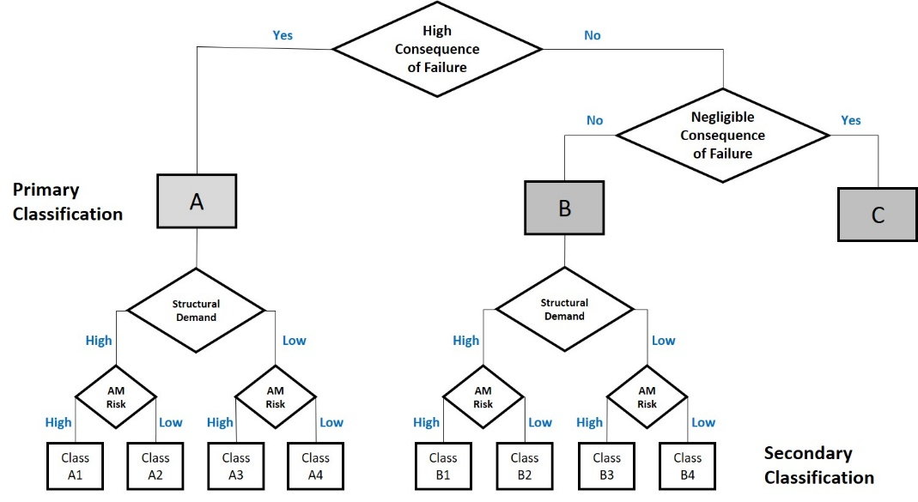
Secondary Classification
Secondary classification is for Class A and B parts only and is primarily used to determine appropriate levels of process control.
Public Use - Quality Leadership Forum 2021 - 27 May 2021

Slide 13
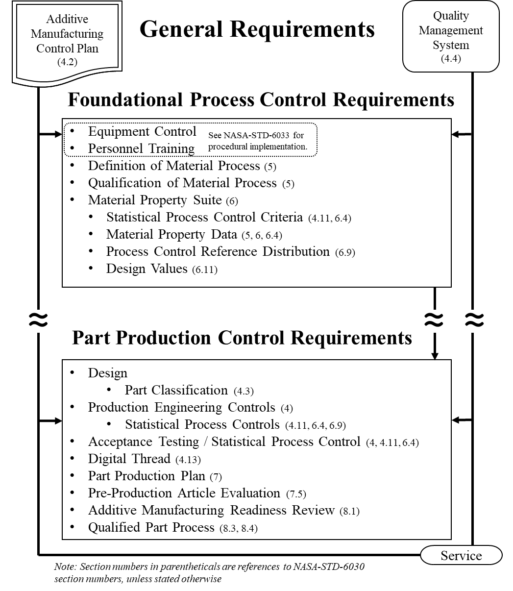
Public Use - Quality Leadership Forum 2021 - 27 May 2021

Slide 14
Deliverables
There are only three deliverables:
  Additive Manufacturing Control Plan (AMCP)
  Material Property Suite (MPS) via an MUA
  Part Production Plan (PPP)
In many/most cases NASA is expected to be invited to the Additive Manufacturing Readiness Review (AMRR)
  NASA’s attendance is only required for Class A1 or A2 Parts
  NASA Approval is NOT required
Public Use - Quality Leadership Forum 2021 - 27 May 2021

Slide 15

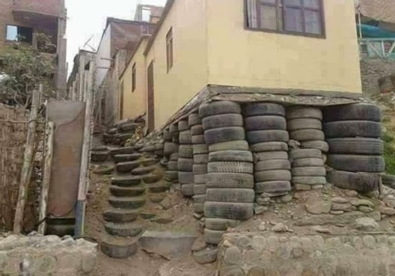
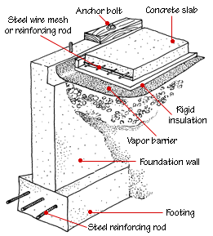

Building a Foundation
Planning for AM certification does NOT start with a part
AM Control Plan should define how the foundation for certification is structured and how it operates
  Equipment and Facility Controls
  Personnel Training
  Process/Machine Qualification
  Material Properties
  Statistical Process Controls
Building this foundation can take years
For most programs, flying a Class A or B part will require a pre-existing foundation, the schedule won’t let you start from scratch.
Public Use - Quality Leadership Forum 2021 - 27 May 2021

Slide 16
Summary of Methodology
Public Use - Quality Leadership Forum 2021 - 27 May 2021

Slide 17
Qualified Material Process (QMP)
Feedstock
Specification
NASA-STD-6033
Begins as a Candidate QMP
Defines aspects of the basic, part agnostic, fixed AM process:
  Feedstock
  Fusion Process
  Thermal Process
Enabling Concept
  Machine qualification and re-qualification, monitored by…
  Process control metrics, SPC, all feeding into…
  Design values
Definition of
Material Process
ECP
Qualification Maintenance Calibration
AM Process
Post-AM Process
Qual. of Material Process
Training Plan
Training
Machine 1
QMP-A, B or C
Foundational Process Controls
Machine 2
Machine 3
Machine “n”
Sub-QMP-A, B or C
Sub-QMP-A, B or C
Sub-QMP-A, B or C
Registration
(A or B)
MPS
Data
PCRD
Data
SPC Criteria
Design
Properties
Design Process
PPP
Public Use - Quality Leadership Forum 2021 - 27 May 2021

Slide 18
Material Properties
Feedstock
Specification
NASA-STD-6033
The Material Property Suite (MPS) consists of four inter-related entities:
Data Repository
Design Values
Process Control Reference Distribution (PCRD)
SPC acceptance criteria for witness testing
Qualification Maintenance Calibration
AM Process
Definition of
Material Process
ECP
Post-AM Process
Qual. of Material Process
Training Plan
Training
Machine 1
QMP-A, B or C
Foundational Process Controls
Machine 2
Machine 3
Machine “n”
Sub-QMP-A, B or C
Sub-QMP-A, B or C
Sub-QMP-A, B or C
Registration
(A or B)
MPS
Data
PCRD
Data
SPC Criteria
Design
Properties
Design Process
PPP
Public Use - Quality Leadership Forum 2021 - 27 May 2021

Slide 19
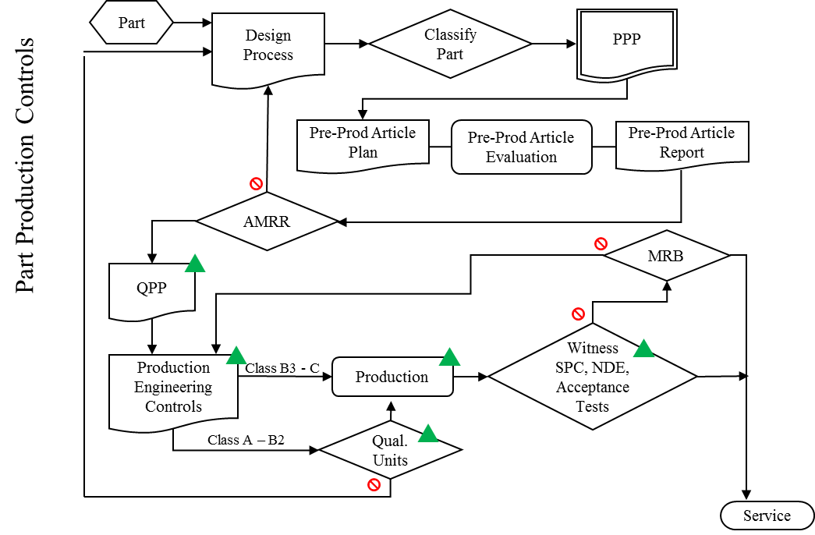
Design Process
This is the last point where a NASA approval is required prior to the delivery of a part
In most cases, we do want to be invited to the readiness review
Public Use - Quality Leadership Forum 2021 - 27 May 2021

Slide 20
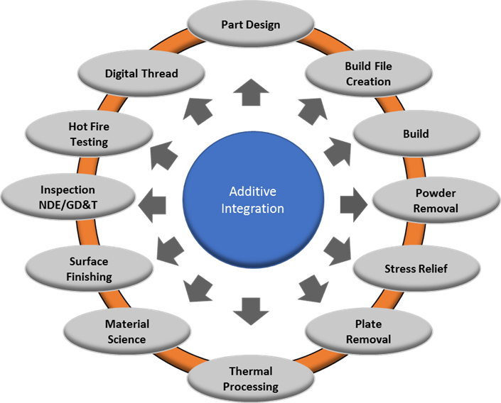
Part Production Plan
AM parts do not yet have a common industry standard of practice
  Challenge to integrate all required aspects of AM design requirements through drawing content
  Requires many aspects to be integrated
    Build layout
    Specification of qualified process ID
    Witness test and acceptance
    Post processing details
    Inspection requirements and limitations
Requiring a AM Part Production Plan as a drawing companion is currently the best option
Public Use - Quality Leadership Forum 2021 - 27 May 2021

Slide 21
Part Production Plan
Part-Specific Information
  Drawing number and part name.
  Illustrations and/or CAD model views (with scale).
  The purpose of the part in context to the system.
  The operational environments (e.g., temperatures, fluids, radiation, etc.).
  Referenced build file name contained in the digital thread.
  Material (including material specifications, if applicable):
  Identification of the QMP specified for production.
  Identification of a specific MPS for the associated material used for part assessment, including influence factors, if applicable.
  Serialization, part marking, and methodology for tracking individual parts, if applicable.
  Cleanliness, if special considerations or requirements apply (e.g., oxygen service, optical surfaces, delicate electronics, etc.).
  Qualification plan, when applicable.
Public Use - Quality Leadership Forum 2021 - 27 May 2021

Slide 22
Part Production Plan, cont.
Part Classification and Associated Rationale
Integrated Structural Integrity Rationale
  Provides justification of part integrity commensurate with its consequences of failure and associated requirements
AM Part Production Summary
Witness Testing
Planned Interruptions
Post-Build Operations Requiring Specific Controls
Preproduction Article Requirements
End Item Data Package Information
How you’re going to revise the PPP
How you’re going to requalify a revised PPP
Public Use - Quality Leadership Forum 2021 - 27 May 2021

Slide 23
AM Part Production
Follow the plan, always, with no short-cuts
Do not change a Qualified Part Process without re-qualification
Efficiency in process monitoring is critical to minimize the inevitable disruption
  Witness tests can take considerable time to complete
  Track the performance of each machine using all available metrics by control chart
  In-process monitoring may provide early warning of changes in machine performance
Emphasize the importance of inspection for every part
  Not just NDE, but visual inspection of as-built conditions
  Watch for changes in part appearance – colors, support structure issues, witness lines/shifts
Consider systemic implications for all non-conformances
Public Use - Quality Leadership Forum 2021 - 27 May 2021

Slide 24
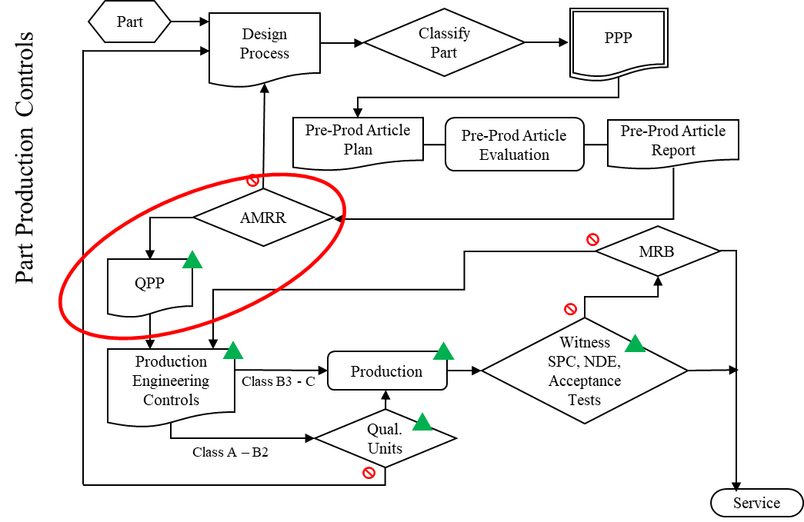
Qualified AM Part Process
Agreed upon and approved AM Part Production Plan
Pre-production article evaluation
AM Manufacturing Readiness Review
  All stakeholders agree AM part development is successful and complete for qualification or production articles to be produced
  Demarcates the point in time when changes to AM part definition (digital files, engineering instructions, etc) are locked. NO MORE CHANGES
  Qualified Part Process (QPP) state is documented in the Quality Management System
Produce to the Plan and STICK TO THE PLAN
Locked Process Is the QPP! Must be documented in the QMS!
Public Use - Quality Leadership Forum 2021 - 27 May 2021

Slide 25
AM Qualification: Governing Principles
Understanding and Appreciation of the AM process
Integration across technical disciplines and throughout the process
Discipline to define and follow the plan
Have a plan
Integrate a Quality Management System
Build a foundation
  Equipment and Facility
  Training
  Process and machine qualification
  Material Properties / SPC
Plan each Part
Design, classification, Pre-production articles
  Qualify and lock the part production process
Produce to the plan – Stick to the plan
Public Use - Quality Leadership Forum 2021 - 27 May 2021

Slide 26
Certification and Qualification
There is NO centralized Certification or Qualification body at NASA.
Each individual Program/Project will be responsible for “Qualifying*” AM Processes and “Certifying” AM Flight Hardware.
  *or accepting another projects “qualification”
NASA’s Engineering and Safety Center (NESC) is standing up an Intra-Agency team representing all major centers to coordinate these efforts.
The hope is that by maintaining a single “NASA AM Ecosystem”, the non-recurring engineering costs associated with each new using program or project will be dramatically reduced.
Public Use - Quality Leadership Forum 2021 - 27 May 2021

Slide 27
Breakout Sessions
Please bring your questions!

Slide 28
Breakout Session 1
  Qualified Material Process and Material Property Suite for Additive Manufacturing
  Bring Your Questions!
Sam Cordner
MSFC Materials Engineer
Doug Wells
MSFC Structural Materials Engineer,
Technical Specialist – Damage Tolerance
Public Use - Quality Leadership Forum 2021 - 27 May 2021

Slide 29
AM Certification: Governing Principles
Understanding and Appreciation of the AM process
Integration across disciplines and throughout the process
Discipline to define and follow the plan
Control what you do :: Evaluate what you get

Slide 30
Classification
Public Use - Quality Leadership Forum 2021 - 27 May 2021

Slide 31
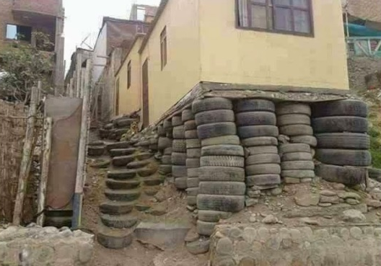
Building a Foundation
Planning for AM certification does NOT start with a part
AM Control Plan should define how the foundation for certification is structured and how it operates
  Equipment and Facility Controls
  Personnel Training
  Process/Machine Qualification
  Material Properties
  Statistical Process Controls
Public Use - Quality Leadership Forum 2021 - 27 May 2021

Slide 32
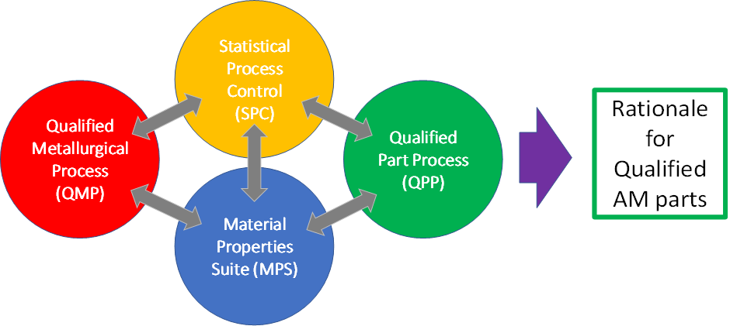
Qualified Material Process (QMP)
Begins as a Candidate QMP
Defines aspects of the basic, part agnostic, fixed AM process:
  Feedstock
  Fusion Process
  Thermal Process
Enabling Concept
  Machine qualification and re-qualification, monitored by…
  Process control metrics, SPC, all feeding into…
  Design values
Feedstock
Specification
NASA-STD-6033
Definition of
Material Process
ECP
Qualification Maintenance Calibration
AM Process
Post-AM Process
Qual. of Material Process
Training Plan
Training
Machine 1
QMP-A, B or C
Foundational Process Controls
Machine 2
Machine 3
Machine “n”
Sub-QMP-A, B or C
Sub-QMP-A, B or C
Sub-QMP-A, B or C
Registration
(A or B)
MPS
Data
PCRD
Data
SPC Criteria
Design
Properties
Design Process
PPP
Public Use - Quality Leadership Forum 2021 - 27 May 2021

Slide 33
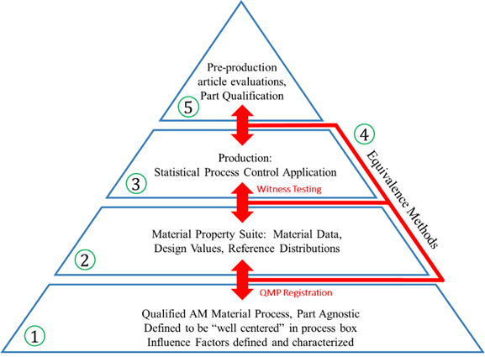
The QMP becomes the Foundation!
Public Use - Quality Leadership Forum 2021 - 27 May 2021

Slide 34
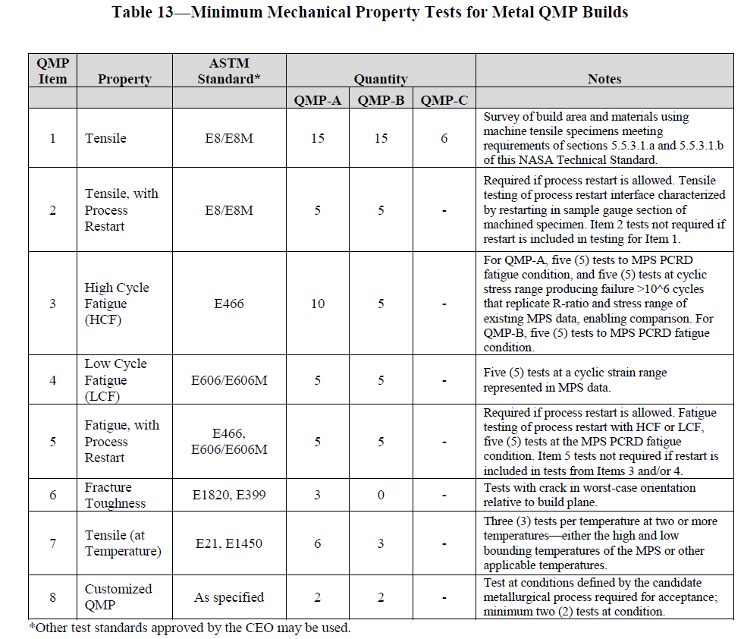
QMP Tables
Public Use - Quality Leadership Forum 2021 - 27 May 2021

Slide 35
Material Properties
The Material Property Suite (MPS) consists of four inter-related entities:
Data Repository
Design Values
Process Control Reference Distribution (PCRD)
SPC acceptance criteria for witness testing
Public Use - Quality Leadership Forum 2021 - 27 May 2021

Slide 36
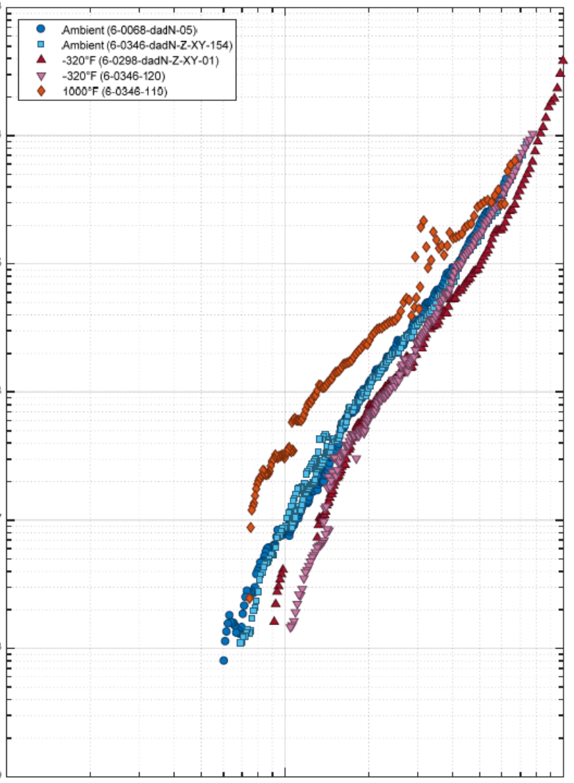
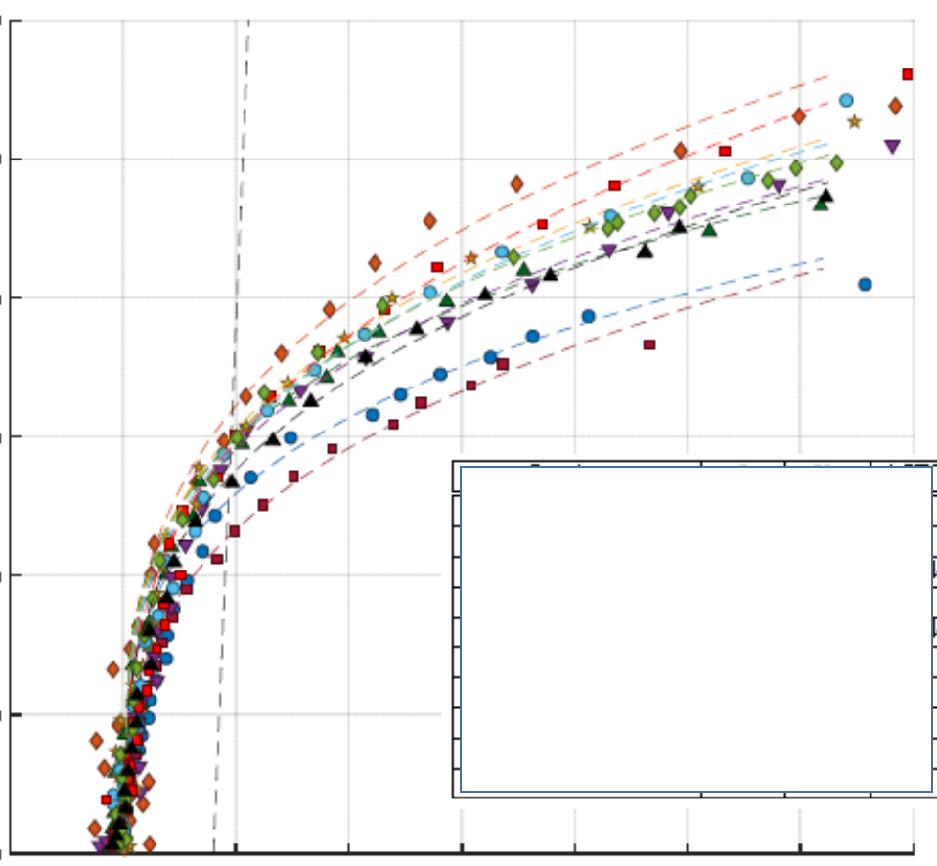
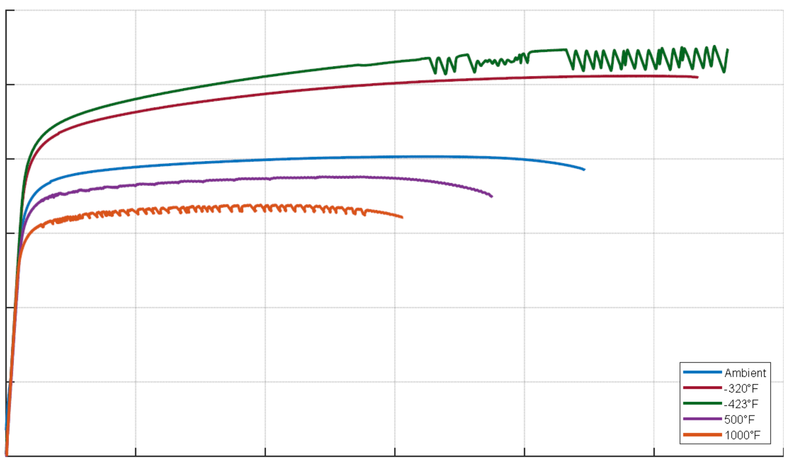
Material Properties
Material properties and design values in additive manufacturing require modifications to the approach typical of traditional metallic materials, with requirements more similar to that used in composites CMH-17
Important distinctions arise due to the sensitive nature of the process and individualistic aspect of AM machines. Each machine is a foundry!
Traditional supplier roles and responsibilities shift with the AM machine making the final material product form and part. (Casting analogy)
  AM Process Vendor is responsible for material integrity
Public Use - Quality Leadership Forum 2021 - 27 May 2021

Slide 37
Material Properties – Data Repository
Includes data from
  Qualification testing
  Material Characterization
  Pre-production Article Evaluations
Contains all data needed for
  Setting Design Values
  Property equivalence evaluations and QMP Registration
  Setting the Process Control Reference Distribution
Grouping of data
Group data by
QMP = Material/process/heat treat
“Combinable” conditions for design
Public Use - Quality Leadership Forum 2021 - 27 May 2021

Slide 38
Material Properties – Design Values
Design Values
Statistically substantiated
Applicable sources of variability included
Utilizes all appropriate data sources in Repository
May include additional margin for safety
DV
μ
Design
Values
Public Use - Quality Leadership Forum 2021 - 27 May 2021

Slide 39
Material Properties – PCRD
Process Control Reference Distribution
Statistically describes nominal witness behavior of a machine
Utilizes all appropriate sources of witness coupon data in Repository
Used to set acceptance criteria for witness tests
σ
μ
PCRD
Public Use - Quality Leadership Forum 2021 - 27 May 2021

Slide 40

Material Properties – SPC
Statistical process controls are important in sustaining certification rationale
Statistical equivalency evaluations substantiate design values and process stability build-to-build
  Process qualification
  Witness testing
  Integration to existing material data sets
  Pre-production article evaluations
Equivalency of material performance is an anchor to the structural integrity rationale for additively manufactured parts
The dark and scary place most manufacturers are NOT used to operating….
Public Use - Quality Leadership Forum 2021 - 27 May 2021

Slide 41
Material Properties Suite
Statistical Process Control
Acceptance Criteria
Derived from PCRD
Acceptance criteria for
witness tests
SPC Acceptance Criteria for Witness Testing
σ
DV
μ
μ
Design
Values
PCRD
Public Use - Quality Leadership Forum 2021 - 27 May 2021

Slide 42
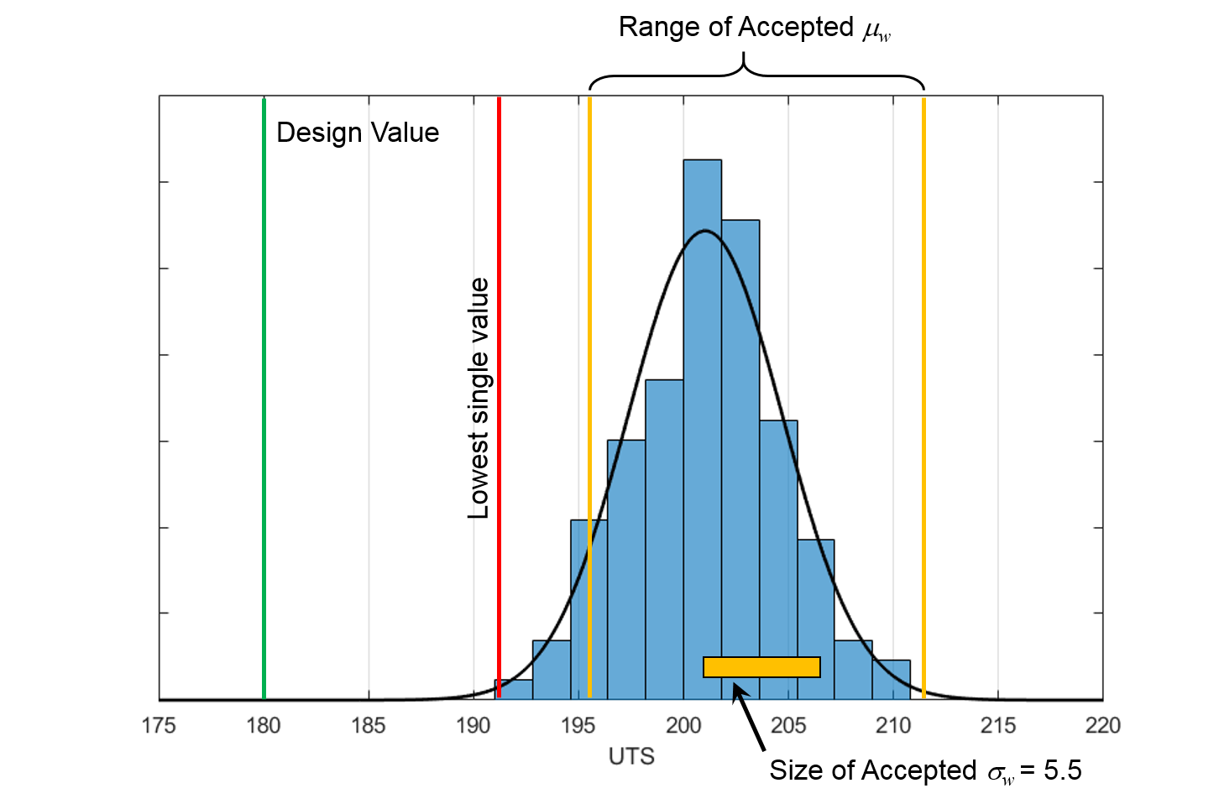
Material Properties Suite – PCRD and SPC Criteria
Witness test acceptance is not intended to be based upon design values or “specification minimums”
Acceptance is based on witness tests reflecting properties in the MPS used to develop design values
Suggested approach
  Acceptance range on mean value
  Acceptance range on variability (e.g., standard deviation)
  Limit on lowest single value
Public Use - Quality Leadership Forum 2021 - 27 May 2021

Slide 43
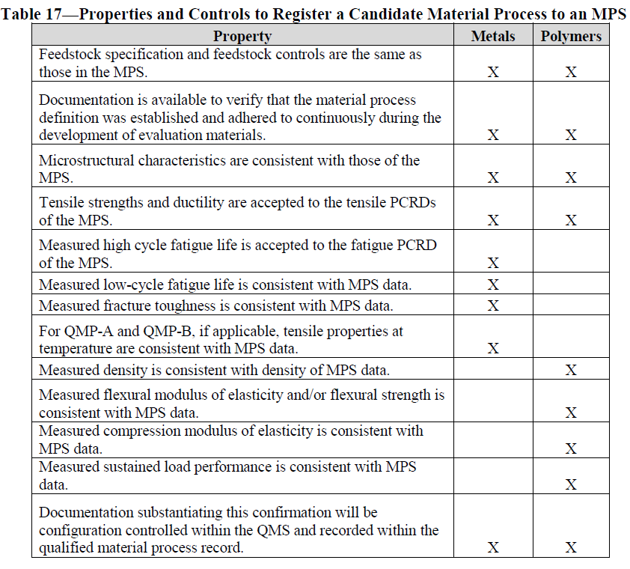
Registering a QMP to an MPS
Public Use - Quality Leadership Forum 2021 - 27 May 2021

Slide 44
Bootstrapping a QMP and MPS
When new AM processes are first established, an MPS may not yet exist to conduct the registration process. In such cases, the material test data generated to produce the QMP are also used to generate the initial MPS (i.e., bootstrapping), and the QMP is registered to the new MPS by default.
Additional data generated from the QMP are used to populate preliminary MPS PCRDs and other material properties to enable registration of additional QMPs.
Public Use - Quality Leadership Forum 2021 - 27 May 2021

Slide 45
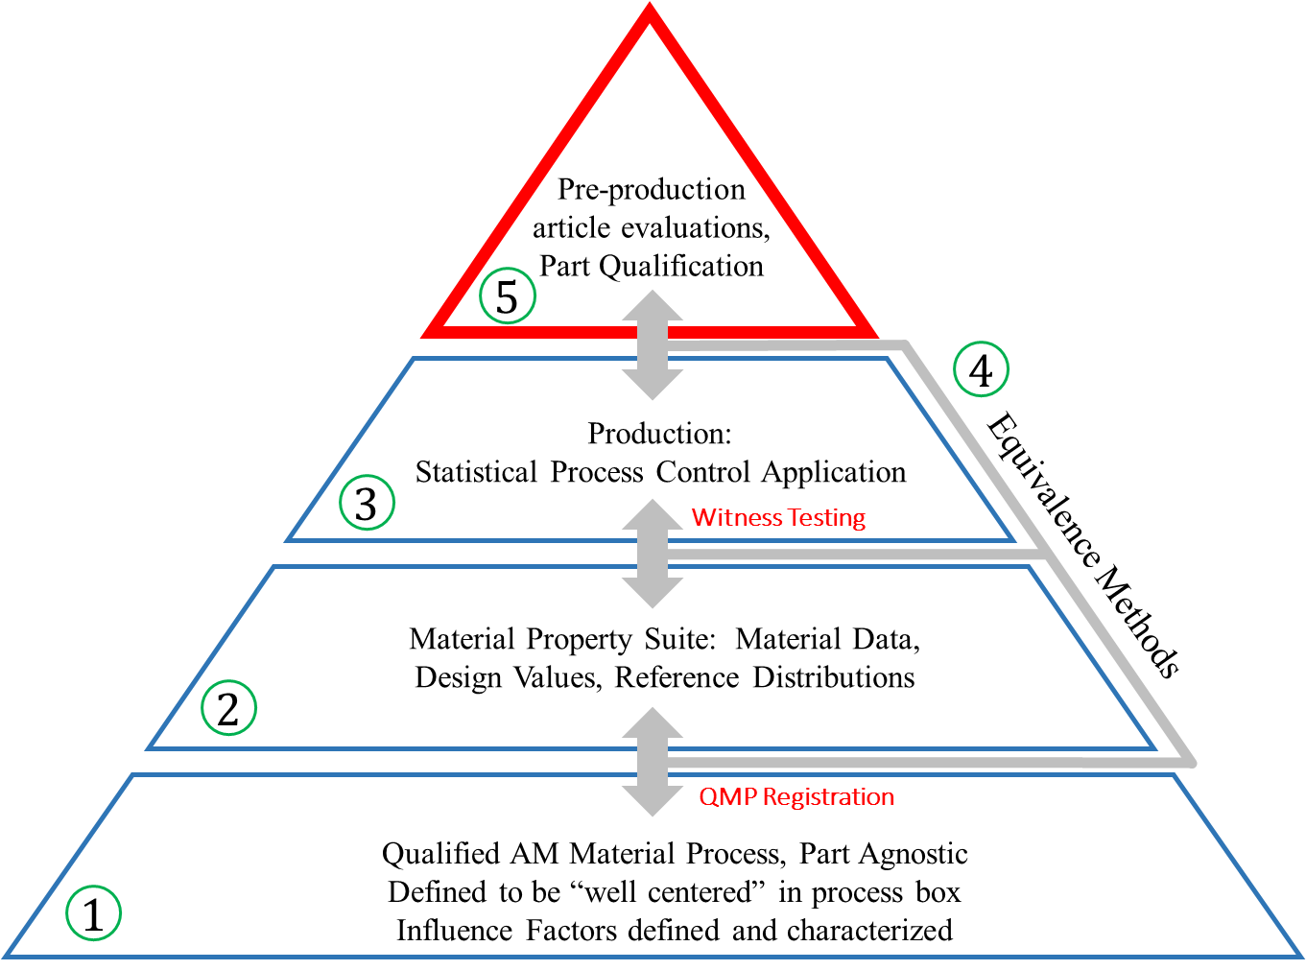
Foundation Complete!!
A basis to begin designing AM parts with certification intent is feasible once the foundation is laid.
Foundation is now ready to support AM part development in an environment with suitable rigor to establish certification.
Public Use - Quality Leadership Forum 2021 - 27 May 2021

Slide 46
Conclusions
QMP’s define the material state for one machine
MPS define the overall material property. It can be broken up in different ways depending on needs
QMP and MPS are the foundations for material control and material design values
Control what you do::Evaluate what you get
Public Use - Quality Leadership Forum 2021 - 27 May 2021

Slide 47
Back Up Slides
Public Use - Quality Leadership Forum 2021 - 27 May 2021

Slide 48
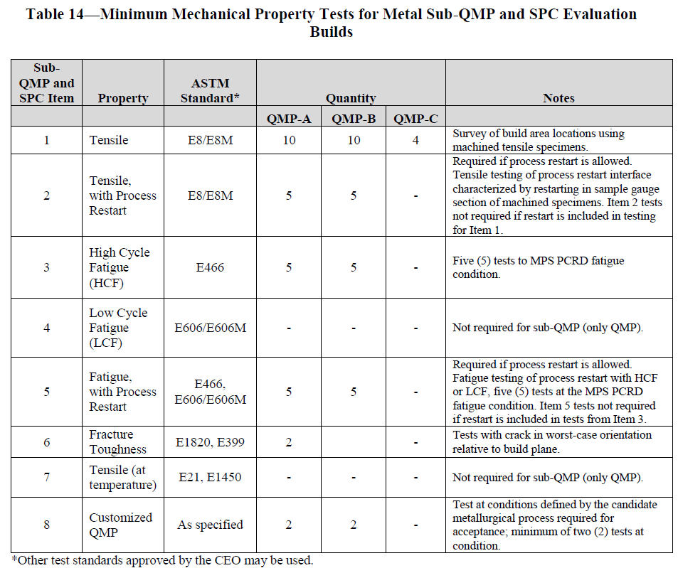
Table 14
Public Use - Quality Leadership Forum 2021 - 27 May 2021

Slide 49
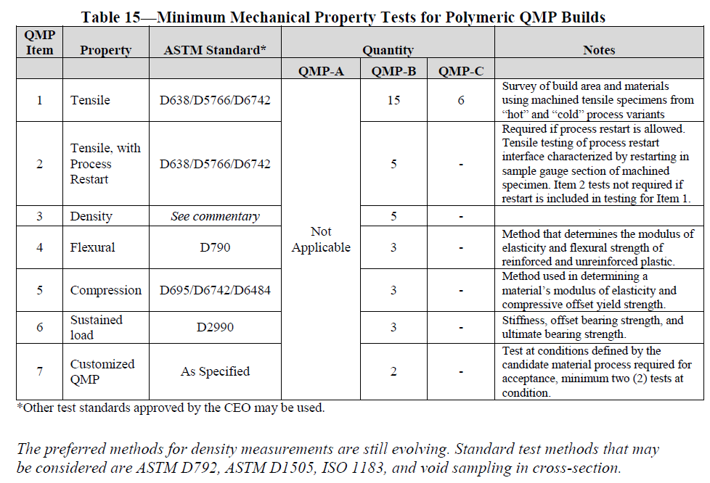
Table 15
Public Use - Quality Leadership Forum 2021 - 27 May 2021

Slide 50
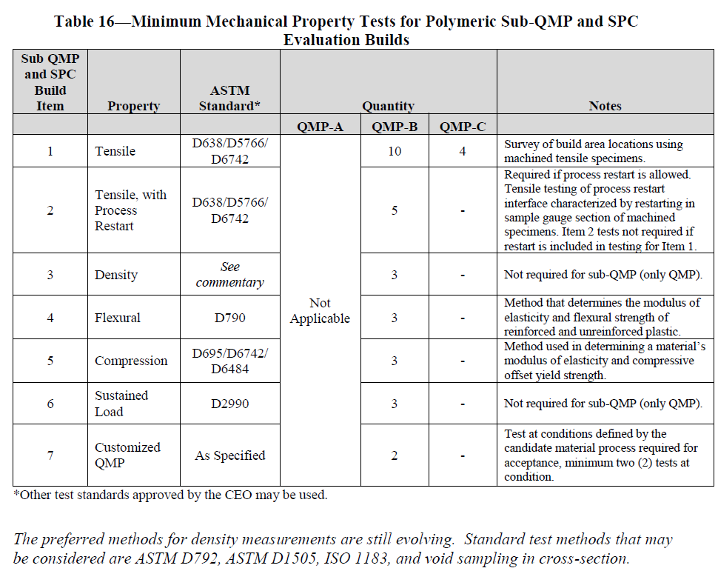
Table 16
Public Use - Quality Leadership Forum 2021 - 27 May 2021

Slide 51
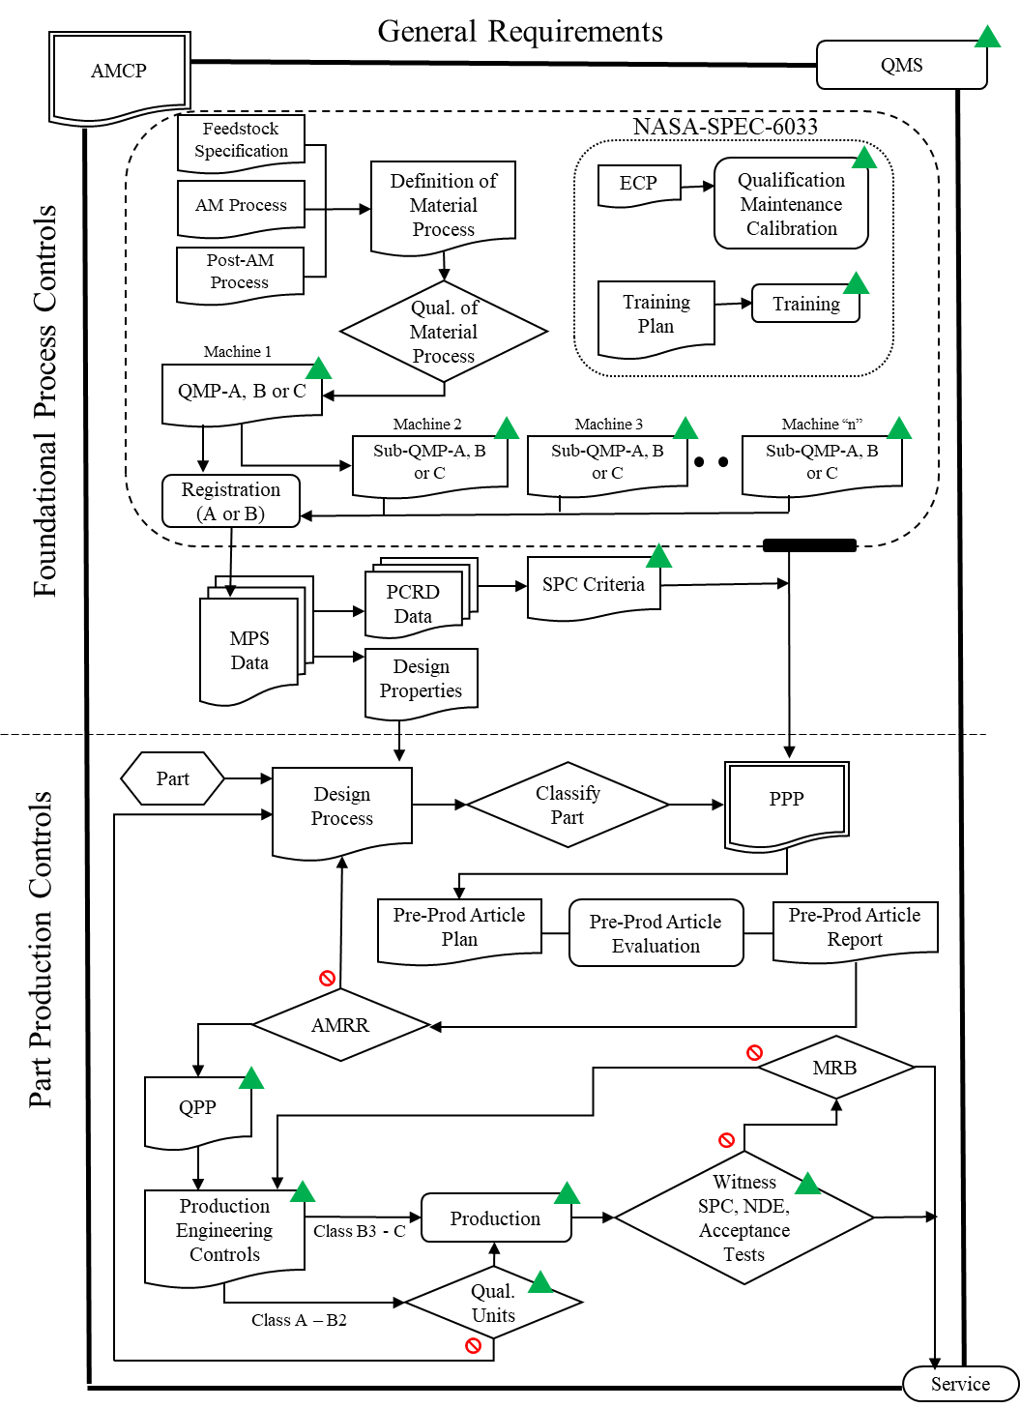
Summary of Methodology
Public Use - Quality Leadership Forum 2021 - 27 May 2021

Slide 52
Applicability
Adaptive technologies—where process parameters change based on active feedback during the manufacturing process—are not allowed without a tailored, point-design methodology.
  e.g. Electron beam powder bed fusion (E-PBF)
Public Use - Quality Leadership Forum 2021 - 27 May 2021

Slide 53
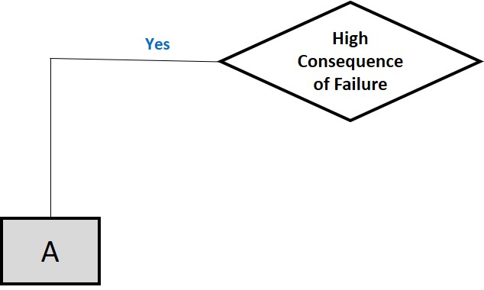
High Consequence of Failure
A part shall be designated as Class A, High Consequence of Failure, if failure of the part leads to a catastrophic hazard or the part is defined as Mission Critical Hardware by the Program Office.
Class A parts shall not:
  Be made from polymeric materials
  Be fasteners
  Contain printed threads.
Public Use - Quality Leadership Forum 2021 - 27 May 2021

Slide 54
Negligible Consequence of Failure
Parts not designated Class A or Class C shall be designated as Class B.
Class B parts shall not:
  Be fasteners
  Contain printed threads.
Public Use - Quality Leadership Forum 2021 - 27 May 2021

Slide 55
Negligible Consequence of Failure
A part shall be designated as Class C, Negligible Consequence of Failure, provided that ALL of the following criteria (see the next slide) are satisfied:
  Failure of part does not lead to any form of hazardous or unsafe condition.
  Failure of part does not eliminate a critical redundancy.
  Part does not serve as primary or secondary containment.
  Part does not serve as redundant structures for fail-safe criteria per NASA-STD-5019.
  Part is not designated “Non-Hazardous Leak Before Burst” per NASA-STD-5019.
  Failure of part does not cause debris or contamination concerns per NASA-STD-6016 .
  Part meets requirements for off-gassing, flammability, and compatibility requirements as described in NASA-STD-6016.
  Failure of part causes only minor inconvenience to crew or operations.
  Failure of part does not alter structural margins or related evaluations on other hardware.
  Failure of part does not adversely affect other systems or operations.
  Failure of part does not affect minimum mission operations.
Public Use - Quality Leadership Forum 2021 - 27 May 2021

Slide 56
Exempt Parts
A part shall be designated as Exempt provided that all of the following criteria are satisfied, and it meets all criteria for Class C, which exempts it from all other requirements in this NASA Technical Standard:
  The part does not require any form of structural assessment.
  The part does not permanently interface to, or attach to, the launch vehicle, spacecraft, habitable module, or any subsystems thereof.
  Except for use in habitable crew spaces, the part does not provide any functionality or serve any purpose to the launch vehicle, spacecraft, or any subsystems thereof.
Public Use - Quality Leadership Forum 2021 - 27 May 2021

Slide 57
Secondary Classification
Secondary classification is for Class A and B parts only and is used to determine appropriate levels of process control
A
B
High
Structural Demand
Low
High
Structural Demand
Low
High
AM Risk
Low
High
AM Risk
Low
High
AM Risk
Low
High
AM Risk
Low
Class
A1
Class
A2
Class
A3
Class
A4
Class
B1
Class
B2
Class
B3
Class
B4
Public Use - Quality Leadership Forum 2021 - 27 May 2021

Slide 58
Structural Demand - Metals
Material Property | Criteria for Low Structural Demand
Loads environment | Defined or bounded loads environment
Environmental degradation | Only due to temperature
Ultimate strength | Minimum margin* ≥ 0.3
Yield strength | Minimum margin* ≥ 0.2
Point strain | Local plastic strain < 0.005
High cycle fatigue, improved surfaces | Cyclic stress range (including any required factors) ≤ 80% of applicable fatigue limit
High cycle fatigue, as-built surfaces | Cyclic stress range (including any required factors) ≤ 60% of applicable fatigue limit
Low cycle fatigue | No predicted cyclic plastic strain
Fracture mechanics life | 20x life factor
Creep strain | No predicted creep strain
*Margin = [σ_{design}/(σ_{operation} * safety factor)] – 1
High
Structural Demand
Low
High
AM Risk
Low
High
AM Risk
Low
Class
A1
Class
A2
Class
A3
Class
A4
Public Use - Quality Leadership Forum 2021 - 27 May 2021

Slide 59
Structural Demand - Polymers
Analysis Input/Material Property | Criteria for Low Structural Demand
All Materials
Loads Environment | Defined or bounded loads environment
Environmental Degradation | Only due to temperature and moisture, if specific environmental performance data exist. Design environment temperature does not cross the Tg.
Fatigue | Cyclic stress range (including any required factors) ≤ 50% of applicable fatigue limit
Sustained stress/creep strain | No sustained stress† and no predicted creep strain
Material with elongation at failure ≥ 3% in application environment
Ultimate strength | Minimum margin* ≥ 0.5
Yield strength‡ | Minimum margin* ≥ 0.3
Material with elongation at failure < 3% in application environment
Ultimate strength# | Minimum margin* ≥ 2.0
High
Structural Demand
Low
High
AM Risk
Low
High
AM Risk
Low
Class
A1
Class
A2
Class
A3
Class
A4
†Includes assembly stress (tight snap fit connections, shrink fits, fastener preloads) and operational stress
‡Yield strength defined by secant modulus to specified strain, by specified offset strain, or as otherwise defined by structural assessment requirements
#Ultimate strength assessed against local maximum principal stress at stress concentrations (brittle material design rules) for low ductility materials
*Margin = [σ_{design}/(σ_{operation} * safety factor)] – 1
Public Use - Quality Leadership Forum 2021 - 27 May 2021

Slide 60
AM Risk
Additive Manufacturing Risk determination will be unique to each material and type of process
High
Structural Demand
Low
 | Metallic |  | Polymer
 | L-PBF | DED | L-PBF | Score For
Additive Manufacturing Risk |  |  |  | Yes | No | Score
All surfaces and volumes can be reliably inspected, or the design permits adequate proof testing based on stress state? | X | X | X | 0 | 5
As-built surface can be fully removed on all fatigue-critical surfaces? | X | X |  | 0 | 3
Surfaces interfacing with support structures are fully accessible and the as-built surface removed? | X | X | X | 0 | 3
Structural walls or protrusions are the equivalent of ≥ 8 trace, (e.g., melt pool, bead, scan path) widths in cross section? | X |  | X | 0 | 2
Structural walls or protrusions are the equivalent of ≥ 2 trace, (e.g., melt pool, bead, scan path) widths in cross section? |  | X |  | 0 | 2
Critical regions of the part do not require support structure? | X | X | X | 0 | 2
High
AM Risk
Low
High
AM Risk
Low
Class
A1
Class
A2
Class
A3
Class
A4
AM risk = HIGH, if cumulative AM Risk score >=5
Public Use - Quality Leadership Forum 2021 - 27 May 2021

Slide 61
Breakout Session 2
  Considerations for Quality Audits of Additive Manufacturing Suppliers
  Bring Your Questions!
Andrew Glendening
GSFC Materials and Processes Assurance
Jeannette Plante
NASA Quality Engineering Technical Fellow
Public Use - Quality Leadership Forum 2021 - 27 May 2021

Slide 62
High Consequence of Failure
A part shall be designated as Class A, High Consequence of Failure, if failure of the part leads to a catastrophic, critical, or safety hazard and/or the part is defined as mission critical by the program or project.
Class A parts shall not:
  Be made from polymeric materials
  Be fasteners
  Contain printed threads.
Public Use - Quality Leadership Forum 2021 - 27 May 2021

Slide 63
Negligible Consequence of Failure
A part shall be designated as Class C, Negligible Consequence of Failure, provided that ALL of the following criteria are satisfied:
  Failure of part does not lead to any form of hazardous condition.
  Failure of part does not eliminate a critical redundancy.
  Part does not serve as primary or secondary containment.
  Part does not serve as redundant structures for fail-safe criteria per NASA-STD-5019, Fracture Control Requirements for Spaceflight Hardware.
  Part is not designated “Non-Hazardous Leak Before Burst” per NASA-STD-5019.
  Failure of part does not cause debris or contamination concerns, as defined by the Non-Fracture Critical Low-Release Mass classification per NASA-STD-5019, NASA-STD-6016, and/or other project/program requirements.
  Failure of part causes only minor inconvenience to crew or operations.
  Failure of part does not alter structural margins or related evaluations on other hardware.
  Failure of part does not adversely affect other systems or operations.
  Failure of part does not affect minimum mission operations.
Public Use - Quality Leadership Forum 2021 - 27 May 2021

Slide 64
Cognizant Engineering Organization (CEO)
NASA-STD-6030, Section 3.2:
Cognizant Engineering Organization: The organization responsible for establishing/maintaining the certified design state of the AM hardware and delivering AM hardware compliant with all levied requirements. The CEO will typically be a supplier to NASA, a subcontractor, or NASA.
Public Use - Quality Leadership Forum 2021 - 27 May 2021

Slide 65
Public Use - Quality Leadership Forum 2021 - 27 May 2021

Slide 66
Deliverables
There are only three deliverables:
  Additive Manufacturing Control Plan (AMCP)
  Material Property Suite (MPS) via an MUA
  Part Production Plan (PPP)
In many/most cases NASA is expected to be invited to the Additive Manufacturing Readiness Review (AMRR)
  NASA’s attendance is only required for Class A1 or A2 Parts
  NASA’s approval is not required (unless a using project says it is)
Public Use - Quality Leadership Forum 2021 - 27 May 2021

Slide 67
Foundational Process Controls
Public Use - Quality Leadership Forum 2021 - 27 May 2021

Slide 68
Part Production Controls
Public Use - Quality Leadership Forum 2021 - 27 May 2021

Slide 69
Quality Assurance’s Role
You don’t have to be a Materials Engineer…
Public Use - Quality Leadership Forum 2021 - 27 May 2021

Slide 70
Quality Assurance’s Role
Foundational Process Controls are only as good as the Quality Program(s) in which they reside
  Fully involved Quality Management Systems
  Equipment and Facility Controls
  Training
  Process & Machine Qualifications
  Machine Maintenance
  Statistical Process Control
  Product and Performance Verification/Validation
  etc…
Part planning must confirm the foundation produces a good part consistently
Part production follows a fixed process with statistical process controls
Control what you do :: Evaluate what you get
Public Use - Quality Leadership Forum 2021 - 27 May 2021

Slide 71
Quality Management Systems
    4.4.1 Quality Management Systems – A QMS compliant to SAE AS9100, Quality Management Systems – Requirements for Aviation, Space, and Defense Organizations, or an alternate QMS approved by the CEO and NASA, documented or referenced in the AMCP, shall be in place for all entities involved in the design, production, and post-processing of AM hardware
  Quality Management System/QMS is mentioned ~100 times in NASA-STD-6030
  Having a well defined and executed QMS is critical for the production of high reliability spaceflight hardware.
  Almost every work product mentioned in NASA-STD-6030 must be maintained under configuration/revision control
Public Use - Quality Leadership Forum 2021 - 27 May 2021

Slide 72
Equipment and Facilities Control
NASA-STD-6033
Feedstock Management
  Similar to weld wire/powder
Digital Thread
  The virtual medium in which data are stored and subsequently referenced through a part’s life cycle. This configuration-managed infrastructure contains and fingerprints the digital references for a part from foundational process controls through part production controls.
(Machine) Installation Controls
Public Use - Quality Leadership Forum 2021 - 27 May 2021

Slide 73
Equipment and Facilities Control, cont.
(Machine) Operational Controls
  Operational Procedures and Checklists
  In-Situ Monitoring
  Configuration Management of AM Machines
    Maintenance, calibration, and qualification events.
    Machine manufacturer service calls.
    Repairs or other changes to machine.
    Changes to associated computers used in production of files for printing (e.g., changes in computer-aided design and slicing software).
    Updates to software and firmware versions.
  Maintenance
  Associated Equipment
  Calibration
Public Use - Quality Leadership Forum 2021 - 27 May 2021

Slide 74
Equipment and Facilities Control, cont.
AM Machine Qualification
  AM Machine Qualification Status for Production
  Establishing Initial Qualification
  Reestablishing Qualification
Operator Certification
  Training Program
Public Use - Quality Leadership Forum 2021 - 27 May 2021

Slide 75
Post Production
NASA-STD-6033 has requirements pertaining to the maintenance of “Any associated equipment whose performance can impact the ability of the AM parts produced to meet the specified requirements”
However, there will likely be equipment, operations, and processes that fall outside of NASA-STD-6030 and NASA-STD-6033 that still require attention and scrutiny, e.g.,:
  Nadcap™ accreditations (suggested, but not required)
  Pyrometry (AMS 2750 for heat treatment, HIP, etc.)
  Subtractive Machining
  Surface Finishing (plating, painting, etc.)
Public Use - Quality Leadership Forum 2021 - 27 May 2021

Slide 76
Testing
The only production tests that NASA-STD-6030 defines in detail are witness tests
  Tensile
  Microstructural Evolution
  Chemistry
  Fatigue
  Note:
    The specific pass/fail criteria are all manufacturer/CEO defined
    The pass/fail criteria are related to, and controlled by, the MPS (the other breakout session)
But there are other tests and evaluations that, while NOT defined in detail in 6030/6033, still require formal documentation and implementation
  Statistical Process Controls (defined by MPS)
  Pre-Production Articles (defined for NASA in the PPP)
  Proof Tests (defined for NASA in the PPP)
  Qualification Tests (defined for NASA in the PPP)
  Part Acceptance (defined for NASA in the PPP)
Public Use - Quality Leadership Forum 2021 - 27 May 2021

Slide 77
Certification and Qualification
There is NO centralized Certification or Qualification body at NASA.
Each individual Program/Project will be responsible for “Qualifying*” AM Processes and “Certifying” AM Flight Hardware.
  *or accepting another projects “qualification”
NASA’s Engineering and Safety Center (NESC) is standing up an Intra-Agency team representing all major centers to coordinate these efforts.
The hope is that by maintaining a single “NASA AM Ecosystem”, the non-recurring engineering costs associated with each new using program or project will be dramatically reduced.
Public Use - Quality Leadership Forum 2021 - 27 May 2021

Slide 78
Conclusions
Certification rationale is most heavily rooted in the foundational controls
  Having a Plan
  Fully involved Quality Management System(s)
  Equipment and Facility Controls
  Training
  Process/machine qualifications
  Material properties
  Statistical Process Control
Part Planning must confirm the process produces a good part consistently
Part production follows a fixed process with statistical process controls
Control what you do :: Evaluate what you get
Public Use - Quality Leadership Forum 2021 - 27 May 2021

Slide 79
Distribution
This presentation is:
  Reference NF 1676L ID:
  Distribution: Public
  Approve Date:
Check STRIVES for Approvals
Public Use - Quality Leadership Forum 2021 - 27 May 2021

