Slide 1
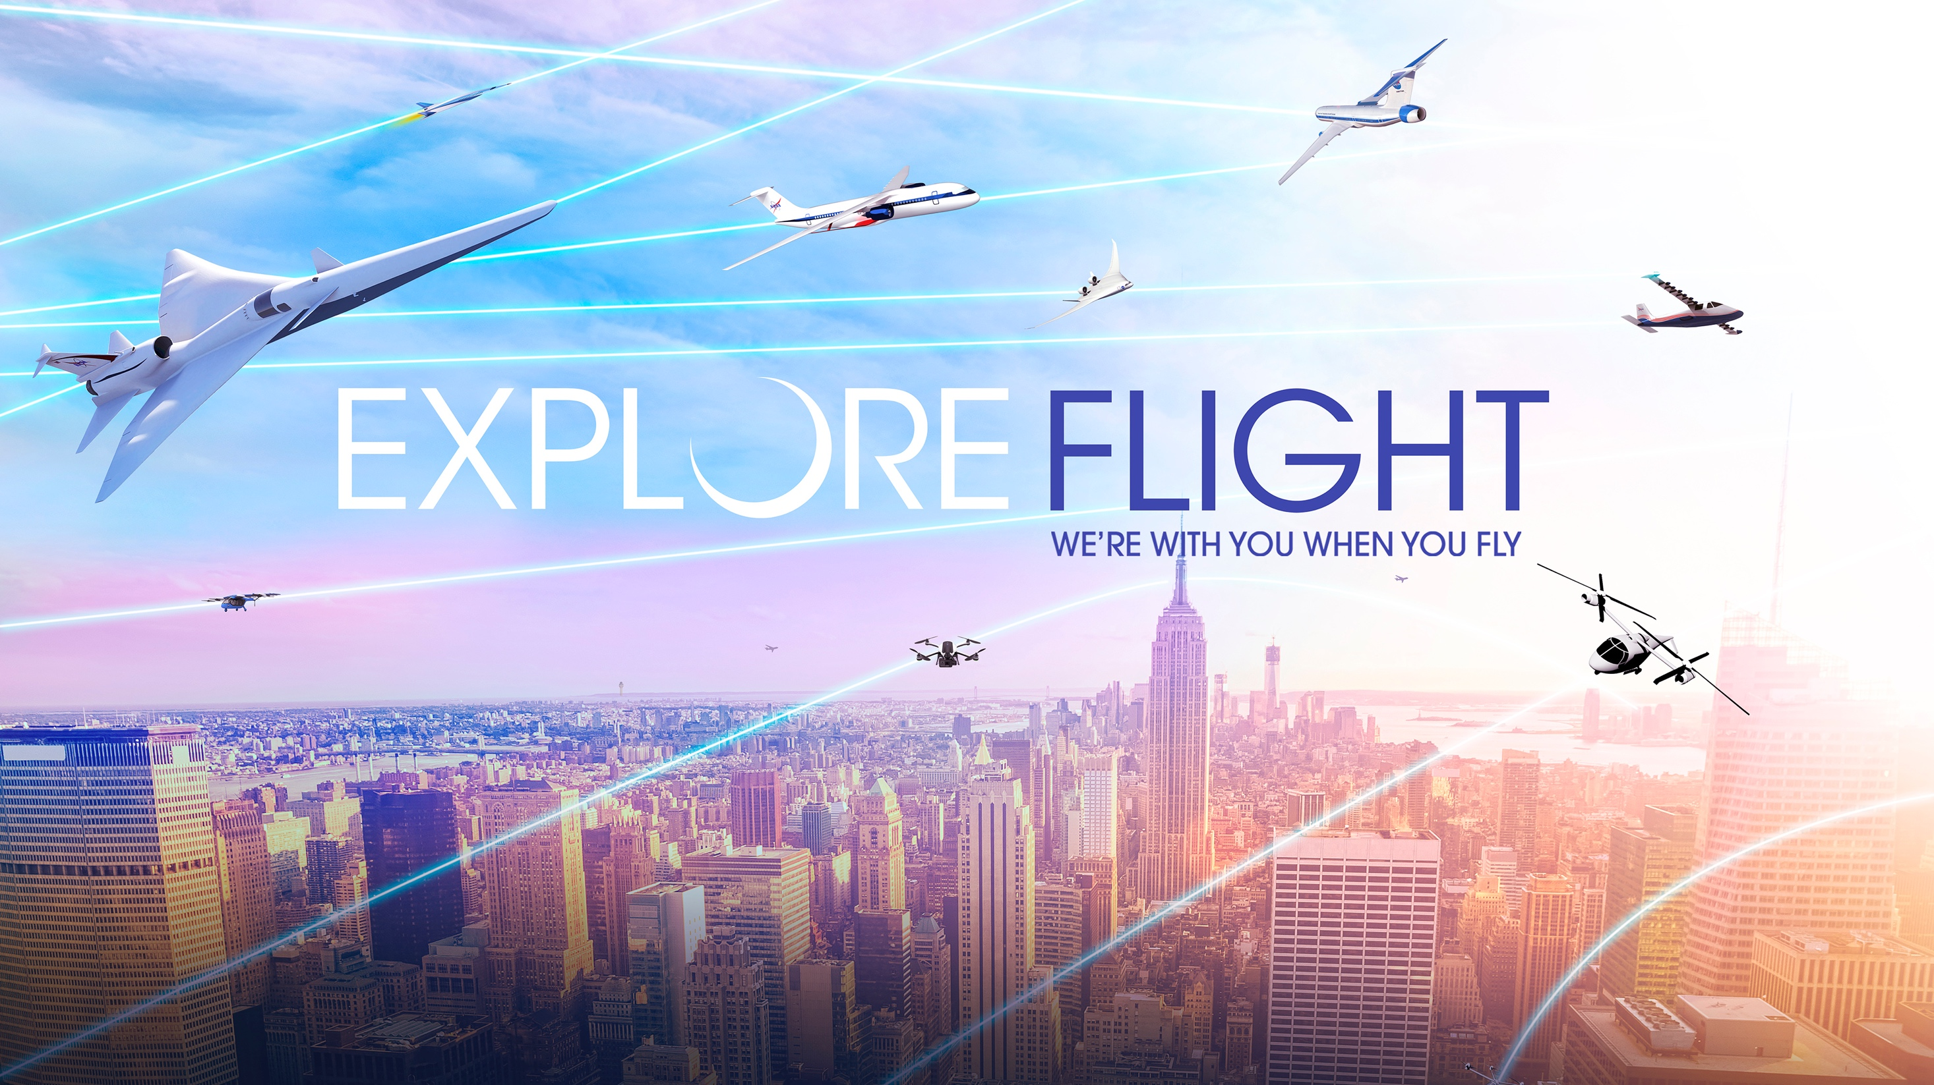

Sustainable Aircraft and Operations Technology Development
Dr. Jimmy Kenyon
Director, Advanced Air Vehicles Program
Aeronautics Research Mission Directorate
June 6, 2021
Notes:
The first “A” in NASA stands for “Aeronautics.” Our aeronautics researchers, engineers and pilots use world-class NASA facilities to keep U.S. aviation first in safety, efficiency and innovation.
We explore technologies that reduce aircraft noise and fuel use, get you gate-to-gate safely and on time, and transform aviation into an economic engine at all altitudes.

Slide 2
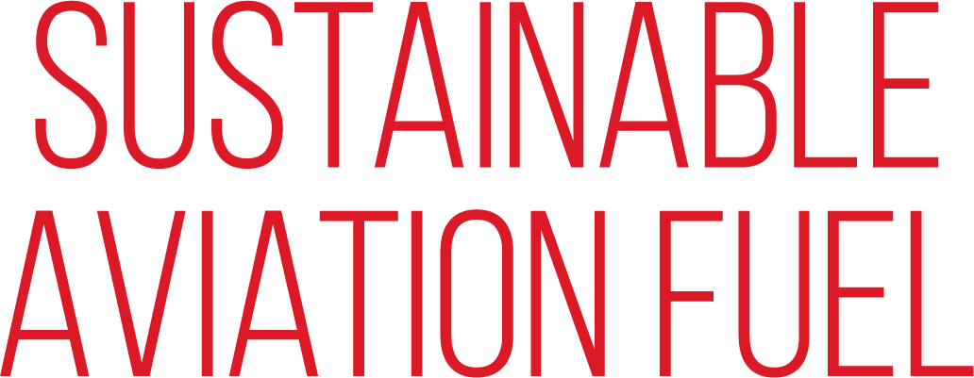


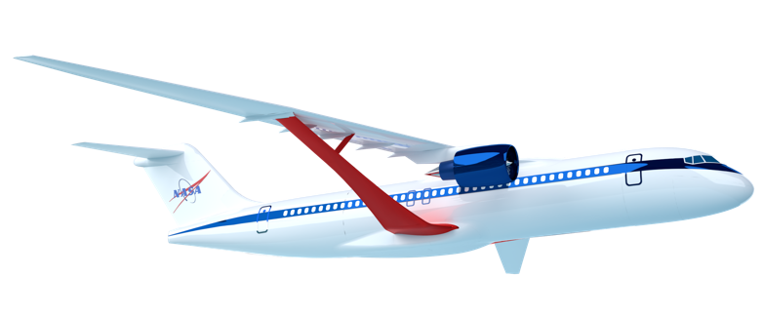
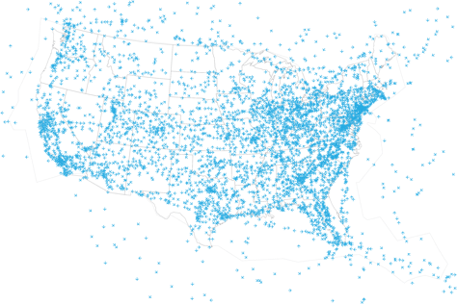

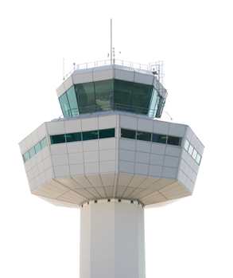
Aviation Industry Pillars for a Sustainable Future
Global Aviation Industry’s GOAL: 50% reduction in carbon emissions by 2050 relative to 2005 and possible net zero emissions by 2060 through these three means
NASA = Primary Role
NASA = Supporting Role
NASA = Primary Role
Notes:
The global aviation community has established the aggressive goals of a 50% reduction in carbon emissions by 2050, and possible net zero emissions by 2060 through these three means - what we fly, how we fly, and the fuels we use to fly. This 50% reduction from 2005 levels is a very aggressive goal, because fleet growth outpaced fleet efficiency improvements since 2005. Even though the operational fleet has become 2% more efficient each year, the total amount of carbon emitted annually in 2018 (912 Mt) is 40% higher than it was in 2005 due to overall traffic growth.
These aggressive goals for overall carbon emissions are focused today on commercial aviation, as that is the predominant form of aviation today. As new aviation sectors develop and flourish, they must do their part to contribute to the sustainability of aviation – they have to be green from the outset.
NASA’s primary contribution and largest investment is in R&D of technologies for low emissions and low noise aircraft.
NASA plays a primary role with significant investment in R&D of operational concepts and technologies deployed by the FAA and on aircraft flight decks. NASA does not have research related to airport infrastructure.
NASA plays a supporting role in characterizing the environmental impact of sustainable aviation fuels, and possibly via use in NASA flight research operations.
The aviation community also has stated a role for market based measures such as carbon offsets, where NASA has no role to play.

Slide 3
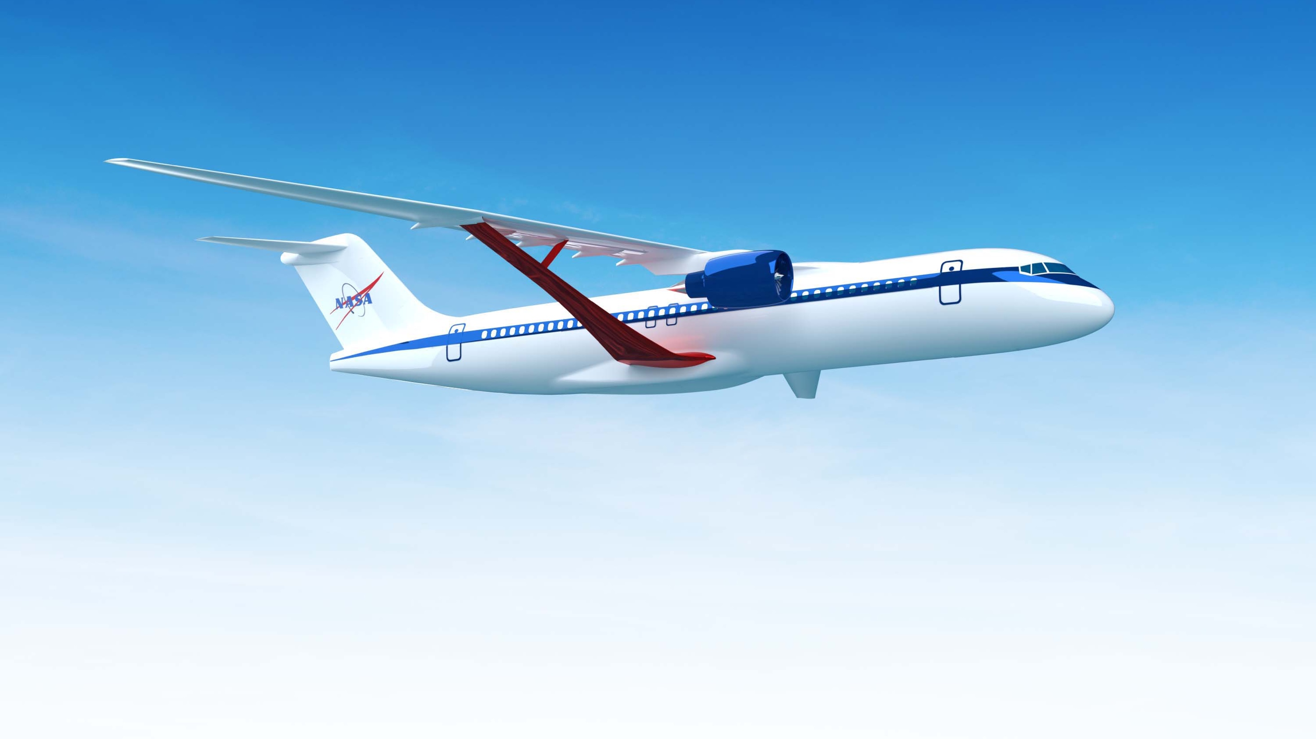
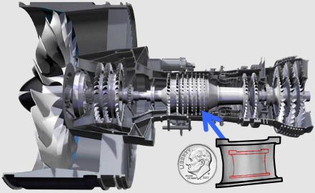
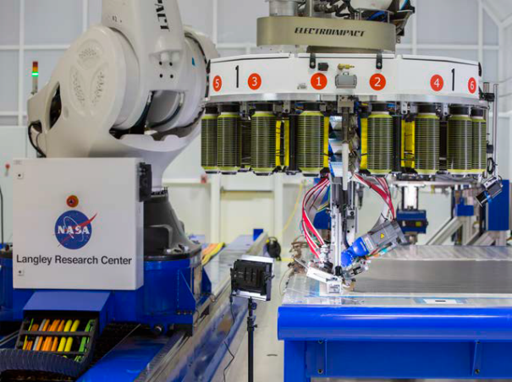
Subsonic Transport Technologies
Ensure U.S. industry is the first to establish the new “S Curve” for the next 50 years of transports
Transonic Truss-Braced Wing
5-10% fuel burn benefit
Small Core Gas Turbine
5-10% fuel burn benefit
Electrified Aircraft Propulsion
~5% fuel burn and maintenance benefit
High-Rate Composite Manufacturing
4x-6x manufacturing rate increase
Notes:
NASA has identified four priority subsonic transport technologies that can have the greatest impact on the future sustainability of commercial aircraft fleet.
These priority technology areas were identified through research over the last twelve years, starting with Advanced Concept Studies in 2008 targeting aircraft with a 2030-35 entry into service.
NASA established aggressive goals targeting noise, emissions, and fuel burn, and worked with industry and academia to identify and drive innovation that can meet those goals. Over the years we’ve winnowed the most promising areas for NASA research to these four areas:
New vehicle level technologies such as the Transonic Truss Braced Wing can bring a 5-10% fuel burn benefit.
Small core gas turbine engines can also yield ad 5-10% fuel burn benefit, and also serve as a critical enabling technology for future hybrid electric systems.
Electrified Aircraft Propulsion can yield another 5% fuel burn benefit and provide other efficiencies such as maintenance
High rate composite manufacturing – 4 to 6 times faster than current production rates – can reduce the weight of new aircraft, reducing fuel consumption, and opens up the design space to new types of structures and vehicles.
NASA has continued to mature these technologies from fundamental concepts and technologies through ground and flight tests, complemented by the Federal Aviation Administration's CLEEN research programs and continued industry innovation.
We are now at the beginning of the next new “S” curve for the next 50 years of commercial transports. The promise of these priority technologies needs to be validated by the mid- to late-2020s so that they can form the foundation of the next generation of vehicles to enter service in the early 2030s.

Slide 4
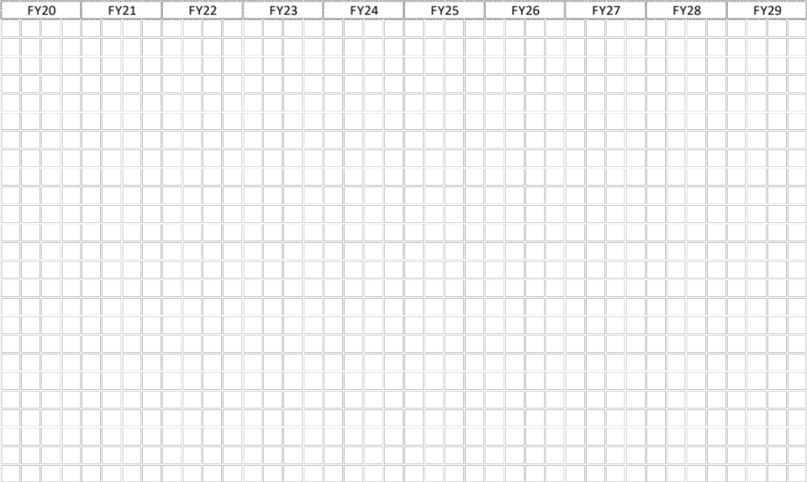
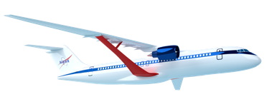
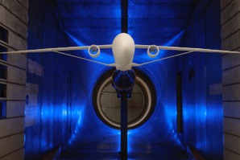
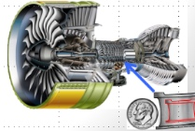
Subsonic Transports: Integrated Technology Development
Technology Readiness Target
Model Based Systems Analysis & Engineering
Flight Test
Leverage
the Asset –
Future Spirals
Sustainable Flight Demonstrator (SFD)
AATT - Transonic Truss Braced Wing
TC Completion
Hi-Rate Composite Aircraft Manufacturing
(HiCAM)
Mfg Demo & Structural Test
Hybrid Thermally Efficient Core (HyTEC)
Core Demonstration & Test
Planned
Notional
Electrified Powertrain Flight Demonstration (EPFD)
Flight Test
AATT - Electrified Aircraft Propulsion
TC Completion
Achieve TRL 6 in time for Industry Product Decision-Making
Notes:
1 slide
This graphic shows how NASA intends to mature these technologies over the next several years, culminating in core demonstrations in time for industry to make decisions about future products.
NASA has initiated discussions with industry to explore their views of the value and need to bring these technologies to flight in an integrated manner.

Slide 5

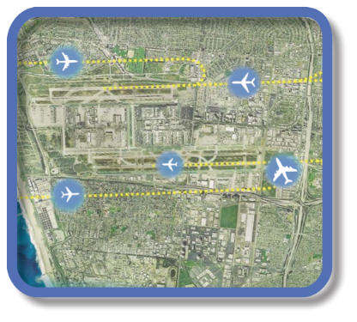

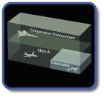


Evolution of Airspace Operations and Safety
+ Complexity, scalability,
and dynamic adaptation
+ Service-oriented architecture for tailored missions-oriented services
+ Efficiency and proactive planning
S-curves
Highly-Automated
Collaborative
Trajectory
Digital Transformation of ATM
Automated in-time safety monitoring and alerting services
Integrated predictive risk mitigation across domains
Automatically-assured adaptive
in-time safety management
(Today)
(~2035)
(~2045)
Notes:
NASA has developed the concepts and tools that have enabled dramatic improvements in operational efficiency of the national air transportation system.
NASA tools have enabled the shift to trajectory based operations, characterized by efficiency and proactive planning across the entire flight route and optimized fleet operations.
NASA is now enabling the next evolution of Airspace management to a collaborative model based on a service oriented architecture, and eventually a highly-automated system that seamlessly manages complexity, scalability, and dynamic adaptation of a diverse set of users.
Attributes of future system:
Scalable
Accessible to all
Integrated safety
Environmentally friendly
Robust and resilient

Slide 6
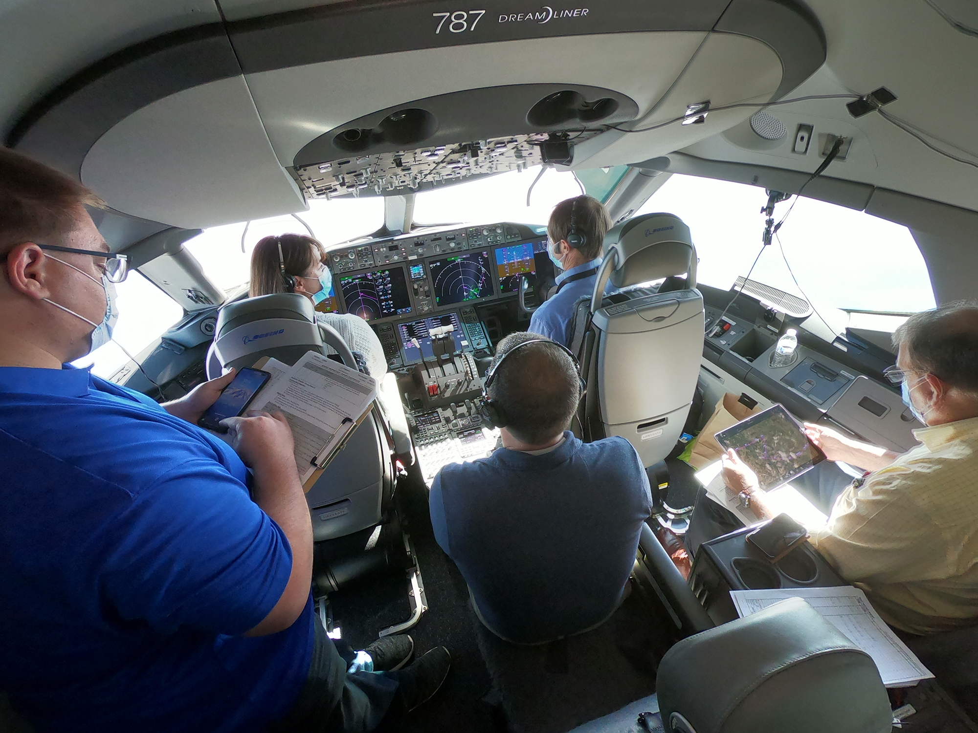
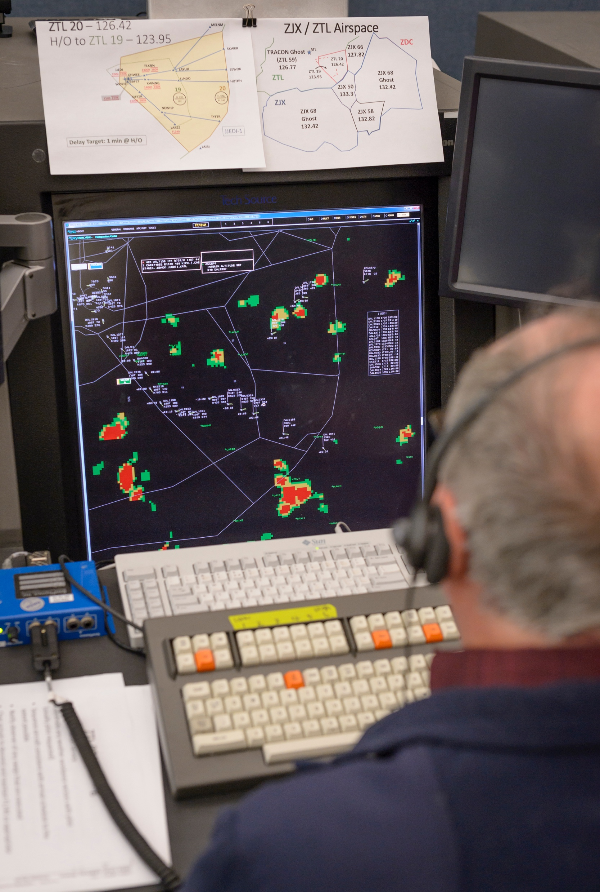
NASA’s Vision for Sustainable Aviation Operations
Integrated trajectories optimized for environmental benefit
Advanced flight deck capabilities to operate on those trajectories
Tailored services that support safe integration of all diverse operations
Notes:
Increased operational efficiency at the vehicle, fleet, and system-wide levels reducing fuel burn, CO₂ emissions, contrail formation and ozone impact. Integrated ground and flight-based technologies for trajectory optimization through every phase of flight.

Slide 7




