Slide 1
Thermal Performance Comparison and Lessons Learned for the Thermal Infrared Sensor Instruments 1 & 2
Veronica Otero (NASA / GSFC)
Dave Neuberger (Lentech, Inc)
43rd International Conference on Environmental Systems
July 12-14, 2021
Virtual

Slide 2
Introduction to Landsat Program / TIRS Instrument
The Landsat program, a joint NASA/USGS effort, is the longest continuously operated Earth satellite program since its first successful launch in 1972. Since then, there have been a total of eight satellite launches.
Landsat-8 was launched in February 2013 and continues to successfully operate on-orbit.
  The Landsat-8 mission was initially baselined with only one instrument, the Operational Land Imager (OLI) instrument.
  The Thermal Infrared Sensor (TIRS) instrument was added late in development, which constrained the development effort to 3 years and the instrument was designated Class C (in a Class B mission) to allow for a quicker delivery and higher risk posture. The short development time led to early long-lead procurements (as early as PDR), a compressed design phase, and an aggressive integration and test campaign in order to meet delivery.
Landsat-9 is scheduled to launch in September of 2021.
  The Landsat-9 mission was established as a full Class-B mission with the constraint to keep the design as similar to Landsat-8 as possible to minimize costs. The GSFC development effort made use of the existing TIRS design, documentation, and spare hardware where possible. The TIRS-2 instrument therefore has a similar overall thermal control system design as that of TIRS-1, which allows for a unique opportunity to perform detailed thermal performance comparisons between the two instrument development efforts.
This paper discusses the key thermal design differences between the two instruments, the comprehensive ground test program for the main instrument subsystems (including challenges and lessons learned), and a look at TIRS-1 on-orbit data to continue thermal performance trending.
Please refer to paper ICES-2021-166 for details not included in this condensed presentation

Slide 3
Primary Design Changes
From TIRS-1 to TIRS-2
The overall thermal control system design between the TIRS-1 and TIRS-2 instruments remained similar. However, two primary drivers led to changes that were implemented on TIRS-2.
  Modifications to higher-level requirements
    TIRS instrument class level was raised from a class C to a class B
      Increased design redundancy required changes to the operational heater scheme
    New Landsat spacecraft safehold orientations were included
      Resulted in increase in sizing and quantity of survival heater circuits
    Micrometeoroid requirements were adjusted (tightened)
      Led to additional shielding in strategic areas negotiated between the Landsat-9 Program Office and TIRS-2 systems engineering, including the addition of high-density Kevlar in select MLI blankets to protect harnessing and electronics
    Surface charging requirements were tightened based on historical data
      Resulted in thermal blanket and coatings changes
  Implementation of key lessons learned from the TIRS-1 program
    Removed decontamination heaters which were not as effective as nearby operational heaters in achieving temperature criteria during dryout and de-ice phases of the mission
    Re-distributed radiator area from the Cryocooler subsystem, which had excess margin, to the Telescope subsystem which had less margin

Slide 4
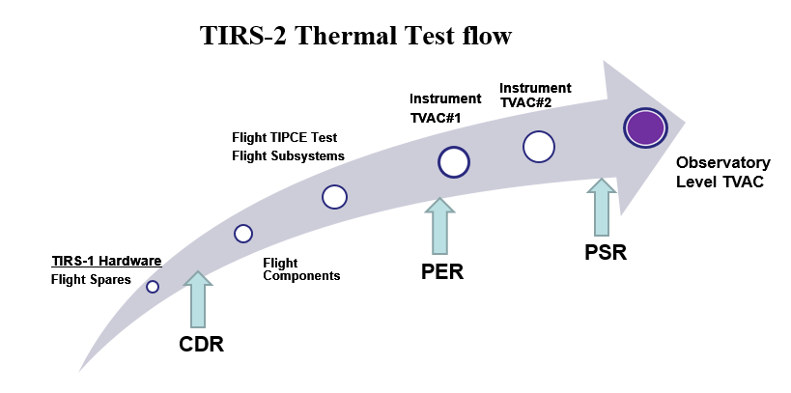
Ground Test / Verification Process
The TIRS-2 Instrument completed a comprehensive testing campaign to verify design changes since TIRS-1 and confirm successful overall performance of the instrument after assembly
TIRS-2 followed the Goddard protoflight qualification testing standards for a Class B mission
Two instrument level tests (pre and post dynamics)
Several subsystem level tests were completed for areas with unique complexities requiring early risk mitigation
Scene Select Mechanism
Earthshield Cold Deployment
Radiator thermal balance test
Early science verification tests, TIPCE (TIRS Instrument Performance and Cryosubsystem Evaluation)
A selection of spare hardware was re-evaluated for possible use on TIRS-2 early in the development phase
Most components began the qualification campaign at lower levels, which resulted in about 18 component level thermal vacuum tests

Slide 5
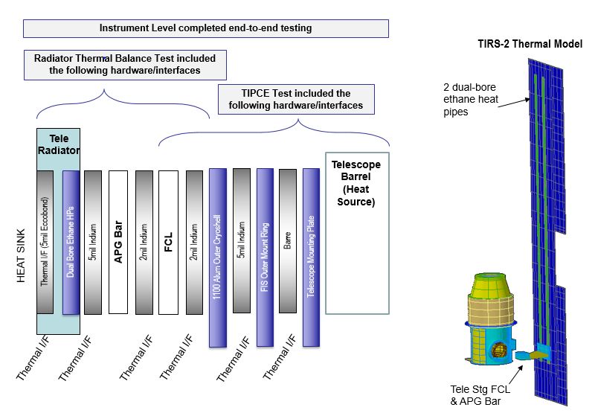
Verification Process - Telescope Radiator & Embedded Ethane Heat Pipes
The TIRS-2 telescope is connected to an independent radiator via a conductive path as shown here
Temperature gradients along the conductive path contribute to the overall performance of the radiator; gradients along the radiator are dependent on the performance of the embedded dual-bore ethane heat pipes
Thermal performance of the telescope radiator system was verified at various stages in development, including:
  Radiator TV/TB test (horizontal heat pipe configuration)
  Instrument level TV/TB test (vertical heat pipe configuration)
  Observatory TV/TB test (horizontal heat pipe configuration)
In a horizontal configuration (with heat pipes level with respect to gravity) the temperature gradient was measured at 0.3-1.4 K
In a vertical configuration (with heat pipes ~90deg with respect to gravity) the temperature gradient was measured at 7-10.4 K
The difference in temperature gradient for the two configurations was in part driven primarily by heat pipe orientation
Thermal balance testing had to take into consideration this variation in thermal system performance
Telescope Stage End-to-End Thermal Verification. Conductance path from telescope outer cryoshell to dedicated radiator.
Lesson Learned: Susceptibility of ethane heat pipe orientation needs to be taken into consideration, and impact to the thermal performance of the system (including increased temperature gradients) should be characterized via dedicated testing.

Slide 6
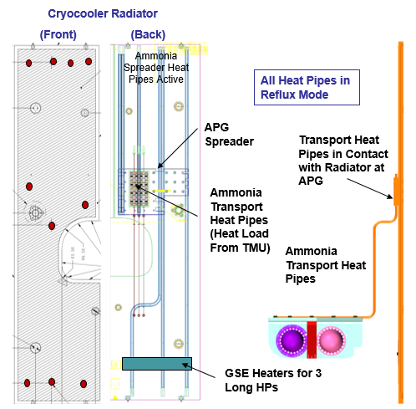
Verification Process - Cryocooler Radiator and Ammonia Heat Pipes
TIRS-2 cryogenic subsystem is cooled to operating temperatures with the use of a two-stage stirling cryocooler
The large amount of cryocooler power dissipation requires a dedicated radiator connected via three long transport ammonia heat pipes, which connect midway to six radiator embedded ammonia heat pipes. This is a unique & undesirable test configuration.
Thermal performance of the telescope radiator system was verified at various stages in development, including:
  Radiator TV/TB test (horizontal heat pipe configuration)
  Ambient tests at various heat loads with IR camera (vertical heat pipe configuration)
  Instrument level TV/TB test (vertical heat pipe configuration)
  Observatory TV/TB test (horizontal heat pipe configuration)
The vertical testing configuration requires a GSE heater to heat the pool of liquid at the bottom of the heat pipes in order to begin circulating fluid along their full lengths prior to turning the cryocooler on since this heat enters the radiator midway.
Cryocooler Radiator Vertical Test Heat Pipe Orientation
Ambient tests were performed early on to understand the impacts of the GSE heaters on the flight hardware performance during startup and for various operational heat loads. Furthermore, in an effort to reduce the additional non-flight heat into the system, it was important to determine the minimum GSE heater power required to keep the heat pipes active in reflux mode to efficiently dissipate up to 140W of cryocooler TMU power dissipation
The test results indicated that a minimum of about 20W was necessary to maintain these heat pipes active with sufficient evaporation in order to be able to reject about 140W of cryocooler TMU power while still maintaining temperatures at a desired range of -30C to +10C (-5C nominal goal).
Lesson Learned: In circumstances where heat pipe orientation is not optimal in ground testing, it is worth the time and effort to characterize (quantify) the effects on the thermal performance of the system via dedicated testing. A configuration where heat is applied midway into heat pipes requires special attention.

Slide 7
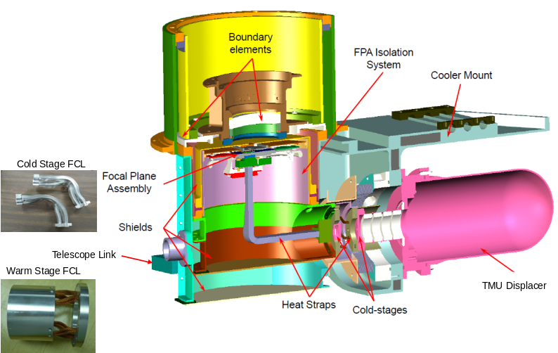
Verification Process - Cryogenic Subsystem (Cold & Warm Stages)
The cryogenic subsystem consists of a Focal Plane Assembly (FPA) that is cooled by a two-stage cryocooler connected via a thermal heat strap. The warmer first stage of the cryocooler connects to a radiative shell which surrounds the colder second stage. The warm stage itself is surrounded by the passively cooled telescope stage.
Since the design was proven during the TIRS-1 verification process, the focus for TIRS-2 was on verification of workmanship during assembly of the flight hardware
Thermal performance of the system was verified at various stages in development, including:
  TIPCE testing campaign - intended for early science verifications, provided a great opportunity to gain thermal data prior to instrument TV/TB test
  Instrument level TV/TB test
  Observatory TV/TB test
Several thermal balance points were completed throughout the TIRS-2 testing campaign, where cold and warm stage heat loads were very much in line with model estimates and TIRS-1 data.
Cryogenic Subsystem Design
Cryogenic Subsystem is comprised of a cold stage (~38K) and warm stage (~95K), surrounded by a telescope stage (~180K).
Lessons Learned:
Thermal performance of a cryogenic system warrants early verification via dedicated flight-like testing
Use of proper temperature sensors (location and type) is critical for providing a way to measure parasitic loading into the cryogenic zones during ground testing
Proper mounting and heat sinking of leads will aid in minimizing parasitics
A suitable data acquisition system is important for data accuracy
Finally, with the use of a cryocooler, care must be taken during the performance mapping process to accurately characterize cold finger heat load vs cryocooler motor power

Slide 8
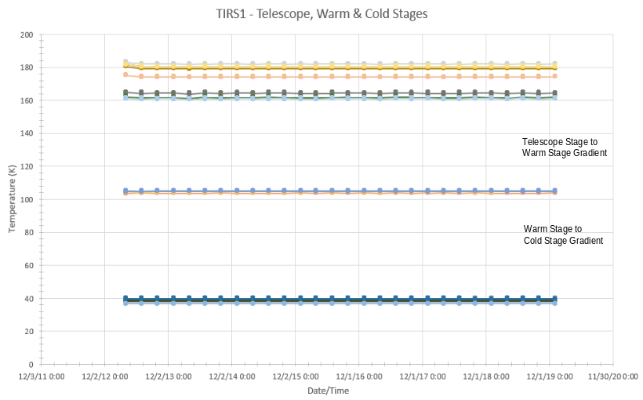
TIRS-1 Data Trending –
General Findings
Unique opportunity to continue trending instrument performance for TIRS-1 throughout on-orbit operations
Data collected from February 2013 (launch) to January 2020
Sampling period of 3 months, gathered at noon for one orbit to track orbital variations and performance changes over the life of the mission
Data gathered included temperature data for key components, component power dissipations, voltages, currents, and heater power data
General findings of the assessment are as follows:
  Consistent temperatures over time
  Constant temperature gradients between thermal zones
  Constant power consumption
  Overall, the parasitics between stages was constant and data did not indicate an increase
TIRS-1 On-Orbit Trending – Cryogenic Stage-to-Stage Temperature Gradients
Detailed findings from the TIRS-1 data trending effort can be found in paper ICES-2021-166.

Slide 9
Questions?

