Slide 1
NASA Universal Waste Management System and Toilet Integration Hardware Delivery and Planned Operation on ISS ICES Paper 2021-403
Melissa McKinley, James L. Broyan, Laura Shaw, Melissa Borrego, NASA Johnson Space Center
Donald L. Carter, NASA Marshall Space Flight Center
Jim Fuller, Collins Aerospace

Slide 2
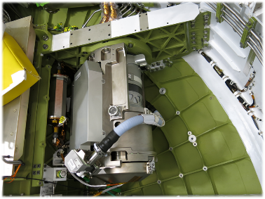
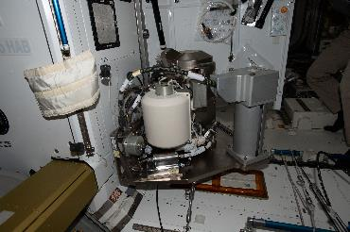
Universal Waste Management System (UWMS)
Universal Waste Management System
ISS Unit – Toilet
Orion Unit – Waste Management System (WMS)
Toilet for exploration missions
Reduction in mass and volume
Toilet is 65% smaller and 40% lighter than current ISS toilet (WHC)
WMS is 61% smaller than Shuttle Toilet
ISS Toilet
Delivered June 2020
Installed May 2021
Orion WMS
Delivered December 2019
Installed into Artemis-2 Vehicle March 2021
Orion UWMS installed in Artemis-2
ISS UWMS installed in Node 3, ISS

Slide 3
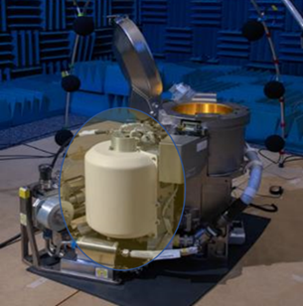
Dual Fan Separator
Dual Fan Separator Design resulted in UWMS reduction in mass/volume
Compact design eliminated a set of fan/controller hardware needed for separate functions which reduced mass and volume
Combines previous toilet designs with separate fans for urine and feces collection into one unit
Single shaft and motor with two fans for entrainment of the waste and separation of liquid/gas functions
Removal of air key to successful recycling of urine on ISS
ISS UWMS Dual Fan Separator show in highlighted area
3

Slide 4
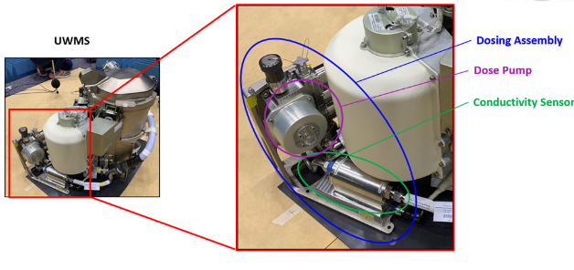
Urine Pretreat Systems
ISS Unit – low pH and strong oxidizing chemicals used to prevent microbial and fungal growth
Dose pump dispenses metered volumes of concentrated pretreat and water for each urination
Conductivity Sensor measures solution to provide a warning of incorrect pretreat concentration to protect downstream recycling systems
Full mixing is part of the design to ensure entire urination volume is treated
Orion unit – Oxone tablets from Shuttle design, urine is vented with no recycling
UWMS with Dosing Assembly including Conductivity Sensor
4

Slide 5
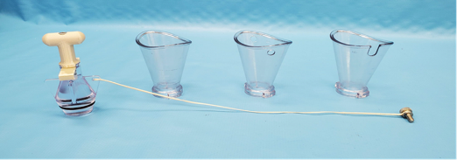
Updated Designs for Urine Funnel and Commode Seat
Urine Funnels
NASA updated urine collection with a urine funnel design optimized for female crew.
Size and shape of funnel intended to improve simultaneous operations (urination and defecation) for female crew
Numerous Crew evaluation and feedback resulted in three designs
On-orbit evaluation with Waste and Hygiene Compartment (WHC) influenced design changes
Commode Seat
Seat size and shape optimized to work with the urine funnel and to improve placement of female crew
Two sizes were flown for evaluation
Urine Funnels and Plug for Toilet
5

Slide 6
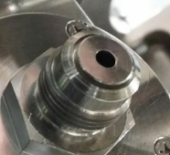
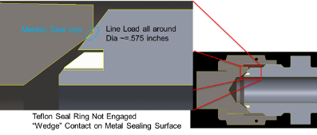
On-orbit Installation Issues
UWMS ISS launched on NG-14 in 10/2020, installation started 12/2020
Issues with Dosing Assembly Seal Replacement
Discovered Conductivity Sensor improperly machined fittings
Installation would result in lack of two levels of containment for Tox 2 fluid, pretreat solution
Additional ground testing also showed issue with sensor operation
Noted to be inaccurate and decayed overtime
Installation was paused for evaluation
Approval given for installation in May 2021 in a “use as-is” configuration to evaluate sensor operation and seal integrity
Orientation relative to mating cap
Improperly machined and damaged fitting on Conductivity Sensor Outlet
6

Slide 7
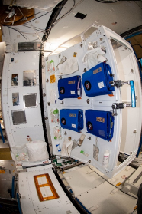
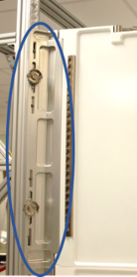
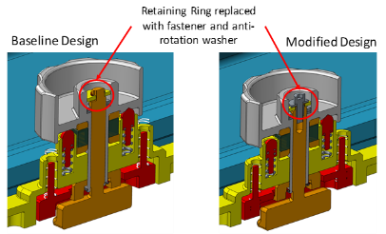
Toilet Integration Hardware - Stall
Deployed in ISS, Node 3 - 2/2019
Provides privacy for existing WHC and adjacent space for Toilet
Port side removed pending installation of Toilet
Stall panels modular design provides flexibility to remove individual panels for maintenance activities
Stall knob repairs
Design issue if over rotated could result in release of internal components
Two knobs damaged due to over rotation
Modifications made and repair kits flown
Addition of fastener and anti-rotation ring
Crew made updates to on-orbit hardware
1.
2.
3.
1. Starboard Stall deployed in Node 3 ISS; 2. View of knobs installed; 3. Design modifications to knob
7

Slide 8
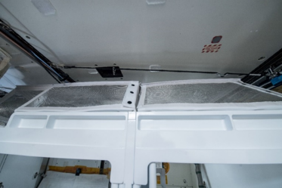
Stall Mesh Screen
Toilet Stall covered by Mesh Screen
Provides containment of any potential free fluid and particles while still allowing air flow
Stainless steel mesh with hole opening size of 2.38 mm (.1 in)
Crew reported damage at interface points
Snaps secure Mesh Screens to top Stall panels
Design updated to reinforce materials at the attachment points
Replacement Mesh Screens delivery in work.
Mesh Frames installed on top of Toilet Stall panels
8

Slide 9
Toilet Installation, Activation and Next Steps
Installation completion targeting 6/8/21
Activation TBD
Spares evaluation
Evaluation of Conductivity Sensor Performance
Technology Demonstration planned 2021
Provides details on consumables usage
Ability of crew to perform simultaneous operations
Overall information on use of a compact toilet in micro-gravity
Informs exploration missions including Orion program milestones
9

