Slide 1
NASA Environmental Control and Life Support Technology Development and Maturation for Exploration: 2020 to 2021
ICES Paper 2021-384
James L. Broyan, Laura Shaw, Melissa McKinley, Catlin Meyer, Michael K. Ewert, NASA Johnson Space Center
Walter F. Schneider, NASA Marshall Space Flight Center
Marit Meyer, Gary A. Ruff, NASA Glenn Research Center
Andrew C. Owens, NASA Langley Research Center
Robyn L. Gatens, NASA Headquarters

Slide 2

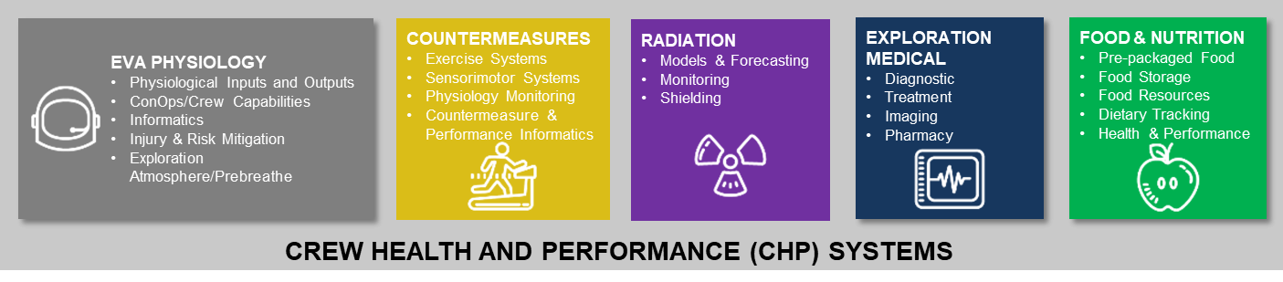
Habitation Systems Capabilities
Broadly divided between vehicle systems (ECLSS) and crew health capabilities (CHP)
Strategic direction provided by a Systems Capability Leadership Team (ECLSS-CHP SCLT)
  9 Capability areas and 39 capabilities
Discussed in this paper (ICES-2021-384)
Additional papers at ICES

Slide 3

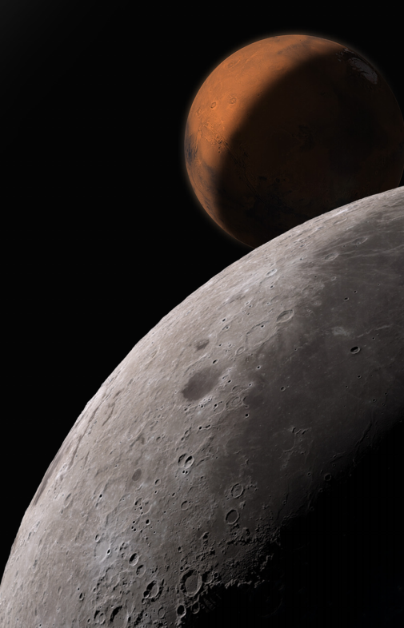
Capability Drivers
Capability needs depend on key mission characteristics
  Strength of gravity (μg, lunar, Martian)
  Total length of the mission or combined missions of an element
  Uncrewed periods (dormancy) between missions
Capability gaps are the difference between SOA and mission needs
  Measured by key performance parameters
Technology solutions must meet Key Performance Parameters (KPPs) and Probability of Success (POS) goals
  Requires testing in appropriate environment and conditions
  Requires sufficiently long testing duration to identify, understand, and mitigate failure modes as well as statistically establish component life
    Inadequate test time requires an unsustainable number of spares to be carried to cover uncertainties
3

Slide 4
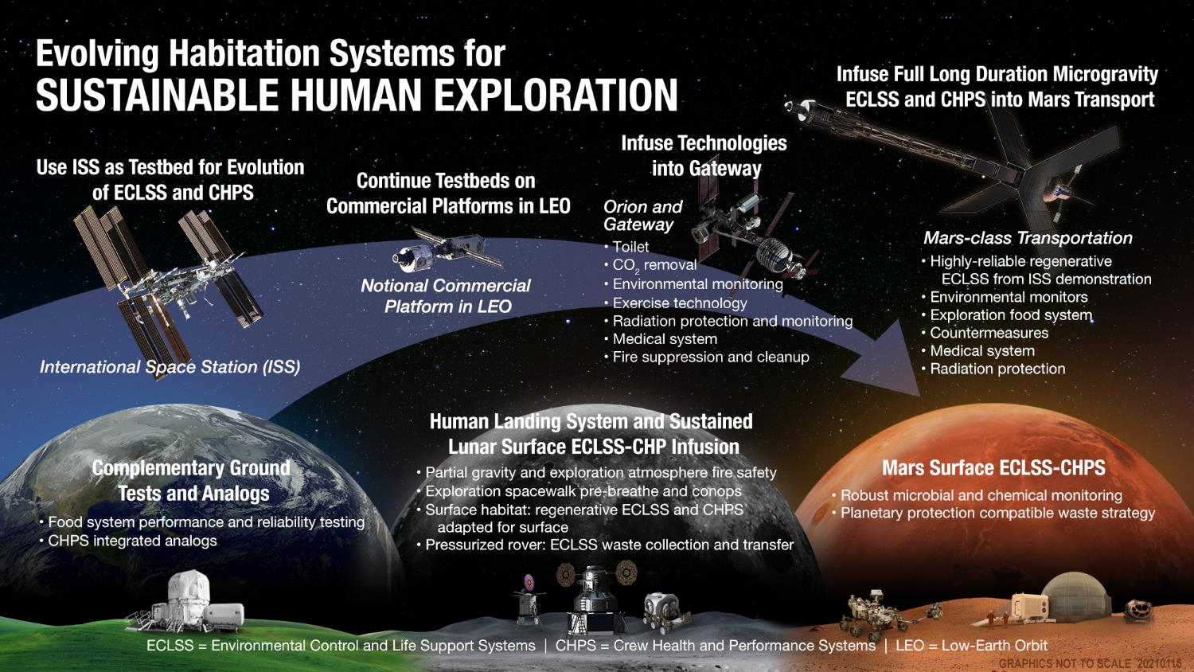
Capability Evolution and Validation
4

Slide 5

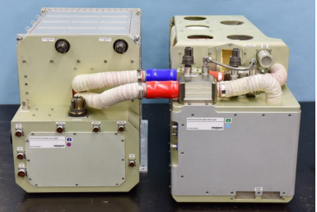
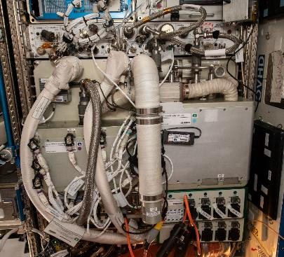
Atmosphere Management Capability Area Status (1/2)
Carbon dioxide removal capability
  Target KPPs:
    1-hr average CO₂ <2000 ppm for 4 crew
    CO₂ purity > 98%
  Technologies under development include:
    Thermal amines
    Liquid amines
    CO₂ deposition
    Ionic liquids
    Metal organic frameworks
  Analysis and test validation with:
    ISS technology demonstrations
    Integrated ECLSS ground testing
    Uncertainty analysis determines how long
    to test to achieve best reduction on spares mass
  Infusion element targets:
    Lunar surface
    Mars transit and surface
Thermal Amine scrubber system (ICES-2019-174)
Thermal Amine scrubber system installed in ISS Destiny module
5

Slide 6
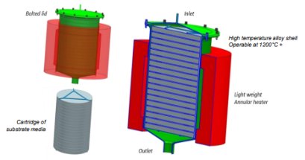

Atmosphere Management Capability Area Status (2/2)
Carbon dioxide reduction capability
  Target KPPs:
    >75% O₂ recovery for ug
    >90% O₂ recovery for partial gravity
  Technologies under development include:
    Sabatier improvements
    Methane pyrolysis – carbon vapor deposition
    Bosch
    Plasma pyrolysis/hydrogen separation
    Microfluidic electrochemical processes
  Analysis and test validation with:
    Ground testing will inform down select
      Degree of closure combined with departure mass analysis
    ISS technology demonstration
  Infusion element targets:
    Lunar surface
    Mars transit and surface
Methane pyrolysis reactor (top) and collection substrate fully loaded with carbon (bottom)
(ICES-2019-103)
6

Slide 7
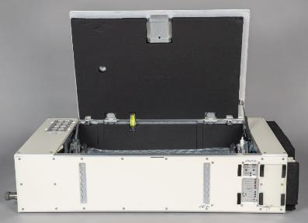
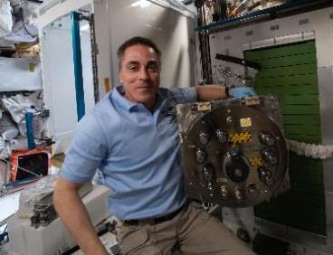
Water Management Capability Area Status
Water recovery – Condensate & urine processing, biocides, dispensing
  Target KPPs:
    >96% water recovery from urine (including urine brine)
    >98% overall water recovery
    Oxidize difficult contaminants ( >92% of DMSD)
    >3 years for unplanned maintenance
  Technologies under development include:
    Brine processing assembly (BPA)
    Urine & water processors upgrades to improve life
    Potable water biocide for dormancy – iodine and silver
    Potable water dispensing for dormancy tolerance
  Analysis and test validation with:
    ISS technology demonstrations
    Integrated ECLSS ground testing
    Analysis determines how long to test to achieve best
    reduction on spares mass
  Infusion element targets:
    Gateway
    Lunar surface
    Mars transit and surface
BPA ready for shipment
Upgraded UPA distillation assembly on ISS
7

Slide 8
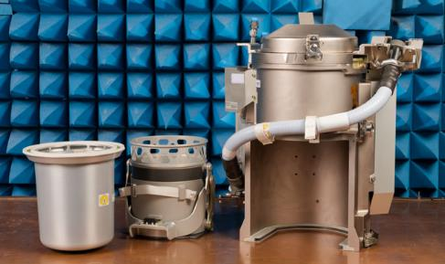
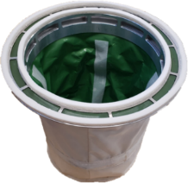
Waste Management Capability Area Status
Waste Management – urine & feces collection, treatment (excludes trash)
  Target KPPs:
    Installed mass <70 kg, installed volume < 0.34 m³
    Consumable mass per defecation <0.05
    >90% O₂ recovery for partial gravity
    Remove >80% of water from feces
  Technologies under development include:
    Universal Waste Management System (UWMS)
    Alternate Fecal Container (AFC)
    Fecal drying technologies
  Analysis and test validation with:
    ISS technology demonstrations
    Ground testing to validate flushing strategies for dormancy
  Infusion element targets:
    Orion
    Mars transit
    Also can support planetary protection objectives
UWMS (left to right: fecal container, lifting mechanism, assembly)
Alternate Fecal Container
8

Slide 9

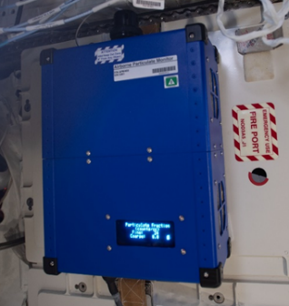
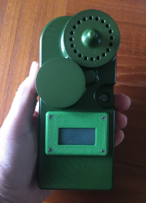
Particle Monitoring Capability Status
Includes: particle size (focus is aerosols and small particles) , quantity, and category
  Target KPPs:
    Measure mass <10 mg/m3
    Size range: 0.1 to 10 um
    Accuracy: +/-10%
    <0.4 kg per device
  Technologies under development include:
    Airborne Particle Monitor
    Mini Aerosol Monitors
  Analysis and test validation with:
    On orbit measurements validated with ground tests
    Results will be inputs to spacecraft air quality index
  Infusion element targets:
    Gateway
    Lunar surface
    Mars transit and surface
Airborne Particle Monitor in ISS Node 3
Mini Aerosol Monitors
9

Slide 10

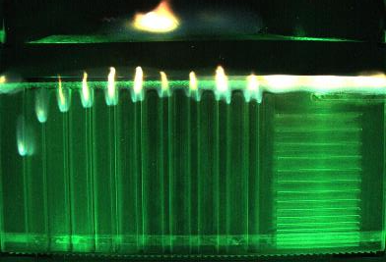
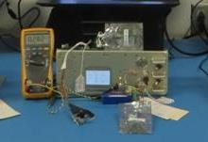
Fire Safety Capability Area Status
Includes material flammability, detection, response, and clean-up
  Target KPPs
    Understand flame propagation in μg for
    elevated oxygen and reduced pressure
    <250 Pa pressure drop at 40cm/s for fire
    cleanup filters
    Fire clean up capacity >40% of filter volume available
    for water/soot/smoke retention
  Technologies under development include:
    Large-scale spacecraft fire scenario demonstration
      Spacecraft Fire Experiment (Saffire)
    Orion smoke eater clean up filter
    Orion smoke detector and combustion product monitor
    Laptop battery fire characterization
  Analysis and test validation with:
    Departing Cygnus fire safety demonstrations
    Future Blue Origin and Commercial Lunar Payloads
    Systems technology demonstrations
  Infusion element targets:
    All μg human elements
    All partial gravity human elements
Saffire V structured PMMA (flow bottom to top)
Combustion product monitor
10

Slide 11

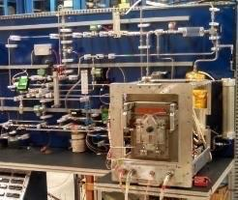
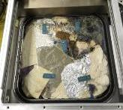
Logistics Capability Area Status
Trash Management (excludes feces and urine collection)
  Target KPPs:
    Increase trash density to >400 kg/m³
    >90% O₂ recovery for partial gravity
    Water activity <0.6
    Recover >80% water content
    Trash jettison for in-flight mass reduction
  Technologies under development include:
    Trash Processing and Compaction System
    Trash to gas technologies
  Analysis and test validation with:
    ISS technology demonstrations
    Departure mass analysis to support technology selection
    for Mars transit
  Infusion element targets:
    Mars transit
    Mas surface for planetary protection
TCPS risk reduction unit
Compacted trash tile
11

Slide 12

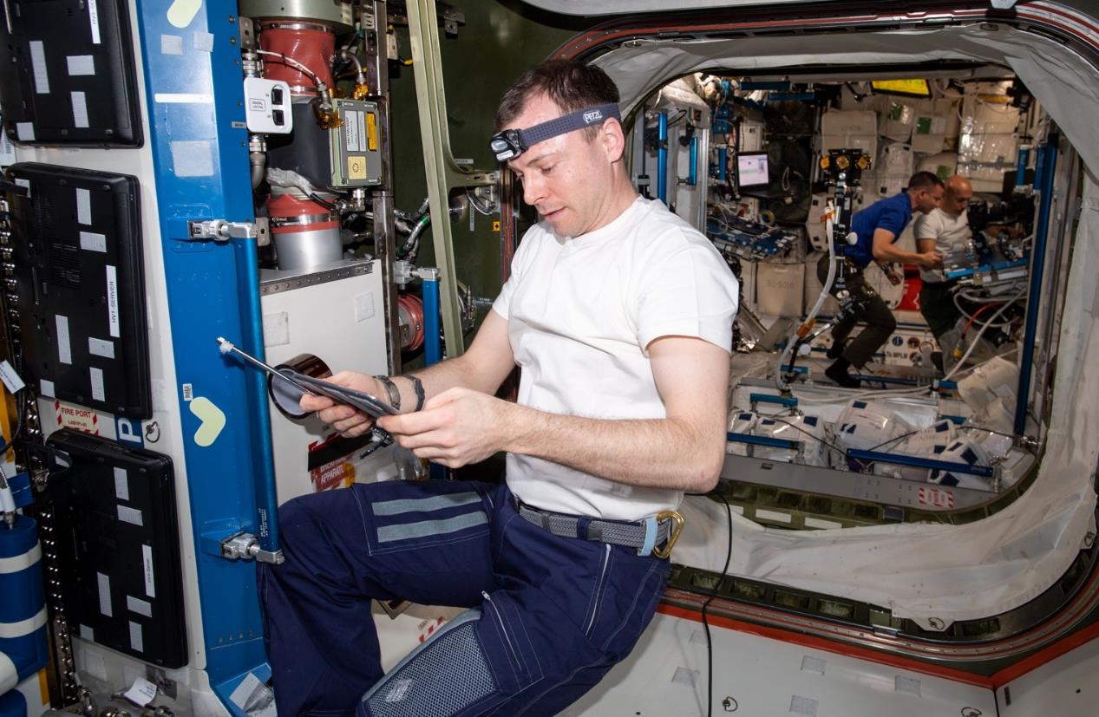
Summary Points
National Aeronautics and Space Administration
NASA is developing multiple developing technologies to close exploration mission gaps
Gaps and KPPs are being refined and public release is planned for late 2021
  Will provide goals for on ramping innovative technologies
  Will inform future technology decisions
Spares uncertainty analysis and departure mass analysis are significant factors in determining a technology's potential benefit for an exploration mission
  Significant testing time in a relevant environment is required to offset the initial uncertainty of any new technology
Recommend using the paper’s references for detailed papers on the ECLSS technologies
12

Slide 13
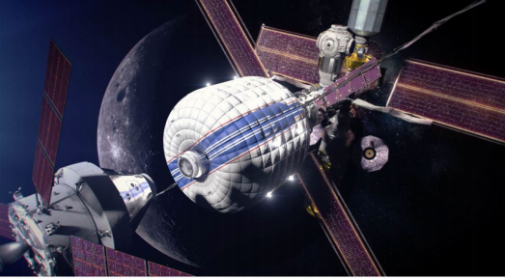
Questions?
13

