Slide 1
Space Crop Production
Gioia Massa
and
Ralph Fritsche
NASA, Kennedy Space Center, FL, USA
JPL CIF: Human Robotics Mars Habitat Workshop

Slide 2
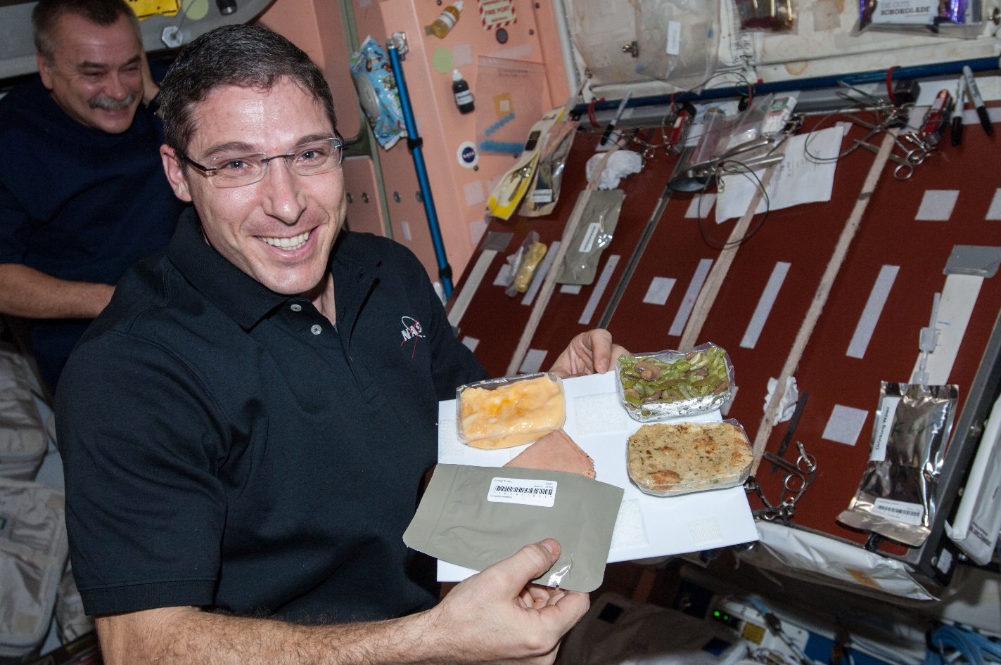
Why plants?
Food
Psychological well being
Atmosphere
Water

Slide 3
The Space Crop Production Vision
Ensure Food System Security on Long Duration Missions Beyond LEO
Near-Term Goal
Nutrient Supplementation of Prepackaged Food
Long-Term Goal
Caloric Replacement to Facilitate Earth Independence
Notes:
Ralph
Ensure Food System Security on Long Duration Missions Beyond Low Earth Orbit (LEO)
Food and nutrition are the first line of defense for crew health and performance
Provide safe, nutritious and acceptable fresh food
Add variety to crew diet
Enhance morale
* Food security is the condition in which crew have continuous access to sufficient safe and nutritious food which meets both their dietary needs and food preferences in order to maintain peak health and performance.
Nutrient Supplementation of the Prepackaged Food System - Needed for: Deep Space Transport
Fresh produce supplements vitamins (B₁, K, C) and bioactive compounds that degrade in the stored food system on multi-year exploration missions
“Pick-and-Eat” crops that require no processing and minimal preparation will provide variety, customization, and psychological appeal
Enable testing and demonstration of dependable crop production before reliance on system.
Limiting factors are vehicle resources mass, power, volume, water, air, crew time
Caloric Replacement to Facilitate Earth Independence - Needed for: Long duration Surface missions on the Moon and Mars
Reduce up-mass associated with pre-packaged food
In addition to “pick and eat” crops, include staple crops that require processing and preparation
Bioregenerative capability will be required for long duration surface missions

Slide 4


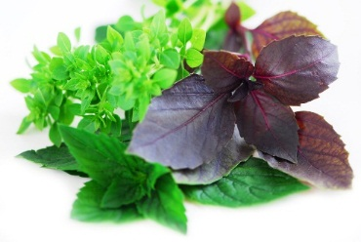
Space Crop Production Candidates
Salad
Leafy Greens
Tomato
Pepper
Radish
Strawberry
Green Onion
Pea
Carrot
Lettuce, Chinese cabbage, Swiss chard, Mizuna, Spinach
Staple Crops
White Potato
Sweet Potato
Rice
Wheat
Dried Bean
Soybean
Peanut
MINIMAL PREPARATION / COOKING
SIGNIFICANT PREPARATION / COOKING
CONSUMED FRESH WITHOUT PROCESSING
Herbs
Basil
Mint
Chives
Dill

Slide 5
Space Crop Production Challenges
Deep Space
Water
Recycling
Radiation
Pressure
Micrometeorites
Surface
Microgravity
Fluid movement
No convection
Dust
Partial gravity
Plant Size
High CO₂
Food Safety / Microbiome
Nutrient output
Sustainability
Abiotic stresses
Vehicle resources
Crew time
Waste
Productivity
Stress tolerance
Environmental optimization
Crop scheduling
Crop

Slide 6


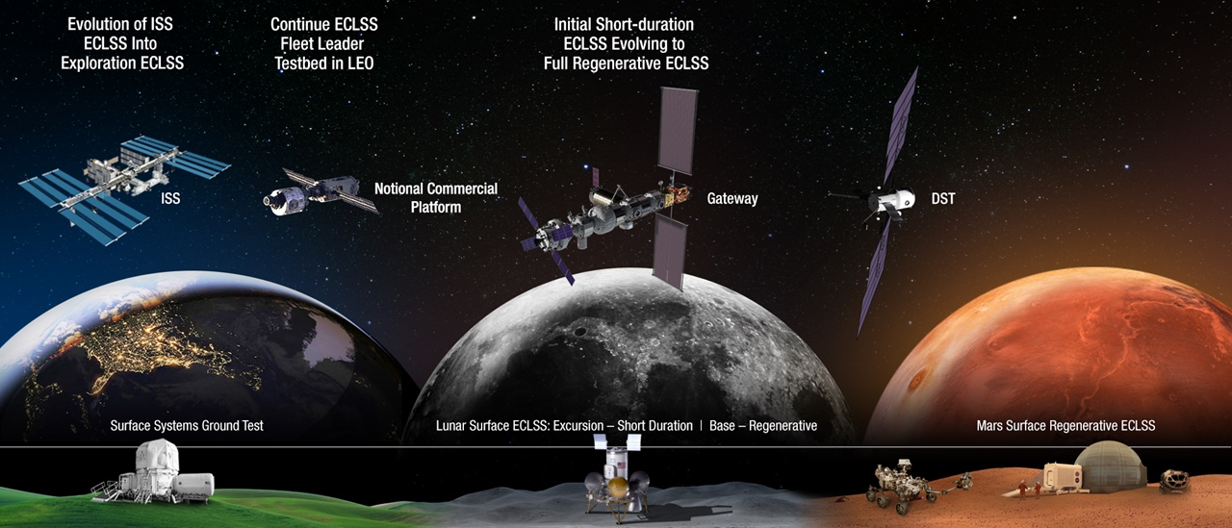
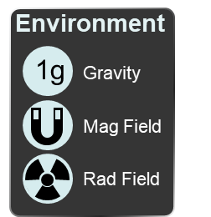



Space Crop Production Roadmap For Exploration
MARS TRANSIT (Crop Production)
GATEWAY (Plant Research)
Operational µg Food Production capability for pick and eat crops to supplement crew diet
ISS (Plant Research and H/W Technology)
Proving Ground to study the effect of deep space radiation on pick and eat crops in µg
Identify challenges and solutions for growing pick and eat crops in µg to support crew nutrition
Scale: One to Two EXPRESS Racks (8-16 Lockers)
Scale: Single Locker
Scale: Single Locker to EXPRESS Rack (8 Lockers)
LUNAR SURFACE (Research/Production)
Ground (Plant Research and H/W Technology)
Develop and deploy operational partial gravity systems for both nutritional support and caloric replacement as both a source of food for long duration lunar missions and as a demonstration for Mars
MARTIAN SURFACE (Production)
Develop space crop production concepts and strategies in support of destinations along the exploration roadmap
Leverage Lunar Surface experience in Food Production systems to extend Earth Independence for Mars missions
Scale: Single Locker to Module
Scale: Single Locker to Module
Scale: Single Locker to Module

Slide 7
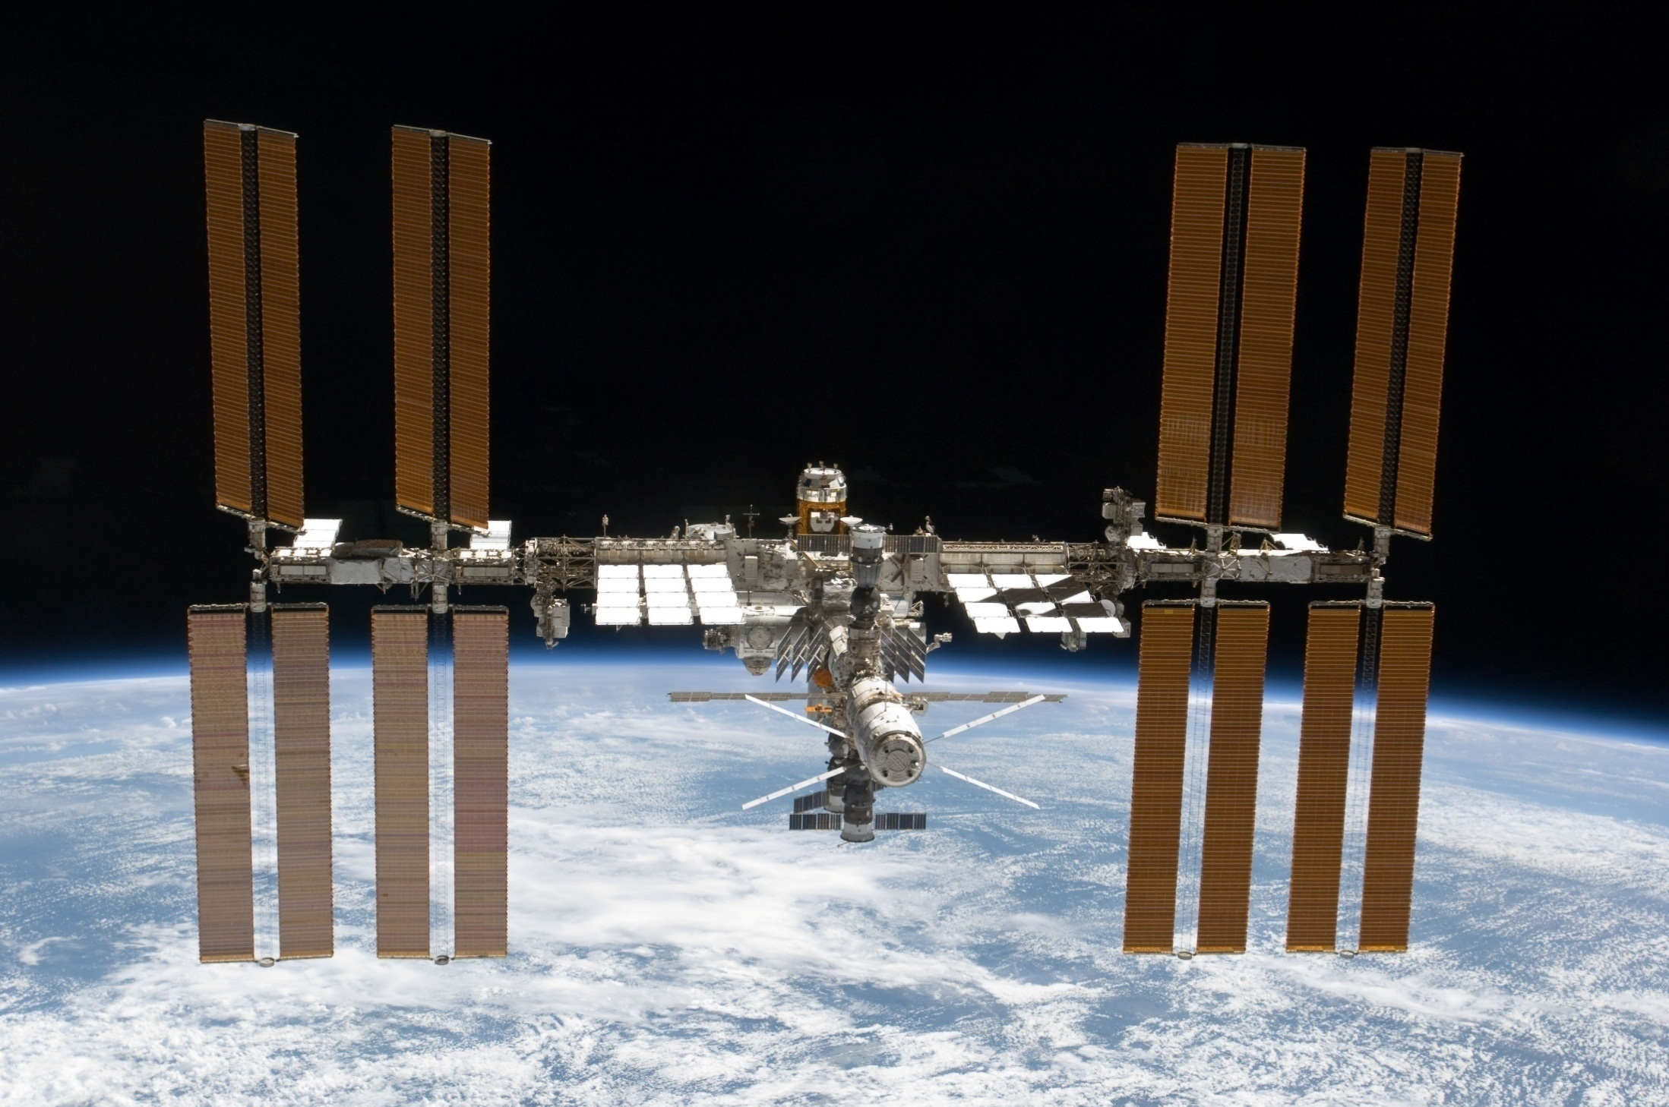
The International Space Station

Slide 8
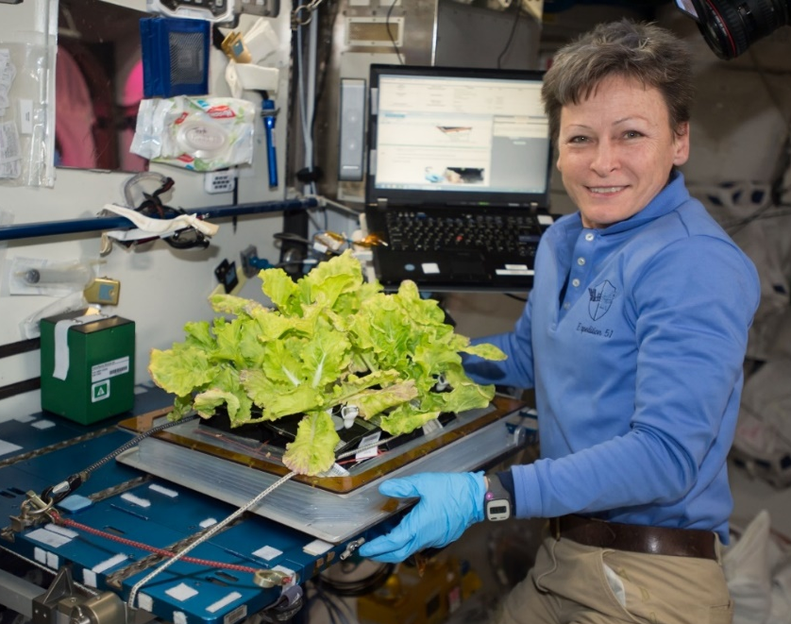
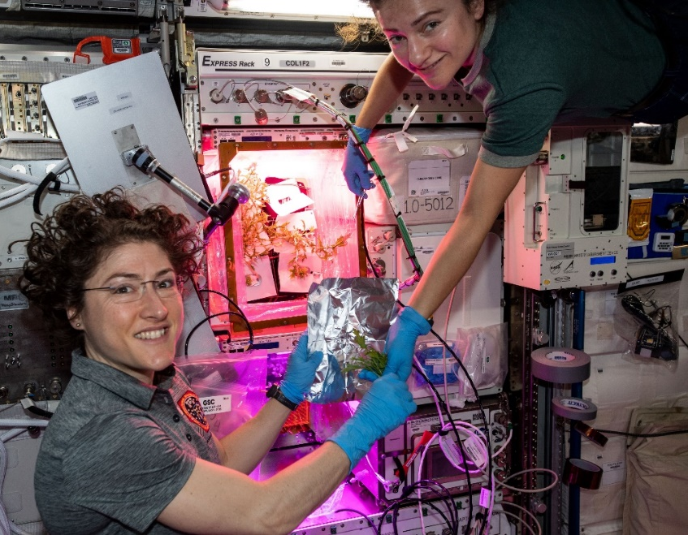

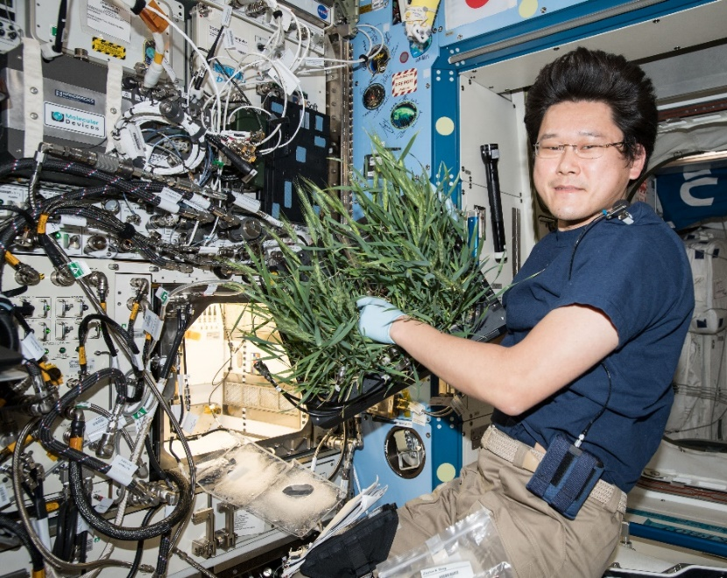
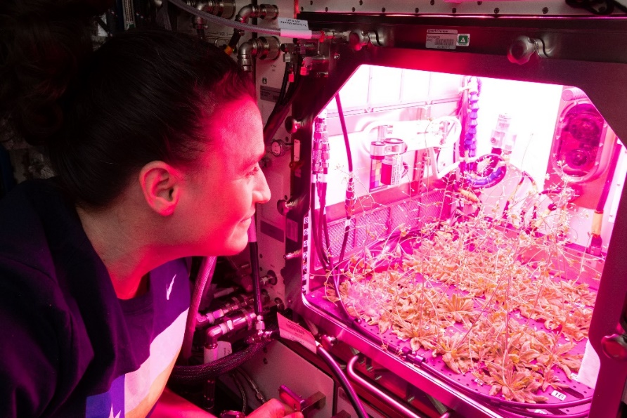

Current NASA Large Plant Research Capabilities On ISS
Notes:
Veggie and the Advanced Plant Habitat

Slide 9
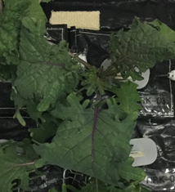
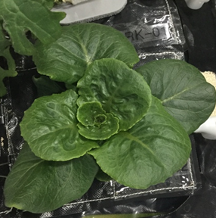
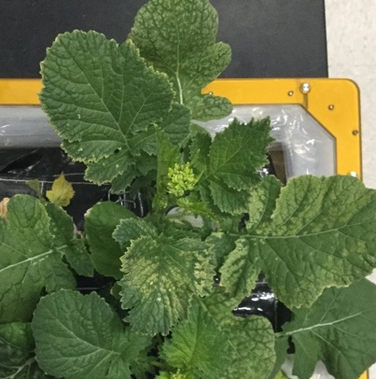
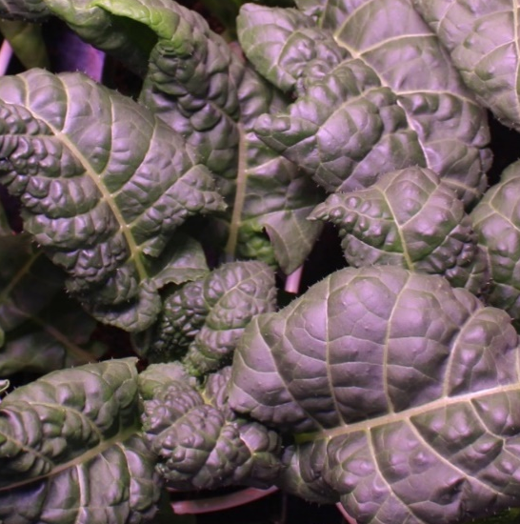
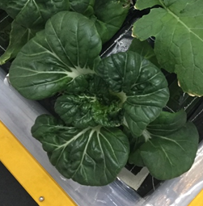
VEG-03 New Crops on Orbit
Red Russian Kale
*Dragoon Lettuce
Wasabi Mustard
*Extra Dwarf Pak Choy
Amara Mustard
Grown in different combinations with Amara Mustard and Extra Dwarf Pak Choi just harvested on ISS!
*= Student Selected Crops!

Slide 10
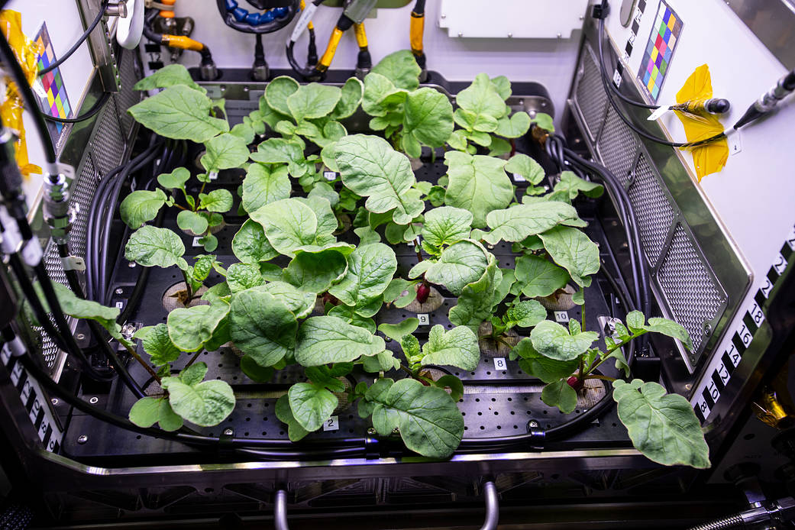
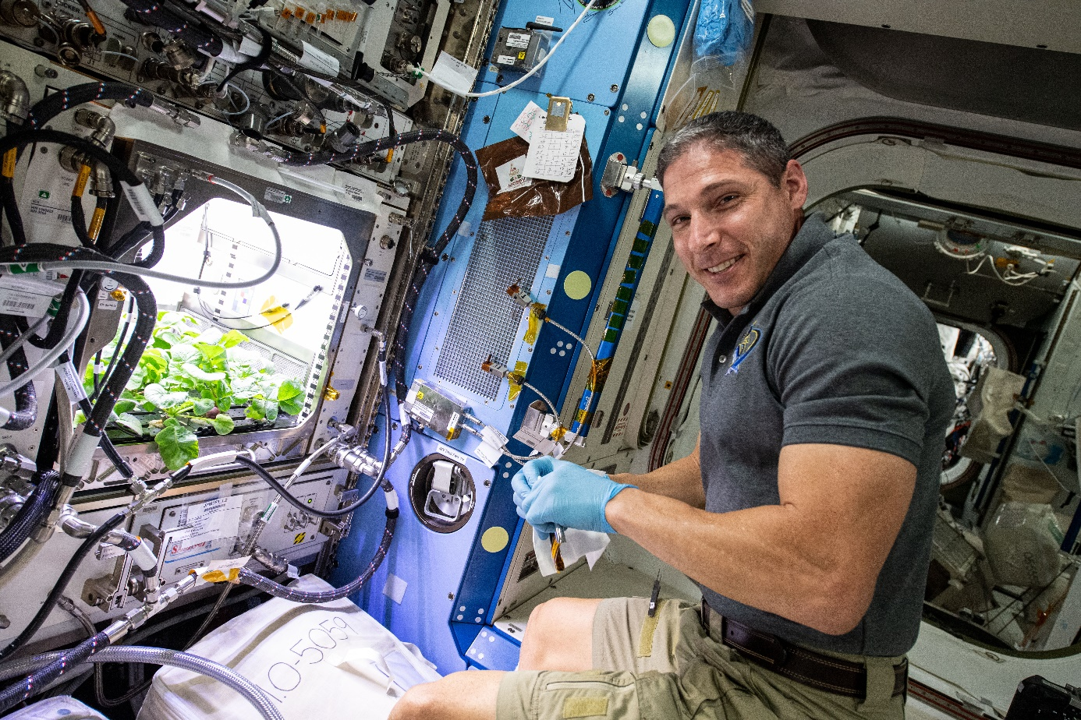
Recent ISS Crop Research
PH-02 Radish Experiment
PI Karl Hasenstein – University of Louisiana, Lafayette

Slide 11
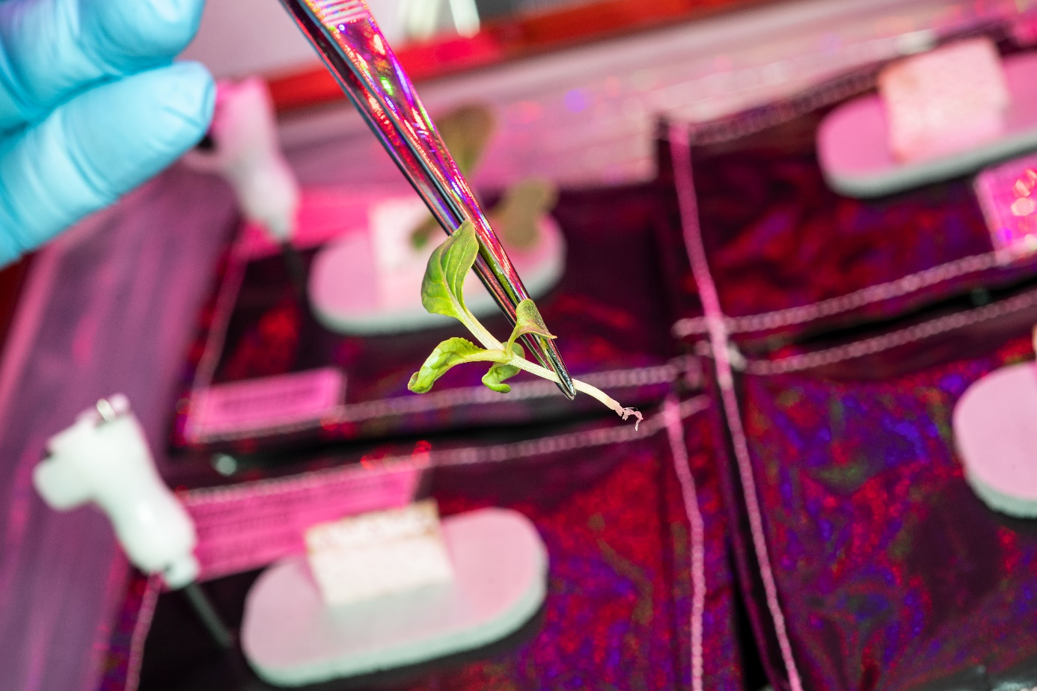
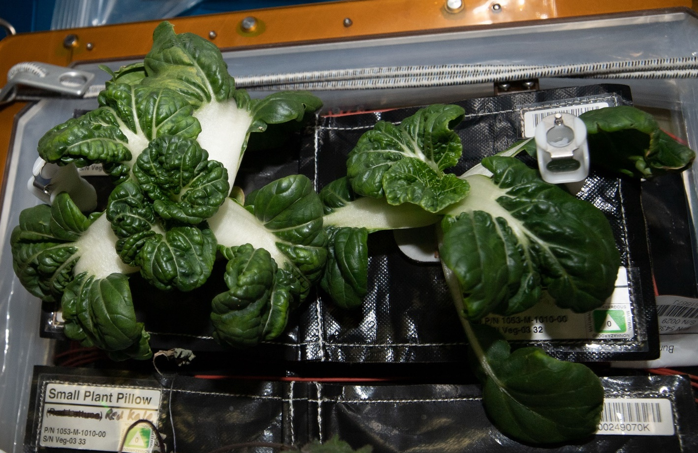
Recent ISS Crop Research
Transplanting 10 Days after initiation
Original
Transplant
Harvest at 29 days
Successful transplanting of ‘Extra Dwarf’ Pak Choi in VEG-03 I

Slide 12
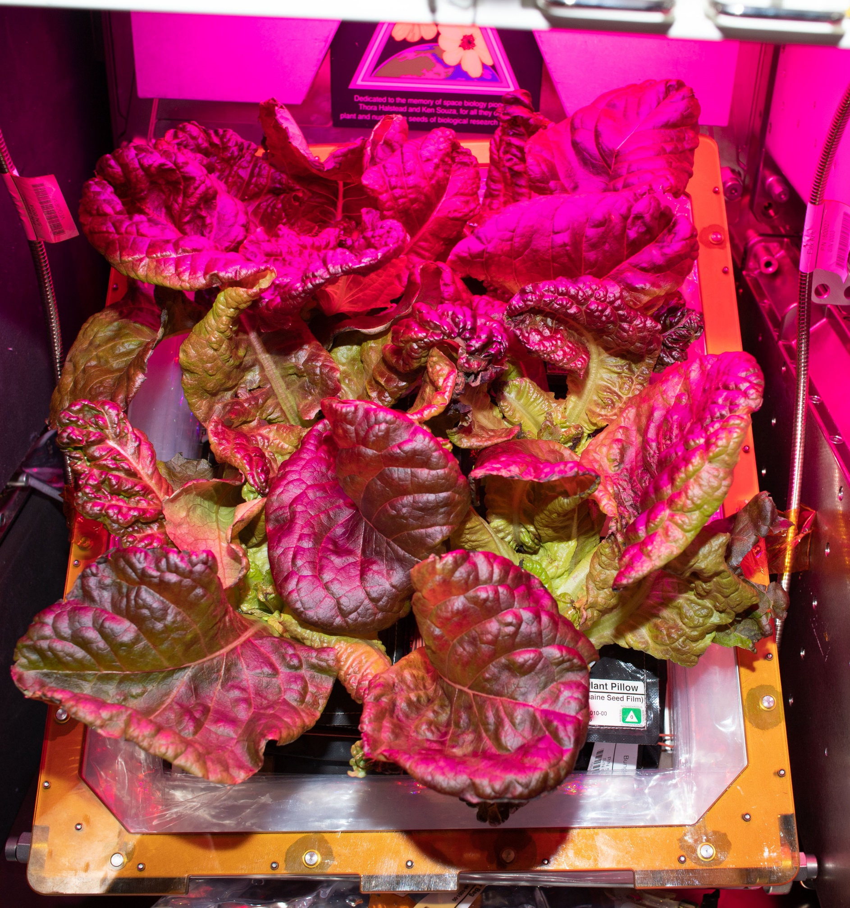
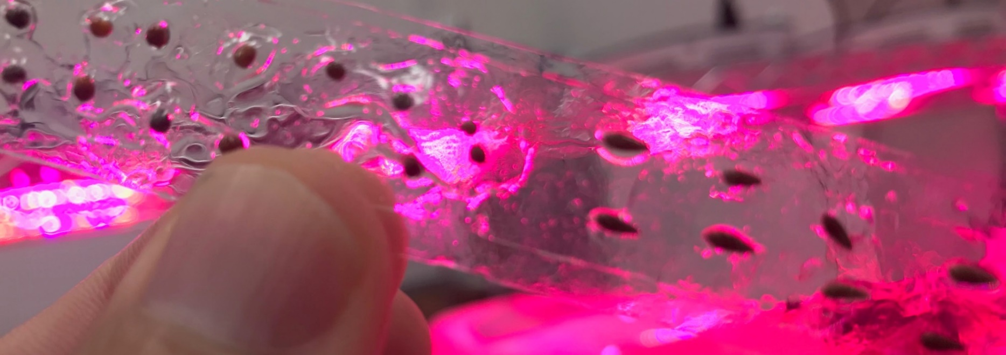
Recent ISS Crop Research
Seed Film technology tested successfully in VEG-03 J

Slide 13
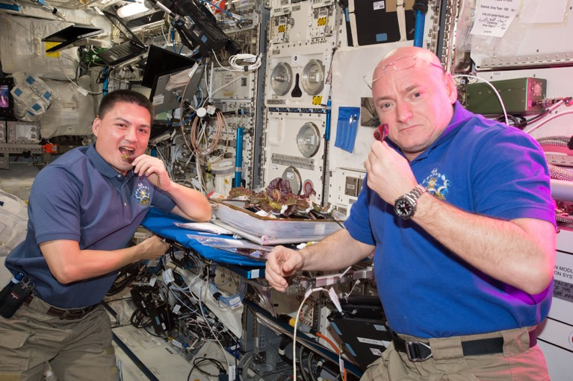
    Horticulture Considerations
  Cultivar selection (Edible Biomass, Yield Verses Volume)
  Genetic Engineering (Environmental Stress Tolerance)
  Microbiome (Plant, Growth System, Vehicle and Crew)
  Optimized Growth Recipes
  Food Safety

Slide 14
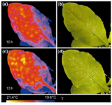
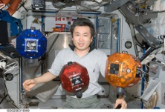
    Hardware and Technology Considerations
        Advanced Lighting
        Sensor Selection and Development
        Imaging Systems for Plant Health and Food Safety Monitoring (Hyperspectral, Multispectral, Fluorescence, Thermal)
        Sensor Fusion
        Autonomy and Robotics
        “Smart” Farmer: AI Control Systems and Predictive Algorithms
        Component Reliability, Maintenance and Miniaturization

Slide 15
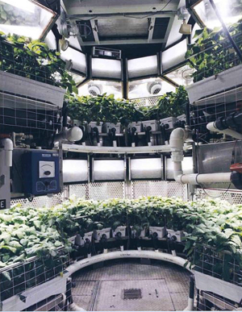
    Crop Production and Bioregenerative Life Support
    Long term presence on Mars will incorporate
    a bioregenerative food capability as a
    component of the life support system
    Will use systems proven on the lunar surface
    Benefits of a bioregenerative system:
      Lower food stowage mass
      Air revitalization
      Water and waste treatment

Slide 16
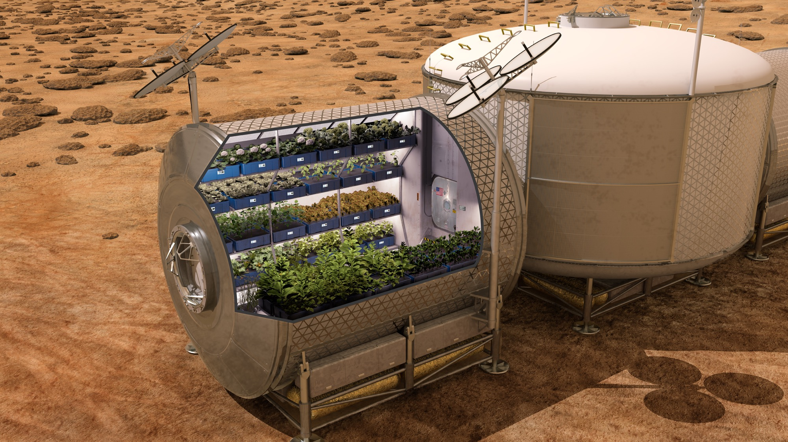
    Challenges of a Bioregenerative Crop System
      Requires close coordination with other life support system components
      Unknown effects of long-term radiation on plant performance, nutrition and acceptability
      Food safety mandates safe processing and handling protocols
      Crew time verses autonomous operations
      Additional hardware for food preparation and storage
      Dedicated module(s) for Pick-and-Eat and Staple Crops
      Hydroponic verses regolith-based systems
Staple Crop Candidates
Rice
Beans
Wheat Berries
Soybeans
Peanuts
Wheat

Slide 17
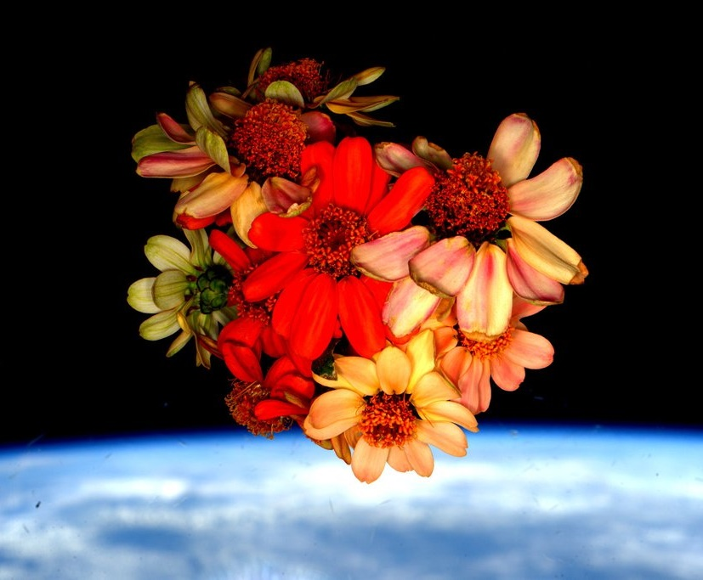
Thank you!

