Slide 1

Trilateral
6th Trilateral
6th Trilateral
TRILATERAL2021
June 16 – 17 , 2021
Trilateral Task Force – Reliability Analysis Supporting
Mission Extension/Post Mission Disposal
Leads: Anthony Diventi and Nancy J Lindsey (NASA – OSMA)
Members: Jesse Leitner (GSFC), Mathew Forsbacka (NASA-OSMA), Toru Yoshihara (JAXA), Kenichi Sato (JAXA), Takashi Yamane (JAXA), Fabrice Cosson (ESA), Silvana Radu (ESA), Sergio Ventura (ESA), Andrea Lopez (ESA), Todd Paulos (JPL), Martin Ratliff (JPL), Robert Abelson (JPL)

Slide 2
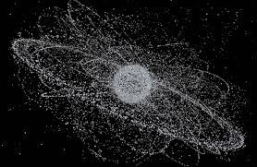
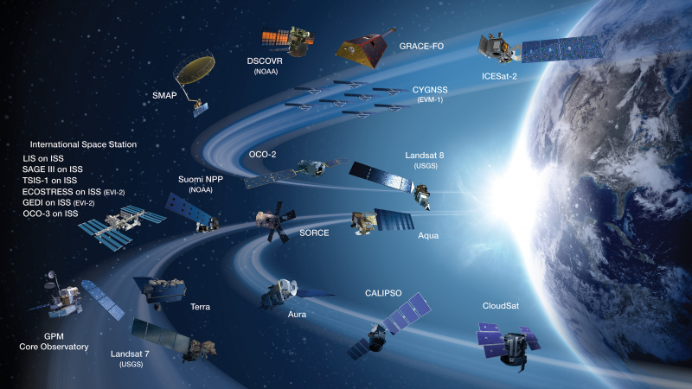

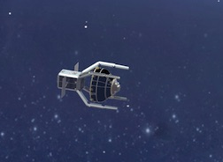
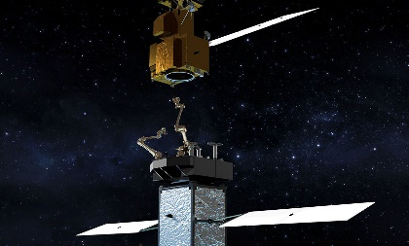
Agenda
  TOR Overview and Status
  Joint Initiatives
    Policy Comparison
    Lessons Learned
    Consensus Doc Overview
  JAXA Initiatives
  ESA Initiatives
  NASA Initiatives
  Summary of our Achievements and Path forward
Nancy J Lindsey: Mission Extension/Post Mission Disposal Task Force

Slide 3


  TOR Overview and Status
Capture a Comprehensive set of
Regulations/Documents on Spacekeeping.
Establish Similarity/Differences in
Regulations/Documents on Spacekeeping.
  Agenda
  TOR Overview and Status
  Joint Initiatives
    Policy Comparison
    Lessons Learned
    Consensus Doc Overview
  JAXA Initiatives ESA Initiatives
  NASA Initiatives
  Summary of Achievements and Path Forward
ISO 24113:2019
JMR-003C/D
JERG-2-026
NASA STD 8719.14b
ODMSP
2020 National Space Policy (US)
2018 Space Policy Directive-3 (US)
NPR 8715.6B
AF91-202
ECSS-U-AS-10C, Rev. 1
Space Activity ACT
FCC 20-54/04-130
Created/updated an International policy table
Shared Regulation and Policy documents
Discussed similarities and differences
Compare reliability estimation methods
for mission extension and post mission.
Establish common framework for
extension and post mission disposal analysis.
Conducted methodology sharing briefings from each agency
Shared example analyses
Discussed similarities and differences
Draft a Trilateral PMD/Extension Analysis Guidance Document
Share the Draft Trilateral PMD/Extension Analysis Guidance Document (internally)
Acquire each agency’s release authorization
Share the Trilateral PMD/Extension Analysis Guidance Document (externally)
Nancy J Lindsey: Mission Extension/Post Mission Disposal Task Force

Slide 4
  Policy Comparison Review
 | International (IADC & ITU) | United States | Japan | France | Europe
Post-Mission Disposal | IADC /ITU Remove mission terminated spacecraft from the useful regions. LEO : Limit life to 25 years (IADC) GEO: raise perigee by 253km + 1000*Solar pressure with eccentricity of 0.003 (IADC) GTO: shorten lifetime of objects left in GTO (ITU) Includes Canada, Germany, France, UK/Ireland, Italy, Nigeria, Poland, Russia, and more ISO (24113:2019) 6.3.1.1 the probability of successful disposal of a spacecraft or launch vehicle orbital stage shall be at least 0.9 6.3.1.2 During the design of a spacecraft for which a disposal maneuver has been planned, an assessment shall be made of the risk that a space debris or meteoroid impact will prevent successful disposal. 6.3.2.1 A launch vehicle orbital stage shall be disposed of in such a way that long-term permanent perturbation forces do not cause it to enter the GEO protected region within 100 years after the end of life. LEO: 6.3.3.1 The orbit lifetime of a spacecraft or launch vehicle orbital stage shall be < 25years for continuous or periodic stays; 100years for intersection/transitional stays in LEO. Disposal methods allowed are: retrieval controlled re-entry natural decay maneuver for natural decay adding drag enhancement GEO: 6.3.2.2 GEO disposal shall satisfy one of the following: 253km + 1000*Solar pressure with eccentricity of 0.003 the orbit has a perigee altitude sufficiently above GEO that long term perturbation forces do not cause entry of the GEO region for 100years. 6.3.2.3 A spacecraft operating in GEO with a periodic presence shall be disposed so that long-term perturbations do not cause it to enter GEO for 100years. . 6.3.4 Re-Entry Casualty risk is to be defined by approving agency. | Requirement 4.5-2 limits the probability of spacecraft being disabled and left in orbit at EOM, which would contribute to the long-term growth of the orbital debris environment by subsequent collision or explosion fragmentation. (NPR 8715.6B) the ODAR and EOMP for all phases of flight including the launch phase per applicability in Section 4.5 NASA STD 8719.14b The analyses documented in the ODAR and EOMP need to include not only collisions that produce large amounts of debris, but also collisions that will terminate a spacecraft’s capability to perform post-mission disposal. This documentation should also address methods being used to reduce risk such as MMOD impact shielding options, or operational collision avoidance and any trade-offs between cost, mission requirements, and risk reduction for each method. (NASA STD 8719.14b) Remove spacecraft and orbital stages from LEO to reduce collision threat to future space operations (NASA STD 8719.14b) Remove spacecraft and orbital stages from GEO to reduce collision threat to future space operations Govern intermediate disposal orbits Assess reliability of post-mission disposal Assess options for disposal beyond Earth’s orbit consistent w/ planetary protection Reliability of post-mission disposal maneuver operations in Earth orbit: > 0.90 at EOM to achieve the following conditions and Shall not to cause a violation of Requirement 4.7-1 pertaining to limiting the risk of human casualty. (NASA STD 8719.14b) For LEO assets - Leave the space structure in an orbit in which natural forces will lead to atmospheric reentry within 25 years after the completion of mission(NASA &NRO); or Maneuver the space structure into a controlled de-orbit trajectory as soon as practical after completion of mission; or Store: Maneuver the space structure into an orbit with perigee altitude above 2000 km and ensure its apogee altitude will be below 19,700 km, both for a minimum of 100 years; or Retrieve the space structure and remove it from orbit within 10 years after completion of mission. (4.6.2.2 & NRO) For near GEO assets (A spacecraft or orbital stage in an orbit near GEO shall be maneuvered at EOM to a disposal orbit above GEO with a predicted minimum perigee of GEO +200 km (35,986 km) or below GEO with a predicted maximum apogee of GEO – 200 km (35,586 km) for a period of at least 100 years after disposal) – Leave in an orbit between LEO and Medium Earth Orbit (MEO) with a perigee altitude greater than 2000 km and apogee altitude below 19,700 km for 100 years; or Leave in an orbit between MEO and GEO) with a perigee altitude greater than 20,700 km and apogee altitude below 35,300 km for 100 years. (4.6.2.3) Disposal (NRO): Between MEO and Geosynchronous Earth Orbit Maneuver to an orbit with perigee altitude above 20,700 km and apogee altitude below 35,300 km (approximately 500 km above semi­synchronous altitude and 500 km below synchronous altitude). Above GEO: Maneuver to an orbit with perigee altitude above 36,100 km (approximately 300 km above synchronous altitude). Heliocentric, Earth-escape: Maneuver to remove the structure from earth orbit, into a heliocentric orbit. Retrieval upon completion of the mission The probability of successful post-mission disposal should be no less than 0.9 (AF 91-202)with a goal of 0.99 or better by Maneuvers (1) a reentry trajectory or (2) a heliocentric, Earth-escape orbit or atmospheric drag for less than 25yrs (DOD – US Debris Mitigation Std & AF91-202). DOD below AF see NASA-STD Maneuver to an eccentric disposal orbit (e.g., GEO transfer) where (1) perigee altitude remains above the LEO zone for at least 100 years, (2) apogee altitude remains below the GEO zone for at least 100 years, and (3) the time spent by the structure between 20,182 +/- 300 km is limited to 25 years or less over 200 years; or, Maneuver to a near-circular disposal orbit to (1) avoid crossing 20,182 +/- 300 km, the GEO zone, and the LEO zone for at least 100 years Storage above GEO above 35,986 km for 100 yrs (AF91-202 as well), Long term reentry MEO/GEO/Etc. limit to 200yrs total, LEO to 25 yrs (AF91-202 as well), and limit the probability of collisions with debris 10 cm and larger to less than 0.001 (1 in 1,000) during orbital lifetime. Retrieval within 5 years. Small satellites, including CubeSats, limit LEO life to <25 yrs and object-time <100 yrs. Space Policy directive 6 “, raising or storing assets on-orbit that is “ sufficiently high orbit is one in which the orbital lifetime of the spacecraft is long enough for the fission products to decay to a level of radioactivity comparable to that of uranium-235 by the time it reenters the Earth’s atmosphere, and the risks to existing and future space missions and of collision with objects in space are minimized” “Spacecraft operating fission reactors in low-Earth orbits shall incorporate a highly reliable operational system to ensure effective and controlled disposition of the reactor FCC/ODMSP (FCC-20-54A para 2 points to ODMSP) 4-2. Reliability of disposal: The probability of successful post-mission disposal should be no less than 0.9 with a goal of 0.99 or better. The geosynchronous Earth orbit (GEO) zone is defined as the region between the altitudes of 35,586 and 35,986 km. The low Earth orbit (LEO) zone is defined as the region below 2000 km altitude. The medium Earth orbit (MEO) is the region between LEO and GEO. Because of fuel gauging uncertainties near the end of mission, a program should use a maneuver strategy that reduces the risk of leaving the structure near an operational orbit regime. 4-1. A spacecraft or upper stage may be disposed of by one of the following methods: a. Direct reentry or heliocentric, Earth-escape: Maneuver to remove the structure from Earth orbit at the end of mission into (1) a reentry trajectory or (2) a heliocentric, Earth-escape orbit. These are the preferred disposal options. For direct reentry, the risk of human casualty from surviving components with impact kinetic energies greater than 15 joules should be less than 0.0001(1 in 10,000). Design-for-demise and other measures, including reusability and targeted reentry away from landmasses, to further reduce reentry human casualty risk should be considered. b. Atmospheric reentry: Leave the structure in an orbit in which, using conservative projections for solar activity, atmospheric drag will limit the lifetime to as short as practicable but no more than 25 years after completion of mission. If drag enhancement devices are to be used to reduce the orbit lifetime, it should be demonstrated that such devices will significantly reduce the area-time product of the system or will not cause spacecraft or large debris to fragment if a collision occurs while the system is decaying from orbit. The risk of human casualty from surviving components with impact kinetic energies greater than 15 joules should be less than 0.0001(1 in 10,000). c. Storage between LEO and GEO: I. Maneuver to an eccentric disposal orbit (e.g., GEO transfer) where (1) perigee altitude remains above the LEO zone for at least 100 years, (2) apogee altitude remains below the GEO zone for at least 100 years, and (3) the time spent by the structure between 20,182 +/- 300 km is limited to 25 years or less over 200 years; or, II. Maneuver to a near-circular disposal orbit to (1) avoid crossing 20,182 +/- 300 km, the GEO zone, and the LEO zone for at least 100 years, and (2) limit the risk to other operational constellations, for example, by avoiding crossing the altitudes occupied by known missions of 10 or more spacecraft using near-circular orbits, for 100 years. d. Storage above GEO: Maneuver to an orbit with perigee altitude sufficiently above 35,986 km (upper boundary of the GEO zone) to ensure the structure remains outside the GEO zone for at least 100 years. e. Long-term reentry for structures in MEO, Tundra orbits, highly inclined GEO, and other orbits: Maneuver to a disposal orbit where orbital resonances will increase the eccentricity for long-term reentry of the structure. In developing this disposal plan, the program should (1) limit the post-mission orbital lifetime to as short as practicable but no more than 200 years, (2) limit the time spent by the structure in the LEO zone, the GEO zone, and between 20,182 +/- 300 km to 25 years or less per zone; and (3) limit the probability of collisions with debris 10 cm and larger to less than 0.001 (1 in 1,000) during orbital lifetime. To limit human casualty risk from the reentry of the structure, surviving components with impact kinetic energies greater than 15 joules should have less than 7 m2total debris casualty area or less than 0.0001 (1 in 10,000) human casualty risk. f. Direct retrieval: Retrieve the structure and remove it from orbit preferably at completion of mission, but no more than 5 years after completion of mission. | Remove post-mission spacecraft from high value regions by requiring that :(JMR-003D) LEO: (1) Retrieve (2) Controlled re-entry (3) Atmospheric reentry will occur in 25 years due to natural causes, (4) Maneuvering to an orbit with atmospheric re-entry will occur in 25 years due to natural causes (5) Reducing orbital lifetime in 25 years by deploying a device GEO: raise perigee by 253km + 1000*Solar pressure with eccentricity of 0.003 GTO: apogee altitude remains below the GEO -200 km for at least 100 years The probability of successful disposal is 0.9 or higher. Space Activity Act Article 22, item (iv): (a) - The applicant provides measures for the controlled reentry (e.g. trajectory, landing point) while ensuring the safety of an expected point of landing or water landing. - The spacecraft or its component, etc. for reentry into Earth has a configuration to be completely ablated, or as a result of sufficient ablation, etc., the risk to the expected point of landing or water landing will not exceed the level stipulated in the international standards or standards provided by the space agency of each state. (b) - The applicant provides measures to elevate the spacecraft to the altitude that would not have any adverse effect on the control of other spacecraft. (c) - The applicant provides measures to put the spacecraft into the orbit around a celestial body other than the Earth or guide it to fall to the celestial body, without any risk of significantly deteriorating the environment of the celestial body. (d) (Article 24 of the Cabinet Office Order)) - The applicant provides measures to vent residual energy, including residual propellant and electricity, which may cause break-up of the spacecraft or to prevent the breakup. - Upon the termination of the control of the spacecraft, the following measures are to be taken for the protected regions: - Efforts must be made so that the spacecraft will be removed from the low earth orbit region within 25 years from the termination of the control. - The spacecraft is to be removed from the geosynchronous orbit immediately. | The probability of having sufficient energy resources to successfully carry out the disposal maneuvers mentioned in paragraphs 3, 4 and 5 above must be at least 0.9. (IADC Compendium) Remove post-mission spacecraft from high value regions by: a) atmospheric reentry will occur in 25 years due to natural causes, b) maneuvering space systems to a storage orbit above 2000km and below 35,500 km, c) maneuvering space systems to a storage Components stationed in an orbit in or passing through protected region B, are placed in an orbit which does not interfere with this region for more than one year. This orbit must be such that, under the effect of natural disturbances, the launcher or its components do not return to protected region B within one hundred years following the end of the operational orbit 235km above GEO. | Each project shall have a debris mitigation plan including a disposal plan for removal of post-mission space vehicles in accordance with the following: a) The operator of a space vehicle shall perform maneuvers to limit orbital lifetime (periodic or permanent) to 25 years maximum via direct reentry, natural reentry, or disposal orbit placement, b) GEO vehicles shall be re-orbited into a disposal orbit 253km + 1000*Solar pressure with eccentricity of 0.003 above GEO. (IADC) - ESA has requirements for LEO and GEO Protected Regions as from IADC and in ECSS-U-AS-10C, Rev. 1 / ISO 24113:2019; - ESA has a "10-3 break-up risk until end of life" requirement as in in ECSS-U-AS-10C, Rev. 1 / ISO 24113:2019; - ESA has a passivation requirement as in ECSS-U-AS-10C, Rev. 1 / ISO 24113:2019; - ESA is using a "0.90 absolute probability of successful disposal" requirement as in ECSS-U-AS-10C, Rev. 1 / ISO 24113:2019; - ESA is using 10-4 re-entry casualty risk as in ESSB-ST-U-004;
  Agenda
  TOR Overview and Status
  Joint Initiatives
    Policy Comparison
    Lessons Learned
    Consensus Doc Overview
  JAXA Initiatives
  ESA Initiatives
  NASA Initiatives
  Summary of Achievements and Path Forward
Common 0.9 minimum Requirement
Common LEO 25 year limit
Common LEO disposal orbit altitude
Nancy J Lindsey: Mission Extension/Post Mission Disposal Task Force
Retrieval within 5yr Requirement
Some Allowances for > 100 years of orbital storage/disposal
Variations in allowable orbital altitudes

Slide 5
  Policy Comparison Review
 | International (IADC & ITU) | United States | Japan | France | Europe
Additional Spacekeeping (Servicing & Debris Removal) | IADC 2007 : “Retrieval is also a disposal option.” ISO/CD 24330 (Under development until 2022) Space systems — Rendezvous and Proximity Operations (RPO) and On Orbit Servicing (OOS) — Programmatic principles and practices ISO (24113:2019) does not address servicing or proximity operations. | United States Government (USG) ODMSP –Rendezvous, proximity operations, and satellite servicing: In developing the mission profile for a structure, the program should limit the risk of debris generation as an outcome of the operations. The program should (1) limit the probability of accidental collision, and (2) limit the probability of accidental explosion resulting from the operations. Any planned debris generated as a result of the operations should follow the standard practices for mission-related debris set forth in Objective 1 - CONTROL OF DEBRIS RELEASED DURING NORMAL OPERATIONS. 5-4. Safety of Active debris removal operations: In developing the mission profile for an active debris removal operation on a debris structure, the program should limit the risk of debris generation as an outcome of the operation. The program should (1) avoid fragmentation of the debris structure, (2) limit the probability of accidental collision, and (3) limit the probability of accidental explosion resulting from the operations. Any planned debris generated as a result of the operations should follow the standard practices for mission-related debris set forth in Objective 1. The operations should be designed for the debris structure to follow applicable post-mission disposal practices set forth in Objective 4 - POSTMISSION DISPOSAL OF SPACE STRUCTURES 2020 National Space policy: “ Evaluate and pursue, in coordination with allies and partners, active debris removal as a potential long-term approach to ensure the safety of flight in key orbital regimes;” SPD-3: “The United States should pursue active debris removal as a necessary long-term approach to ensure the safety of flight operations in key orbital regimes. This effort should not detract from continuing to advance international protocols for debris mitigation associated with current programs. “ FCC : Proximity Operations 59 (FCC-CIRC1811-02).With increasing interest in satellite servicing and other non-traditional missions, there have been an increasing number of commercial missions proposed that involve proximity operations and rendezvous of spacecraft. We propose that applicants be required to disclose whether the spacecraft will be performing any space rendezvous or proximity operations. The statement would indicate whether the satellite will be intentionally located or maneuvering near another spacecraft or other large object in space. Such operations present a potential collision risk, and operators will need to address that risk, as well as any risk of explosions or generation of operational debris that might occur through contact between spacecraft, as part of debris mitigation plans. Accordingly, we propose a disclosure requirement regarding these types of operations FCC 20-54 Proximity Operations 122. In the Notice, the Commission noted the increasing number of commercial missions proposed involving proximity operations and rendezvous of spacecraft. The Commission proposed that applicants be required to disclose whether the spacecraft is capable of, or will be, performing rendezvous or proximity operations. The Commission also sought comment on whether the rules should include anything more specific regarding information sharing about proximity operations with the 18th Space Control Squadron or any successor civilian entity.435.We adopt a disclosure requirement that would identify situations where there are planned rendezvous and proximity operations and provide a vehicle for further review of those operations. The disclosure requirement follows the general approach in the revised ODMSP of analyzing such operations within the framework of standard debris mitigation objectives—limiting debris release, preventing accidental explosions, and limiting collision risk. Commenters generally supported this approach. We note the evolving and developing nature of these operations, and accordingly find that more specific technical or operational requirements are premature at this time Member of CONFERS (The Consortium for Execution of Rendezvous and Servicing Operations) Studies | JERG-2-026 On-orbit service: Intentional interference by a servicing spacecraft with a client spacecraft for refueling, resupplying, adding or replacing functionalities and assisting post mission disposal. Active debris removal (ADR) for inactive spacecraft / target debris and transportation to/from a space station is also a part of on-orbit servicing. ADR shall be taken in to (1) Avoid unintended generation of debris caused by a collision upon RPO, physical contact and docking with a target as well as the loss of debris mitigation functions are defined as a critical hazard (e.g. serious effect on environment).(2) Conduct a hazard analysis of the entire system integrating a servicing spacecraft, target and ground system, and take safety measures to address the identified hazards and hazard causes based on fault tolerance.(3) Additional fault tolerance or equivalent measures are considered when a collision could lead to a catastrophic consequence such as serious threat to the manned spacecraft because of its size, orbit and/or payload properties. (4) Avoid inducing failures direct or indirect (impingement, contamination, etc) in servicing of client system. (5) Inability to separate client and servicing if required. | In 2019, France released its Space Defense Strategy, in which it acknowledged the increasing importance in-orbit services will have in the future due to the high number of objects in orbit and the need to remove debris. France is involved in the development of IOS in the field of Active Debris Removal, reconfiguration and de-orbiting. France has contributed to the development of Space Debris Mitigation Guidelines of the Committee, the European Code of Conduct for Space Debris Mitigation and, to the IADC Space Debris Mitigation Guidelines. The French Technical Regulation is consistent with these guidelines, as well as with the ISO 24113 standard. France is currently using debris mitigation policies to guide CPO and RPO. | ESA’s Close Proximity Operations (CPO) Working Group is preparing the safety/sustainability requirements (e.g. technical, operational, verification & validation) for non-human rated missions executing rendezvous, proximity and capture operations. The CPO Working Group will provide technical inputs to the European Cooperation for Space Standardization (ECSS) Space Traffic Management Working Group on technical aspects concerning the development of worldwide Rendezvous and Proximity Operations (RPO) and On Orbit Servicing (OOS) for 2022 RPO/OOS draft guidelines and best practices handbook release. ESA is currently using debris mitigation policies to guide CPO and RPO. Member of CONFERS
  Agenda
  TOR Overview and Status
  Joint Initiatives
    Policy Comparison
    Lessons Learned
    Consensus Doc Overview
  JAXA Initiatives ESA Initiatives
  NASA Initiatives
  Summary of Achievements and Path Forward
Common do no harm requirements: avoid debris generation
Common maintenance of compliance with debris mitigation policies
Nancy J Lindsey: Mission Extension/Post Mission Disposal Task Force
Variations in established policies
Common challenge of developing evolved reliability and hazard assessment tactics for Servicing/ADR
Notes:
France Reference : https://espi.or.at/publications/espi-public-reports/send/2-public-espi-reports/557-in-orbit-services-full-report ) ---

Slide 6
  Methodology Lessons Learned
FTA
Reference & Adjusted Rates
Risk
PRA/PA
Judgments: Good as New
Statistical Probability Derivation & Updates
Life Limited Items
RBD
FMEA/ FMECA
  Agenda
  TOR Overview and Status
  Joint Initiatives
    Policy Comparison
    Lessons Learned
    Consensus Doc Overview
  JAXA Initiatives
  ESA Initiatives
  NASA Initiatives
  Summary of Achievements and Path Forward
Support of Risk-Informed Decision Making
RBD
Scenario and System Assessment
Quantitative an Qualitative Analysis
Nancy J Lindsey: Mission Extension/Post Mission Disposal Task Force

Slide 7
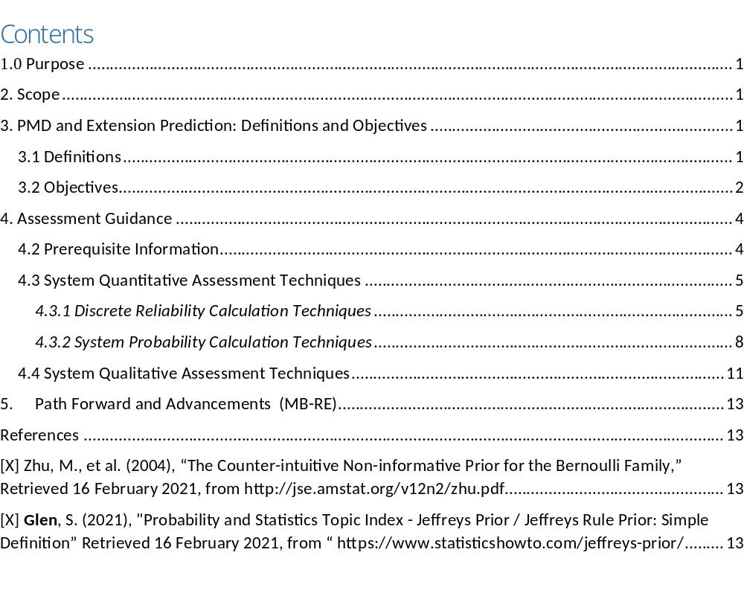
  Consensus Document Overview
  Agenda
  TOR Overview and Status
  Joint Initiatives
    Policy Comparison
    Lessons Learned
    Consensus Doc Overview
  JAXA Initiatives
  ESA Initiatives
  NASA Initiatives
  Summary of Achievements and Path Forward
Utility and Advancements ……………………….……………………………………
The intent of this guidance document is to assist spacefaring entities in assessing their designs and operational plans for extending missions and post mission disposal by sharing proven techniques and lessons learned from TRILATERAL Agencies in making risk/value based decision while assuring compliance with applicable for post-mission disposal. Ideally this will help all spacefaring entities to consider the sustainment of our shared space environment for now and the future. Therefore public release/sharing is the goal.
Nancy J Lindsey: Mission Extension/Post Mission Disposal Task Force

Slide 8
  Agenda
  TOR Overview and Status
  Joint Initiatives
    Policy Comparison
    Lessons Learned
    Consensus Doc Overview
  JAXA Initiatives ESA Initiatives
  NASA Initiatives
  Summary
  of Achievements and Path Forward
Imminent Extension and PMD Advancements
Nancy J Lindsey: Mission Extension/Post Mission Disposal Task Force

Slide 9
  JAXA Definition and Methodology Planning
JMR-003D based on ISO24113:2019
  Agenda
  TOR Overview and Status
  Joint Initiatives
    Policy Comparison
    Lessons Learned
    Consensus Doc Overview
  JAXA Initiatives
  ESA PMD Initiatives
  NASA Initiatives
  Summary of Achievements and Path Forward
Spacecraft operation period
Launch
Orbital injection
End of mission
Launch
phase
Normal operation phase
Extended operation phase 1
Extended operation phase 2
0.9 was not a severe requirement because of conditional assumption.
Disposal
Disposal
Disposal
Time
Conditional Probability of successful disposal (JMR-003C)
1.0
0.9 or higher
Need to re-evaluate probability of successful disposal to be 0.9 or higher at the end of extended operation period.
1.0
0.9 or higher
Probability of successful disposal (JMR-003D)
0.9 got to be a severe requirement because normal operation phase has to be taken into account.
?
0.9 or higher
?
0.9 or higher
Issue 1
Conventional reliability analysis employs MIL-HDBK-217F with very conservative conditions. It is not suitable for the intent of successful PMD requirement and could violate even with the very reliable satellite.
Issue 2
There has to be the evaluation guideline in support of mission extension.
Toru Yoshihara: Mission Extension/Post Mission Disposal Task Force

Slide 10
  JAXA’s Integration of TF Activities
JMR-003D does not officially require 0.9 as a reliability of disposal function.
Design phase
  Agenda
  TOR Overview and Status
  Joint Initiatives
    Policy Comparison
    Lessons Learned
    Consensus Doc Overview
  JAXA Initiatives
  ESA PMD Initiatives
  NASA Initiatives
  Summary of Achievements and Path Forward
Preparation of disposal plan
Disposal function in design
Evaluating reliability of disposal function
Management of operation life limited items (OLIs)
Establishing health assessment procedures for disposal function
Design and assess to protect against impact of SD/MM
Ensuring resources for disposal operations
1) Update reliability requirement and establish compliance guidance.
2) Add the new process to re-evaluate probability of successful disposal.
Management of propellant for disposal maneuver
Re-evaluation of reliability of disposal function
Evaluation of remaining life of OLIs required for disposal
Evaluation of the soundness of equipment required for disposal
JMR-003D does not specify this process.
It will be addressed in the next version.
Decision for mission extension / termination w.r.t successful PMD
Execution of disposal plan in case of mission termination
Operation phase
Procedure of decision making for mission extension / termination w.r.t successful PMD
Toru Yoshihara: Mission Extension/Post Mission Disposal Task Force

Slide 11
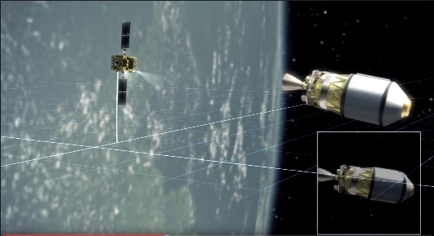
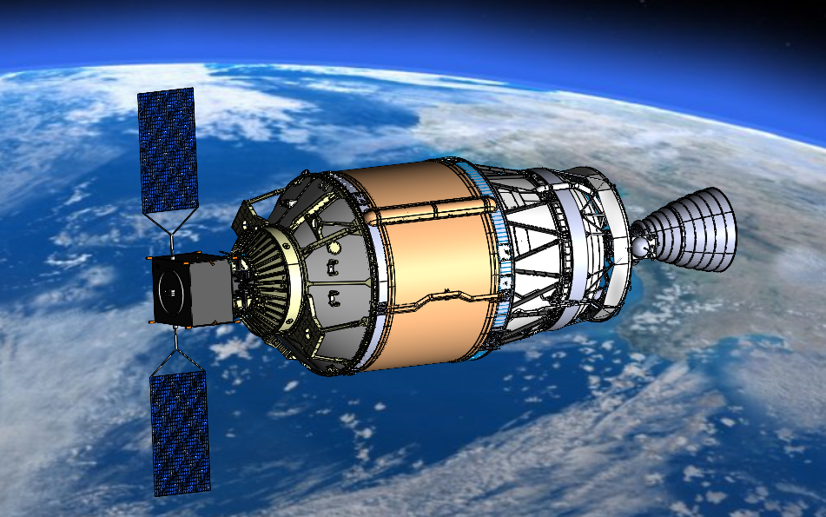

Active Debris Removal by on-orbit servicing technology
  Commercial Removal of Debris Demonstration (CRD2)
  is the mission to demonstrate removing an existing large debris in orbit, in partnership with private sectors.
  Agenda
  TOR Overview and Status
  Joint Initiatives
    Policy Comparison
    Lessons Learned
    Consensus Doc Overview
  JAXA Initiatives
  ESA PMD Initiatives
  NASA Initiatives
  Summary of Achievements and Path Forward
Phase-I
Key technologies demonstration
Phase-II
ADR demonstration
FY2022
FY2025~
Re-entry
Astroscale
Removal and re-entry of 2nd stage of launch vehicle
Non-cooperative rendezvous,
proximity operation, inspection
JAXA procures services and R&D results, not spacecrafts.
JAXA sets service specifications and safety requirements (JERG-2-026).
Astroscale is the partner company for CRD2 Phase-I.
The client object is Real H-2A upper stage left in Low Earth Orbit.
Toru Yoshihara: Mission Extension/Post Mission Disposal Task Force

Slide 12
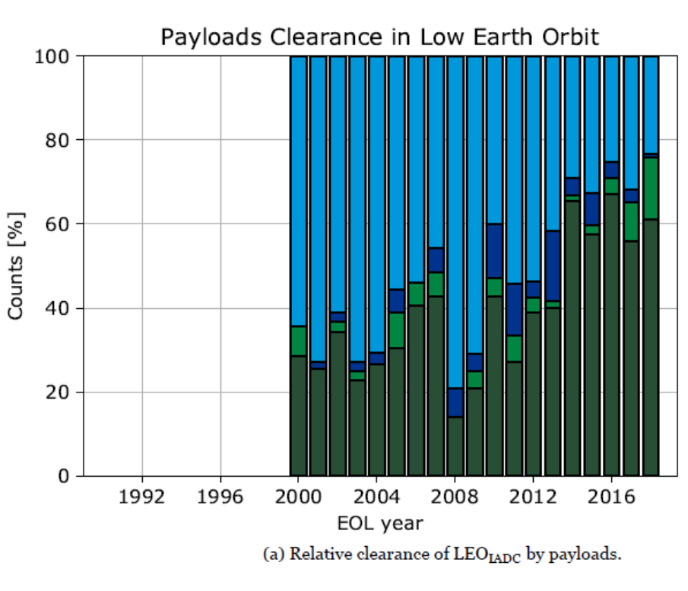
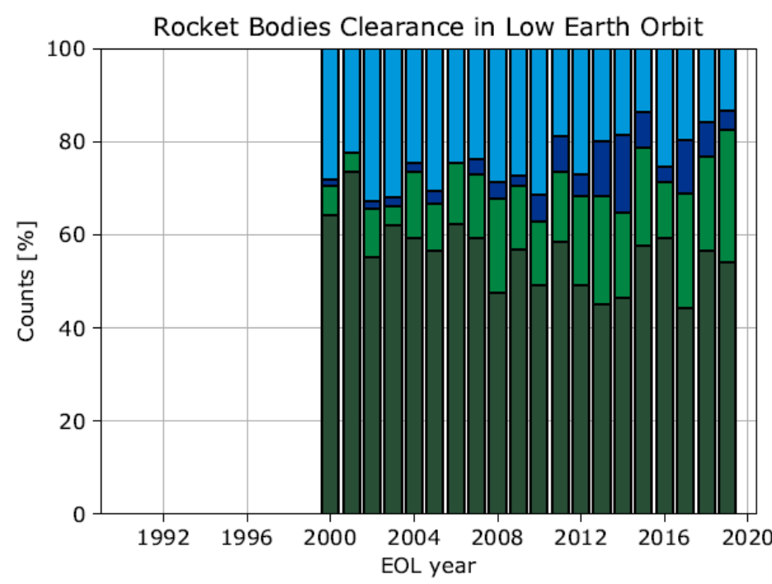
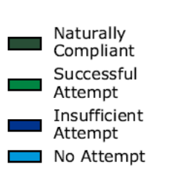
  ESA – Current situation
Currently: low success rate of PMD for both Satellites and Launchers
  Agenda
  TOR Overview and Status
  Joint Initiatives
    Policy Comparison
    Lessons Learned
    Consensus Doc Overview
  JAXA Initiatives
  ESA Initiatives
  NASA Initiatives
  Summary of Achievements and Path Forward
ESA’s Annual Space Environment Report issue 4.0, 29/10/2020 reference: GEN DB LOG 00288 OPS SD
Fabrice Cosson: Mission Extension/Post Mission Disposal Task Force

Slide 13
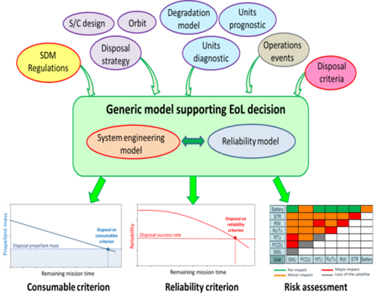
  ESA – RAMS R&D Activities
  Agenda
  TOR Overview and Status
  Joint Initiatives
    Policy Comparison
    Lessons Learned
    Consensus Doc Overview
  JAXA Initiatives
  ESA Initiatives
  NASA Initiatives
  Summary of Achievements and Path Forward
Completed R&D
On-going R&D
Reliability Model Enabling Satellite Life Extension and Safe Disposal
Validated Reliability Models for Satellite EoL Operations
Objectives:
Improve Quantitative risk assessment in support to Remaining Useful Lifetime (RUL) estimation => Reliability consolidated prediction
Provide a Qualitative risk assessment => Risk assessment matrix
Fabrice Cosson: Mission Extension/Post Mission Disposal Task Force

Slide 14
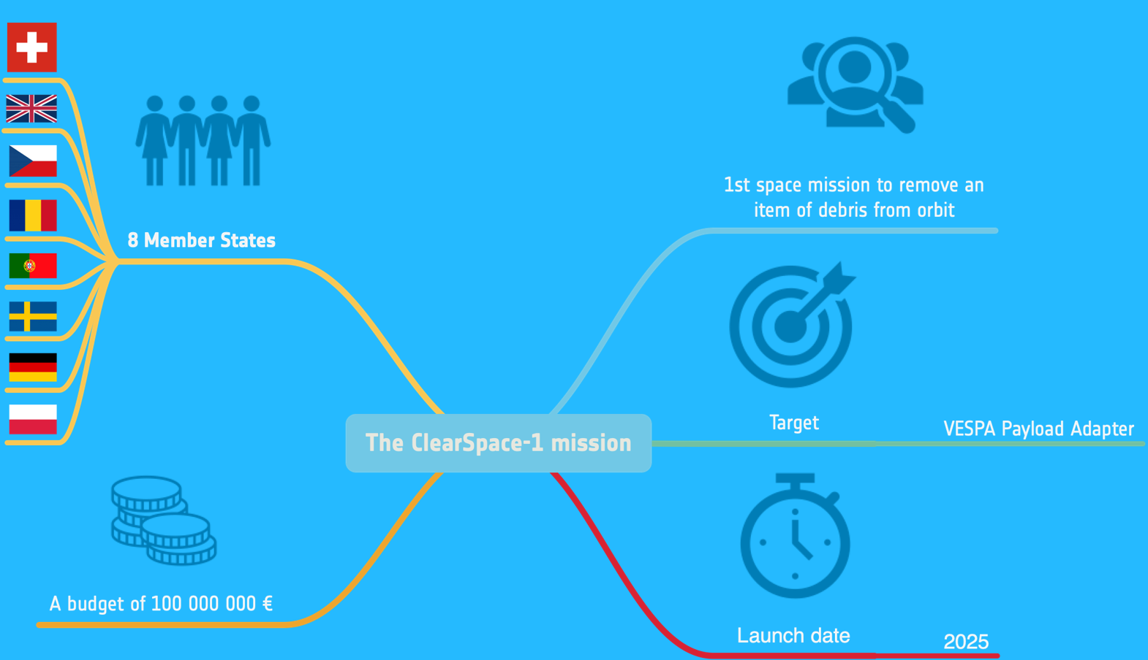
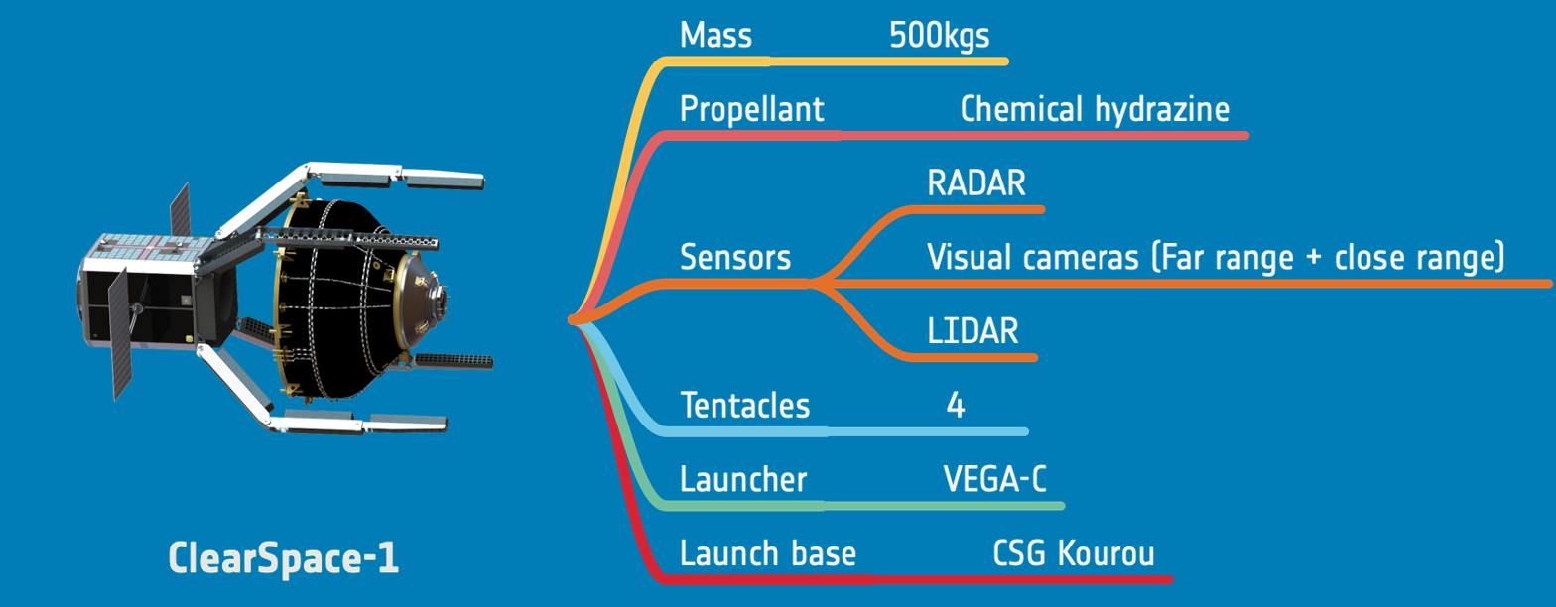
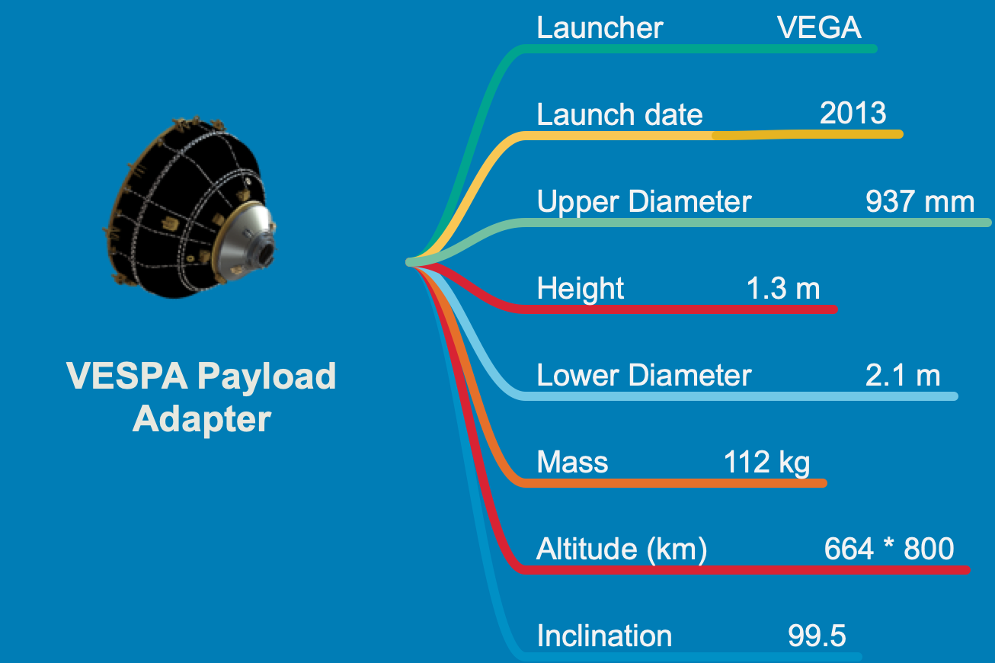
  ESA - ClearSpace-1 Retrieval and Disposal Mission
1st space mission to remove an item of debris from orbit
  Agenda
  TOR Overview and Status
  Joint Initiatives
    Policy Comparison
    Lessons Learned
    Consensus Doc Overview
  JAXA Initiatives
  ESA Initiatives
  NASA Initiatives
  Summary of Achievements and Path Forward
Clean up space
Demonstrate the technologies needed for debris removal
Open a new market for in-orbit servicing and debris removal
Fabrice Cosson: Mission Extension/Post Mission Disposal Task Force

Slide 15
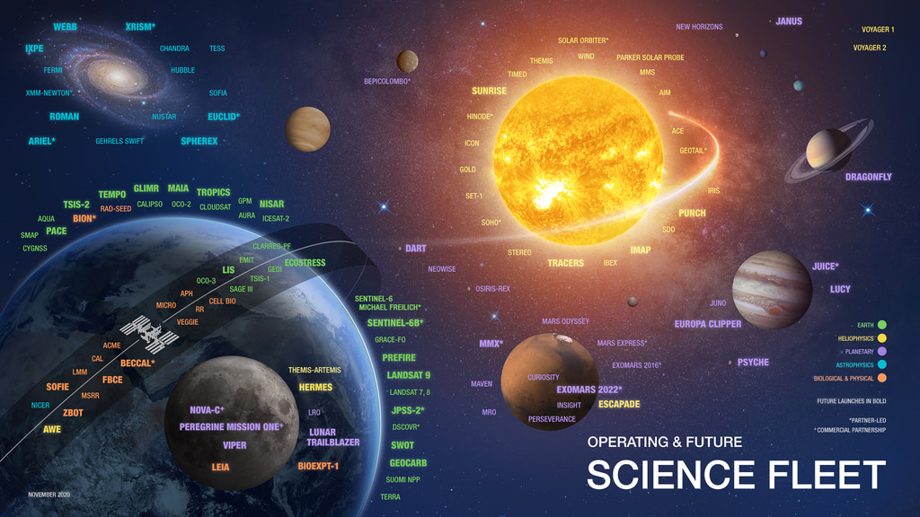
  NASA Today and Tomorrow
  Agenda
  TOR Overview and Status
  Joint Initiatives
    Policy Comparison
    Lessons Learned
    Consensus Doc Overview
  JAXA Initiatives
  ESA Initiatives
  NASA Initiatives
  Summary of Achievements and Path Forward
NASA is utilizing and expanding the use of performance, best practices, and data sharing via digital evolution efforts to enable effective Reliability modelling to enable Life Extension and Safe Disposal decisions.
Nancy J Lindsey: Mission Extension/Post Mission Disposal Task Force
Notes:
https://svs.gsfc.nasa.gov/30998
The consensus document will be shared with all centers when approved to ensure consistency across NASA and its vendors and to solicit additional insights/innovations.

Slide 16
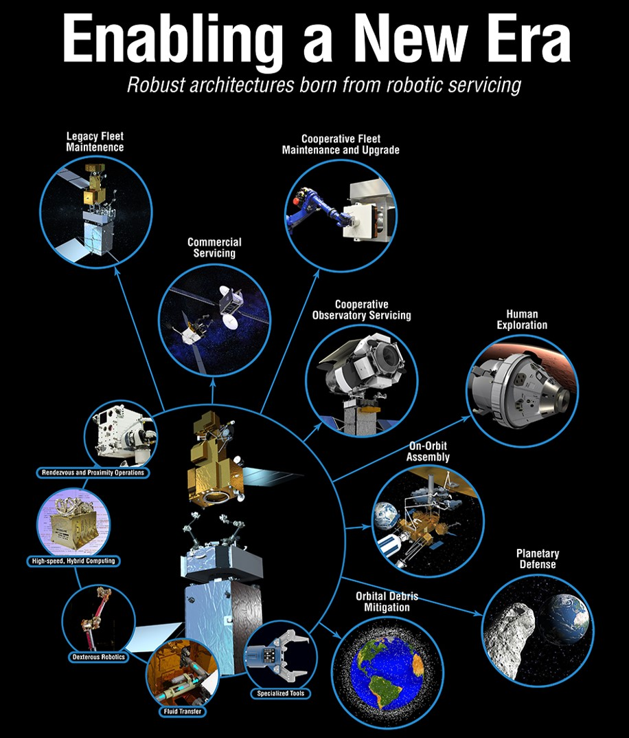

  NASA On-orbit Servicing Goals
For future space endeavors to continue to be successful and meaningful,
Architectures, Operations/Disposal Plans, and Capabilities, must include servicing.
  Agenda
  TOR Overview and Status
  Joint Initiatives
    Policy Comparison
    Lessons Learned
    Consensus Doc Overview
  JAXA Initiatives
  ESA Initiatives
  NASA Initiatives
  Summary of Achievements and Path Forward
Robotic Refueling Mission Phase 1
A NEW ERA
HST Servicing
NASA On-Orbit Satellite Servicing Study, mandated by Congress and supported by the NASA Advisory Council (NAC)
Robotic Refueling Mission Phase 2
On-orbit Servicing, Assembly, and Manufacturing 1
Capture/Retrieval Disposal of Missions and Debris
Disposal
On-orbit Assembly and Adaptive Control for Evolving Systems
Nancy J Lindsey: Mission Extension/Post Mission Disposal Task Force
Notes:
https://nexis.gsfc.nasa.gov/images/NASA_Satellite%20Servicing_Project_Report_0511.pdf --- 2010

Slide 17
  NASA On-orbit Servicing Considerations
Liability
  Agenda
  TOR Overview and Status
  Joint Initiatives
    Policy Comparison
    Lessons Learned
    Consensus Doc Overview
  JAXA Challenges
  ESA PMD Initiatives
  NASA Initiatives
  Summary of Achievements and Path Forward
Technology/Digital Transformation
Space Law
Policy & Regulation
A NEW ERA
Salvage Rights
Spacekeeping
Assurance
Disposal
National Security
Enabling design concepts
PMD/Extension Analysis Consideration Expansion
Nancy J Lindsey: Mission Extension/Post Mission Disposal Task Force
Notes:
https://www.jstor.org/stable/resrep22845.6
Now CONFERS Recommended Design and Operational Practices (Reviewed Oct 2020) is available online.

Slide 18
Reliability Task Force Path Forward
New Terms of Reference (TOR) for supporting CPO and ADR
P
Capture a Comprehensive set of
Regulations/Documents on Servicing
Review/Establish Similarity/Differences
in Regulations/Documents on
Servicing Reliability
  Agenda
  TOR Overview and Status
  Joint Initiatives
    Policy Comparison
    Lessons Learned
    Consensus Doc Overview
  ESA PMD Initiatives
  JAXA Challenges
  NASA Initiatives
  Summary of Achievements and Path Forward
JERG-2-026
IDA - On-Orbit Manufacturing and Assembly of Spacecraft
IADC-02-01(2007)
ISO/CD 24330
2020 National Space Policy (US)
ODSMP
2018 Space Policy Directive-3 (US)
Planned ECSS/ESA CPO Guidance Handbook
NASA On-Orbit Satellite Servicing Study Project Report
NASA COLA Handbook
Create an International policy table
Share Regulation/Policy and other documents
Discuss similarities and differences
  Policy
  Plans/Techniques
Provide Recommendations to Agency
and ISO Efforts for Servicing Documents
Release/Enhance PMD/Extension
common guidance and examples
P
Codify technical considerations and analysis for reliability and viability of servicing
Discuss analysis approach similarities and differences for serving for:
  Mission Operations
  Mission Disposal
Expand scope and participation (Design/Safety/Mainatainbilty/Etc.)
Acquire each agency’s release authorization
Share the Trilateral PMD/Extension Analysis Guidance Document (externally)
Provide/supplement the guidance document with examples.
Engage in example discussions to share value assessments and approaches (common learning)
Explore operational and analysis methodology advancements and update guidance as warranted and found via expanded data sharing.
Nancy J Lindsey: Mission Extension/Post Mission Disposal Task Force

Slide 19
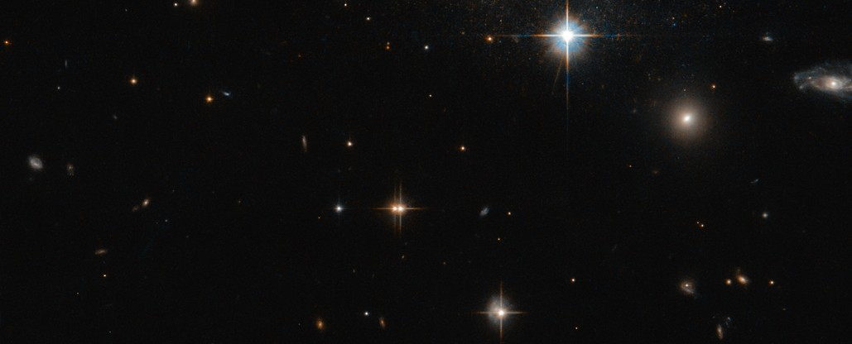
QUESTIONS?

Slide 20
BACKUP

Slide 21
Reliability Task Force Current
TOR Detailed Status
Objectives of the Task Force |  |  | Status
Id | Description | Timeline
01 | Capture a comprehensive set of regulations and documents related to space and orbit protection, controlling or limiting space debris, post mission disposal, and life/reliability estimation. | Jan-Jun. 2019 | Done - in Task Force (TF) spacekeeping policy table has been created and maintained. It covers Fragmentation Minimization, Fragmentation Debris Minimization, Post-Mission Disposal, Operational Debris Suppression, Collision Avoidance, and Servicing & Debris Removal.
02 | Establish differences between existing and in development space debris mitigation/re-entry safety requirements influencing reliability. | Jan.-Jun. 2019 | Done - Same/Slight differences found in Causality area requirements but no impact to reliability processes or assessing probability of successful de-orbit.
03 | Compare reliability estimation methods/guidance for both mission extension and post mission disposal across Agencies. | Jan.-Jun. 2019 | Done - in TF sharing sessions/ presentations (posted on ESA portal) And Consensus document being drafted
04 | Establish common outline/framework for developing space system reliability estimates in support of operational mission extension/post mission disposal analysis. | June 2019 – Nov 2020 | Done - Outline for Consensus Document is complete. And Consensus document being drafted

Slide 22
Reliability Task Force Current
TOR Detailed Status
2. Inputs for Task Force activities |  |  | Status
Id | Description | Timeline
01 | Policies, regulations, requirements, guidance, related to space and orbit protection, controlling or limiting space debris, post mission disposal, and life/reliability estimation. | Dec. 2018 | Done - Regulations have been shared and kept up-to-date in TF policy table.
02 | Results of R&D activities in the field of reliability engineering with application to mission extension/post mission disposal. | Dec. 2018 | Done - Process improvements have been shared and continue to be shared via TF meeting and ESA portal.
03 | Presentation of current and/or proposed mission extension/post mission disposal reliability estimation methods from each respective Agency | June 2019 – Dec 2019 | Done - in TF sharing sessions/ presentations (posted on ESA portal)

Slide 23
Reliability Task Force Current
TOR Detailed Status
3. Activities |  |  | Status
Id | Description | Timeline
01 | Collect inputs for task force activities. | Dec. 2018-Jan. 2019 | Done
01.1 | Set up website accounts for each Task Force member – upload documents from our respective Agencies. | April 2019 | Done - ESA SharePoint is up and running.
02 | Discuss differences between existing and in-development space debris mitigation/re-entry safety requirements/regulations influencing reliability. | Jan.-Jun. 2019 | Done – with TF discussion and presentations (posted on ESA portal)
02.1 | Provide DRAFT comparison matrix (considerations e.g. probability goal/level, absolute/conditional probability, timeframe, MMOD, software, human) - NASA | April 2019 | Done – No significant differences found and the similarities are being documented in a draft consensus document. A matrix of regulations is being maintained to highlight consideration variations.
02.2 | Provide NASA’s perspective on FCC guidance material. | Apr. 2019 | Done – FCC regulation are in The TF regulation matrix . (FCC refers to ODMSP)
02.3 | Provide view on ISO 24113 update and its impact on reliability. This activity is linked to 03.2. | Apr. 2019 | Done – Updated in TF policy Table. TF; It will be re-verified as current before releasing table in consensus document.

Slide 24
Reliability Task Force Current
TOR Detailed Status
 |  |  | Status
Id | Description | Timeline
03 | Share reliability estimation methods/guidance for both mission extension and post mission disposal across Agencies. | Jan.-Jun. 2019 | Done – via presentations and discussion in Trilateral TF
03.1 | Provide 15min overviews from each Agency on reliability estimation methods supporting mission extension and post mission disposal. | Apr. 2019 | Done – with TF discussion and presentations (posted on ESA portal)
03.2 | Review JAXA’s technical note, KPEO-T-1825K, on JAXA’s position with regards to the ISO 24113 update prior to next meeting. | Apr. 2019 | Done – reflected in JAXA process descriptions (JERG-0-002)
04 | Common TriLateral Mission Extension/Post Mission Disposal Methodology Framework | Nov 2019 – Nov 2020 | Done – with plan to develop consensus Document and associated outline.
04.1 | Common Reliability Estimation Framework Outline – agreed to by ESA, JAXA, and NASA | Jan 2020 | Done – with consensus Doc outline
04.2 | Common Reliability Estimation Framework Draft Document – agreed to by ESA, JAXA, and NASA | May 2020 – May 2021 | Done – draft document (multiple versions) have been drafted and shared. Current goal is to have a shareable final version at TRILATERAL.
04.3 | Common Reliability Estimation Framework Final Document Proposal – agreed to by ESA, JAXA, and NASA | June 2021 - Sept 2021 | Acquire each agency’s approval of Trilateral consensus document. Share Trilateral/agency approved consensus document publically.

