Slide 1







CFD Vision 2030:
Progress and Perspectives
Andrew Cary Bil Kleb
the Boeing Company NASA Langley Research Center
John Chawner Ray Kolonay
Cadence Design Systems, Inc. Air Force Research Laboratory
Earl Duque Eric Nielsen,
Intelligent Light NASA Langley Research Center
William Gropp Brian Smith
University of Illinois Lockheed Martin Aeronautics Company

Slide 2
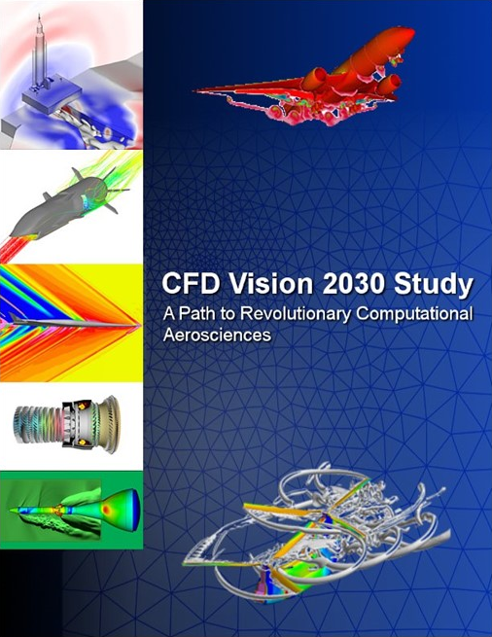
CFD Vision 2030 Study
Boeing-led NASA Contract concluding in 2014 outlining desired state of CFD in 2030 for aerospace
  Jeff Slotnick, Abdi Khodadoust (Boeing Research & Technology)
  Juan Alonso (Stanford), Dimitri Mavriplis (Wyoming), David Darmofal (MIT), William Gropp (Illinois/NCSA)
  Elizabeth Lurie (Pratt and Whitney)
Outcomes
  Developed key CFD recommendations for NASA
  Outlined Grand Challenge problems to assess and promote capability
  Defined Roadmap for technology development
Study has become a cornerstone of NASA CFD and a benchmark for others

Slide 3
AIAA Vision 2030 Integration Committee
Integration committee formed in 2017 to support reaching the Vision
Numerous activities
  2019 Aviation Five-year perspective special session
  Sponsored multiple Forum 360 events
  2021 SciTech Grand Challenge session
  Revisiting the Roadmap
    How much progress has been made?
    How should it be refreshed to reflect present status?
Roadmap subcommittee developed report and Roadmap update
  Consulted with subject matter experts
  Reviewed key publications across aerospace
  Developed TRL interpretation for standard assessment of milestones
  Probably have unintended omissions at this time – ongoing effort

Slide 4
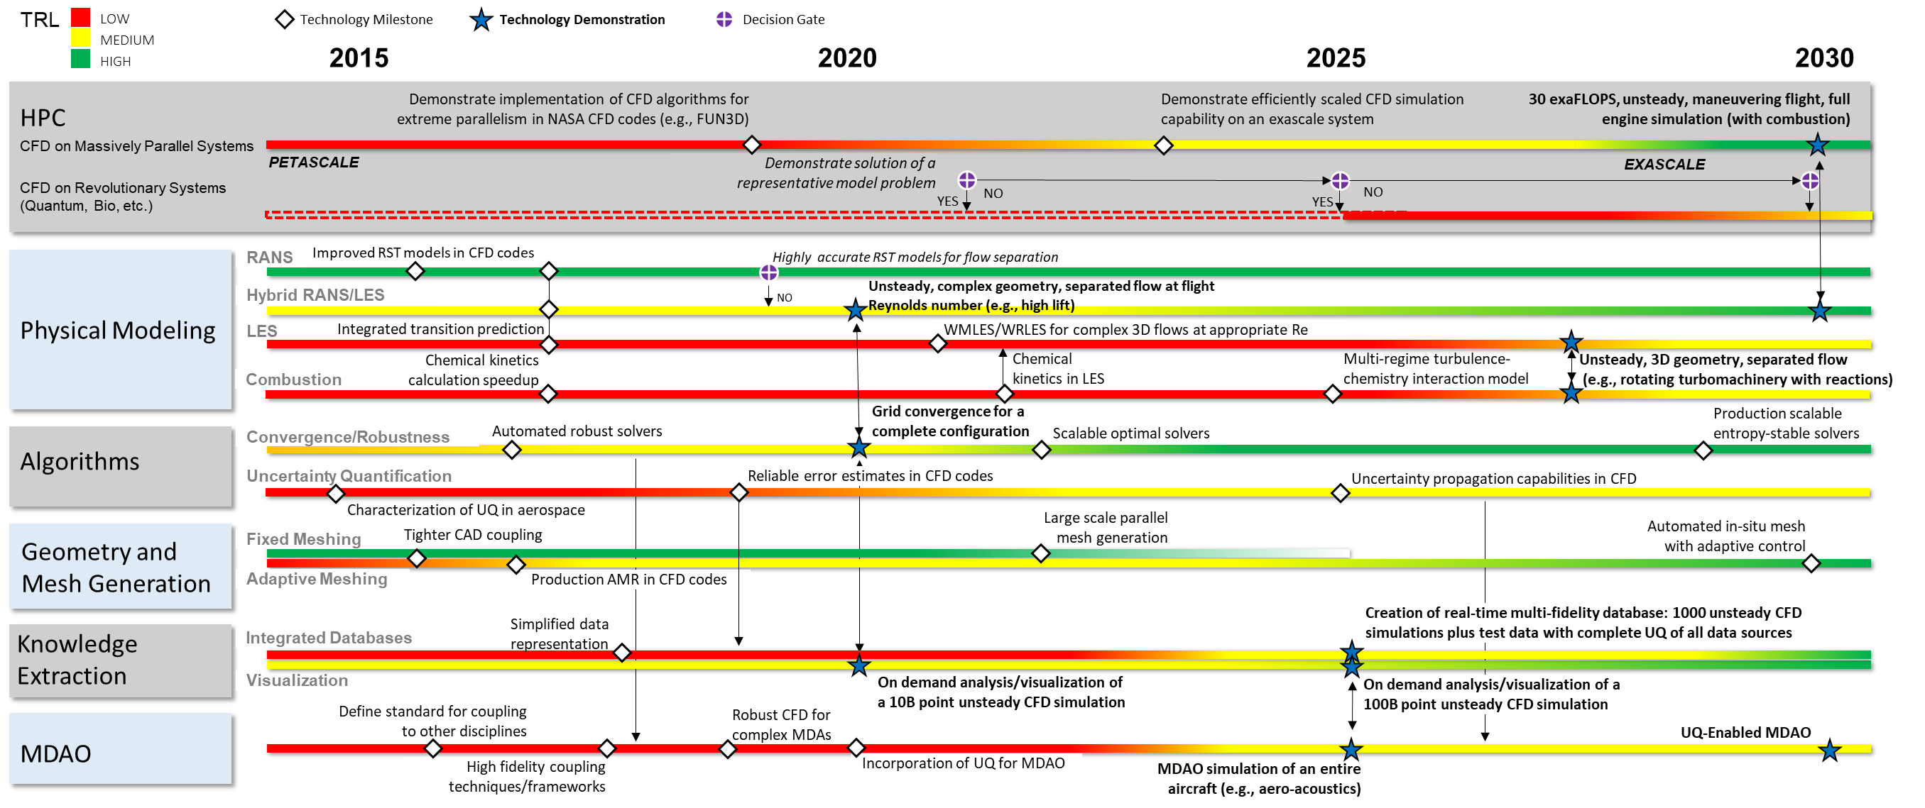
Overall Roadmap (original)
Notes:
Overall structure/Domains
Comment on 2020 Technology demonstrations
HLPW3 and HLPW4
Grid convergence for M6
SC2019 Mars lander

Slide 5
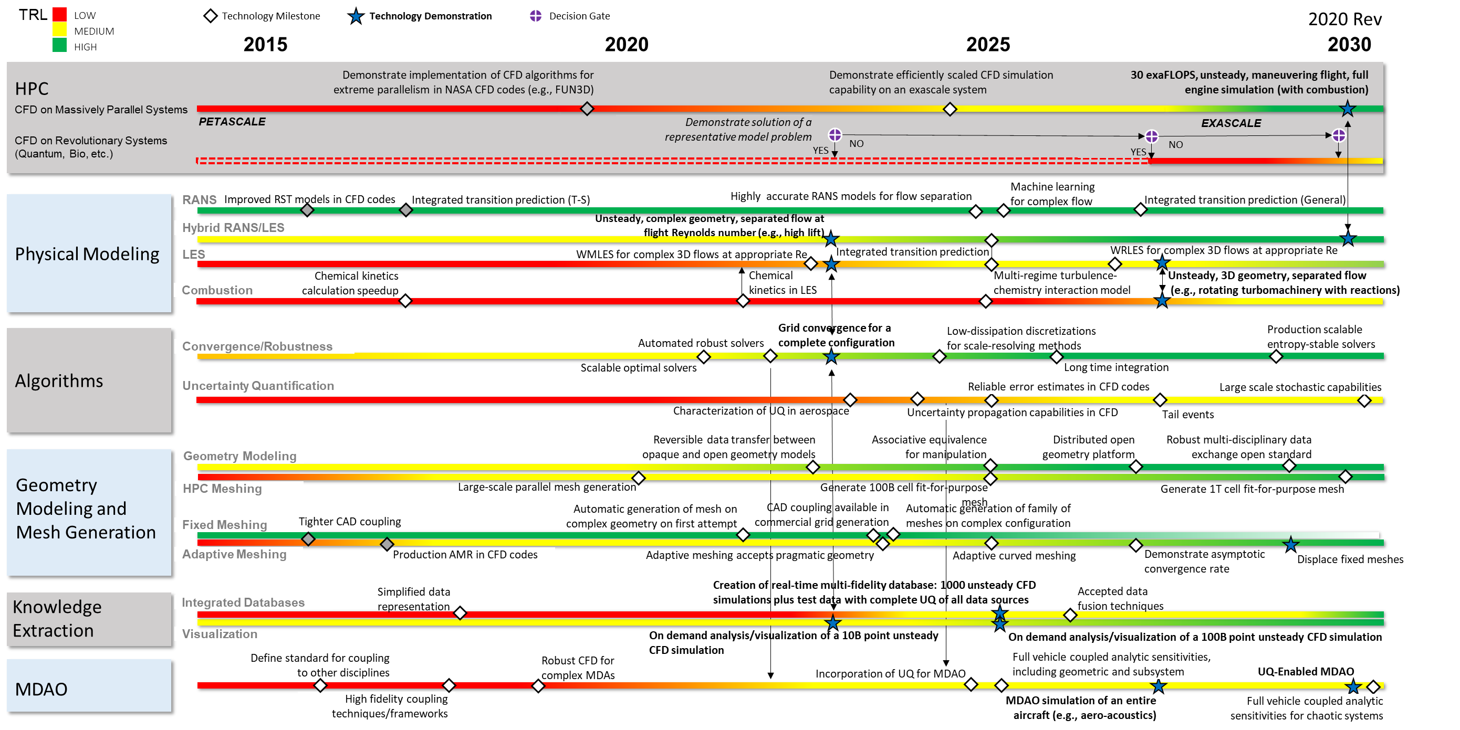
Overall Roadmap (revised)
Notes:
Key modifications:
Delayed numerous milestones
Enhanced Geometry modeling
Added machine learning
…
In 2020
H-O curved meshing. See 1st para of section, Mesh Generation under Recent Developments
Adaptive Meshing. See 4th para of same section.
Bespoke geometry modeling systems. See 2nd para of subsection Geometry Modeling.
In Last 5-Years
Challenges posed by B-Rep NURBS geometry models. 3rd para in Geometry Modeling.
Experimentation with alternative geometry representations (spatial occupancy, Sub-D surfaces, facets). Referenced throughout geometry modeling subsection.
Adaptation – Well on the path to ubiquity.
High-Order Mesh Curving – Meshing may actually be more mature than the H-O flow solvers.
Items that have changed since 2014 to include in the presentation – as far as HPC, I would include
AI/ML. Another one that often comes to mind (for me at least, not sure how Bill G or others feel) is the
eternal quest for true, single-source performance portability. I think this is a long ways off at this point (we
can’t even get compilers within a given architecture to replicate human efficiencies) and is a Holy Grail
in some sense – perhaps even outright unachievable.

Slide 6
Summary
Overall, industry is making progress toward CFD Vision 2030, but not as fast as desired
Most milestones are being slipped, but we are also getting more clarity on what is required
Additional information will be published on www.cfd2030.com/report
  Literature review document (last five years)
  Updated Roadmap
  Annual updates
  How you can contribute

