Slide 1
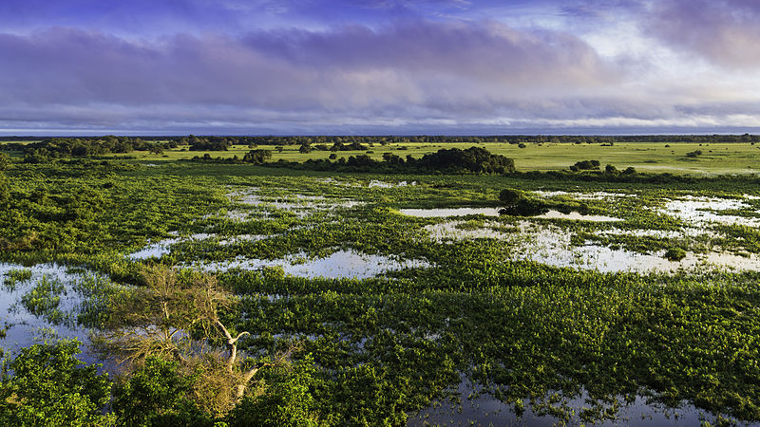

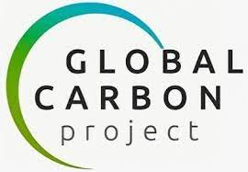
Defining wetlands and their role in the methane budget
Ben Poulter (NASA GSFC), Pep Canadell (CSIRO), Rob Jackson (Stanford), Prabir Patra (JAMSTEC), Judith Rosentreter (Yale Univ), Marielle Saunois (LSCE), Ann Stavert (CSIRO), Zhen Zhang (UMD)
Image credit: Filipefrazao

Slide 2
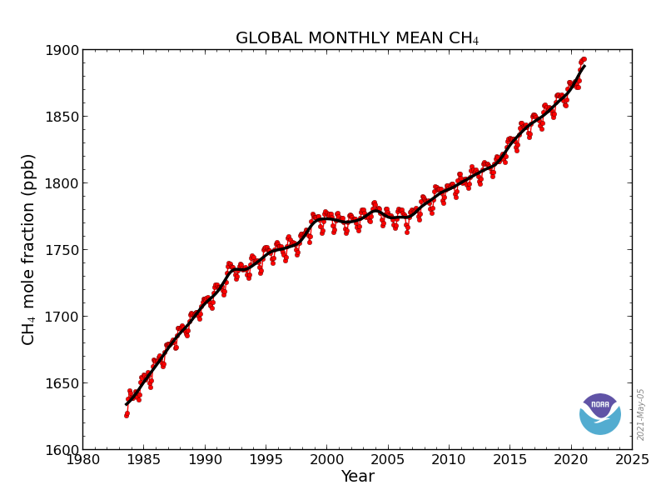
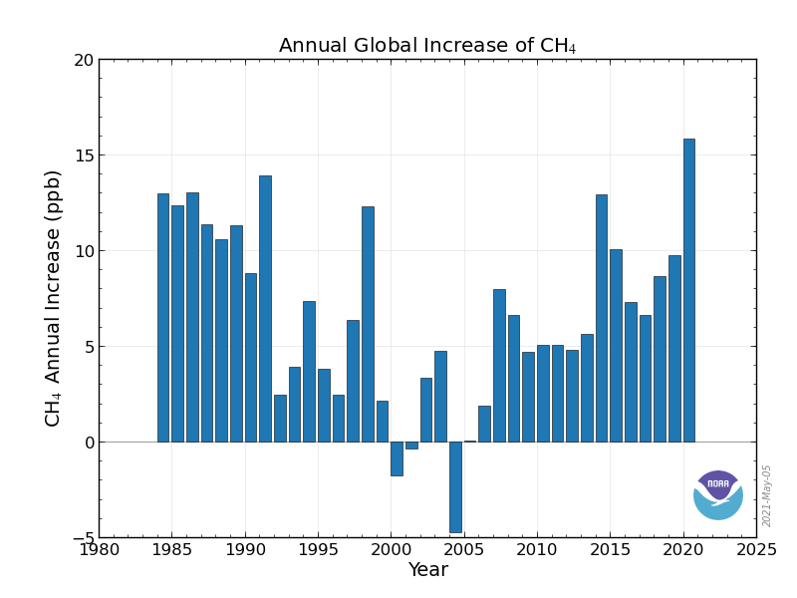
Atmospheric methane (CH₄) concentrations have more than doubled since the industrial revolution
Methane is a greenhouse gas 82x (GWP-20) more potent than CO2 (29x, GWP-100)
The short lifetime, 11.8 years, provides several opportunities for mitigation
1970s: 1200-1300 ppb (Ehhalt 1974)
2020: 1879 ppb
2020 growth: 15.85 ppb increase

Slide 3

Global Atmospheric Methane from Jan 1, 2018 through Nov 30, 2018, https://www.youtube.com/watch?v=FWOhcSVW3p0

Slide 4
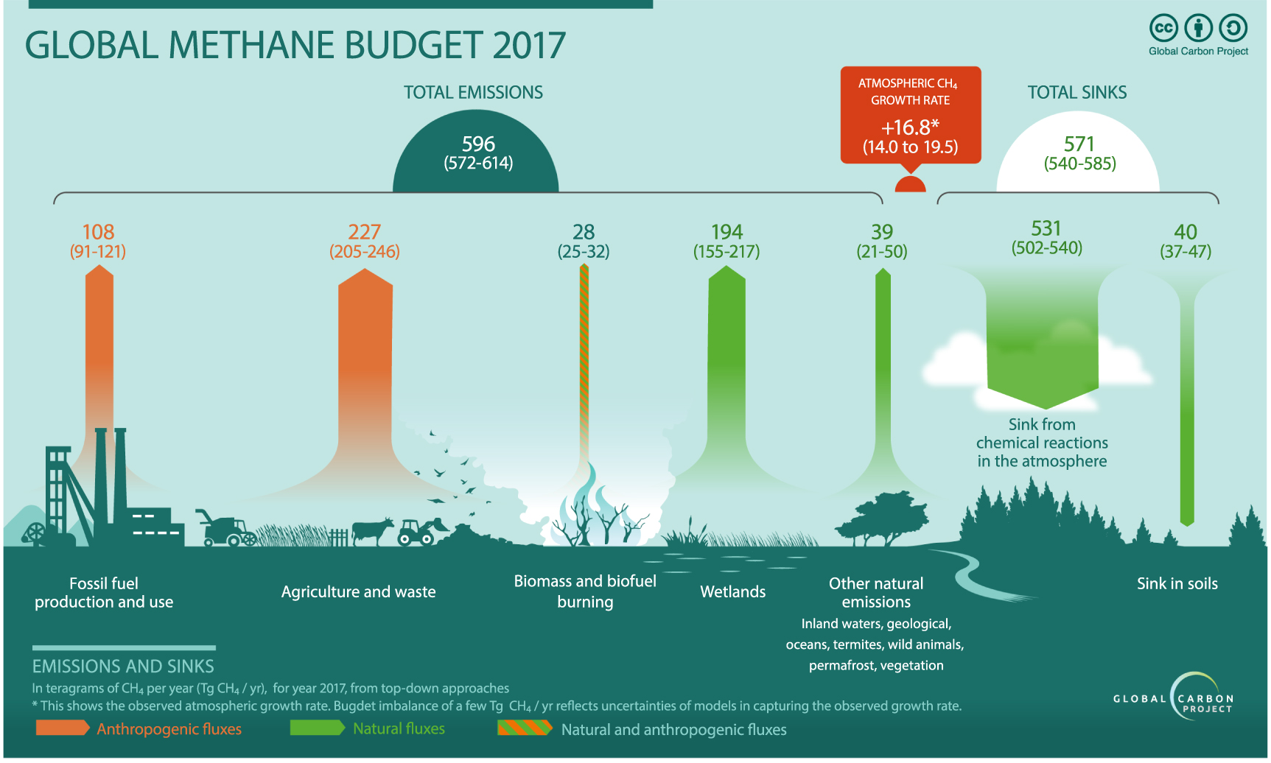
Jackson et al., 2020

Slide 5
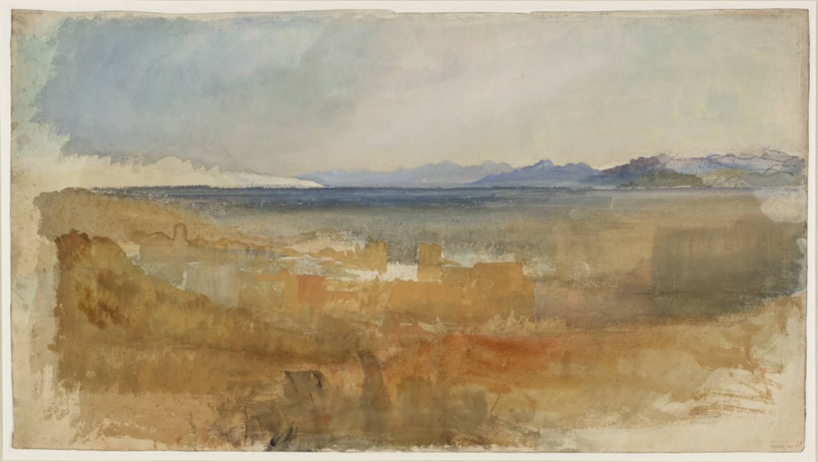
Main points of presentation:
Wetlands are a significant source of methane to the atmosphere
Remote sensing is improving understanding of tropical wetland CH₄ budget
Advances needed to partitioning indirect climate vs. direct human drivers
CO₂ + 4 H₂ → CH₄ + 2 H₂O
Image Credit: Joseph Mallord William Turner, Tate Museum

Slide 6
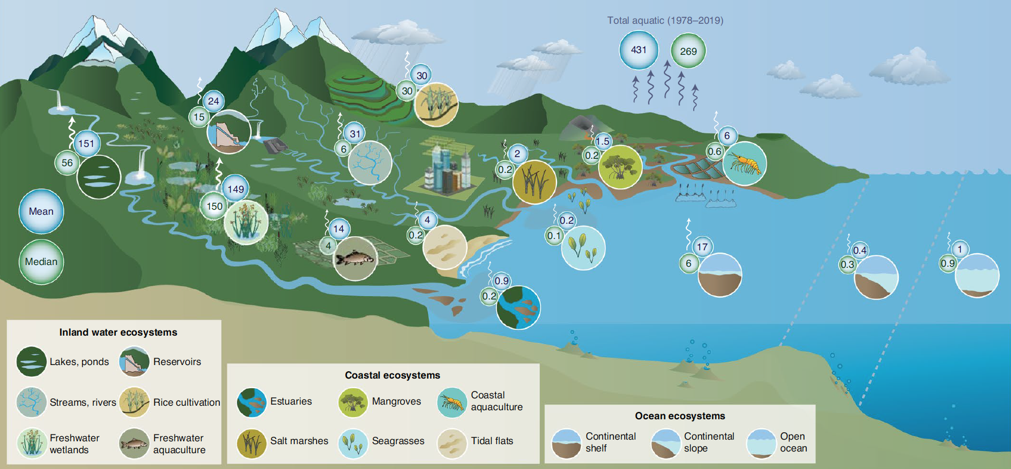
1) Natural and anthropogenic wetlands are an important source of methane to the atmosphere
Rosentreter et al., 2021

Slide 7
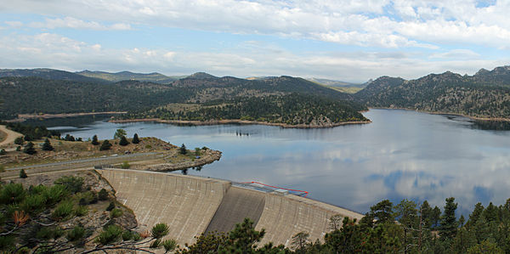
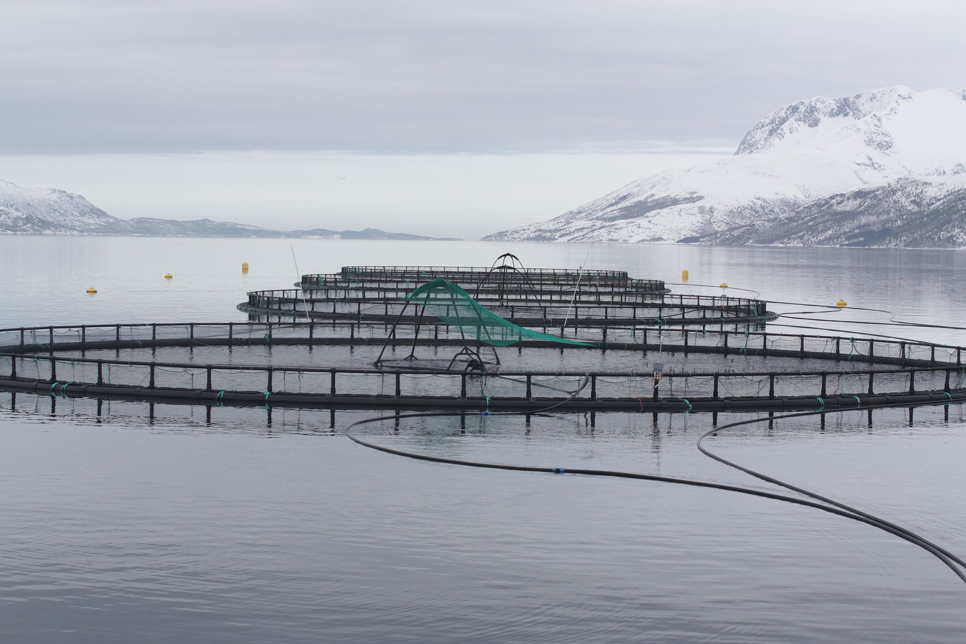
1) Natural and anthropogenic wetlands are an important source of methane to the atmosphere
Image Credit: Jeffrey Beall
Image Credit: Thomas Bjørkan
Rosentreter et al., 2021

Slide 8
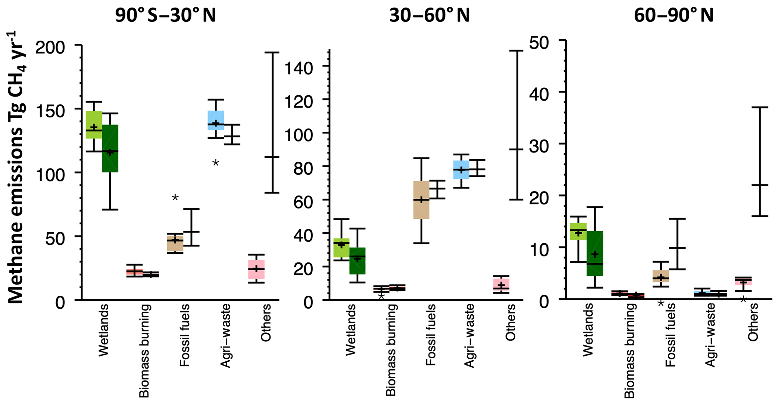
1) Natural and anthropogenic wetlands are an important source of methane to the atmosphere
Agriculture and waste (light blue) are largest source of CH₄ emissions in tropics
Tropical wetlands contribute to about 70% of global wetland CH₄ emissions
Saunois et al., 2020

Slide 9
2) Satellite and airborne remote sensing is improving tropical wetland CH₄ budget
Using hybrid approach (Wetland Area Dynamics for Methane Modeling, WAD2M), we estimate global vegetated wetland cover ~13 Mkm², and tropical wetlands ~5.5 Mkm²
Permanent streams, rivers, ponds, and lakes account for +4.5 Mkm² (1.4 Mkm² in tropics)
Zhang et al., 2021

Slide 10
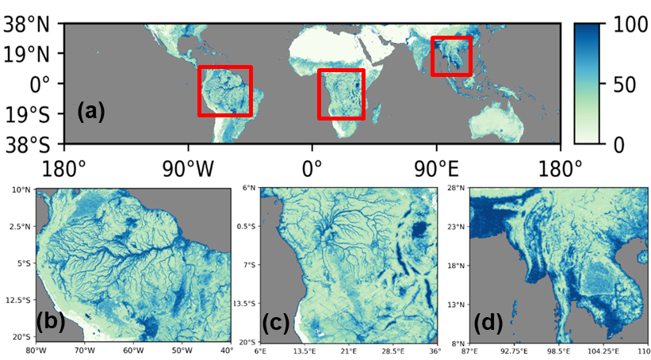
2) Satellite and airborne remote sensing is improving tropical wetland CH₄ budget
Advances in microwave remote sensing (next talk) and new missions will provide higher-spatial resolution, temporal revisit, and surface retrievals
  e.g., NASA CYGNSS and SWOT missions, the NASA-ISRO NISAR mission
Surface water area fraction from CYGNSS (%)
Jensen et al., 2020

Slide 11
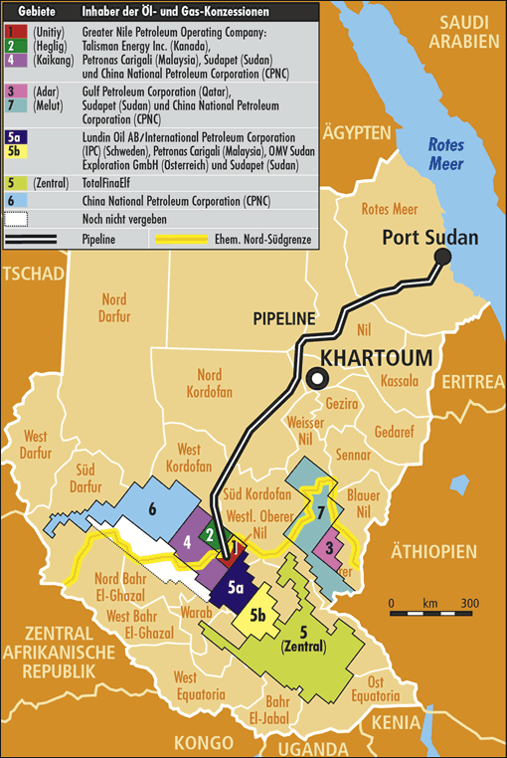
2) Satellite and airborne remote sensing is improving tropical wetland CH₄ budget
Greenhouse-gas satellites (i.e., TROPOMI) can detect CH₄ enhancements to estimate wetland methane fluxes
Challenges remain in partitioning fluxes to natural and anthropogenic sources
Pandey et al., 2021

Slide 12
3) Advances needed to partitioning indirect climate vs. direct human drivers
Isotopes constrain role of wetlands in renewed growth of atmospheric CH₄ concentrations
Post-2007 growth would require sustained +10 to 30 Tg yr⁻¹ increase in wetland emissions
Ignoring ENSO effect on IAV, this would require unrealistic Q10 of 10-50; Fluxnet-CH₄ is 2.57
Zhang et al., in rev

Slide 13
3) Advances needed to partitioning indirect climate vs. direct human drivers
GOSAT detecting increases in methane emissions over Brazil + Amazonia
  +5.8 Tg CH₄ yr⁻¹ increase from 2010-2013 vs 2014-2017 (Wilson et al., 2020)
  +6.0 Tg CH₄ yr⁻¹ from 2011-2013 vs 2014-2018 (Tunnicliffe et al., 2020)
‘Natural’ as a proxy for biogenic, includes wetlands, agriculture, and fire
Indirect evidence used in attribution, i.e., temperature trends, seasonal timing of increase
Wilson et al., 2020

Slide 14
3) Advances needed to partitioning indirect climate vs. direct human drivers
Euan Nisbet:
  ‘livestock are mobile wetlands’
Chang et al. (2019) Tier 2 estimate of enteric fermentation and revised isotopic signature for ruminants support large increases in tropical agriculture emissions
In-situ and aircraft campaigns over tropical wetland and agriculture areas can improve partitioning of emissions
Chang et al., 2019

Slide 15
Wetlands and their role in the methane budget
Reducing anthropogenic methane emissions is integral to attaining goals of Paris Agreement
An improved understanding of wetland methane emissions will contribute to more effective methane emission reduction and monitoring from oil and gas activities and from agriculture
Advancing our understanding of wetlands methane emissions includes:
  Enhancing capabilities to partition ‘natural’ or ‘biogenic’ fluxes
  Improving observations and their spatial resolution and temporal revisit
  Integrating in-situ, aircraft, and spaceborne observations with modeling capabilities (inversions, process-models, data-drive models)
    in-situ -> methane production, transport (trees!), and consumption pathways; isotopic source signatures; supporting flux tower networks
    aircraft -> vertical profiles, isotopes, improved geographic and temporal representation
  Monitoring wetland destruction via fire, drainage, and wetland creation via aquaculture, reservoirs
Image credit: Filipefrazao

Slide 16
Attribution Slide
Slide 1, Filipefrazao, File:Pantanal, Mato Grosso, Brasil.jpg, 2014. This file is licensed under the Creative Commons Attribution-Share Alike 3.0 Unported license, https://commons.wikimedia.org/wiki/File:Pantanal,_Mato_Grosso,_Brasil.jpg.
Slide 5, Joseph Mallord William Turner, Lago Maggiore, 1828. Image released under Creative Commons CC-BY-NC-ND (3.0 Unported) https://www.tate.org.uk/art/artworks/turner-lago-maggiore-d25155,
Slide 7 - Jeffrey Beall, File:Gross Reservoir.JPG, 2014. This file is licensed under the Creative Commons Attribution 3.0 Unported license, https://commons.wikimedia.org/wiki/File:Gross_Reservoir.JPG.
Slide 7 - Thomas Bjørkan, File: Fish_cages.jpg, 2010. This file is licensed under the Creative Commons Attribution 3.0 Unported license, https://en.wikipedia.org/wiki/Offshore_aquaculture#/media/File:Fish_cages.jpg.
Slide 15: File:Pantanal, Mato Grosso, Brasil.jpg, 201. This file is licensed under the Creative Commons Attribution-Share Alike 3.0 Unported license, https://commons.wikimedia.org/wiki/File:Pantanal,_Mato_Grosso,_Brasil.jpg.

