Slide 1
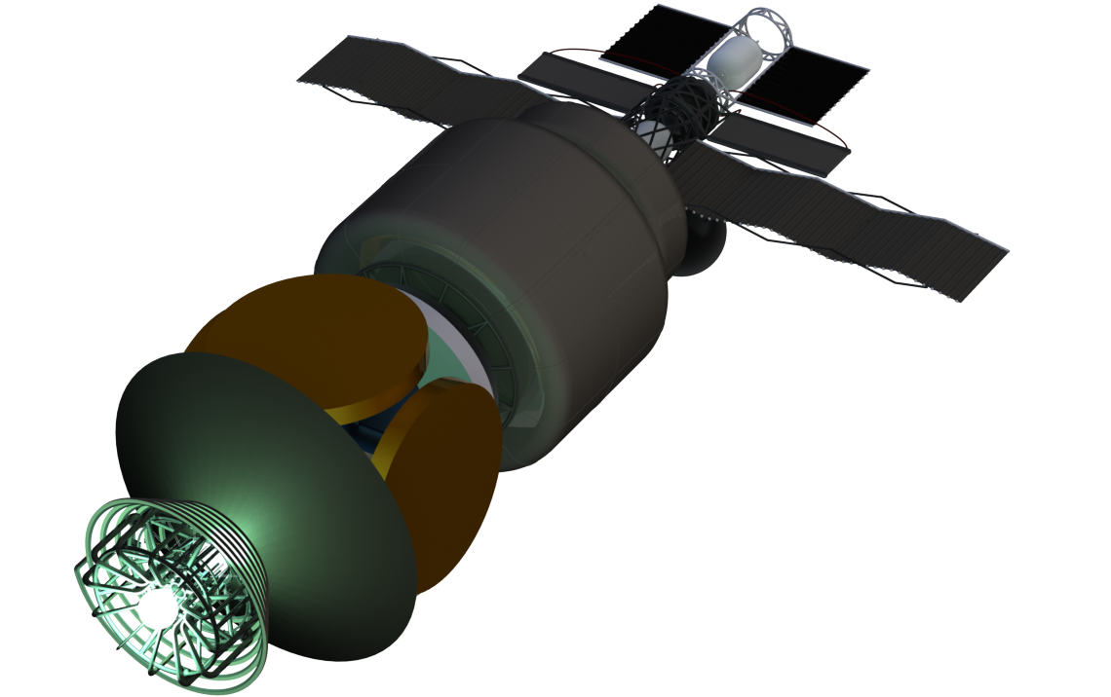
LRF Magnetic Nozzle Status – Halbach Array Development
[1]
Nathan Schilling

Slide 2
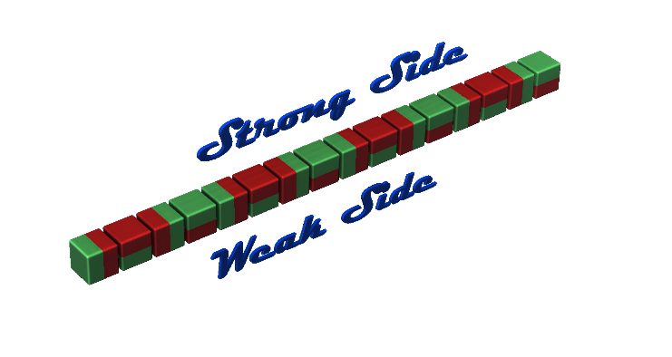
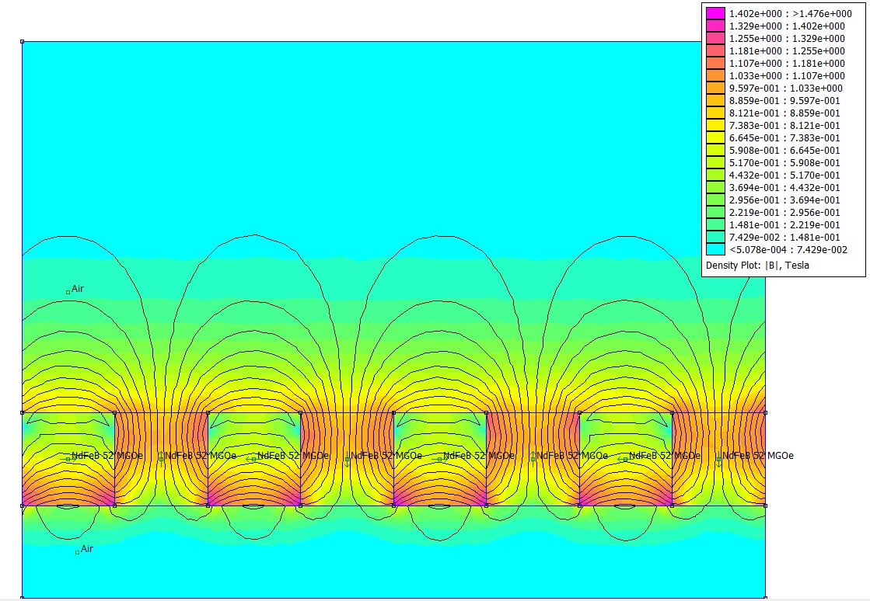
What is a Halbach Array?
Arrangement of permanent magnets that results in a high –strength magnetic field on one side and a lower magnetic field strength on the other [4]
Useful for maximizing field strength inside the nozzle, and reducing interaction with the interstellar medium
Want to extend Halbach array from permanent magnets to wires
[2]
[3]

Slide 3
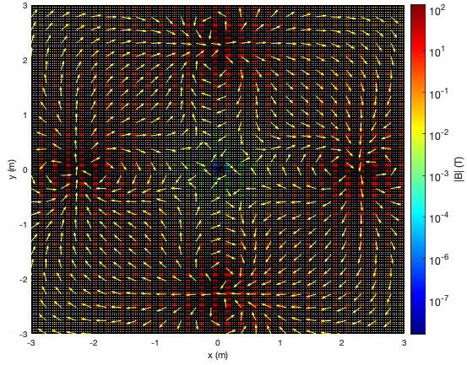
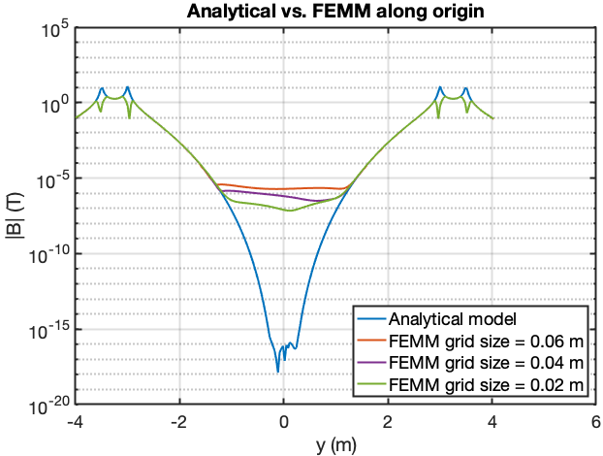
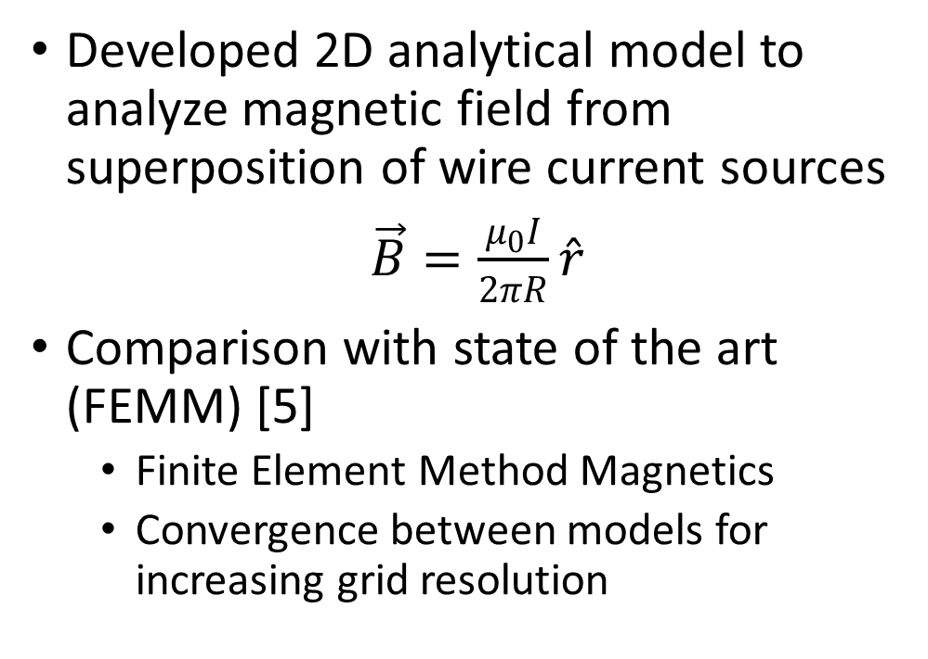
Methodology
Developed 2D analytical model to analyze magnetic field from superposition of wire current sources
$\vec{B}=\frac{μ_{0}I}{2πR}\hat{r}$
Comparison with state of the art (FEMM) [5]
  Finite Element Method Magnetics
  Convergence between models for increasing grid resolution
Field from 8 wires (4 dipoles), each with 1 MA

Slide 4
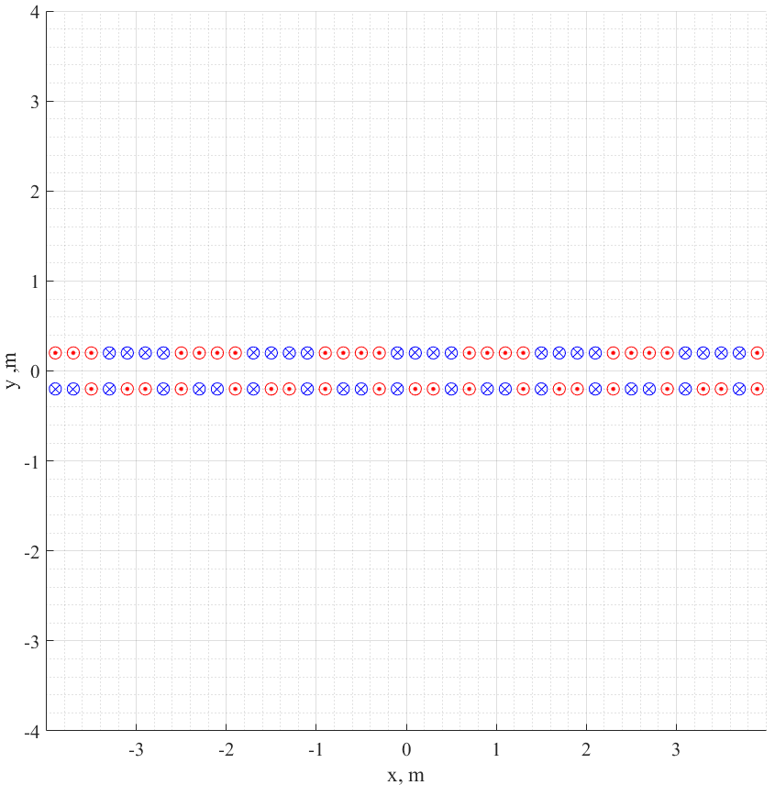
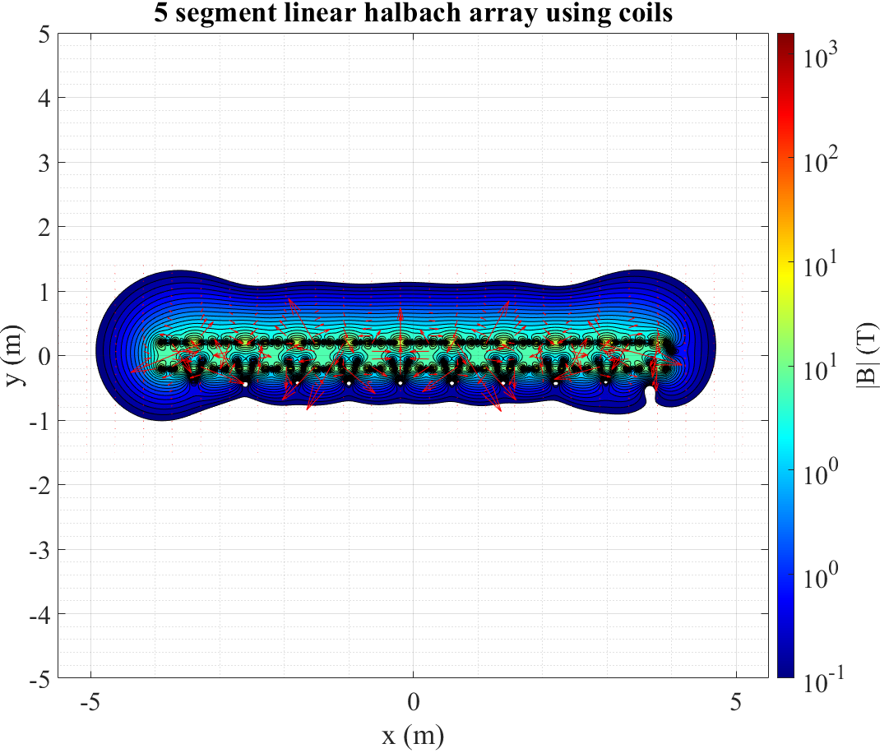
Methodology - Five segment array
Red box is one segment
Each wire carries 1 MA
Reproduces Halbach effect

Slide 5
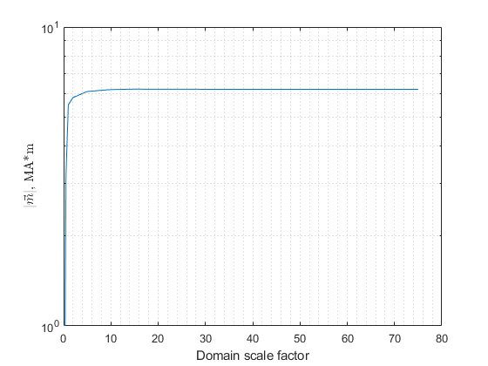
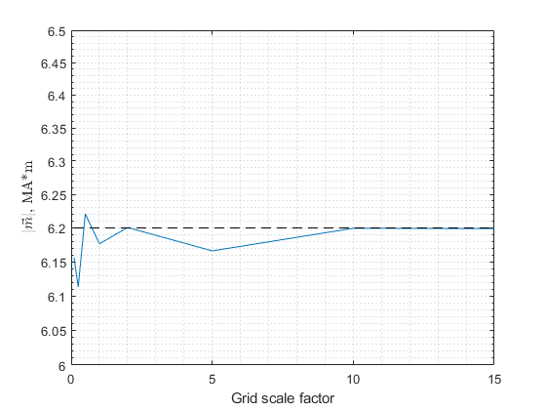
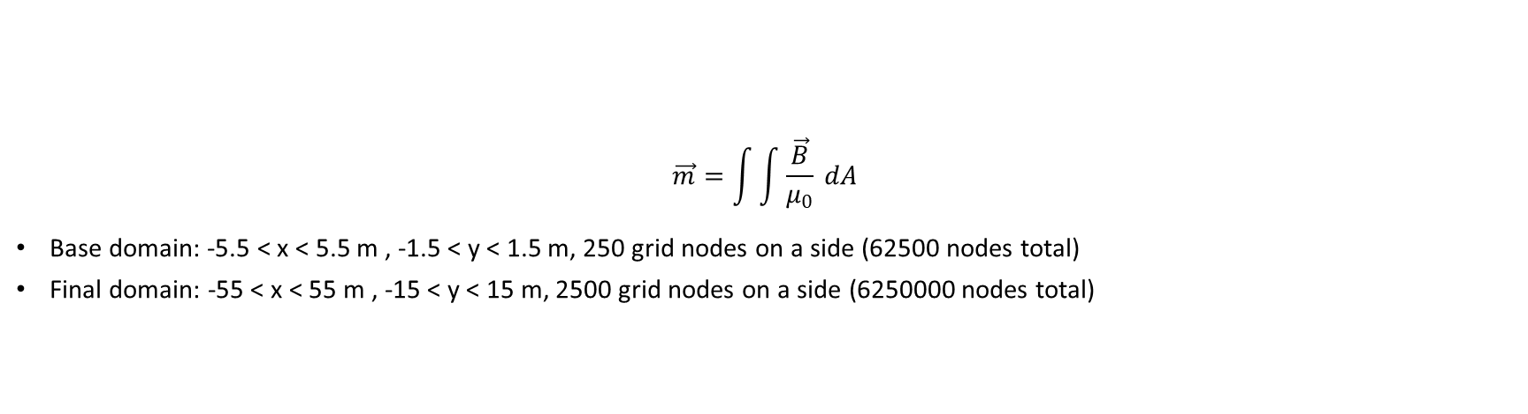
Methodology – FOM and sensitivity analysis
$$\vec{m}=\int{\int{\frac{\vec{B}}{μ_{0}} dA}}$$
Base domain: -5.5 < x < 5.5 m , -1.5 < y < 1.5 m, 250 grid nodes on a side (62500 nodes total)
Final domain: -55 < x < 55 m , -15 < y < 15 m, 2500 grid nodes on a side (6250000 nodes total)

Slide 6
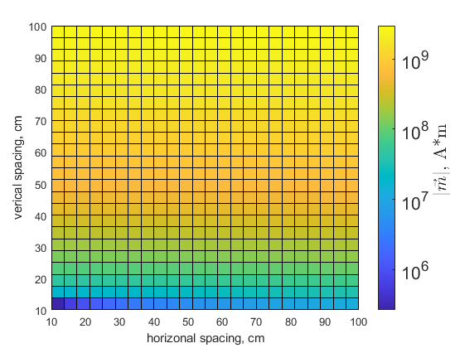
Results
Prioritize separating wires
Need to change how figure of merit is calculated
  Integrate over area just under/over the center segment
  Change to 3 segment array
  Visualize field in addition to FOM calculation

Slide 7
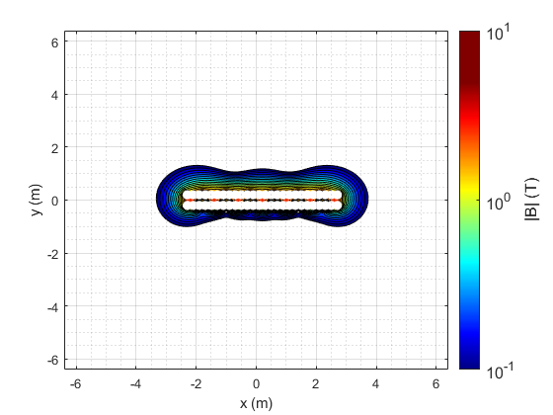
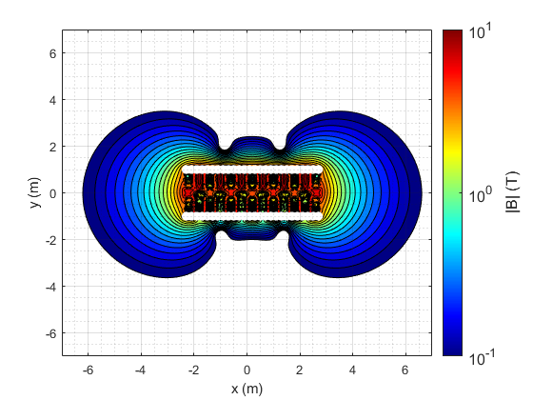
Results
Increased FOM doesn’t seem to result in better design

Slide 8
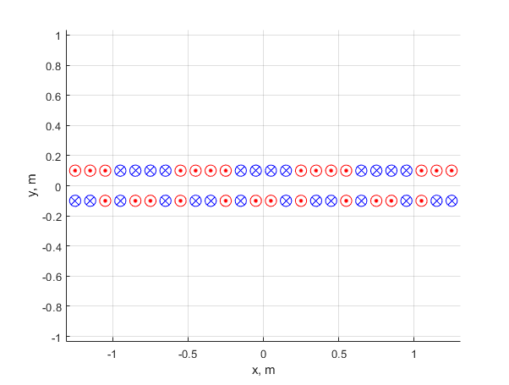
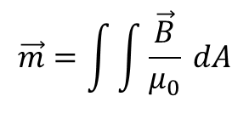
Results
$$\vec{m}=\int{\int{\frac{\vec{B}}{μ_{0}} dA}}$$
Need to change how figure of merit is calculated
  Integrate over area just under/over the center segment
  Change to 3 segment array
  Visualize field in addition to FOM calculation

Slide 9
References
Image credit Augustin Demonceaux
Gearloose21, “Orientation of strong and weak side in a linear Halbach array (Strong side up),” 2016. URL: https://en.wikipedia.org/wiki/Halbach_array#/media/File:Linear_Halbach_Array_(Strong_side_up).png Retrieved 06/04/21
Teapat, “Field lines around a Halbach array,” Wikimedia Commons, 2011. URL: https://commons.wikimedia.org/wiki/File:Halbach_array_field.jpg Retrieved 06/04/21
Halbach, K., "Design of permanent multipole magnets with oriented rare earth cobalt material,“ Nuclear Instruments and Methods, 1980, Vol. 169, No. 1, pp. 1–10. doi:10.1016/0029-554X(80)90094-4
Baltzis, K., “The finite element method magnetics (FEMM) freeware package: May it serve as an educational tool in teaching electromagnetics?,” Education and Information Technologies, 2001, pp. 19-36.

Slide 10
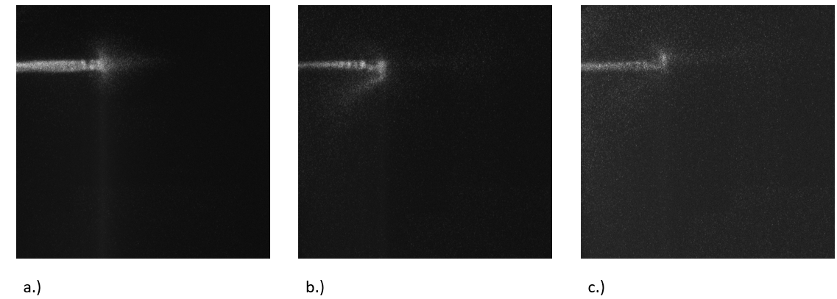
ICCD Imaging of Deflection
a.) No Magnet
b.) Field directed into page
c.) Field directed out of page
Operating Conditions
V_{applied} = 5 kV
1 μs pulse width,
p = 400 mTorr
B ~ 200 G (Neodymium Permanent Magnet)
Plasma Parameters
n_{e} ~ 1e15 cm⁻³
T_{e} ~ 2-5 eV

Slide 11
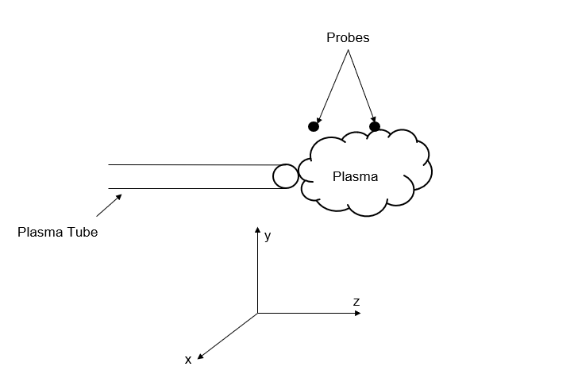
Probe Mapping of Ion Current
Maps of the current density were created by mounting a probe on a motion controller and translating it in the x and y direction while taking measurements.
The probe is biased to a negative voltage (-50 V) to measure ion current.
25 mm x 25 mm and 25 mm x 38 mm, 300-point grids were used to get high spatial resolution
x
z

Slide 12
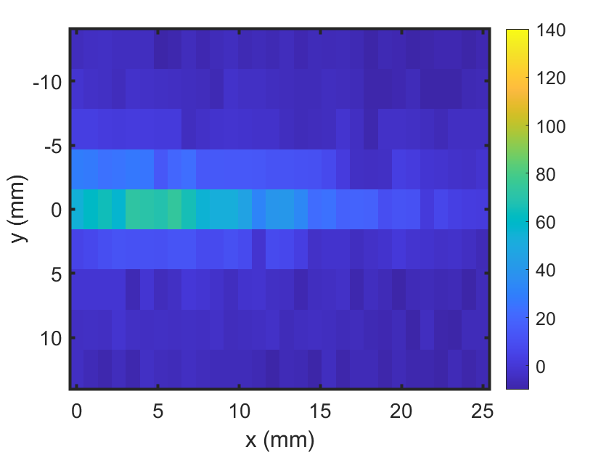
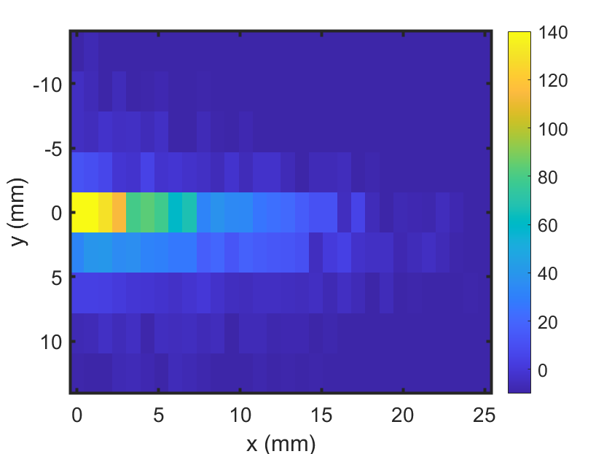
Single Probe Mapping of Current Density
Ion Current (A) *10⁻⁶
a.) No magnet
b.) Permanent Magnet with diverging field on axis (~200 G)

Slide 13
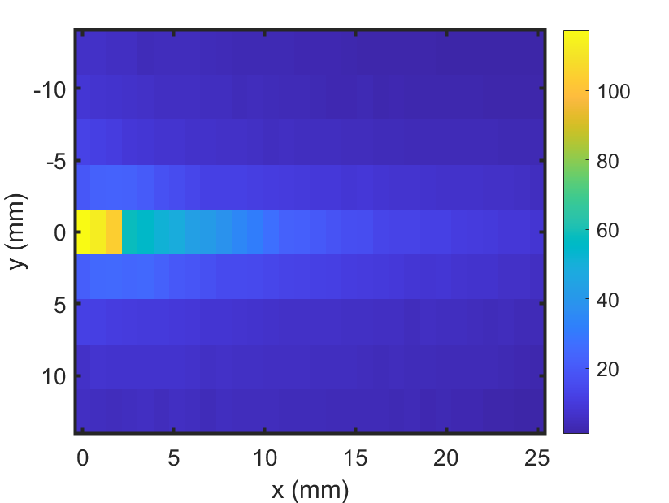
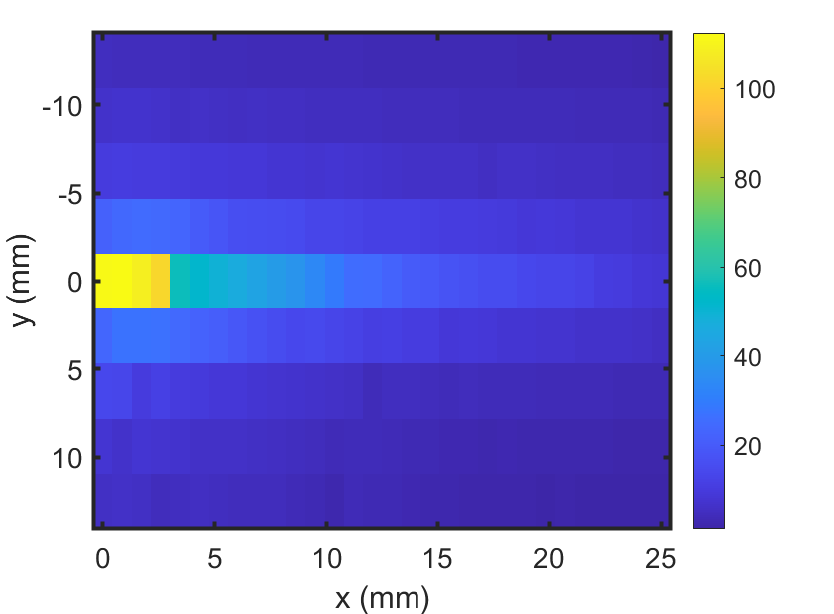
Single Probe Mapping with Perpendicular Field
Ion Current (A) *10⁻⁶
a.) No Magnet
b.) Magnet Perpendicular Field (+z) (~300 G)
b.) Magnet Perpendicular Field (-z) (~ 300 G)

Slide 14
Thoughts on Maps
When the plasma jet is expanding into a diverging magnetic field parallel to the axis of motion, we see that the plasma is confined more than when expanding into a diverging field perpendicular to the axis of motion .

