Slide 1
Interpretation of Vehicle Tumbling Predictions From 6-DOF Entry and Descent Simulation
Jacob Needels, Neerim Corporation, jacob.t.needels@nasa.gov
Peter Gage, Neerim Corporation
Jeffrey Hill, NASA Ames Research Center
June 2021

Slide 2
Overview
Motivation
Background
6-DOF Simulation Results
Physical Cause of Tumbling
Jaffe Stability Criterion
  Parametric Dependence
  Application to Sensitivity Analysis
  Implications for Design
Conclusions

Slide 3
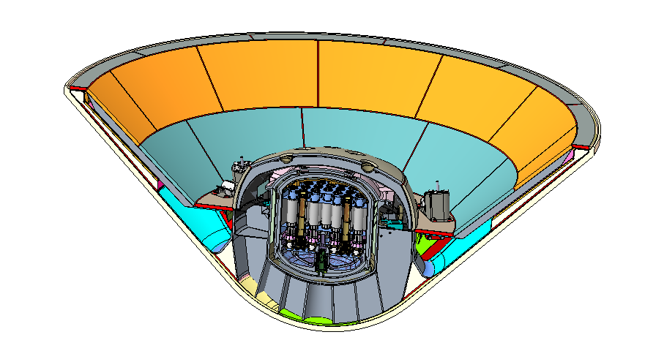
Motivation
Blunt body entry vehicles are subject to angle of attack oscillations which can diverge into tumbling under certain conditions during terminal descent.¹
Mars Sample Return Earth Entry Vehicle (MSR EEV) is baselining a fully passive entry vehicle (no drogue), therefore tumbling is a primary concern for containment assurance.
6-DOF numerical simulations indicate an unacceptable degree of tumbling for a 60 deg sphere cone geometry, driving the program to steeper cone angles.
The cone angle risk trade motivated a root cause analysis of tumbling observed in simulation.
1. Schoenenberger, M. and Queen, E., “Limit Cycle Analysis Applied to the Oscillations of Decelerating Blunt-Body Entry Vehicles”, NATO RTO Symposium AVT-152 on Limit-Cycle Oscillations and Other Amplitude-Limited, Self-Excited Vibrations, 2008.

Slide 4
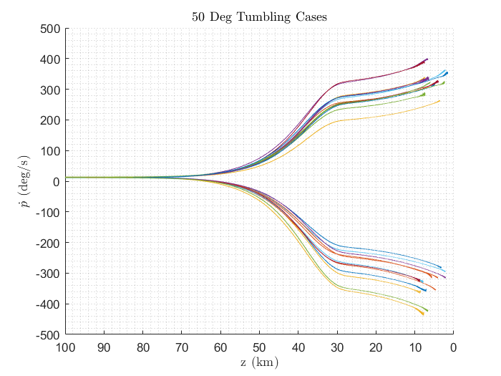

6-DOF Simulation Results
Dispersed entry trajectories were simulated using POST2 software by B. Tackett, LaRC.
High dimensional parameter space (~40 dispersed inputs).²
No single input parameter drives tumbling.
However, all tumbling cases exhibit high roll rates.
  What is the physical cause of rollup?
$${C_{N}}_{Disp}=[C_{N}\left(α,β\right)+U_{C_{N}}^{A}](1+U_{C_{N}}^{M})$$
50 Deg
Dispersed Inputs
60 Deg
Trial
Table from an internal sensitivity study, B. Tackett.
Red shading indicates parameter near bounds of uncertainty range.
Mach > 4
2. Schoenenberger, M., Dyakonov, A., and Van Norman, J., “Mars Science Laboratory Aerodynamic Database”, Release 1.0, 2012.

Slide 5
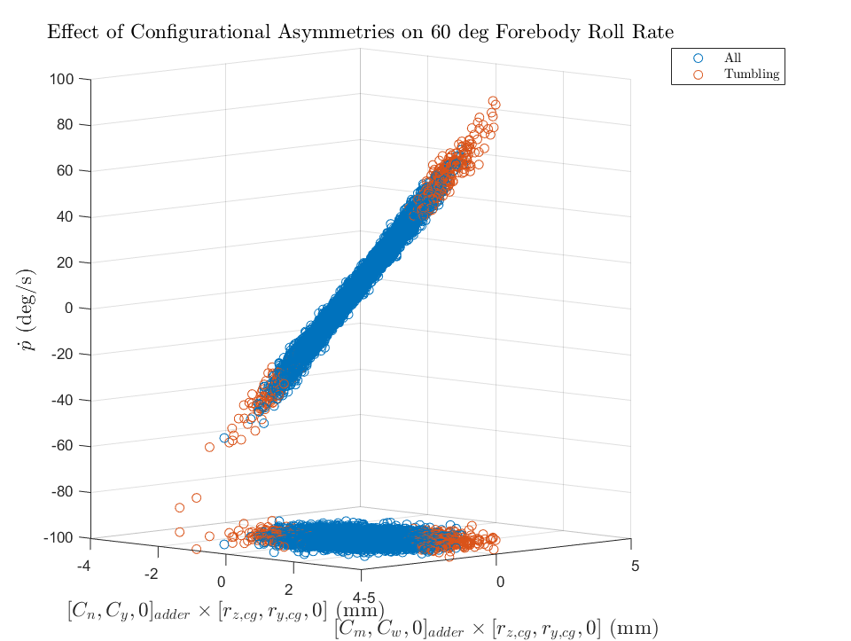
Physical Cause of Tumbling
Configurational asymmetries are known to cause roll anomalies in military RVs.^{3,4}
Hypersonic interaction of mass and aero assumed uncertainties leads to high induced roll rate and subsonic tumbling.
  Warrants effort to refine uncertainties and show evidence for Basis of Estimate.
3. Glover, L., “Effects on Roll Rate of Mass and Aerodynamic Asymmetries for Ballistic Re-Entry Bodies”, Journal of Spacecraft and Rockets, Vol. 2, No. 2, March 1965.
4. Regan, F., Re-entry Vehicle Dynamics, AIAA Education Series, 1984.

Slide 6
Jaffe Stability Criterion
For a given roll rate, is there a way to predict whether a given vehicle configuration will tumble with manageable set of inputs?
Literature search: P. Jaffe at JPL studied this problem in the late 1960’s for drogue-less entry on Venus.
Derived a stability criterion based on simplification of EOMs for terminal descent.

Slide 7

Jaffe Stability Criterion
Total angle-of-attack envelope.⁵
$$ξ_{env}=ξ_{o}\frac{\left(P_{o}−4ρ_{o}M^{0.25}\right)}{(P−4ρM^{0.25})}\exp\left(−\frac{1}{2}\left(\int_{0}^{X}{ρ\overline{H}}+2\left(\frac{\dot{X^{′}}}{\dot{X}}\right)−\frac{P}{{\left(P^{2}−4ρM\right)}^{0.5 }}\left[ρ\left(\overline{H}−2\overline{T}\right)−\left(\frac{\dot{X^{′}}}{\dot{X}}\right)\right]dX\right)\right) (1)$$
$$ρ\left[\overline{H}−\frac{AC_{D}}{m}+\frac{2g}{ρV^{2}}−\frac{\frac{P_{0}}{ρ_{0}^{0.5}}}{{\left(\frac{P_{0}^{2}}{ρ_{0}}−4M\right)}^{0.5}} \left(\overline{H}−2\overline{T}+\frac{AC_{D}}{2m}−\frac{g}{ρV^{2}}\right)\right] (2)$$
Substituting in exponential atmosphere, Jaffe arrived at the following expression for stability.⁵
  Stable for positive values.
High roll rates drive the vehicle to instability, but require a combination of mass and subsonic aerodynamic properties to tumble.
Tumbling always occurs during terminal descent, where aerodynamic forces are smallest compared to gravitational forces.
5. Jaffe, P., "Terminal Dynamics of Atmospheric Entry Capsules," AIAA Journal, Vol. 7, No. 6, June, 1969.

Slide 8
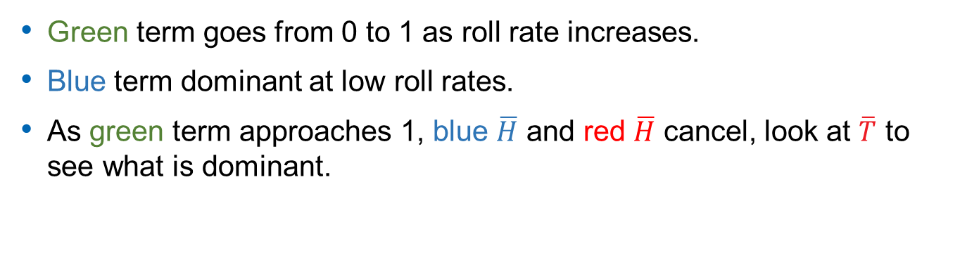

Parametric Dependence of Jaffe Criterion
$$ρ\left[\overline{H}−\frac{AC_{D}}{m}+\frac{2g}{ρV^{2}}−\frac{\frac{P_{0}}{ρ_{0}^{0.5}}}{{\left(\frac{P_{0}^{2}}{ρ_{0}}−4M\right)}^{0.5}} \left(\overline{H}−2\overline{T}+\frac{AC_{D}}{2m}−\frac{g}{ρV^{2}}\right)\right]$$
$$\overline{H}=\left(\frac{A}{2m}\right)\left[C_{N_{α}}−\left(\frac{md^{2}}{I}\right)\left(C_{m_{q}}+C_{m_{\dot{α}}}\right)\right]−\left(\frac{g}{ρV^{2}}\right)$$
$$\overline{T}=\left(\frac{A}{2m}\right)\left[C_{N_{α}}+\left(\frac{md^{2}}{I_{x}}\right)C_{m_{pa}}\right]−\left(\frac{g}{ρV^{2}}\right)$$
$$M=\left(\frac{Ad}{2I}\right)C_{m_{α}}$$
$$P=\frac{I_{x}}{I}\frac{p}{V}$$
$f(A,C_{D},m,C_{N_{α}},$ $C_{mq}+C_{m\dot{α}},C_{m_{α}},I,I_{X},d$)
Green term goes from 0 to 1 as roll rate increases.
Blue term dominant at low roll rates.
As green term approaches 1, blue $\overline{H}$ and red $\overline{H}$ cancel, look at $\overline{T}$ to see what is dominant.

Slide 9
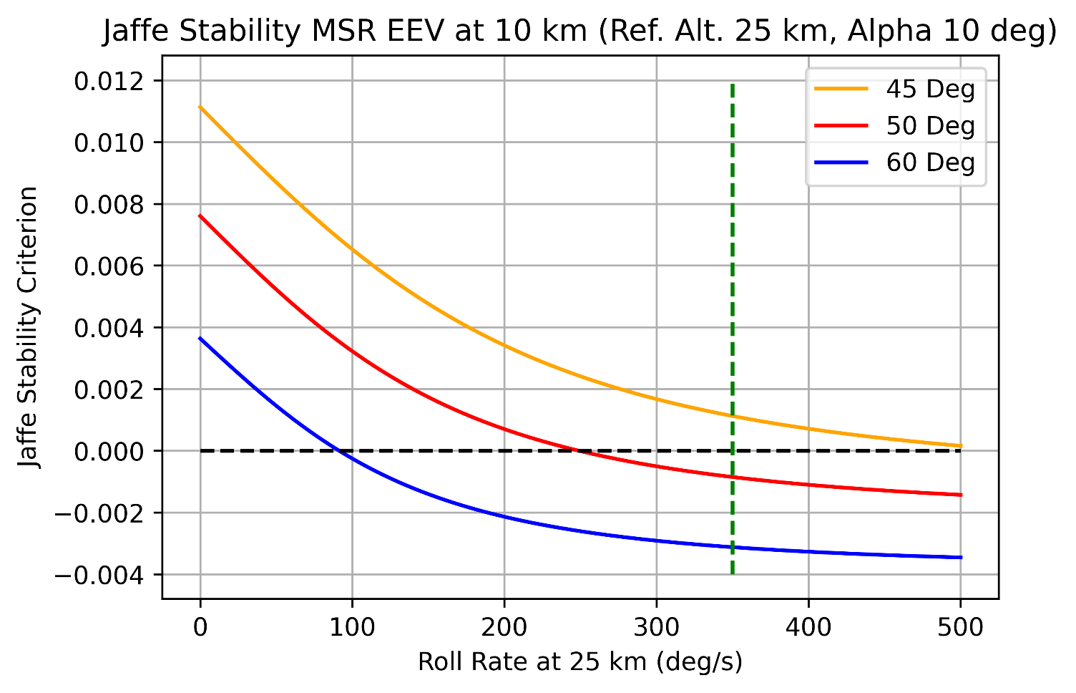
Application of Jaffe Stability Criterion
Stability criterion plotted against roll rate for MSR EEV representative design configurations.
  Indication of stability margin for given roll rate.
  Validation filter – trends accurate with 6-DOF.
Max roll rate observed in 6-DOF sim
Stability Limit

Slide 10
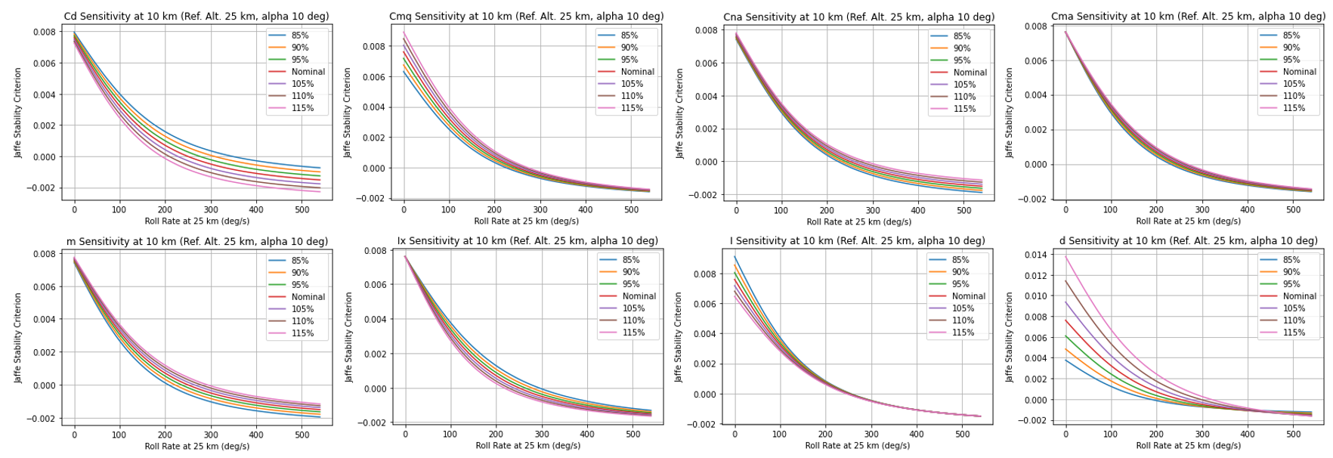
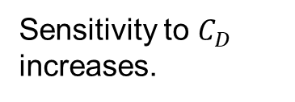
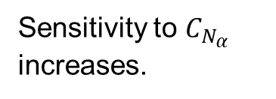
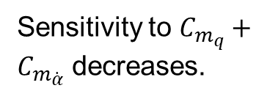
Implications for Design
Sensitivities vary with roll rate.
  Closed form analytic expression, quick solutions.
  Promotes rapid insight into what matters.
Sensitivity to $C_{D}$ increases.
Sensitivity to $C_{m_{q}}+C_{m_{\dot{α}}}$ decreases.
Sensitivity to $C_{N_{α}}$ increases.

Slide 11
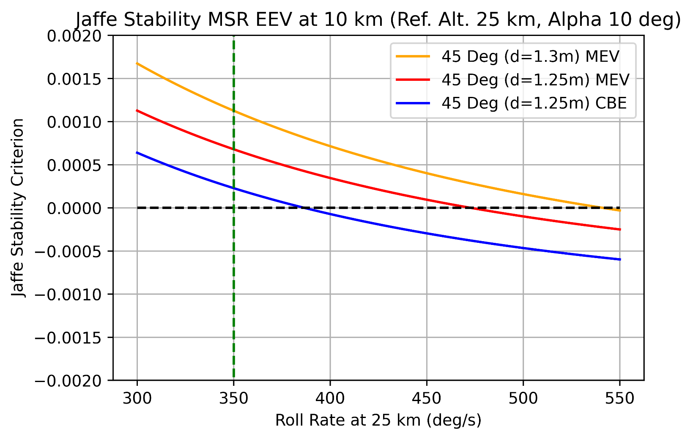
Implications for Design
Sensitivity to mass.
  Stability margin diminishes by 100 deg/sec with CBE mass.
  Evaluating stability at maximum mass is not conservative.
Stability Limit
Max roll rate observed in 6-DOF sim

Slide 12
Conclusions
Observed tumbling for MSR EEV is driven by interaction of configurational asymmetries, in the form of mass property and hypersonic aerodynamic uncertainties.
  More detailed study may generate evidence to justify reduced uncertainty ranges in Monte Carlo dynamic analysis.
  Reduced uncertainties will reduce predicted likelihood of tumbling.
Multi-fidelity approach is beneficial:
  Jaffe Criterion trends validated through comparison with 6-DOF results
  Computationally inexpensive.
  Provides an indication of stability margin.
  Guides design modifications that can improve stability.
Since tumbling occurs subsonically, robustness against tumbling can be validated in full scale test.
  Drop test articles at credible bounding roll rate and CG offset.
  Check whether tumbling is observed.⁶
6. Jaffe, P., "Dynamic Stability Tests of Spinning Entry Bodies in the Terminal Regime", Journal of Spacecraft and Rockets, Vol. 8, No. 6, June, 1971.

Slide 13
Questions?

Slide 14
References
1. Schoenenberger, M. and Queen, E., “Limit Cycle Analysis Applied to the Oscillations of Decelerating Blunt-Body Entry Vehicles”, NATO RTO Symposium AVT-152 on Limit-Cycle Oscillations and Other Amplitude-Limited, Self-Excited Vibrations, 2008.
2. Schoenenberger, M., Dyakonov, A., and Van Norman, J., “Mars Science Laboratory Aerodynamic Database”, Release 1.0, 2012.
3. Glover, L., “Effects on Roll Rate of Mass and Aerodynamic Asymmetries for Ballistic Re-Entry Bodies”, Journal of Spacecraft and Rockets, Vol. 2, No. 2, March 1965.
4. Regan, F., Re-entry Vehicle Dynamics, AIAA Education Series, 1984.
5. Jaffe, P., "Terminal Dynamics of Atmospheric Entry Capsules," AIAA Journal, Vol. 7, No. 6, June, 1969.
6. Jaffe, P., "Dynamic Stability Tests of Spinning Entry Bodies in the Terminal Regime", Journal of Spacecraft and Rockets, Vol. 8, No. 6, June, 1971.
7. Mitcheltree, R.A., Fremaux, C.M. “Subsonic Dynamics of Stardust Sample Return Capsule”, NASA TM 110329, March 1997.
8. MSR EEV DAC-2 Closure TIM 4.0 EDL Performance.
9. 60 Deg MC POST2 inputs/results supplied by B. Tackett, LaRC.
10. 50 Deg MC POST2 inputs/results supplied by B. Tackett, LaRC.
11. MSR EEV AWG on December 2, 2020 by J. Van Norman, LaRC.
12. MSR EEV DAC-3A Closure TIM 2.3 Final DAC-3A Flight Dynamics.

Slide 16
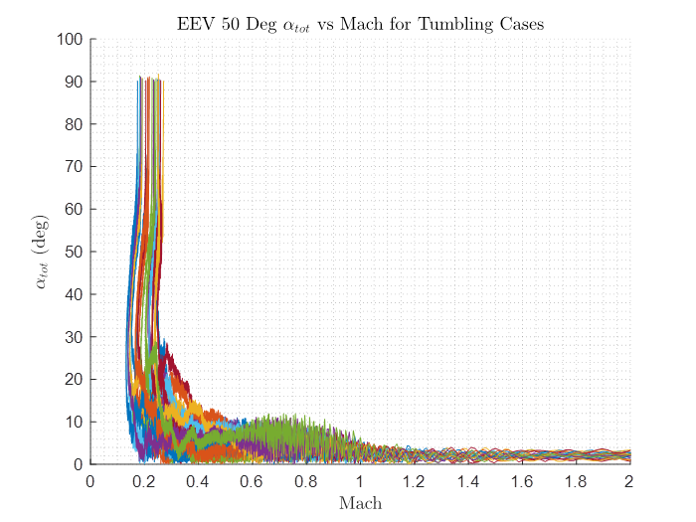
Backup
Terminal Descent.
  Variation in dynamic pressure with altitude is small.

