Slide 1
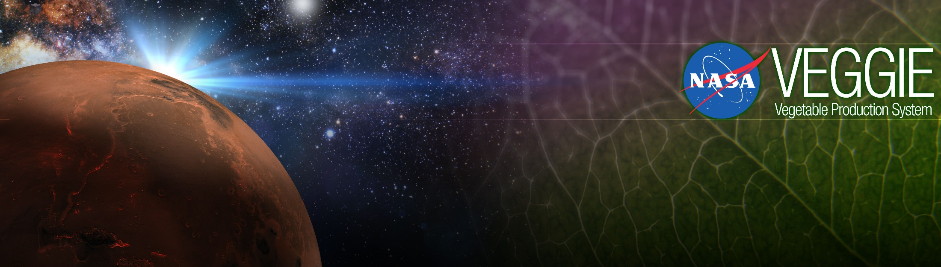
Plants in Space, Veggie, and Space Crop Production
Gioia Massa
NASA, Kennedy Space Center, FL, USA

Slide 2


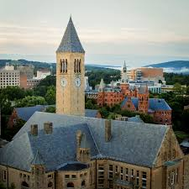
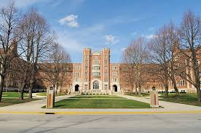
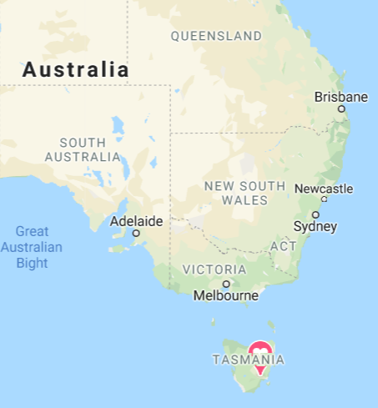
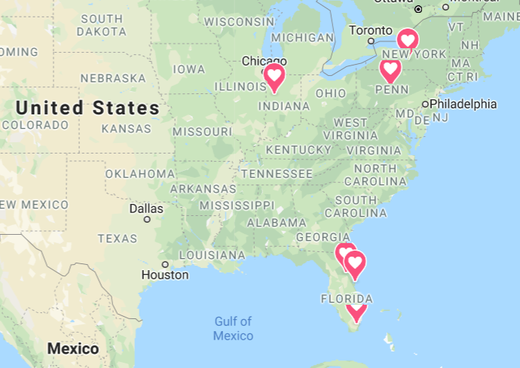


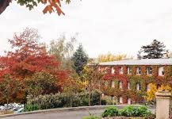


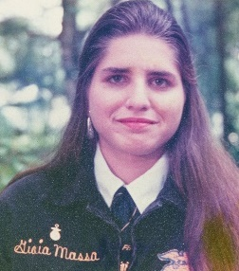

My Journey

Slide 3

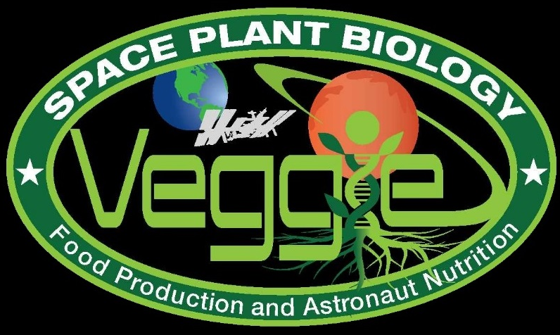
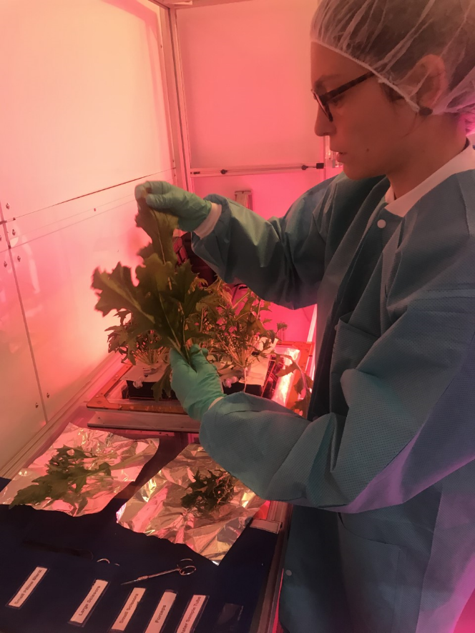
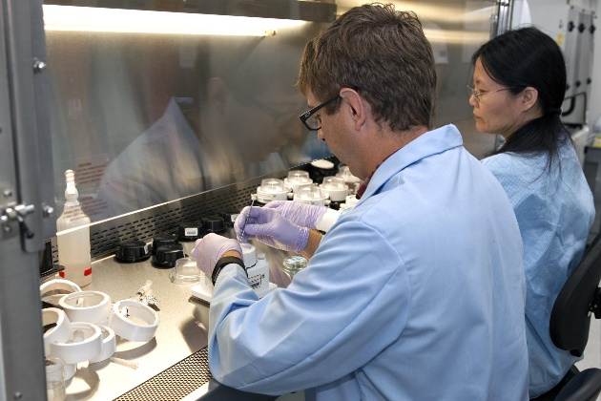
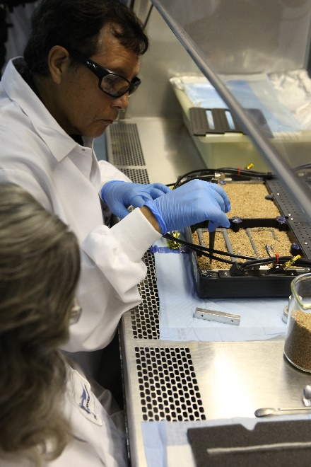
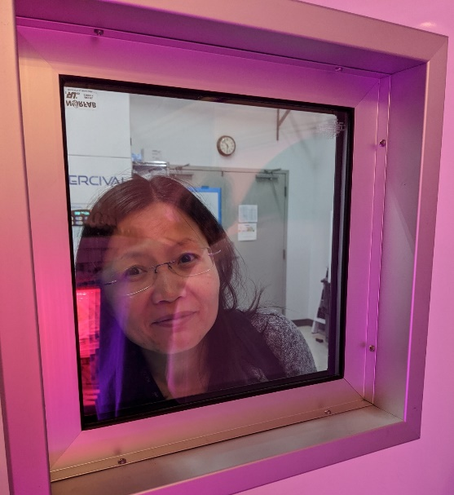
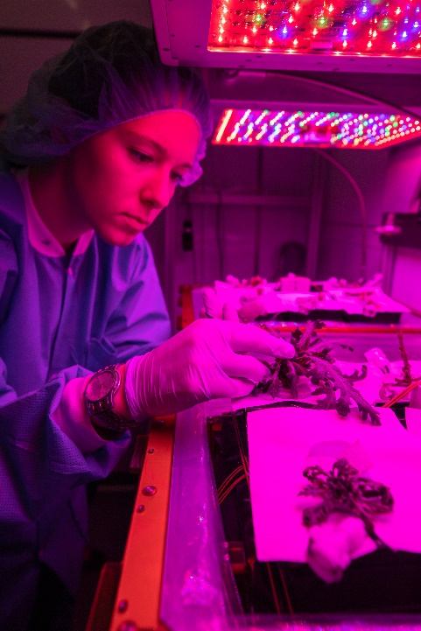
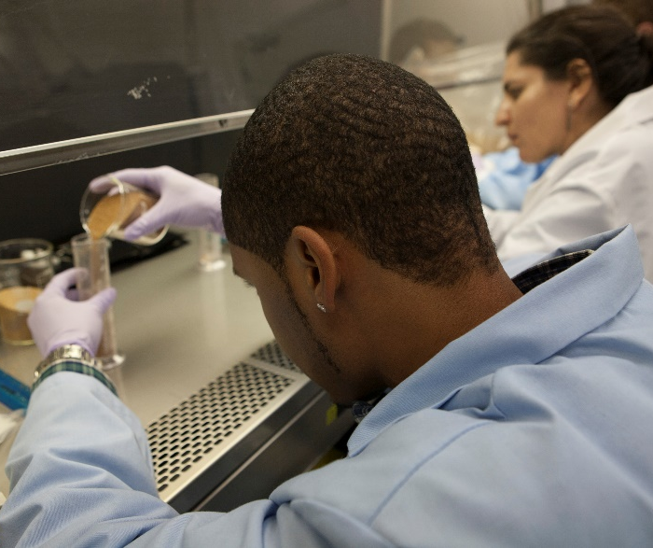
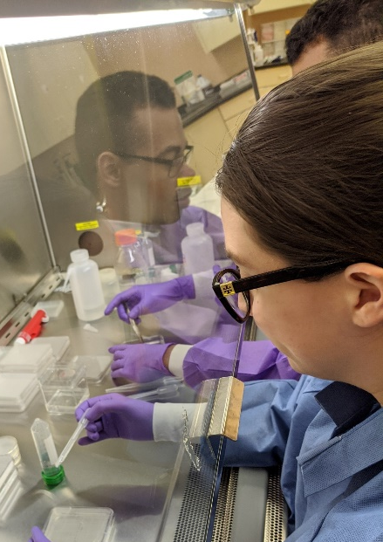
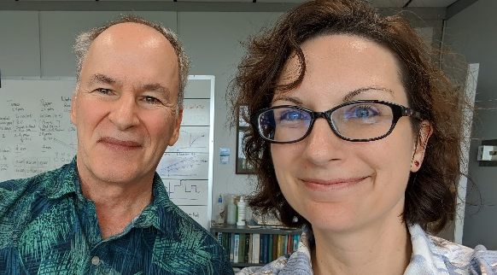
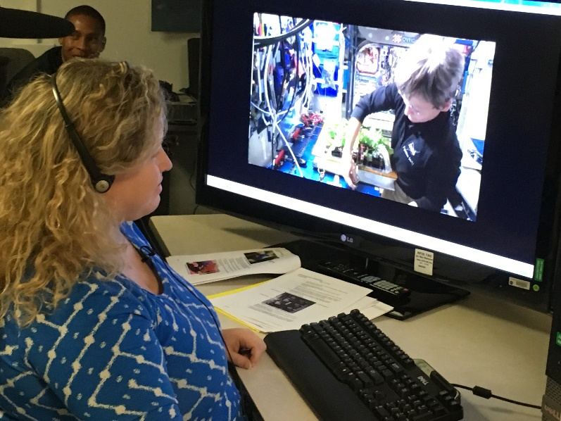
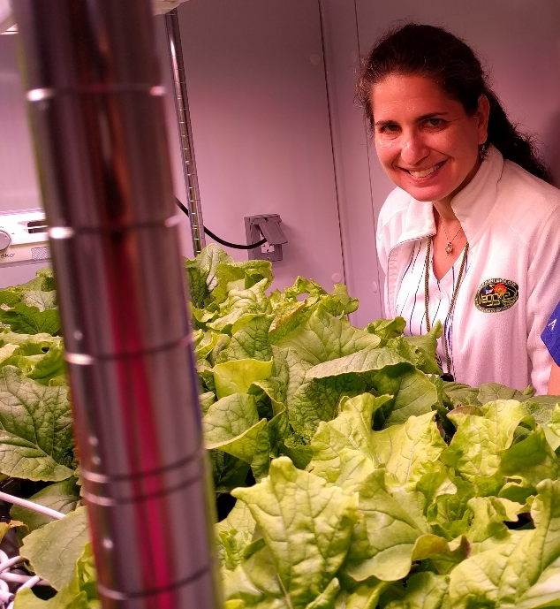
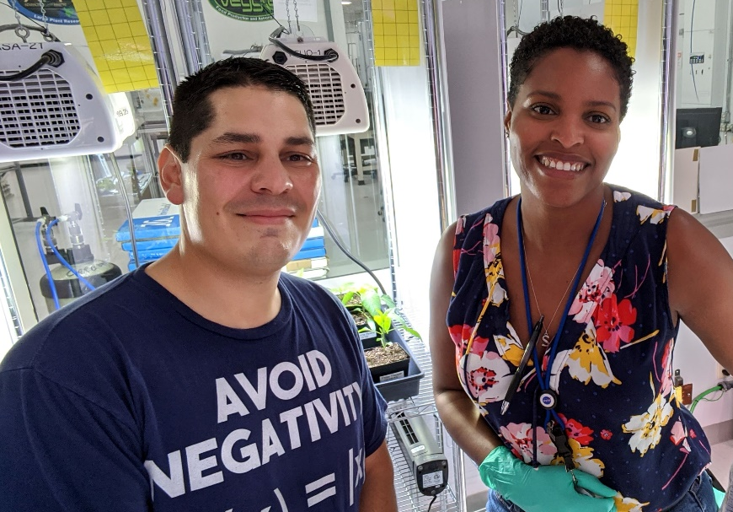
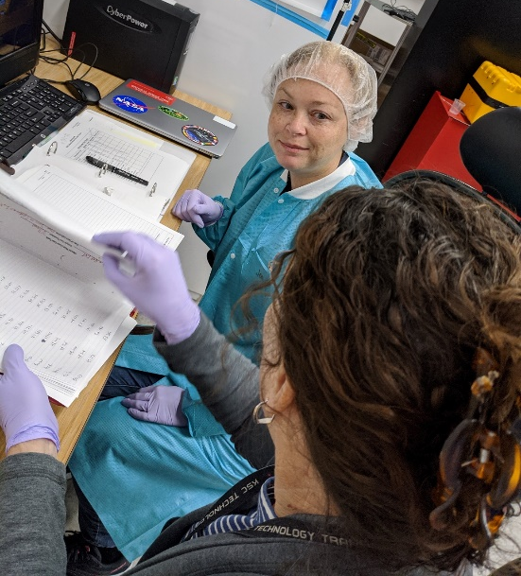

Slide 4
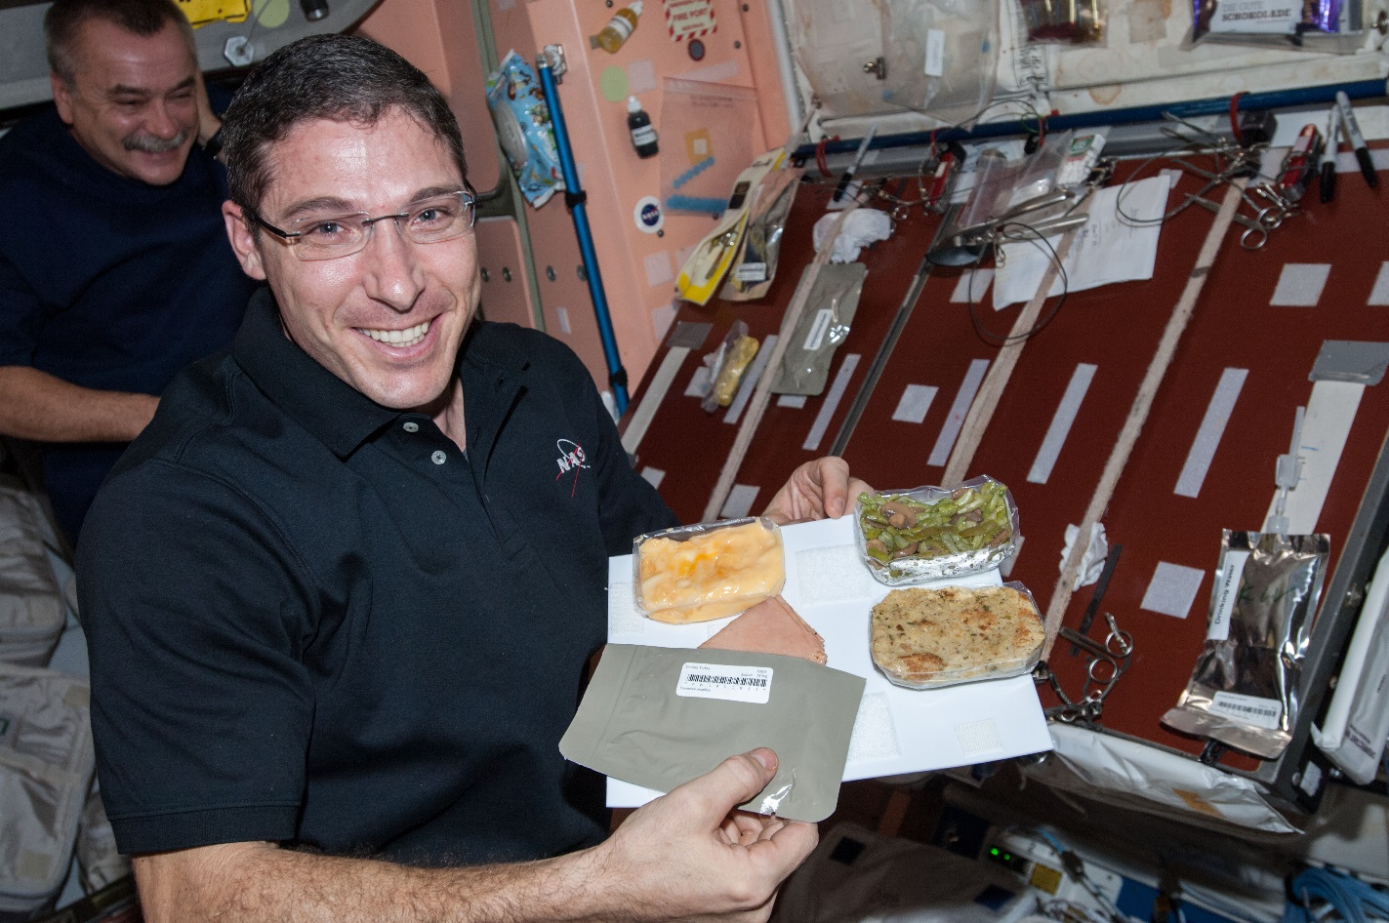
Why grow plants in space?
Food
Psychological well being
Atmosphere
Water

Slide 5
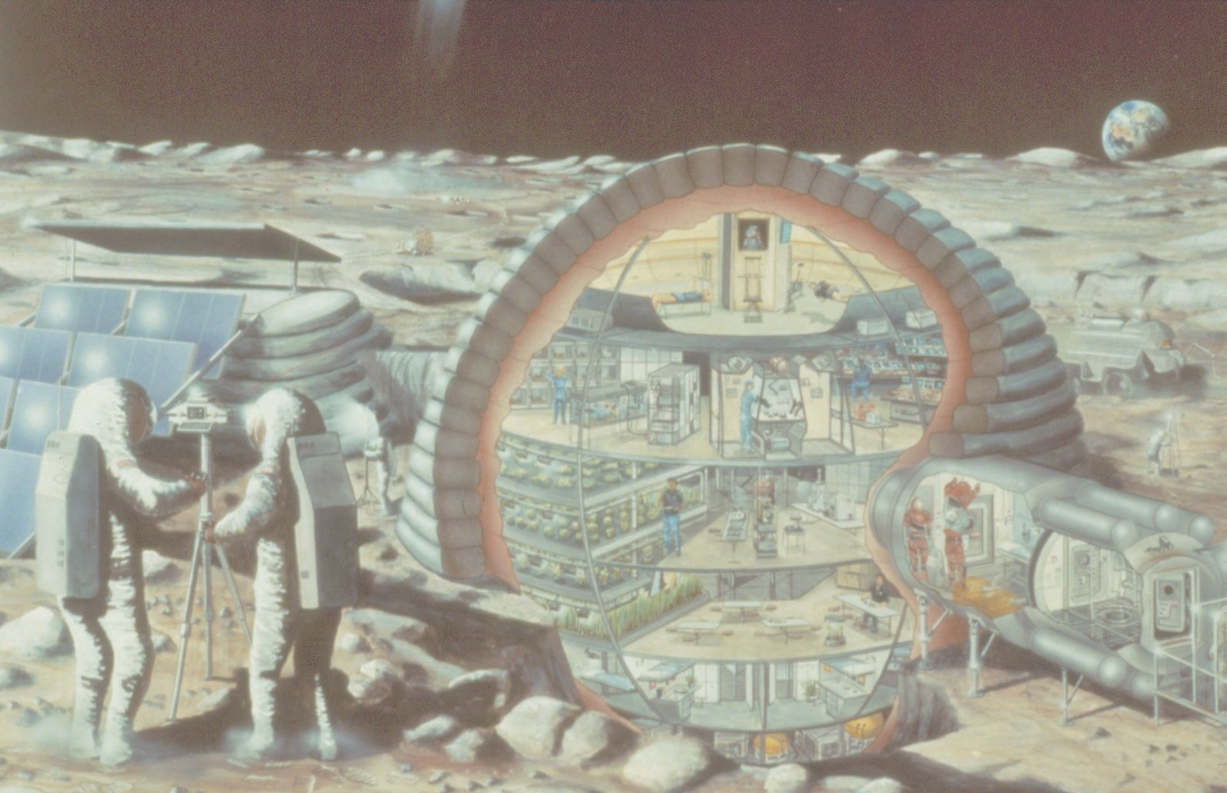

Slide 6
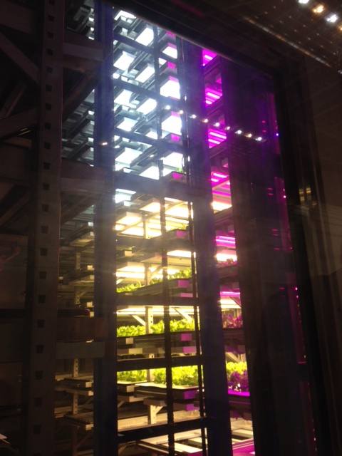
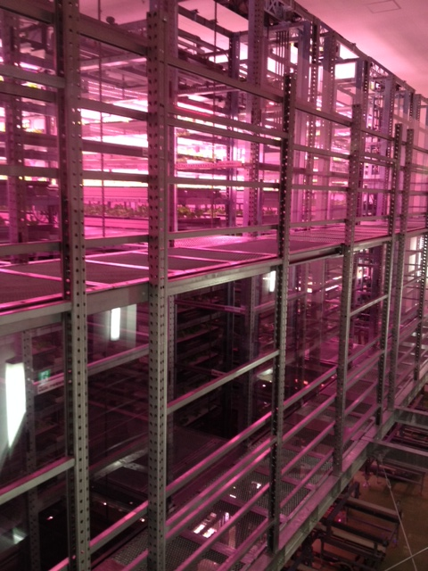
Plant Factories
Photos of Osaka Prefecture University training facility courtesy of Ray Wheeler

Slide 7
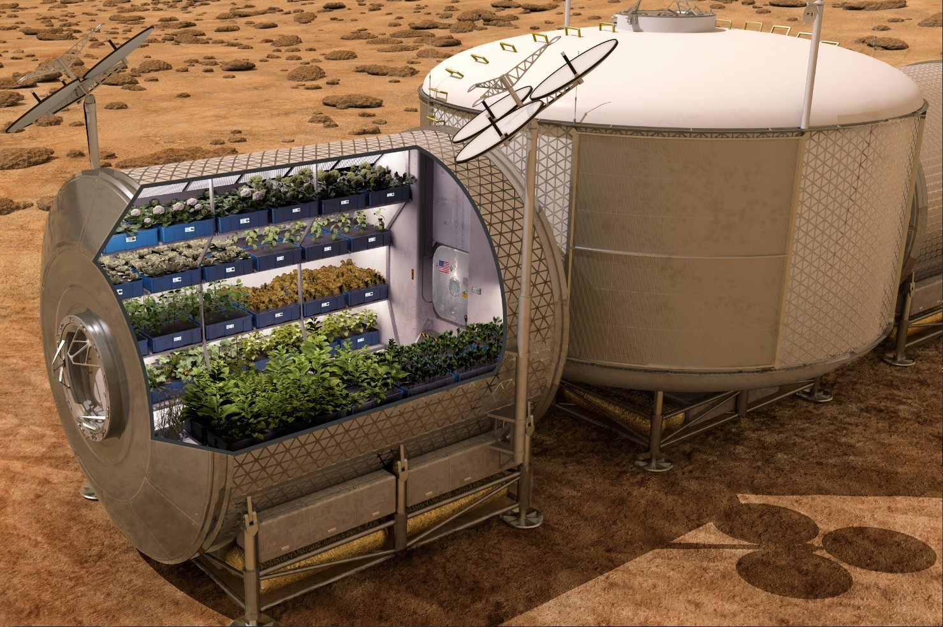

Slide 8
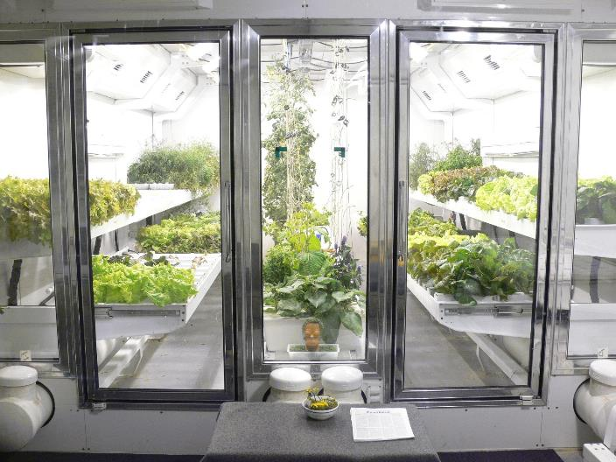
South Pole Greenhouse
Photo courtesy of Lane Patterson

Slide 9
The Space Crop Production Vision
Ensure Food System Security on Long Duration Missions Beyond LEO
Near-Term Goal
Nutrient Supplementation of Prepackaged Food
Long-Term Goal
Caloric Replacement to Facilitate Earth Independence
Notes:
Ralph
Ensure Food System Security on Long Duration Missions Beyond Low Earth Orbit (LEO)
Food and nutrition are the first line of defense for crew health and performance
Provide safe, nutritious and acceptable fresh food
Add variety to crew diet
Enhance morale
* Food security is the condition in which crew have continuous access to sufficient safe and nutritious food which meets both their dietary needs and food preferences in order to maintain peak health and performance.
Nutrient Supplementation of the Prepackaged Food System - Needed for: Deep Space Transport
Fresh produce supplements vitamins (B₁, K, C) and bioactive compounds that degrade in the stored food system on multi-year exploration missions
“Pick-and-Eat” crops that require no processing and minimal preparation will provide variety, customization, and psychological appeal
Enable testing and demonstration of dependable crop production before reliance on system.
Limiting factors are vehicle resources mass, power, volume, water, air, crew time
Caloric Replacement to Facilitate Earth Independence - Needed for: Long duration Surface missions on the Moon and Mars
Reduce up-mass associated with pre-packaged food
In addition to “pick and eat” crops, include staple crops that require processing and preparation
Bioregenerative capability will be required for long duration surface missions

Slide 10


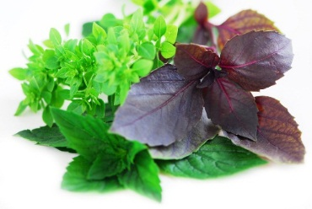
Space Crop Production Candidates
Salad
Leafy Greens
Tomato
Pepper
Radish
Strawberry
Green Onion
Pea
Carrot
Lettuce, Chinese cabbage, Swiss chard, Mizuna, Spinach
Staple Crops
White Potato
Sweet Potato
Rice
Wheat
Dried Bean
Soybean
Peanut
MINIMAL PREPARATION / COOKING
SIGNIFICANT PREPARATION / COOKING
CONSUMED FRESH WITHOUT PROCESSING
Herbs
Basil
Mint
Chives
Dill

Slide 11

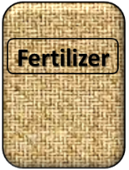

Plant Growth and the Environment
5 Cardinal Factors of Plant Growth…..
O₂

Slide 12
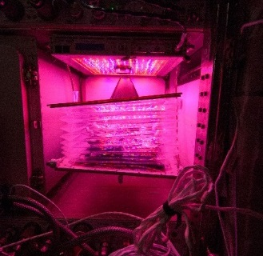
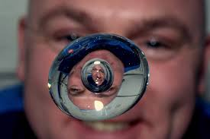

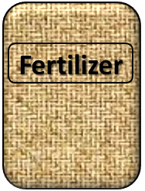
The Space Environment
….and how these work with and without Gravity!
Humans like white light, but plants may grow well with other wavelengths
No convection in space so need to mix the air
O₂
Water forms a ball, and water and air don’t mix well, and roots need both!
Fertilizer is heavy to launch so we need to learn how to recycle plant waste

Slide 13

The Space Environment
….and how these work with and without Gravity!

Slide 14
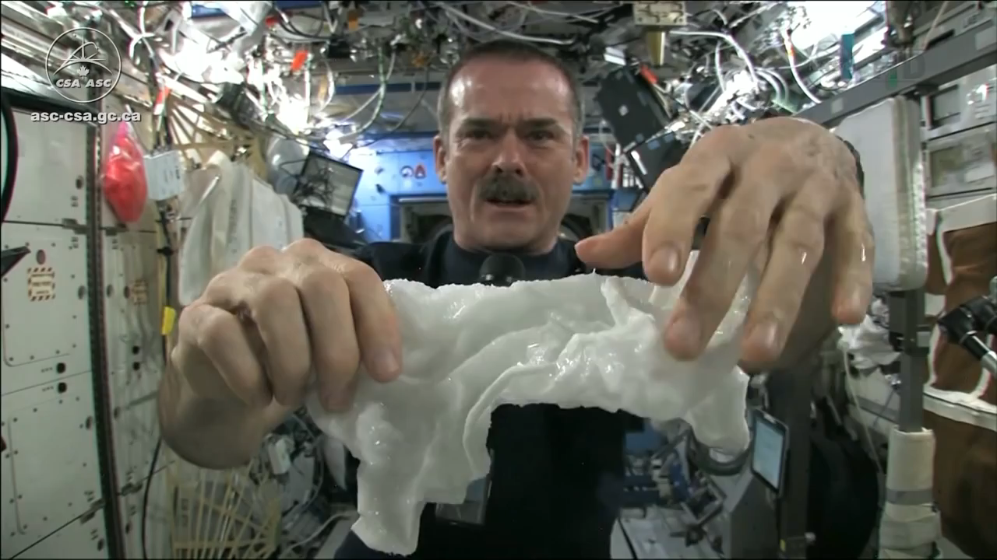
The Space Environment
….and how these work with and without Gravity!
Please Play Video 2

Slide 15
Space Crop Production Challenges
Deep Space
Water
Recycling
Radiation
Pressure
Micrometeorites
Surface
Microgravity
Fluid movement
No convection
Dust
Partial gravity
Plant Size
High CO₂
Food Safety & Microbiome
Nutrient output
Sustainability
Abiotic stresses
Vehicle resources
Crew time
Waste
Productivity
Stress tolerance
Environmental optimization
Crop scheduling
Crop

Slide 16


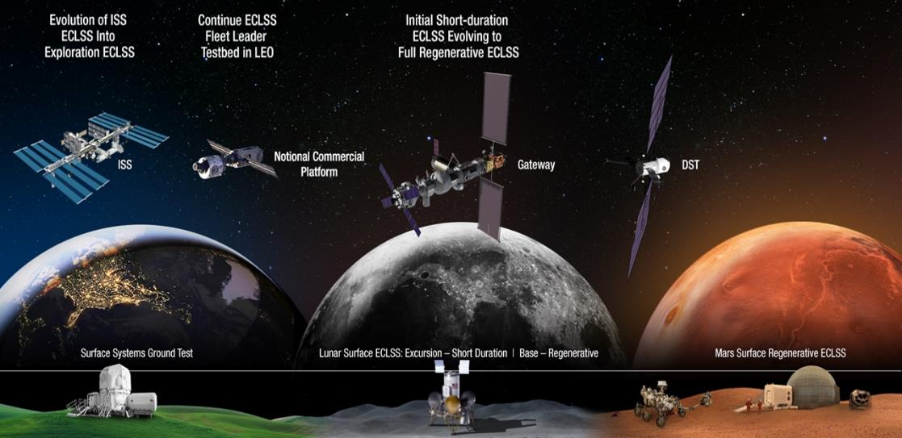


Space Crop Production Roadmap For Exploration
MARS TRANSIT (Crop Production)
GATEWAY (Plant Research)
Operational µg Food Production capability for pick and eat crops to supplement crew diet
ISS (Plant Research and H/W Technology)
Proving Ground to study the effect of deep space radiation on pick and eat crops in µg
Identify challenges and solutions for growing pick and eat crops in µg to support crew nutrition
Scale: One to Two EXPRESS Racks (8-16 Lockers)
Scale: Single Locker
Scale: Single Locker to EXPRESS Rack (8 Lockers)
LUNAR SURFACE (Research/Production)
Ground (Plant Research and H/W Technology)
Develop and deploy operational partial gravity systems for both nutritional support and caloric replacement as both a source of food for long duration lunar missions and as a demonstration for Mars
MARTIAN SURFACE (Production)
Develop space crop production concepts and strategies in support of destinations along the exploration roadmap
Leverage Lunar Surface experience in Food Production systems to extend Earth Independence for Mars missions
Scale: Single Locker to Module
Scale: Single Locker to Module
Scale: Single Locker to Module

Slide 17
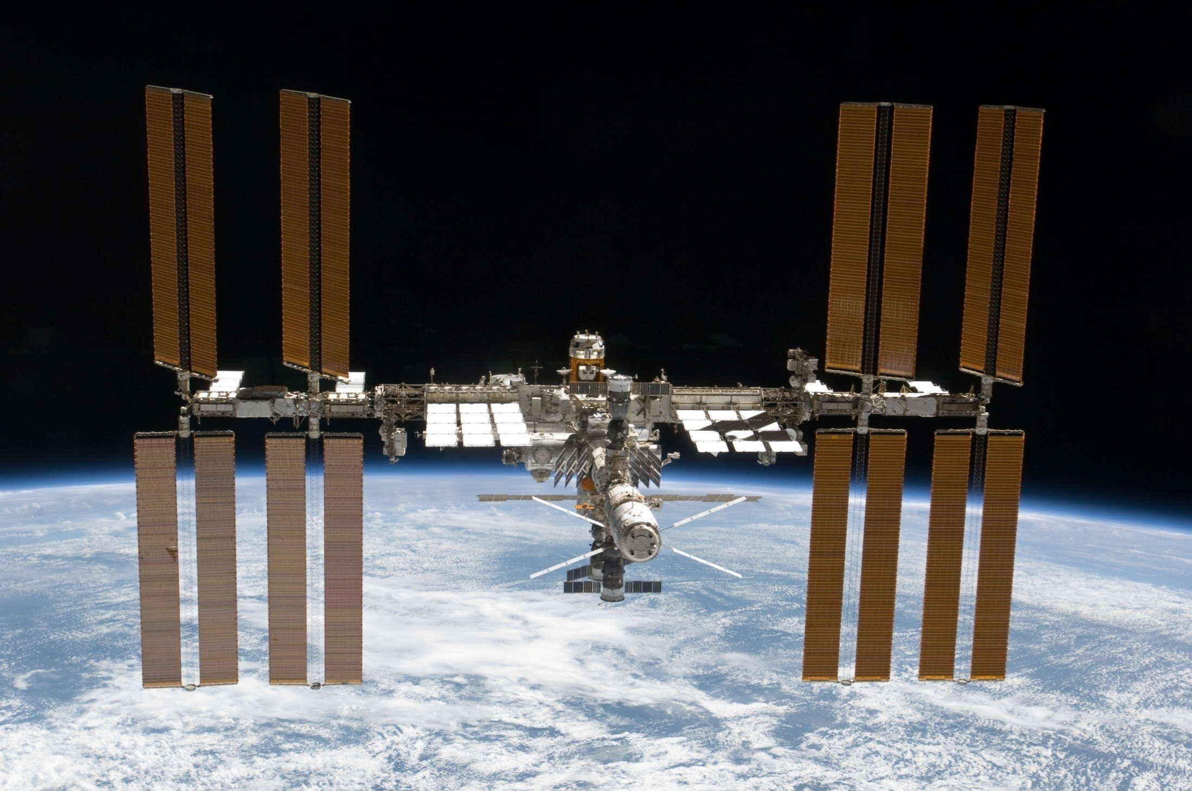
The International Space Station

Slide 18
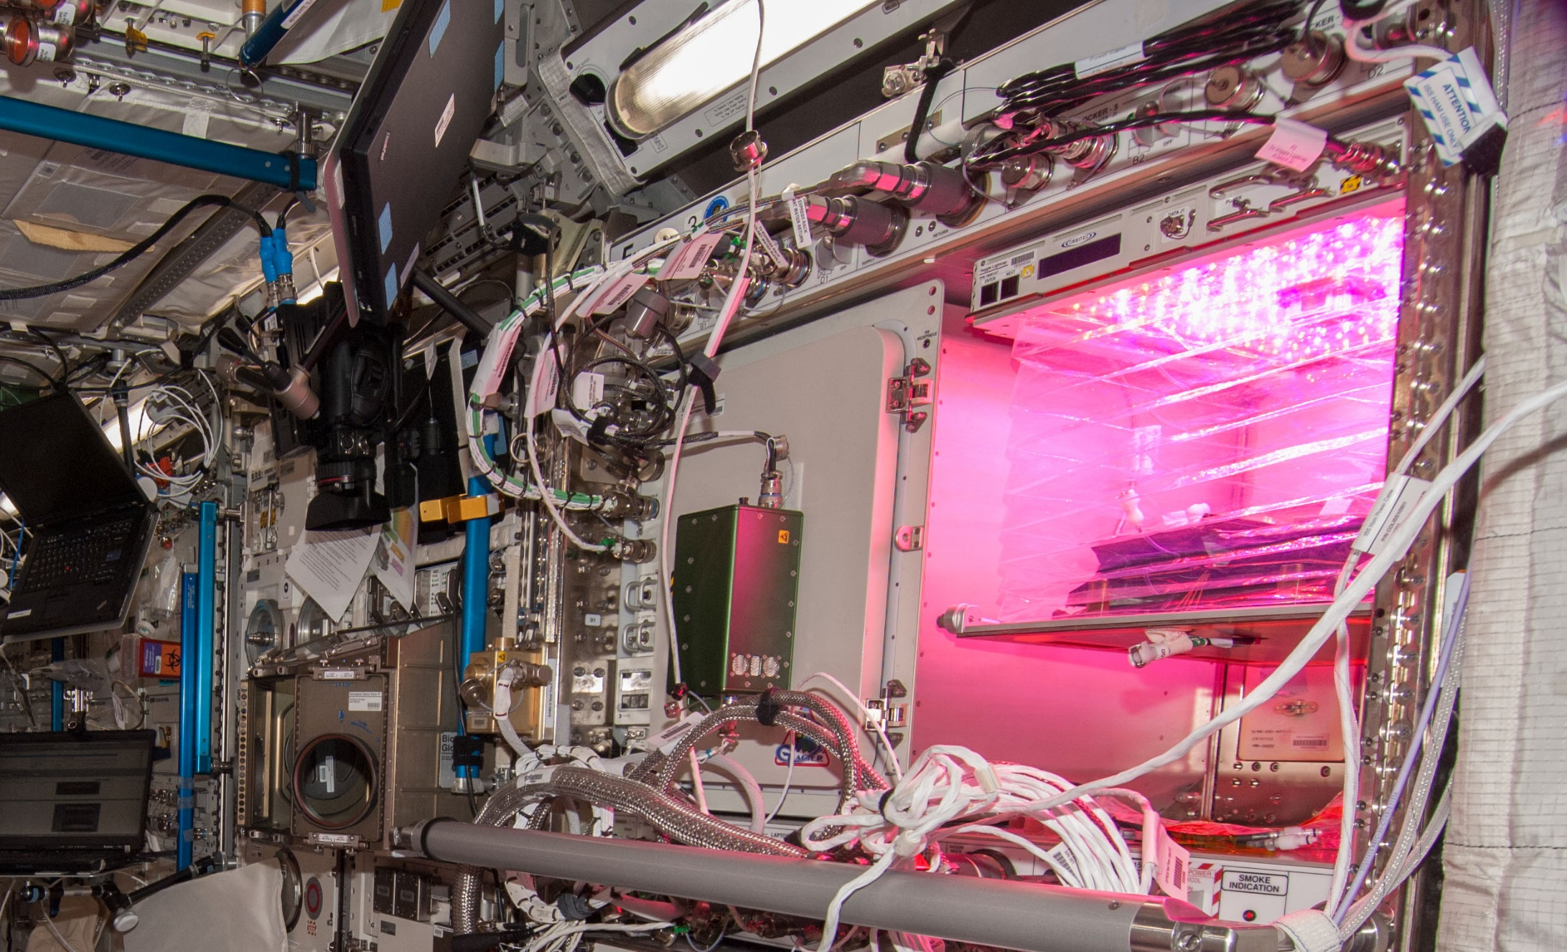
Veggie on ISS

Slide 19
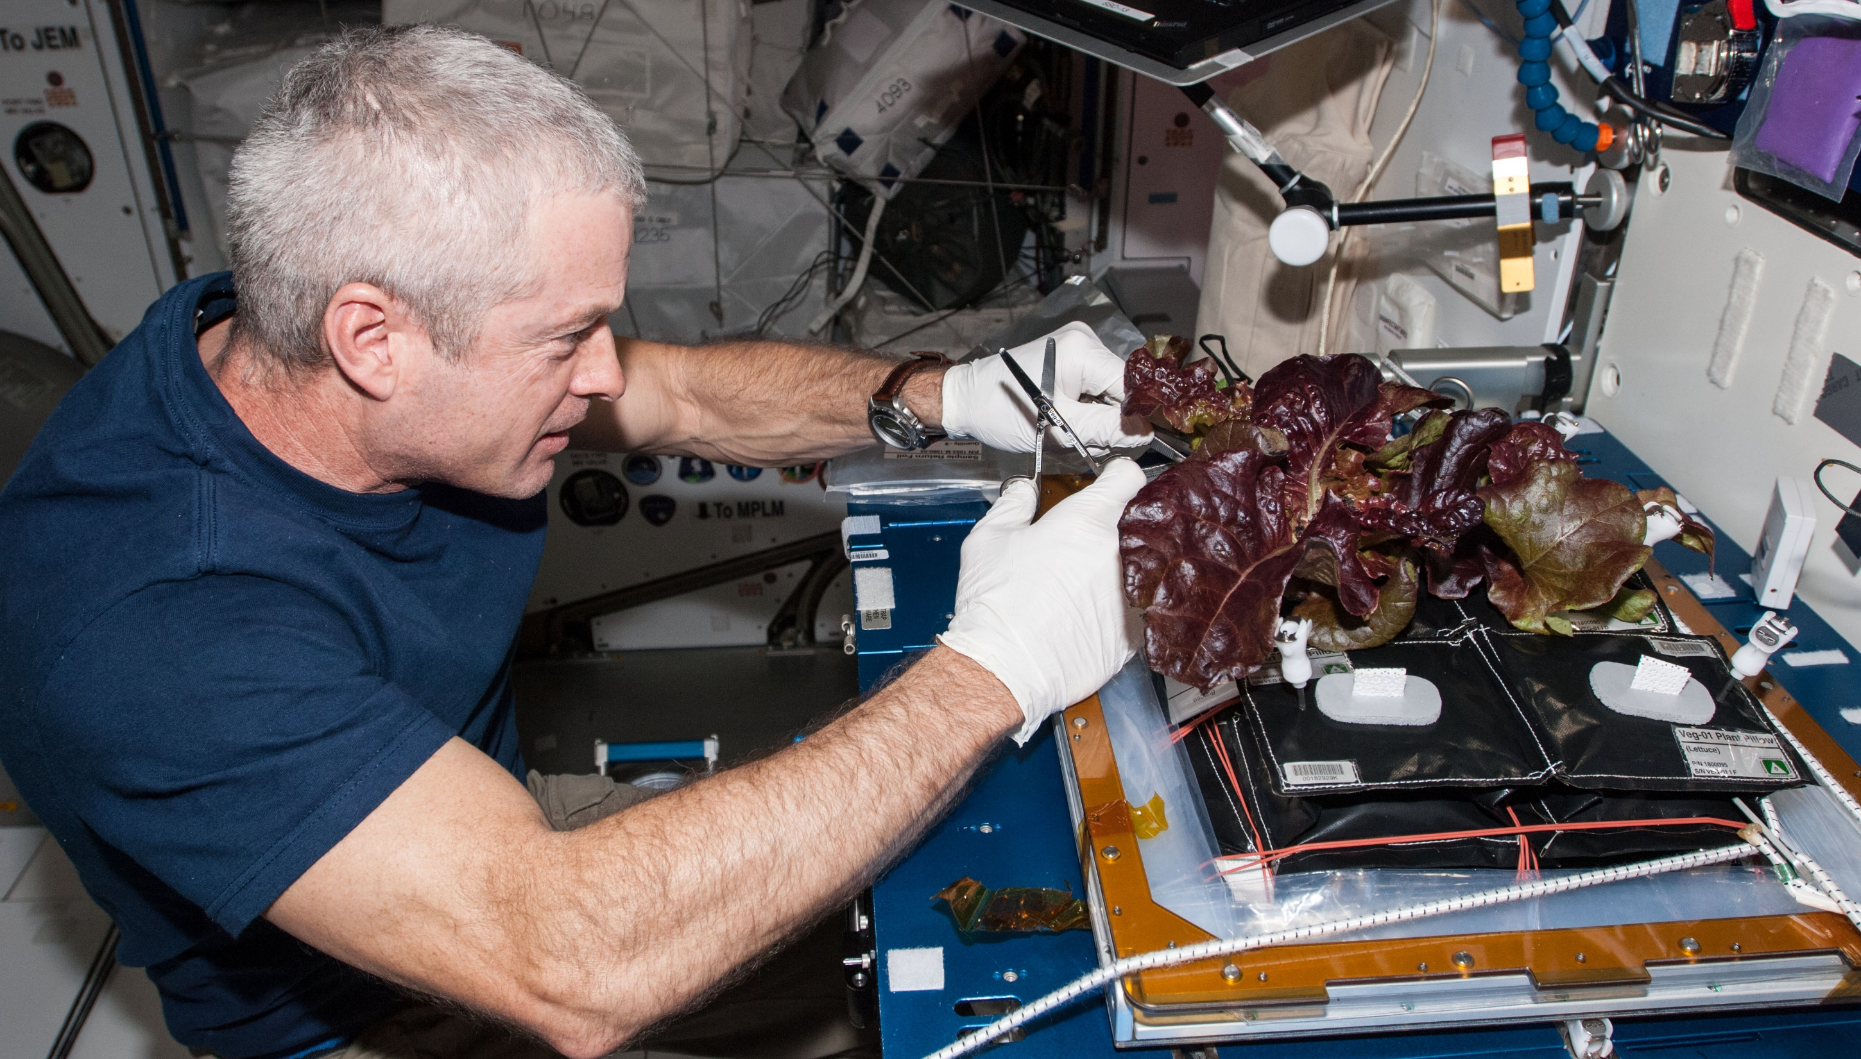
Veg-01A Harvest

Slide 20
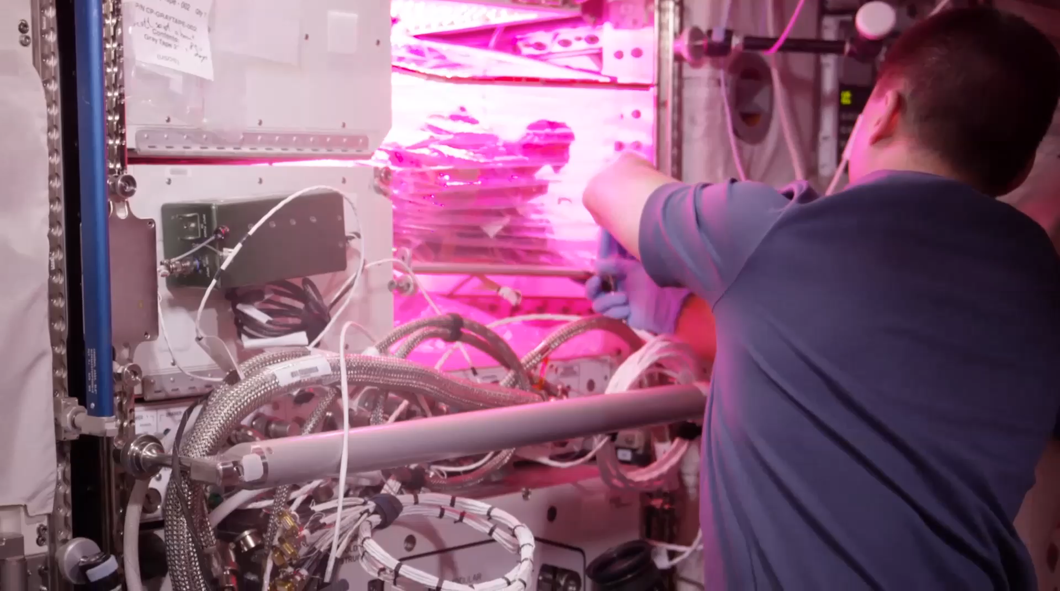
VEG-01B Harvest (August 2015)
Notes:
Veg-01 second crop, first consumption

Slide 21
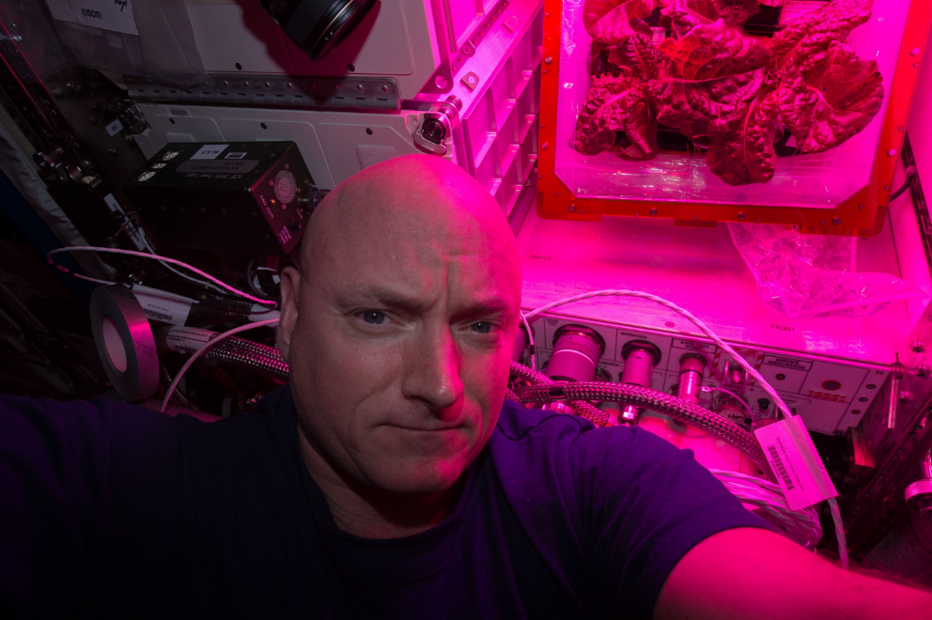
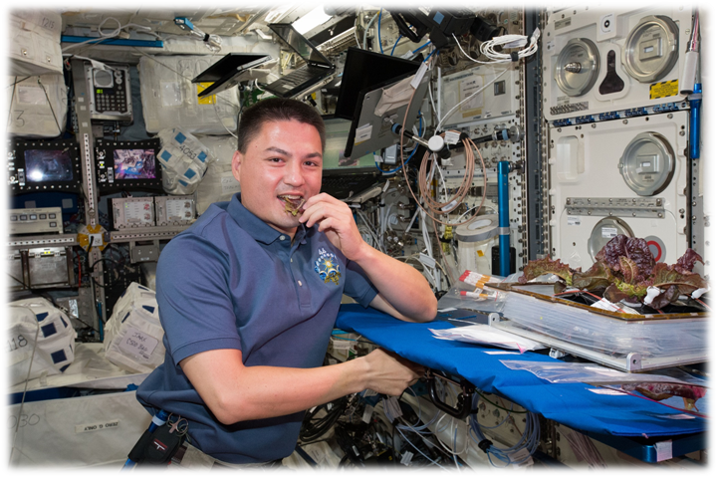
Astronaut Comments
Scott Kelly
  the logistical complexity of having people live and work in space for long periods
  the supply chain that is required
  For Mars, need a space craft that is more self-sustainable with regards to its food supply
Kjell Lindgren
  benefit of eating the fresh food
  contribution that plants have to the ISS ecosystem
  psychological benefit - it’s really fun to see green growing things in the sterile environment of the ISS

Slide 22
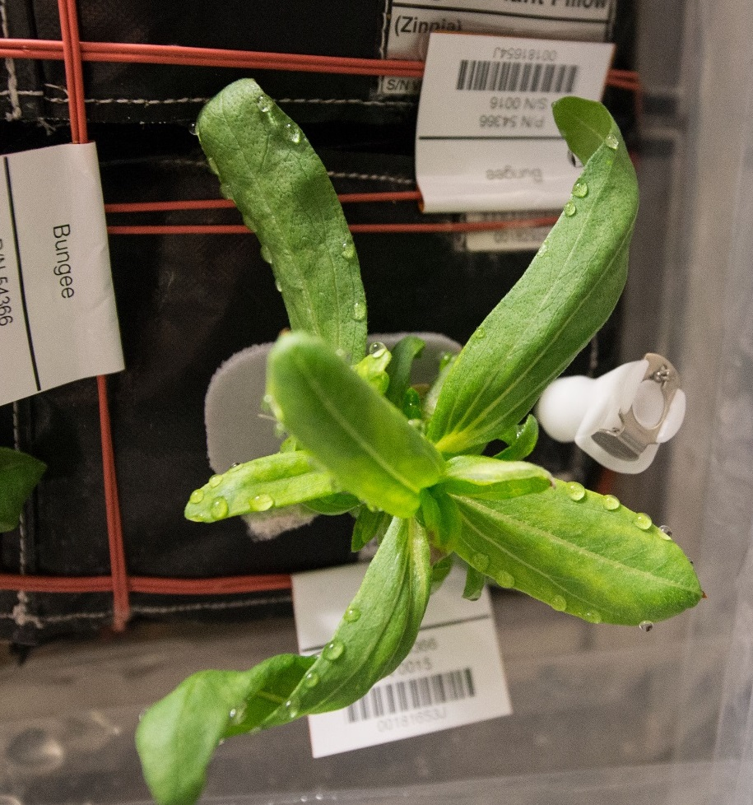
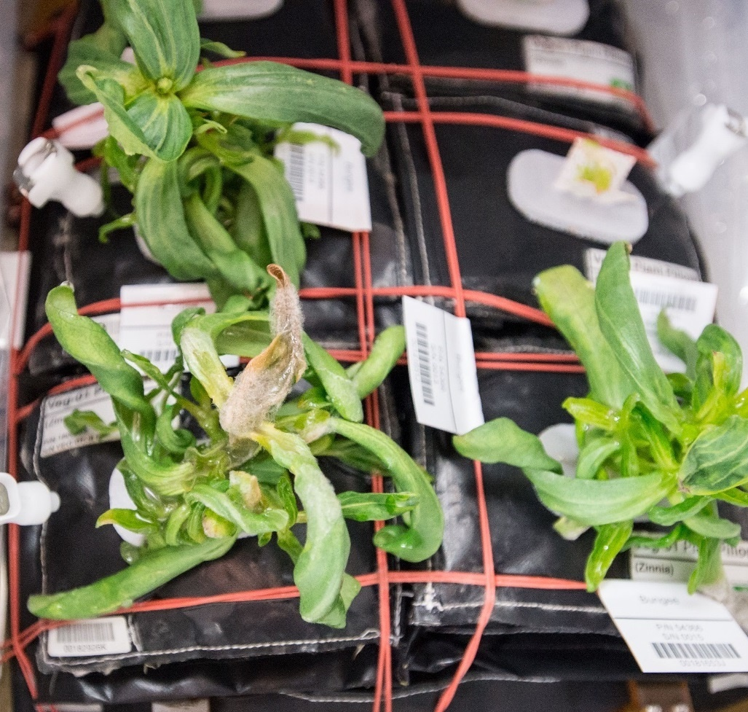
Ventilation and Water Issues & Consequences in Zinnia
Guttation and Leaf Curling
Fungal Development & Abnormal Growth

Slide 23
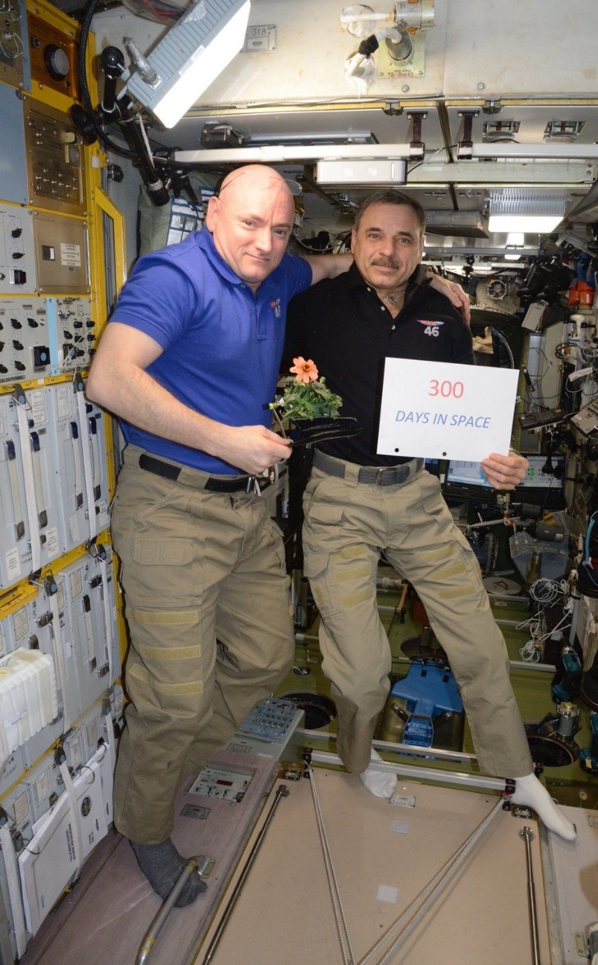
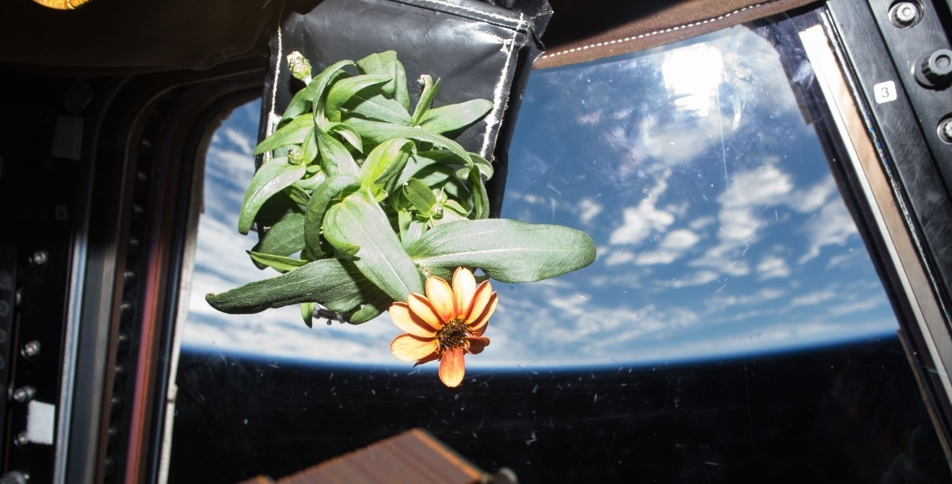
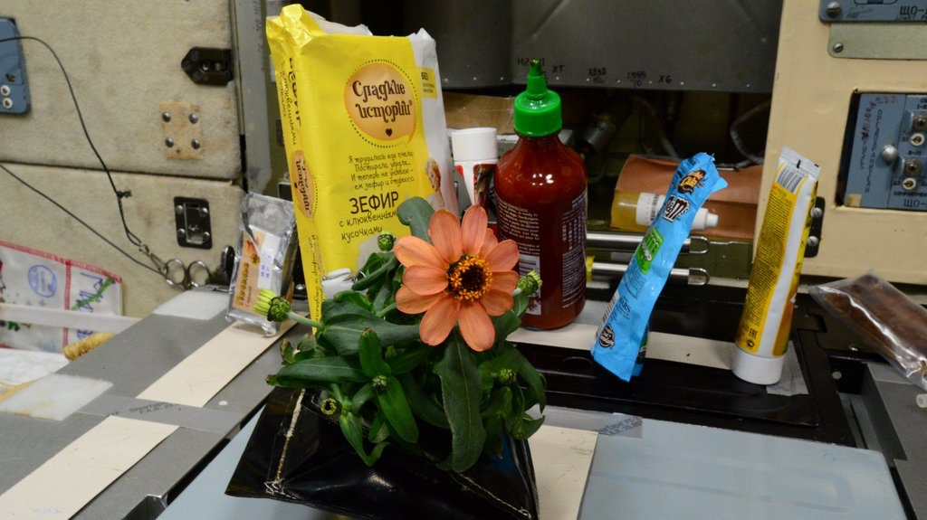
Zinnia Action Shots

Slide 24
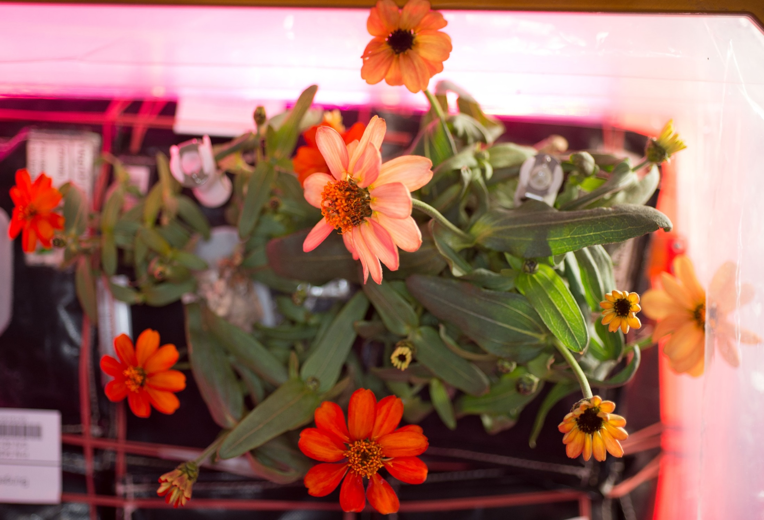
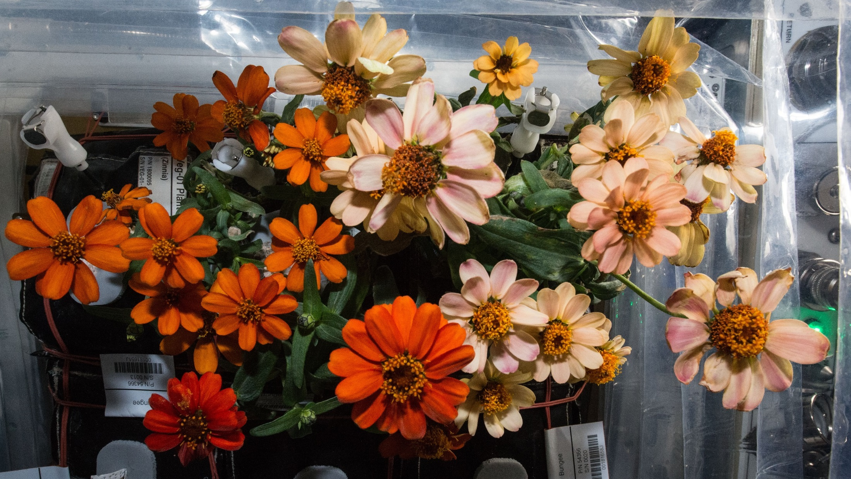
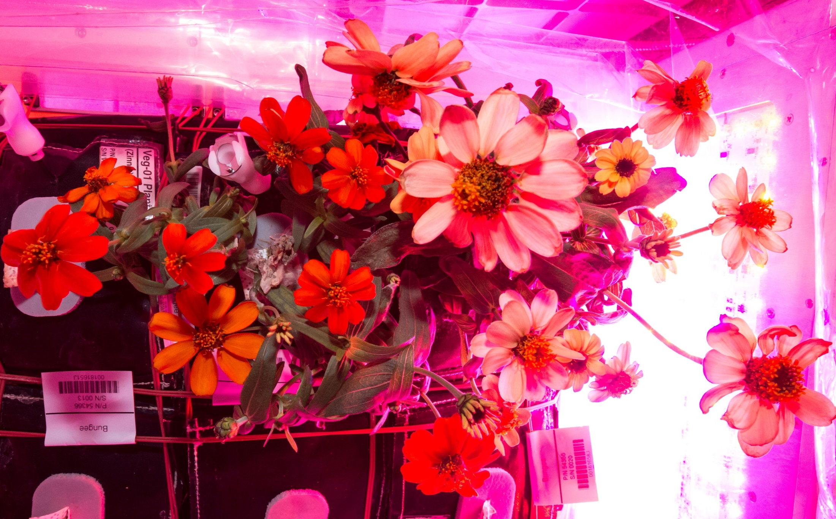
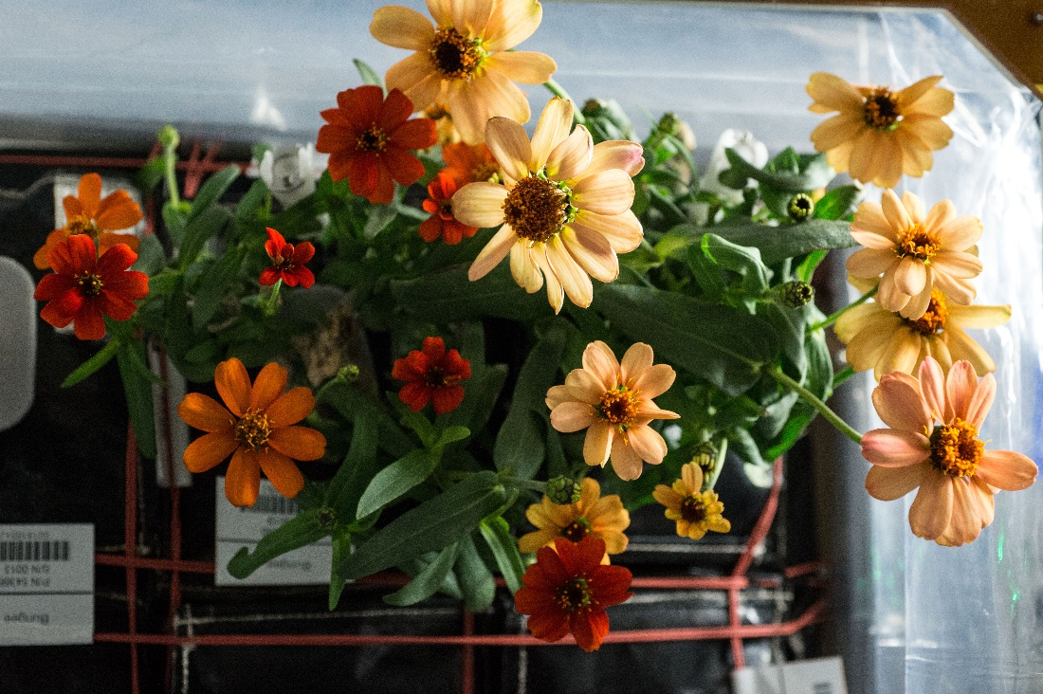
And they bloomed, and bloomed...
77 DAI
80 DAI
71 DAI
87 DAI

Slide 25
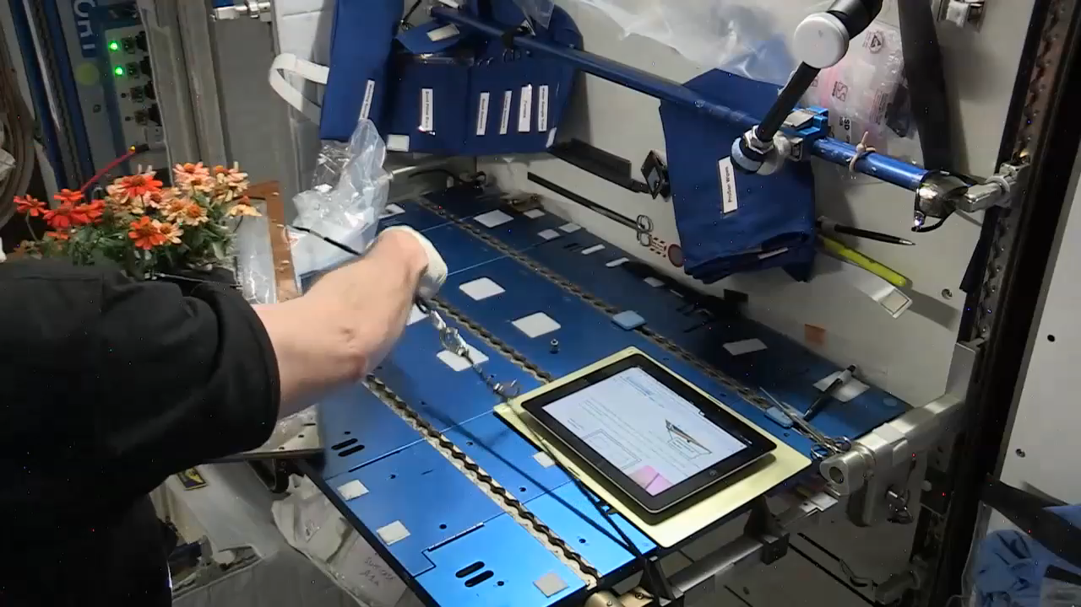
Zinnia Harvest on February 14, 2016
Notes:
Video by Rachel Hobson

Slide 26
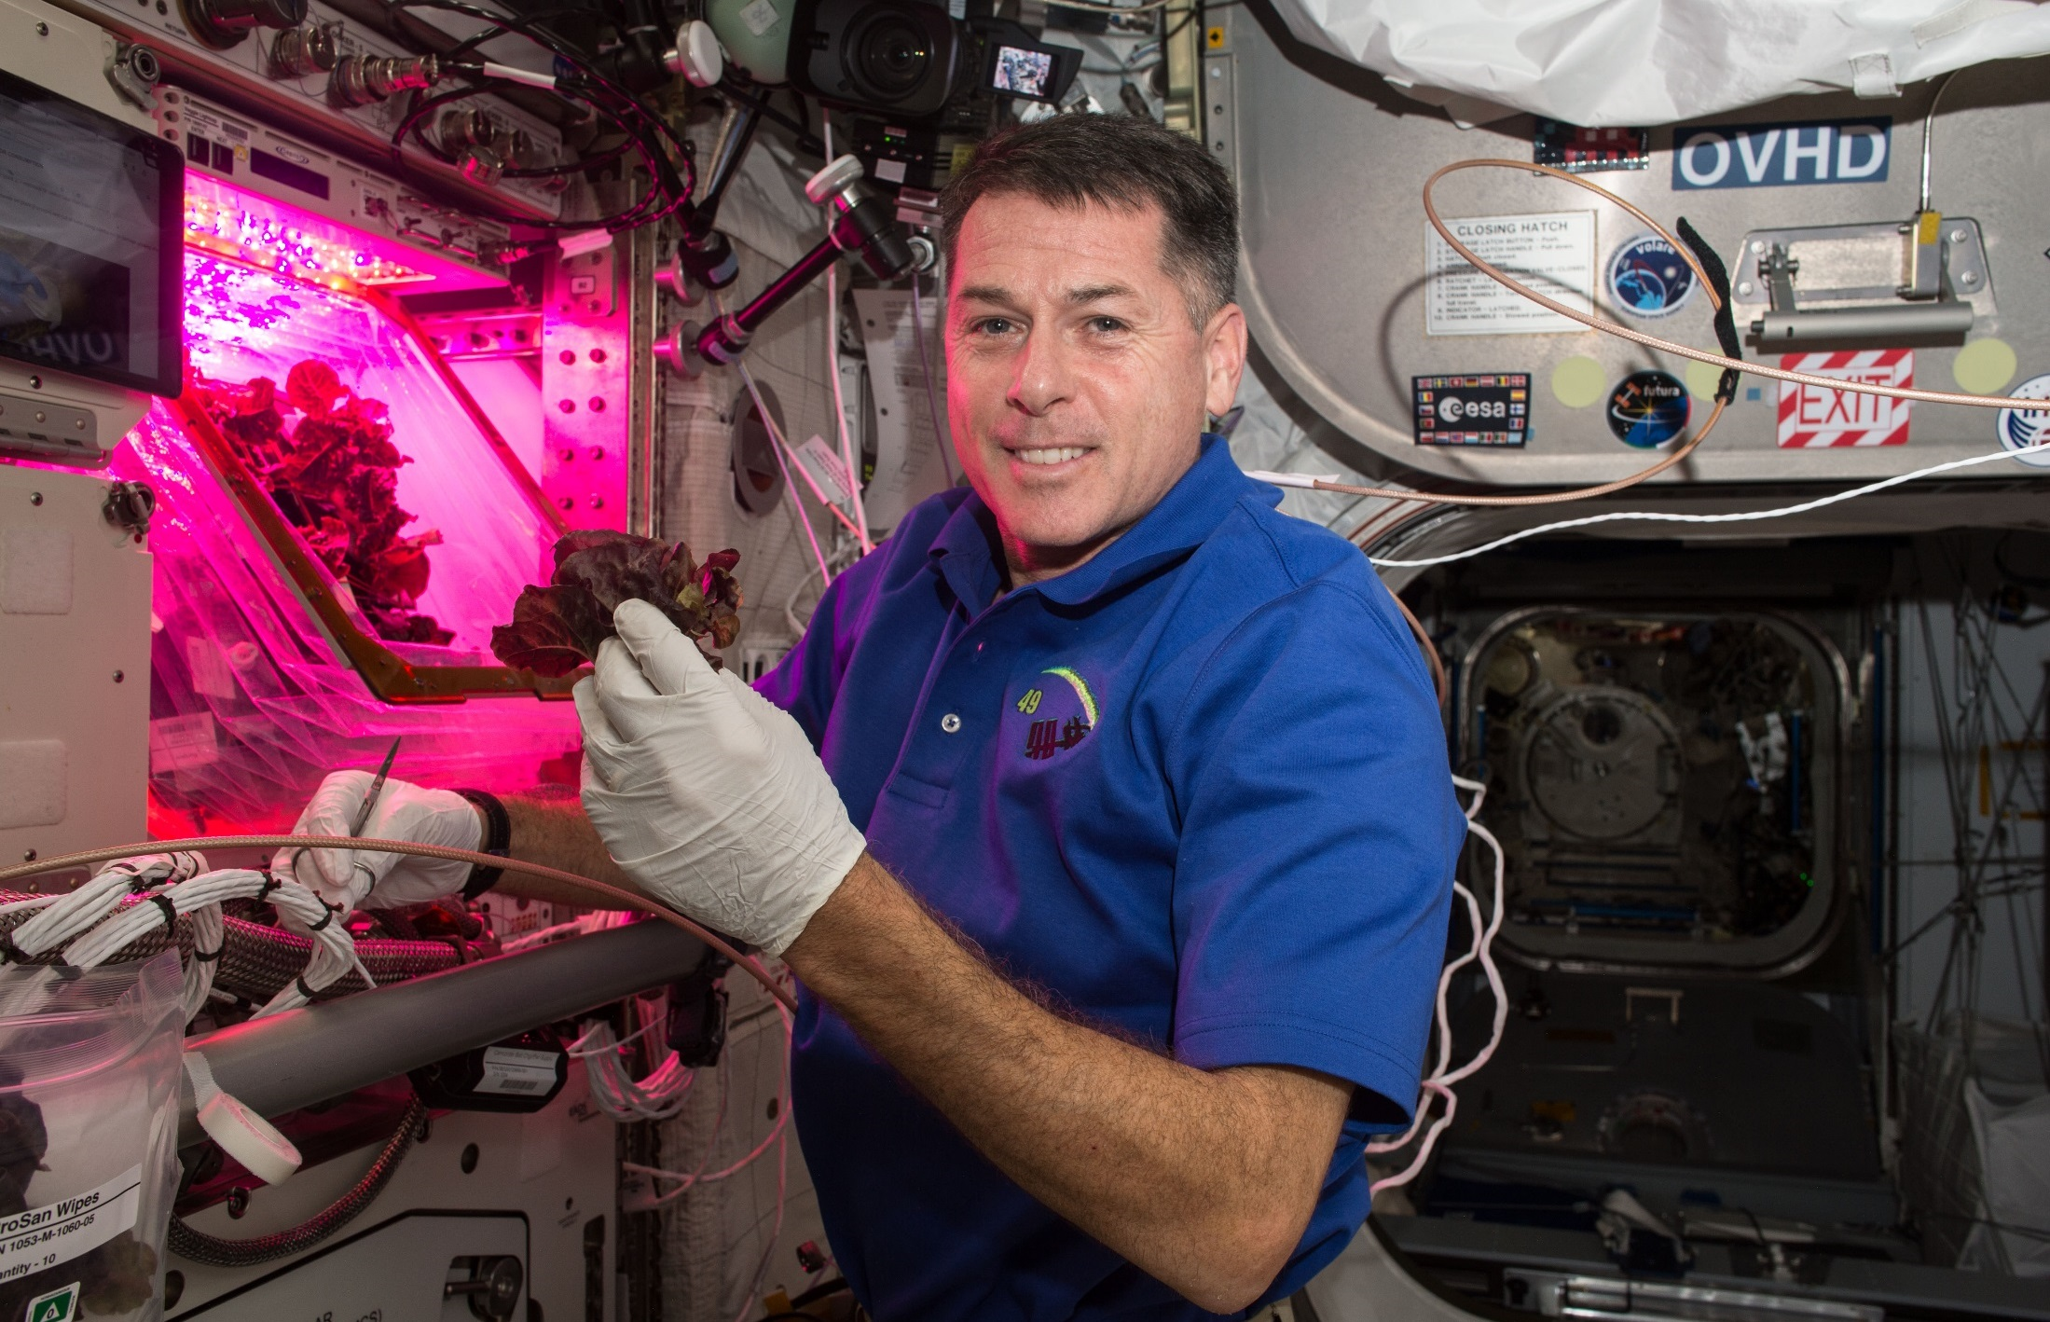
Red Lettuce Cut-and-Come-Again

Slide 27

VEG-03C Cut-and-Come-Again

Slide 28

A Tale of Two Veggies

Slide 29





VEG-03 New Crops on Orbit
Red Russian Kale
*Dragoon Lettuce
Wasabi Mustard
*Extra Dwarf Pak Choy
Amara Mustard
Grown in different combinations with Amara Mustard and Extra Dwarf Pak Choi harvested recently on ISS!
*= Student Selected Crops!

Slide 30


VEG-04
Research to study the impacts of Red: Blue: Green light ratios on Mizuna crop growth, nutrient composition, organoleptic appeal and microbial food safety with additional assessments of crew behavioral health.
Collaboration between KSC, JSC, Purdue University and SNC-ORBITEC

Slide 31



VEG-04 Crew Engagement

Slide 32


Plant Aromas Also Enhance Astronaut Experiences

Slide 33


Recent ISS Crop Research
PH-02 Radish Experiment
PI Karl Hasenstein – University of Louisiana, Lafayette

Slide 34


Recent ISS Crop Research
Transplanting 10 Days after initiation
Original
Transplant
Harvest at 29 days
Successful transplanting of ‘Extra Dwarf’ Pak Choi in VEG-03 I

Slide 35


Recent ISS Crop Research
Seed Film technology tested successfully in VEG-03 J

Slide 36

Thank you!
Veggie and Space Crop Production teams
Astronauts Steve Swanson, Rick Mastracchio, Scott Kelly, Kjell Lindgren, Shane Kimbrough, Peggy Whitson, Jack Fischer, Joe Acaba, Scott Tingle, Serena Auñón-Chancellor, Alex Gerst, Anne McClain, David Saint-Jacques, Christina Koch, Nick Hague, Drew Morgan, Jessica Meir, Kate Rubins, Mike Hopkins, Shannon Walker
NASA’s Space Biology Program, ISS Program, Human Research Program

