Slide 1


Prandtl Propeller Project: Understanding, Researching and Designing Propellers
Wendy Yang and Aurora Mak
520-Aerodynamics and Propulsion
Mentor: Jason Lechniak

Slide 2
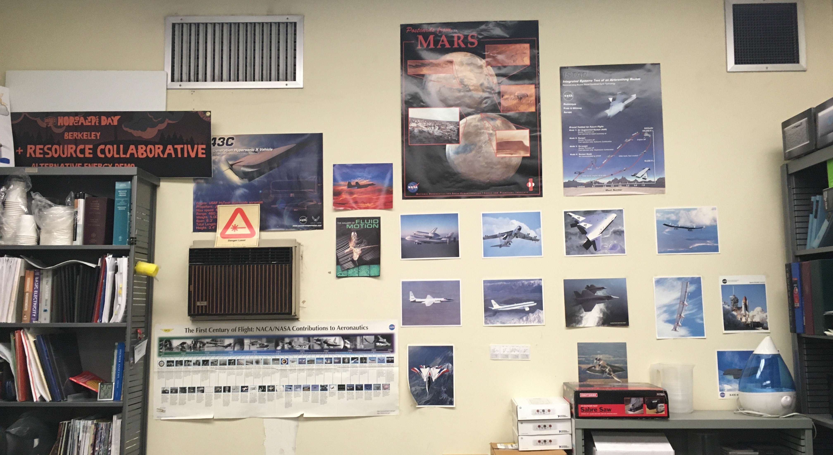
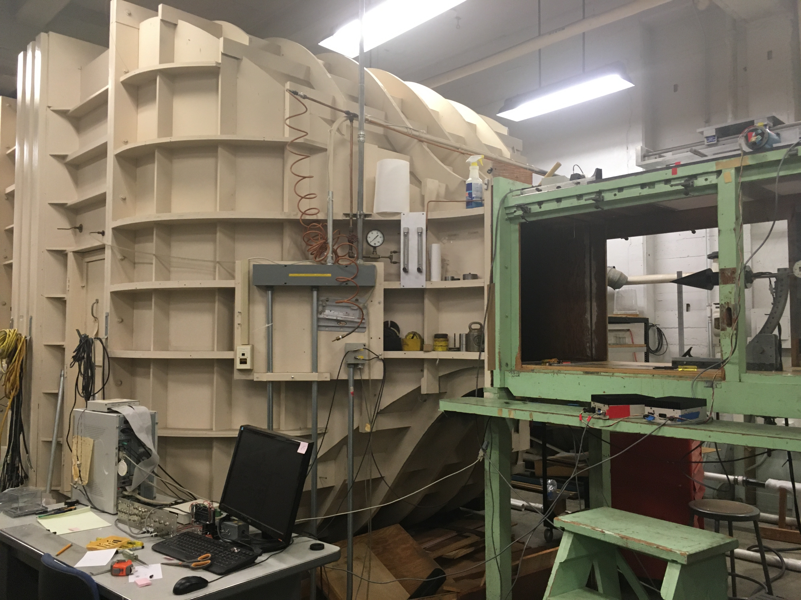
Wendy Yang
University of California, Berkeley
Mechanical Engineering
2021
Previously:
UCB Fluid Mechanics Laboratory
L'SPACE MSFC NPWEE project
JSC Micro-G NeXT
AmeriCorps JusticeCorps
Amateur Rocketry at UCB

Slide 3
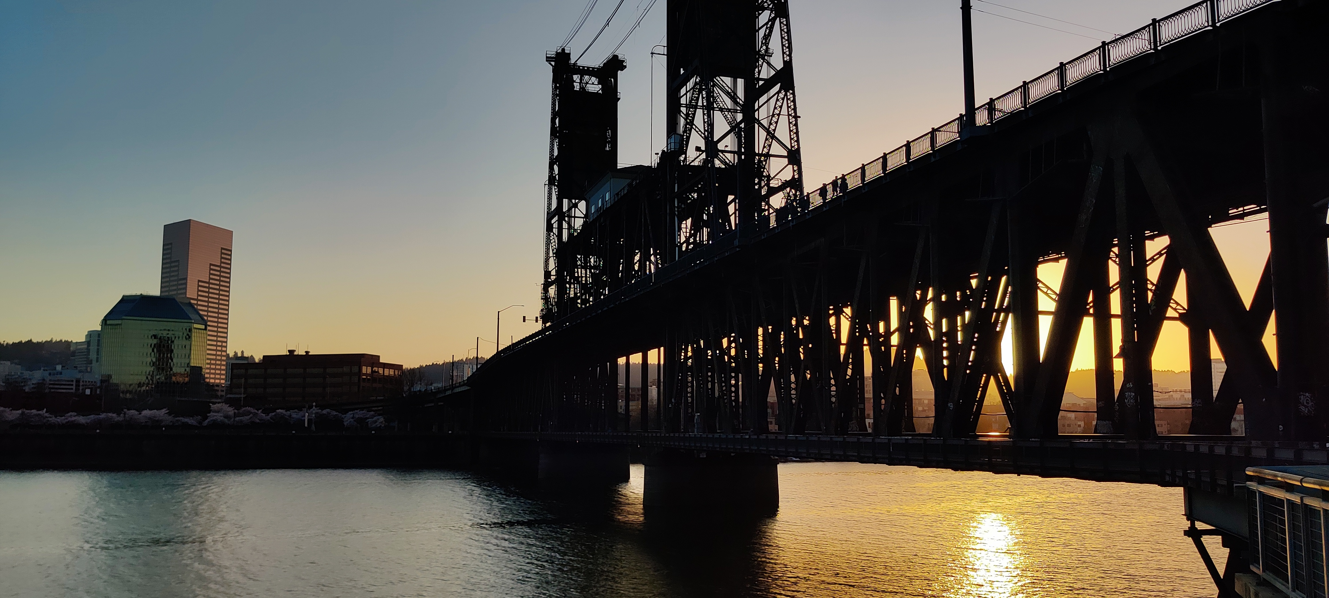
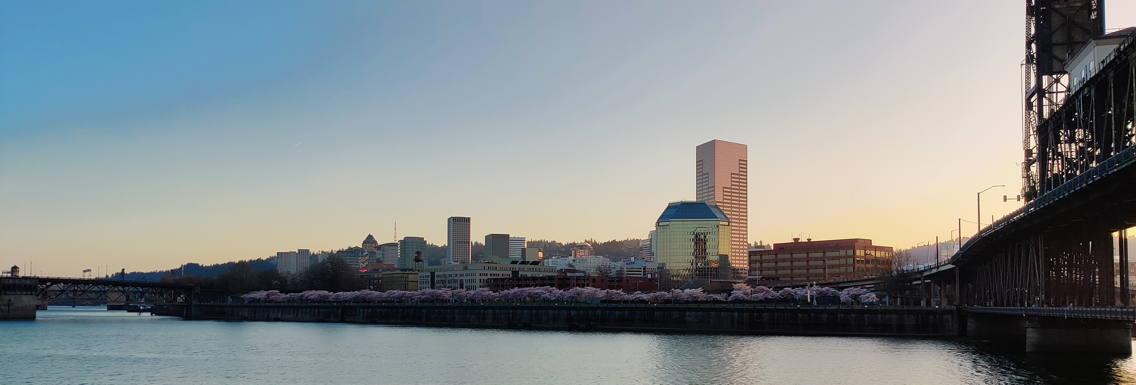
Aurora Mak
Portland State University
Mathematics
2021
Previous Work:
  Fall 2020 Prandtl Propeller Project:
        Focused on foundational mathematics
        Derivation of equations in Prandtl 1933
Hobbies:
  Cooking
  Fashion
  Reading
  Video Games
    Valheim
    Fall Guys
    Resident Evil 7
  Formula 1

Slide 4
Overview
Goals:
All About Understanding!
All to Build on Previous Design Methods to Automate the Process
Document the Researching Process for Understanding and Publication
Use CAD and CFD to model and analyze Prandtl Propellers
Further Understanding of Traditional Wing and Propeller Design
  Researching Traditional Aero Papers
Further Understanding of Prandtl Wing and Propeller Design
  Collaborating with Prandtl-M

Slide 5
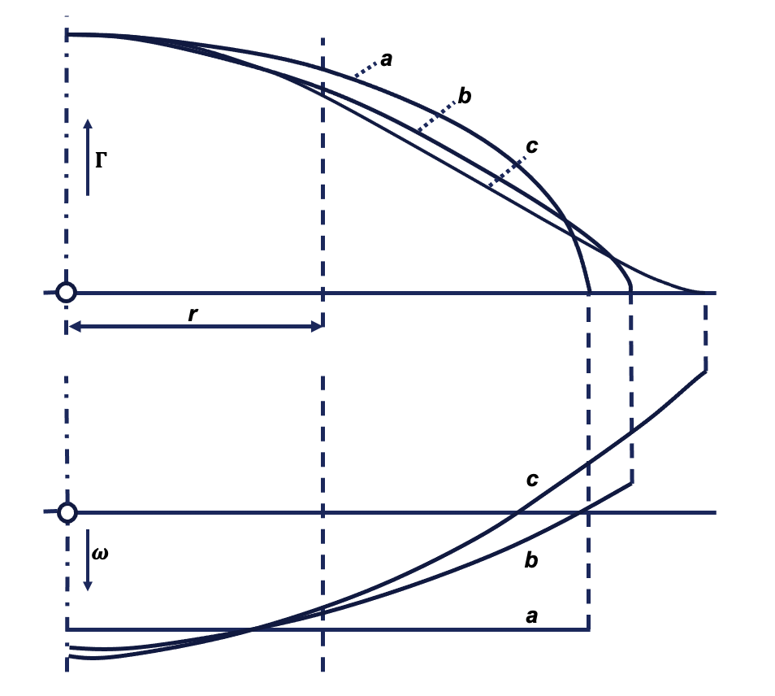
Background Info
Wing design –
  Elliptical Spanload(Lift Distribution)
  Elliptical Planform
  Set Span
Prandtl wing design –
  Bell Curve Spanload
  Set Structural Weight
Prop design –
  Elliptical Spanload
  Thrust contribution at tips
Prandtl Prop Design –
  Bell Curve Spanload
  Inboard Localized Thrust
Prior to this 1933 paper, the proposed best lift distribution was the elliptical spanload.
The, Prandtl proposes that a bell curve lift distribution is more efficient.

Slide 6
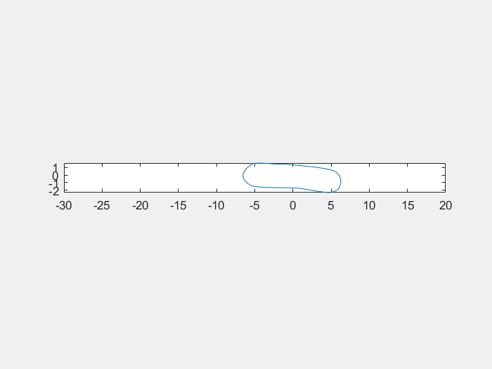
Background Info
Challenges with prop design
Span constraint
Minimum induced loss design
based on constant downwash
(Goldstein 1929)
Finite efficiency (Prandtl and Betz 1927)
Comparison with stock propellers
Performance comparison
Stock vs Prandtl
Benefit comparison
Stock propeller based design
Use same airfoil (flat plate, Clark Y, Eppler 63, NACA 4412)
Different C(r) and twist angle

Slide 7
Tasks
Research
  History and traditional methods of wing design and analysis
  Digging into designs assumptions from a mathematical perspective
Documentation
  Writing a technical paper for publication and internal documentation
Collaborating with PRANDTL-M
  Develop more understanding of Prandtl wing design to then apply to the development of a Prandtl Inspired Propeller design method.

Slide 8
Tasks
Coding
  Using MATLAB and XFOIL to analyze aerodynamics performance of the propeller cross sections
  Using MATLAB to develop further understanding of varying parameterizations for lift distribution
  Use CAD to model propellers for CFD and manufacturing

Slide 9
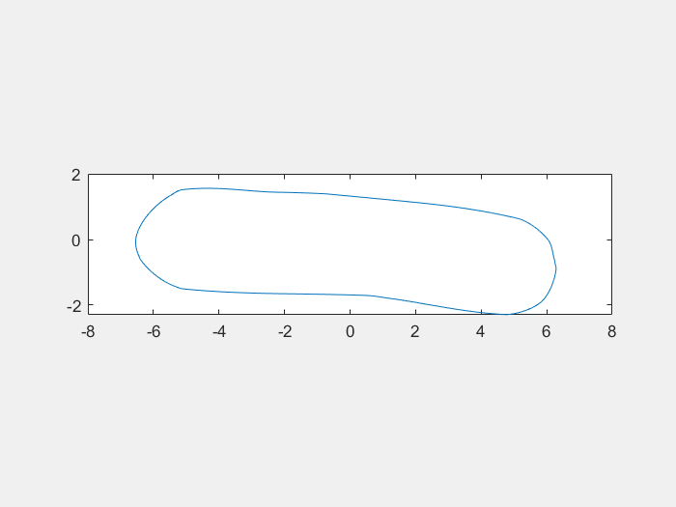
Contributions
MATLAB
Code to rotate propeller section
  Untwist stock propeller section
  Align chord and feed into CFD
  Twist again for Prandtl
Rotated airfoil generator

Slide 10
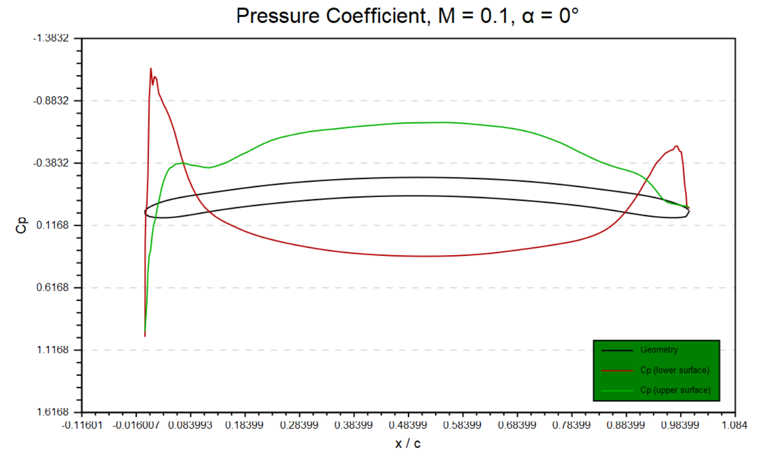
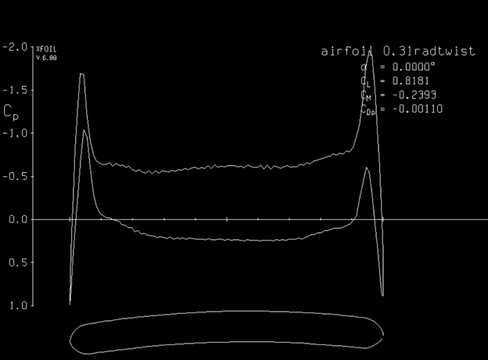
Contributions
XFOIL/AFTGen
Analyze 20 stock propeller sections performance
Determine if stock propeller section good basis

Slide 11
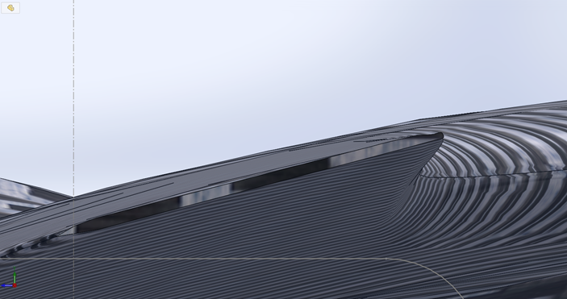
Contributions
SOLIDWORKS
Create better propeller models
Use airfoil model (Clark Y)

Slide 12
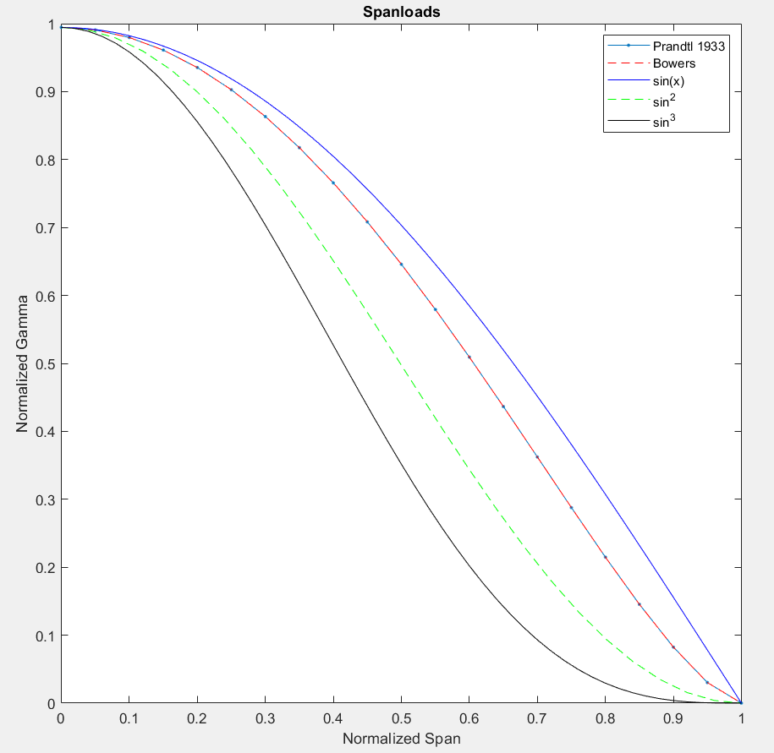
Contributions
Matlab:
  Non-dimensional and normalized spanload parameterizations
  Able to relate equations
  Different parameterizations imply different span

Slide 13
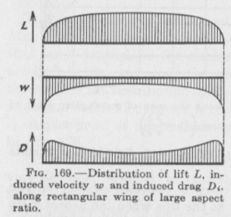

Contributions
Assumptions:
  Constant Downwash assumed in derivation of Induced Drag
  Must be investigated since downwash is no longer constant
  German technical papers are harder to read when you don't know German
  Finding this assumption validates our desire to research traditional methods and theory.

Slide 14
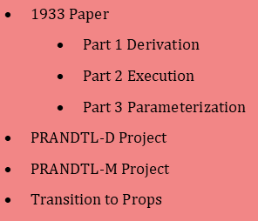
Contributions
Technical Write-Up
  Edit and expand the write-up
  Add in the PRANDTL-M design method.
  Incorporate the information from nondimensional plots
  Record and elaborate on assumptions to investigate

Slide 15
Lessons Learned
Don't trust that software will read the coordinates correctly
Researching for a project is not as easy as it seems
Not translated
Not uniform in variable names
Not as in depth as desired
Utilizing Academic Resources when possible
Take notes, take notes, take notes.
Talking through papers as a group was very helpful.

Slide 16
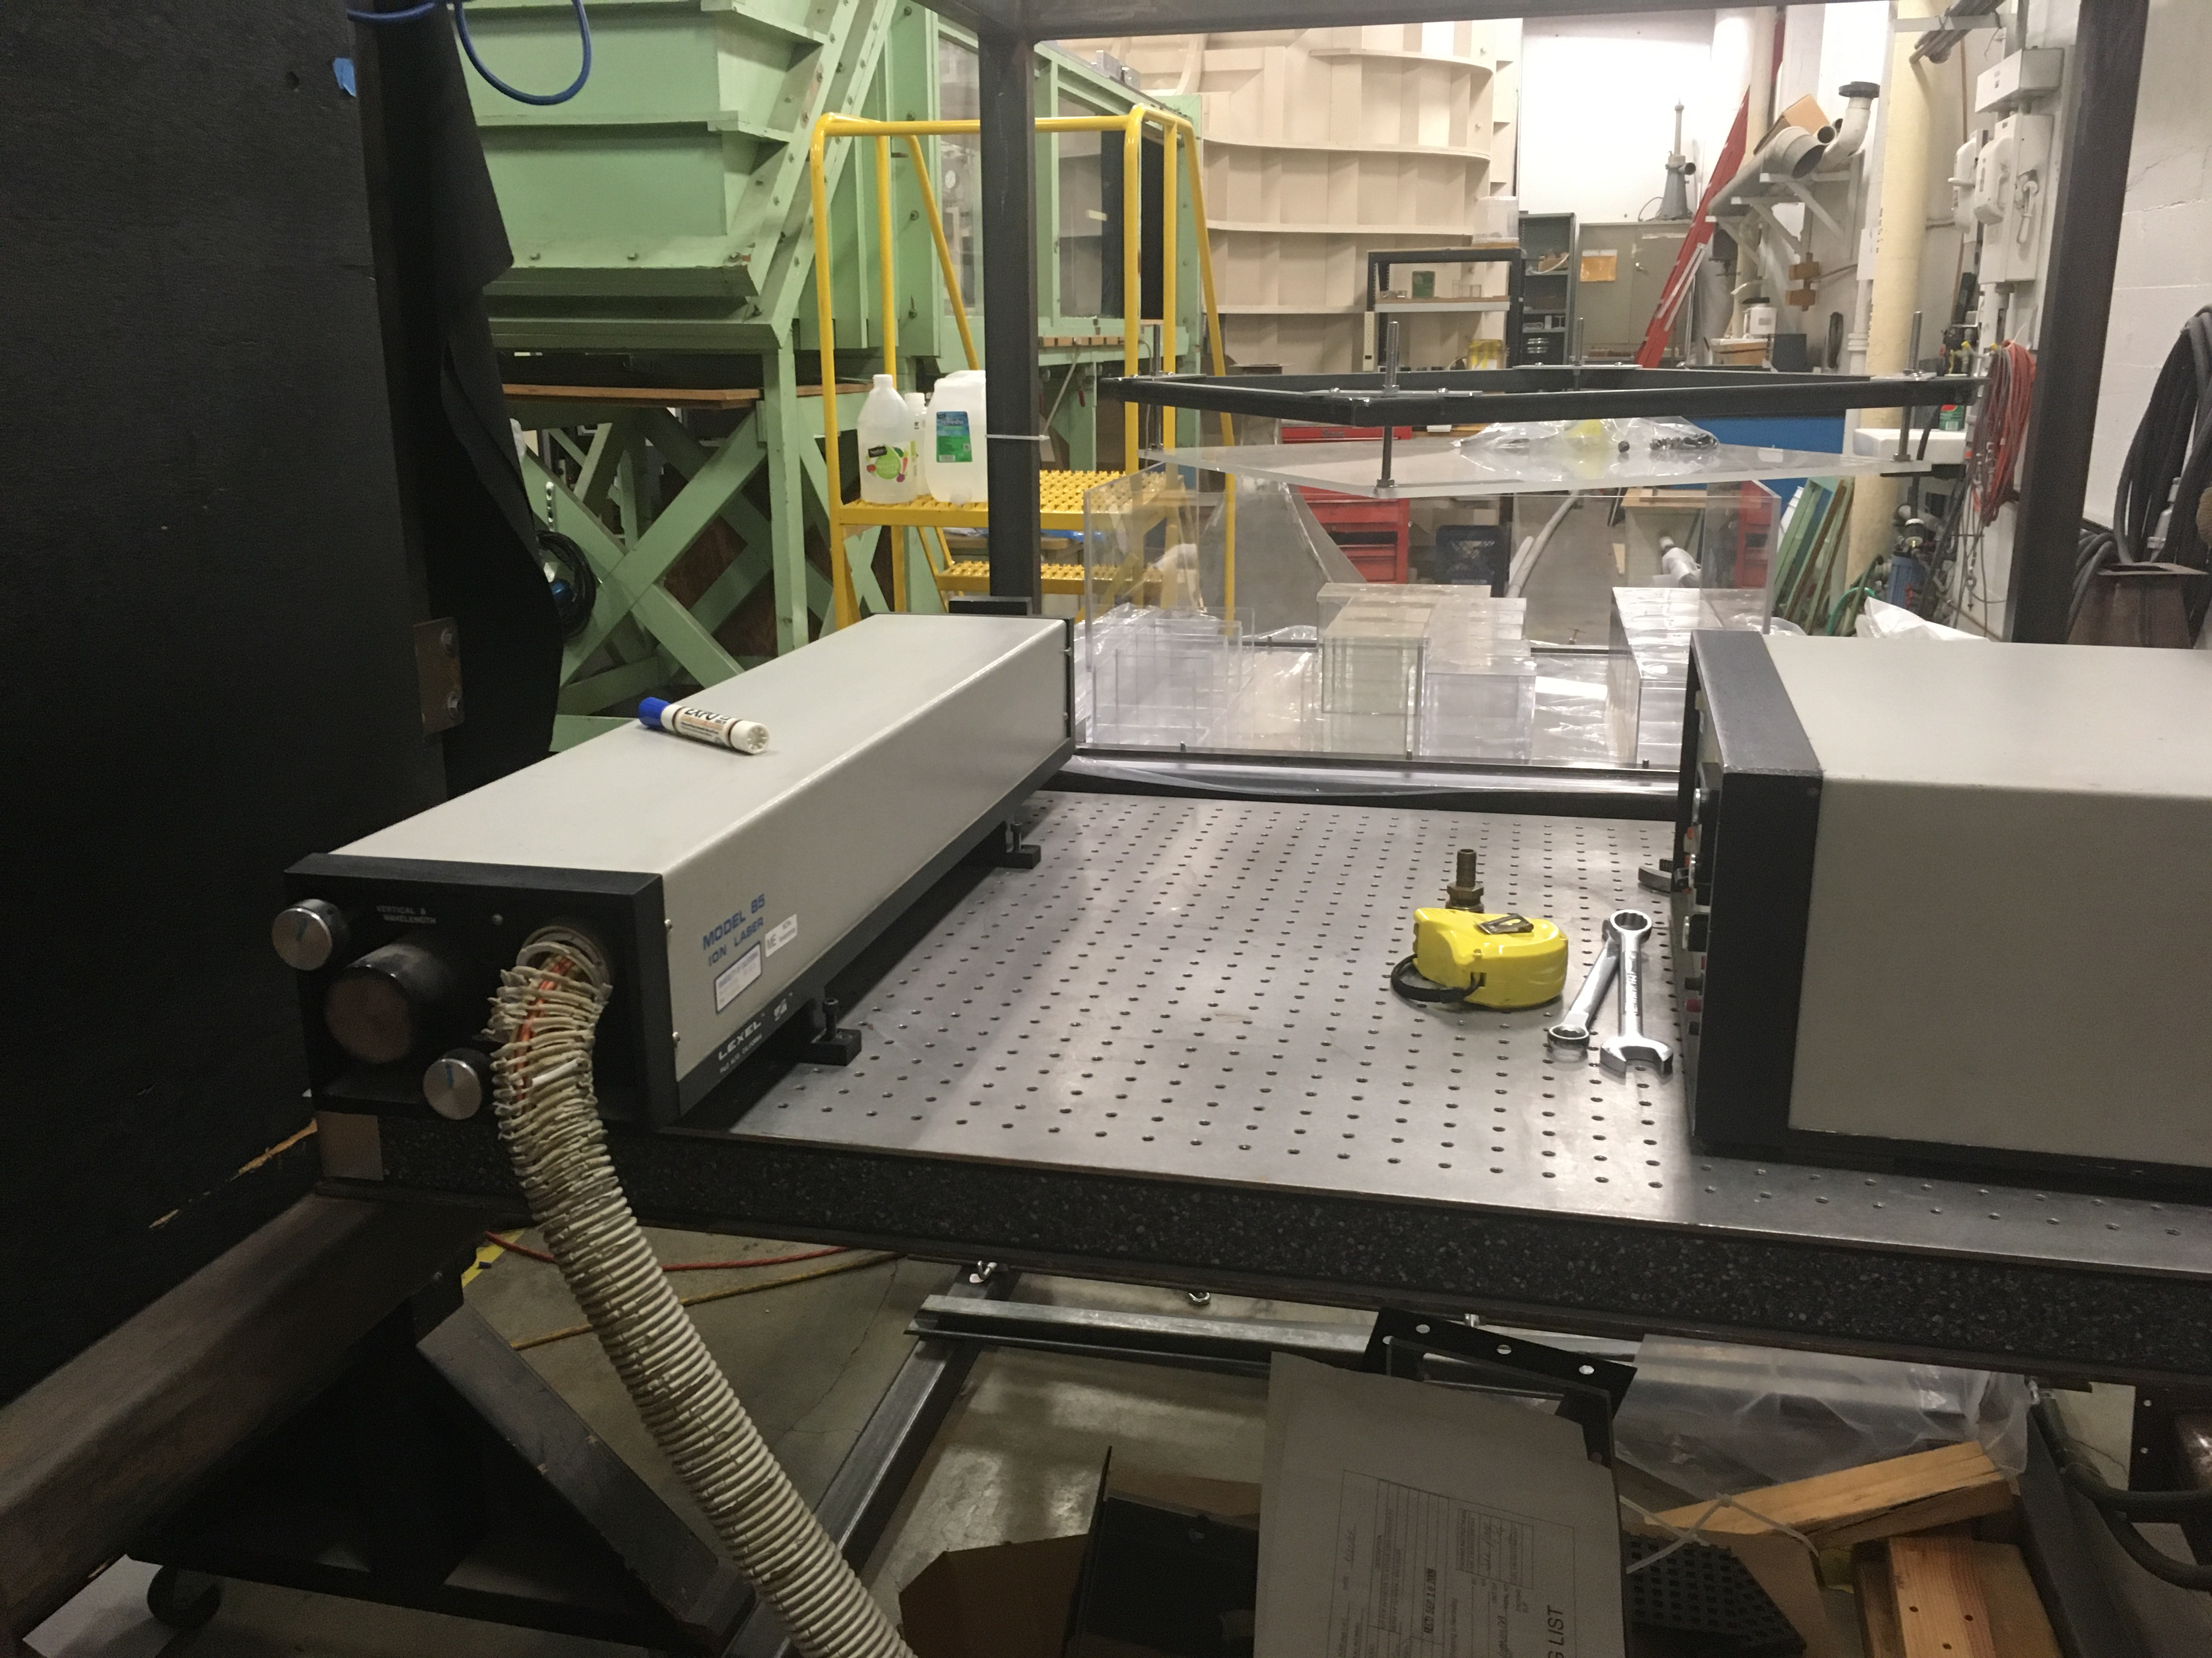
Future Work
Continue to work on this project for summer session
Having working CAD with Prandtl incorporated
Create algorithm for Prandtl twist on prop
Perform CFD analysis on Prandtl prop
Dye injection experiment on Prandtl wing performance
Analyze wind tunnel data on Prandtl wing
After internship
NPWEE project with MSFC
Grad school (potentially working on this from the academia side)

Slide 17
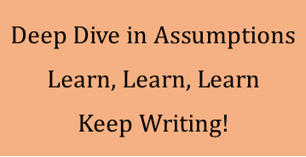
Future Work
Continue to work on this project for summer session
Further the research into assumptions
Keep learning what we can
Increase documentation
After internship
Graduate in June
Return next session and continue working
Working on personal writing projects

Slide 18
Internship Experience
Great time working with other interns on related projects
  Prandtl-M team
  RVLT team
Parttime limits the ability to do all events and do the project
  Pick and Choose
  Getting to work on cutting edge projects

Slide 19
Acknowledgements
Thank you!
Jason Lechniak,
Kurt Kloesel,
Lisa Illowsky,
Mostafa Youseff,
Jean Ghantous,
Daniel Velasquez,
Dave Berger,
Hannah Farley,
Sophia Hahn,
David Voracek,
Al Bowers,
Professor Ömer Savaş
Eric Ibarra,
Dave McBride,
Steve Cumming

Slide 20
Questions?

