Slide 1

Air-Cooled Temperature Swing Compression System Rebuild
ICES Paper 2021-129
Marian Alcid and Kelby Gan (Presenters)
Tra-My Justine Richardson and Darrell Jan
Jonathan Castellanos

Slide 2
Agenda
Background and overview of AC-TSAC
Hardware upgrades
Software and LabVIEW program updates
Proposed tests
Future work

Slide 3
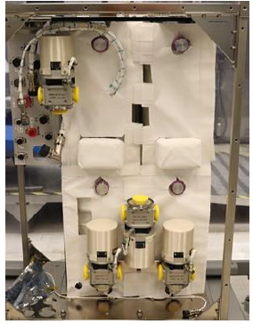
Air-Revitalization System Workflow
Air with reduced CO₂ content
H₂
Cabin
CO₂ Compressor
Separator
Cabin Air
CO₂ Removal Assembly
CO₂ Reduction
Assembly
Low
Pressure
CO₂
Electrolyzer
High pressure
CO₂
CH₄, H₂O
H₂O
CH₄
4BCO₂
AC-TSAC
O₂
Vent
Mechanical Compressor + Accumulation Tanks
CDRA
Cabin
Next Gen:
Current SOA:
Isobe, J., et al., Carbon Dioxide Removal Technologies for U.S. Space Vehicles: Past, Present, and Future. International Conference on Environmental Systems, 2016.
Richardson, T-M, J., et al., A Trade-off Study of the Spacecraft Carbon Dioxide Management System using the Analytical Hierarchy Process. International Conference on Environmental Systems, 2018.
Cmarik, G., et al., 4-Bed CO2 Scrubber – From Design to Build. International Conference on Environmental Systems, 2020.
Richardson, T-M, J., et al., A Trade-off Study of the Spacecraft Carbon Dioxide Management System using the Analytical Hierarchy Process. International Conference on Environmental Systems, 2018.

Slide 4
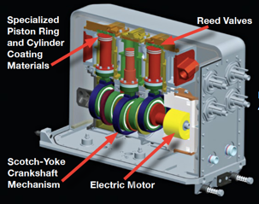
AC-TSAC Overview
Replacement for mechanical compressor
Solid-state compressor
  No rotating machinery
Zeolite adsorbent bed
Two canister beds operating in alternate cycles
  Constant output of high-pressure CO₂
Richardson, T-M, J., et al., A Trade-off Study of the Spacecraft Carbon Dioxide Management System using the Analytical Hierarchy Process. International Conference on Environmental Systems, 2018.

Slide 5
Full-Cycle Operation
COOLING
PRODUCTION
ADSORPTION
COMPRESSION
O=C=O
BED A
O=C=O
O=C=O
O=C=O
O=C=O
O=C=O
O=C=O
O=C=O
O=C=O
O=C=O
O=C=O
O=C=O
O=C=O
O=C=O
O=C=O
O=C=O
O=C=O
O=C=O
O=C=O
O=C=O
O=C=O
O=C=O
PRODUCTION
COOLING
ADSORPTION
O=C=O
BED B
O=C=O
O=C=O
O=C=O
O=C=O
O=C=O
O=C=O
O=C=O
O=C=O
O=C=O
O=C=O

Slide 6
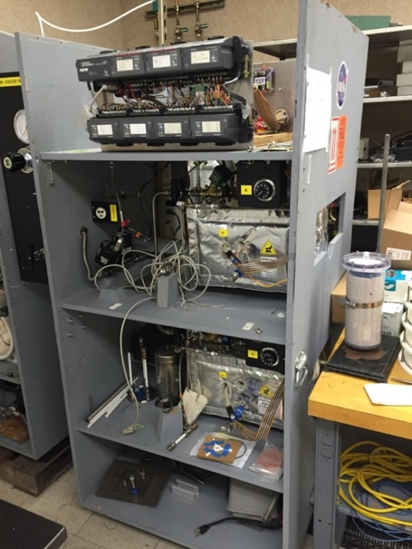
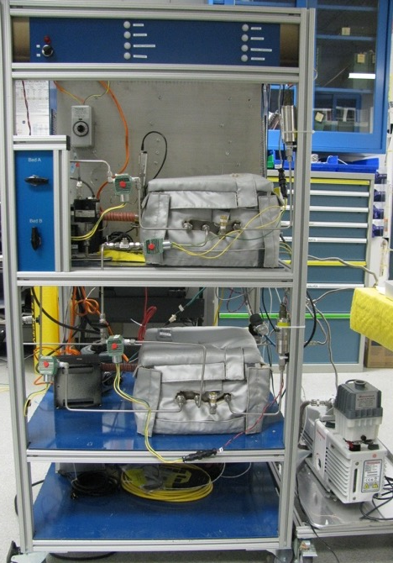
Rebuild
New/Updated:
Aluminum frame
Front panel
  -Main power switch
  -Canister stage indicator lights
  Solenoid valves
  Vacuum pump
  Thermostats
  Pressure controller
  Pressure relief valves
Carried over:
MFCs
Pressure transducers
Blowers
Old Rack
New Rack

Slide 7
Hardware Upgrades
Previous sorbent retaining screen - large mesh size
Current sorbent retaining screen – 80 x 700 mesh (35 micron)

Slide 8
Hardware Upgrades
Canister front panel
Canister back panel
Feedthroughs

Slide 9
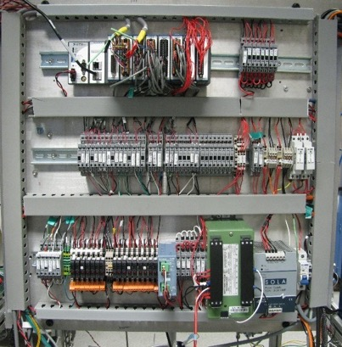
Controller and Electrical Panel

Slide 10
AC-TSAC Software Overview
Bakeout Program
  Automated regeneration of sorbent
Data Logging Program
  Records system status and sensor data
Auto Cycle Program
  Main operating program for AC-TSAC
  Completely automated operation of the system
10

Slide 11
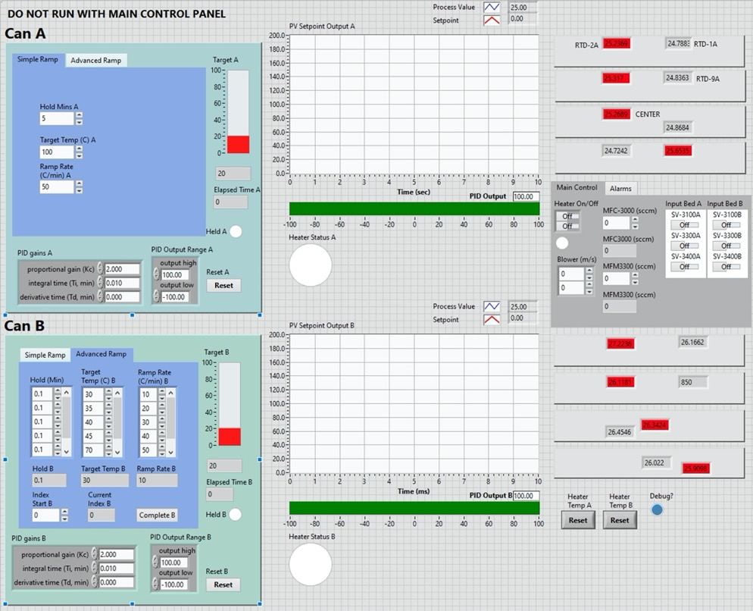
Bakeout Program
Notes:
Used for regenerating zeolite sorbent
Sorbent exposed to atmosphere
Coming out of long-term storage and inactivity
Previous program required manual operation
Program features:
Automated operation
Controlled ramp rate (simple and advanced control)
Holding temperature for a pre-determined length of time
Independent bakeout of individual sorbent canister beds

Slide 12
Bakeout Program Overview
Full regeneration required:
  Sorbent exposed to atmosphere
  Coming out of long-term storage and inactivity
Program features:
  Automated operation
    Previous bakeout operation was done manually by the user
  Controlled ramp rate (simple and advanced control)
  Holding temperature for a pre-determined length of time
  Independent bakeout of individual sorbent canister beds

Slide 13
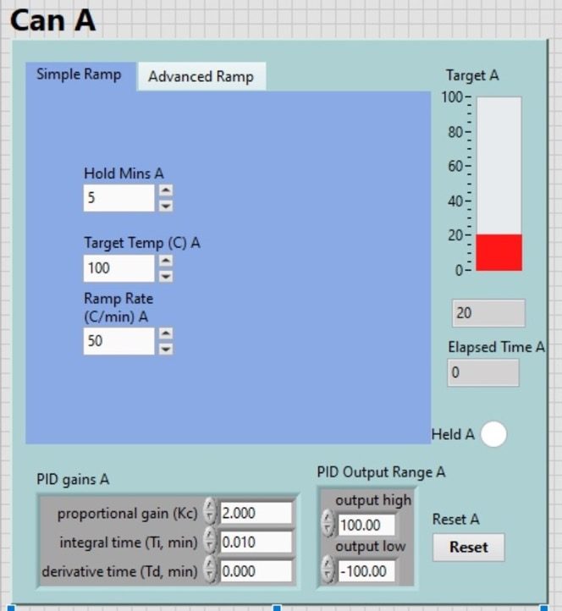
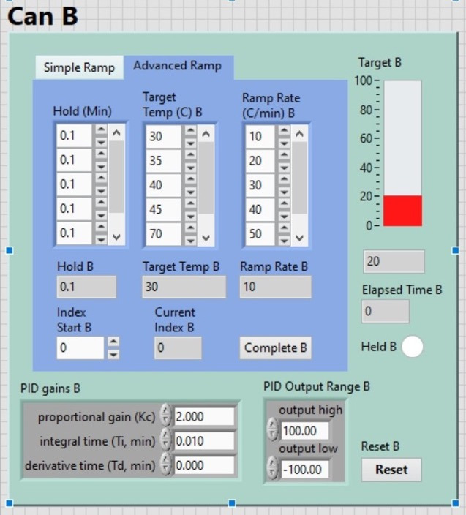
Bakeout Program
Notes:
-Explain differences between simple and advanced ramp
-

Slide 14
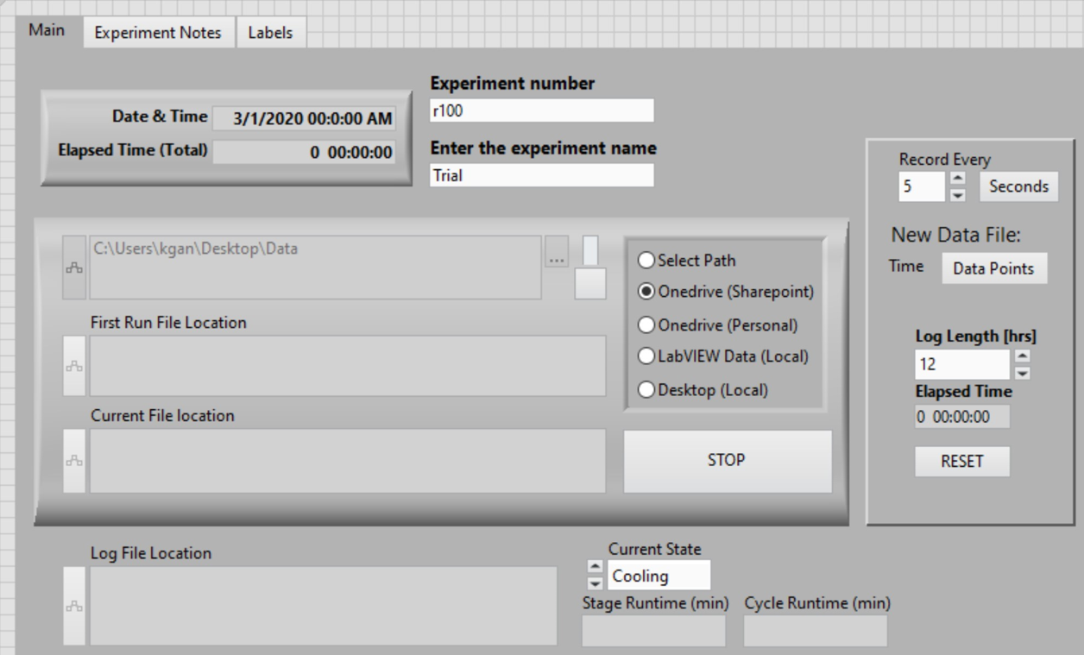
Data Logging Program
Notes:
Records system status and sensor data during system operation
Updated Logging program to support new NI cRIO hardware
Program features:
Easily add new sensors for recording
Ability to save copies to multiple locations
Save experiment notes with data
Easily adjust record rate
Automatically create new data log to reduce individual files’ size

Slide 15
Data-Logging Program
Updated Logging program to support new NI cRIO hardware
Program features:
  Easily add new sensors for recording
  Ability to save copies to multiple locations
  Save experiment notes with data
  Easily adjust record rate
  Automatically create new data log to reduce individual files’ size

Slide 16
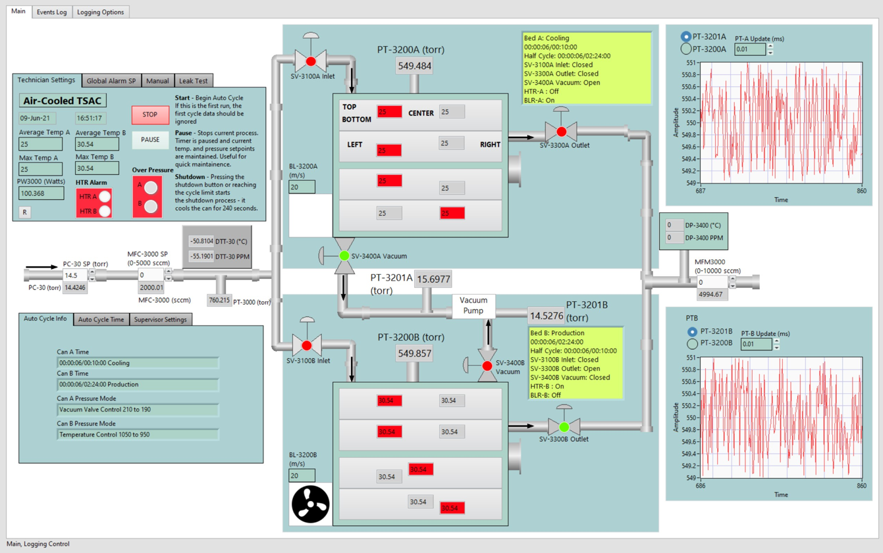
Auto-Cycle Program
Notes:
Main control program for solid-state CO₂ compressor operation
Program updated for use with cRIO hardware and improved for usability and modularity
Program features:
Completely automated operation
Easily reprogrammable
All temperatures, sensor readings all on one screen
Pause and Idle operation for quick hardware maintenance
Integrated Data Logging program

Slide 17
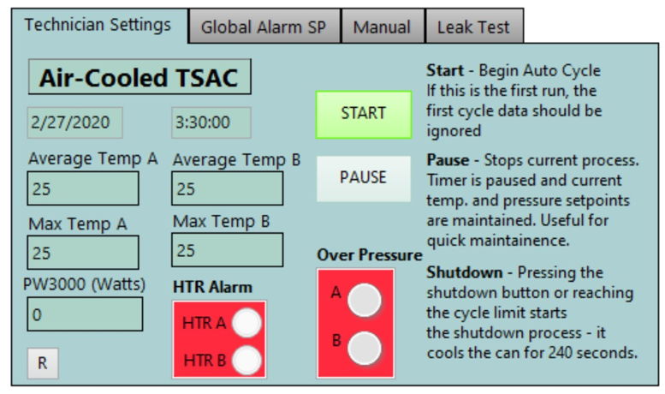
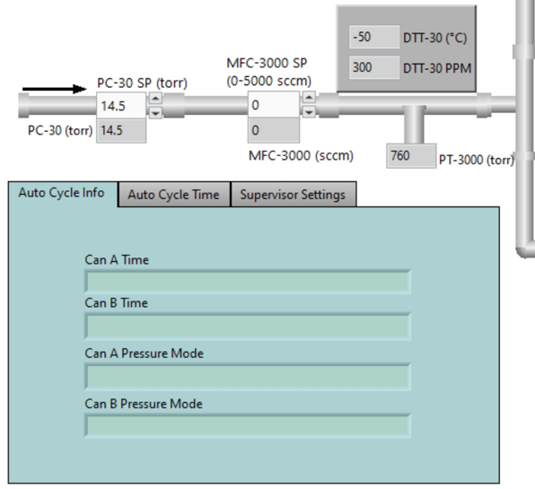
Auto-Cycle Program
Notes:
Main control program for solid-state CO₂ compressor operation
Program updated for use with cRIO hardware and improved for usability and modularity
Program features:
Completely automated operation
Easily reprogrammable
All temperatures, sensor readings all on one screen
Pause and Idle operation for quick hardware maintenance
Integrated Data Logging program

Slide 18
Auto-Cycle Program
Main control program for solid-state CO₂ compressor operation
Program updated for use with cRIO hardware and improved for usability and modularity
Program features:
  Completely automated operation
  Easily reprogrammable
  All temperatures, sensor readings all on one screen
  Pause and Idle operation for quick hardware maintenance
  Integrated Data Logging program

Slide 19
Proposed Tests
144 minute half-cycle tests
  Based on CDRA operating cycle
  Inlet pressure: 200 torr
  Outlet flowrate: ~1600 sccm (4.1 kg CO₂/day)
80 minute half-cycle tests
  Based on 4BCO₂ operating cycle
Extended test runs (1+ week)
4BCO₂-TSAC integration tests at MSFC

Slide 20
Future Work
Operate AC-TSAC with other zeolites or novel sorbents
Heat pipes
Heater redesign
Canister redesign
Flight hardware design

Slide 21
Acknowledgements
Allen Yau – NASA ARC (KBR)
Jason Samson – NASA ARC
Ryan Purdy – NASA ARC (Intern)
Tim Giesy – NASA MSFC
Greg Cmarik – NASA MSFC (ESSCA)
Jim Knox – NASA MSFC (ESSCA)
AES-LSS Management Team

