Slide 1
Utah Test and Training Range Hazard Database Creation for Mars Sample Return
18th International Planetary Probe Workshop
Sierra Luoma, Montana Tech
Ben Tackett, Analytical Mechanics Associates

Slide 2
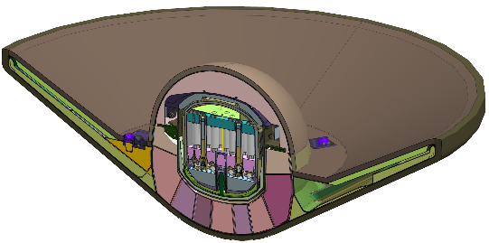
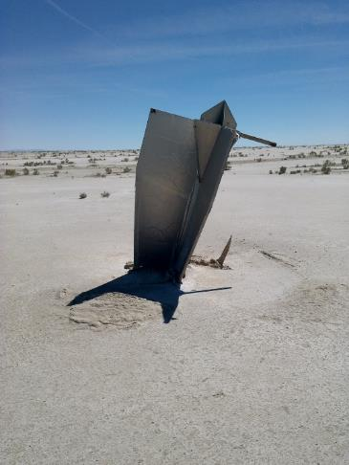
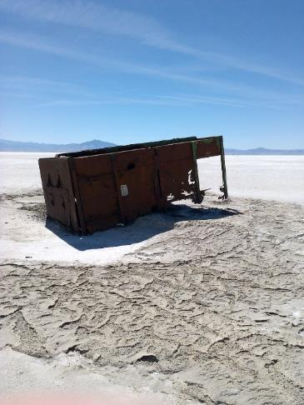
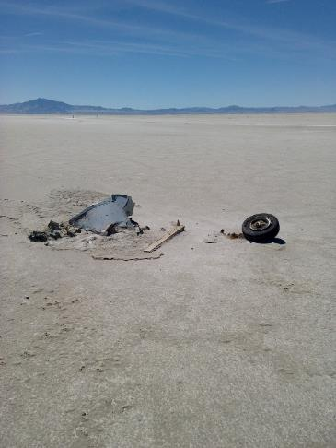
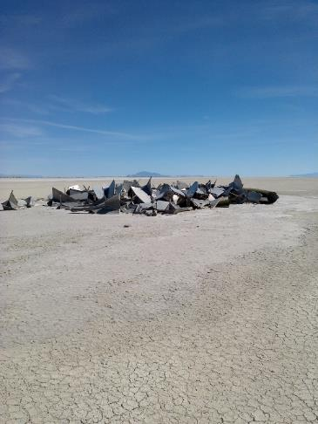
Introduction
The Earth Entry System (EES) for NASA’s Mars Sample Return mission:
Is a small entry capsule that transports the Mars samples from the Earth Return Orbiter to the Earth’s surface at UTTR
Lands at UTTR without a parachute at velocities > 40 m/s (90 mph)
Is designed to protect the Mars samples for landings on either the soft UTTR playa soil or man-made objects (i.e., hazards) in the landing area
The objective of this image processing work is to develop a map of the hazards in the UTTR landing area that can be used to derive the probability of the EES encountering these objects
Mars Sample Return EES Concept

Slide 3
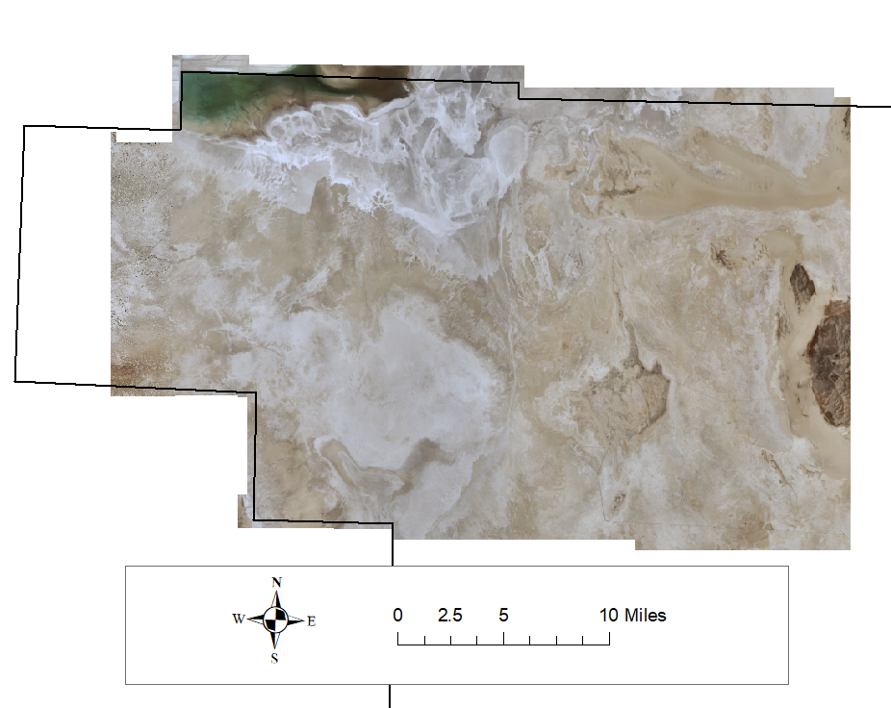
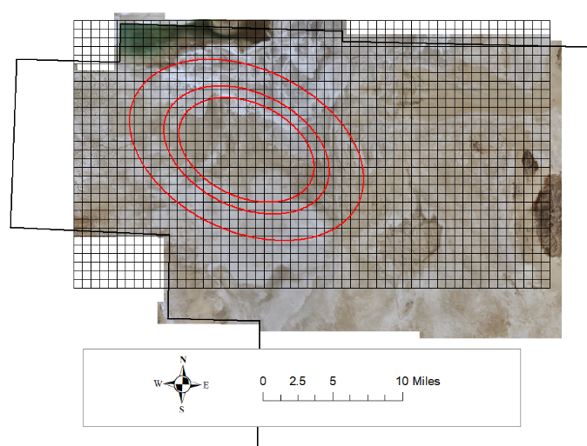
UTTR Images
The images are high resolution aerial photography of the UTTR south range.
Resolution: 15cm
RGB images.
These images were used for image processing in ERDAS Imagine and ESRI’s ArcMap for hazard identification.

Slide 4
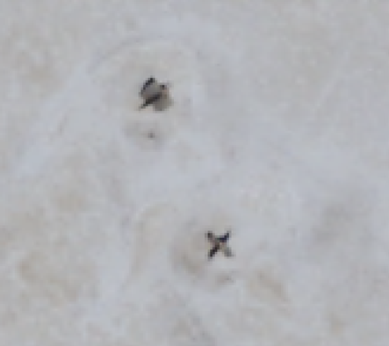
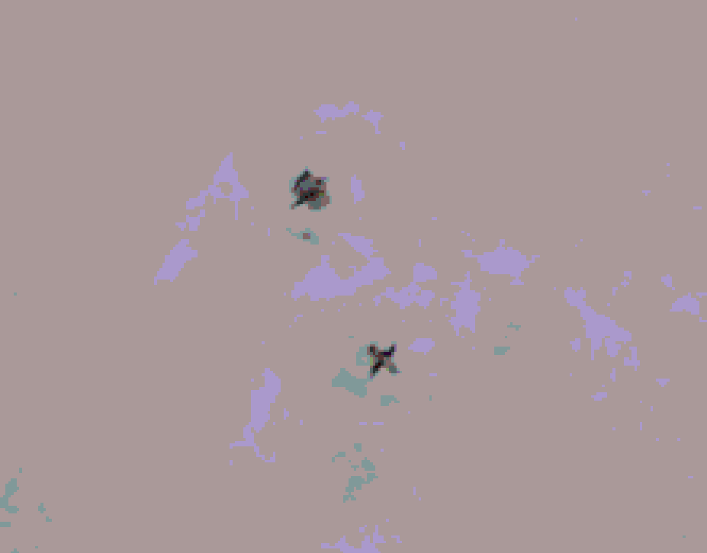
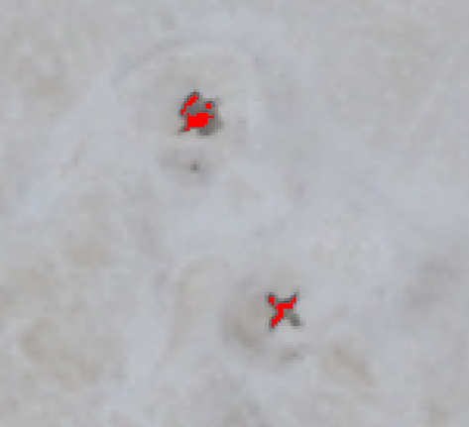
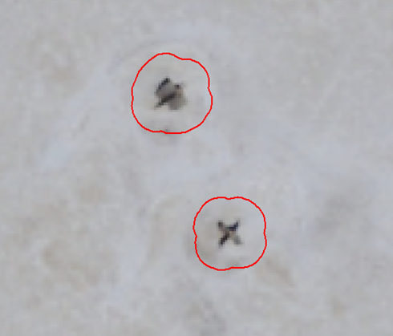
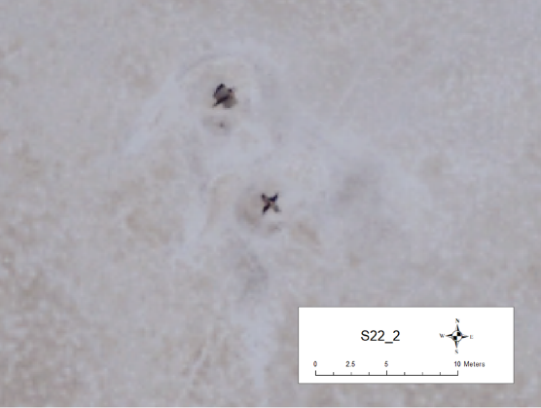
Image Processing Steps
Original Image
RGB clustering & RGB grouping.
Create polygons and check for hazards.
Add buffer to all hazards.
Add to hazard database and characterize hazards.
Take an image of each hazard.

Slide 5
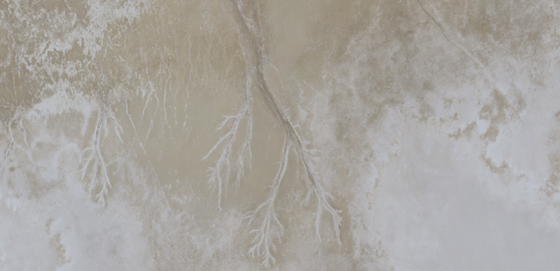
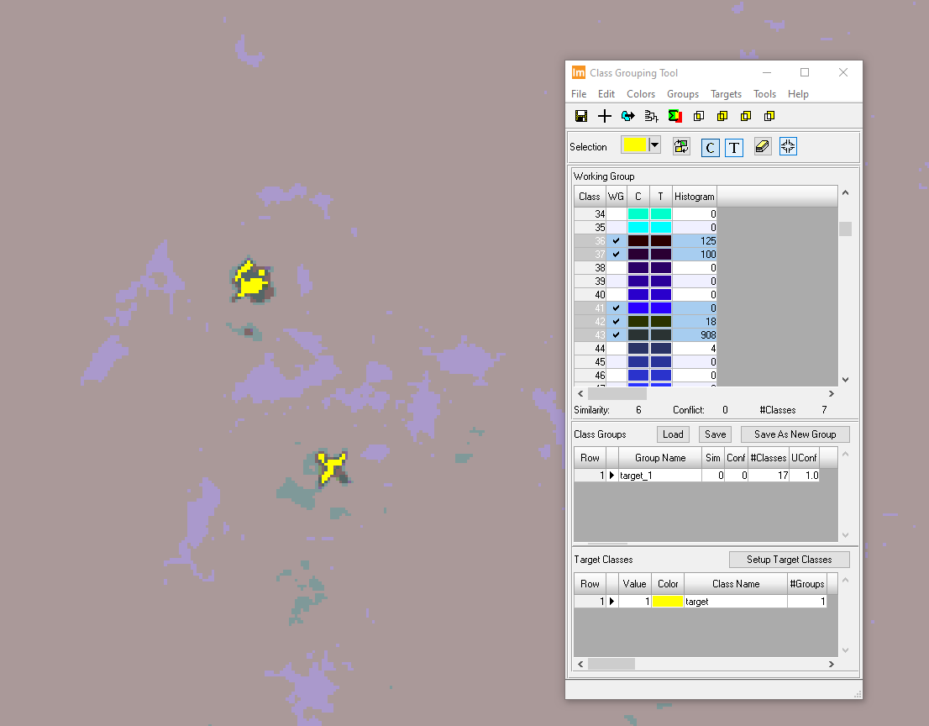
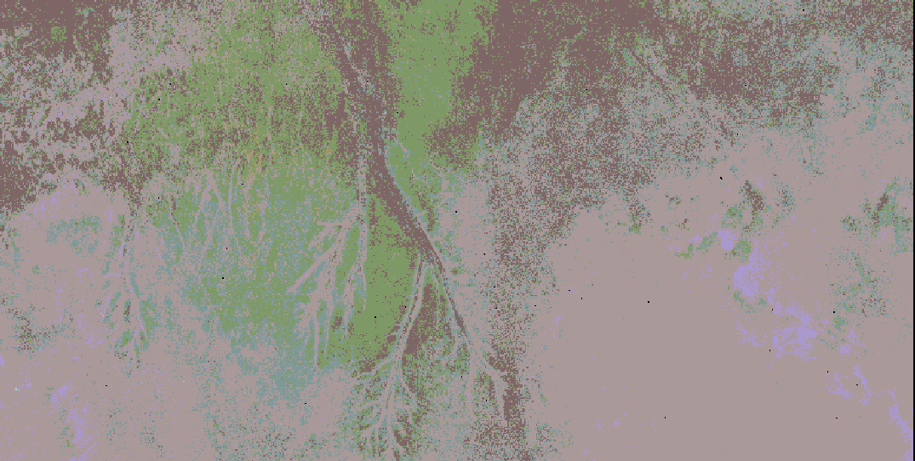
RGB Clustering & RGB Grouping
In Hexagon’s ERDAS Imagine, the RGB clustering tool produces grouped classes of pixels that share similar spectral signatures.
The RGB grouping tool allows these classes to be selected and saved to separate layers in a raster image.
Original Image
RGB Cluster
RGB Grouping
RGB Cluster

Slide 6
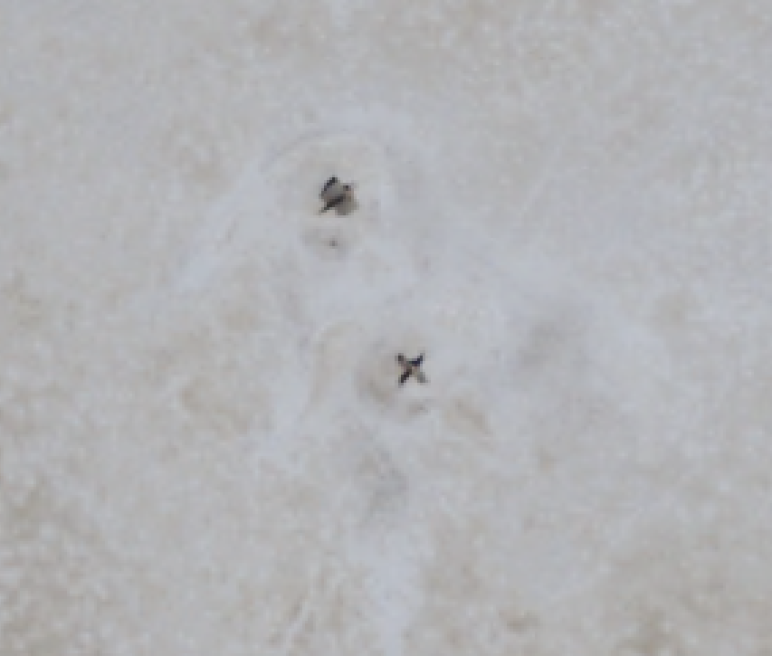

Creating Polygons in ArcMap
After grouping the images in ERDAS Imagine, the images are exported and imported into ESRI’s ArcMap using the Raster to Polygon geoprocessing tool.
These polygons are reviewed to verify they are potential hazards in the UTTR.
Original Image
Hazard Polygons

Slide 7
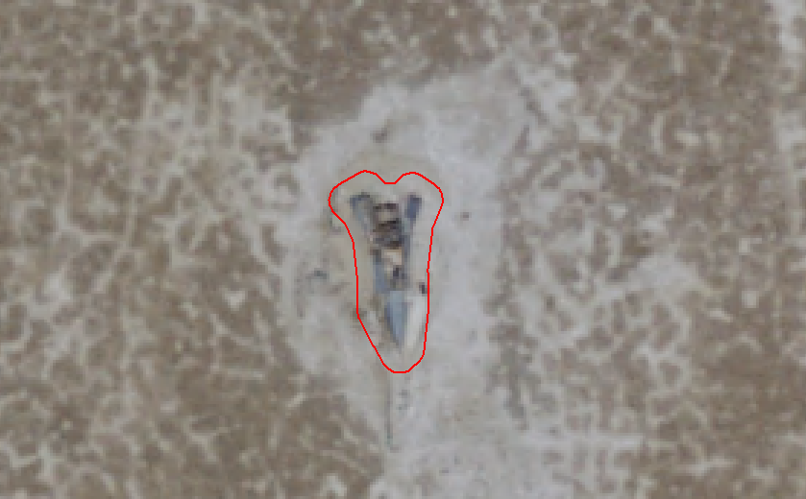
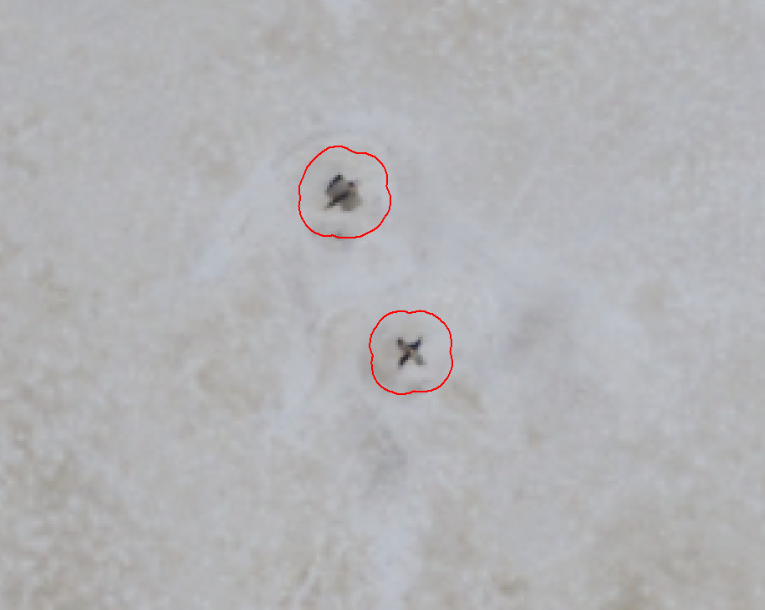
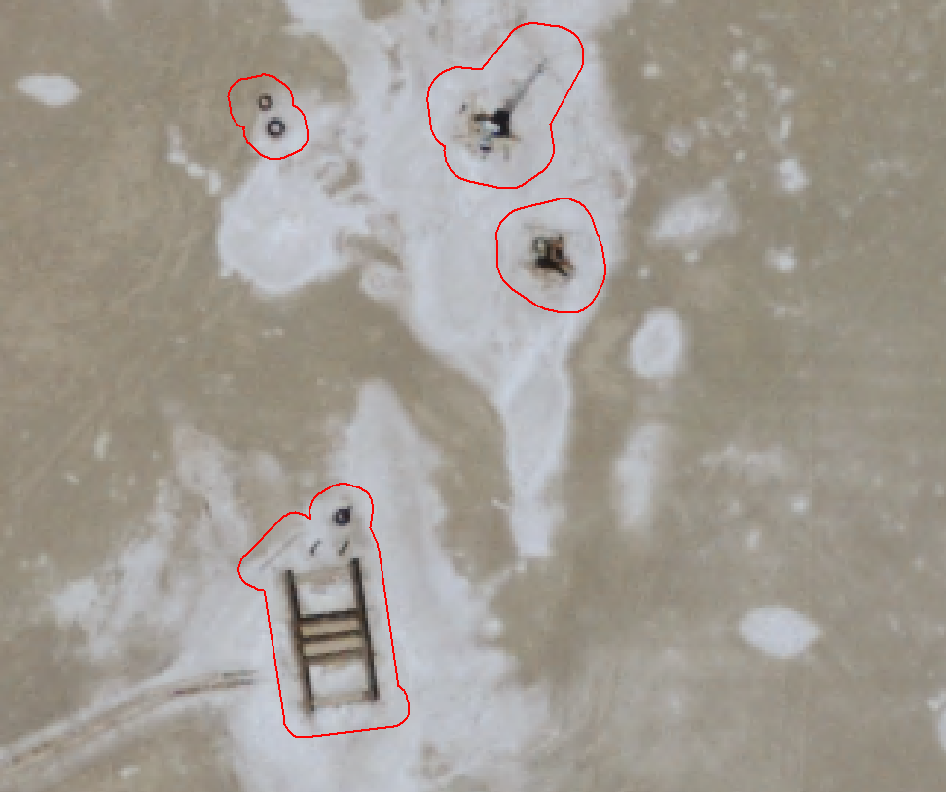
Adding Buffers to Hazards
The buffer tool adds extra area around each hazard depending on the type of hazard:
  Target darts: 1.25m buffer distance
  Other hazards: 0.75m buffer distance
The buffer adds extra area to safely account for each object and the diameter of the EES

Slide 8
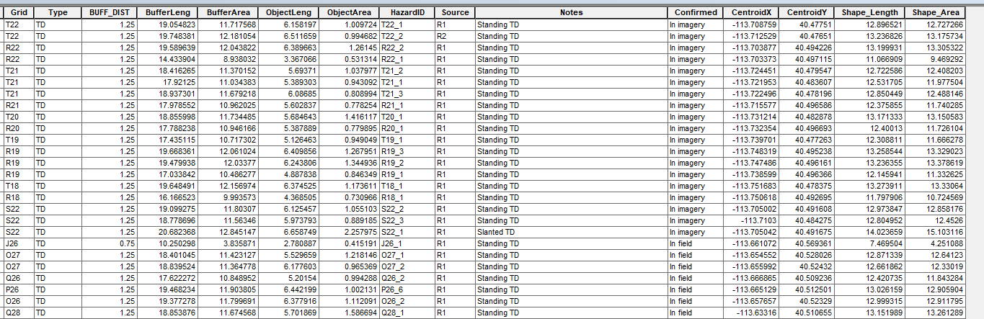
Hazard Database Format
The hazard database has the following fields to fully categorize each hazard:

Slide 9
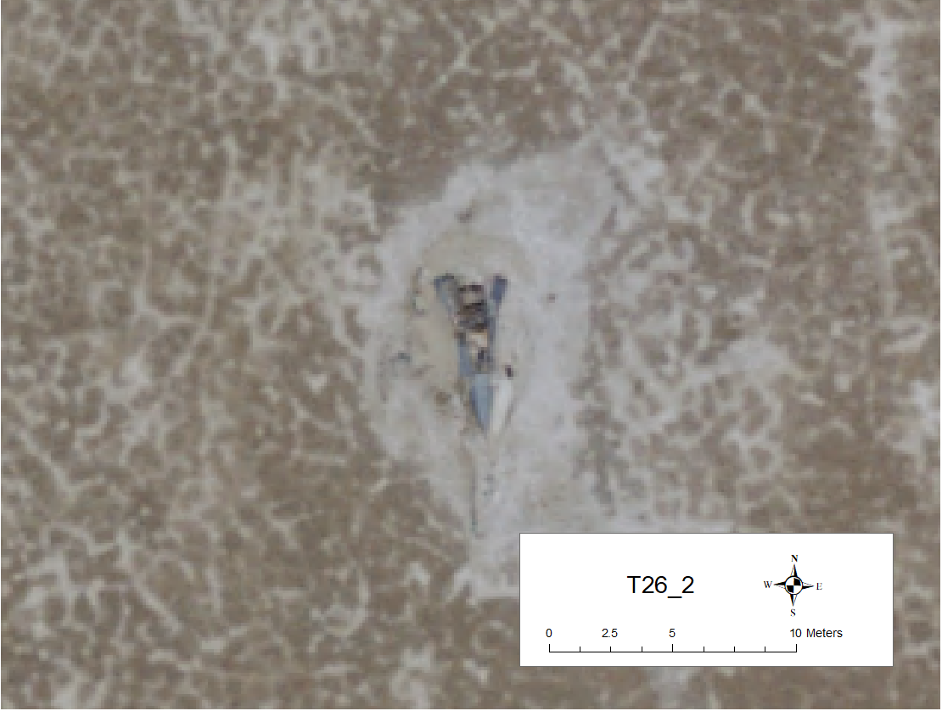

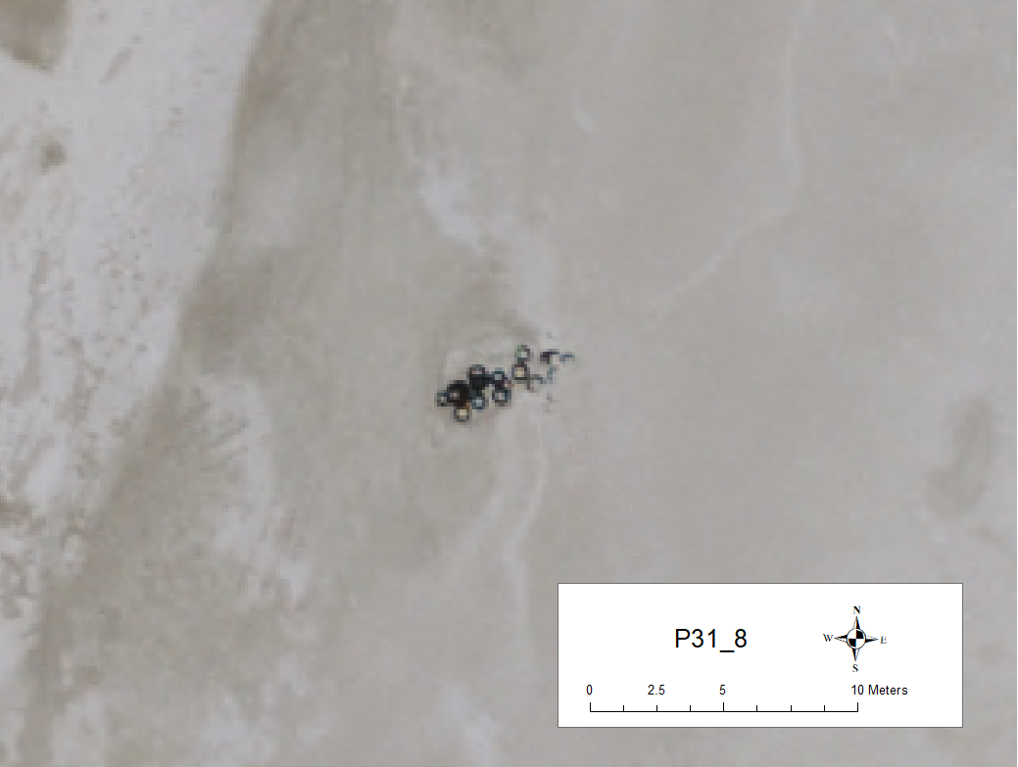
Hazard Images
An image of each hazard is saved with a hazard ID and grid location.

Slide 10
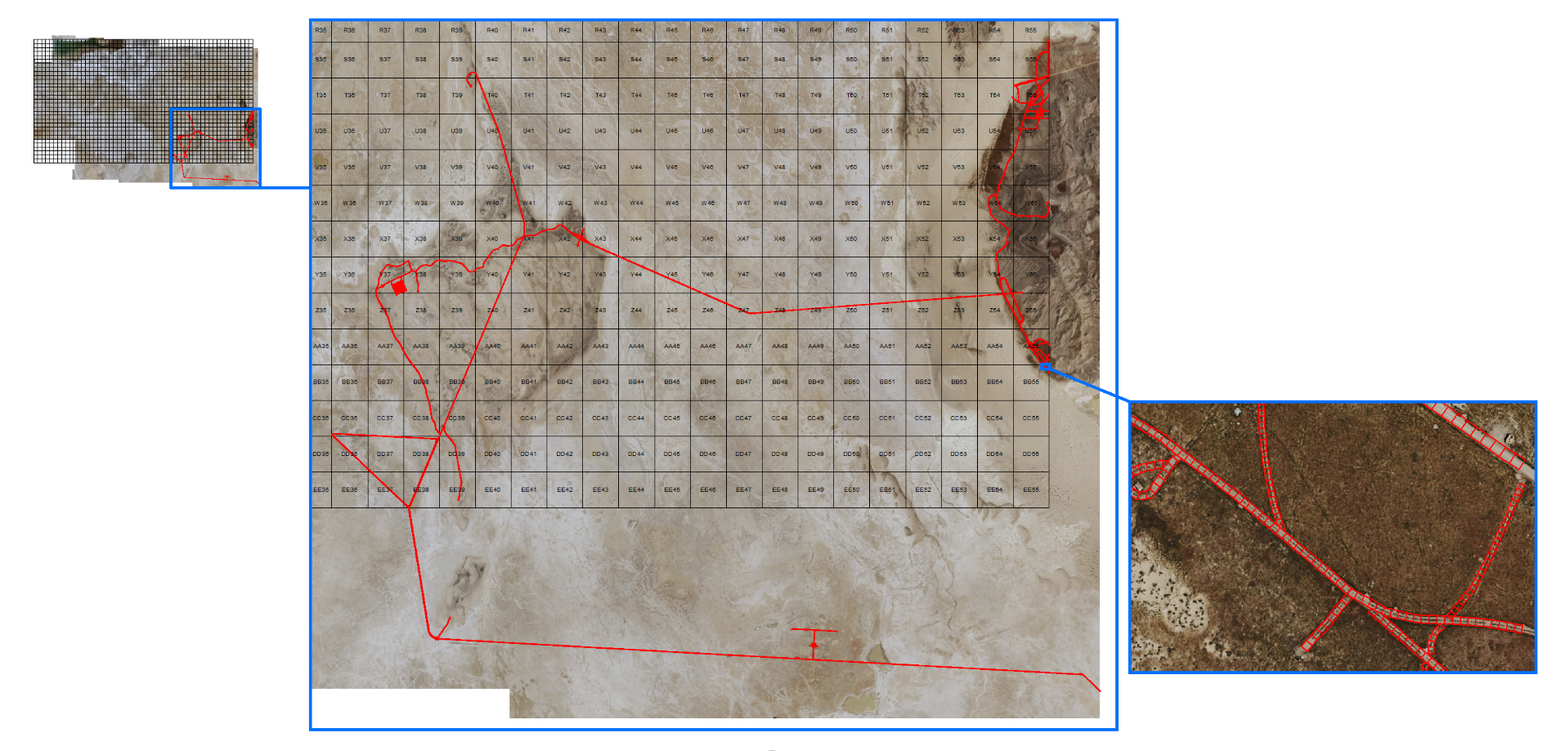
Road Hazard Area
There are over 16,000 polygons that make up the road hazards.
These polygons were made using a combination of manual and automatic methods in ESRI’s ArcMap.

Slide 11
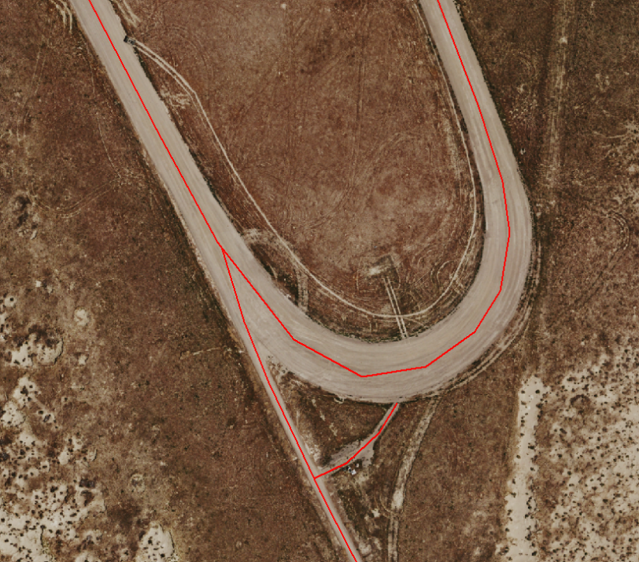
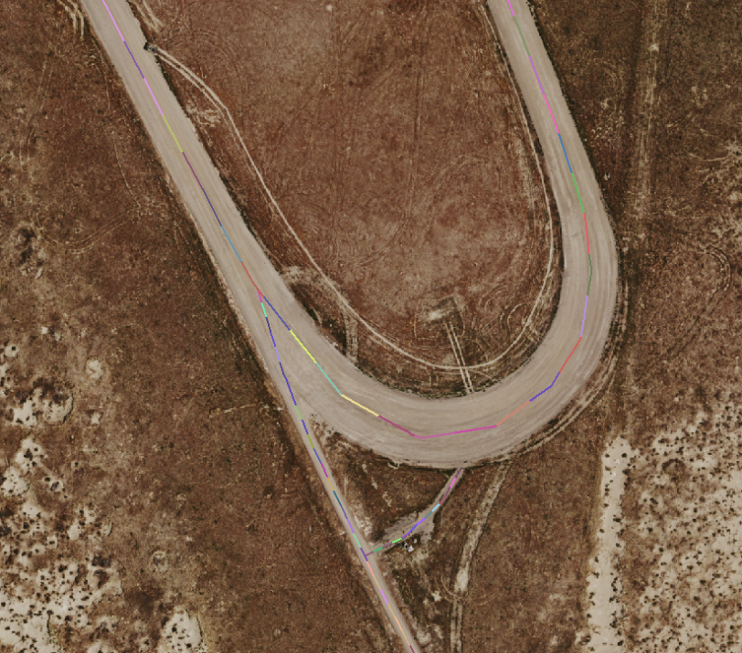
Road Polygon Creation Process
Create road lines
Measure and segment roads

Slide 12


Road Polygon Creation Process
Create buffer
Adjust placement and add polygons

Slide 13
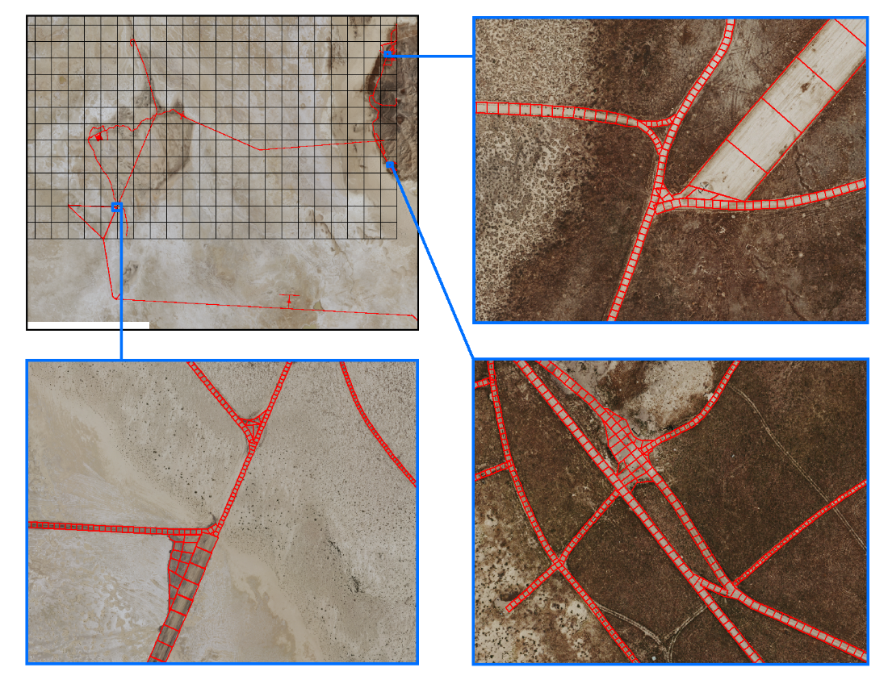
More Examples

Slide 14
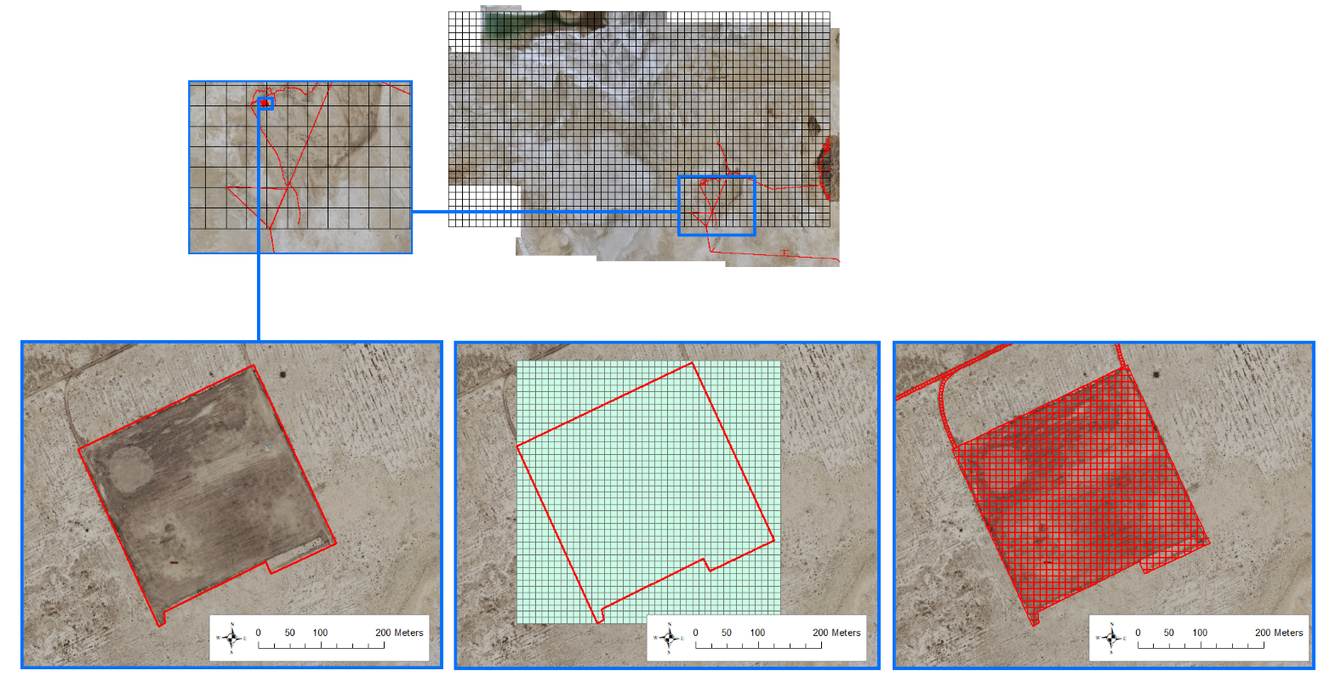
Segmenting the Square Area
Create a fishnet grid to fit the area with 10-meter square cubes
Cut the fishnet grid to the shape of the outlined area
Outline area

Slide 15
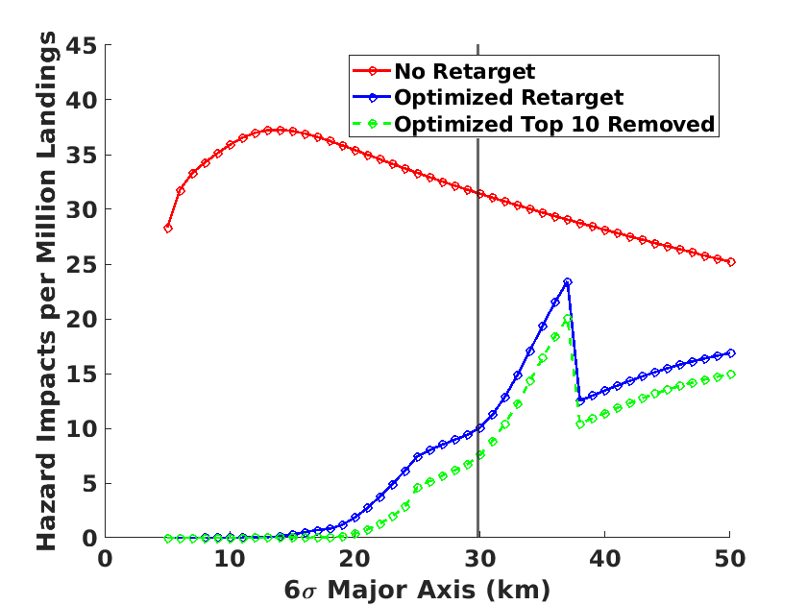
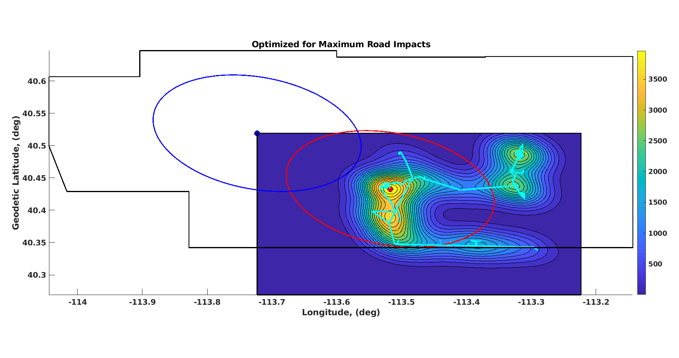
Probability Assessment
The hazard locations and areas are used for determining the probability of impacting a ground hazard during the Earth Entry Vehicle landing
Utilize Mahalanobis Distance and the predictability of the EES landing distribution to analytically calculate impact probabilities
Determine optimal landing location to minimize ground hazard impacts for a variable landing distribution subject to location constraints
Evaluate ‘worst-case’ probability scenarios, like impacting a road along the ground track
Determine which hazards could be removed for the largest effect on reducing impact probability

