Slide 1
Optimization of the 4-Bed CO₂ Scrubber Performance Based on Ground Tests
ICES Paper 2021-71
James C. Knox – Dynetics
Gregory E. Cmarik – Jacobs Space Exploration Group
Warren Peters – Marshall Space Flight Center
NASA/MSFC/ES62

Slide 2
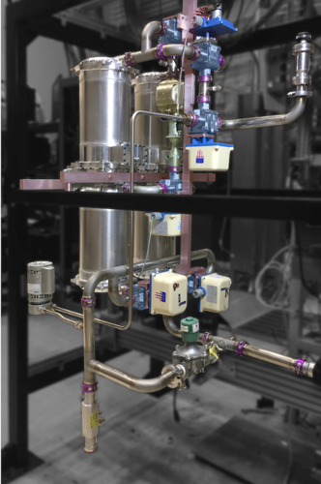
Linus (Ground Test) 4BMS
Similarities to flight 4BCO2:
Bed size, sorbents, and heaters
Blower (for selected tests)
Precooler (in later tests)
Check valve
Air save pump (in later tests)
Differences:
Conventional vs. AM duct elbows
Commercial ball valves vs. custom flight plug valves
Linus CO₂ removal performance expected to closely match flight system
LINUS

Slide 3
4BMS Schematic

Slide 4
Linus Repeatability
Performance results for standard conditions
Inlet and general operational parameters for standard conditions
Test Title | Date Run | 4BMS in/out CO2 Removal, kg/day | 4BMS inlet/outlet efficiency
4BLv3-33 | 9/30/2018 | 4.67 | 85.2
4BLv4-37 | 11/10/2018 | 4.72 | 85.6
4BLv4-38 | 11/12/2018 | 4.72 | 85.5
4BLv4-41a | 11/27/2018 | 4.72 | 85.0
4BLv4-41b | 12/3/2018 | 4.69 | 84.3
4BLv4-45f | 12/7/2018 | 4.67 | 85.0
 | Average | 4.71 | 85.1
Process Air Flow Rate, SCFM | 26
Total Half Cycle Time, Minutes | 80
CO2 Inlet ppCO2, torr | 2
Inlet Temperature, degF | 56
Inlet Dewpoint, degF | 53
Standard deviation is 0.5% of the average CO₂ removal rate
Linus CO₂ removal performance exceeds requirement by over 30%
Notes:
Experimental pool limited to tests with standard conditions with respect to flow rate, cycle time, and inlet CO2 partial pressure
Observation of the binomial distribution and distinct separation in performance led to consideration of grouping in two distinct data sets
It was not immediately evident which parameter change led to this sizable change in performance metrics
Also noted that repeatability improves for latter tests. This is a result of more rigid control over inlet parameters and stability in the hardware configuration in the last two test series.
Repeatability indicates the statistical significance of data mining results

Slide 5
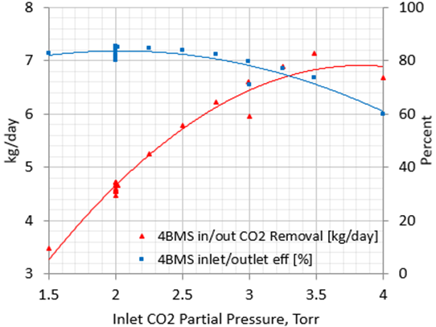
CO₂ Removal Performance
Standard deviation is 0.5% of the average CO₂ removal rate
Linus CO₂ removal performance exceeds requirement by over 30%
Notes:
Experimental pool limited to tests with standard conditions with respect to flow rate, cycle time, and inlet CO2 partial pressure
Observation of the binomial distribution and distinct separation in performance led to consideration of grouping in two distinct data sets
It was not immediately evident which parameter change led to this sizable change in performance metrics
Also noted that repeatability improves for latter tests. This is a result of more rigid control over inlet parameters and stability in the hardware configuration in the last two test series.
Repeatability indicates the statistical significance of data mining results

Slide 6
Statistical Analysis of CO₂ Removal
Stop light theme with dark green very strong, dark red very weak
Strikethrough indicates P-Value below 0.05
False positives can occur due to coincidental changes
Scatter plots used narrow down to correlated pairs with likely causality
All strongly correlated parameters coincidental except OP6 and OP7 (Primary and Secondary heater power)
Notes:
Correlation analysis of removal rate provides an illustration of this approach. The three correlation statistics provide complementary information; Pearson applies to linear relationships, Spearman to non-linear but monotonic relationships, and quadradic to non-linear, non-monotonic relationships
Statistical analysis of all experiments shows very strong correlation between system removal rate and inlet CO2, as expected, providing confidence in approach
However, false positives can occur due to coincidental circumstances, such as for run time, where the strong indication of correlation is due to monotonic increases in inlet CO2 partial pressure during the last set of tests
Once again the delineation between the early and late experiments is evident. Next consider only tests where inlet CO2 was at the standard condition

Slide 7
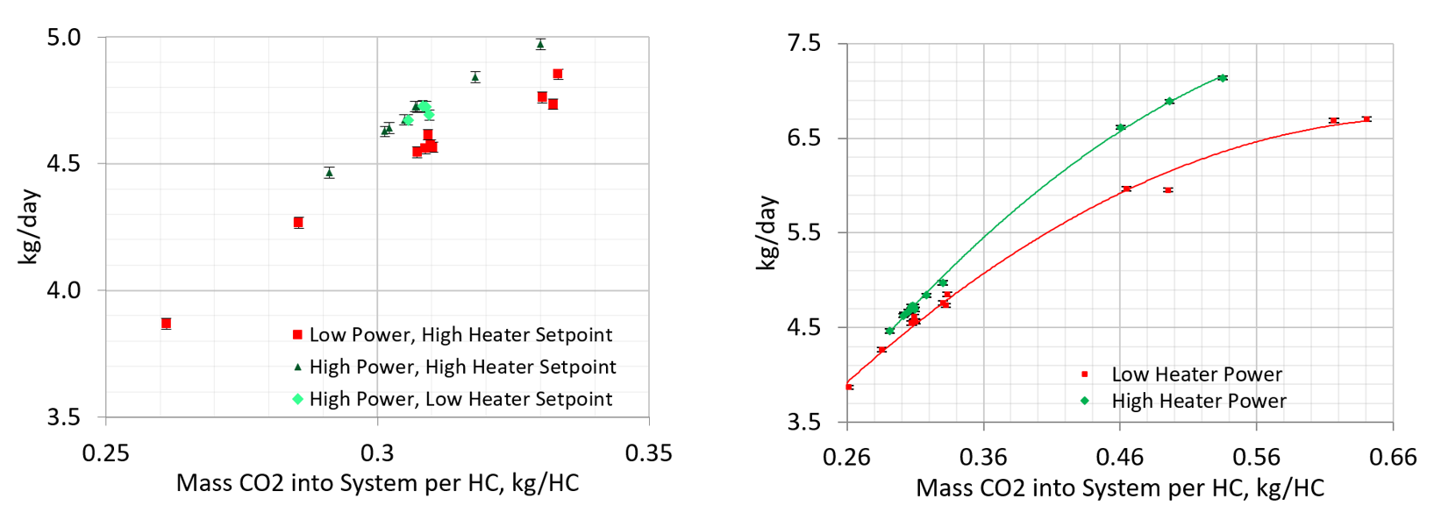
Review of Causality
Change in heater setpoint did not significantly alter performance
Change in heater power did show causality for observed performance change
Notes:
Correlation analysis of removal rate provides an illustration of this approach. The three correlation statistics provide complementary information; Pearson applies to linear relationships, Spearman to non-linear but monotonic relationships, and quadradic to non-linear, non-monotonic relationships
Statistical analysis of all experiments shows very strong correlation between system removal rate and inlet CO2, as expected, providing confidence in approach
However, false positives can occur due to coincidental circumstances, such as for run time, where the strong indication of correlation is due to monotonic increases in inlet CO2 partial pressure during the last set of tests
Once again the delineation between the early and late experiments is evident. Next consider only tests where inlet CO2 was at the standard condition

Slide 8
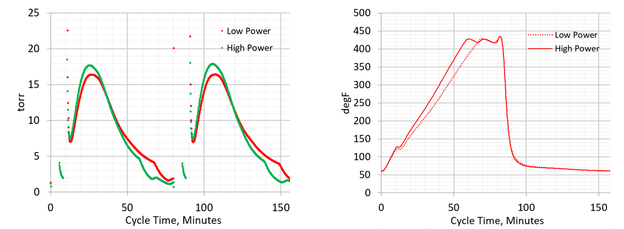
Heater Power Impacts
Sorbent Bed Pressures During Desorption
Sorbent Bed Temperatures During Desorption
The bed temperature rises more quickly for the high-power case
Temperature increase of 3% at peak pressure
Equilibrium capacity decrease of 40% due to temperature change
Continuing analysis via simulation and test may lead to performance improvements
Notes:
Transition back to Greg

Slide 9
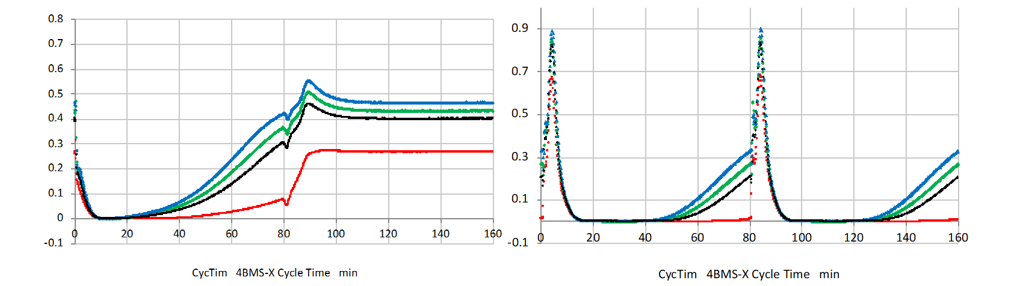
Insights From Internal CO₂ Sensor
CO₂ Volume Percent via Sorbent Bed CO₂ Sample Line
CO₂ Volume Percent via System CO₂ Sample Line
Large differences in sorbent bed and system breakthrough curves
Desiccant bed breakthrough curve begins at 80-minutes
Rollup is evident with peak at 90-minute mark
Understanding internal conditions leads to performance improvement opportunities
Notes:
Transition back to Greg

Slide 10
Potential 4BMS Improvements
Heater Fin Modifications
Alternate Desiccant
Structured Sorbents
Desiccant Bed Heaters

