Slide 1


National Aeronautics and Space Administration
Advanced Air Mobility
Parimal Kopardekar, Director, NASA Aeronautics Research Institute
June 4, 2021
www.nasa.gov

Slide 2
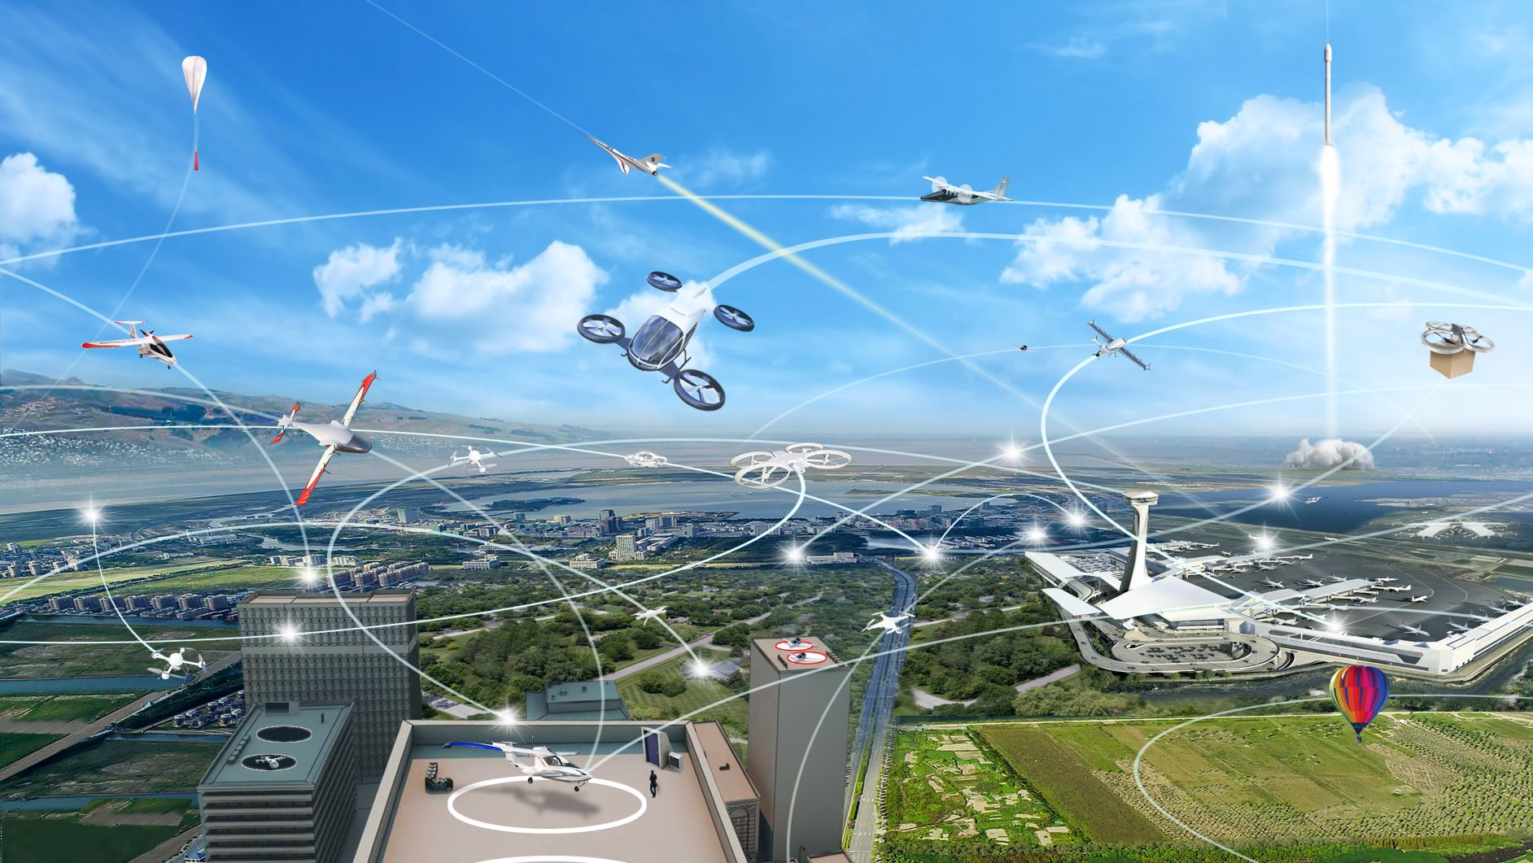
One mile of surface transportation takes you one mile, whereas one mile of aviation land can take you anywhere

Slide 3

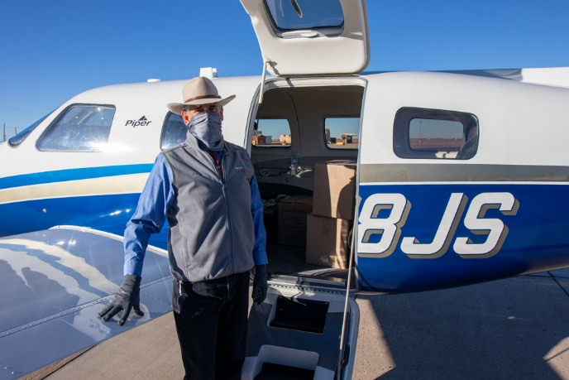
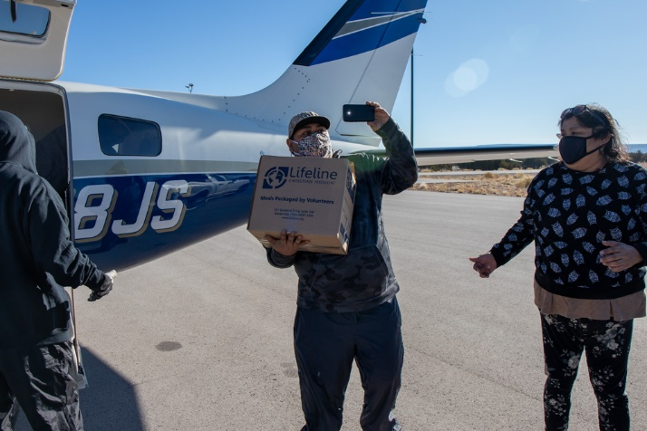
Student Project: Connecting Supply Chain Nodes via Aviation
Delivery of 320 fresh produce boxes from Salinas to remote California food banks
Pilots from Angel Flight West delivered 780 pounds of water and half a ton of food donated to Zuni Tribe in New Mexico

Slide 4
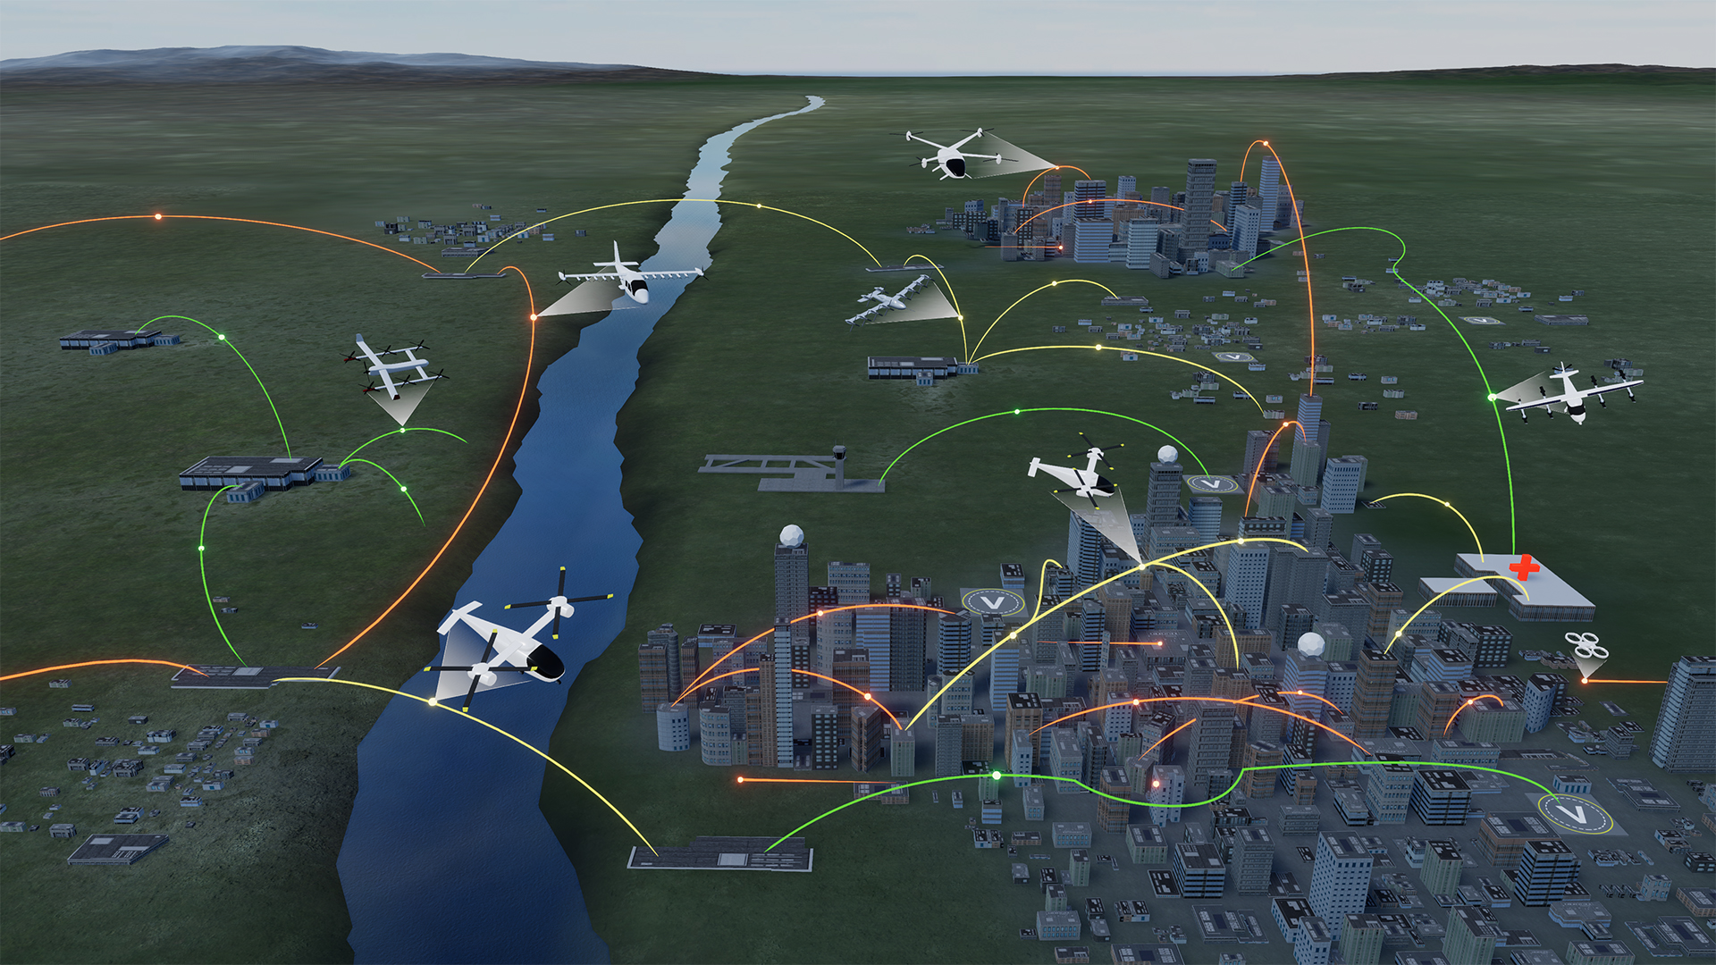


Advanced Air Mobility
On Demand
Air-Taxi
Rural Operations
Urban Operations
Regional
Network
Inter-City
eVTOL
Cargo
Delivery
Cargo
Delivery
Airport
Transfer
Medical
Transfer
Distribution
Center/Warehouse
High Density
Corridor
Air
Ambulance
Fleet
Operations
Inter-city
eVTOL
Small
Package Delivery
Cross-metro
Transfer
Safe, sustainable, affordable, and accessible aviation for transformational local and intraregional missions

Slide 5
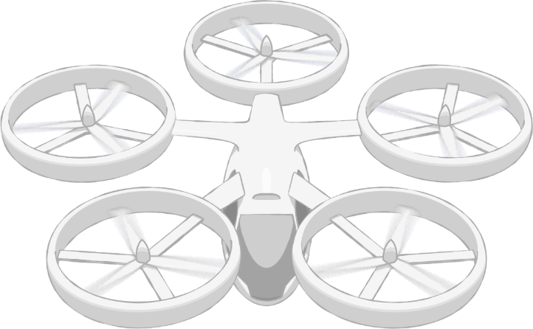
NASA AAM Mission Priorities
Human Response to Noise
Regional M&S Capabilities, & Supply Chain
Community Integration
Architectures
Operational Rules, Roles, & Procedures
Comm, Nav, Surveillance, Information
UAM Supplemental Data Services
In-time Aviation Safety Management System
Community Integration
Airspace System Design & Implementation
Airspace & Fleet Operations Management
Source and Fleet Noise
Vehicle Propulsion Reliability
Environmental and Failure conditions
Distributed Electric Propulsion
Vehicle
Development & Production
Individual Vehicle Management & Operations
Automated Flight and Contingency Management
m:N, Pilots to Operators
Assured Automated Architectures
High Density Vertiplex
National Campaign
Aircraft & Aircrew Barriers
Airspace Barriers
Community Integration Barriers
Systems and Architecture Requirements

Slide 6




AAM Ecosystem Working Groups (AEWG)
https://nari.arc.nasa.gov/aam-portal/
  Align on a common vision for AAM
  Collectively identify and investigate key hurdles and associated needs
  Learn about NASA’s research and planned transition paths
  Develop AAM system and architecture requirements
  Adopt a strategy for engaging the public on AAM
  Support regulatory and standards development
  Form a connected stakeholder community
Accelerate the development of safe and scalable AAM flight operations by bringing together
the broad and diverse ecosystem
6

Slide 7

Airspace “System” Should be Ready
When Vehicles are Ready

Slide 8
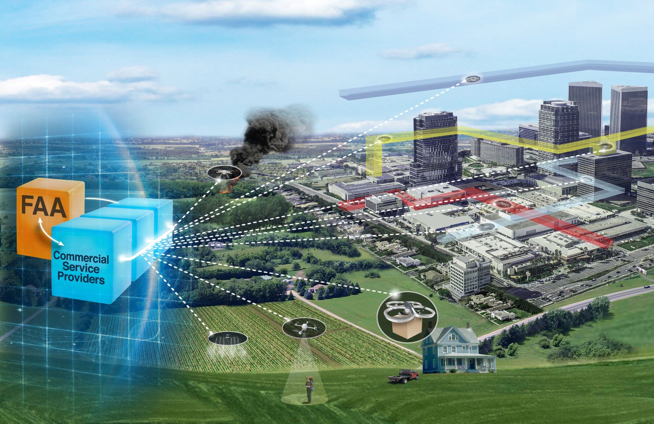
Airspace Considerations
Scaled operations without burdening current air traffic system
Building on Unmanned Aircraft System (UTM) success and lessons learned
8

Slide 9
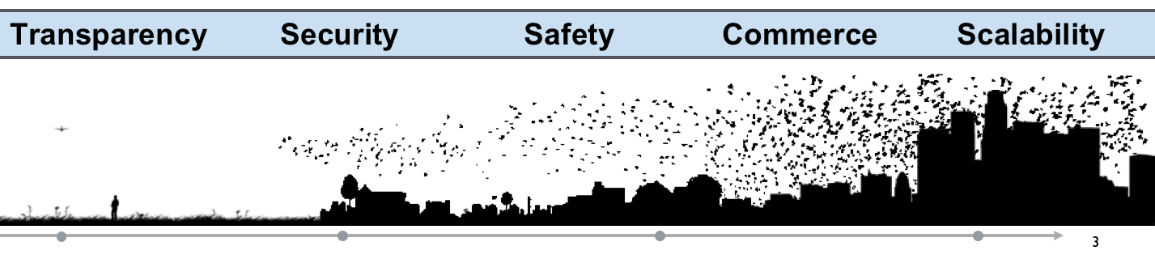
What is Unmanned Aircraft System Traffic Management?
UTM is an “air traffic management” ecosystem for small UAS in low altitude airspace
UTM utilizes industry’s ability to supply services under FAA’s regulatory authority where these services do not exist.
UTM development will ultimately identify services, roles/responsibilities, information architecture, data exchange protocols, software functions, infrastructure, and performance requirements to enable the management of low-altitude UAS operations.
9

Slide 10
UTM Service-Based Architecture
Industry Development & Deployment
Flight Information Management System
Enables airspace controls
Facilitates requests
Supports response in emergencies impacting NAS
UAS Service Supplier
Federated Structure
Cloud-based system
Automated System
Supports UAS with services (e.g. separation, weather, flight planning, contingency management, etc.)
Supplemental Data Service Provider
Supplies supplemental data to USS and UAS Operator to support operations
UAS / UAS Operator
Individual Operator
Fleet Management
On-board capabilities to support safe operations
FAA Development & Deployment
Supplemental Data Service Provider
Inter-USS communication and coordination
Terrain
Weather
Surveillance Performance
National
Airspace
System
Inter-data provider communication and coordination
NAS Data Sources
Flight
Information
Management
System
Constraints, Directives
UAS
Service
Supplier
Requests, Decisions
NAS
state
Operations, Deviations
NAS
impacts
Operations
Constraints
Modifications
Notifications
Information
Operations, Constraints,
Notifications,Information
Operation
requests
Real-time
information
Public Safety
Public
UAS
Operator
UAS
Operator
UAS
Operator
Color Key:
…
FAA Function
Operator Function
Discovery
Registration Data/Services
Authentication/Authorization
V2V
Comm.
Other Stakeholders
Shared
responsibilities
UAS
UAS
UAS

Slide 11
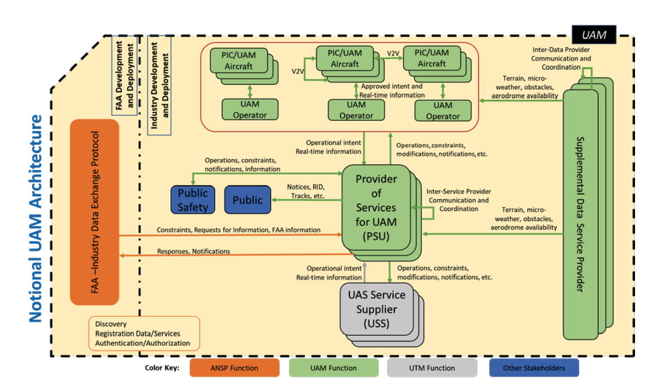
Notional UAM Architecture

Slide 12
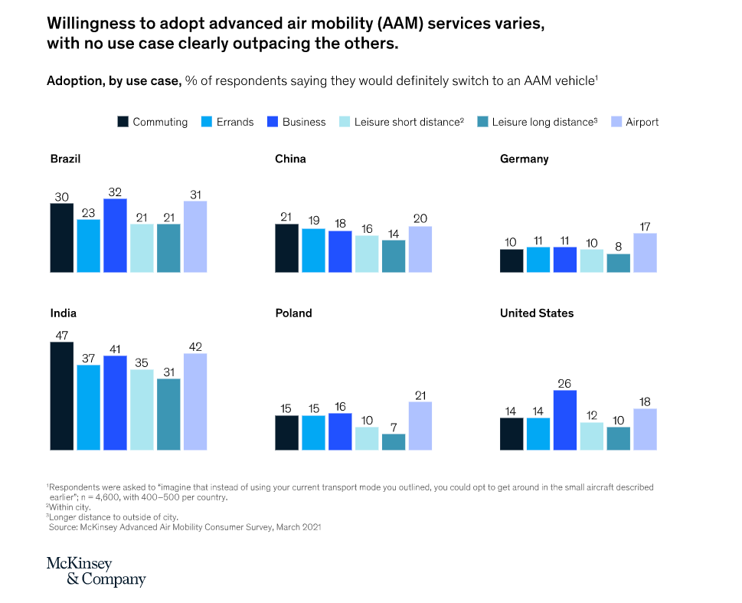
Willingness to adopt advanced air mobility (AAM) services varies, with no use case clearly outpacing the others.
https://www.mckinsey.com/industries/aerospace-and-defense/our-insights/up-in-the-air-how-do-consumers-view-advanced-air-mobility

Slide 13
National Aeronautics and Space Administration
Innovating in aviation while respecting its safety tradition.
Contact: parimal.h.kopardekar@nasa.gov

