Slide 1
ICES-2020-370
More Data Needed for Failure Rate Estimation, Validation, and Uncertainty Reduction
Andrew Owens and William Cirillo
NASA Langley Research Center
Nicole Piontek, Chel Stromgren, and Jason Cho
Binera, Inc.
July 13, 2021
50th International Conference on Environmental Systems
12-15 July 2021

Slide 2
Overview
Current space system development and test schedules are unlikely to provide enough data to support accurate and precise failure rate estimates for future exploration systems
Accurate/precise failure rate estimates are critical for crewed misisons beyond Low Earth Orbit (LEO); current risk mitigation strategies (quick abort/resupply) will not be available
Accurate failure rate estimation is difficult to do without data
Estimates can be improved via testing, but may require very long test durations
Bayesian updating is a useful method for combining an initial estimate (“prior”) with observed data in order to generate a better estimate (“posterior”)
  However, it takes a lot of test time to generate good failure rate estimates, especially for reliable systems
  End result can depend heavily on selected prior when there isn’t much data available
Even after more than a decade of ISS operations, significant uncertainty remains in Environmental Control and Life Support Systems (ECLSS) failure rates, and this uncertainty increases the amount of mass required to mitigate risk on exploration missions
This paper examines the impact of different strategies for initial failure rate estimation on risk and mass for future exploration missions
7/13/2021

Slide 3
Beyond-LEO Missions Present Unique Supportability Challenges
Future human spaceflight missions beyond Low Earth Orbit (LEO) will operate in a logistically isolated environment for 6-10x longer than any previous crewed missions
Current/past operations rely on abort capability and regular resupply to mitigate risk
Abort/resupply not feasible for Mars missions
Supportability is a
first-order driver of mass and risk
Accurate failure rate estimates are necessary for crew safety
Endurance, the crewed time between resupply flights, will be an order of magnitude greater challenge for future crewed Mars missions
Supportability describes the system characteristics, such as reliability and maintainability, that drive logistics and support requirements necessary for safe and effective operations
Absence of logistics resupply opportunities, combined with extremely limited abort capability, drives the need for an updated logistics strategy to ensure a high level of crew safety
Mars missions:
750-1,200 days without logistics resupply
Maximum previous on-orbit experience:
up to 119 days without logistics resupply
Each dot represents a time period where a crew remained in space between launch/landing or a new vehicle arrival at stations. Includes missions up to November 19, 2018.
7/13/2021
Owens, A. C. Multiobjective Optimization of Crewed Spacecraft Supportability Strategies. Doctoral Thesis. Massachusetts Institute of Technology, Cambridge, MA, 2019.

Slide 4
Failure Rate Estimation is Difficult, Especially Without Data
ISS experience shows that initial failure rate estimates are often inaccurate, sometimes by a factor of 5 or more
  Most of ISS Orbital Replacement Units (ORUs) with updated failure rates are considered more reliable than predicted
  ~15% of ORUs are considered less reliable than predicted
Underestimated failure rates (i.e. overestimated reliability) are a crew safety issue because they result in underestimated risk
Even if most items are more reliable than expected, the ones with overestimated reliability will tend to dominate risk
Note: Mean Time Between Failures (MTBF) is another parameter used to represent reliability.
MTBF = 1 / failure rate
MTBF is not equal to predicted lifetime, and should not be used directly to estimate spares.
Less reliable than predicted
More reliable than predicted
Stromgren, C., Goodliff, K. E., Cirillo, W., and Owens, A. The Threat of Uncertainty - Why Using Traditional Approaches for Evaluating Spacecraft Reliability Are Insufficient for Future Human Mars Missions. Presented at the AIAA SPACE 2016, Long Beach, CA, 2016.
7/13/2021

Slide 5
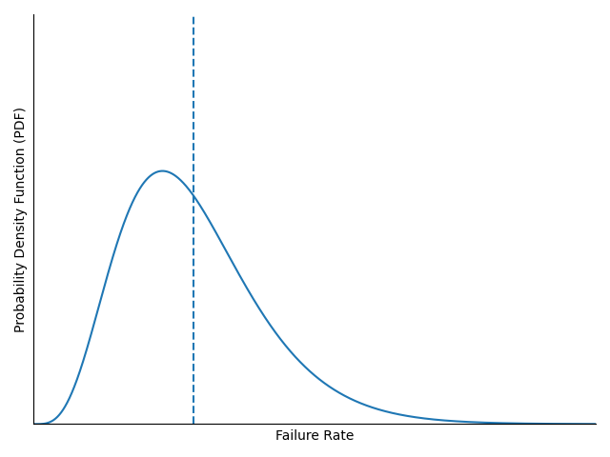
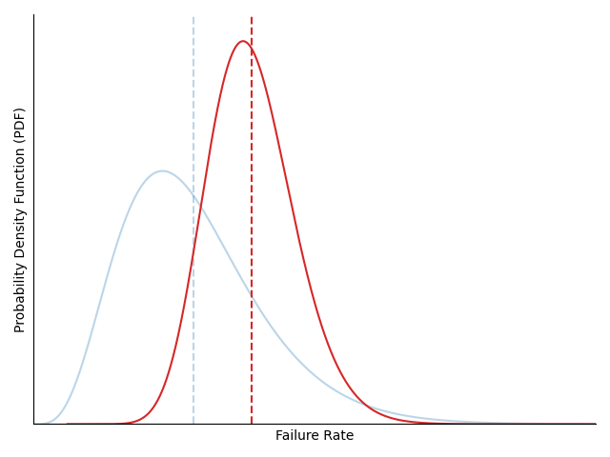
Bayesian Failure Rate Estimation
Failure rates cannot be measured directly; instead estimated via statistical analysis
  Bayesian updating combines an initial estimate (“prior”) with data to generate an updated estimate (“posterior”)
  For failure rate estimation, relevant data includes operating time and failure counts
  Posterior estimate approaches true value and uncertainty is reduced as more data are gathered
Even with perfect knowledge of the failure rate, the number of failures that will occur during a mission cannot be known ahead of time
Supportability fundamentally involves a balance between mass and risk, informed by the failure rate estimates
Expected Value
Probability Density Function (PDF)
Prior Estimate
(initial belief)
Bayesian Update
Data
Posterior Estimate
(current best estimate based on initial belief and observed behavior)
7/13/2021

Slide 6
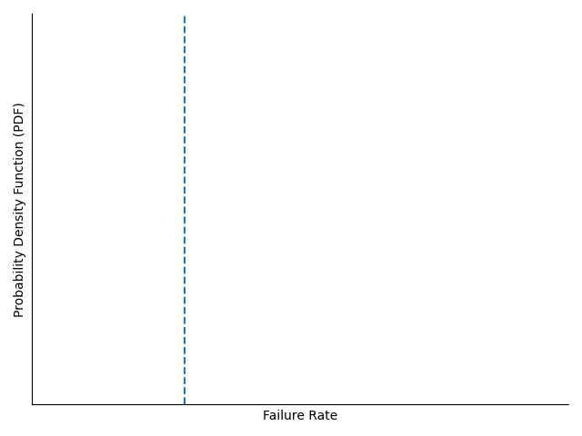
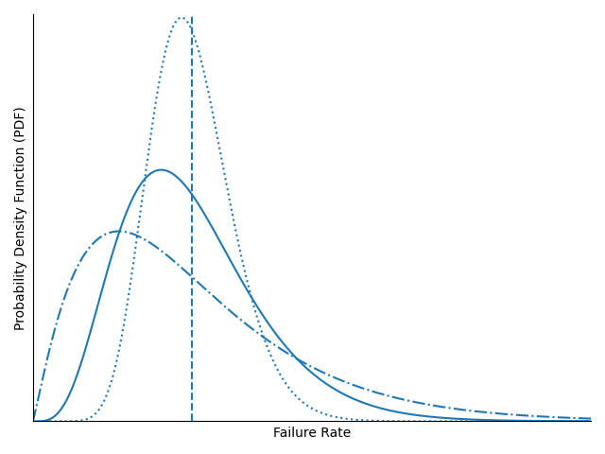
Initializing Priors with Uncertainty
Bayesian analysis treats the parameter being estimated as an uncertain value, represented by a probability distribution
However, initial engineering estimates of failure rates typically only provide a point estimate (often the expected value)
Uncertainty in initial failure rate estimates must be characterized to perform Bayesian updates
  Individualized uncertainty estimates provides highest fidelity, but requires a lot of additional effort
  More common approach is to assign initial uncertainty as a function of the point estimate and some other parameter, which is applied to all items
  Alternatively, a non-informative prior can be used (described on slide 8)
Updated failure rate estimates are strongly influenced by prior uncertainty levels, especially when data are limited
Point Estimate
Lower Uncertainty
(Narrower)
Medium Uncertainty
Higher Uncertainty
(Wider)
7/13/2021

Slide 7
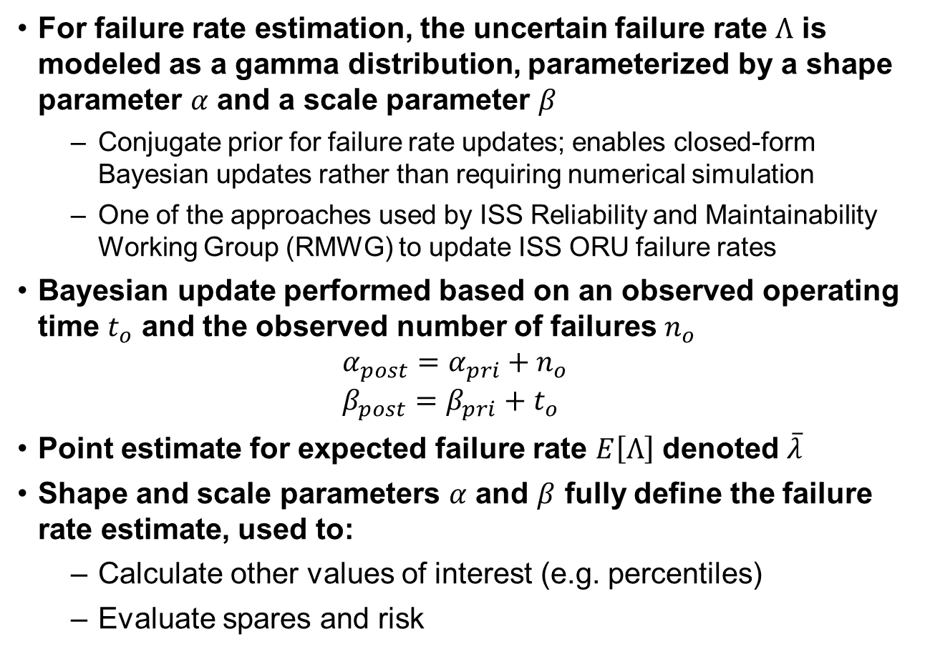
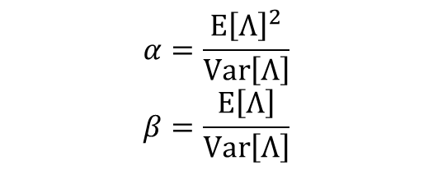
Bayesian Failure Rate Estimation Terminology
For failure rate estimation, the uncertain failure rate $Λ$ is modeled as a gamma distribution, parameterized by a shape parameter $α$ and a scale parameter $β$
  Conjugate prior for failure rate updates; enables closed-form Bayesian updates rather than requiring numerical simulation
  One of the approaches used by ISS Reliability and Maintainability Working Group (RMWG) to update ISS ORU failure rates
Bayesian update performed based on an observed operating time $t_{o}$ and the observed number of failures $n_{o}$
$α_{post}=α_{pri}+n_{o}$
$β_{post}=β_{pri}+t_{o}$
Point estimate for expected failure rate $E\left[Λ\right]$ denoted $\overline{λ}$
Shape and scale parameters $α$ and $β$ fully define the failure rate estimate, used to:
  Calculate other values of interest (e.g. percentiles)
  Evaluate spares and risk
$$α=\frac{E{\left[Λ\right]}^{2}}{Var\left[Λ\right]}$$
$$β=\frac{E\left[Λ\right]}{Var\left[Λ\right]}$$
See paper for more details

Slide 8
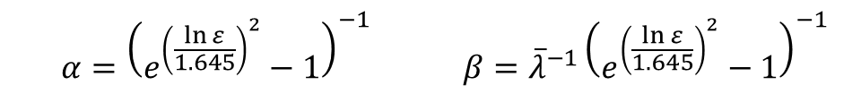
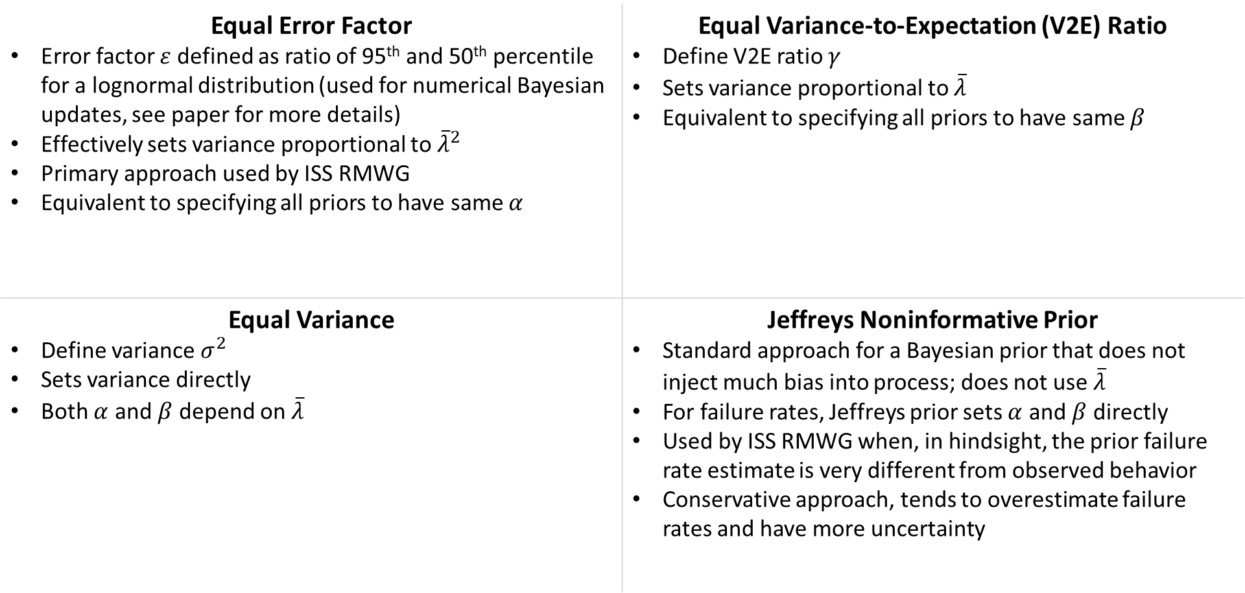


Four Methods for Prior Uncertainty Initialization
Equal Error Factor Error factor $ε$ defined as ratio of 95th and 50th percentile for a lognormal distribution (used for numerical Bayesian updates, see paper for more details) Effectively sets variance proportional to ${\overline{λ}}^{2}$ Primary approach used by ISS RMWG Equivalent to specifying all priors to have same $α$ | Equal Variance-to-Expectation (V2E) Ratio Define V2E ratio $γ$ Sets variance proportional to $\overline{λ}$ Equivalent to specifying all priors to have same $β$
Equal Variance Define variance $σ^{2}$ Sets variance directly Both $α$ and $β$ depend on $\overline{λ}$ | Jeffreys Noninformative Prior Standard approach for a Bayesian prior that does not inject much bias into process; does not use $\overline{λ}$ For failure rates, Jeffreys prior sets $α$ and $β$ directly Used by ISS RMWG when, in hindsight, the prior failure rate estimate is very different from observed behavior Conservative approach, tends to overestimate failure rates and have more uncertainty
$$α=\frac{\overline{λ}}{γ}$$ | $$β=\frac{1}{γ}$$
$$α={\left(e^{{\left(\frac{\ln{ε}}{1.645}\right)}^{2}}−1\right)}^{−1}$$ | $$β={\overline{λ}}^{−1}{\left(e^{{\left(\frac{\ln{ε}}{1.645}\right)}^{2}}−1\right)}^{−1}$$
$$α=\frac{{\overline{λ}}^{2}}{σ^{2}}$$ | $$β=\frac{\overline{λ}}{σ^{2}}$$
Note: There are likely other methods; these are simply the four that were examined in this work. We welcome recommendations or discussion of other approaches to examine.
$$α=0.5$$ | $$β=0$$
7/13/2021

Slide 9
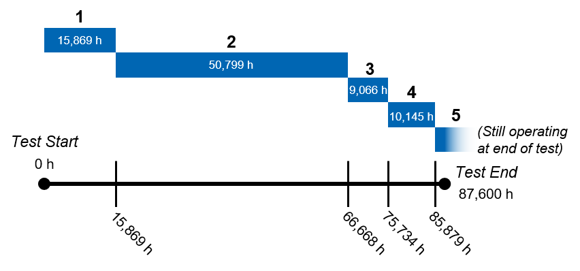
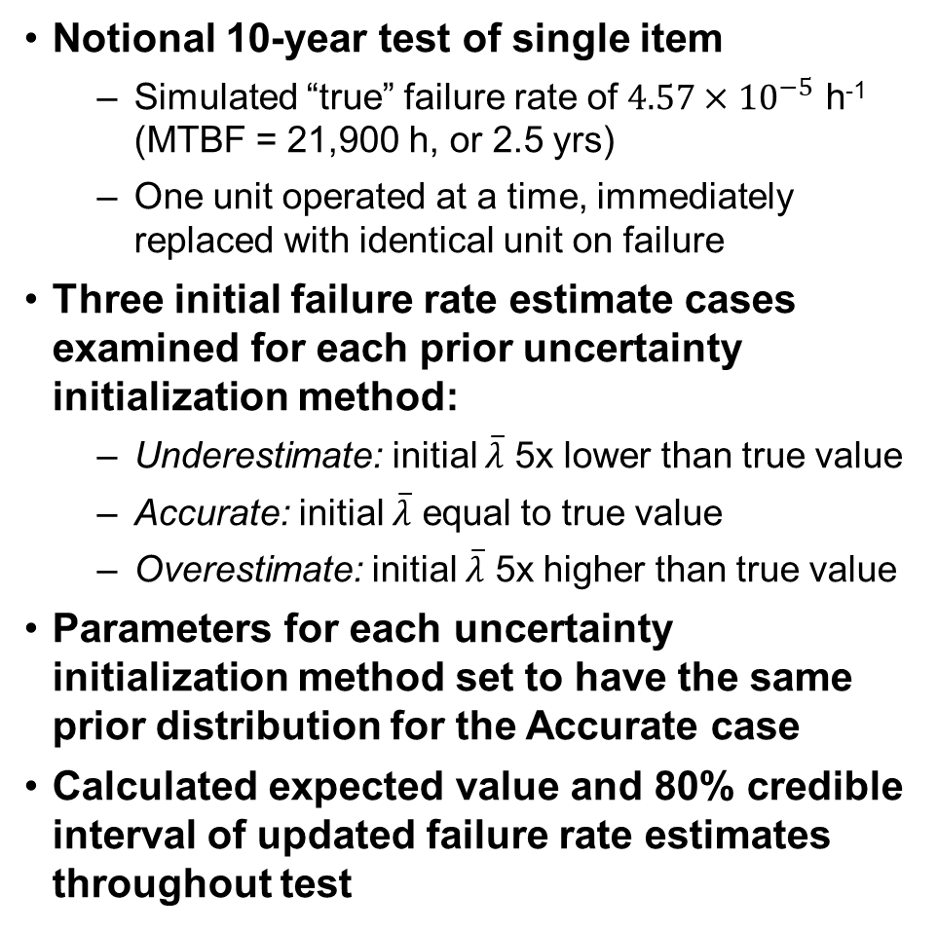
Analysis Using Simulated Test Data
Notional 10-year test of single item
  Simulated “true” failure rate of $4.57×10^{−5}$ h⁻¹ (MTBF = 21,900 h, or 2.5 yrs)
  One unit operated at a time, immediately replaced with identical unit on failure
Three initial failure rate estimate cases examined for each prior uncertainty initialization method:
  Underestimate: initial $\overline{λ}$ 5x lower than true value
  Accurate: initial $\overline{λ}$ equal to true value
  Overestimate: initial $\overline{λ}$ 5x higher than true value
Parameters for each uncertainty initialization method set to have the same prior distribution for the Accurate case
Calculated expected value and 80% credible interval of updated failure rate estimates throughout test
Note: These results represent just one of many possible outcomes of the simulation. Even with a fixed, known failure rate, there is no way to know precisely when an item will fail randomly.
7/13/2021

Slide 10
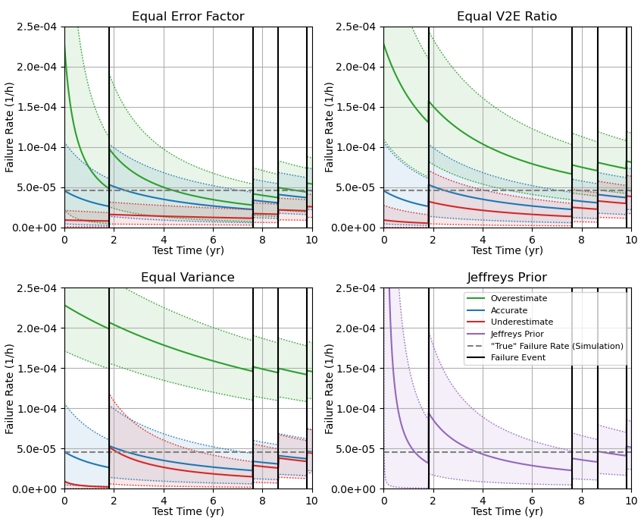
Results: Updates from Simulated Test Data
Simulated “true” failure rate shown by gray dashed line
Accurate prior (blue) same for all cases
Overestimate (green) and underestimate (red) have different initial variances, depending on uncertainty initialization method
All estimates approach the true failure rate and reduce uncertainty as more data are gathered
However, some priors approach the true value very slowly
  Underestimates using Equal Error Factor (red, top left)
  Overestimates using Equal Variance (green, bottom left)
7/13/2021

Slide 11
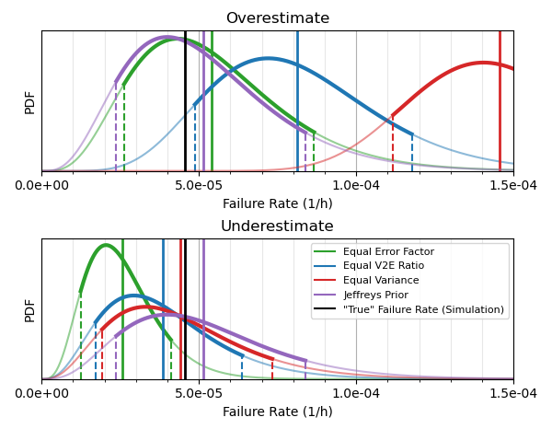
Results: Updates from Simulated Test Data
Focusing on result after update:
  Full posterior PDFs shown for each uncertainty initialization case
  Only results from over-/underestimated priors shown, because results from accurate priors are the same in all cases
Some uncertainty initialization methods better for correcting overestimates; others better for correcting underestimates
  Overestimate: “true” value not in 80% credible interval for Equal V2E and Equal Variance
  Underestimate: “true” value not in 80% credible interval for Equal Error Factor
Updates from Jeffreys Prior not impacted by over- or underestimates
Updated Estimates After Full 10 yr Test
Solid vertical lines = expected value
Dotted vertical lines = edges of 80% credible interval
7/13/2021

Slide 12
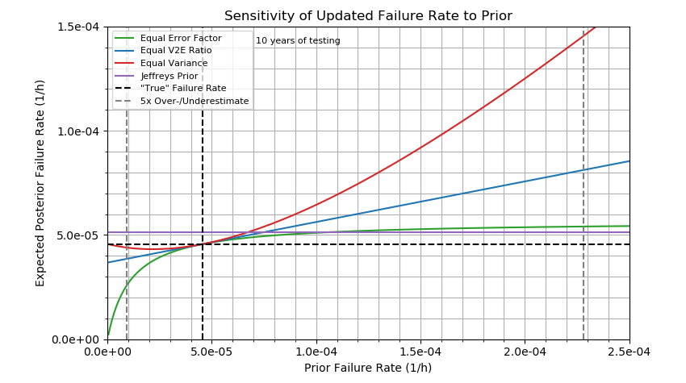
Results: Sensitivity to Inaccurate Prior
Equal Variance approach not as effective at correcting overestimated failure rates
Equal V2E Ratio approach is equally good at correcting overestimates and underestimates
Overestimated
Posterior Failure Rate
Jeffreys Prior does not use initial estimates, and is therefore not sensitive to inaccurate priors
Equal Error Factor approach not as effective at correcting underestimated failure rates
Underestimated
Posterior Failure Rate
Underestimated
Prior Failure Rate
Overestimated
Prior Failure Rate
7/13/2021

Slide 13
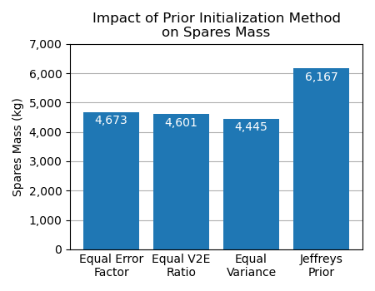
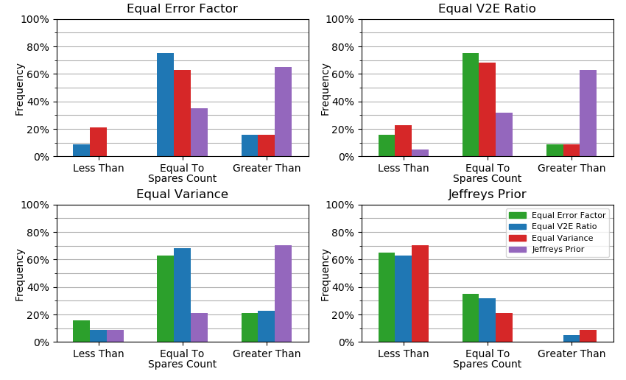
Results: Spares Mass and Spares Counts
Histogram of Relative Spares Counts
(model indicated by color relative to model indicated by axis title)
Spares allocated for notional 1,100-day Mars mission
Probability of Sufficiency (POS) = 0.98
Only includes ECLSS spares
See paper for more details
Equal Variance method resulted in fewer spares being allocated for ~20% of ORUs relative to Equal Error Factor
Informative priors result in lower spares mass than Jeffreys Prior
  If reasonably accurate priors can be generated, they are valuable
  Jeffreys Prior mitigates the risk of an inaccurate prior at the cost of increased uncertainty, resulting in increased spares mass
Spares mass is only part of the story; missions also need to carry the correct spares
Different prior initialization techniques result in different spares allocations, which have different risk implications
7/13/2021

Slide 14
Discussion
Results of Bayesian failure rate estimation are strongly impacted by choice of prior uncertainty initialization, even after a decade of testing
  Equal Error Factor: Quick correction of overestimates, slow correction of underestimates
  Equal V2E Ratio: Equally effective at correcting over- and underestimates
  Equal Variance: Slow correction of overestimates, quick correction of underestimates
  Jeffreys Prior: No initial estimate needed, but conservative approach w/ higher uncertainty
Potential bias in estimating technique should be carefully considered
  Set of initial estimates likely to contain both over- and underestimates
  If update strategy is more effective at correcting overestimates, set of updated failure rates may be biased towards underestimates, and vice versa
Based on ISS data, underestimated initial failure rates have been less common that overestimates, but underestimates have more significant consequences for crew safety
  Underestimated failure rates result in insufficient spares and hidden risk / reduced crew safety
  Overestimated failure rates result in excess spares, increasing logistics challenges
  In a resource-limited environment, increased logistics challenges may negatively impact other system elements, increasing mission/program risk and cost
7/13/2021

Slide 15
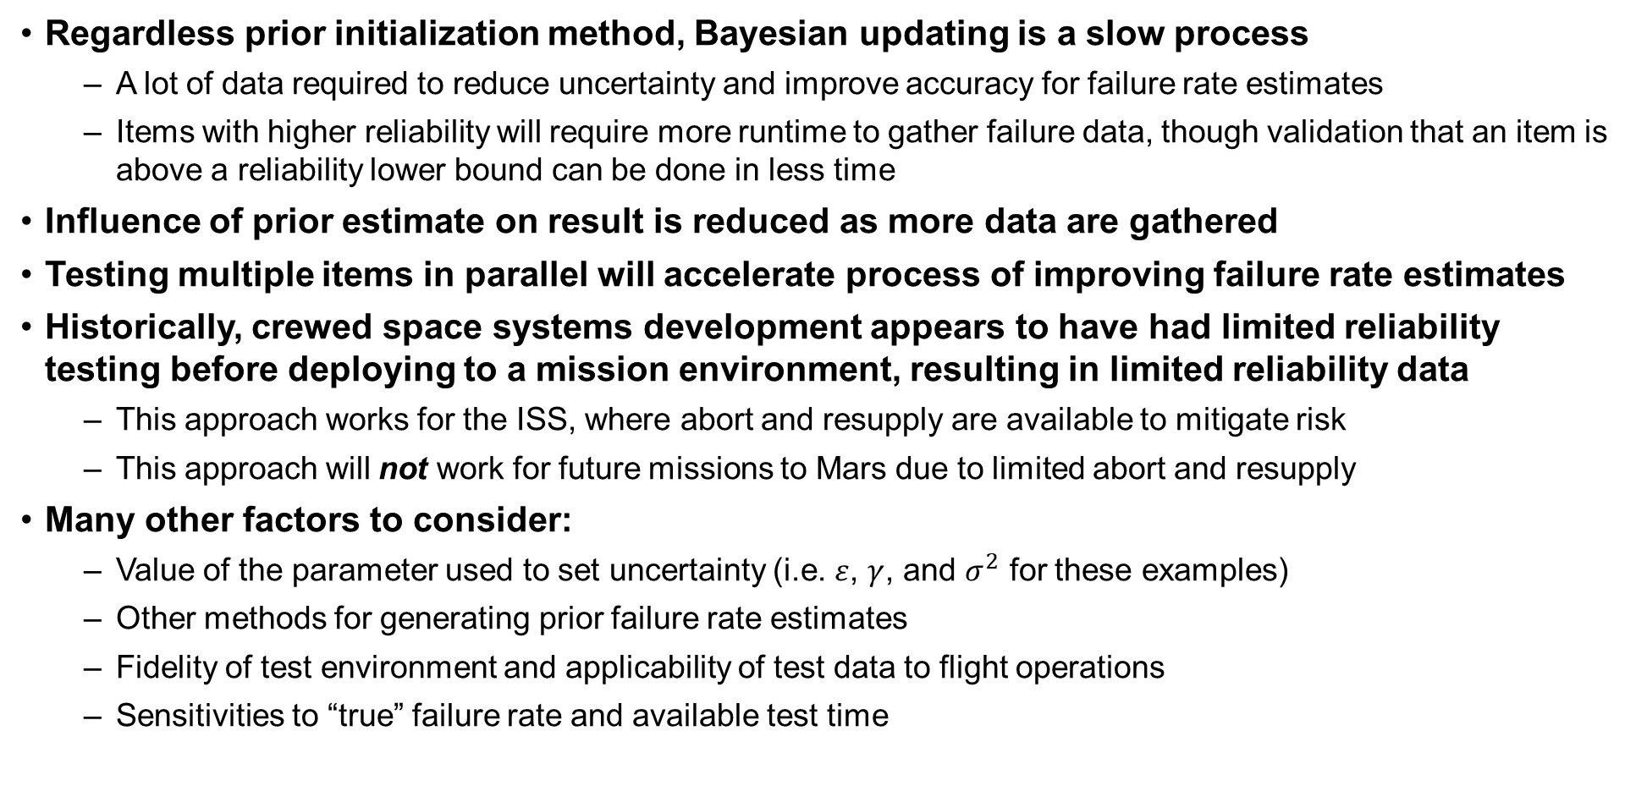
Discussion
Regardless prior initialization method, Bayesian updating is a slow process
  A lot of data required to reduce uncertainty and improve accuracy for failure rate estimates
  Items with higher reliability will require more runtime to gather failure data, though validation that an item is above a reliability lower bound can be done in less time
Influence of prior estimate on result is reduced as more data are gathered
Testing multiple items in parallel will accelerate process of improving failure rate estimates
Historically, crewed space systems development appears to have had limited reliability testing before deploying to a mission environment, resulting in limited reliability data
  This approach works for the ISS, where abort and resupply are available to mitigate risk
  This approach will not work for future missions to Mars due to limited abort and resupply
Many other factors to consider:
  Value of the parameter used to set uncertainty (i.e. $ε$, $γ$, and $σ^{2}$ for these examples)
  Other methods for generating prior failure rate estimates
  Fidelity of test environment and applicability of test data to flight operations
  Sensitivities to “true” failure rate and available test time
7/13/2021

Slide 16
Conclusions
Supportability will be a greater challenge for future crewed exploration missions than it has been before, due to longer mission endurances and lack of abort/resupply
Accurate and precise failure rate estimates are required to effectively manage risk and spares mass on exploration missions
Initial failure rate estimates are often inaccurate, but can be improved via Bayesian updating based on data from testing and operations
  However, Bayesian updating can be a slow process, and results are strongly influenced by choice of priors (i.e. initial failure rate and level of uncertainty)
  Long test durations will be required to generate sufficient data to validate failure rates and reduce uncertainty, but testing can be accelerated by testing multiple units in parallel
Historical approaches to reliability testing have typically not generated a lot of reliability data prior to flight, and will not be sufficient to enable safe and effective crewed exploration of Beyond-LEO destinations, particularly Mars
More data are needed to refine failure rate estimates, reduce risk, and ensure crew safety
System/technology development programs should include testing needs alongside other factors when performing trade studies and allocating resources, and ensure that reliability, supportability, and risk assessments are informed by applicable test data
7/13/2021

Slide 17
References
Owens, A., De Weck, O., Stromgren, C., Goodliff, K. E., and Cirillo, W. Supportability Challenges, Metrics, and Key Decisions for Future Human Spaceflight. 2017.
Cirillo, W., Aaseng, G., Goodliff, K., Stromgren, C., and Maxwell, A. Supportability for Beyond Low Earth Orbit Missions. Presented at the AIAA SPACE 2011 Conference & Exposition, Long Beach, CA, 2011.
Owens, A. C. Multiobjective Optimization of Crewed Spacecraft Supportability Strategies. Doctoral Thesis. Massachusetts Institute of Technology, Cambridge, MA, 2019.
Stromgren, C., Goodliff, K. E., Cirillo, W., and Owens, A. The Threat of Uncertainty - Why Using Traditional Approaches for Evaluating Spacecraft Reliability Are Insufficient for Future Human Mars Missions. Presented at the AIAA SPACE 2016, Long Beach, CA, 2016.
Owens, A. C., de Weck, O. L., Stromgren, C., Goodliff, K., and Cirillo, W. Accounting for Epistemic Uncertainty in Mission Supportability Assessment: A Necessary Step in Understanding Risk and Logistics Requirements. Presented at the 47th International Conference on Environmental Systems, Charleston, SC, 2017.
Owens, A., and de Weck, O. How Much Testing Is Needed to Manage Supportability Risks for Beyond-LEO Missions? Presented at the International Conference on Environmental Systems, Boston, 2019.
Owens, A., and de Weck, O. International Space Station Operational Experience and Its Impacts on Future Mission Supportability. Presented at the International Conference on Environmental Systems, Albuquerque, NM, 2018.
Dezfuli, H., Kelly, D., Smith, C., Vedros, K., and Galyean, W. Bayesian Inference for NASA Probabilistic Risk and Reliability Analysis. Publication NASA/SP-2009-569. National Aeronautics and Space Administration, Washington, DC, 2009.
Peter, A., Das, D., and Pecht, M. Appendix D: Critique of MIL-HDBK-217. In Reliability Growth: Enhancing Defense System Reliability, National Academies Press, pp. 203–245.
Ebeling, C. E. An Introduction to Reliability and Maintainability Engineering. Waveland Press, Long Grove, Ill, 2010.
Shynk, J. J. Probability, Random Variables, and Random Processes: Theory and Signal Processing Applications. Wiley, Hoboken, NJ, 2013.
Karlis, D., and Xekalaki, E. “Mixed Poisson Distributions.” International Statistical Review, Vol. 73, No. 1, 2007, pp. 35–58. doi:10.1111/j.1751-5823.2005.tb00250.x.
Slay, F. M., Bachman, T. C., Kline, R. C., O’Malley, T. J., Eichorn, F. L., and King, R. M. Optimizing Spares Support: The Aircraft Sustainability Model. Publication AF501MR1. Logistics Management Institute, McLean, VA, 1996.
Fox, B. “Discrete Optimization Via Marginal Analysis.” Management Science, Vol. 13, No. 3, 1966, pp. 210–216. doi:10.1287/mnsc.13.3.210.
Hillier, F. S., and Lieberman, G. J. Introduction to Operations Research. McGraw-Hill, Boston, 2001.
Owens, A., Cirillo, W. M., Piontek, N., Stromgren, C., and Cho, J. Analysis and Optimization of Test Plans for Advanced Exploration Systems Reliability and Supportability. Presented at the International Conference on Environmental Systems, 2021.
7/13/2021

