Slide 1
Digital Twin for Quality and Mechanical Systems Assurance
Alejandra Constante
NASA GSFC/MEI
Code 373

Slide 2
Agenda
Quality Assurance Activities
Process Definitions
Digital Twins
Quality Assurance Informed Decisions
Taxonomy of Processes

Slide 3
Introduction
Have you had these kind of problems?
  Suspect that the supplier is not following a rigorous process control
  Inspect parts that look good, but you are not completely sure (e.g. bonded or welded parts)
  Lack of familiarity with failures associated to the process of parts manufactured by an external supplier
  Absence of technical evidence to approve/reject a requirement waiver
  Need to find a Subject Matter Expert to understand the root cause of parts issues/failures during I&T

Slide 4
Quality Assurance Activities
The NPR 8735.2C defines hardware quality assurance program requirements for programs and projects
NASA Quality Assurance domains were defined using a Model Based construct
Quality Assurance needs tools to support early lifecycle activities
QA02 Critical Items and Processes Determination
QA05 Supply Chain Risk Management
QA06 Product Readiness
QMS Standards and Certifications
Review, approval, control for special processes
QMS control to ensure external processes/products conform
QA07 Product Quality Assurance
Generate objective evidence of conformance for each safety-critical product or process attribute
QCI or NDE performed by government
QA09 NASA Product Acceptance Process and Data
Parts and materials certifications and traceability data
Define acceptance requirements for qual or engineering units
Plante J., NASA Quality Assurance Across the Mission Lifecycle via NPR 8735.2C, April 2021
Notes:
-Special process: Process that results in a condition of conformance that cannot be fully verified by means of destructive inspection at the point of acceptance, and thus, assurance of conformance is attained through adherence to process control specifications and verifying compliance incrementally during production.
-Complex: Items that have quality characteristics, not wholly visible in the end item, for which contractual conformance must be established progressively through precise measurements, tests, and controls applied during purchasing, manufacturing, performance, assembly, and functional operation.

Slide 5
Process Definitions (NPR 8735.2C Appendix A)
Special Process
Results in a condition of conformance that cannot be fully verified by means of non-destructive inspection
The point of acceptance and the assurance of conformance is attained through adherence to process control specification and verifying compliance incrementally during production
Complex
Items that have quality characteristics, not wholly visible in the end item
For which contractual conformance must be established progressively through precise measurements, test, and controls applied during purchasing, manufacturing, performance, assembly, and functional operation
Welding, Creative Commons
Argonne’s tribology lab. Creative Commons
NPR 8735.2C, Hardware Quality Assurance Program Requirements for Programs and Projects, March 12, 2021 Welding - Lamar CC, Welding, licensed under a Creative Commons Attribution 4.0 International License, 2020 "Argonne's Tribology Lab: Tensile Test Machine" by Argonne National Laboratory is licensed under CC BY-NC-SA 2.0
Notes:
-Complex processes are those manufacturing process that require Quality Assurance to evaluate the product conformance
-Welding, plating, and machining are examples of complex processes

Slide 6
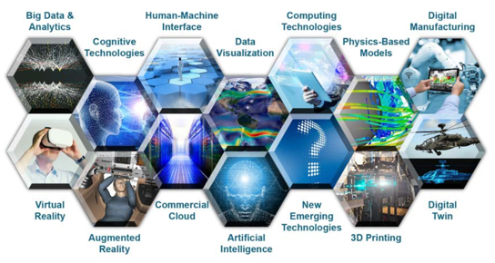
Digital twin
Integrated models that consider physics, simulations, and history of a vehicle or system to mirror its performance
Revolution on the traditional manufacturing process
Digital twins are connected to the simulated process to receive “real time” feedback and improve themselves
https://ac.cto.mil/wp-content/uploads/2019/06/2018-Digital-Engineering-Strategy_Approved_PrintVersion.pdf
Glaessgen E. H. and Stargel D.S. The Digital Twin Paradigm for future NASA and U.S. Air Force Vehicles, 53rd Structural Dynamics, and Material Conference: Special Session on the Digital Twin, AIA 2012-1818.

Slide 7
Quality Assurance Informed Decisions
Informed quality assurance decisions will easily flow from a clear perspective of the minimum requirements through each state of the manufacturing life cycle of a product
  Understanding complex process parameters contributes to the creation of a road map that facilitates decision making process
  Evaluate product conformances of special processes
  Identify process and product deviations using verification and validation techniques earlier in the development life cycle

Slide 8
Taxonomy of Processes
The Taxonomy of Processes is a tool to organize the technical knowledge required by Quality Assurance during assessment and inspections.
This taxonomy helps inspections and assessments performed by Quality Assurance:
  Provides information from NASA and industry approved standards.
  Identifies process controls and product acceptance criteria.
  Facilitates multi-disciplinary collaboration between materials, quality, mechanical, and electrical disciplines.
Notes:
Processes: includes special and complex processes

Slide 9
Benefits of using Taxonomy of Processes
Keep of digital records of validation and inspection assessments which could be used during failure review boards
Reduce the time spent on extensive surveys of technical standards and documentation
Provide continuous feedback to the taxonomy based on the findings and lessons learned of failure review dispositions

Slide 10
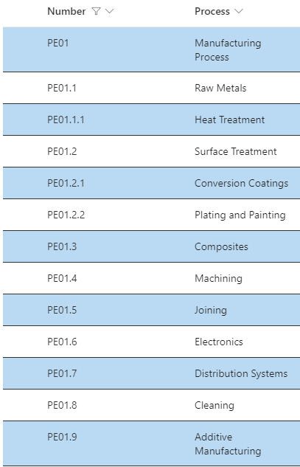
Taxonomy of Processes
9 Process subcategories
  50 Processes
    13 Elements

Slide 11
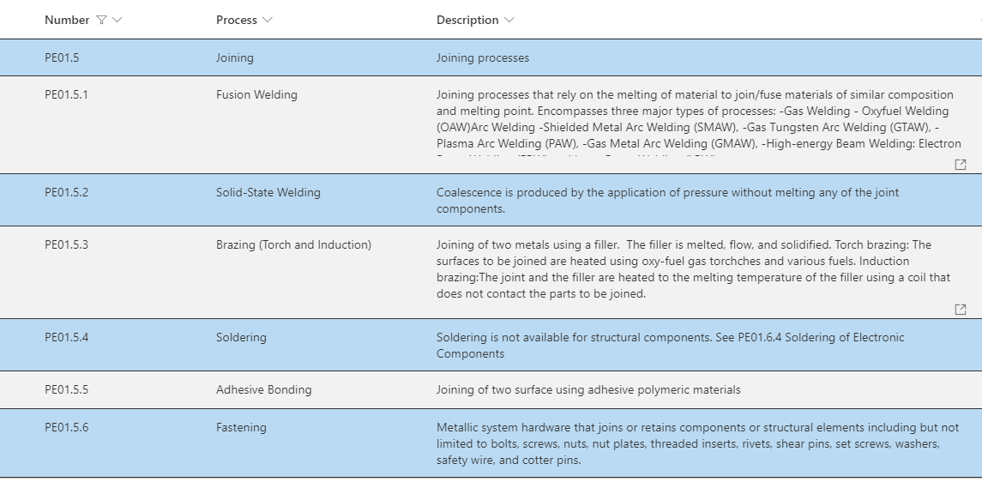
Joining Processes

Slide 12
Taxonomy of Processes - Elements
QA02 Critical Items and Process Determination
QA05 Supply Chain Risk Management
QA09 NASA Product Acceptance Process and Data
Number | Process | Description | Nadcap Audit Criteria | NASA Guidance | Materials | Certification Programs | Industry Standards | Process type | Process Control | Main Variables | Non-Destructive Evaluation (NDE) | Product Acceptance
PE0.1.X.X | QA02 | QA02 | QA05 | QA05 | QA05 | QA05 | QA05 | QA06 | QA06 QA07 | QA06 | QA07 | QA09
QA06 Product Readiness
QA07 Product Quality Assurance
The NPR 8735.2C defines hardware quality assurance program requirements for programs and projects and quality assurance domains (QA)
Notes:
Certification Programs: Training programs offered by professional associations to increase specific knowledge and skills toward a high quality product.
Main Variables: Process parameters that shall be controlled to produce the output expected by the customer.
Material Types: Primary, secondary, and tertiary
Process Control: Actions follow to validate/verify the controlled variables
Product Acceptance: Criteria established to define the minimum performance of the product.

Slide 13
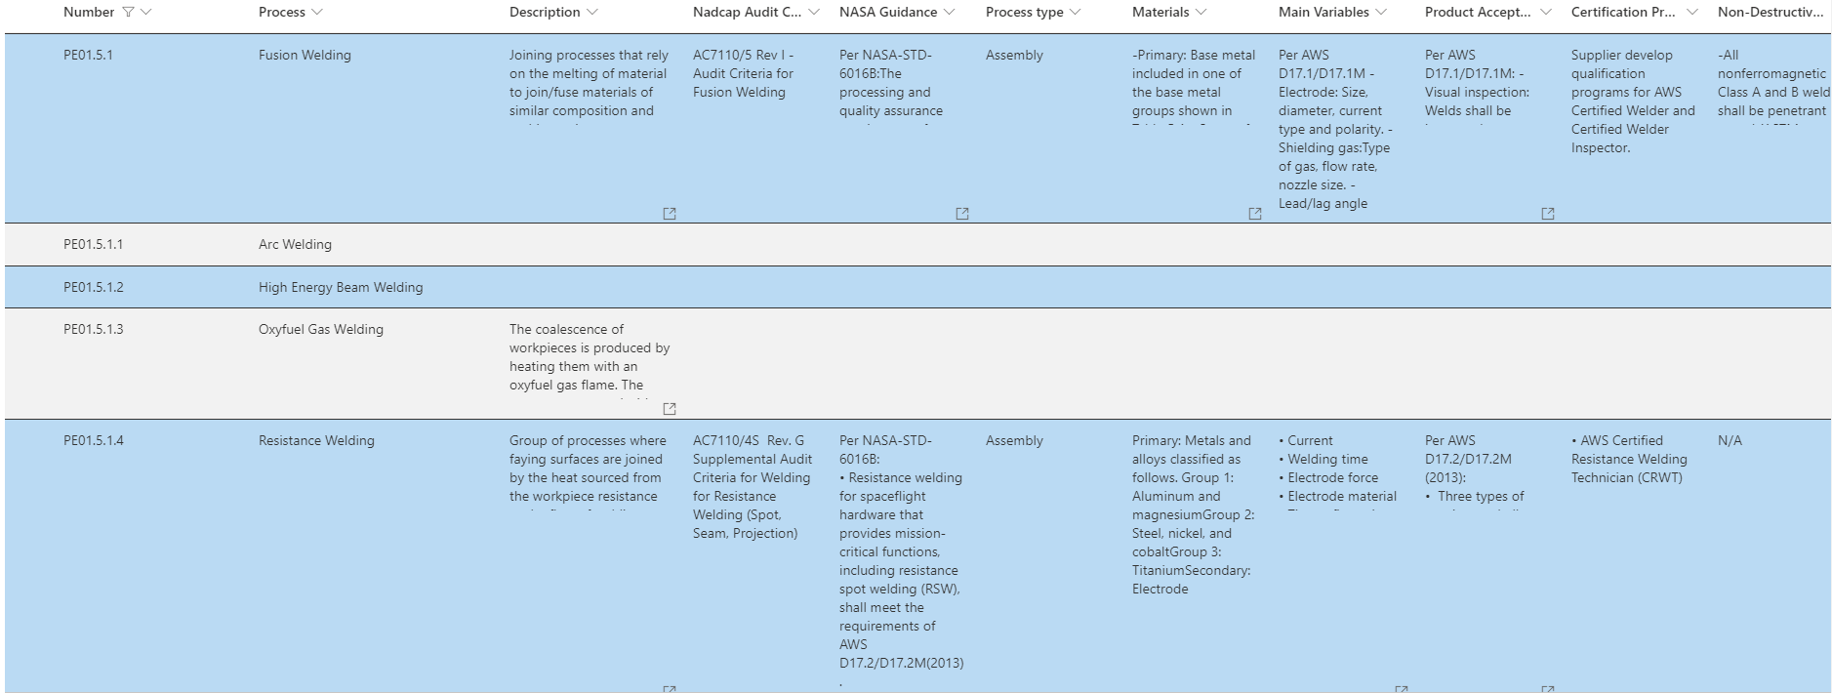
Fusion Welding

Slide 14
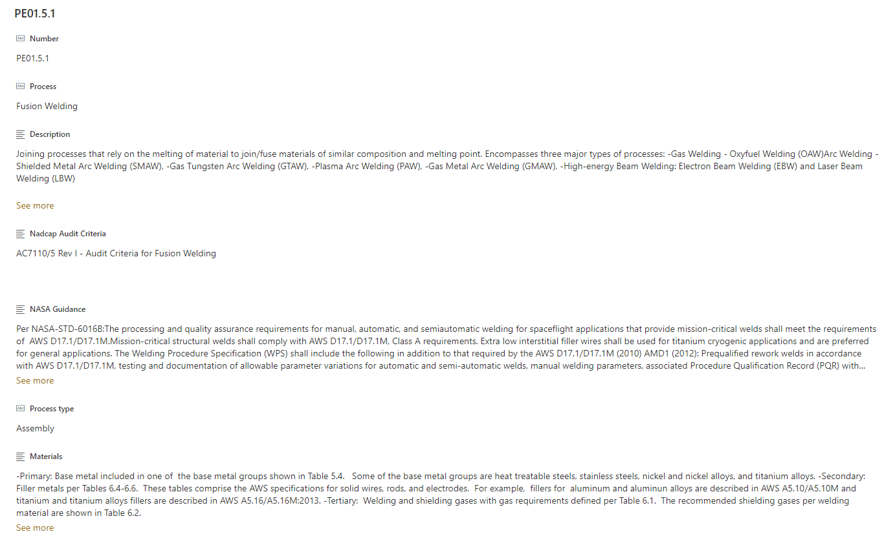
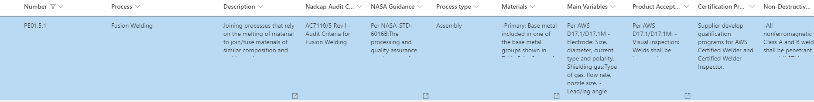
Fusion Welding

Slide 15

Take away
Taxonomy of Process
Surveillance Plan
Internal Audit Plan
Mandatory Inspection Points (MIPs)
Training Programs
NPR 8735.2C Quality Assurance Domains
Model-Based Safety and Mission Assurance (MBMA)
Notes:
NPR 7900 2D Chapter 2

Slide 16

Summary
The taxonomy of processes is a tool that facilitates the digital transformation of the NASA Quality Assurance policy
Process elements in the taxonomy are part of the Quality Assurance domains formulated in the NPR 8735.2C
Knowledge of process elements earlier in the life cycle will help with supplier assessments and inspections

Slide 17
Taxonomy of Processes
Please contact us if you want to help us with special process surveillance
or if you want to contribute in any other way at
ANDREW.GLENDENING@NASA.GOV
ALEJANDRA.CONSTANTEPEREZ@NASA.GOV

Slide 18
Backup

Slide 19
Taxonomy elements
Alias: Additional process names reported in the NASA Standards, Industry Standards, and Nadcap Audit Criteria.
Certification Programs: Training programs offered by professional associations to increase specific knowledge and skills toward a high-quality product.
Main Variables: Process parameters that shall be controlled to produce the output expected by the customer.
Material Types: Primary, secondary, and tertiary
Process Control: Actions follow to validate/verify the controlled variables
Product Acceptance: Criteria established to define the minimum performance of the product.

Slide 20
Process Types Categories
Primary: Shaping process. Casting, molding, powder sintering, forming, and composite lay-up
Secondary: Bulk heat treatment, material removal processes, and surface treatment
Assembly: Joining, test-inspection, and assembly.

Slide 21
Types of materials
Primary: Input material of part that will be modified by the process
Secondary: Component used to modify the primary material
Tertiary: Additive or environment used to modify the characteristics of the process

Slide 22
Process Control- Generic Aspects
Develop, maintain, and adhere to a process control document describing the process and procedures, including all steps in the processing sequence. Process control documents should define requirements for process and procedures as applicable.
Main process steps should be carried out as defined by shop papers. Shop paper should provide traceable part identification, processing steps, and documentation of rework if done.
Process parameters should be recorded either manually or by the automatic process equipment.
Elements of process control that should always/routinely be inspected.
Preproduction tests are all technical requirements shall be performed prior to or on the initial plated, painted, and surface treated parts to a purchaser, when a change in materials/processing requires approval, and when the cognizant engineer requires confirmatory testing. (Apply to coatings, plating, and painting)

Slide 23
Product Acceptance – General aspects
Visual inspection is required for most of the processes
Lot acceptance test should be documented and meet the sampling plan.
Each lot shall be inspected to ensure that the lot consist of all treated items of the same type, class, form, and method, treated under the same process conditions, and submitted for acceptance at one time.
Final inspections and test should stamped off or signed off and dated as required.

Slide 24
Validation and Verification
Validation: Process to demonstrate that the product or process satisfy the user needs. Proof that the product accomplished the intended purpose and is ready to use.
Verification: Process to provide or establish the specification satisfaction on the process or product. Proof that the product complies with the specification.

