Slide 1
An Update In Assimilating Microwave Imager Radiance Data In All-sky Conditions In GEOS and JEDI
Jianjun Jin, Min-Jeong Kim, Will McCarty, Amal El Akkraoui
Dan Holdaway and Ricardo Todling
NASA GMAO
18th JCSDA Technical Review Meeting and Science Workshop
June 7 - 10, 2021

Slide 2
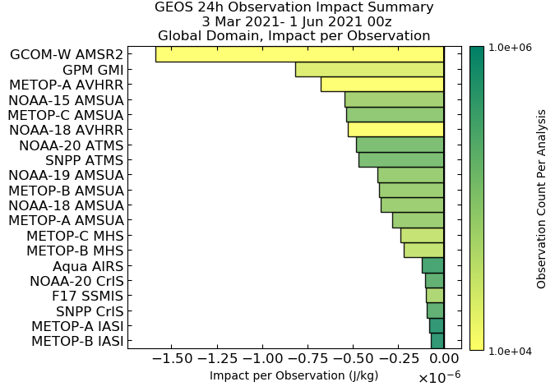
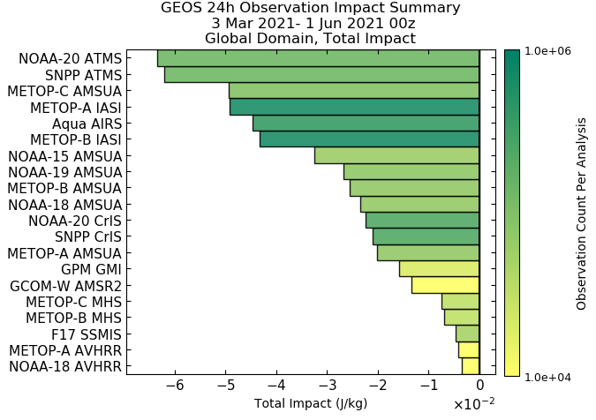
Impacts of assimilating GMI and AMSR2 in GEOS-5 FPP
AMSR2 and GMI have largest impact per observations among satellite radiance data but have overall smaller impact than many other MW or IR sounder because of limited channels are assimilated over water.
Among these MW data, brightness temperature data at 23 GHz have larger impacts than data at other channels do.

Slide 3
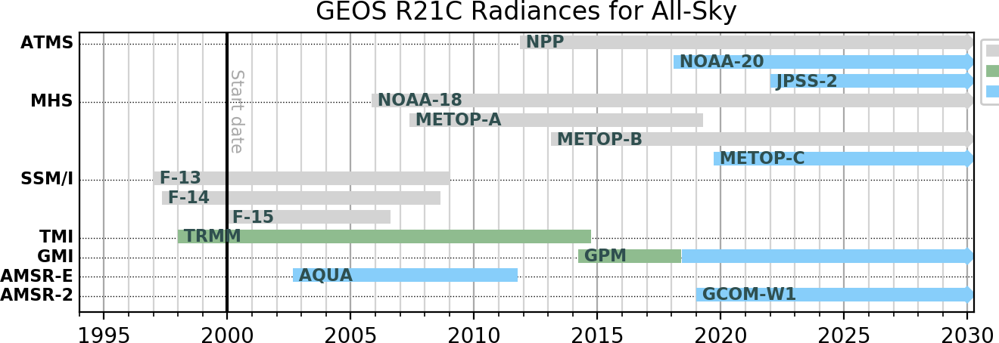
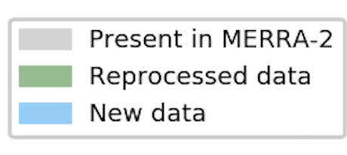
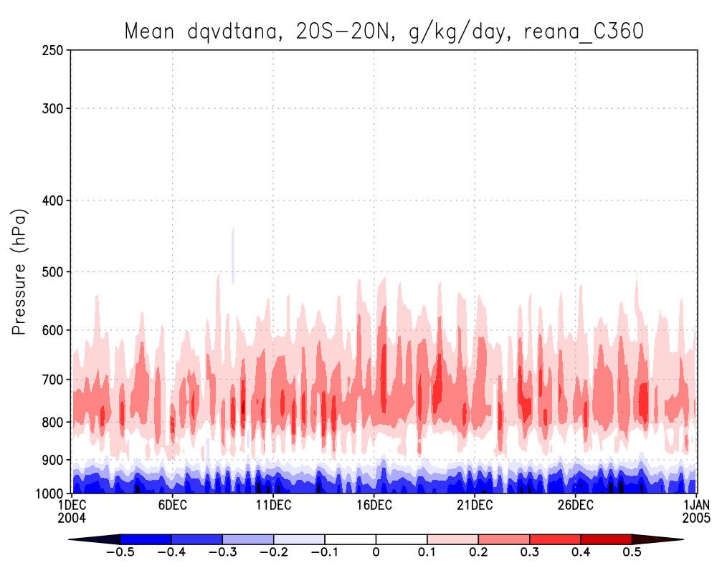
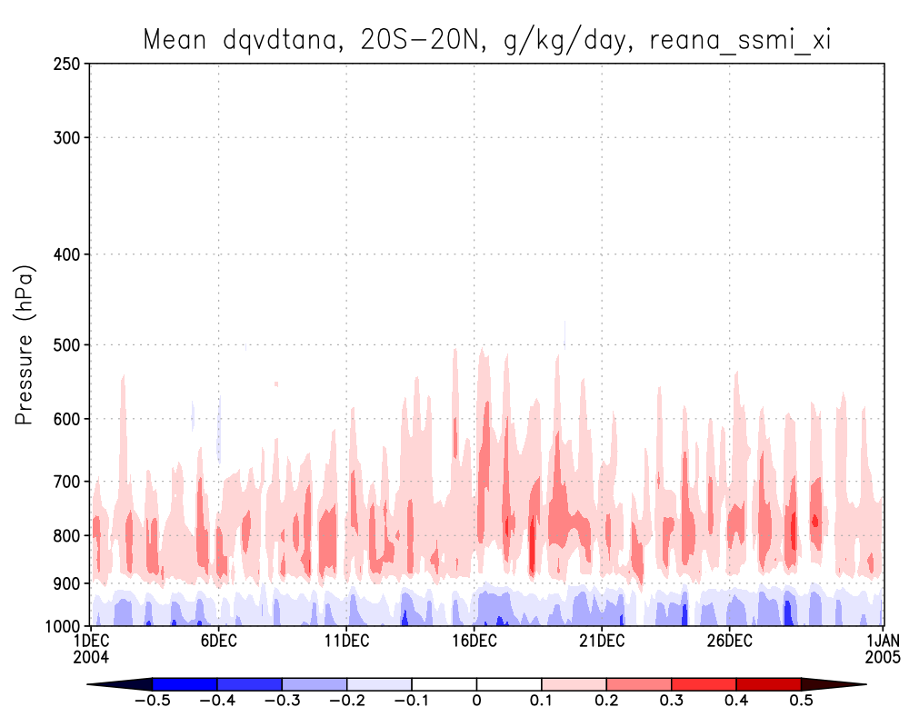
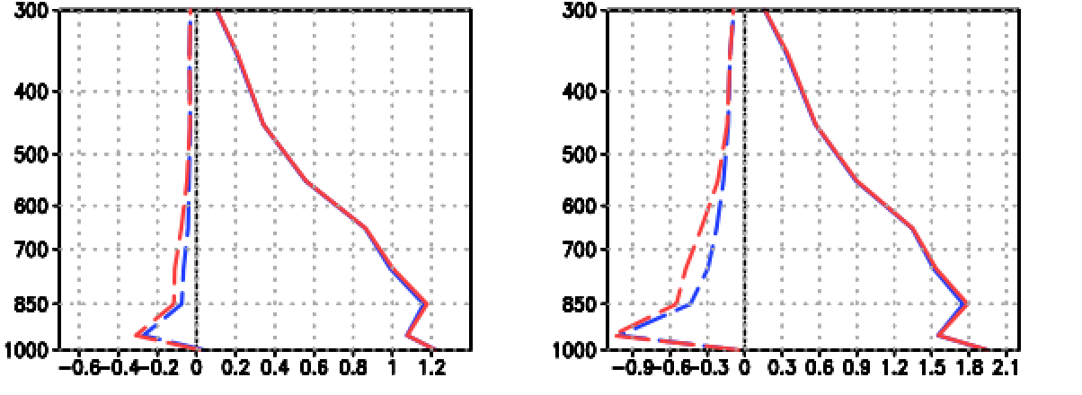
Microwave Radiance All-sky Data Assimilation In GEOS Reanalysis, GEOS-R21C (A Retrospective Analysis For The 21st Century)
Changes from MERRA-2
ATMS: clear-sky => all-sky
MHS: clear-sky => all-sky
SSM/I: clear-sky => all-sky
TRMM: rain-rate => all-sky
AMSR-E: not used => all-sky
AMSR-2: not used => all-sky
GMI: not used => all-sky
Specific humidity (q) analysis increments in tropics (20º S – 20º N), g/kg/day
Specific humidity difference: radiosonde – GEOS, Dec 2004
Global Tropics (20º S – 20º N)
SSM/I in clear-sky DA
Dec 2004
SSM/I in all-sky DA
Dec 2004
Dash line, mean;
Solid line, RMS;
Red, SSM/I in clear-sky, Dec 2004;
Blue, SSM/I + TMI + ASMRE in all-sky
Pressure (hPa)
Moisture analysis increments are smaller in all-sky assimilation, reducing the “shock” when these increments are applied to mode forecasts.
GEOS humidity analysis is closer to radiosonde observations in tropical convection regions.

Slide 4
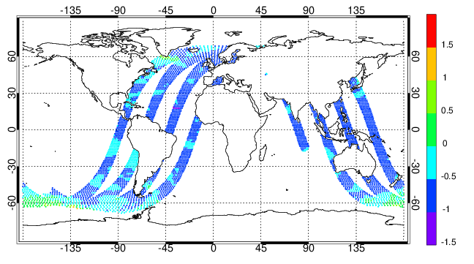
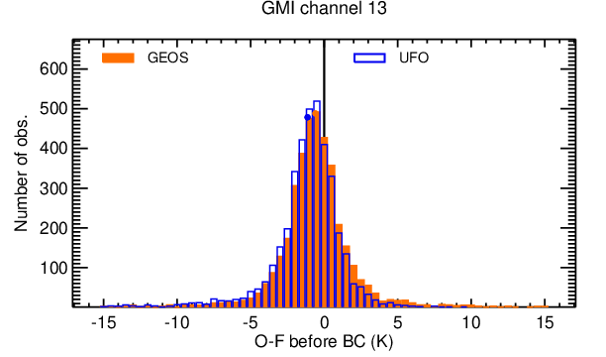
AMSR2 and GMI All-sky Radiance Data Assimilation In JEDI
Updated HofX operators for GMI and AMSR2
    GMI’s unique channel-dependent geophysical views are counted.
    Rain and snow clouds, which are state and control variables besides liquid and ice clouds in GEOS, are added in FV3-JEDI.
    Added all-sky observational error functions along with cloud retrieval functions.
    A couple of generic filters such as model total column vapor for quality control.
  Ongoing work
    Adding bias correction
    Month-long validation of FV3-JEDI with new GEOS outputs.
GMI Ch13 HofX bias when a wrong scan angle is used, K
00 hr, Nov 15, 2020
GMI Ch13 O–F in GSI and UFO (with new HofX), K

