Slide 1
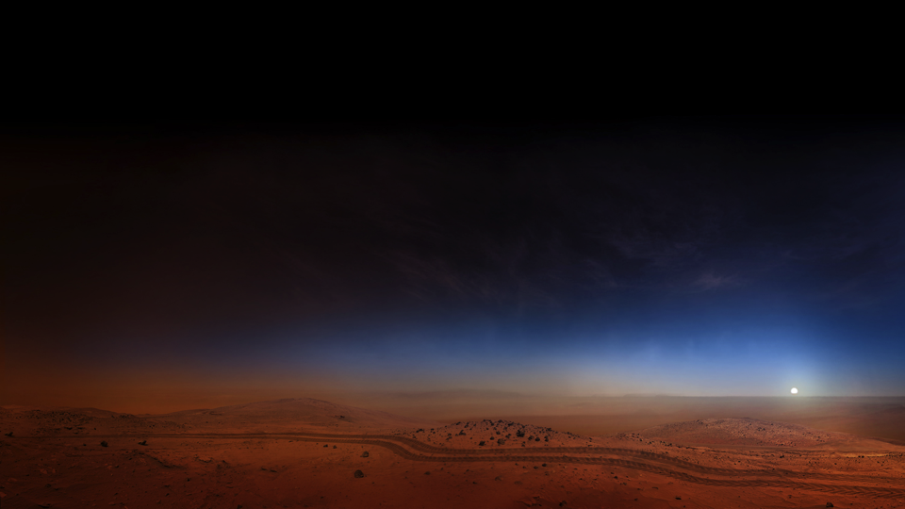
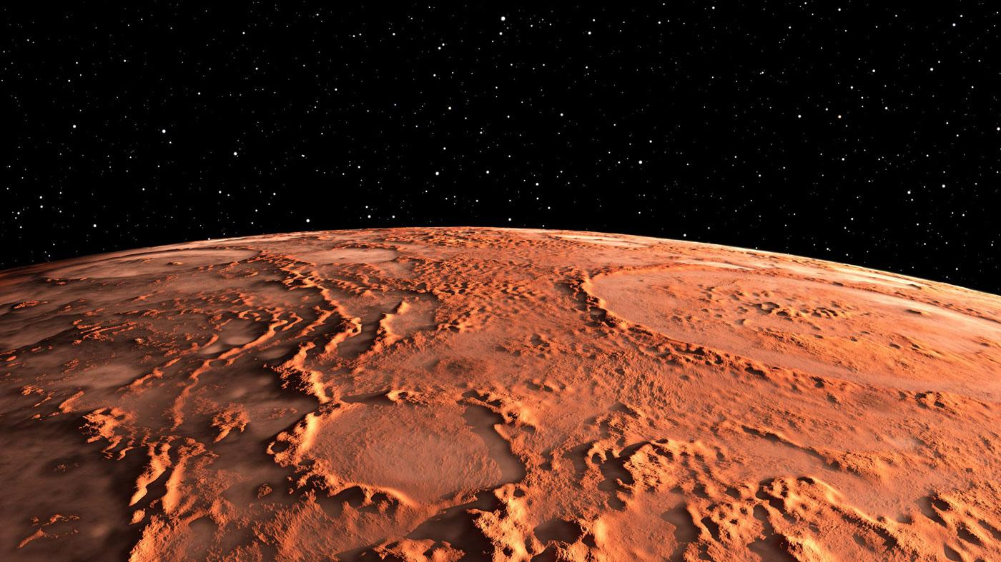

National Aeronautics and
Space Administration
Autonomous Guidance, Navigation, & Control (GN&C) for Next-Generation Missions
Keynote Talk @ ESA GNC 2021 Conference
22 June 2021
Cornelius J. Dennehy
NASA Technical Fellow for GN&C
NASA Engineering & Safety Center (NESC)
NASA Goddard Space Flight Center (GSFC)
Greenbelt, Maryland USA
Disclaimer
“The views, opinions, and/or findings contained in this presentation are those of the author/presenter and should not be interpreted as representing the official views or policies, either expressed or implied, of the National Aeronautics and Space Administration (NASA)”

Slide 2
Keynote Talk Outline
NESC Organizational Perspective : “Autonomous GN&C” Strategic Vector
Automation versus Autonomy
What Autonomous GN&C Is (and is not)
Motivation for Autonomous GN&C
Some Examples of Autonomous GN&C
V&V Challenges
On-Going Trends: How will the GN&V Community Adapt?
Closing Thought

Slide 4
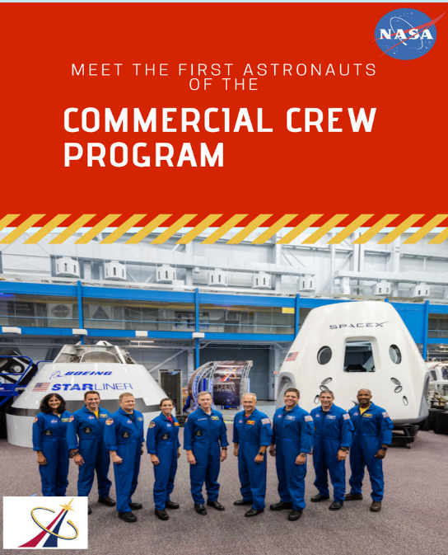
NASA Technical Fellows are the Stewards of their disciplines across the Agency, each of us considering the tools, testbeds, technologies and workforce needed for the future of our respective engineering discipline to support all the NASA Mission Directorates.
The NASA Technical Fellows also are responsible for disseminating their discipline lessons learned and establishing best practices.
Each Technical Fellow has defined a Strategic Vector for their discipline.
In my case => Autonomous GN&C

Slide 5
Three Strategic NASA Stretch Goals for Which Autonomous GN&C Will Be Required
  Robotic Science Mission Stretch Goal:
    Capability for autonomous rendezvous, proximity operations, and scientific interactions (e.g. sampling) with unknown, uncharacterized and uncooperative natural body targets of interest at deep space distances without reliance on Earth support
  Human Spaceflight Stretch Goal:
    Capability for autonomous in-space assembly and servicing of crewed vehicles, power and propulsion modules, long term habitats, multi-purpose space platforms in cislunar and deep space regimes
  Aeronautics Stretch Goal:
    Capability for multi-vehicle autonomous UAS flight operations in the National Airspace System
    Capability for autonomous Urban Air Mobility (UAM) vehicles carrying humans and cargo under weather tolerant conditions in complex GPS degraded urban environments
Overarching Theme: Building Autonomous GN&C Capabilities will Enable Robust and Reliable NASA Science, Exploration, and Aeronautic Missions Anytime/Anywhere

Slide 6
Automation versus Autonomy

Slide 7
What Autonomous GN&C Is and Isn’t
Autonomous GN&C is not Automation, but likely would be implemented in part with automatic functions
Autonomous GN&C is not necessarily Artificial Intelligence (AI), but likely would employ elements of AI such as Perception, Machine Learning, Classification, etc.
Autonomous GN&C is not about making systems “Intelligent”, “Advanced”, “Smart” or “Un-Crewed” but rather is fundamentally about making self-sufficient and self-directed
In its most complete form Autonomous GN&C is an integrated end-to-end system of perceptive sensing hardware, processing hardware, and actuation hardware whose actions are governed by goal-driven algorithms that function and operate in a self-sufficient and self-directed manner independent of external commands.
There can be building blocks of Autonomous GN&C, such as Autonomous Navigation
Source: Terry Fong (NASA, 2018)

Slide 8

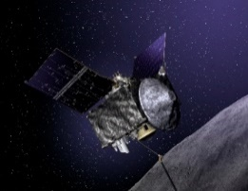
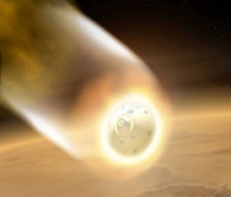
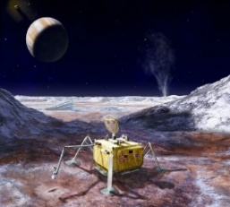
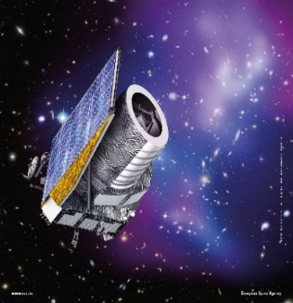
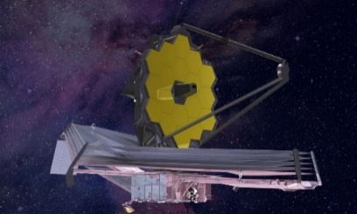
Autonomous Guidance, Navigation, & Control (GN&C) Big Picture
NASA, as well as other aerospace organizations, have common interests in Autonomous G&C capabilities.
  We are investing in Autonomous GN&C Systems technology, sensor & actuator hardware + software algorithms, Research and Development (R&D)
Beyond these R&D aspects both NASA and ESA (and our industry partners) have the challenging responsibility of architecting, designing, developing, launching and operating spaceflight systems for human and scientific exploration.
  So the ultimate goal is the subsequent infusion of this technology into engineering practice by our industry partners on our Agency’s spaceflight missions.
Many of these future ESA and NASA mission will have demanding new requirements for onboard autonomy, optimization, adaptation, and fault tolerant operations.
  For example, adaptive guidance for optimizing aerodynamic and propulsion performance during planetary Entry, Descent, and Landing (EDL)

Slide 9
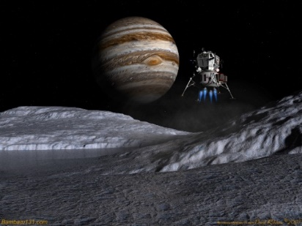
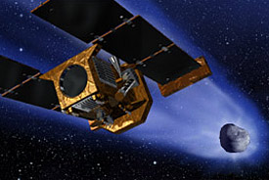
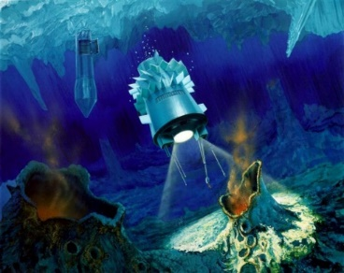
Motivation: Examples of Mission Attributes That Drive the Need for Trusted GN&C Autonomy
NASA is planning future missions where Trusted* GN&C Autonomy will be needed because:
the cadence of decision making exceeds communication constraints (time delays, data bandwidth, and limited communication windows)
time-critical decisions (for orbit/trajectory control maneuvers, system health, system reconfiguration, etc.) must be made on-board the vehicle
critical decisions can be better made using the rich on-board data compared to limited downlinked data (“opportunistic science”)
exploration into unknown/uncharacterized mission flight regimes poses unacceptable risks. For example, autonomous navigation or target selection for icy worlds, interior oceans, caves, pits, etc.
local on-board decisions improve robustness and reduces complexity of system architecture
autonomous decision making can reduce system cost
autonomy can improve performance and/or create new functionalities (e.g., increased launch availability, distributed collaborative multi-vehicle arrays )
variability in crew training, proficiency, etc. associated with manual control poses unacceptable risks
Planetary Landers
Europa Undersea Cryobot
Comet Sample Return
* Building the trust in Autonomous GN&C will dictate new ways for performing V&V and the overall manner in which we will certify Autonomous GN&C

Slide 10
Autonomous GN&C Can Play a Role in Several Arenas
Source: Terry Fong (NASA, 2018)
All types of future missions will have new requirements for onboard autonomous decision making, optimization, adaptation, and fault tolerant operations

Slide 11
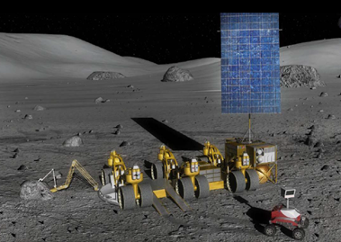
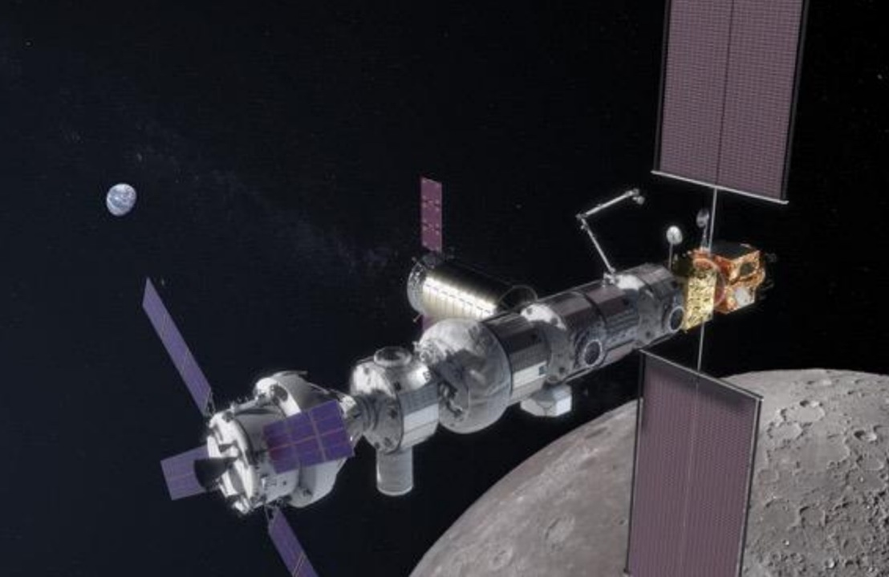
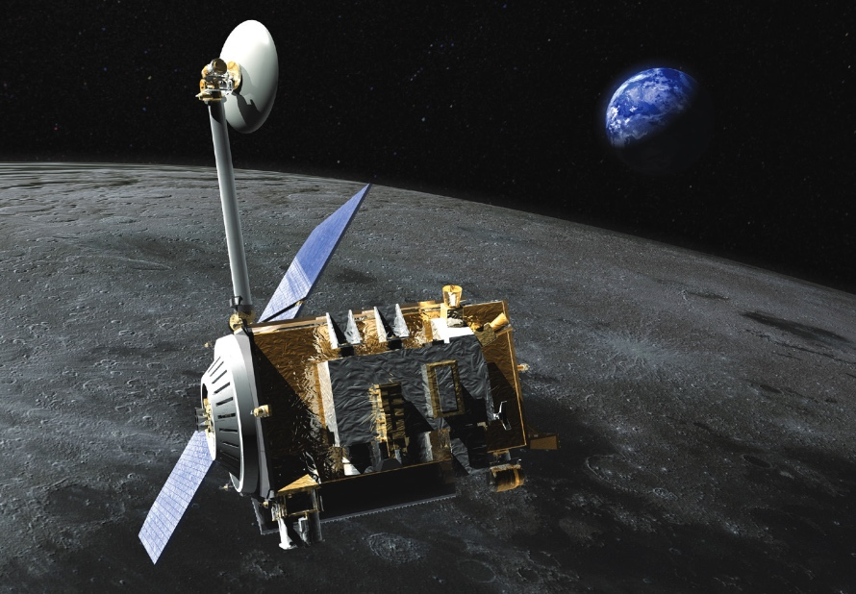
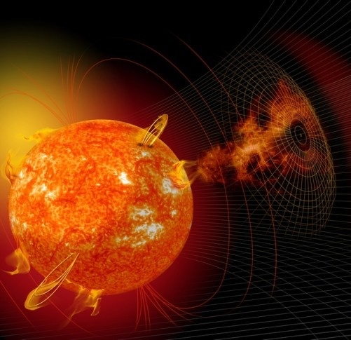
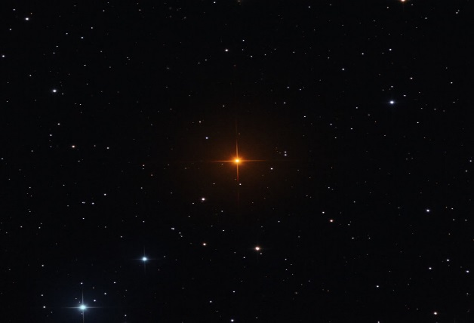
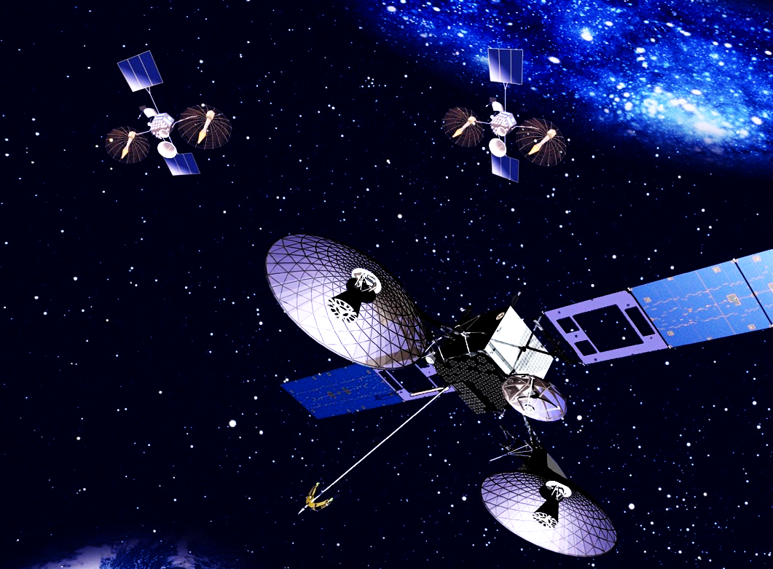
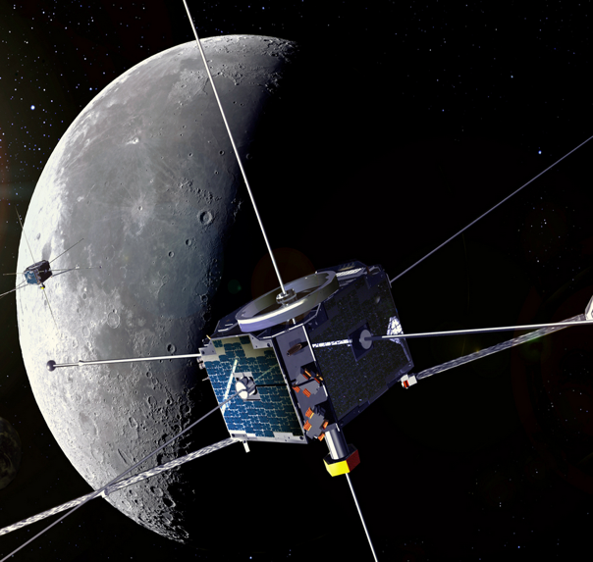
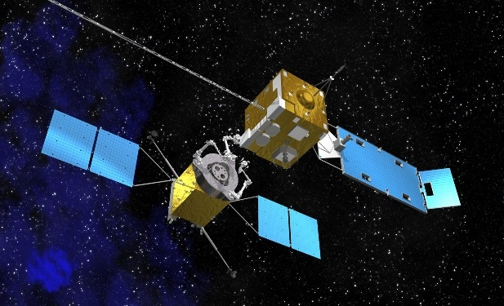
Lunar Exploration: Several Roles for Autonomous Navigation Using GNSS
Lunar Surface Operations, Robotic Prospecting,& Human Exploration
Human-tended Lunar Vicinity Vehicles (Gateway)
Robotic Lunar Orbiters,
Resource & Science Sentinels
Earth, Astrophysics, & Solar Science Observations
Satellite Servicing
Lunar Exploration Infrastructure
UNCLASSIFIED

Slide 12
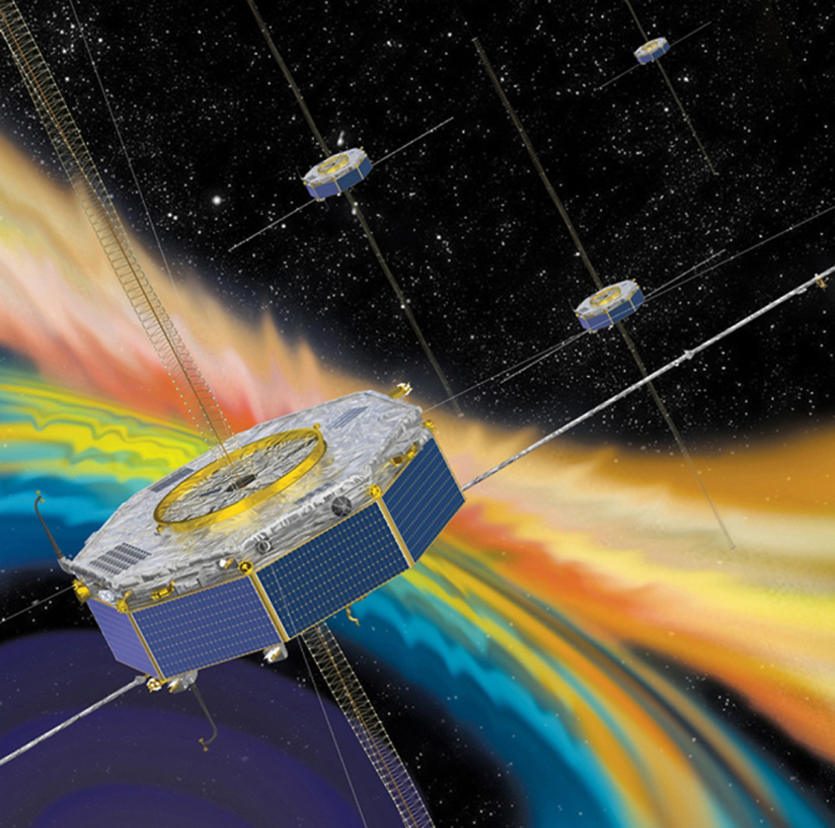
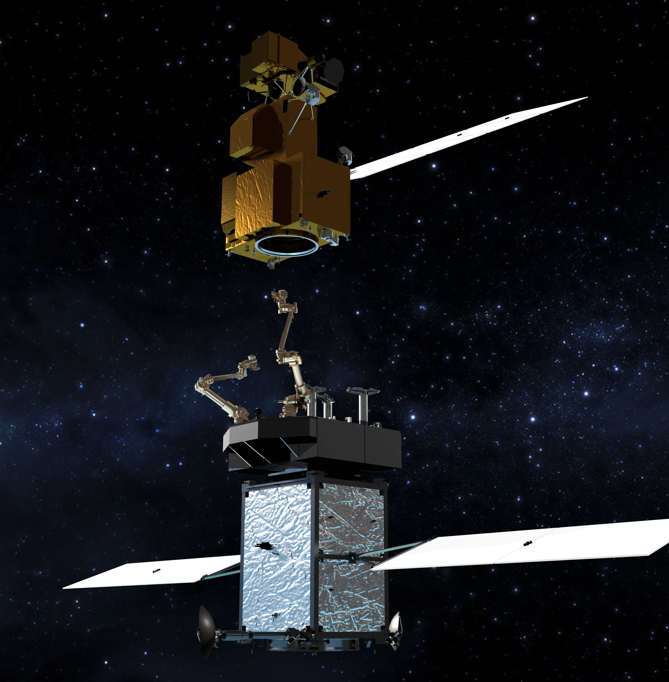
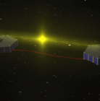
Demonstrated Benefits of GNSS-Based Autonomous Navigation
Supports increased satellite autonomy, lowering mission operations costs (savings up to $500-$750K/year)
Significantly improves real-time navigation performance (from km-class to meter-class)
Supports quick trajectory maneuver recovery (from 5-10 hours to minutes)
GNSS timing reduces need for expensive on-board clocks (from $100sK-$1M to $15K-$50K)
Enables new/enhanced capabilities and better performance for High Earth Orbit (HEO) and Geosynchronous Earth Orbit (GEO) missions
IMAGE
IMAGE
IMAGE
IMAGE
UNCLASSIFIED
Notes:
Clockwise from top L: Earth weather prediction using Advanced Weather Satellites, Space Weather Observations/Formation Flying, Precise Position Knowledge and Control at GEO, Precise Relative Positioning,

Slide 13
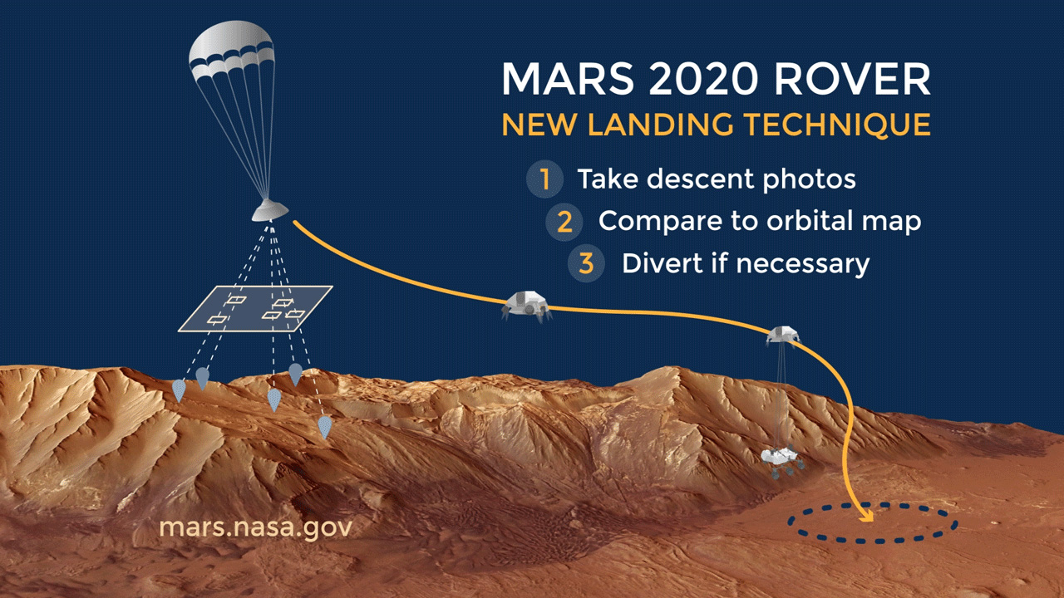


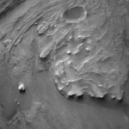
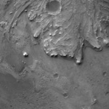
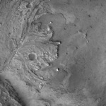

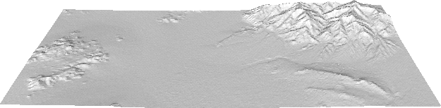
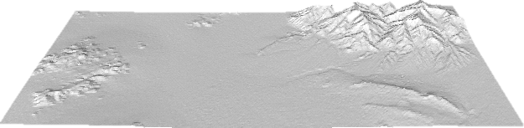

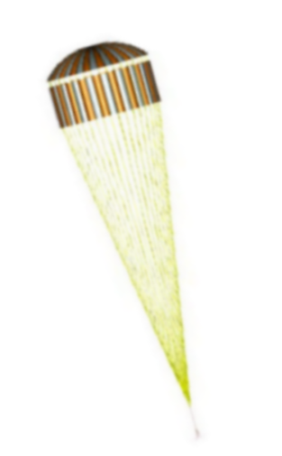
Mars2020 Terrain Relative Navigation (TRN) + Safe Target Selection (STS)
“7 minutes
of Terror”
IMU
Mars2020 Advanced the State of Autonomous GN&C
descent
imaging
map
Safe landing on Mars surface on 18 February 2021. Most demanding landing accuracy of any Mars mission to date.

Slide 14
Example 1: Autonomous GN&C for Future Planetary Pinpoint Landings
Hierarchical Decision Making
for Autonomous GN&C
Source: B. Acikmese
(Univ. of Wash., Feb 2020

Slide 15
Example 2: Autonomous Landing of Rocket Boosters
Source: B. Acikmese
(Univ. of Wash., Feb 2020

Slide 16
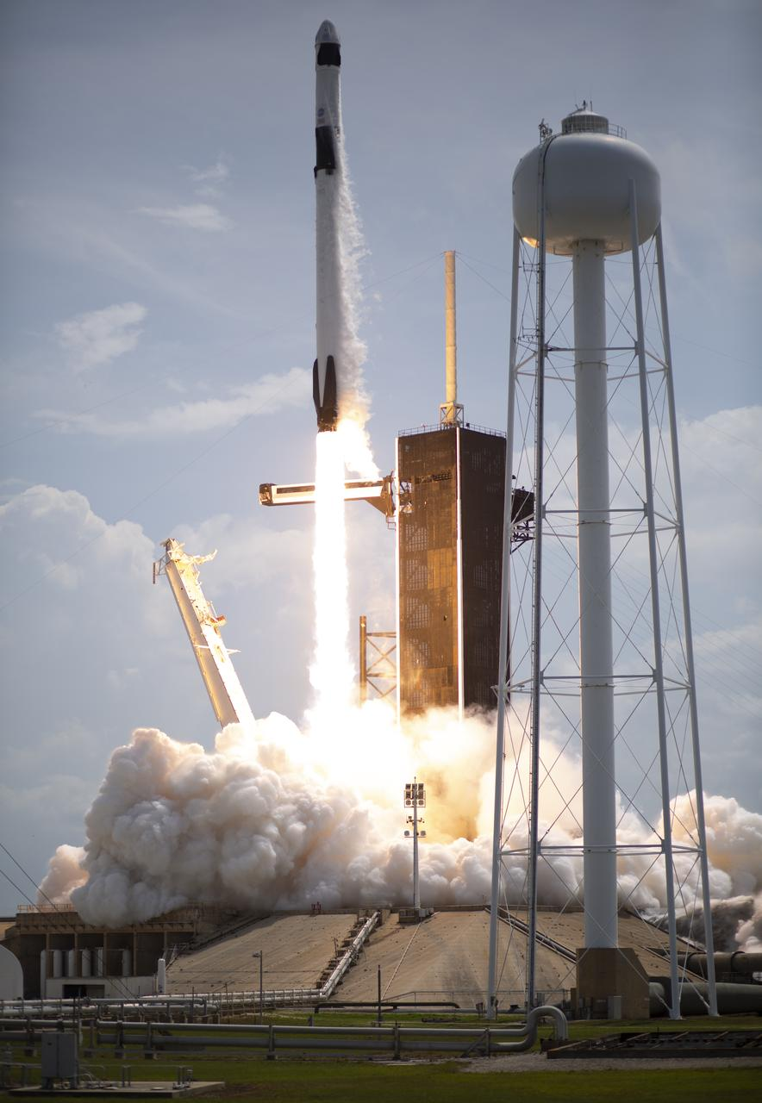
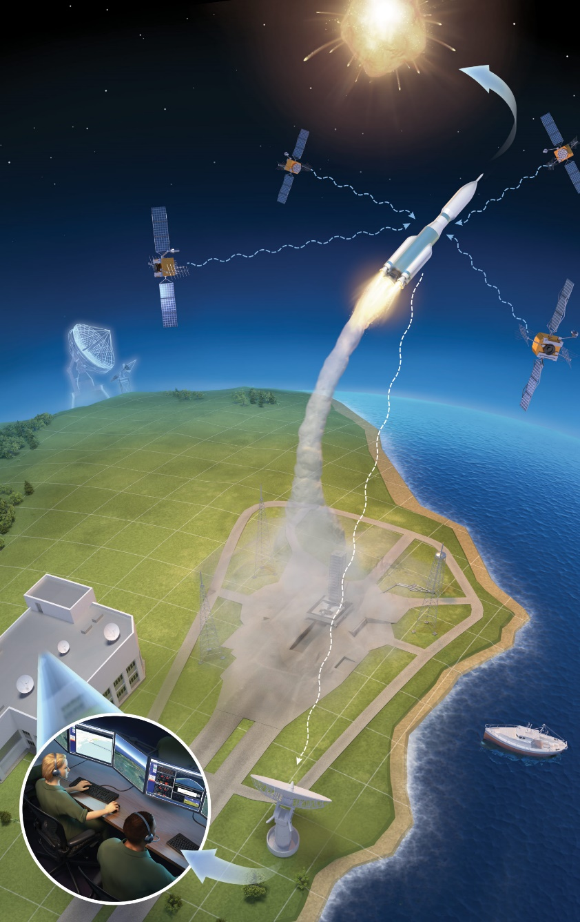
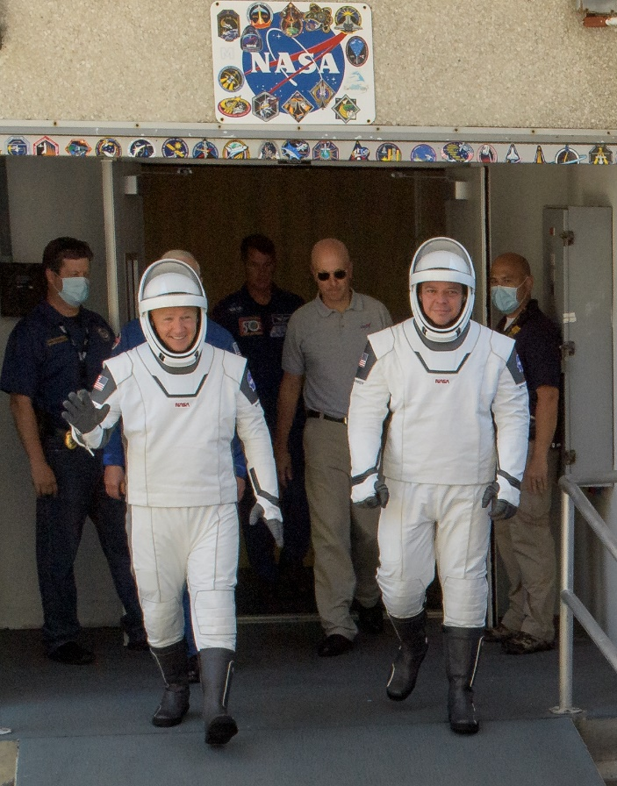

Example 3: Autonomous Flight Termination System (AFTS)
Autonomous Flight Termination System (AFTS):
First Employment on Human Spaceflight Mission - SpaceX Crew Demo 2 (30 May 2020)
Independent, self-contained subsystem onboard launch vehicle that automatically makes flight termination / destruct decisions
Box on the vehicle (AFTU)
  Tracking from GPS and INS sensors
  Rule set built in pre-flight period
  Rule violation terminates flight
Radar and command stations can be phased out at range
Telemetry down-link drops from safety critical to situational awareness, post-flight, and mishap investigation
SL-15 mission will demo resilient use of combined GPS/Galileo
Multiple
GPS sources
(4 minimum)
L-band signal
Aborted launch
S-band
signal
downlink
Cost reduction
because offsite
radar and
command sites
are eliminated
Command
Center
Fouled range
Telemetry
dish
Range officers
UNCLASSIFIED
Notes:
Some jobs stay with the humans
Clear to launch
Good AFTU load
Clear range
Weather conditions
Mishap announcement and investigation
Post-flight data review

Slide 17
An Aeronautics Example for the Space Community’s Consideration
NASA’s Advanced Air Mobility Mission: The Third Aviation Revolution
Advanced Air Mobility Mission Will Depend on Transformational
Tools & Technologies, Many From GN&C, to Build Trusted Autonomy
for Safety-Critical Flight Systems

Slide 18
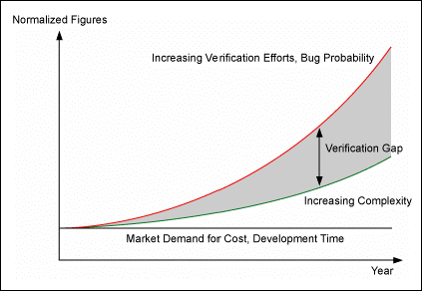
Autonomous GN&C Poses a Verification & Validation (V&V) Challenge
No shortage of promising algorithms to implement Autonomous GN&C functions
However there is likely to be a significant Verification and Validation (V&V) gap as the GN&C community of practice is unprepared to “certify” flight systems employing fully Autonomous GN&C
Verification is expense pahse of the mission life cycle
A Multi-Agency (ESA, CNES, DLR, NASA) Workshop on GN&C Algorithms V&V was recently to identify the key issues and future risk mitigations for V&V
  Members of the GN&C Algorithm V&V Workshop will be reporting on the outcomes of this as part of this conference

Slide 19
On-Going Trends: How will the GN&V Community Adapt?
To embrace the full-potential of Autonomous GN&C the GN&C community needs to understand and prepare for the on-going trends:
  Machine Learning applied to control problems
  Perception + Optimization ➔ Autonomous decision making
  Highly-Networked Cyber-Physical dynamical systems
Therefore to make Autonomous GN&C a practical reality our GN&C community will need to adopt much more of a “systems engineering viewpoint” and learn how to structure and integrate the emerging technologies across multiple disciplines such as Computer Science, Software, Avionics, Machine Learning. etc.
Future mission applications of Autonomous GN&C will challenge the GN&C engineering discipline by requiring more interdisciplinary team system-wide coordination to address the challenges of increasing complex system-level interfaces and interactions over project lifecycle.

Slide 20
Closing Thought: We Need to Find the Right Sweet Spot
Suggest our Academic researchers work more closely with the Space Agencies and Industry to better understand the mission “pull” such that the technology pipeline from academia can produce Autonomous GN&C technology that can be readily infused in future missions.
Academia
Industries
Suggest our Industry partners (Large System Integrators) understand and embrace to potential of Autonomous GN&C to both provide unprecedented space system performance and reduce development and operational costs
Space Agencies
Suggest the Space Agencies lead the way by providing a vision and a strategic pathway for a new GN&C engineering eco-system that fully exploits Autonomous GN&C
Important in Many Ways to Build the Industry –
Not Just a Space Agency Program

Slide 21

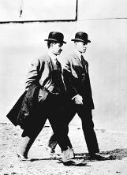
A Final Thought: Don’t Wait, Just Do It
From the October 9th, 1903 edition of the New York Times:
“[A] flying machine which will really fly might be evolved by the combined and continuous efforts of mathematicians and mechanicians in from one million to ten million years.”
From Orville Wright’s diary October 9th, 1903:
“We started assembly today.”
Source: Jess Sponable (DARPA, 2014)
21

Slide 22
THANKS FOR YOUR ATTENTION!
QUESTIONS?

Slide 23
ESA GNC 2021 Conference Keynote Talk Title and Abstract
Autonomous GN&C Technology for Next-Generation Missions
Abstract:
Along with its spacefaring international partner agencies NASA has a common interest in the development and application of Autonomous Guidance, Navigation, and Control (GN&C) technologies for its next-generation missions, both for human and scientific exploration, in Earth orbit, in Cis-Lunar space, Lunar orbit, and in deep space flight regimes across the solar system. Many of these future NASA missions will have demanding new requirements for onboard autonomy, optimization, adaptation, and reliable fault tolerant operations. A noteworthy example is the need for adaptive guidance to optimize aerodynamic and propulsion performance during planetary Entry, Descent, and Landing (EDL). The NASA GN&C community of practice needs to understand, and learn how to combine and infuse, multiple relevant on-going technology trends, such as Machine Learning and Artificial Intelligence, to be able to synthesize a new generation of space platforms/vehicles with first-of-a-kind capabilities for autonomous decision making. This talk will highlight, from the NASA perspective, the drivers for Autonomous GN&C describing the overall benefits of and challenges for architecting, developing, and certifying the reliability of these next-generation spacecraft employing advanced perception, autonomous navigation, adaptive flight control and maneuver/motion planning capabilities.

Slide 24

Short Bio for Neil Dennehy
Mr. Dennehy joined NASA in 2000 as the Assistant Chief for Technology for the Guidance, Navigation and Control Division at the Goddard Space Flight Center in Greenbelt, Maryland. Since 2005 he has served as the NASA Technical Fellow for Guidance, Navigation and Control (GN&C) providing stewardship for the GN&C discipline across NASA. He is a member of the NASA Engineering and Safety Center (NESC) organization where he provides technical leadership for independent test and analysis, risk assessment and problem resolution for NASA’s GN&C engineering discipline issues and anomalies. He also serves as the lead for the NASA Technical Fellow Office with the NESC organization. A long time ago he received a B.S. degree in Mechanical Engineering from the University of Massachusetts at Amherst and the S.M. degree in Aeronautics and Astronautics from the Massachusetts Institute of Technology in Cambridge, Massachusetts.
Neil Dennehy
NASA Technical Fellow for GN&C
NASA Engineering and Safety Center (NESC)
cornelius.j.dennehy@nasa.gov
+1.240.687.9077

