Slide 1
Data Optimization for the Cloud
Earthdata Cloud Services
Patrick Quinn
EED-2 / Element 84
patrick@element84.com
James Gallagher
EED-2 / OPeNDAP
jgallagher@opendap.org
This work was supported by NASA/GSFC under Raytheon Technologies contract number NNG15HZ39C.
This document does not contain technology or Technical Data controlled under either the U.S. International Traffic in Arms Regulations or the U.S. Export Administration Regulations.

Slide 2
Review
What is ‘Cloud optimized’
Why care

Slide 3
I have a file location. How do I get the data I care about from it?
Locate parts of the file I need to read to get the data I care about
Read the parts of the file that have my data
Translate bytes I got into the data I wanted, usually decompressing and throwing away things I had to read but didn’t want

Slide 4
Files on a hard drive
Latency is very low, under 0.1ms for SSD
Throughput is very high, > 200 MB/s.
Parallelism is low, usually one CPU
Consequences for file formats:
Optimal formats favor many small reads getting only the necessary data.
SSD: Solid State Drive
CPU: Central Processing Unit

Slide 5
Files in the cloud
Latency is very high, 70ms or more for S3
Throughput is very high, up to 25G/s
Parallelism is very high
Consequences for file formats:
Optimal formats emphasize using fewer reads, even if it means fetching extra data only to discard it.
Too many reads makes it faster to download the whole file and process offline.
S3: Simple Storage Service

Slide 6
Cloud-Optimized =
Able to fetch lots of data in a small number of reads
But operating at a scale where you can’t just fetch everything

Slide 7
OPeNDAP in the Cloud and the DMR++
How the server reads/subsets data from S3
DMR++: Dataset Metadata Response with extensions

Slide 8
Overview
Three possible ways to build ‘OPeNDAP in the Cloud’
Let's talk about the ways each can be an optimal solution
How the technique we chose works in practice
DMR == DAP4 Dataset Metadata Response
DMR++ == DMR with extra metadata
DAP4: Data Access Protocol, version 4

Slide 9
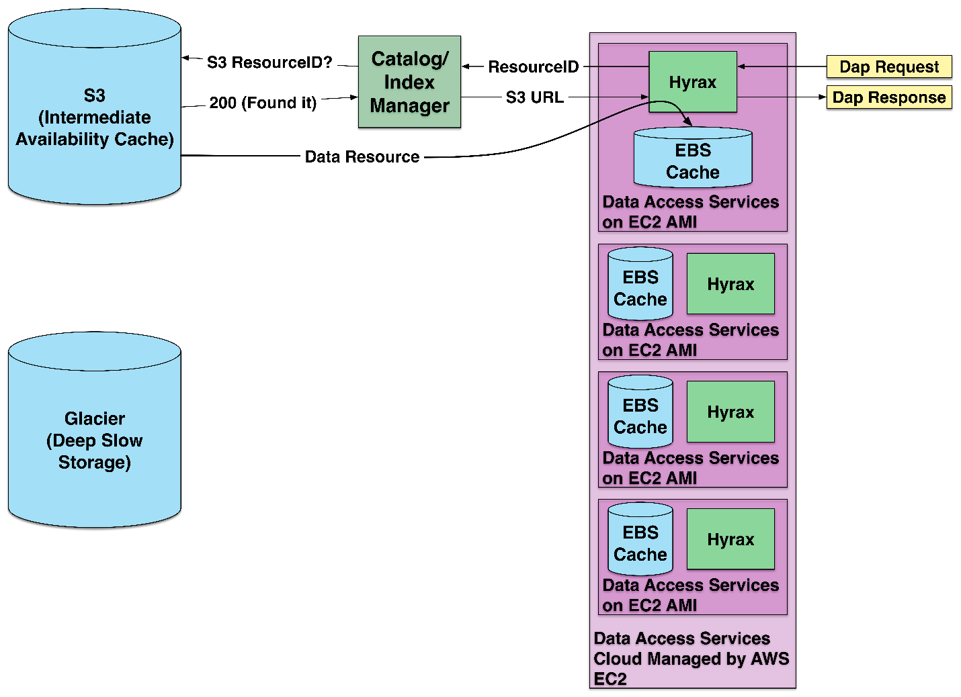
Arch 1: Baseline
Access using whole files retrieved from Amazon’s Simple Storage Service (S3)
EC2: Amazon’s Elastic Computing
AMI: Amazon Machine Instance
EBS: Elastic Block Store

Slide 10
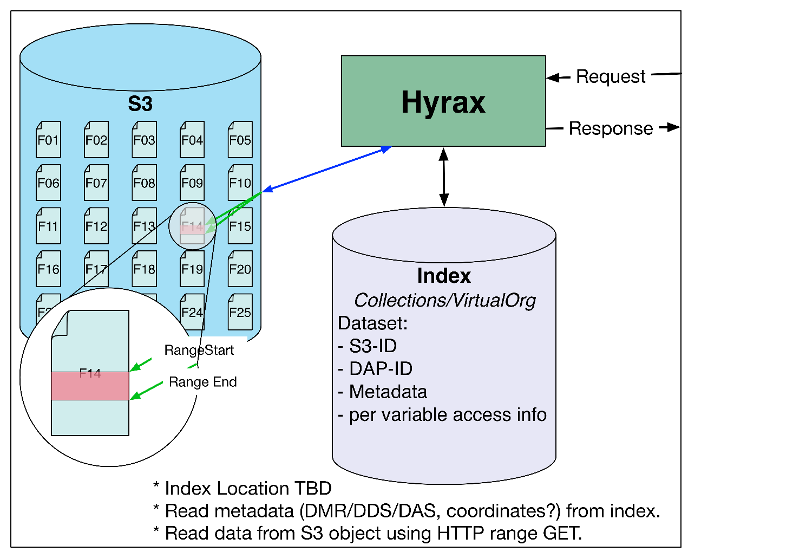
Arch 2: Files with HTTP Range GETs
HTTP Range-Get access to whole files in S3
HTTP: Hypertext Transfer Protocol
DDS: Data Access Protocol (DAP) Dataset Descriptor Structure
DAS: DAP Dataset Attribute Structure

Slide 11
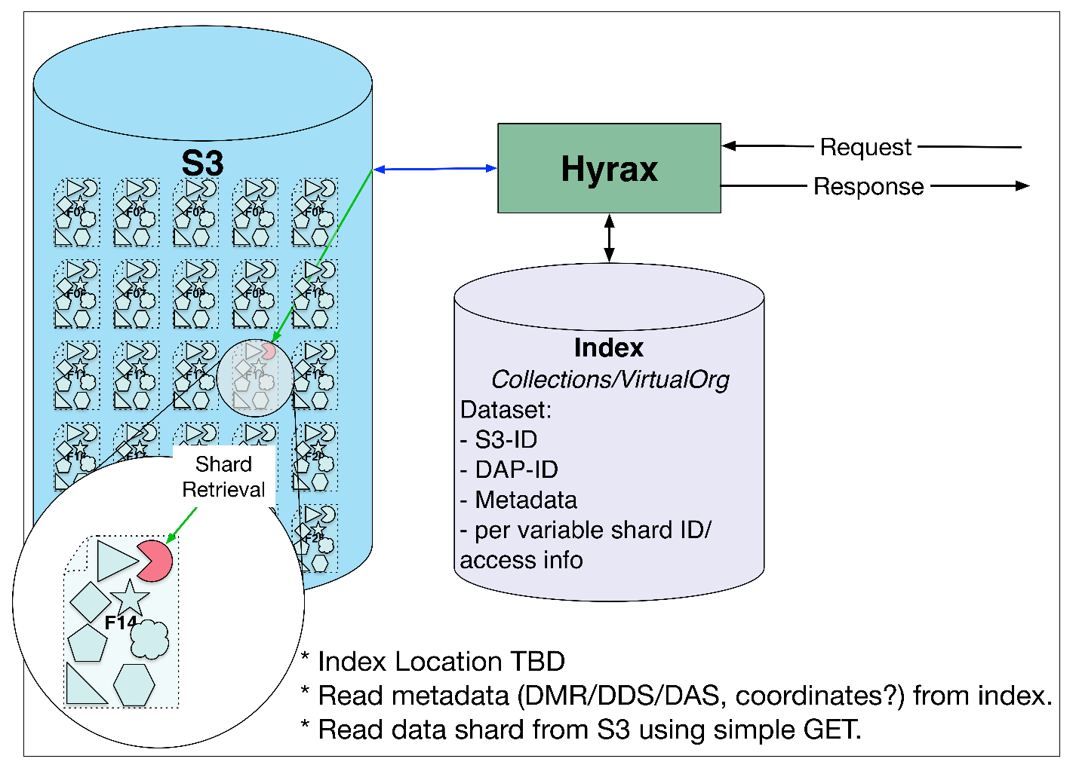
Arch 3: Shredded HDF5 Files
HTTP Get access to parts of HDF5 files as objects in S3
HDF5: Hierarchical Data Format, version 5
TBD: To Be Determined

Slide 12
Compare these designs
Transferring the whole file can be the fastest way to get data – even small amounts of data. Why?
  Because files with many small parts require many accesses, each with high latency
Virtual sharding preserves the original data file (can be used by Arch #1) and allows subset-in-place access.
  To be performant, this virtual sharding must be optimized
  NB: this can only be used if metadata are computed beforehand.
True sharding is the solution chosen by the designers of zarr
  For files with many variables/shards the cost of access to the whole file is very high (think 1,000 variables * 100 chunks/var * X latency)*
  Reduce size – eliminate duplicate objects

Slide 13
Hyrax/DMR++ Use: Set up
First, build the DMR++ metadata file
  Choose options that alter the appearance of the file
  DMR++ documents are (now) XML
Store the Data and DMR++ metadata in S3, or another web object store (WOS)
  We use CMR to find these S3 objects
XML: eXtensible Markup Language
WOS: Web Object Store
CMR: Common Metadata Repository

Slide 14
Hyrax/DMR++ Use: Data access
The server reads the byte-offset and size (i.e., number of bytes) of a variable from the DMR++
The server uses HTTP Range GET operations to read just those bytes
The server typically must issue many reads in parallel to get data for one variable
Discrete ‘chunks’ are then assembled into the variable’s value

Slide 15
Hyrax/DMR++ Use: Optimization
Issue parallel reads
Decompress ‘chunks’ in parallel
Combine adjacent ‘chunks’ to maximize transfer volume per request

Slide 16
Other tricks
The DMR++ can be used to aggregate data across many objects
It is generally much faster than aggregations formed using files
  There is no need to open each file and read it’s metadata
It can also be used on spinning disks
Data are accesses without the format API library – maybe we could make a very thin server?
API: Application Programmer Interface

Slide 17
Questions?
James Gallagher
EED-2 Software Engineer
jgallagher@opendap.org

Slide 18
This work was supported by NASA/GSFC under Raytheon Technologies contract number NNG15HZ39C.

