Slide 1
Development of an Inertia Relief Method for Aircraft with Dissimilar Engines in LEAPS
Bryce L. Horvath
NASA Langley Research Center
Systems Analysis and Concepts Directorate
Gregory A. Wrenn
Analytical Mechanics Associates, Inc.
Systems Analysis and Concepts Directorate
8/4/2021
This material is a work of the U.S. Government and is not subject to copyright protection in the United States.

Slide 2
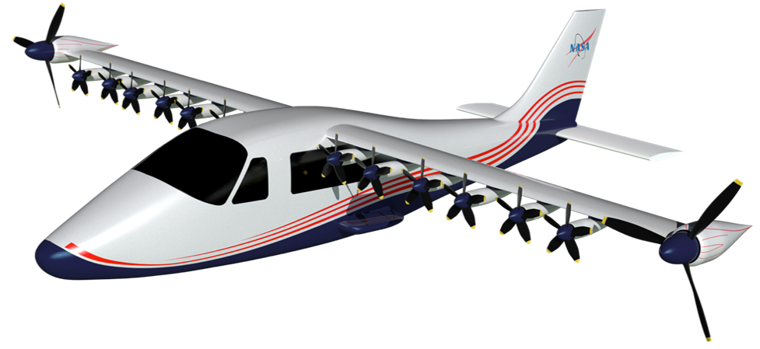
Introduction and Objective
LEAPS – Layered and Extensible Aircraft Performance System
  Conceptual design tool for integrated aircraft design
  Modules: Mission analysis, Propulsion, Aerodynamics, and Weights/Structures
  Engine inertia relief method limited to a single engine type
New aircraft concepts incorporate multiple sizes and types of engines
  X-57 Maxwell
Objectives:
  Evaluate the existing LEAPS engine inertia relief method for distributed propulsion
  Develop an update for aircraft with dissimilar engines
Image Credit: NASA

Slide 3
Engine Inertia Relief
Application of load representing the inertia of the engine
LEAPS Engine Inertia Relief Factor (EIRF)
  Relative measure of engine inertia relief
  Calculated with regression equations inspired by beam methods
  Function of:
    Wing design
    Engine weight, location, and quantity
  Ranges from 1 to 0.84
    1.0 --> No engine inertia relief
    0.84 --> Maximum benefit
Simplified Wing Loads During Pull Up Maneuver
Wing Lift
Engine Inertia

Slide 4

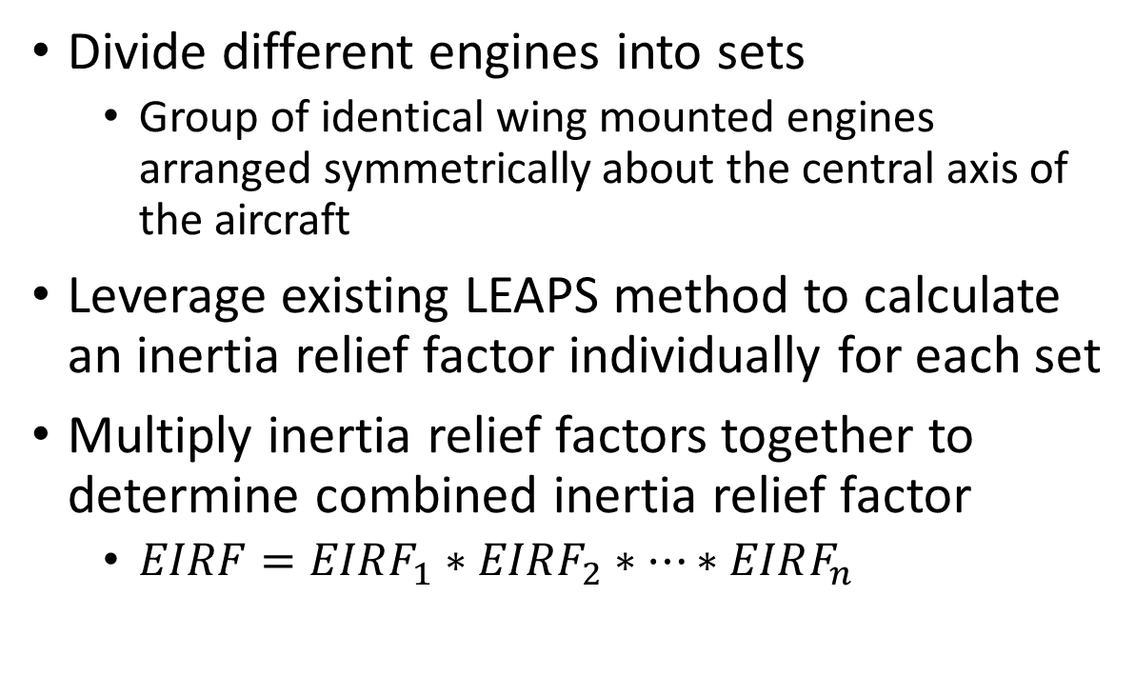


Methodology Extension for Aircraft with Dissimilar Engines
Divide different engines into sets
  Group of identical wing mounted engines arranged symmetrically about the central axis of the aircraft
Leverage existing LEAPS method to calculate an inertia relief factor individually for each set
Multiply inertia relief factors together to determine combined inertia relief factor
  $EIRF=EIRF_{1}∗EIRF_{2}∗…∗EIRF_{n}$
Engine Set 1
$$EIRF_{1}$$
Engine Set 2
$$EIRF_{2}$$
$$EIRF=EIRF_{1}∗EIRF_{2}$$

Slide 5
Validation Approach
Compare LEAPS wing weight with wing weight from higher order tools
  SUITCASE – Equivalent plate method
  AMMIT – Beam based analysis tool
  LEAPS – Regression equations inspired by beam methods
Baseline Aircraft
  Boeing 777
  Boeing 737
  ATR-42
Considering relative error and prediction trends

Slide 6
Evaluation of Method Extension
Modified ATR-42
100% of Engine Weight in Distributed Set (14 Engines)
Equal Weighting Between Engine Sets (14+2 Engines)
100% of Engine Weight in Discrete Set (2 Engines)

Slide 7
Summary of all Evaluated Configurations

Slide 8
Conclusions
LEAPS engine inertia relief method evaluated for distributed propulsion concepts
An extension of this method was developed to allow for inertia relief on aircraft with multiple engine sizes
New method implemented in LEAPS and included in the initial public release of LEAPS

