Slide 1
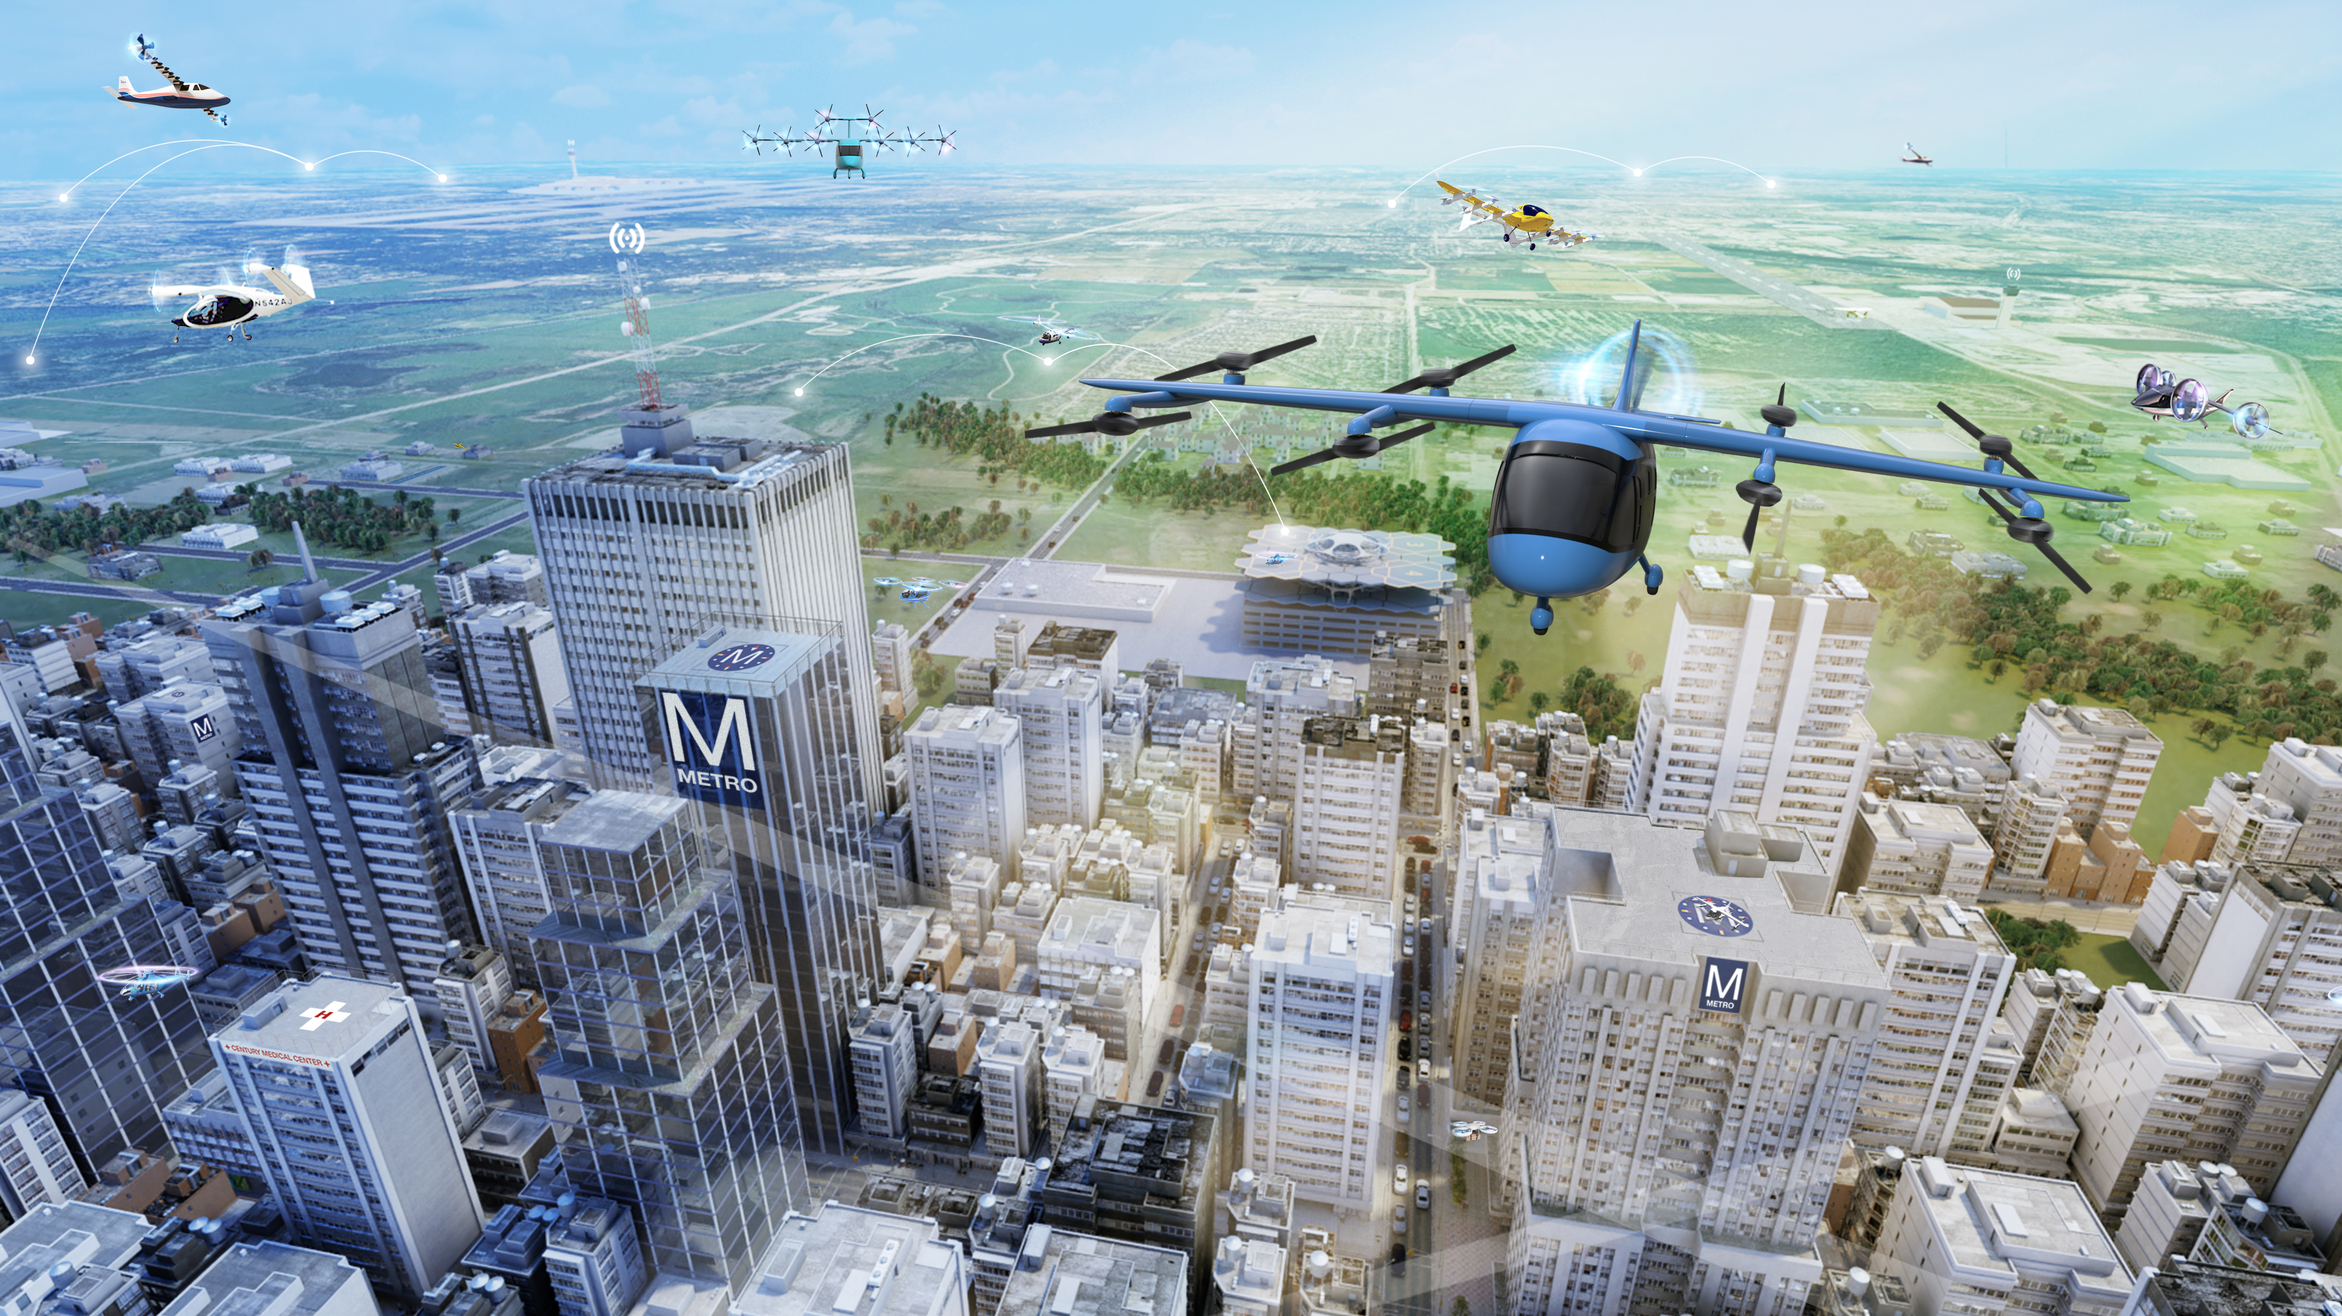

NASA Advanced Air Mobility (AAM) Mission

Slide 2
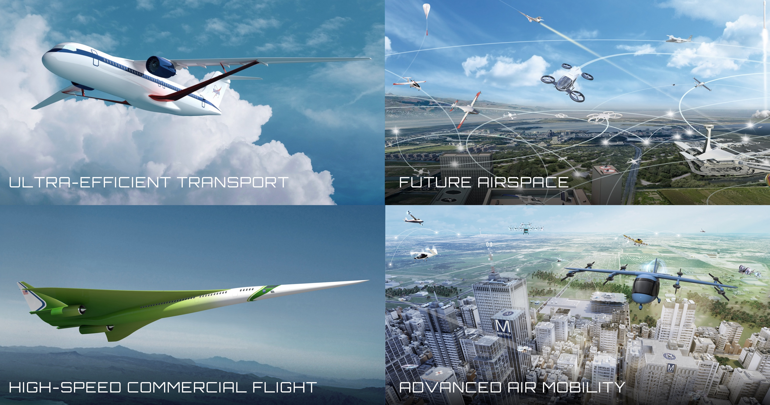


Four Transformations for Sustainability, Greater Mobility, and Economic Growth
Notes:
NASA is leading transformation of aviation in several ways:
Locally - through Advanced Air Mobility, Unmanned Aircraft Systems, and use of electric Vertical Takeoff and Landing – we are transforming the way people and goods move through aviation. We’re rallying emerging markets to tackle the challenges of creating an air transportation system featuring all-electric, autonomous, efficient and safe systems operating over the most rural countryside to the densest, skyscraper-filled urban environment.
Across the nation – we are enabling transformative improvements in the efficiency of commercial aviation, with particular focus on the single aisle fleet – Boeing 737 size – through developing and demonstrating integrated electric propulsion in small to large aircraft, advanced materials, advanced propulsion systems, and new ways to design and build aircraft.
Globally – we are sustainably connecting the world through high-speed commercial flight. We are removing barriers to commercial supersonic flight over land by proving that we can get rid of the sonic boom, tackling the next challenges in local noise and emissions, and investigating the potential of even higher speed flight.
System wide – we are transforming the efficiency and safety of the entire global aviation system through future airspace tools and system design that supports all of these users
Right now we’re creating the DNA of an aviation system that is transformed. NASA explores technologies that reduce aircraft noise and fuel use, get you gate-to-gate safely and on time, and transform aviation into an economic engine at all altitudes.
Each of these transformations is taking place grounded in a mindset of sustainability, enabling global mobility and economic growth.
In the emerging markets, environmental sustainability will be a key constraint in the development of low boom supersonic aircraft and short range, electrified vertical take-off and landing (eVTOL) aircraft for Advanced Air Mobility missions.
And we’re creating the fundamental building blocks of knowledge and capability to enable these transformations.

Slide 3
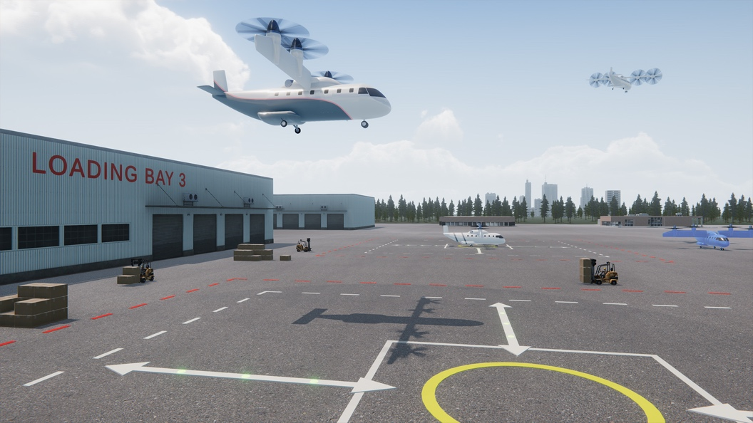
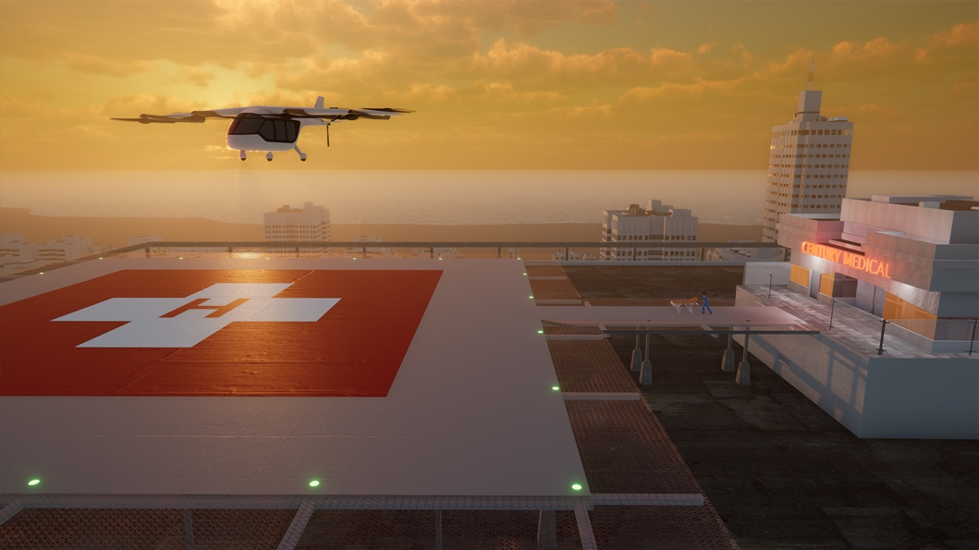
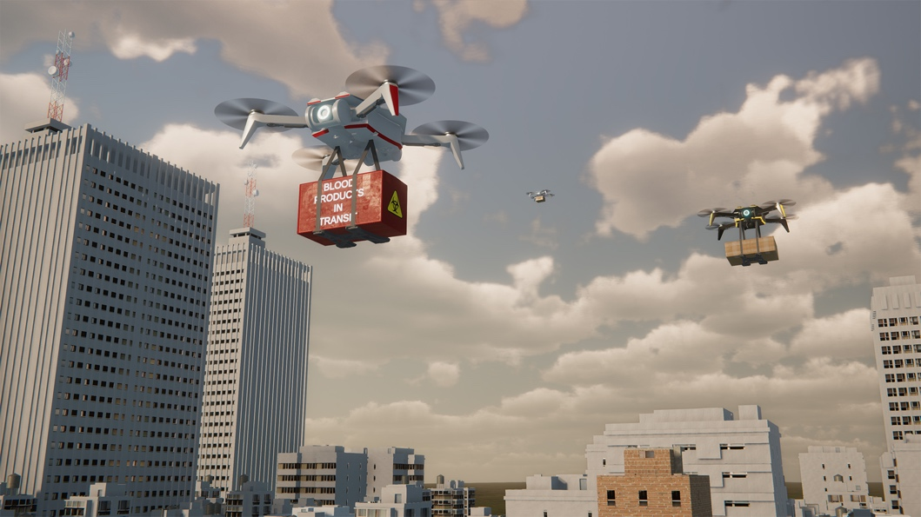
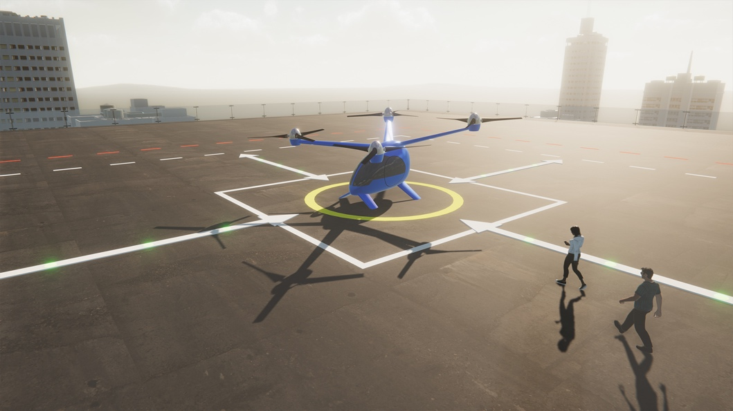
Advanced Air Mobility is Emerging
REGIONAL PASSENGER AND CARGO
TRANSPORT
PUBLIC GOOD
CONSUMER/ ENTERPRISE GOODS AND SERVICES
PASSENGER TRANSPORT
Latest studies show an annual estimated market of $115B by 2035

Slide 4
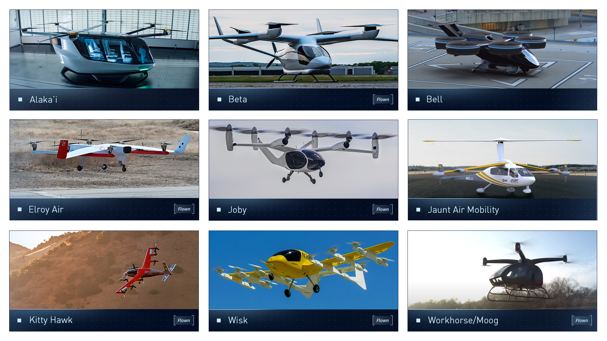
Strong Domestic (e)VTOL Industry Base

Slide 5



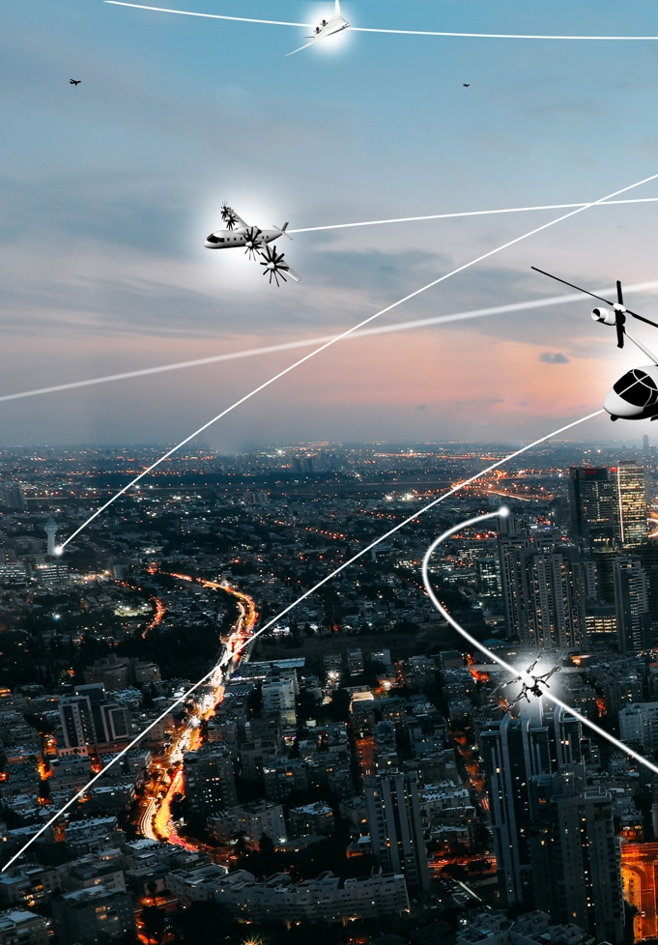
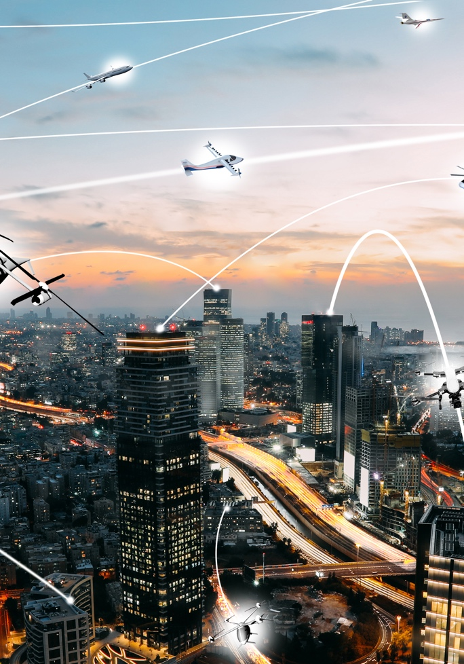
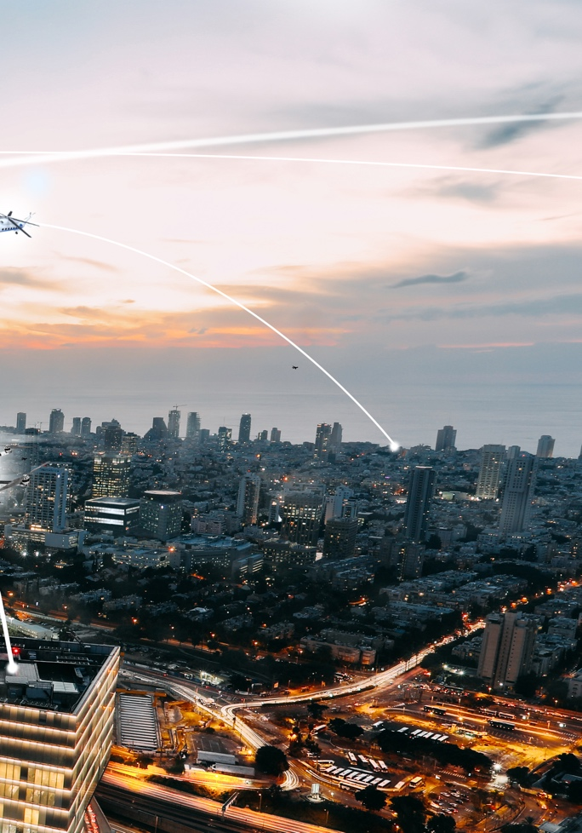
NASA Role to Address AAM Challenges
Vehicle Development and Operations
Airspace Design and Operations
Community Integration
  NASA and key partners are collectively taking on the most difficult mission challenges to enable industry to flourish by 2030
  Research and Development Portfolio
  Robust Ecosystem Partnerships
  AAM National Campaign Series
NASA to deliver long term technical solutions and architecture requirements for the industry and regulatory communities

Slide 6
AAM Sustainability
Sustainable Operations
High Demand, multi-modal, no-emissions, with automated networked vehicle operations providing significant public good (fire and medical) and time savings to regular travelers (regional and local)
Clean Technology and Infrastructure
As aircraft become more electric, the importance of achieving zero emissions becomes a power grid infrastructure challenge
Production Resiliency
Production certifications and supply chain for aviation must transform to accommodate sustainable technology and energy
AAM Sustainability is based on creating opportunities for public good and convenience use-cases that leverage clean technologies through the supply chain and operations
6

Slide 7
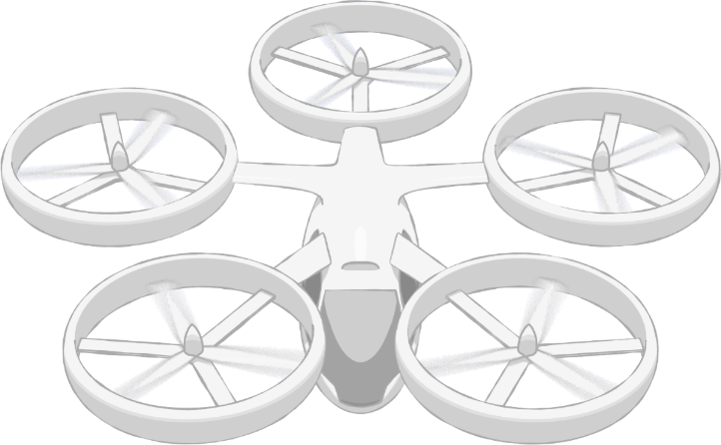
NASA AAM Mission Priorities
Human Response to Noise
Regional M&S Capabilities, & Supply Chain
Community Integration
xTM Architectures
Operational Rules, Roles, & Procedures
Comm, Nav, Surveillance, Information
UAM Supplemental Data Services
In-time Aviation Safety Management System
Community Integration
Airspace System Design & Implementation
Airspace & Fleet Operations Management
Source and Fleet Noise
Vehicle Propulsion Reliability
Environmental and Failure conditions
Distributed Electric Propulsion
Vehicle
Development & Production
Individual Vehicle Management & Operations
Automated Flight and Contingency Management
m:N, Pilots to Operators
Assured Automated Architectures
High Density Vertiplex
National Campaign
Aircraft & Aircrew Barriers
Airspace Barriers
Community Integration Barriers
7
Systems and Architecture Requirements

Slide 8




AAM Ecosystem Working Group (AEWG)
  Align on a common vision
  for AAM
  Collectively identify and investigate key hurdles and associated needs
  Learn about NASA’s research and planned transition paths
  Develop AAM system and architecture requirements
  Adopt a strategy for engaging the public on AAM
  Support regulatory and standards development
  Form a connected stakeholder community
Accelerate the development of safe and scalable AAM flight operations
by bringing together the broad and diverse ecosystem

Slide 9
National Campaign Series support of the Industry Timeline
  Industry proposed
  UML-1 unlock
  Industry proposed
  UML-2 unlock
  Industry proposed UML-3 unlock
  Industry proposed
  UML-4 unlock
  CY2020
  CY2021
  CY2022
  CY2023
  CY2024
  CY2025
  CY2026
  CY2027
  CY2028
  CY2029
  CY2030
NC-1 Operational Safety
Help catalyze UML 1, 2…
NC-2 Complex Operations
Key enablers to accelerate the UML 3&4 timeline…
NC-3 High Volume Vertiports
Remain Agile… Assess and align the AAM strategy with industry needs
Legend
NC Series Progression
X-Series Simulations
R&D Flight Tests
NC-4 Scaled Urban Demo
NC Series Ops Demonstrations
  UML ”unlocks” based on a range of publicly available industry projections and conversations with partners; not a consensus view

Slide 10
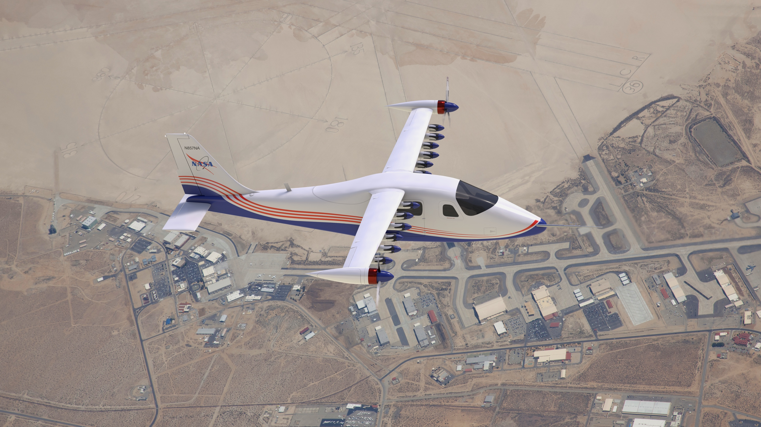
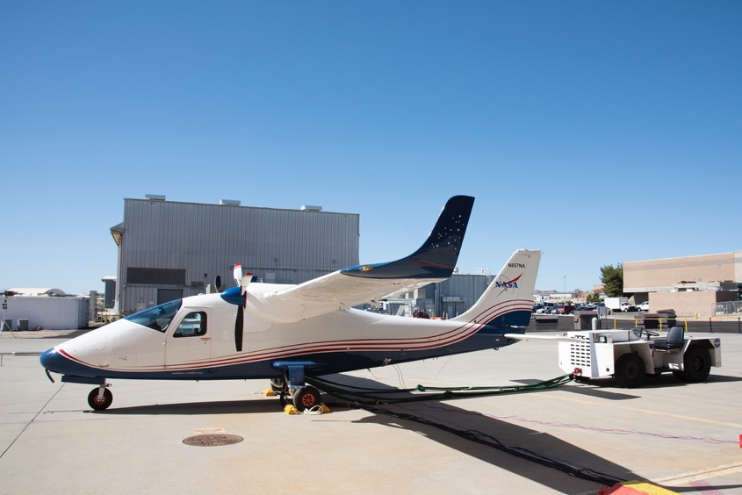
www.nasa.gov |
10

