Slide 1
Cloud-Optimized Data Access using OPeNDAP’s Dataset Metadata Response (DMR++)
2021 ESIP Summer Meeting
Patrick Quinn
NASA / EED-2 / Element 84
patrick@element84.com
This work was supported by NASA/GSFC under Raytheon Technologies contract number NNG15HZ39C.
This document does not contain technology or Technical Data controlled under either the U.S. International Traffic in Arms Regulations or the U.S. Export Administration Regulations.
Notes:
* OPeNDAP = Open-source Project for a Network Data Access Protocol
ESIP = Federation of Earth Science Information Partners
NASA = National Aeronautics and Space Administration
EED-2 = Earth Observing System Data and Information System (EOSDIS) Evolution and Development 2
GSFC = Goddard Space Flight Center

Slide 2
Let’s step waaaaaaay back
2021 ESIP Summer Meeting

Slide 3
I have a file location. How do I get the data I care about from it?
Locate parts of the file I need to read to get the data I care about
Read the parts of the file that have my data
Translate bytes I got into the data I wanted, usually decompressing and throwing away things I had to read but didn’t want

Slide 4
Files on a hard drive
Latency is very low, under 0.1 milliseconds for a Solid-State hard drive (SSD)
Throughput is very high, > 200 megabytes per second.
Parallelism is low, usually one machine
Consequences for file formats:
Optimal formats favor many small reads getting only the necessary data.

Slide 5
Files in the cloud
Latency is very high, 70ms or more for Amazon S3 (Simple Storage Service)
Throughput is very high, up to 25 gigabits per second
Parallelism is very high
Consequences for file formats:
Optimal formats emphasize using fewer reads, even if it means fetching extra data only to discard it.
Too many reads makes it faster to download the whole file and process offline.

Slide 6
Cloud-Optimized =
Able to fetch lots of data in a small number of reads
But operating at a scale where you can’t just fetch everything

Slide 7
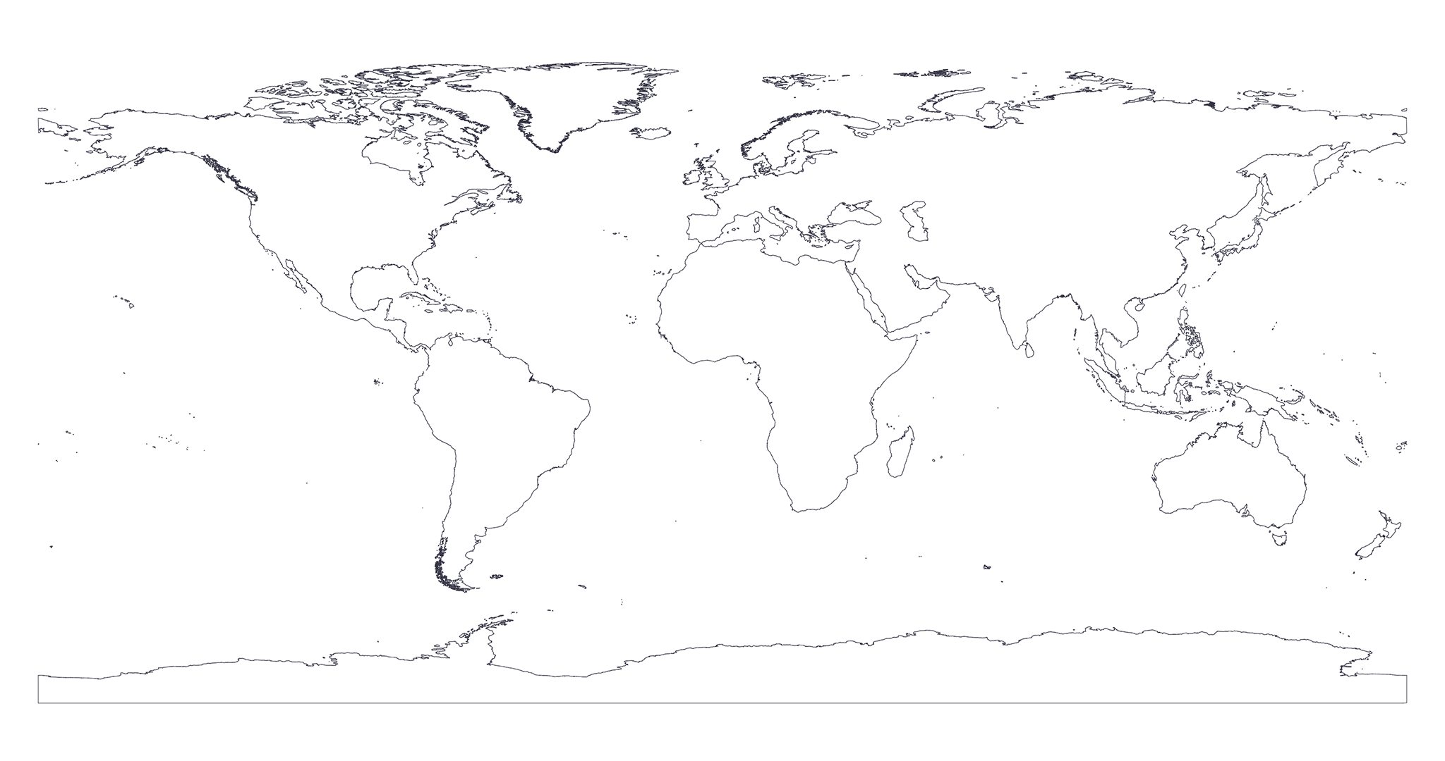
Easy Win: Metadata in one read
Typical NetCDF4 (Network Common Data Form) Data File
File Metadata
Dimension 1 Metadata
Dimension 1 Data
Dimension 2 Metadata
Dimension 2 Data
Variable A
Variable B
Variable A Metadata
Variable B Metadata
Variable A Data
Variable B Data
Variable D Metadata
Variable C
Variable D
Coastline Image © OpenStreetMap contributors
Variable C Metadata
Variable C Data
Variable D Data

Slide 8
OPeNDAP DMR++
Zarr Metadata
Variable A Metadata
Variable A Metadata
Variable B Metadata
File Metadata
Dimension 1 Metadata
Variable B Metadata
File Metadata
Dimension 1 Metadata
Variable C Metadata
Variable C Metadata
Dimension 2 Metadata
Dimension 2 Metadata
Variable D Metadata
Variable D Metadata
Byte Offsets of Chunks of Data
Byte Offsets of Chunks of Data
(USGS + The HDF Group Prototype)
Typical NetCDF4 (Network Common Data Form) Data File
File Metadata
Dimension 1 Metadata
Dimension 1 Data
Dimension 2 Metadata
Dimension 2 Data
Variable A
Variable B
Variable A Metadata
Variable B Metadata
Variable A Data
Variable B Data
Variable D Metadata
Variable C
Variable D
Coastline Image © OpenStreetMap contributors
Variable C Metadata
Variable C Data
Variable D Data

Slide 9
The Hard Work: Data Locality
Easy Case: latitude, longitude, time. 3 Dimensions.
On disk: Always 1 dimension.
You must collapse your data dimensions to 1D. There are fundamental trade-offs that no one can solve for you.
Optimizing for analysis on one dimension hurts analysis on the others.

Slide 10
The Hard Work: Data Locality
Coastline Image © OpenStreetMap contributors

Slide 11
The Hard Work: Data Locality
Coastline Image © OpenStreetMap contributors

Slide 12
The Hard Work: Data Locality
“Chunking”, some extreme examples:
Pangeo recommends 100-megabyte chunks, roughly equal dimension sizes for in-cloud processing, mostly for huge model datasets. Huge minimum data transfer but low request count.
GEDI (Global Ecosystem Dynamics Investigation) and ICESat-2 (Ice, Cloud and land Elevation Satellite) often have ~10-kilobyte chunks for granules approximately 1 gigabyte in size. Huge request count but low minimum data transfer.
Even if they were in the same format, these would perform very differently on different systems for different use cases. Your mileage may vary!

Slide 13
Accessing NetCDF via zarr-python
2021 ESIP Summer Meeting

Slide 14
We provide this
Typical NetCDF4 Data File
File Metadata
Dimension 1 Metadata
Dimension 1 Data
Dimension 2 Metadata
Dimension 2 Data
Variable A
Variable B
Variable A Metadata
Variable B Metadata
Variable A Data
Variable B Data
Variable C
Variable D
Variable C Metadata
Variable D Metadata
Coastline Image © OpenStreetMap contributors
Variable C Data
Variable D Data

Slide 15
We provide this
I want this
Typical NetCDF4 Data File
File Metadata
Dimension 1 Metadata
Dimension 1 Data
Dimension 2 Metadata
Dimension 2 Data
Variable A
Variable B
Variable A Metadata
Variable B Metadata
Variable A Data
Variable B Data
Variable C
Variable D
Variable C Metadata
Variable D Metadata
Coastline Image © OpenStreetMap contributors
Variable C Data
Variable D Data

Slide 16
We provide this
I want this
To get it, libraries need this
Typical NetCDF4 Data File
File Metadata
Dimension 1 Metadata
Dimension 1 Data
Dimension 2 Metadata
Dimension 2 Data
Variable A
Variable B
Variable A Metadata
Variable B Metadata
Variable A Data
Variable B Data
Variable C
Variable D
Variable C Metadata
Variable D Metadata
Coastline Image © OpenStreetMap contributors
Variable C Data
Variable D Data

Slide 17
We provide this
I want this
To get it, libraries need this
Typical NetCDF4 Data File
File Metadata
Dimension 1 Metadata
Dimension 1 Data
Dimension 2 Metadata
Dimension 2 Data
Variable A
Variable B
Variable A Metadata
Variable B Metadata
Variable A Data
Variable B Data
The Challenge:
We need a small percentage of the file, but we don’t know where to find the bytes we need without reading a significant percentage of the file.
Variable C
Variable D
Variable C Metadata
Variable D Metadata
Coastline Image © OpenStreetMap contributors
Variable C Data
Variable D Data

Slide 18
Zarr Metadata
Variable A Metadata
File Metadata
Dimension 1 Metadata
Variable B Metadata
Variable C Metadata
Dimension 2 Metadata
Variable D Metadata
Byte Offsets of Chunks of Data
(USGS + The HDF Group Prototype)
Typical NetCDF4 Data File
File Metadata
Dimension 1 Metadata
Dimension 1 Data
Dimension 2 Metadata
Dimension 2 Data
Variable A
Variable B
Variable A Metadata
Variable B Metadata
Variable A Data
Variable B Data
The Challenge:
We need a small percentage of the file, but we don’t know where to find the bytes we need without reading a significant percentage of the file.
Variable D Metadata
Variable C
Variable D
Coastline Image © OpenStreetMap contributors
Variable C Metadata
Variable C Data
Variable D Data

Slide 19
Zarr Metadata
Variable A Metadata
File Metadata
Dimension 1 Metadata
Variable B Metadata
Variable C Metadata
Dimension 2 Metadata
Read this all up front in a single, fast read.
Directly read only data of interest
Variable D Metadata
Byte Offsets of Chunks of Data
(USGS + The HDF Group Prototype)
Typical NetCDF4 Data File
File Metadata
Dimension 1 Metadata
Dimension 1 Data
Dimension 2 Metadata
Dimension 2 Data
Variable A
Variable B
Variable A Metadata
Variable B Metadata
Variable A Data
Variable B Data
The Challenge:
We need a small percentage of the file, but we don’t know where to find the bytes we need without reading a significant percentage of the file.
Variable D Metadata
Variable C
Variable D
Coastline Image © OpenStreetMap contributors

Slide 20
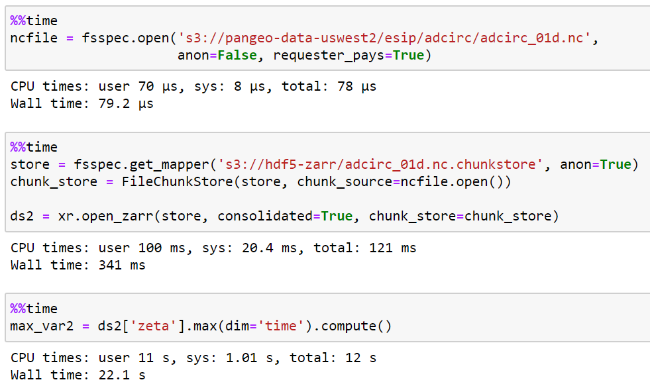
Image source: Rich Signell (USGS) https://medium.com/pangeo/cloud-performant-reading-of-netcdf4-hdf5-data-using-the-zarr-library-1a95c5c92314

Slide 21
More details and examples
“Cloud-Performant NetCDF4 / HDF5 Reading with the Zarr Library”
by Rich Signell (USGS), Aleksandar Jelenak (The HDF Group), and John Readey (The HDF Group)
https://medium.com/pangeo/cloud-performant-reading-of-netcdf4-hdf5-data-using-the-zarr-library-1a95c5c92314
(Or search “medium netcdf zarr”)

Slide 22
Optimizations to EOSDIS Access
EOSDIS Zarr Store
1
1. NASA’s Earth Observing System Data and Information System

Slide 23
Zarr Metadata
Variable A Metadata
File Metadata
Dimension 1 Metadata
Variable B Metadata
Variable C Metadata
Dimension 2 Metadata
Variable D Metadata
Byte Offsets of Chunks of Data
(USGS + The HDF Group Prototype)
Typical NetCDF4 Data File
File Metadata
Dimension 1 Metadata
Dimension 1 Data
Dimension 2 Metadata
Dimension 2 Data
Variable A
Variable B
Variable A Metadata
Variable B Metadata
Variable A Data
Variable B Data
The Challenge:
We need a small percentage of the file, but we don’t know where to find the bytes we need without reading a significant percentage of the file.
Variable D Metadata
Variable C
Variable D
Coastline Image © OpenStreetMap contributors

Slide 24
OPeNDAP DMR++
Variable A Metadata
File Metadata
Dimension 1 Metadata
Variable B Metadata
Variable C Metadata
Dimension 2 Metadata
Variable D Metadata
Byte Offsets of Chunks of Data
Zarr Metadata
Variable A Metadata
File Metadata
Dimension 1 Metadata
Variable B Metadata
Variable C Metadata
Dimension 2 Metadata
Variable D Metadata
Byte Offsets of Chunks of Data
(USGS + The HDF Group Prototype)
Typical NetCDF4 Data File
File Metadata
Dimension 1 Metadata
Dimension 1 Data
Dimension 2 Metadata
Dimension 2 Data
The Challenge:
We need a small percentage of the file, but we don’t know where to find the bytes we need without reading a significant percentage of the file.
Variable A
Variable B
Variable A Metadata
Variable B Metadata
Coastline Image © OpenStreetMap contributors
Variable A Data
Variable B Data
Variable C
Variable D

Slide 25
OPeNDAP DMR++
Variable A Metadata
File Metadata
Dimension 1 Metadata
Variable B Metadata
Variable C Metadata
Dimension 2 Metadata
Variable D Metadata
Byte Offsets of Chunks of Data
Zarr Metadata
Variable A Metadata
File Metadata
Dimension 1 Metadata
Variable B Metadata
Variable C Metadata
Dimension 2 Metadata
Variable D Metadata
Byte Offsets of Chunks of Data
(USGS + The HDF Group Prototype)
Typical NetCDF4 Data File
File Metadata
Dimension 1 Metadata
Dimension 1 Data
Dimension 2 Metadata
Dimension 2 Data
The Challenge:
We need a small percentage of the file, but we don’t know where to find the bytes we need without reading a significant percentage of the file.
Variable A
Variable B
Variable A Metadata
Variable B Metadata
Coastline Image © OpenStreetMap contributors
Variable A Data
Variable B Data
Variable C
Variable D

Slide 26
Optimization 1: Allow Reading EOSDIS NetCDF from Zarr Python
EOSDIS Cloud
zarr-eosdis-store
OPeNDAP DMR++
Typical EOSDIS Data File
Read Metadata
Read Data
Zarr Python Library

Slide 27
Zarr Read Data
Coastline Image © OpenStreetMap contributors

Slide 28
Optimization 2: Cache Handshaking Information
EOSDIS Cloud
EOSDIS Zarr Storage Library
(New)
OPeNDAP DMR++
Typical EOSDIS Data File
Read Metadata
Read Data
Get Data
Internet Services
Egress App
Needs Auth
Get Token
Login
Zarr Python Library
Redirect toToken Check
Check Token
EOSDIS Zarr Storage Library
(New)
Internet Services
Egress App
Redirect to Get Data
Get Data
Internet Services
Egress App
Redirect to Pre-Signed S3 URL
Get Data
AWS S3
Actual Bytes
By default, for every request, often hundreds or more

Slide 29
Optimization 2: Cache Handshaking Information
EOSDIS Cloud
EOSDIS Zarr Storage Library
(New)
OPeNDAP DMR++
Typical EOSDIS Data File
Read Metadata
Read Data
Get Data
Internet Services
Egress App
Needs Auth
Get Token
Login
Keep this Cookie
Zarr Python Library
Redirect toToken Check
Check Token
EOSDIS Zarr Storage Library
(New)
Internet Services
Egress App
Redirect to Get Data
Cache this URL
Get Data
Later requests skip to here
Egress App
Internet Services
Redirect to Pre-Signed S3 URL
Get Data
AWS S3
Actual Bytes
By default, for every request, often hundreds or more

Slide 30
Zarr Read Data
Coastline Image © OpenStreetMap contributors

Slide 31
Optimization 3: Combine Requests for Near-Adjacent Ranges
Zarr Read Data
Coastline Image © OpenStreetMap contributors

Slide 32
Optimization 4: Parallelize once we have an S3 URL
Zarr Read Data
Coastline Image © OpenStreetMap contributors

Slide 33
Optimization 5: Cache outputs for future reads
Zarr Read Data
Coastline Image © OpenStreetMap contributors

Slide 34
It’s open source!
https://github.com/nasa/zarr-eosdis-store

Slide 35
Conclusions
2021 ESIP Summer Meeting

Slide 36
Conclusions
Cloud access optimization demands read latency optimization
      Combine many smaller reads into fewer larger reads (metadata & data)
      Skip expensive network actions such as auth or redirects, if possible, via cookies and caching
      Parallelize reads

Slide 37
Questions?
Patrick Quinn
EED-2 Software Engineer
patrick@element84.com

Slide 38
This work was supported by NASA/GSFC under Raytheon Technologies contract number NNG15HZ39C.
The coastline image (page8, 10,14, 15, 16, 17, 18, 19, 23, 24, 25, 27, 32, 31, 32, 33) was produced by the aurthor using openstreetmaps data. See the publisher permissions https://www.openstreetmap.org/copyright
"You are free to copy, distribute, transmit and adapt our data, as long as you credit OpenStreetMap and its contributors. If you alter or build upon our data, you may distribute the result only under the same licence. [...] We require that you use the credit “© OpenStreetMap contributors”.
small graphics (magnifying glass and lightbulb) was created by author

