Slide 1
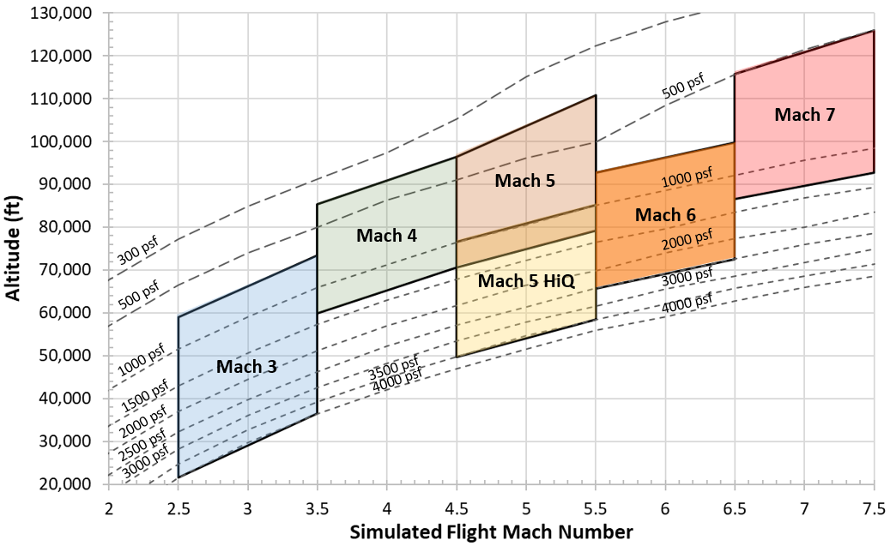
NASA LaRC - 8-Ft. High Temperature Tunnel
Facility tied to NASA’s premier hypersonic CFD team
  Mach 3, 4, 5, 6, 7
  20,000 – 120,000 ft. altitude
  True flight enthalpy (temperature up to 3600°R)
Vitiated air – Combustion with CNG
New Mach 6, water cooled, nozzle in design & fabrication – Integration to start Fall 2021
Nozzle Design Mach | Tunnel Config. | Nozzle Exit Diameter (in) | Dynamic Pressure Range (psf) | Stagnation Temperature (°R) | Altitude Simulation (kft) | Reynolds Number (10⁶/ft)
Mach 3 | Mixer | 54.4 | 700 - 4000 | 875 - 1300 | 22 - 60 | 1.4 - 11
Mach 4 | Mixer | 96 | 400 - 1300 | 1300 - 1900 | 60 - 95 | 0.64 - 2.6
Mach 5 | Mixer | 96 | 400 - 1300 | 1900 - 2600 | 70 - 110 | 0.54 - 2.1
Mach 5 (HiQ) | Mixer | 54.4 | 1000 - 3500 | 1900 - 2600 | 50 - 85 | 1.4 - 5.6
Mach 6 | No Mixer | 70 | 700 - 2500 | 2600 - 3400 | 65 - 100 | 0.82 - 3.4
Mach 7 | No Mixer | 96 | 500 - 1300 | 3400 - 4000 | 85 - 125 | 0.59 - 1.5

Slide 2
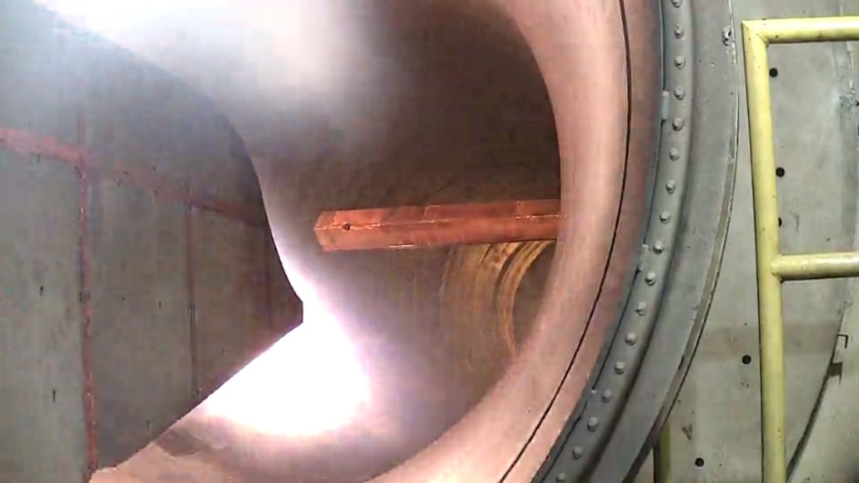
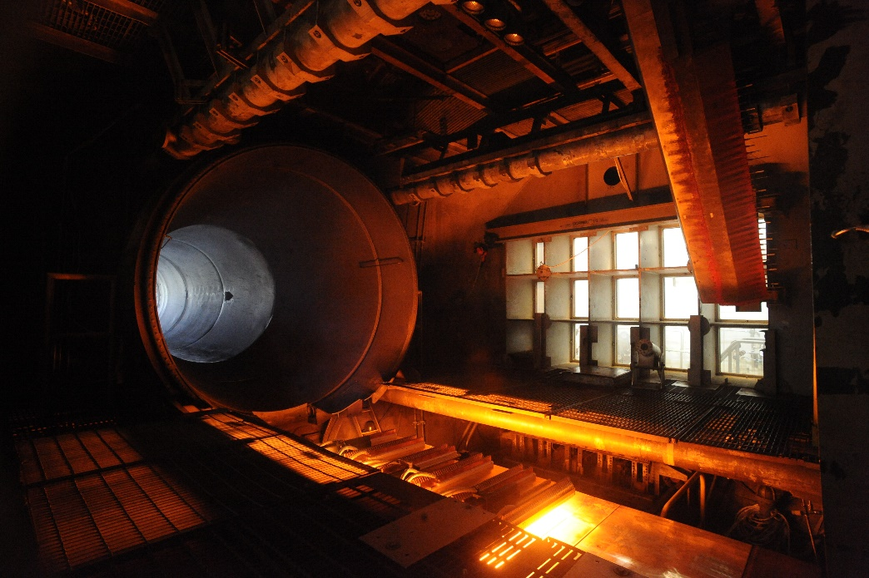
NASA LaRC - 8-Ft. High Temperature Tunnel
Test Features:
Propulsion Testing
  Ignition testing
  Operability testing
Material/Structure Testing
Force Measure System (FMS) data
Jet fuel delivery system
  Heated fuel delivery system
  Chilled fuel delivery system
Radiant pre-heat lamps (up to 3000 °F
Engine diagnostic imaging
Radiant Lamps in operation over test specimen

Slide 3
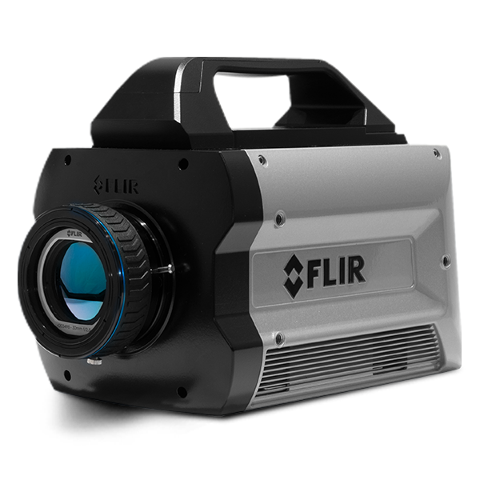
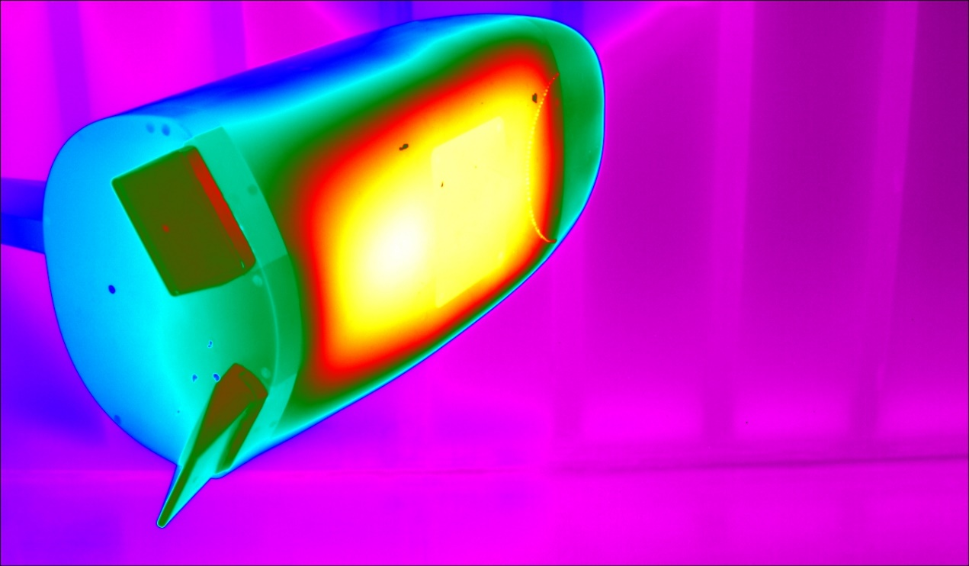
NASA LaRC - 8-Ft. High Temperature Tunnel
Test Features:
Visual data
  IR imaging (high speed and low speed)
    This camera can capture high-speed events using full resolution (1280x1024) @180 Hz, and up to 29 kHz at reduced resolutions
  Engine diagnostic imaging (previous page)
FLIR X8500SC
Cobra MRV

Slide 4
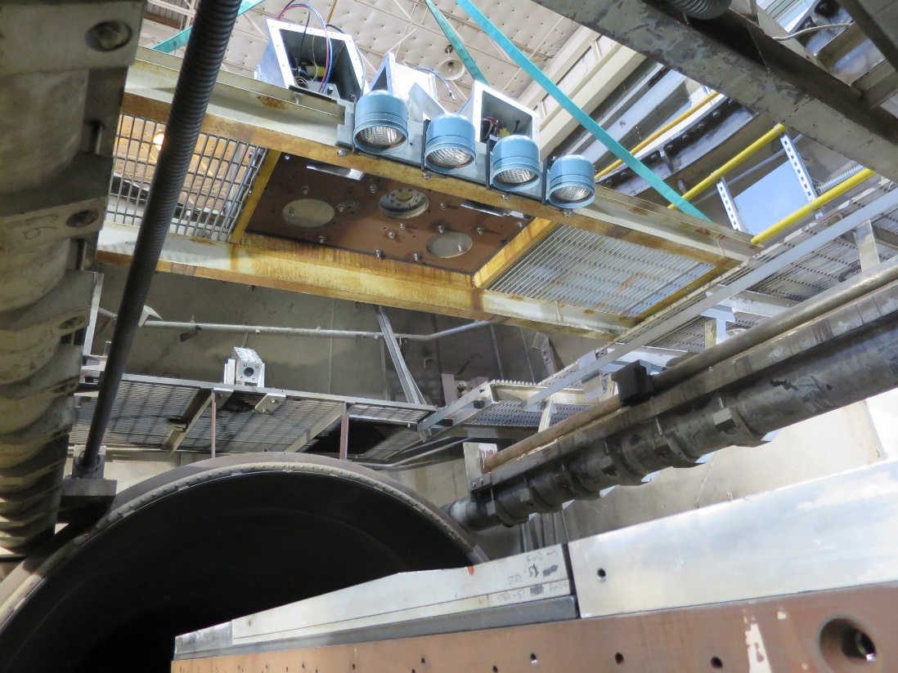
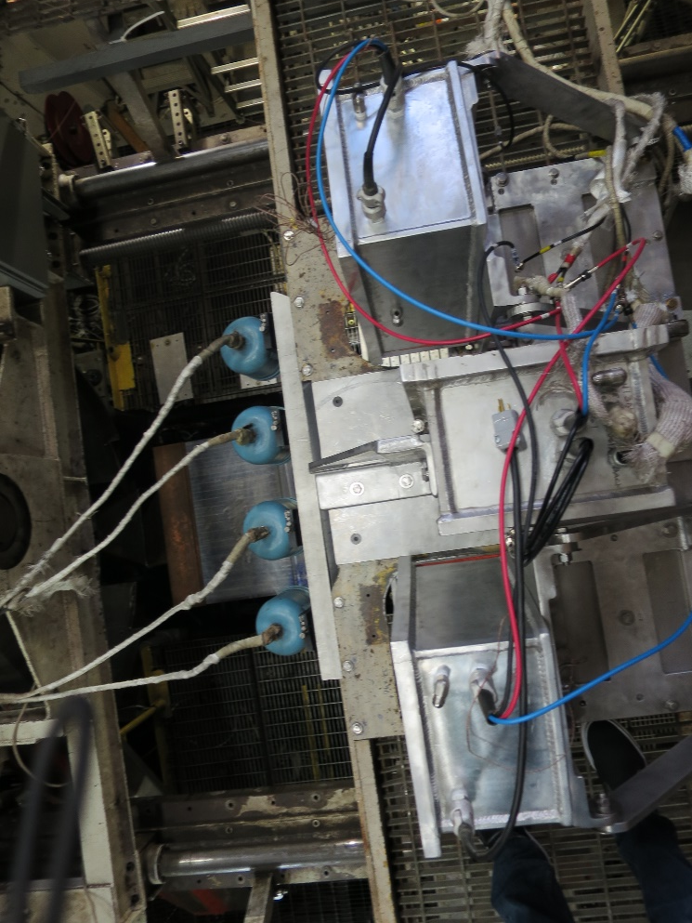
NASA LaRC - 8-Ft. High Temperature Tunnel
Test Features:
Visual data (continued)
  Photogrammetry
  Digital image correlation (DIC)
Radiant Lamps over test specimen

