Slide 1
A Synthesis Plugin for Auralization of Rotor Self Noise
Siddhartha Krishnamurthy, NASA Langley Research Center
Aric R. Aumann, Analytical Services and Materials
Stephen A. Rizzi, NASA Langley Research Center
AIAA Aviation Forum, August 5, 2021
Copyright 2021 United States Government as represented by the Administrator of the National Aeronautics and Space Administration and Analytical Services and Materials. All Rights Reserved.
Published by the American Institute of Aeronautics and Astronautics, Inc., with permission.

Slide 2
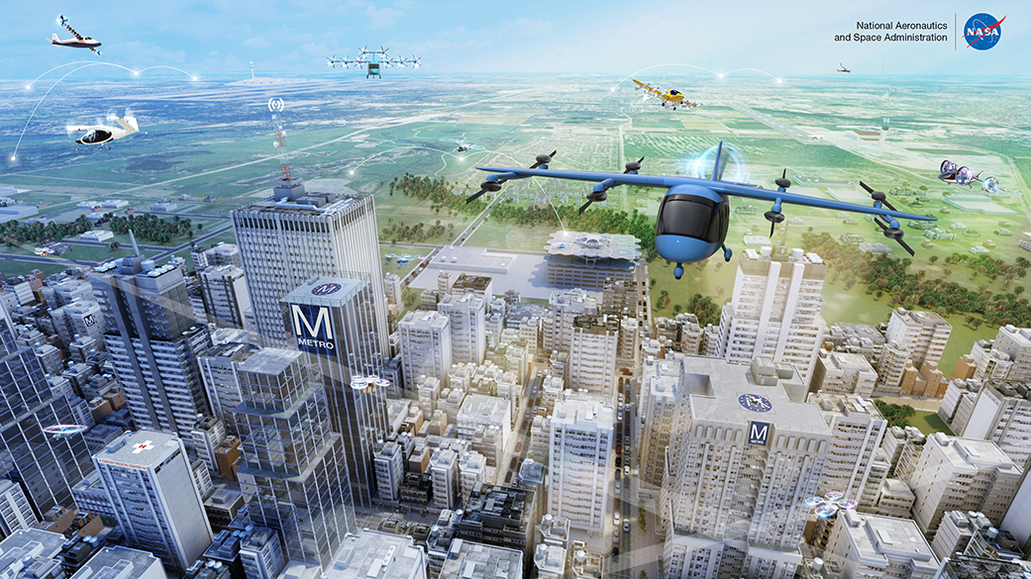
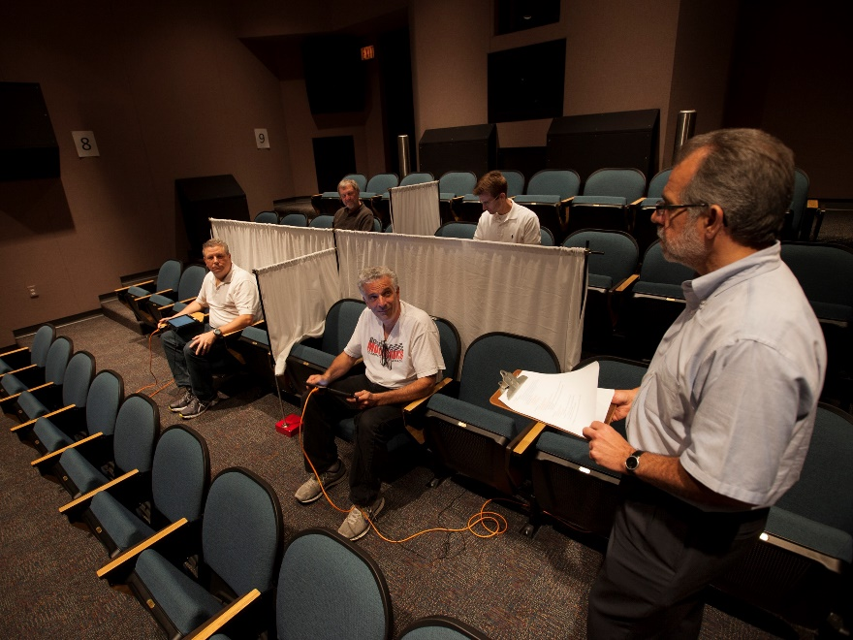
Motivation
Need to understand community response to noise from future advanced air mobility vehicles
Play recorded or auralized sounds of these aircraft in NASA Langley Exterior Effects Room to test subjects
  Auralizations: sounds generated from numerical data
Exterior Effects Room, NASA Langley Research Center

Slide 3
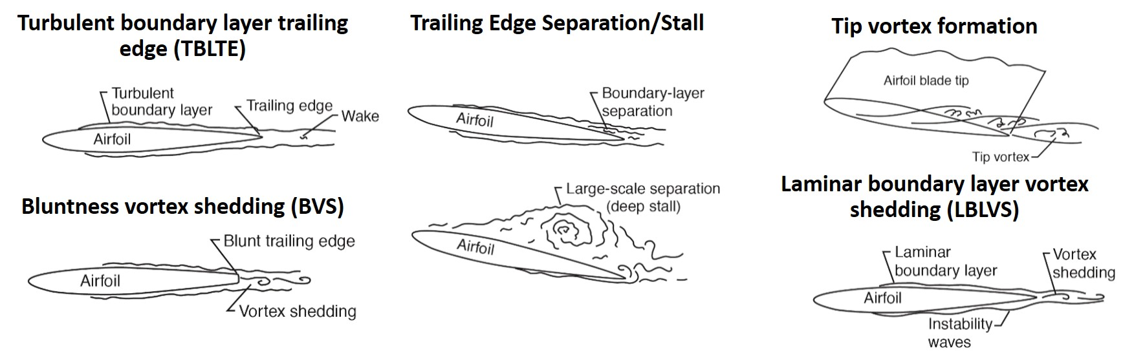
Rotor Blade Self Noise
Rotor self noise is a combination of the following noise sources:
More Information: T.F. Brook and S.D. Pope, “Airfoil self-noise and prediction,” NASA-RP-1218, Hampton, VA, 1989

Slide 4
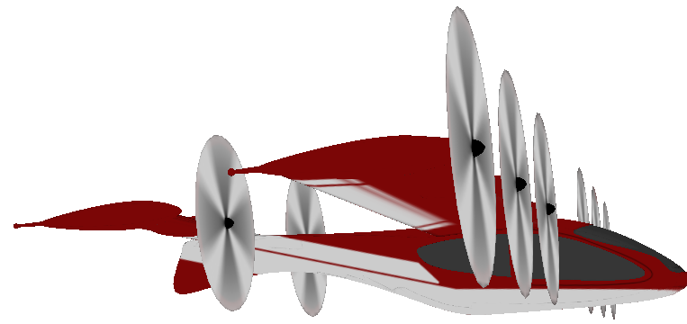
NASA Auralization Framework (NAF) Overview - Standard Use Case
Update Scene
Acoustic Predictions
Find Paths
Per Path
Emission Angle
Path
Synthesize Source Noise
Path: Gain, Time Delay, Filters (GTF)
Direct Path
Sample Buffer
GTF Series
Propagate
Reflected Path
Output Buffer
Ground Observer
Auralization at Ground Observer
Output
Loop

Slide 5
Modulated Broadband Synthesis Plugin
The Modulated Broadband Synthesis Plugin was developed to synthesize broadband self noise
Update Scene
Modulated Broadband Synthesis Plugin
Find Paths
Self Noise Acoustic Predictions
Per Path
Emission Angle
Path
Synthesize Source Noise
Path: Gain, Time Delay, Filters (GTF)
Sample Buffer
GTF Series
Propagate
One set of acoustic predictions per rotor
Output Buffer
Output
Loop

Slide 6
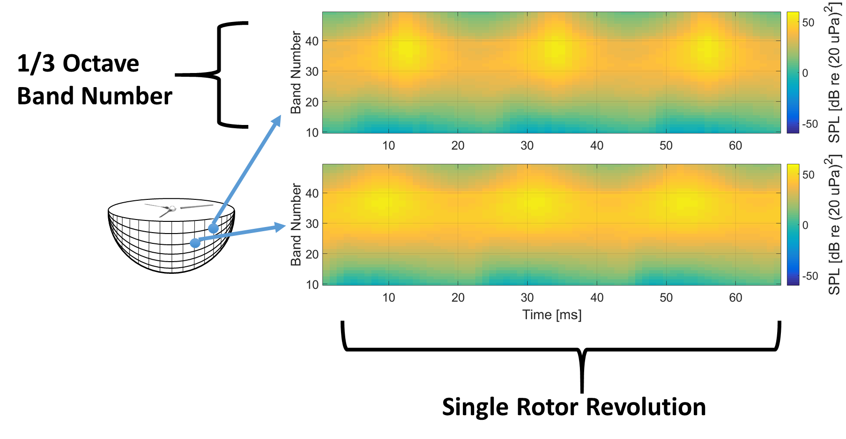
Broadband Self Noise Acoustic Predictions
Self noise acoustic predictions are sound pressure levels in each 1/3 octave band as a function of time over a single rotor revolution.

Slide 7
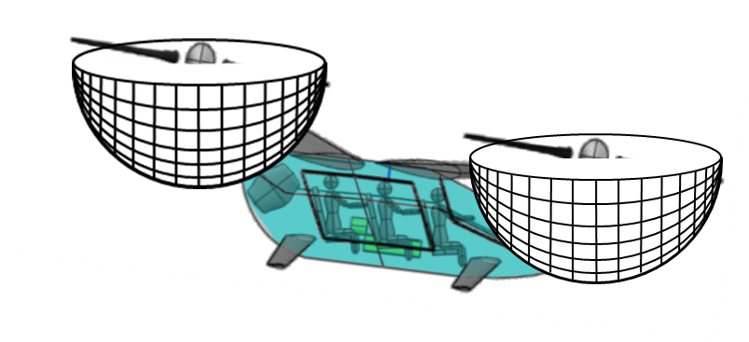
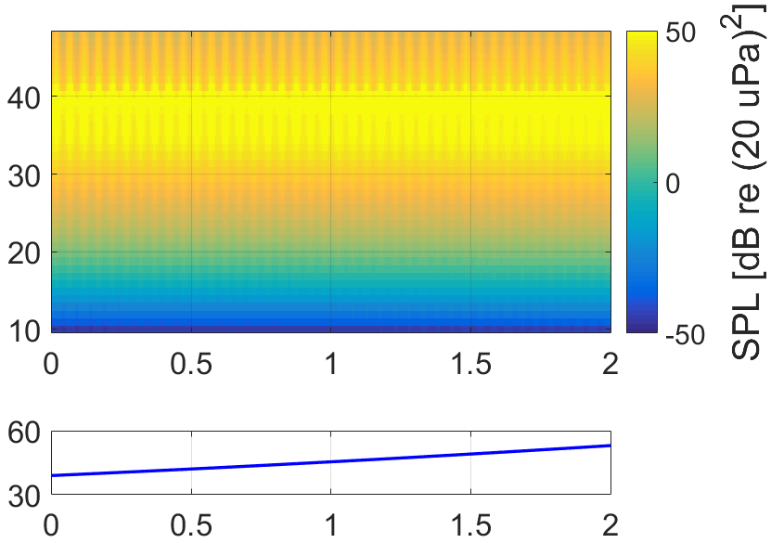
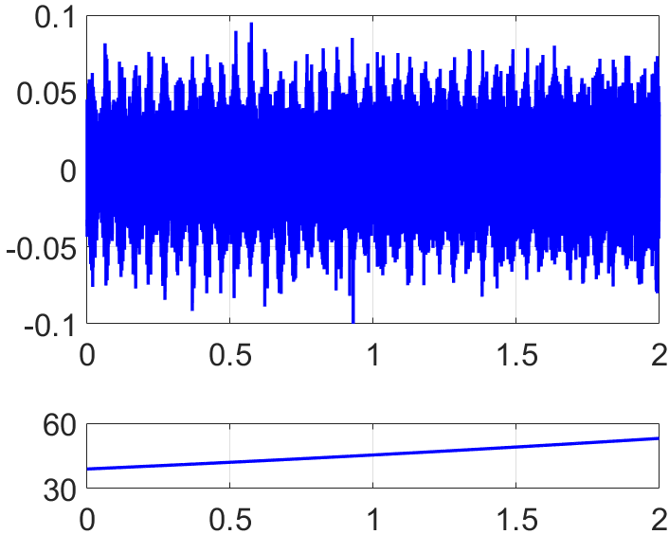



Self Noise Flyover Sound Synthesis (Conceptual Overview)
Primary Steps:
  Extend self noise data over flyover duration by interpolating over emission angles from source to ground observer.
  Use extended self noise data to modulate a stochastic signal.
Paper explains how primary steps were adapted to work within the NAF.
Sound Pressure Level Prediction Data Formed by Interpolating Over Single Rotor Revolution Data
Synthesized Sound Near Rotor to Propagate to Ground Observer
Band Number
Pressure [Pa]
$$θ$$
Ground
Ground Observer
$θ$[deg]
$θ$[deg]
Flyover Duration [s]
Flyover Duration [s]

Slide 8

Quadrotor Flyover
Auralize straight and level flyover of NASA eVTOL quadrotor concept
46.3 m/s (90 KTAS)
7.15$°$
1000 ft
(Not to Scale)
0.36 miles
0.36 miles
Start Position
Ground
Observer Flush with Ground
End Position

Slide 9
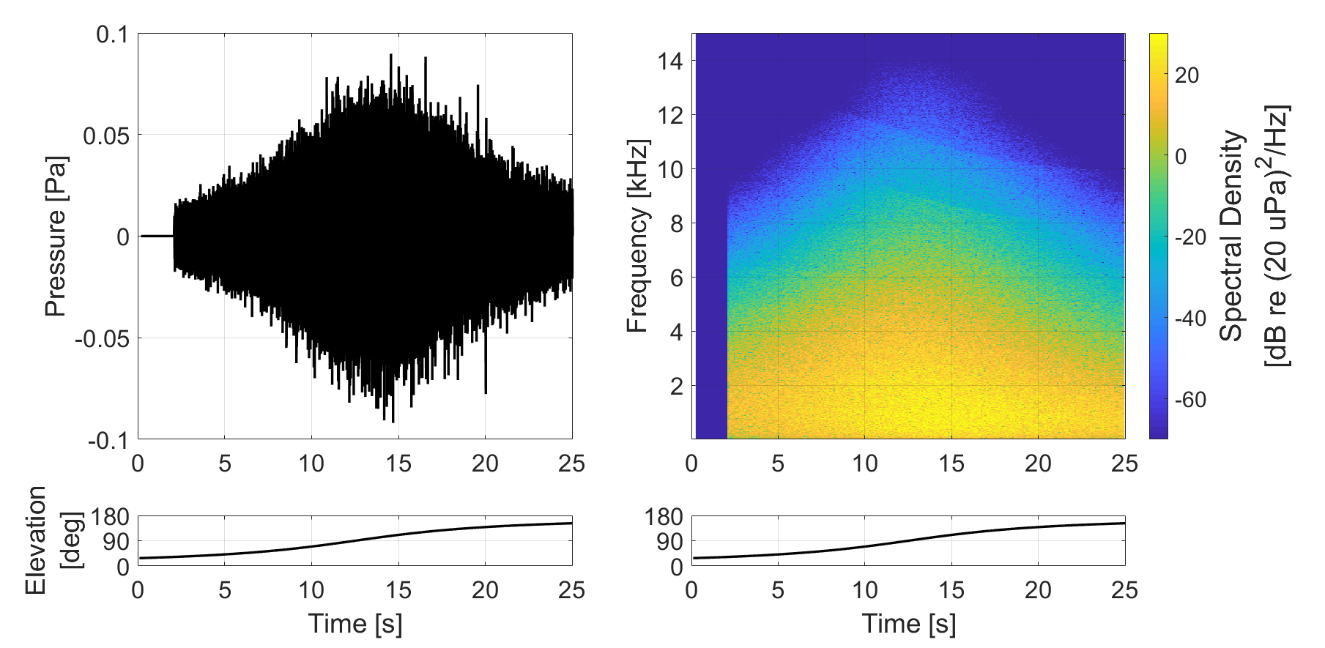

Auralization Results
NAF Modulated Broadband Synthesis Plugin auralized full NASA eVTOL quadrotor flyover at ground observer.

Slide 10
Summary
Self noise synthesis implemented into NAF Modulated Broadband Synthesis Plugin.
  Plugin available in NAF 1.2 public release.
Demonstrated use of plugin; paper describes plugin architecture in NAF.
Plugin accepts self noise acoustic predictions in the form of spectral time histories.
  New capability for NAF.
Plugin exercised by auralizing NASA eVTOL quadrotor concept vehicle.

Slide 11

Acknowledgements and Thank You
  Sound files are available for download at:
  http://stabserv.larc.nasa.gov/flyover/
Modulated Broadband Synthesis Plugin developed with support from Transformational Tools & Technologies Project of the NASA Transformative Aeronautics Concepts Program.
Self noise synthesis conceptual development performed with support from the Revolutionary Vertical Lift Technology Project of the NASA Advanced Air Vehicles Program.
Email: siddhartha.krishnamurthy@nasa.gov

Slide 12
Image References
Slide 2:
  AAM Concept art from: https://www.nasa.gov/sites/default/files/thumbnails/image/aam-design4-new-image-2-24-2021-3.jpg.
  Picture of Exterior Effects room provided by Steve Rizzi, NASA Langley Research Center.
Slide 3:
  Self noise sources provided by Nicole A. Pettingill, NASA Langley Research Center, but originally from T.F. Brook and S.D. Pope, “Airfoil self-noise and prediction,” NASA-RP-1218, Hampton, VA, 1989.
Slides 4 and 5:
  NAF flowchart and aircraft flyover animation taken from Aumann, Aric and Tuttle, Brian, “NASA Auralization Framework 1.2 Upcoming Release,” Spring 2021 Acoustics Technical Working Group VIRTUAL Meeting, April 13-14, 2021.
Slides 6-8:
  Quadrotor and rotor pictures from Silva, C., et al., “VTOL Urban Air Mobility Concept Vehicles for Technology Development.” Paper 3847. 2018 Aviation Technology, Integration, and Operations Conference, Atlanta, GA, 2018.
All other images generated by presenter (Siddhartha Krishnamurthy).

