Slide 1
Role of NDE and In-Situ Process Monitoring in Managing Risk of AM Hardware In Space
Erin Lanigan
NASA Marshall Space Flight Center
Nondestructive Evaluation Team
JASON Study on AM Integrity In Space
June 24, 2021

Slide 2
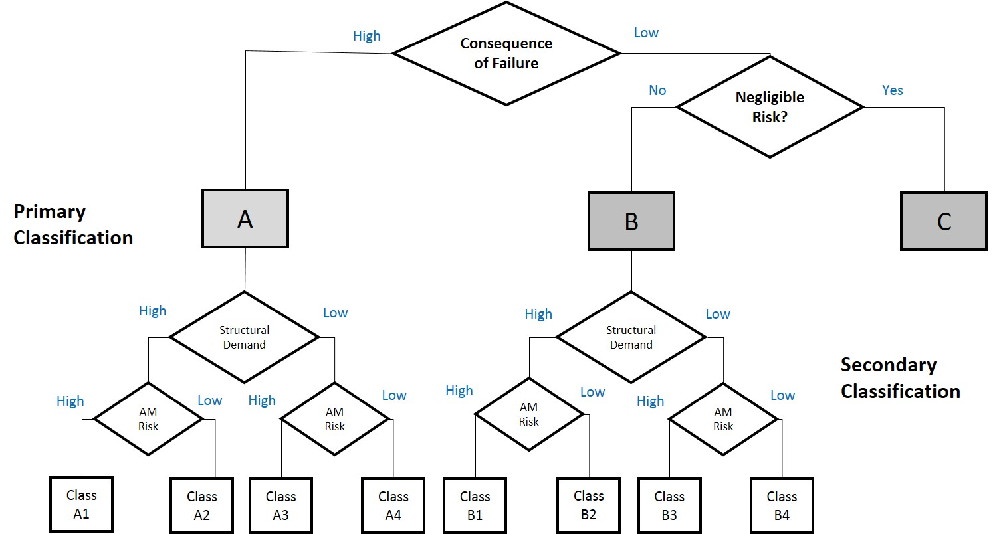
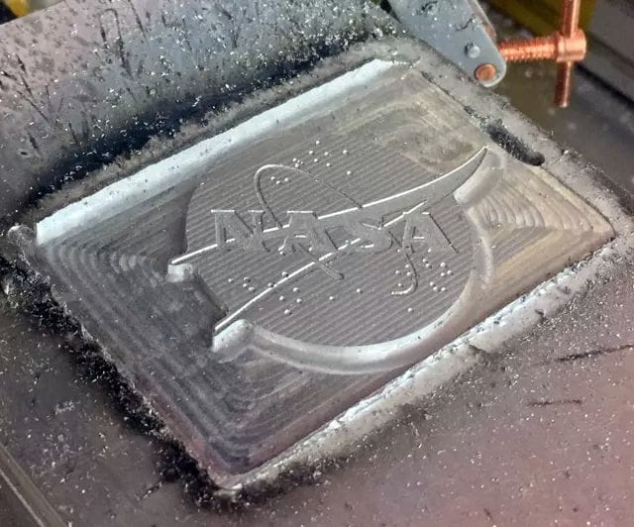
We will discuss the use of NDE and in-situ monitoring for certifying AM hardware and in-space manufacturing.
Certification framework
Qualification of NDE and in-situ monitoring
In-space additive manufacturing
Approved for Public Release – Distribution is Unlimited

Slide 3
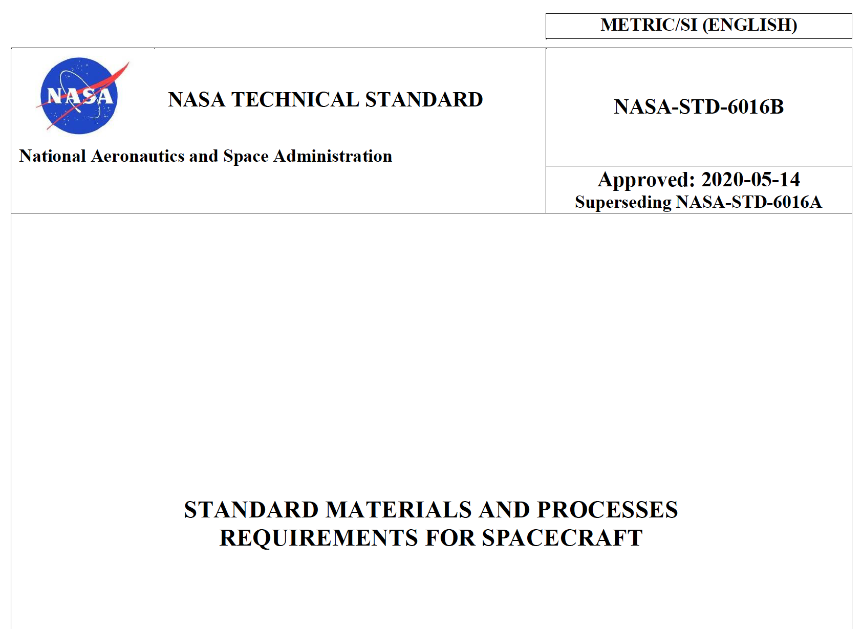
The current logic of additive manufactured part certification is outlined in NASA-STD-6016B, NASA-STD-6030, and NASA-STD-6033.
MSFC-STD-3716
MSFC-SPEC-3717
Standard for Additively Manufactured Spaceflight Hardware by Laser Powder Bed Fusion in Metals
Specification for Control and Qualification of Laser Powder Bed Fusion Metallurgical Processes
NASA-STD-6030
NASA-SPEC-6033
NASA Technical Standard
NASA Technical Standard
NASA-STD-6016B
Additive Manufacturing Requirements for Spaceflight Systems
Additive Manufacturing Requirements for Equipment and Facility Control
General M&P requirements
Handbook coming soon with more specifics on implementation.

Slide 4
Risk-based part classifications for AM parts consider the risk of AM manufacturability and inspectability.
Catastrophic Failure?
Heavily Loaded?
Does the build have challenging aspects or areas that cannot be inspected?

Slide 5
The NASA standard requires quantitative NDE with full coverage of the surface and volume for Class A Parts.
Language:
“All Class A parts shall receive quantitative NDE with full coverage of the surface and volume of the part, including verifiable detection of critical initial flaw size in critical damage tolerant parts, with any coverage limitations due to NDE techniques(s) and/or part geometry documented in the PPP”
Rationale:
“NDE provides a necessary degree of quality assurance for AM parts in addition to the process controls of this NASA Technical Standard.”
“No methodology currently exists to preclude all AM process failure modes through the available manufacturing process controls.”
(emphasis added)

Slide 6
For Class A parts, the NDE approach must comply with the Special NDE requirements in NASA-STD-5009.
Language:
“The NDE approach for Class A parts shall meet the Special NDE requirements of NASA-STD-5009, Nondestructive Evaluation Requirements for Fracture Critical Metallic Components, and be documented in the PPP.”
Rationale:
“The defects of interest in AM are of a different nature than those listed in Tables 1 and 2 of NASA-STD-5009, and AM microstructures can impact the effectiveness of NDE methods. Therefore, all inspection of fracture critical AM hardware should be treated as Special NDE.”
“Alternative flaw screening methods for Class A parts (e.g., proof testing) may be feasible with full justification provided in the PPP.”

Slide 7
The NASA standard requires NDE for process control with full coverage of the surface and volume for Class B Parts.
Language:
“All Class B parts shall receive NDE for process control with full coverage of the surface and volume of the part, including verifiable detection of critical initial flaw size in critical damage tolerant parts, with any coverage limitations due to NDE techniques(s) and/or part geometry documented in the PPP”
Rationale:
“NDE for process control requires the use of physical reference standards for calibration and acceptance criteria based on the capability of the NDE technique but does not require quantitative validation of flaw detection.
“Targeted approaches for NDE can be proposed and approved per the PPP.”
(emphasis added)

Slide 8
For Class B parts, the NDE approach must meet the requirements in NASA-STD-5009.
Language:
“The NDE approach for Class B parts shall meet the Special NDE requirements of NASA-STD-5009 and be documented in the PPP.”
Rationale:
“The requirements in NASA-STD-5009 establish important controls, including the definition, validation, documentation, and approval of all NDE procedures, standards, methods, and acceptance criteria […]”
“Alternative post-build quality assurance methods for Class B parts (e.g., proof testing), as well as a reduction in NDE scope for Class B parts, may be feasible with full justification provided in the PPP."

Slide 9
Passive in-situ process monitoring may be used as a quantitative indicator of part quality, if qualified.
Language:
“Prior to use as a quantitative indicator of part quality for part acceptance, passive in-situ process monitoring technologies shall be qualified by the CEO to the satisfaction of NASA in a manner analogous to other NDE techniques.”
Rationale:
“All processes that are used to establish quantifiable quality assurance metrics are qualified against established criteria to verify detection reliability, calibration, and implementation. If in-situ monitoring techniques are employed for such purposes, the need for such qualification is unchanged.”
(emphasis added)

Slide 10
Passive in-situ process monitoring may NOT replace NDE.
Rationale (cont.):
“Certification of a passive in-situ monitoring technology relies upon a thorough understanding of the physical basis for the measured phenomena, a proven causal correlation of the measured phenomena to a well-defined defective process state, and a proven level of reliability for detection of the defective process state.”
“If qualified in the manner stated above, an in-situ process monitoring technique can be used to complement NDE in the Integrated Structural Integrity Rationale of the PPP. At this time, even a qualified in-situ process monitoring method cannot be considered a complete replacement for NDE.”
“Even if qualification is not desired, the use of in-situ process monitoring is encouraged as a source of process control data. This data can also be used to help guide targeted inspection.”
(emphasis added)

Slide 11
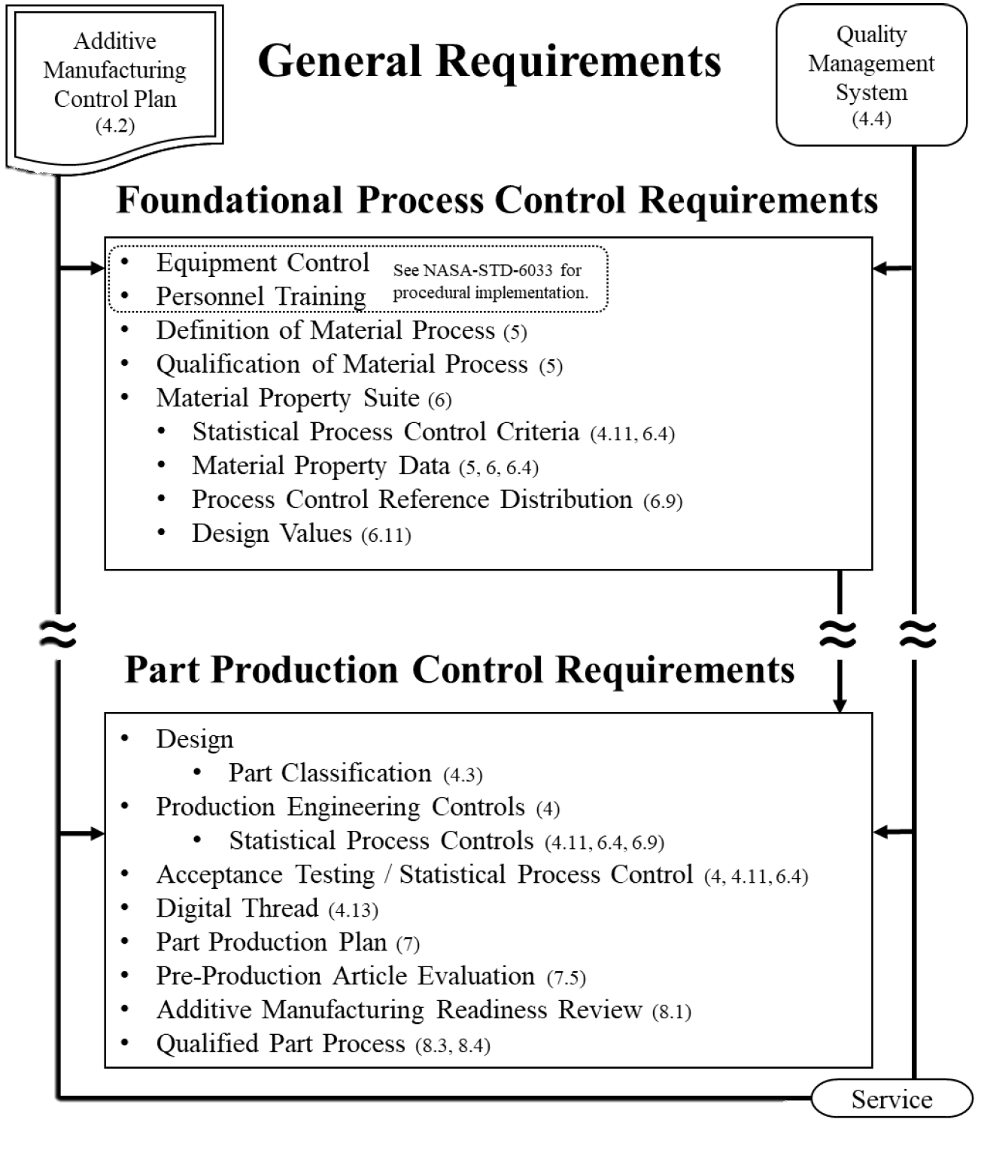
In-situ monitoring can be used in several aspects of certification:
Qualification of Material Process (QMP)
Use with process development
Part Classification
Improve inspectability for better risk posture
Inspection process must be qualified by cognizant engineering org. (CEO)
Part Production Plan
Integrated Structural Integrity Rationale (ISIR):
Can be specified as a defect screening action
Must be qualified by CEO
Production Controls
Could develop certain metrics to track over time

Slide 12
The current certification approach does not accommodate the use of adaptive systems.
“Closed-loop process control based on adaptive in-situ monitoring technologies that alter the defined AM process in response to monitored phenomena are not currently applicable technology per this NASA Technical Standard and cannot be used without prior approved tailoring.”
Adaptive (Closed-Loop) Systems
Monitor the process using sensors (e.g. meltpool thermal signature) and change a machine/process parameter (e.g. laser power) to optimize the response
Currently available in many directed energy deposition (DED) systems
Two issues for verification:
(control system)
Verify the sensor performance, algorithm and machine response
Verify the physics – does controlling this parameter result in a good part?
(materials)

Slide 13
For certifying closed-loop control systems, NASA can leverage the expertise of the spacecraft control systems community.
Verification of a control system:
Verify the accuracy of the sensor data
Verify the software/algorithm processing and response
Verify that the changed parameter responds correctly
Black box issue:
For commercial systems, machine parameters may not be known, algorithms may not be accessible
Ideal approach: collaborate with machine manufacturers
Can also develop transfer function by studying inputs/outputs

Slide 14
Verifying that the adaptive system results in good material is a challenge that will require further study.
What is being monitored, and to what end?
Assume you’re monitoring the meltpool thermal emissions
Are you looking to keep it constant, or vary it based on part geometry?
What does it really tell you about the process and the material?
Is this a good indicator of material quality?
Is the resulting microstructure/morphology consistent and repeatable?
What parameter will you change?
More complex if monitoring multiple signals and/or changing multiple parameters
Qualify process for each different system, alloy, part?

Slide 15
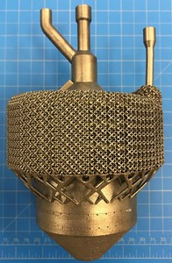
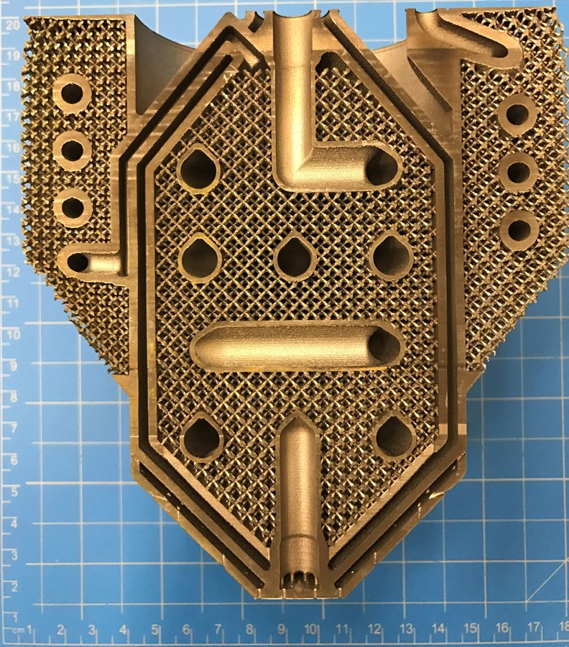
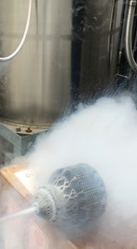
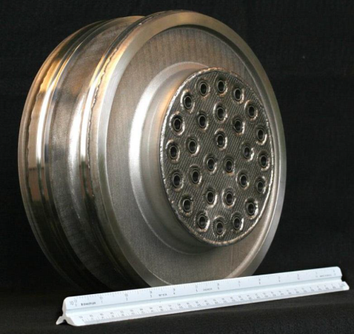
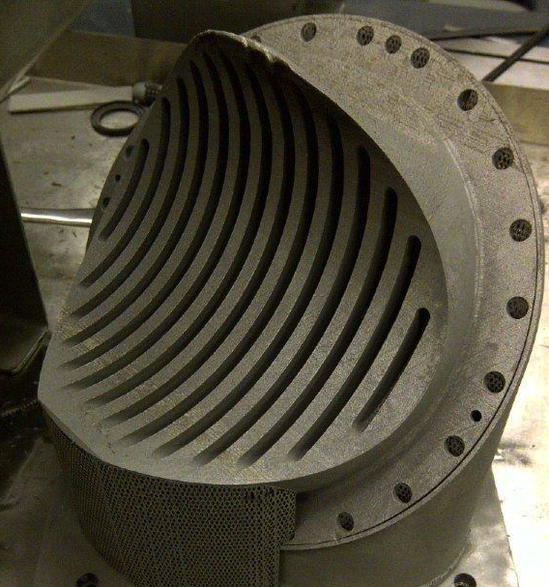
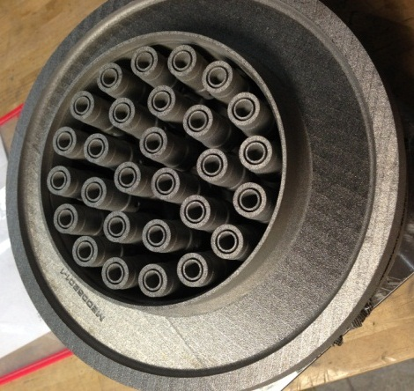
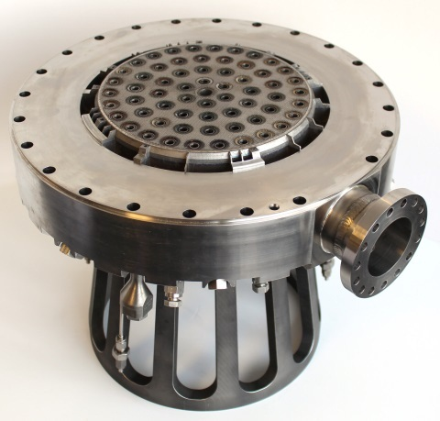
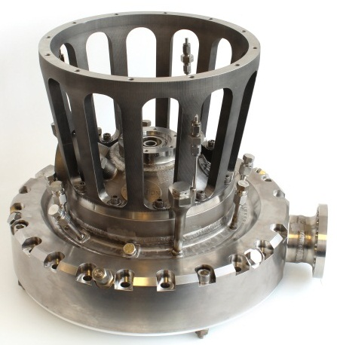
NASA is interested in qualifying in-situ monitoring for complex, critical parts that are difficult to inspect using traditional NDE.
Cryogenic Heat Exchanger-Injector-Condenser Demo
28-Element Inconel® 625 Fuel Injector
Reduced 163 parts to 2
Schedule reduced from 1 year to 4 months
70% cost reduction
RS-25 Pogo Accumulator Z-Baffle
Over 100 Welds Eliminated
Nearly 35% Cost Reduction
Injector Assembly
MSFC Project with Army Air and Missile Defense (AMD)

Slide 16
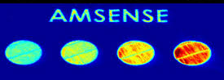
MSFC has investigated in-situ process monitoring through various mechanisms.
ASTM Working Group WK73289
Small Business Innovation Research
“Standard Guide for In-Situ Monitoring of Metal Additive Manufactured Parts”
Monitoring Systems
ASTM AM Center of Excellence
EOS | Optical Tomography
& Meltpool Monitoring
ARCTOS | Thermal Tomography & High-Speed Spatter Imaging
Completed a study to survey the landscape of in-situ monitoring technologies

Slide 17
There are many different in-situ process monitoring technologies which observe different physical phenomena.
Electromagnetic Frequency Spectrum
Ultrasonic Frequency Spectrum
Monitor During Build Process
Inspection Between Build Layers
Passive
Infrared/near-IR
melt pool monitoring
Visual
Laser profilometry
(No external excitation)
Active
-
Laser ultrasonic
X-ray
(Added excitation)

Slide 18
There are also different additive manufacturing technologies that can be monitored.
Powder Bed Systems
Freeform Fabrication
Process:
Laser Powder Bed Fusion (L-PBF)
Electron Beam Melting (EBM)
Selective Laser Sintering (SLS)
Laser Directed Energy Deposition (DED)
Electron Beam Free Form Fabrication (EBF³)
Rapid Plasma Deposition
Additive Friction Stir Weld
Fused Filament Fabrication (FFF)
Feedstock:
Metals: Nickel alloys, copper alloys, titanium alloys, etc.
Polymers: nylon, polyamide
Metal powder/wire/chips
Filament: polymer, carbon fiber, biological, etc.

Slide 19
There are two main functions of in-situ process monitoring:
Process Control Function
Part Quality Function
Real-time warning of build problems
Use to check for process drift
Monitor effects of parameter changes, spatter, etc.
Not counting on it for quantitative part quality metrics or defect detection
May help tell you where to look for a problem, but would require verification with NDE
Quantitative analysis of part quality
Requires a known correlation between indications, physics of the process, and actual defects in the finished part
Need to know probability of detection
Extra step – verify actual size, location of created defects
Need to treat it like NDE – believe and investigate every indication
Can’t dismiss anything as a false positive unless proven
vs.

Slide 20
When considering the use of in-situ process monitoring for part qualification, there are a few aspects that challenge the current paradigm.
In-process vs. post-process NDE
Often, defect observations are indirect
Directly observing process variation, inferring final defect
Must understand physical basis for measured phenomena
Need to prove a causal correlation from measured indications to defect state
Probability of detection (POD) study must include secondary verification of created defects
Closed-loop process control
Current qualification logic based on a locked process
For real-time parameter changes, a new approach is needed
no longer nondestructive

Slide 21
There are aspects of the NASA AM certification approach that will require tailoring for in-space manufacturing.
General Approach
Lay out AM Control Plan, identify requirements that must be tailored
Verification & validation of part quality are the main challenges
Plan to create standard builds and witness specimens that are downmassed from ISS for NDE inspection and metallurgical evaluation
For long duration missions, will need onboard quality assurance
This is key to the value proposition for in-space manufacturing!
Must be able to produce functional, certified parts.
Ground-based prototype system

Slide 22
The current approach to in-space manufacturing quality control includes using ground-based analog systems.
Current Approach
Currently assume FFF is similar on-ground vs. in-space
Use ground-based prototype with same settings for testing
Cannot assume this for metal systems, will have to test
Establish appropriate materials knockdown factors
Ground testing can provide insight into material, but cannot replicate the exact conditions experienced by a certain part
In-situ monitoring can help guide part-to-part comparisons.
Ground-based prototype system

Slide 23
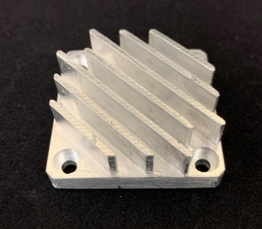
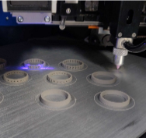
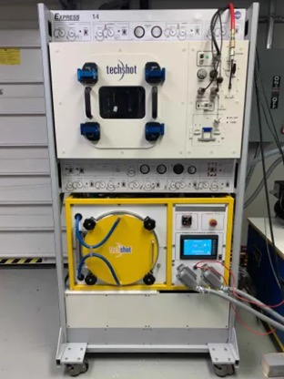
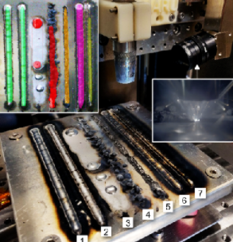
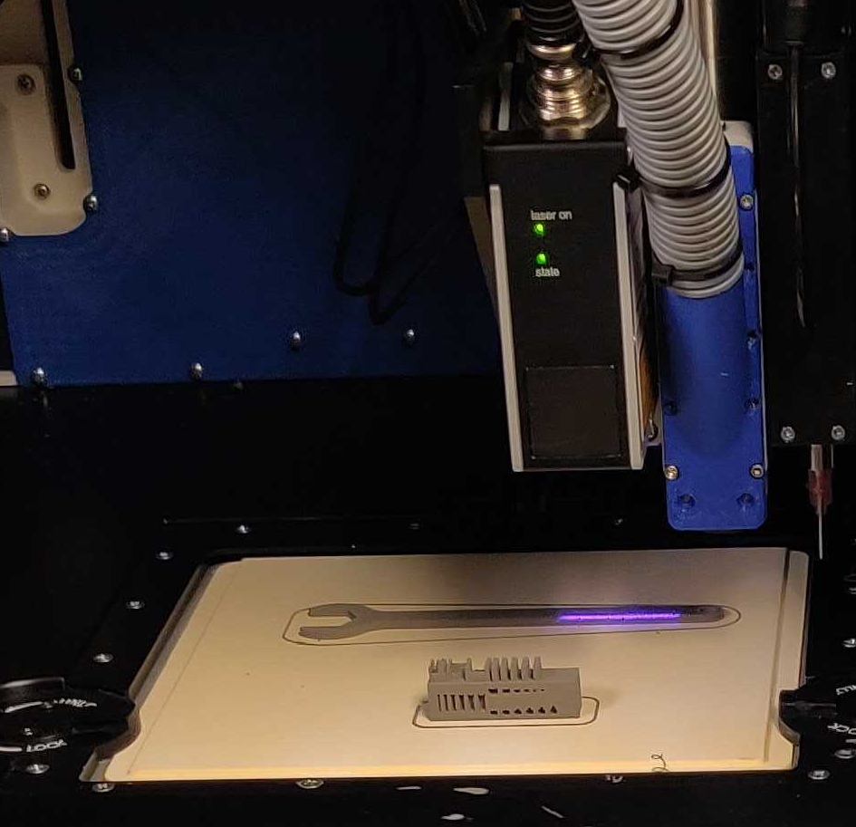
Current metal manufacturing technology developments include in-situ monitoring with automated processing.
Redwire (Made in Space) Vulcan
TechShot, Inc. FabLab
Wire-Arc Additive Manufacturing
+ Weld Quality Grading Machine Vision
Bound Metal Deposition
+ Laser Profilometry
Ground-based prototype system

Slide 24
The main considerations for implementation of NDE in space are physics, size, automation, and interpretation.
Physics
Techniques that require fluid or powder are challenging
Some techniques require large, heavy equipment (ex: x-ray source)
Manual operations require crew time and expertise
Automation is preferred
Data typically requires skilled interpretation
Results can be sent back to Earth for analysis
OR develop automated processing, machine learning
Size
Automation
Interpretation
Ground-based prototype system

Slide 25
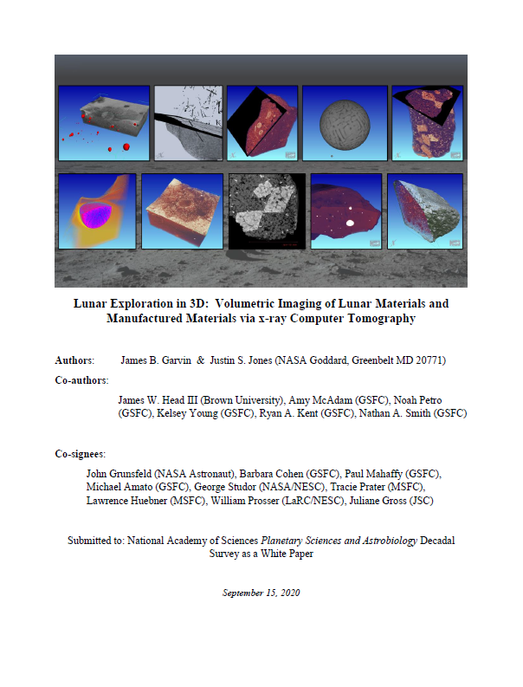
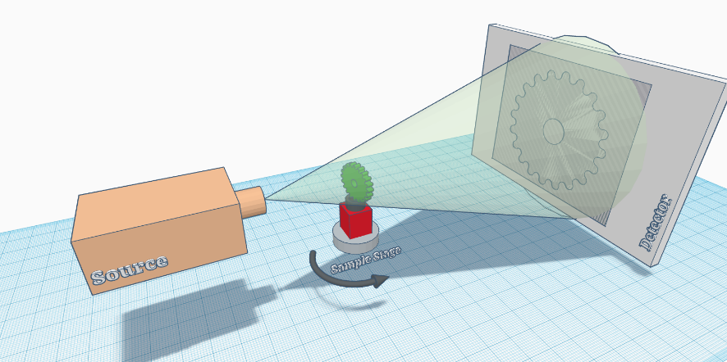
Computed tomography technology tailored for operation in a space environment is being studied and developed.
NASA Goddard Space Flight Center (GSFC) has led efforts to advance In-Space X-ray Computed Tomography (CT). (VOXEL effort/P.I. Dr. Justin S. Jones)
Efforts include Concept Development and Trade Studies to assess feasibility for CT in different environments (ISS, lunar, Martian, crewed/non-crewed)
Instrument Design Lab (IDL) study in late 2019 - early 2020 demonstrated core system feasibility and key requirements met for a pathfinder, prototype design, including deep dives into 12 major subsystems (systems integration, thermal, electrical, radiometry, mechanisms, and more).
White Paper Submitted to the National Academy of Sciences Planetary Sciences and Astrobiology Decadal Survey

Slide 26
In-space computed tomography capability would benefit many different missions, not just manufacturing.
5 Key Beneficiaries of In-space 3D inspection Capability
In-Space Manufacturing (e.g. Made In Space (Redwire), Techshot, FabLab)
Engineering Quality Assurance (QA) / Failure Analysis (FA) (flaw detection in parts)
Human Safety/Mission Assurance (impact damage detection, protective gear)
Science/Return Sample Triage (rocks, assays, drill cores)
In-Situ Resource Utilization (ISRU)
First demonstration (ISS) of xCT in space for NDE of AM samples, planetary samples, and inspection
To the Moon via Gateway or Artemis crewed missions as a rapid, critical in situ NDE tool
To Mars for in situ sample assessment on 2030’s era mobile labs, in context for cryogenic drill core sample return
Beyond the Moon and Mars is Europa and other ocean worlds – fast surveys of samples
Ultimately, the autonomous “commodity style” xCT system with scalable range of applications
Extended Pathways for CT in Space Use:

Slide 27
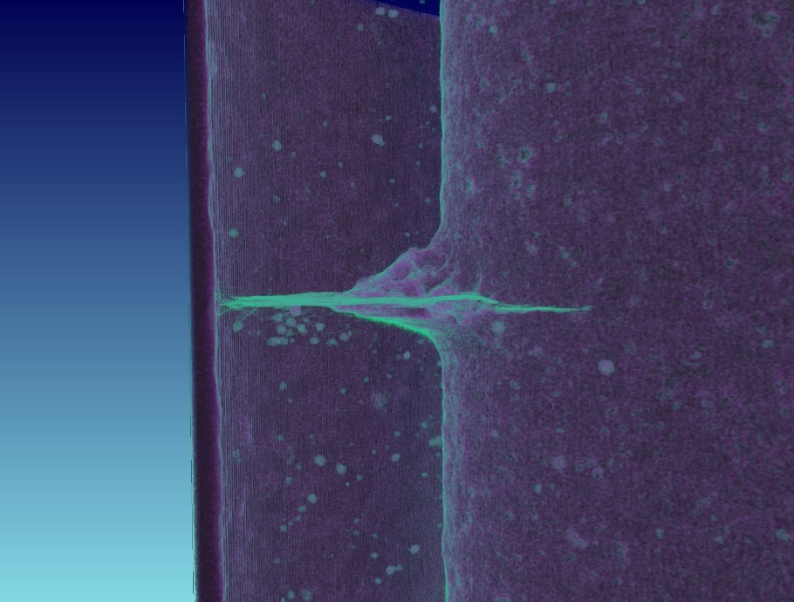
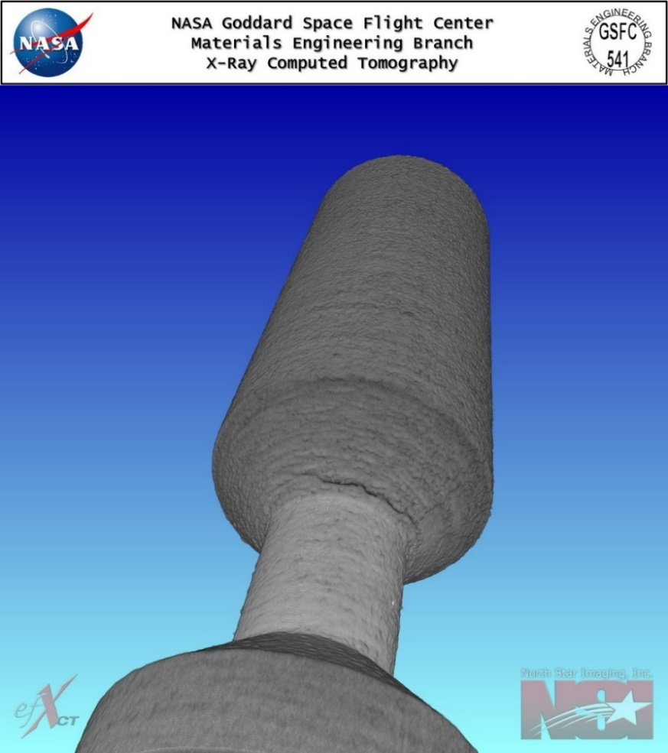
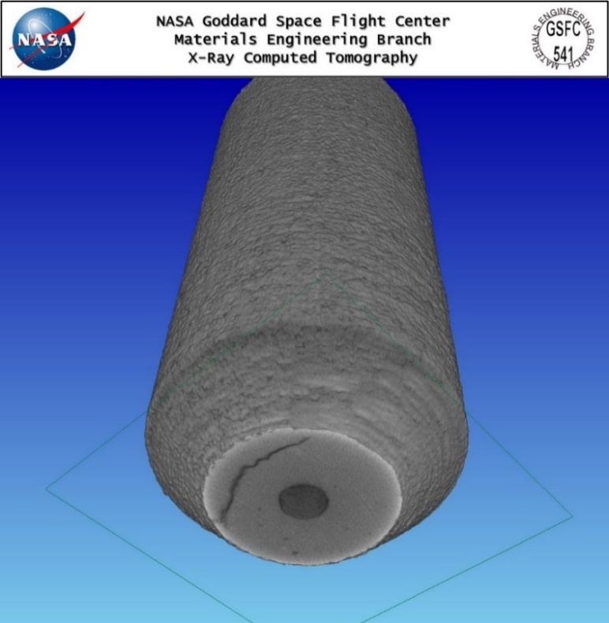
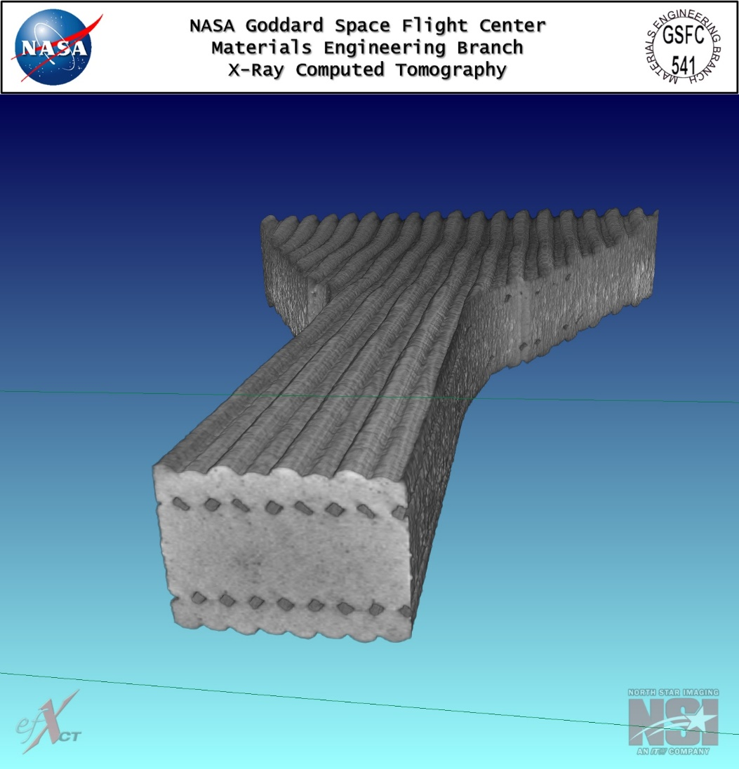
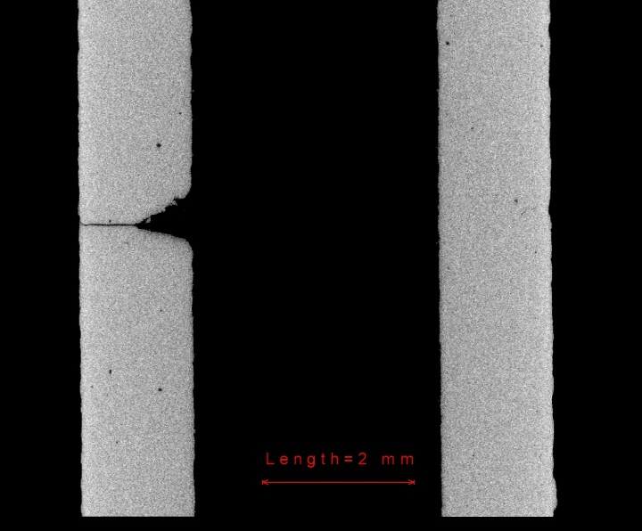
Computed tomography is the main technique used for ground-based NDE and certification of AM parts.
Key Application: AM Part Inspection and Qualification for ISM parts
Ti6Al4V AM Venturi with stress relief crack
3D printed dog bone
Ti6Al4V AM with radial cracks

Slide 28
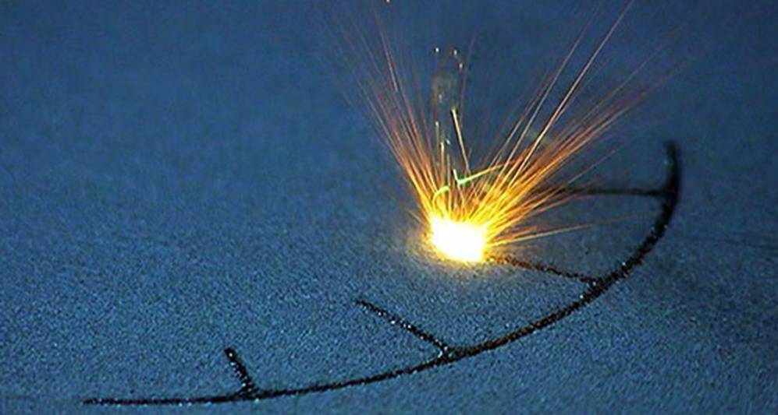
In summary, NDE and in-situ monitoring both have a role in certification of AM hardware and in-space manufacturing.
To use for quantitative part quality function, monitoring system must be qualified.
→ Main challenge: developing correlation of indication to verified defect
Qualifying closed-loop, adaptive systems will require a new approach to the QMP.
In-situ monitoring is a key enabler for certification of in-space manufacturing.
NDE is still vital for verification of post-build quality.
Thank you for your time!
Questions?

