Slide 1
Forces of Flight for a Lift+Cruise VTOL Aircraft
Flight condition:
On the ground
Weight

Slide 2
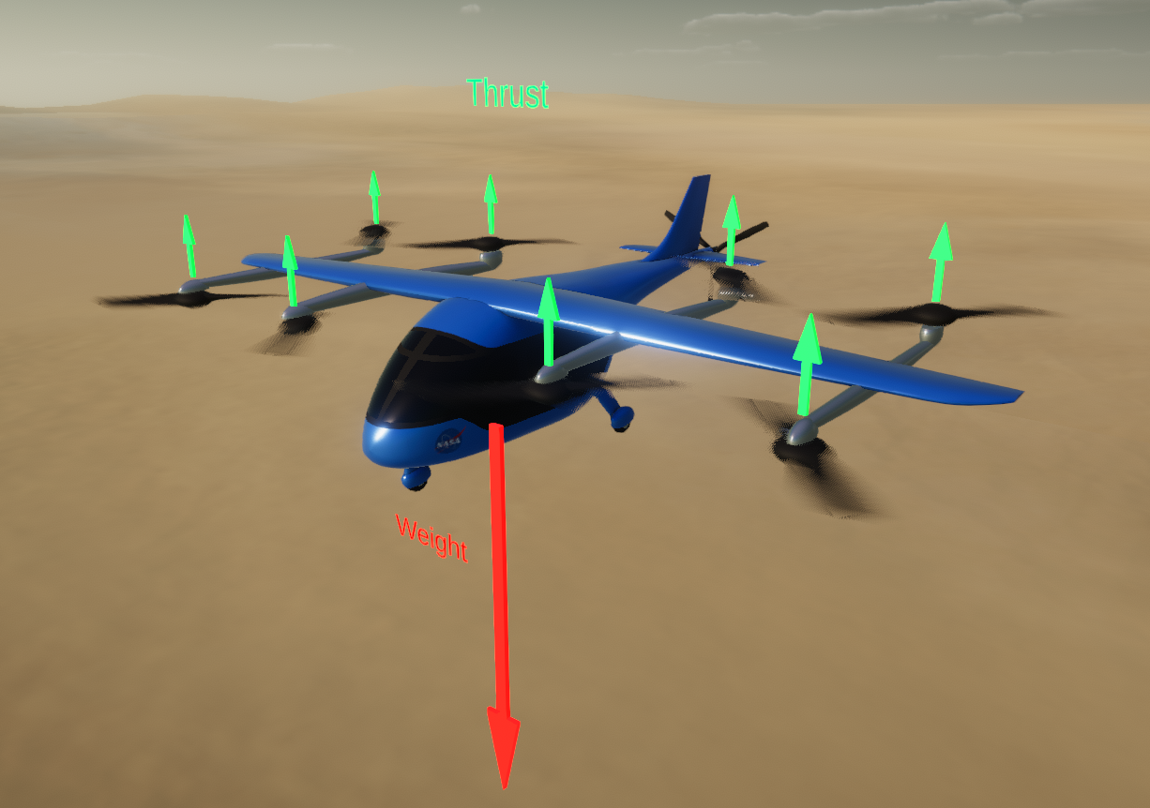
Forces of Flight for a Lift+Cruise VTOL Aircraft
Flight condition:
Hover
Thrust
Weight

Slide 3
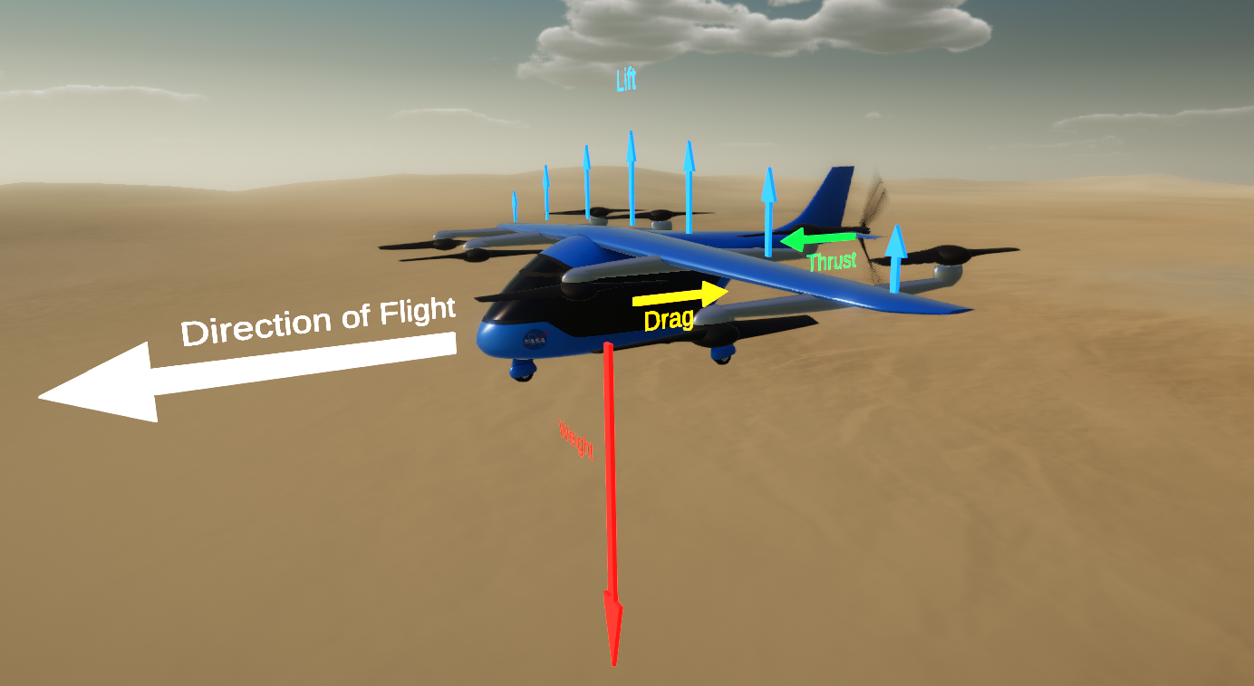
Forces of Flight for a Lift+Cruise VTOL Aircraft
Flight condition:
Cruise
Lift
Weight

