Slide 1

Artemis & Human Landing System Program Overview
Lisa Watson-Morgan, Program Manager
Human Landing System Program
NASA Marshall Space Flight Center
Huntsville, Alabama

Slide 2
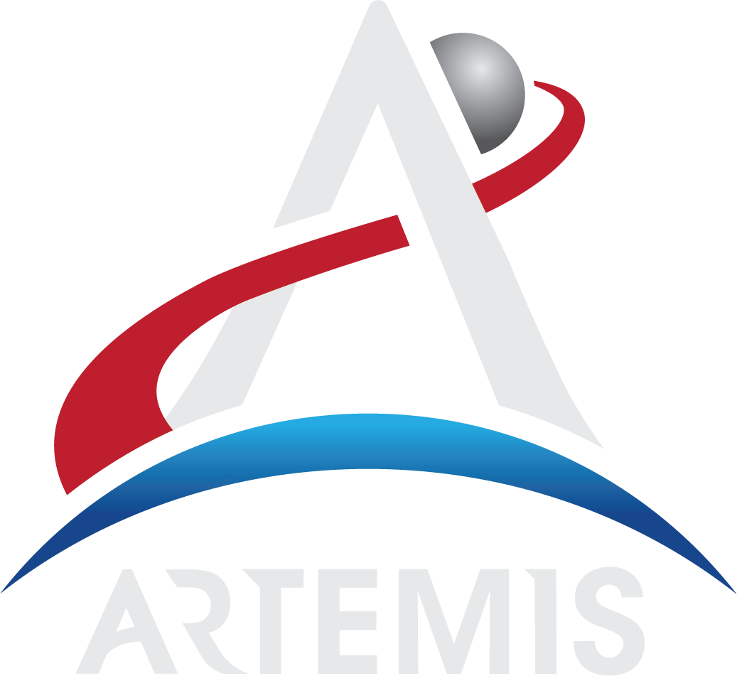
The Artemis Program
Artemis is the twin sister of Apollo and goddess
of the Moon in Greek mythology. Now, she
personifies our path to the Moon as the name
of NASA’s program to return astronauts to the
lunar surface.
When they land, Artemis astronauts will step
foot where no human has ever been before:
the Moon’s South Pole.
With the horizon goal of sending humans to
Mars, Artemis begins the next era of exploration.

Slide 3
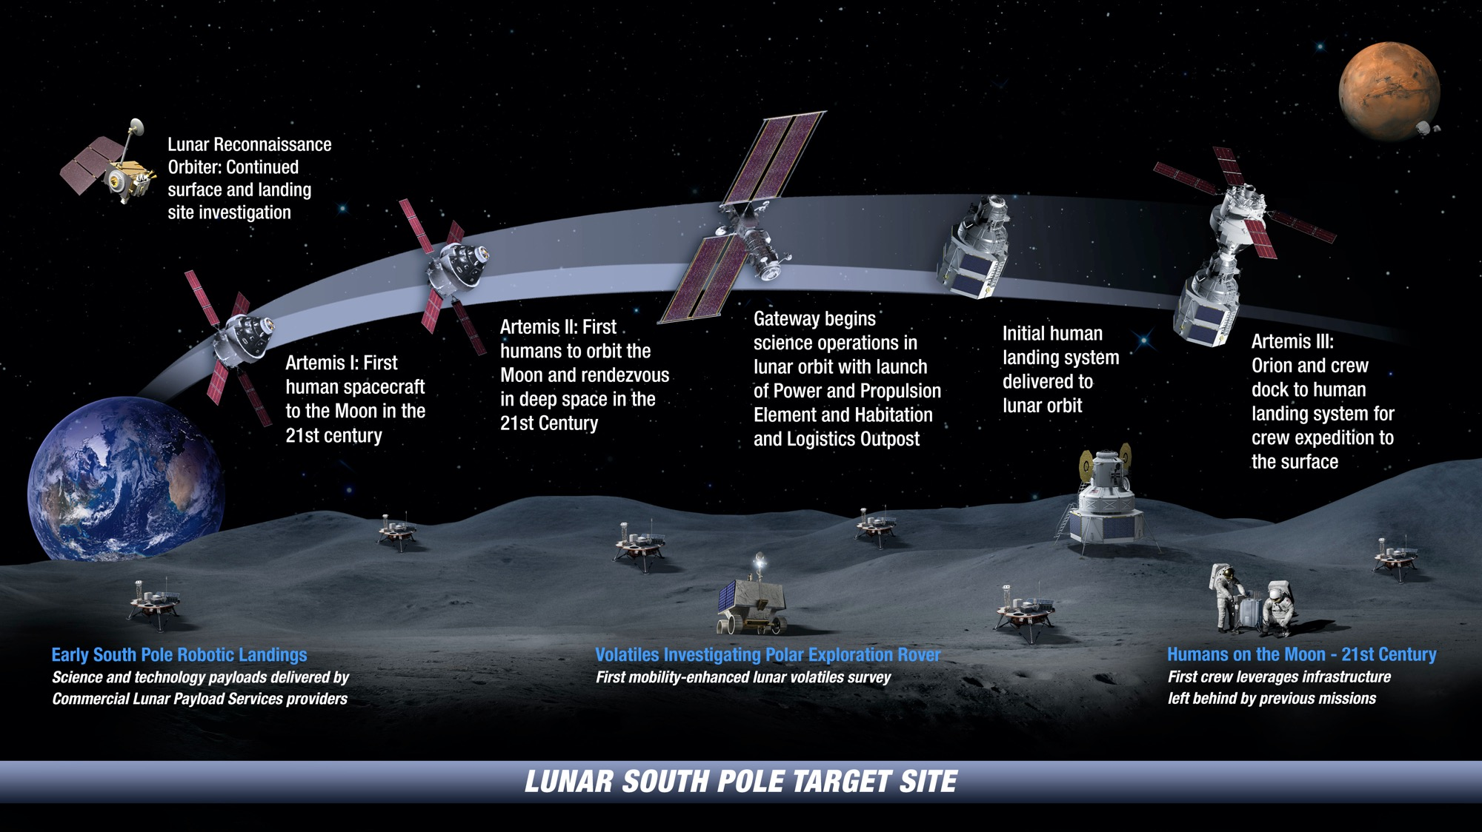
ARTEMIS: Landing Humans on the Moon

Slide 4
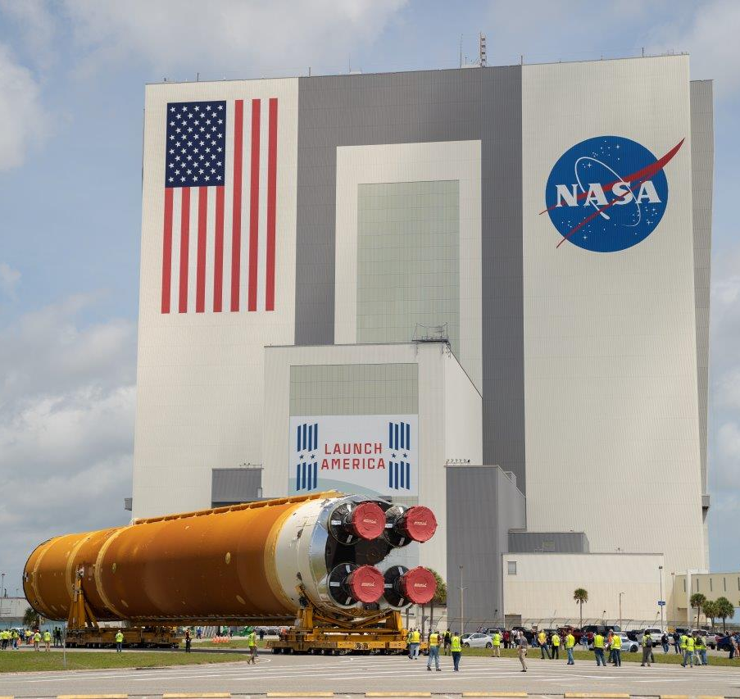
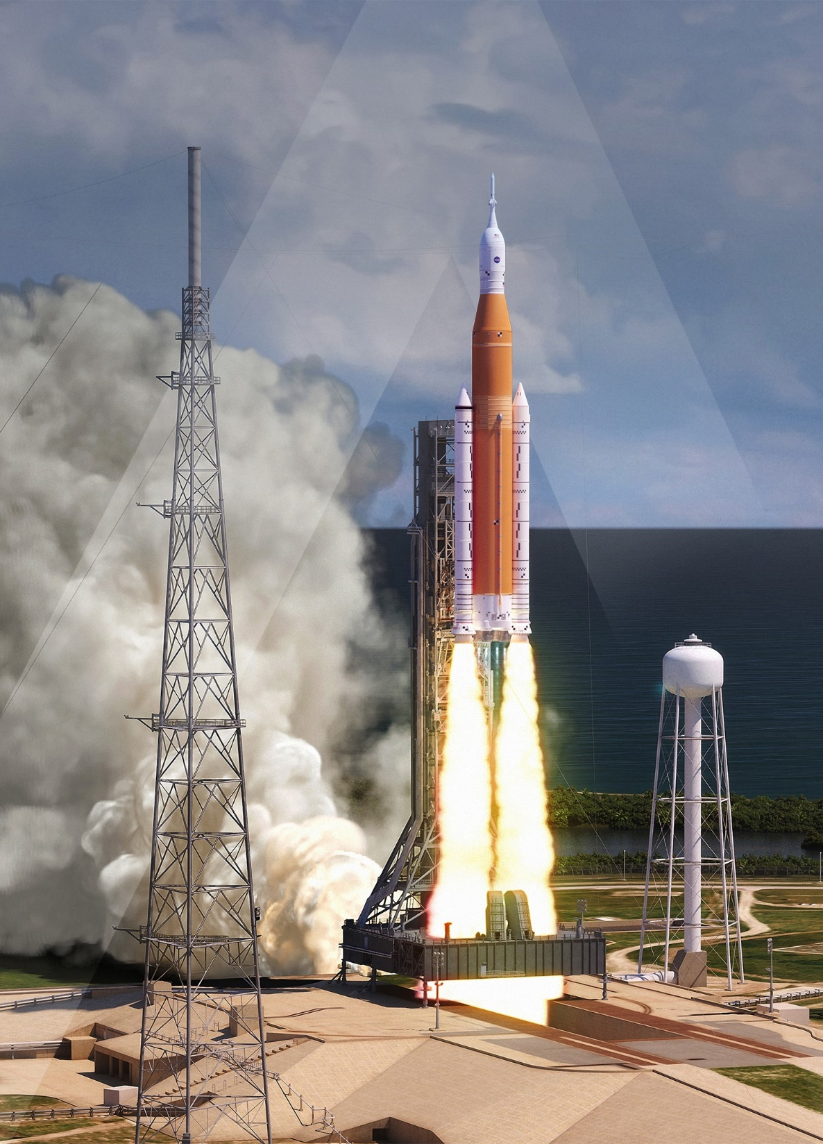

Slide 5
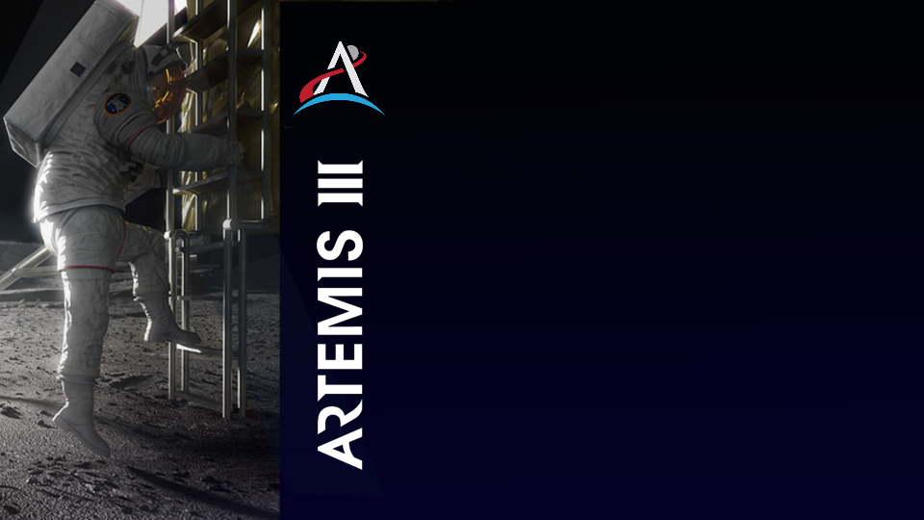
HUMANS ON THE MOON:
ARTEMIS III
The Artemis III mission will land the first woman and
the first person of color on the Moon. This mission will be the culmination of the rigorous testing and more than two million miles accumulated in space on NASA’s deep space transportation systems during Artemis I and II.
Orion and its crew will once again travel to the Moon, this time to make history with the first woman and next man to walk on the surface. Two astronauts will board the human landing system, which will carry them to the lunar South Pole with science tools and equipment.
The exact landing site depends on several factors, including the specific science objectives
and the launch date.

Slide 6

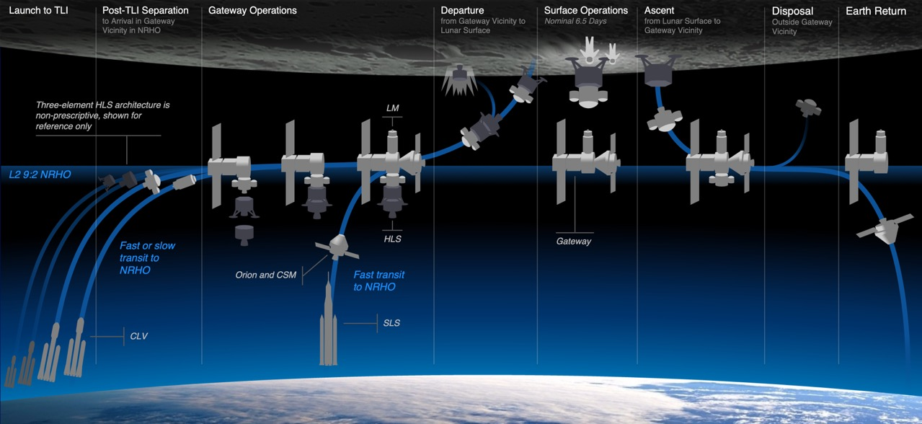
App H Generic Concept of Operations

Slide 7
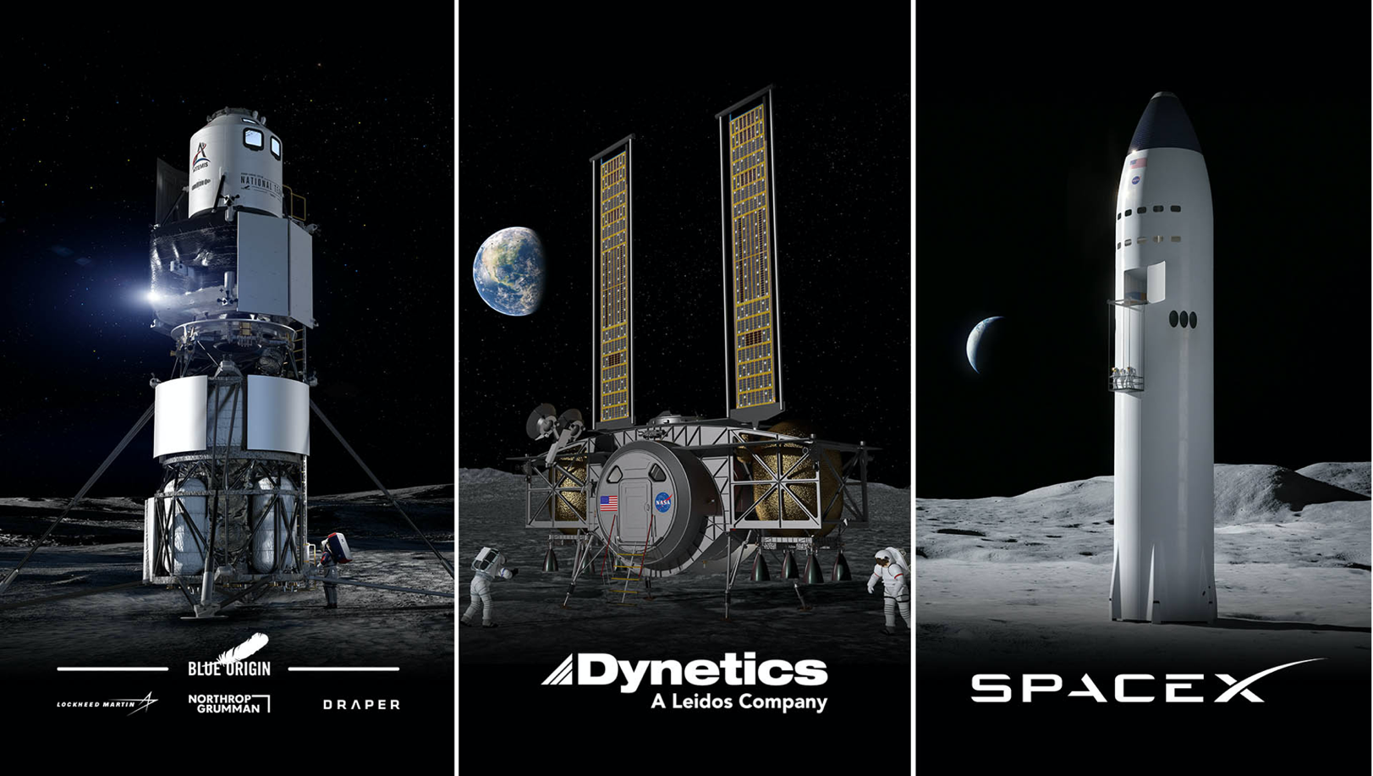

Slide 8
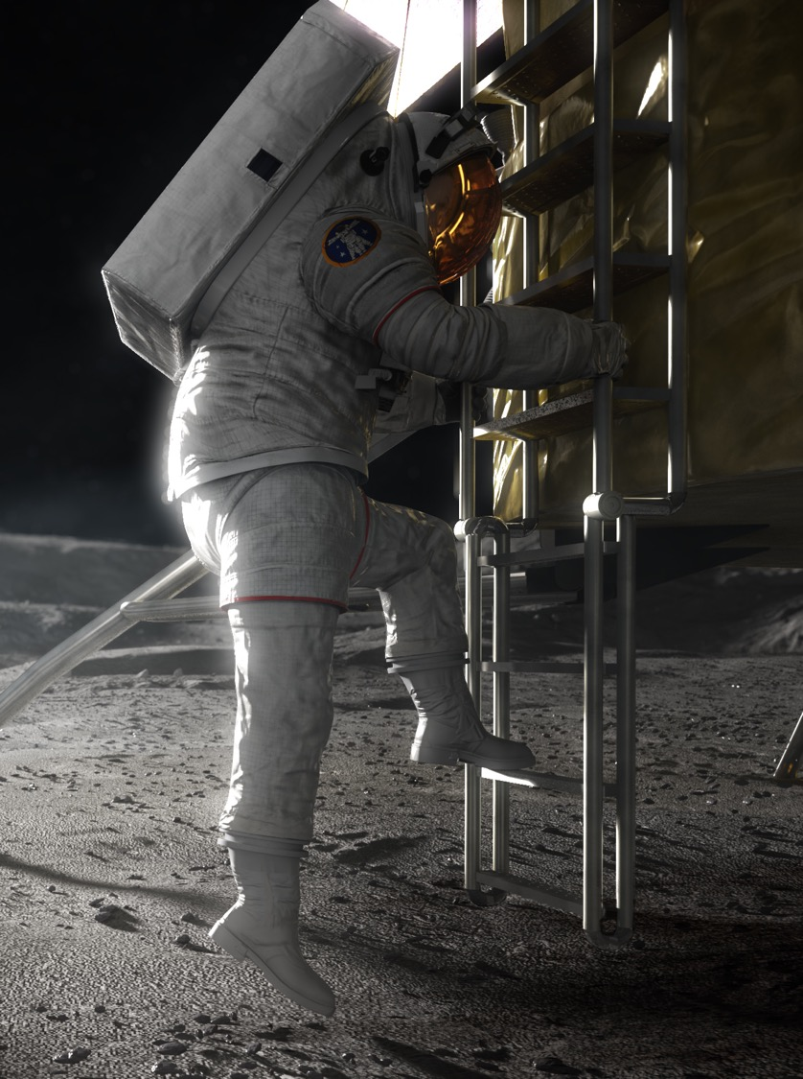
Human Landing System App H Status
✓
APR 2020 | Base Period Selections Announced
MAY 2020 | Base Period Contracts Awarded
AUG 2020 | Contractor Certification Baseline Reviews (CBRs)
OCT 2020 | Issue Option A Solicitation
DEC 2020* | Contractor Continuation Reviews/CR Closeouts
MAR 2021 | Base Period was extended up to April 30, 2021
APR 2021 | **NASA selects SpaceX to develop HLS **Option A selection under protest NCEs extended thru Aug 4, 2021
✓
✓
✓
✓
✓
✓
NASA REFERENCE DESIGN

Slide 9
Human Landing System App N Status
✓
APR 2021 | NASA issues App N RFI App N/LETS Industry Forum
Summer 2021 | App N RFP issued
Fall 2021 | App N Awarded
✓

Slide 10
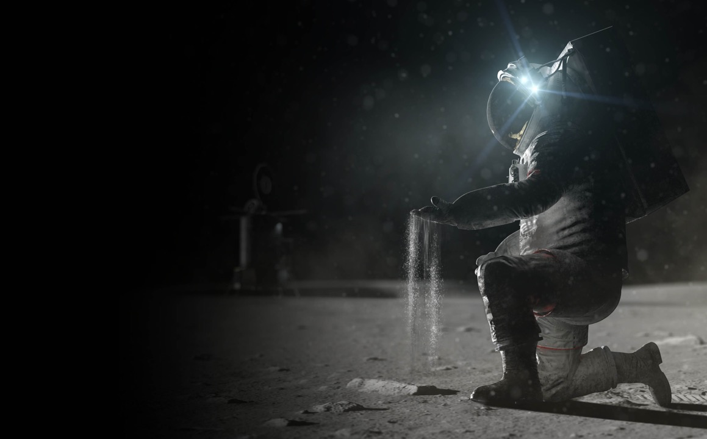
HLS & Materials
Systems & Capabilities
Additive Manufacturing
Thermal Protection Systems
Challenges
Space Environment
  MMOD
  Radiation
  Lunar Dust
Flammability

Slide 11
Notes:
ISRU

Slide 12
Mission Needs Drive Design

Slide 13
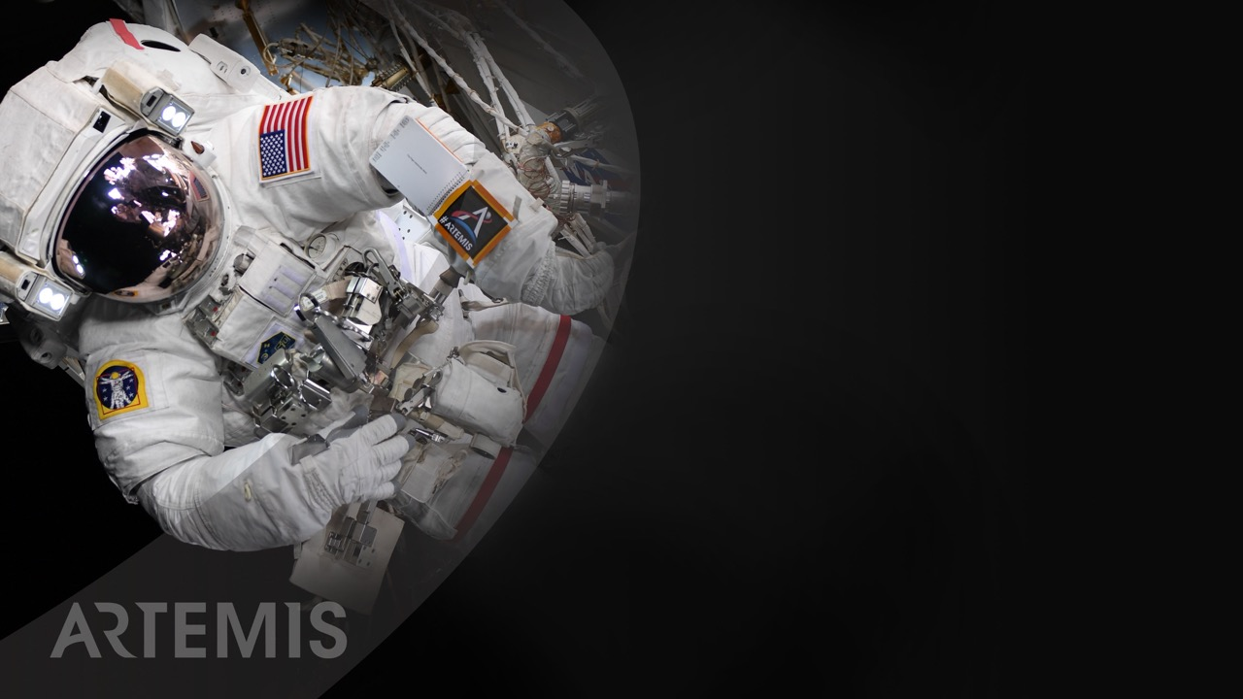
Let’s go.
The time is now.
We have the capability
We have the purpose
We have the charge
We have the responsibility

Slide 14

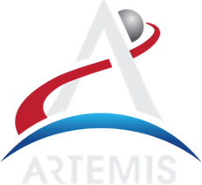

Slide 15
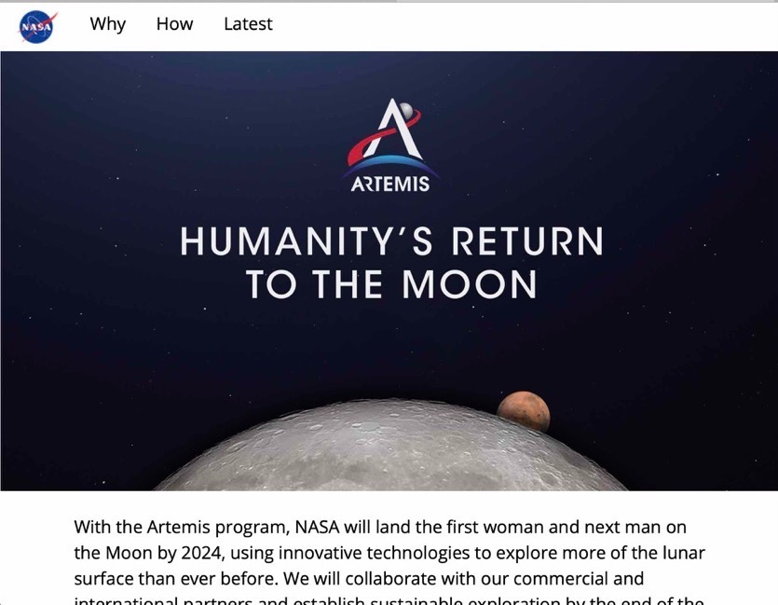




Version suggested for wide public audiences and general topics
Update handles and web links to match your topic
Stay Connected
@NASAArtemis
@NASAArtemis
@NASAArtemis
blogs.nasa.gov/artemis
Sign up for updates at nasa.gov/subscribe
nasa.gov/artemis

