Slide 1
CFD 101: Grid Generation
NASA Langley/Ames EDL Seminar Series for Summer Interns
Adam Wise, a.j.wise@nasa.gov

Slide 2
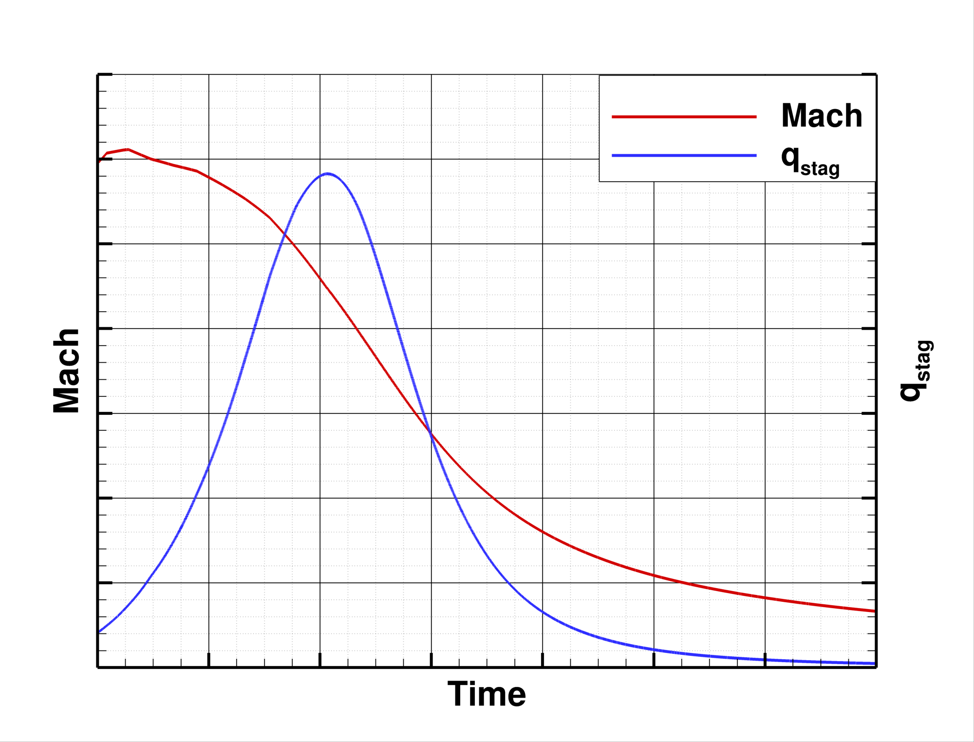
Introduction
Why is this important?
  Critical to estimate environments that Entry, Descent and Landing (EDL) vehicle Thermal Protection Systems (TPS) will experience, especially surface heating rates during entry
What is needed?
  Trajectory conditions that span the heat pulse
  A reacting CFD solver such as LAURA, DPLR, FUN3D, US3D, or etc.
  A grid specifically tailored for accurate computation of surface heating quantities
    Geometry definition – drawing, surface grid, CAD

Slide 3
Outline
What makes a good grid?
  Focus on aeroheating
Example Workflow
  Step through an example grid generation workflow
  Inflatable re-entry vehicle
Issues & Advancements
  Briefly mention where typical aerothermodynamics grids give us trouble and some ways forward

Slide 4
What makes a good grid?

Slide 5
What Type of Geometry?
Axisymmetric Blunt body (Capsule)
  We simulate this type of vehicle a lot!
Sometimes grids also need to be made for:
  Lifting bodies
  Wing-bodies
  Etc.
Sometimes grids need to include local features, such as:
  Protuberances, e.g. antennae radomes
  Cavities, e.g. inset access panel
  Nozzles

Slide 6
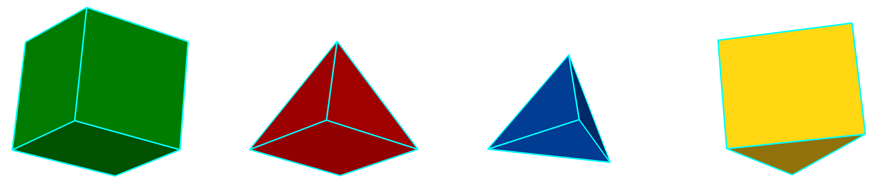
What Type of Grid?
Many different grid element types, including:
…but what grid type should be used to get the best surface heating results?
  Hexahedral!
  …or, possibly, triangular prisms
Hexahedron Pyramid Tetrahedron Triangular prism

Slide 7
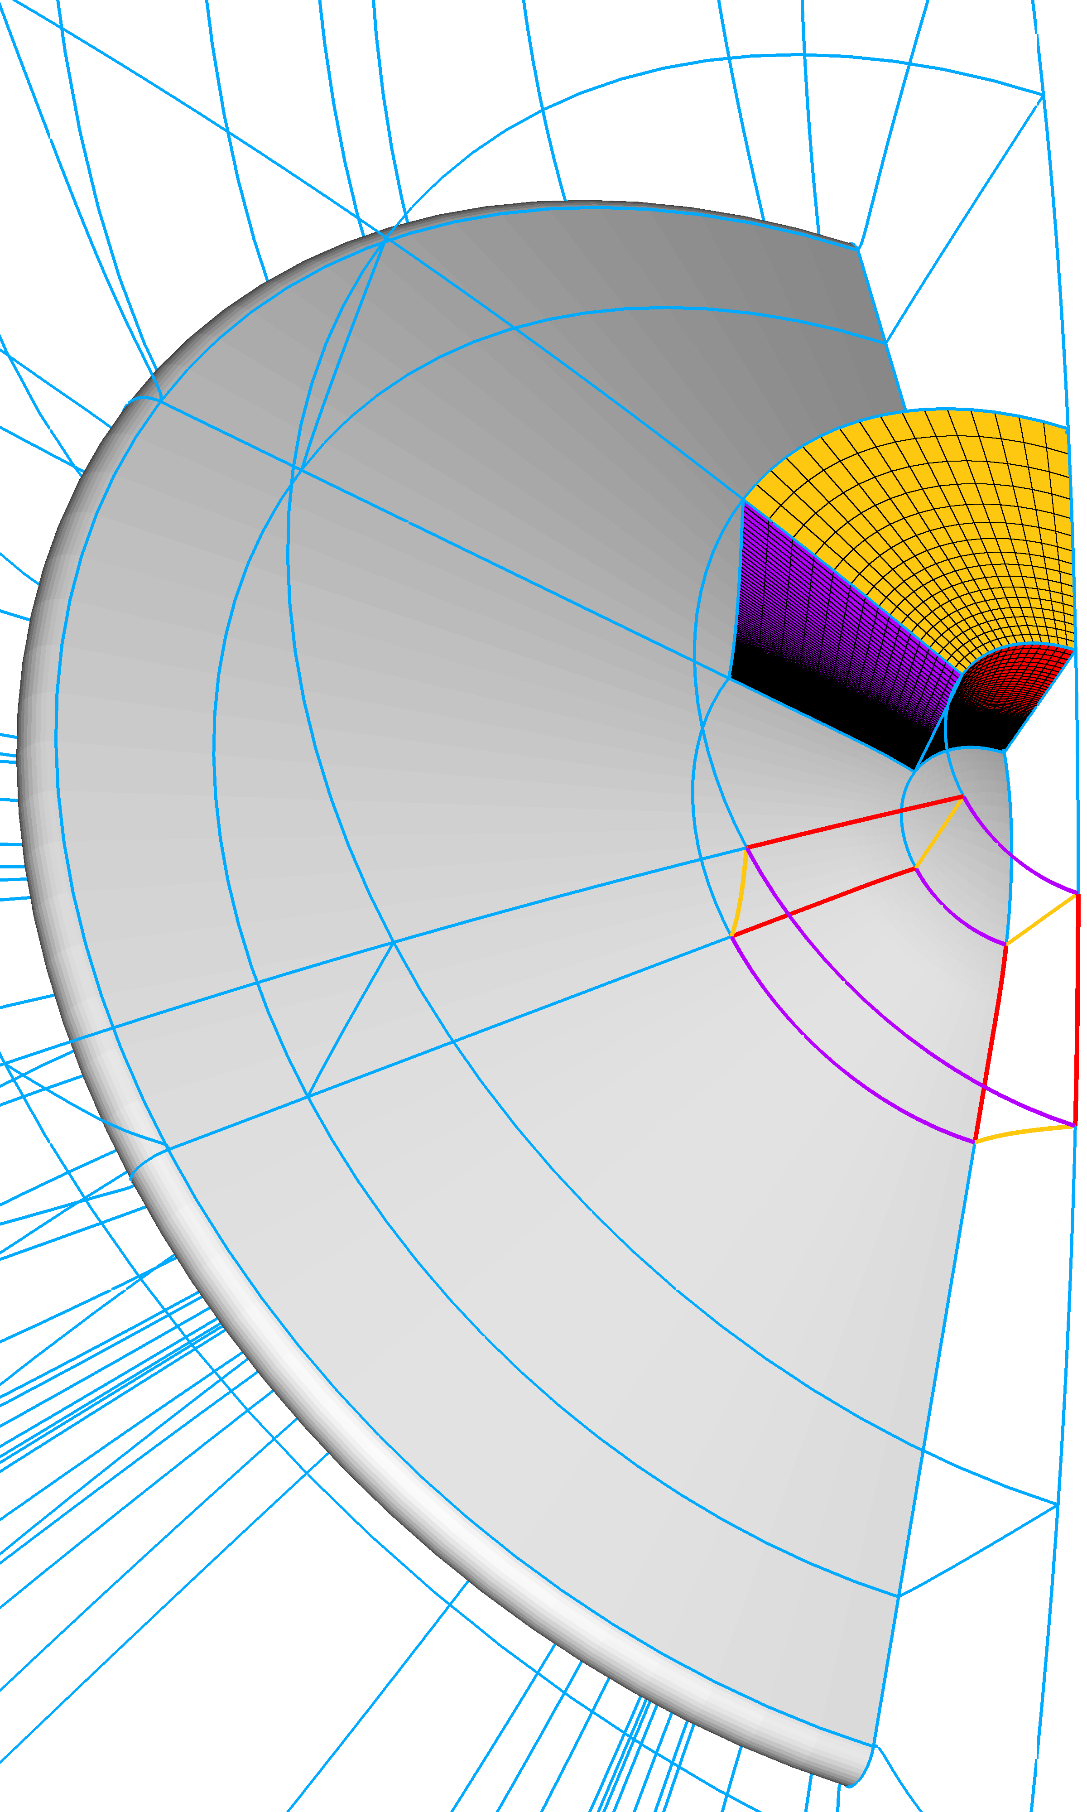
What Makes a Good Aerothermodynamic Grid?
*Nomenclature – database, connector, domain, block
We know what makes a good structured grid
  Surface orthogonality
  Viscous spacing with low cell Reynold’s number at the wall; ~1
  Controlled stretching ratios;
  Grid aligned to the bow shock
  *Unbroken radial grid lines that extend from the vehicle surface to the outer boundary
  Singularity free (3D)
  Nose patch corners far from stagnation point
Chief difficulties:
  Square peg – round hole
  Impractical – hand crafting difficulty and time
  Local modifications – global effects
i
k
j
LAURA Requirements
  Structured, unformatted, multiblock, Plot3D…
    Hexahedral elements define volumes
    Neighbor vertices implicitly known – ijk ordering
    Block/domain boundary point matching
    2D, Axisymmetric, 3D
  Load balancing*

Slide 8
Example Workflow

Slide 9
Workflow Setup
Axisymmetric Geometry
Grid Generation Tool – PointWise
  PointWise, Inc.
  Follow-on software tool after Gridgen
  Structured and Unstructured (including hybrid and viscous) mesh creation and modification
  Flexible CAD import, modification (quilting, cutting, etc.) and basic surface creation
  Scriptable
Grid Interpolation Tool – Radial_interp
  Developed by David Saunders (AMA, Inc., ARC-TSA)
  https://sourceforge.net/projects/cfdutilities/files/RADIAL_INTERP/
  Generates a new volume grid or flowfield from the original volume data and a new surface, or volume, grid
  Assumes:
    Plot3D, multiblock structured grids
    One layer of blocks from the geometry surface to the outer boundary

Slide 10
Basic Workflow Procedure
Create connectors that conform to the vehicle’s outer mold line (OML) along one half of the symmetry plane
Dimension the connectors and distribute the points
Extrude a 2D grid using hyperbolic grid solver through the boundary layer
Use Bezier curves to create connectors that bound the extent of the 2D freestream domain; then create and smooth the domain (TFI or Elliptic)
Extrude (rotate) the 2D domain 180-degrees to create a 3D volume grid with symmetry plane
Replace poles on the surface grid with H-grid patches
Use Radial_interp to create a new 3D volume grid without poles
Define boundary conditions

Slide 11
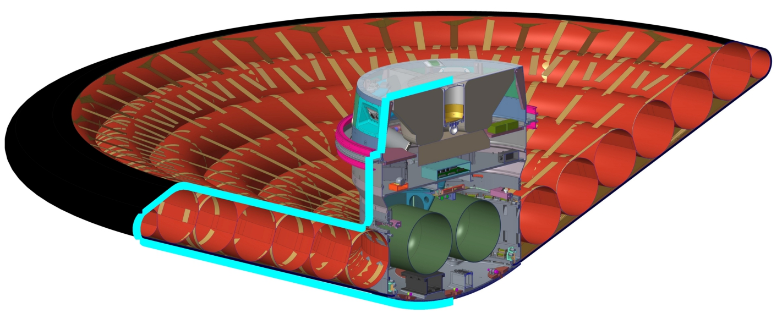
1. Create Connectors
Create connectors that conform to the vehicle’s outer mold line (OML) along one half of the symmetry plane
Pointwise Database (underlying geometry definition)
  Technical drawing or analytic definition – create within PW
  CAD or surface grid – CAD cleanup, quilting, intersecting/cutting, etc.
Draw surface centerline on appropriate DB surfaces
  Ensure that surface grid points constrained DB surface

Slide 12
2. Dimension and Distribute Points
Dimension the connectors and distribute the points and consider:
  Geometry features – steps, local curvature, etc.
  Local flow features – e.g. expanding flow near the max-diameter shoulder
  Overall grid point count and load balancing
Smoothly distribute points
  Hyperbolic tangent distribution function
  Keep stretching ratio ~1.2 on fine grid

Slide 13
3. Grow Boundary Layer Grid
Extrude a 2D grid using hyperbolic grid solver through the boundary layer
  Ensures surface orthogonality
  Try to extrude beyond local flow features such as high-curvature regions, cavities and steps
Hyperbolic PDE – initial value problem
  2D/3D extrusion method

Slide 14
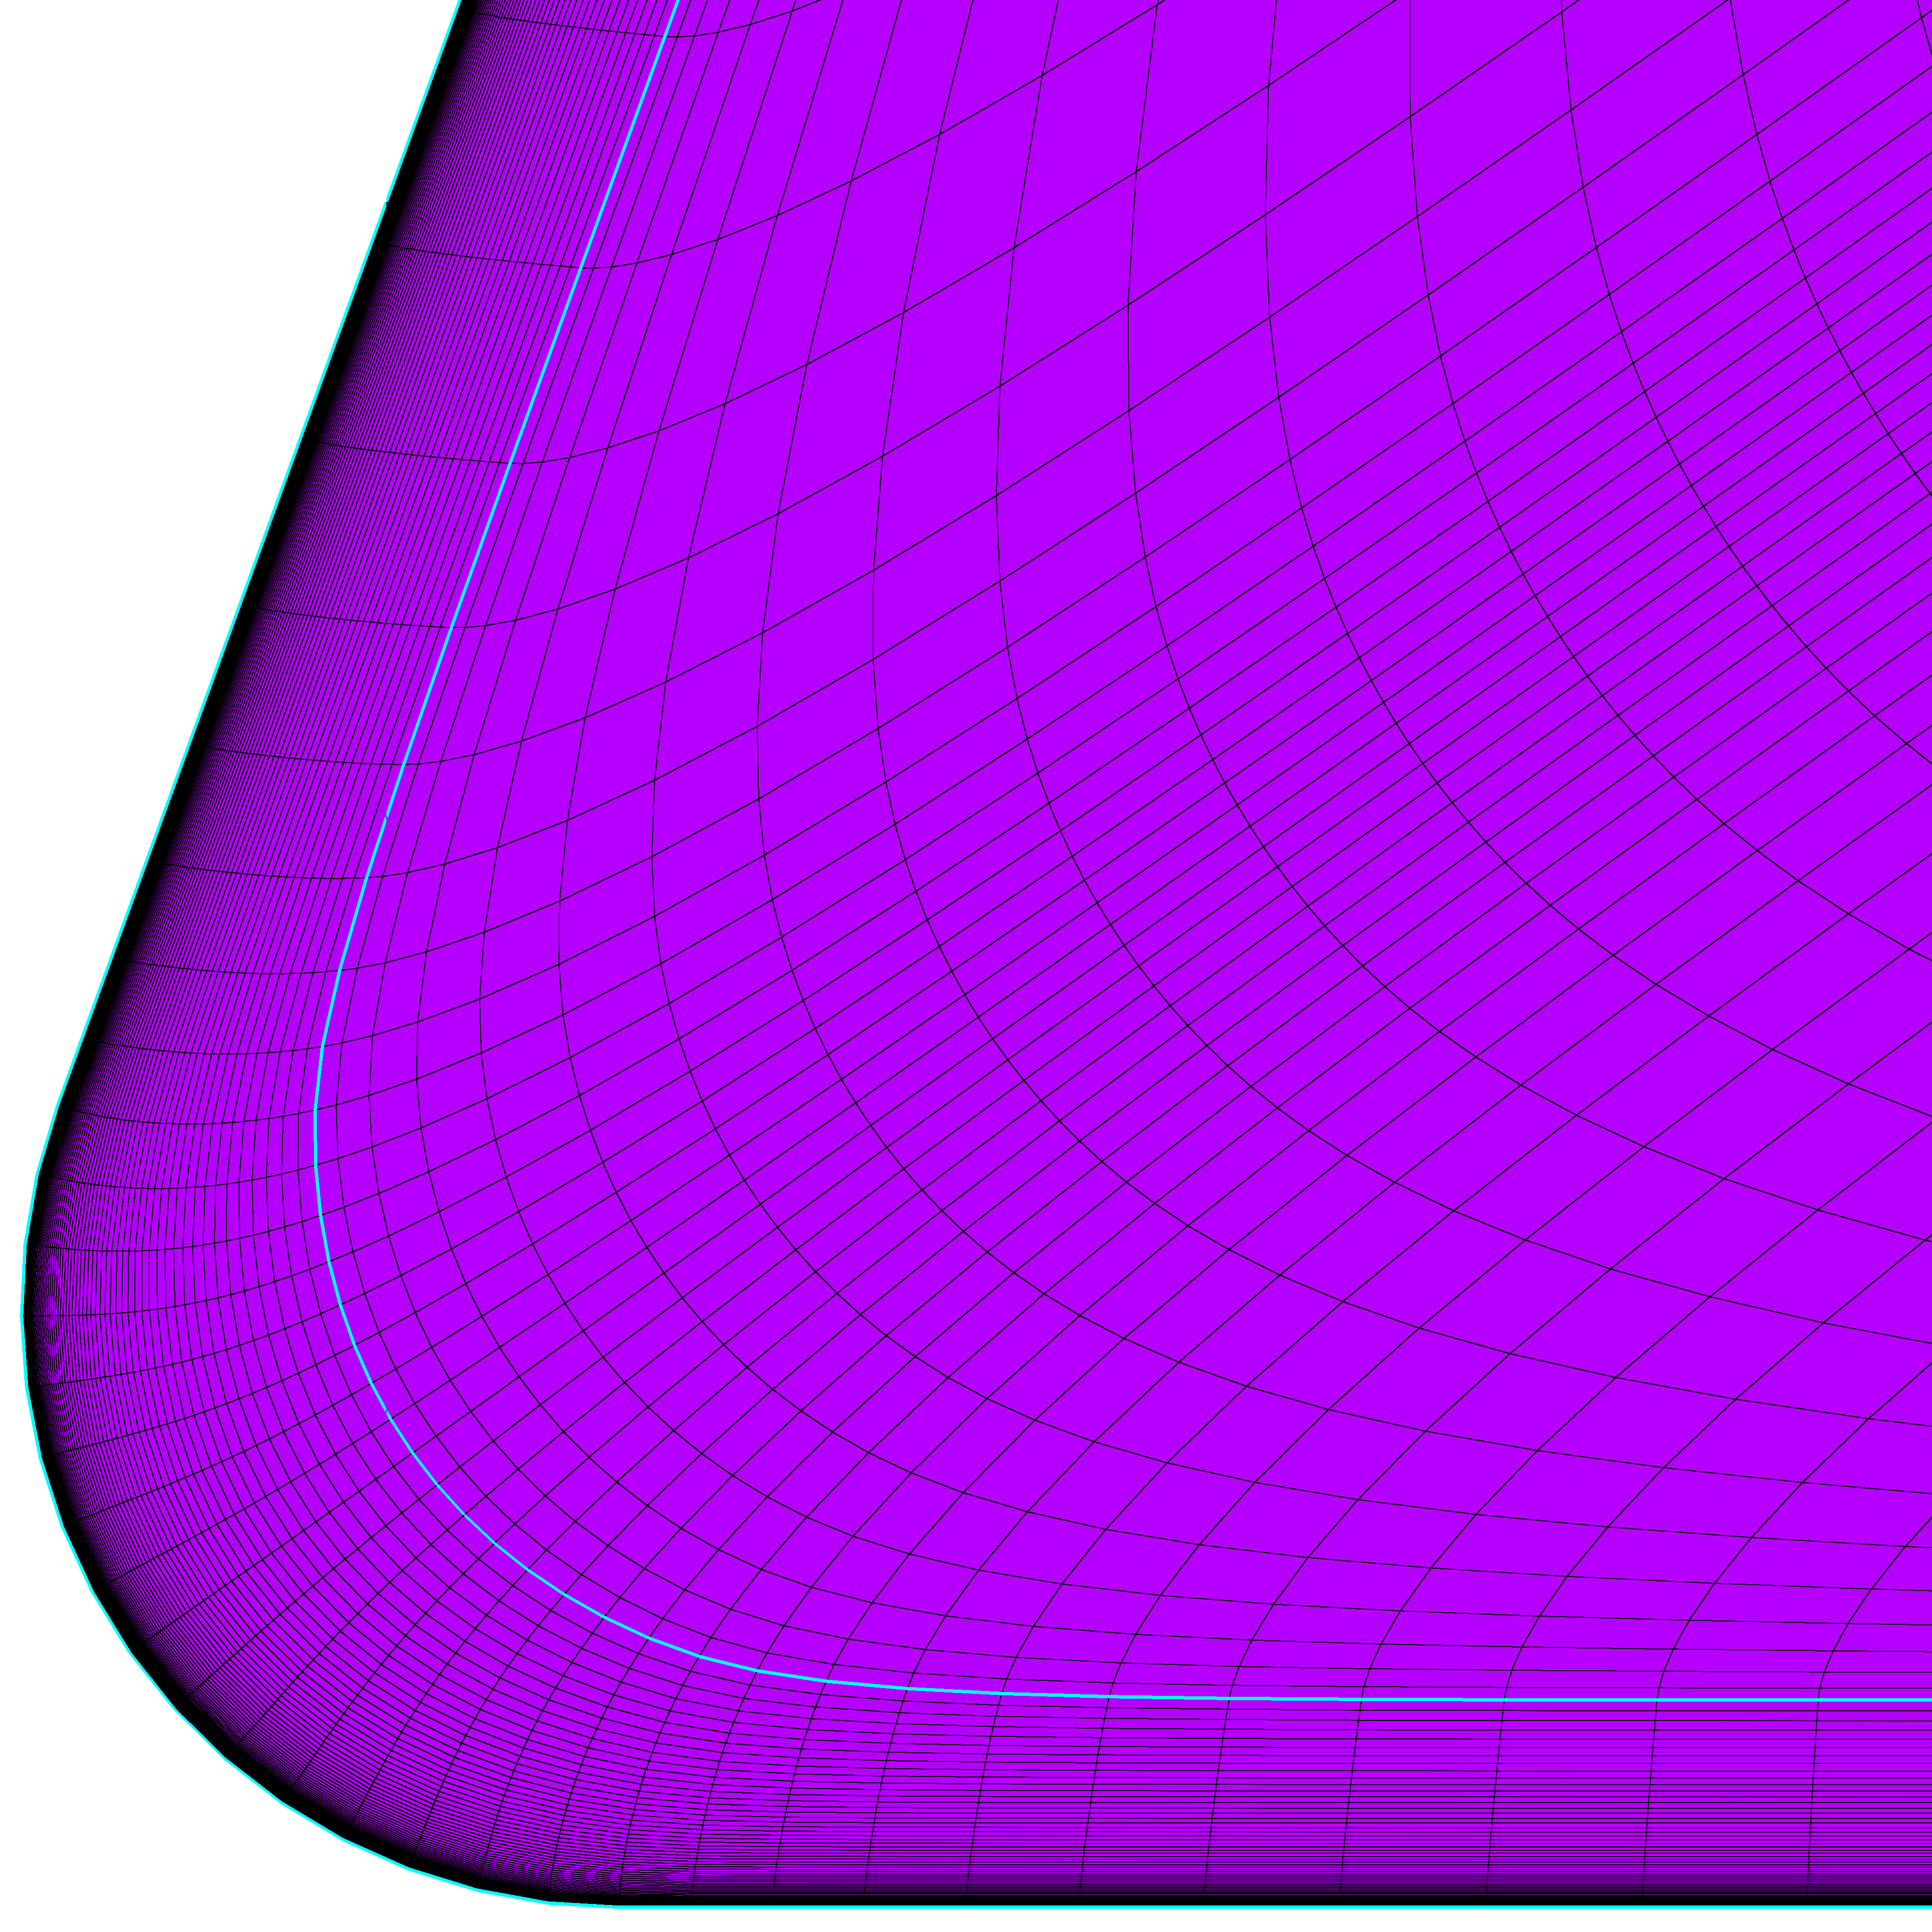
4. Attach Inviscid Domain
Use Bezier curves to create connectors that bound the extent of the 2D freestream domain
  Create the inviscid domain(s)
  Used elliptic solver to smooth
Control domain size and shape
Elliptic PDE – boundary value problem
  Iterative domain and block smoothing
  Various BCs - Adjacent, Interpolate, Orthogonal, Current
  Set relaxation factor to zero for hyperbolically grown layers

Slide 15
5. Extrude (rotate)
Extrude (rotate) the 2D domain 180-degrees to create a 3D volume grid with symmetry plane
  Project 2D mesh to symmetry plane
  Extrude (rotate) about geometry’s axial centerline
  Reorder ijk orientations if needed

Slide 16
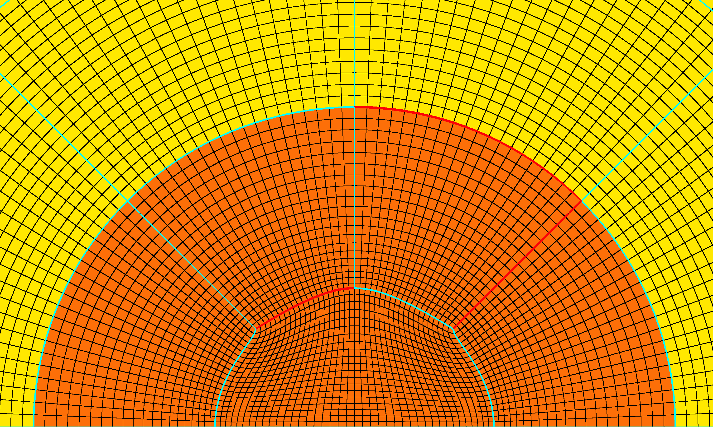
6. Replace Surface Poles with H-Grids
Replace poles on the surface grid with H-grid patches
  Consider corner quality
  Properly distribute (TanH) points and match adjacent domain boundary spacings
  Elliptic smoothing –> check stretching ratios
Spacing:
Adjacent
Angle:
Orthogonal
Spacing:
Interpolate
Angle:
Orthogonal
Spacing:
Adjacent
Angle:
Adjacent

Slide 17
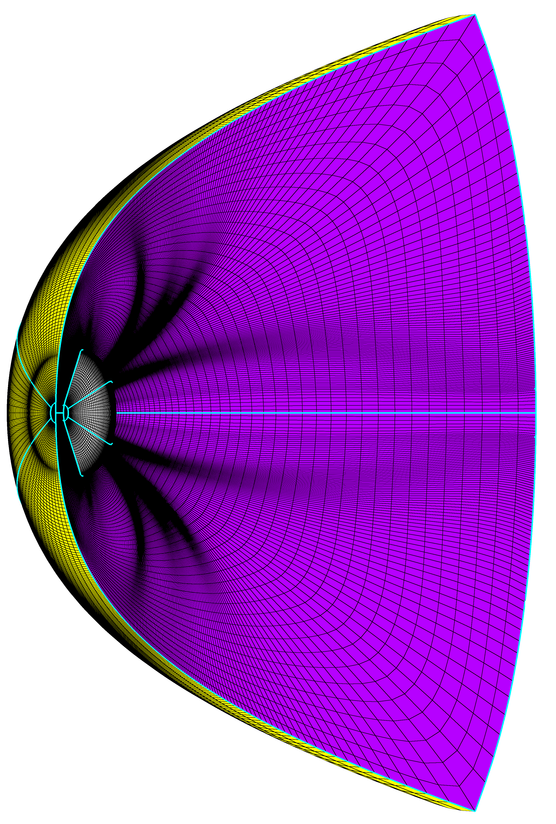
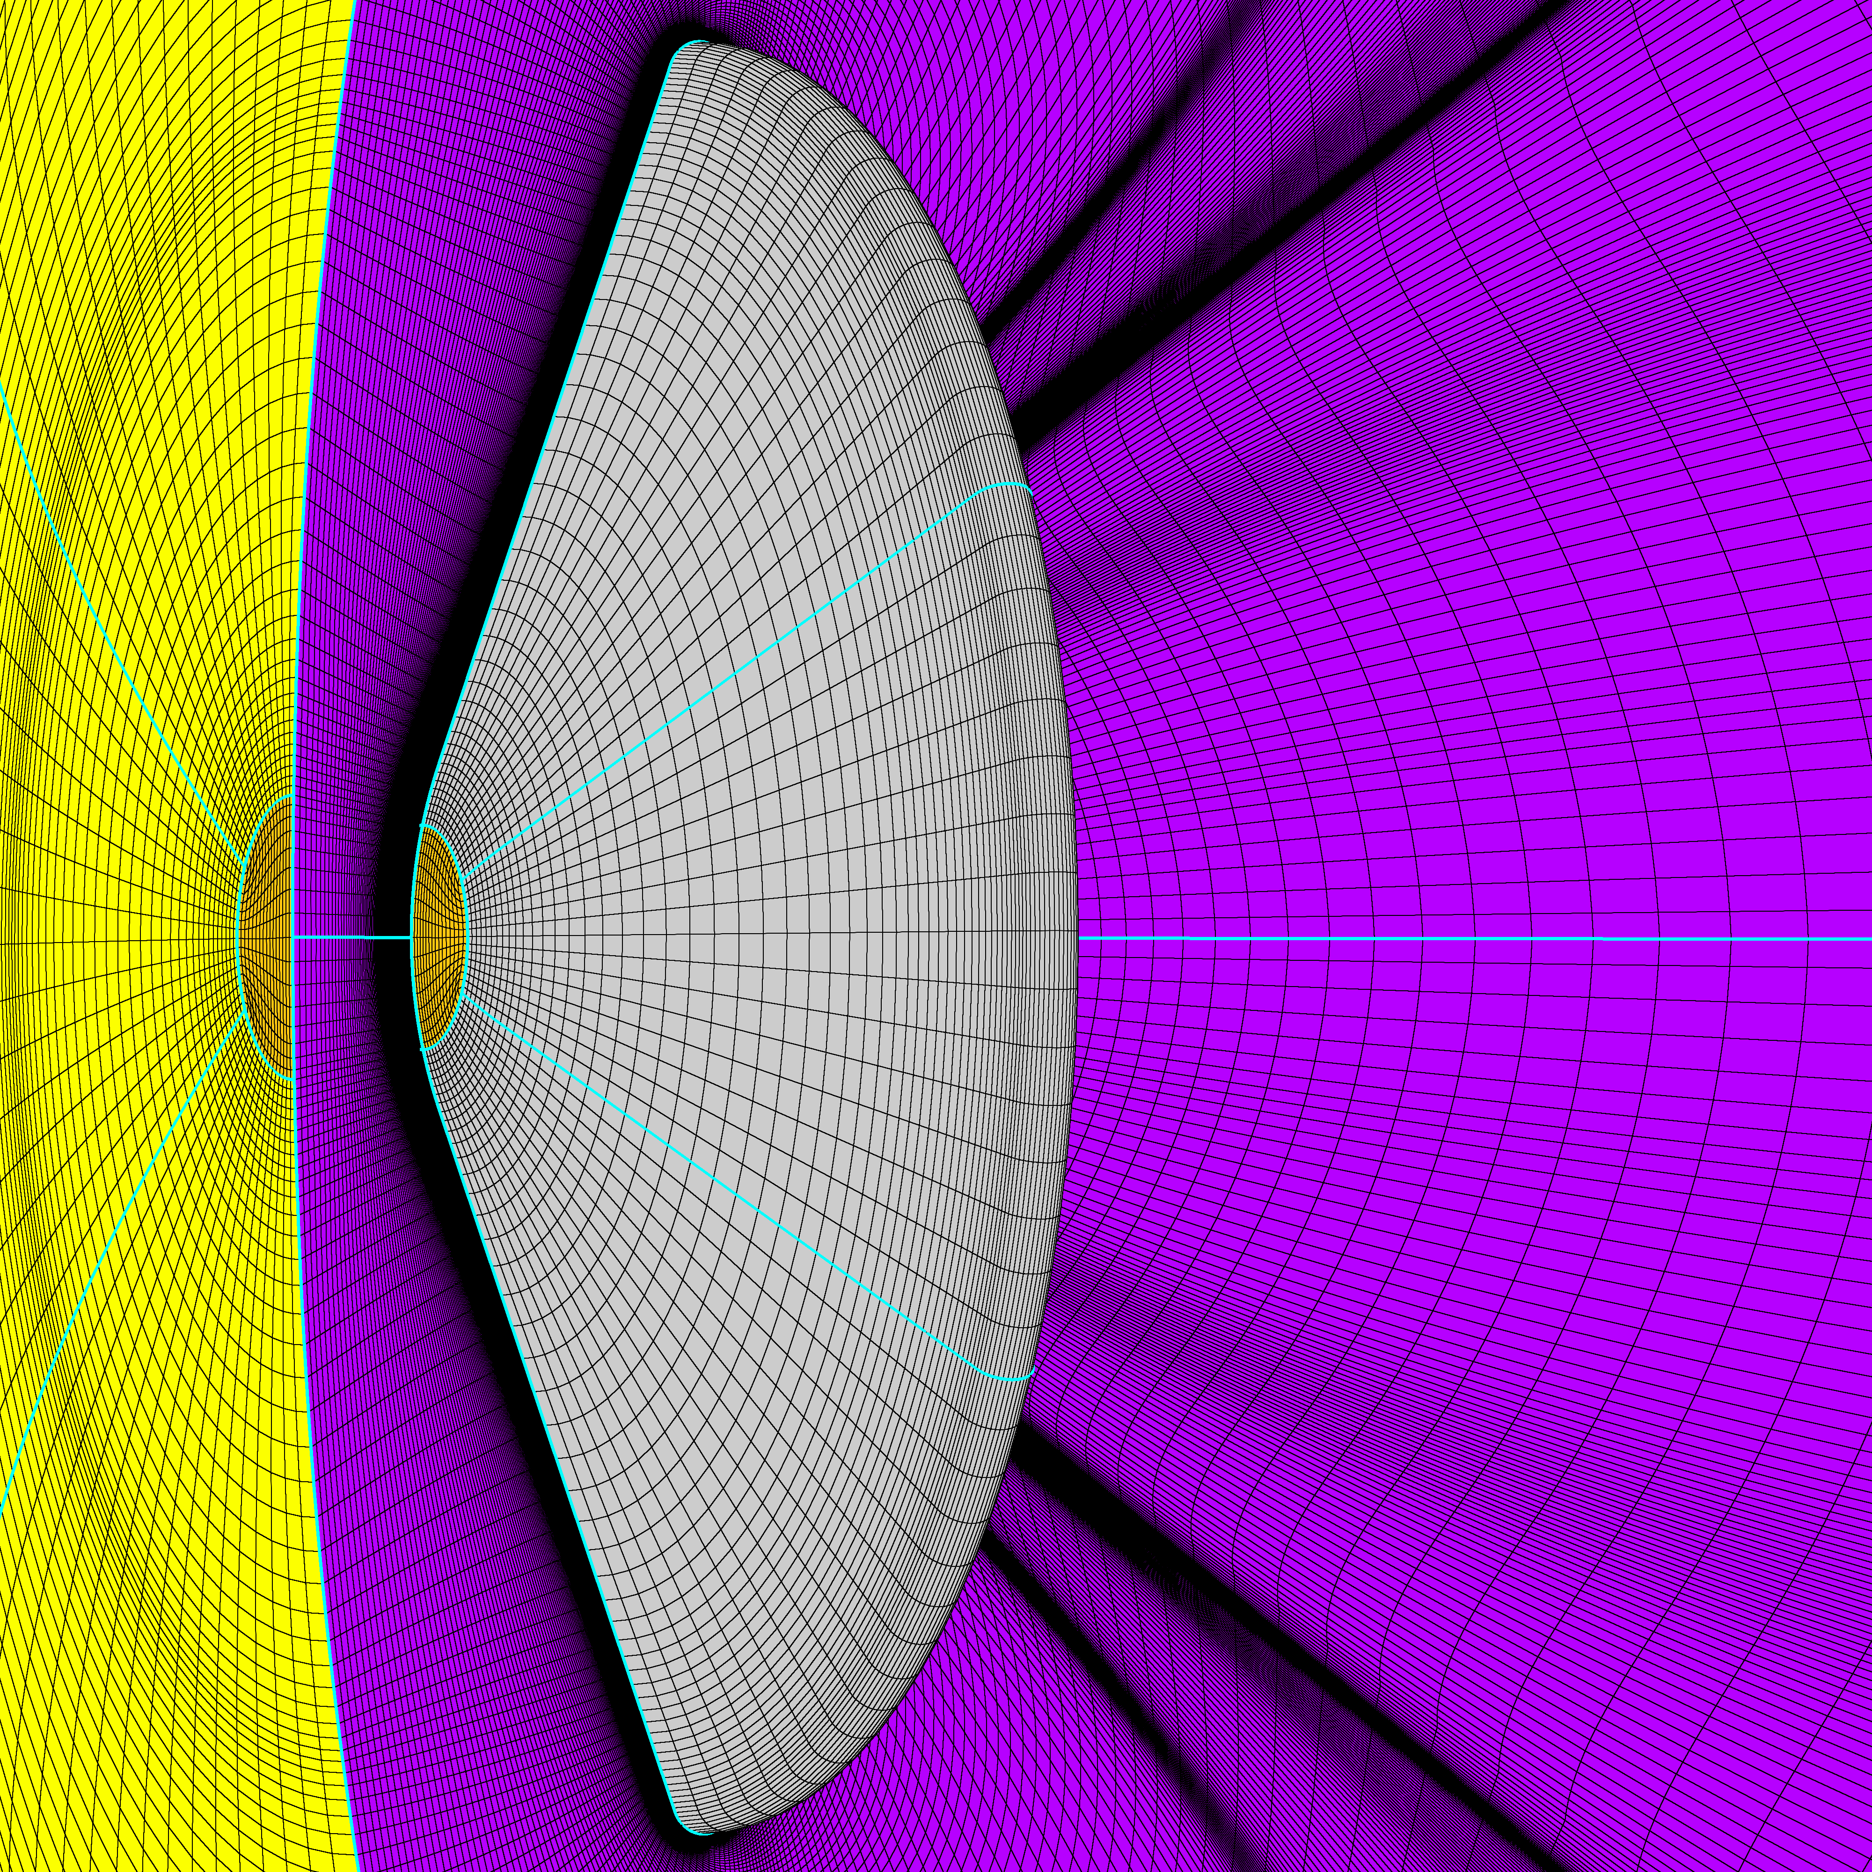
7. Use Radial_Interp
Use Radial_interp to create a new 3D volume grid without poles
  Use Radial_interp to generate pole-less volume grid
  Split and order grid blocks -> load balancing
  Reorganize blocks -> Logical order for BC setup, finding potential problems and post-processing

Slide 18
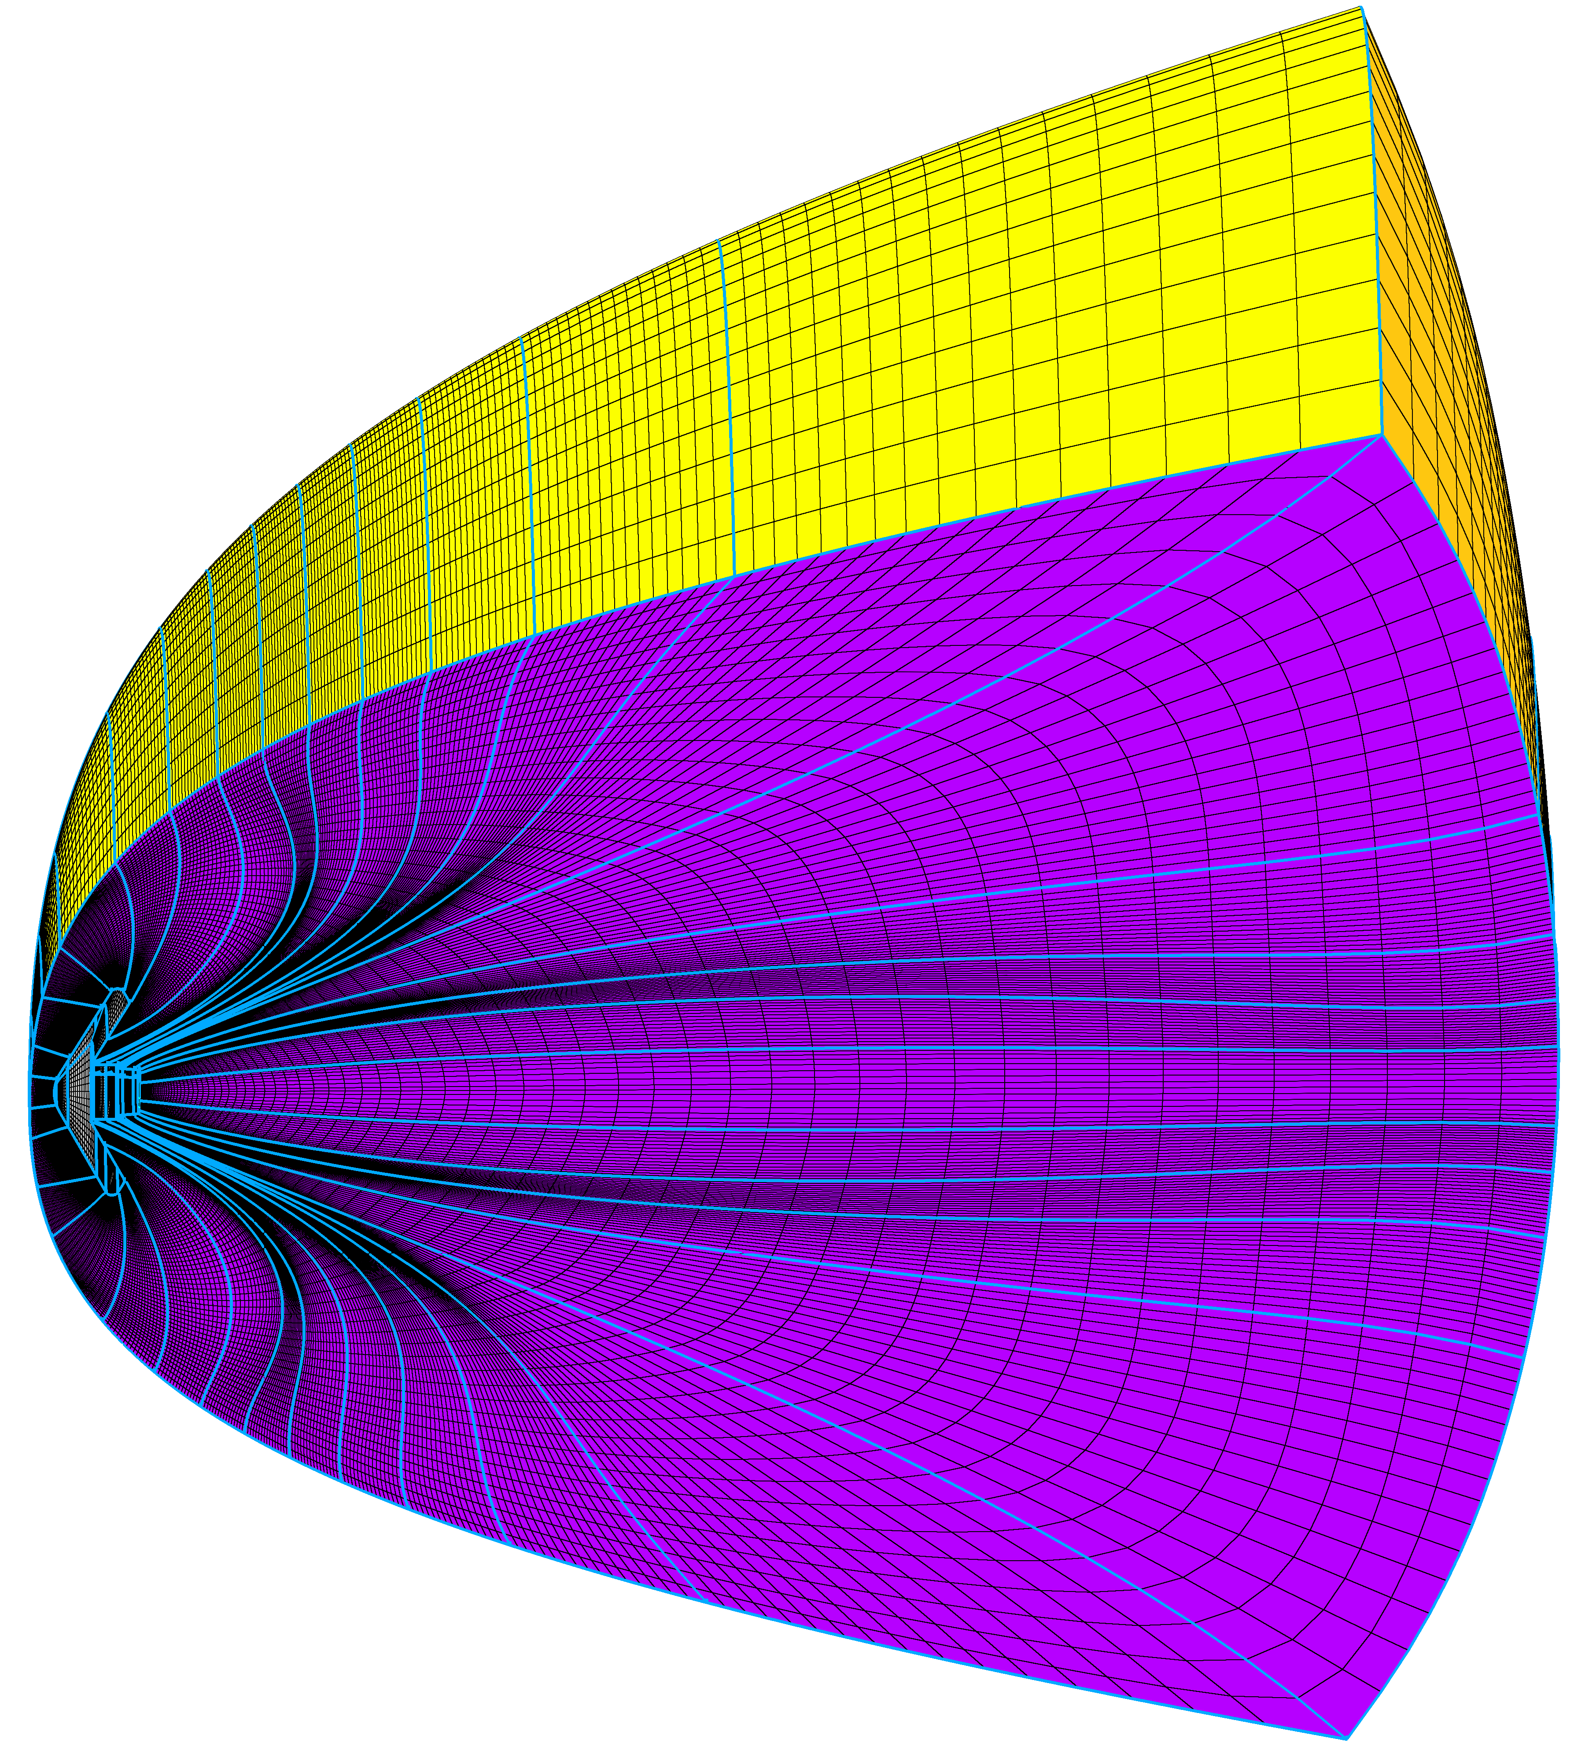
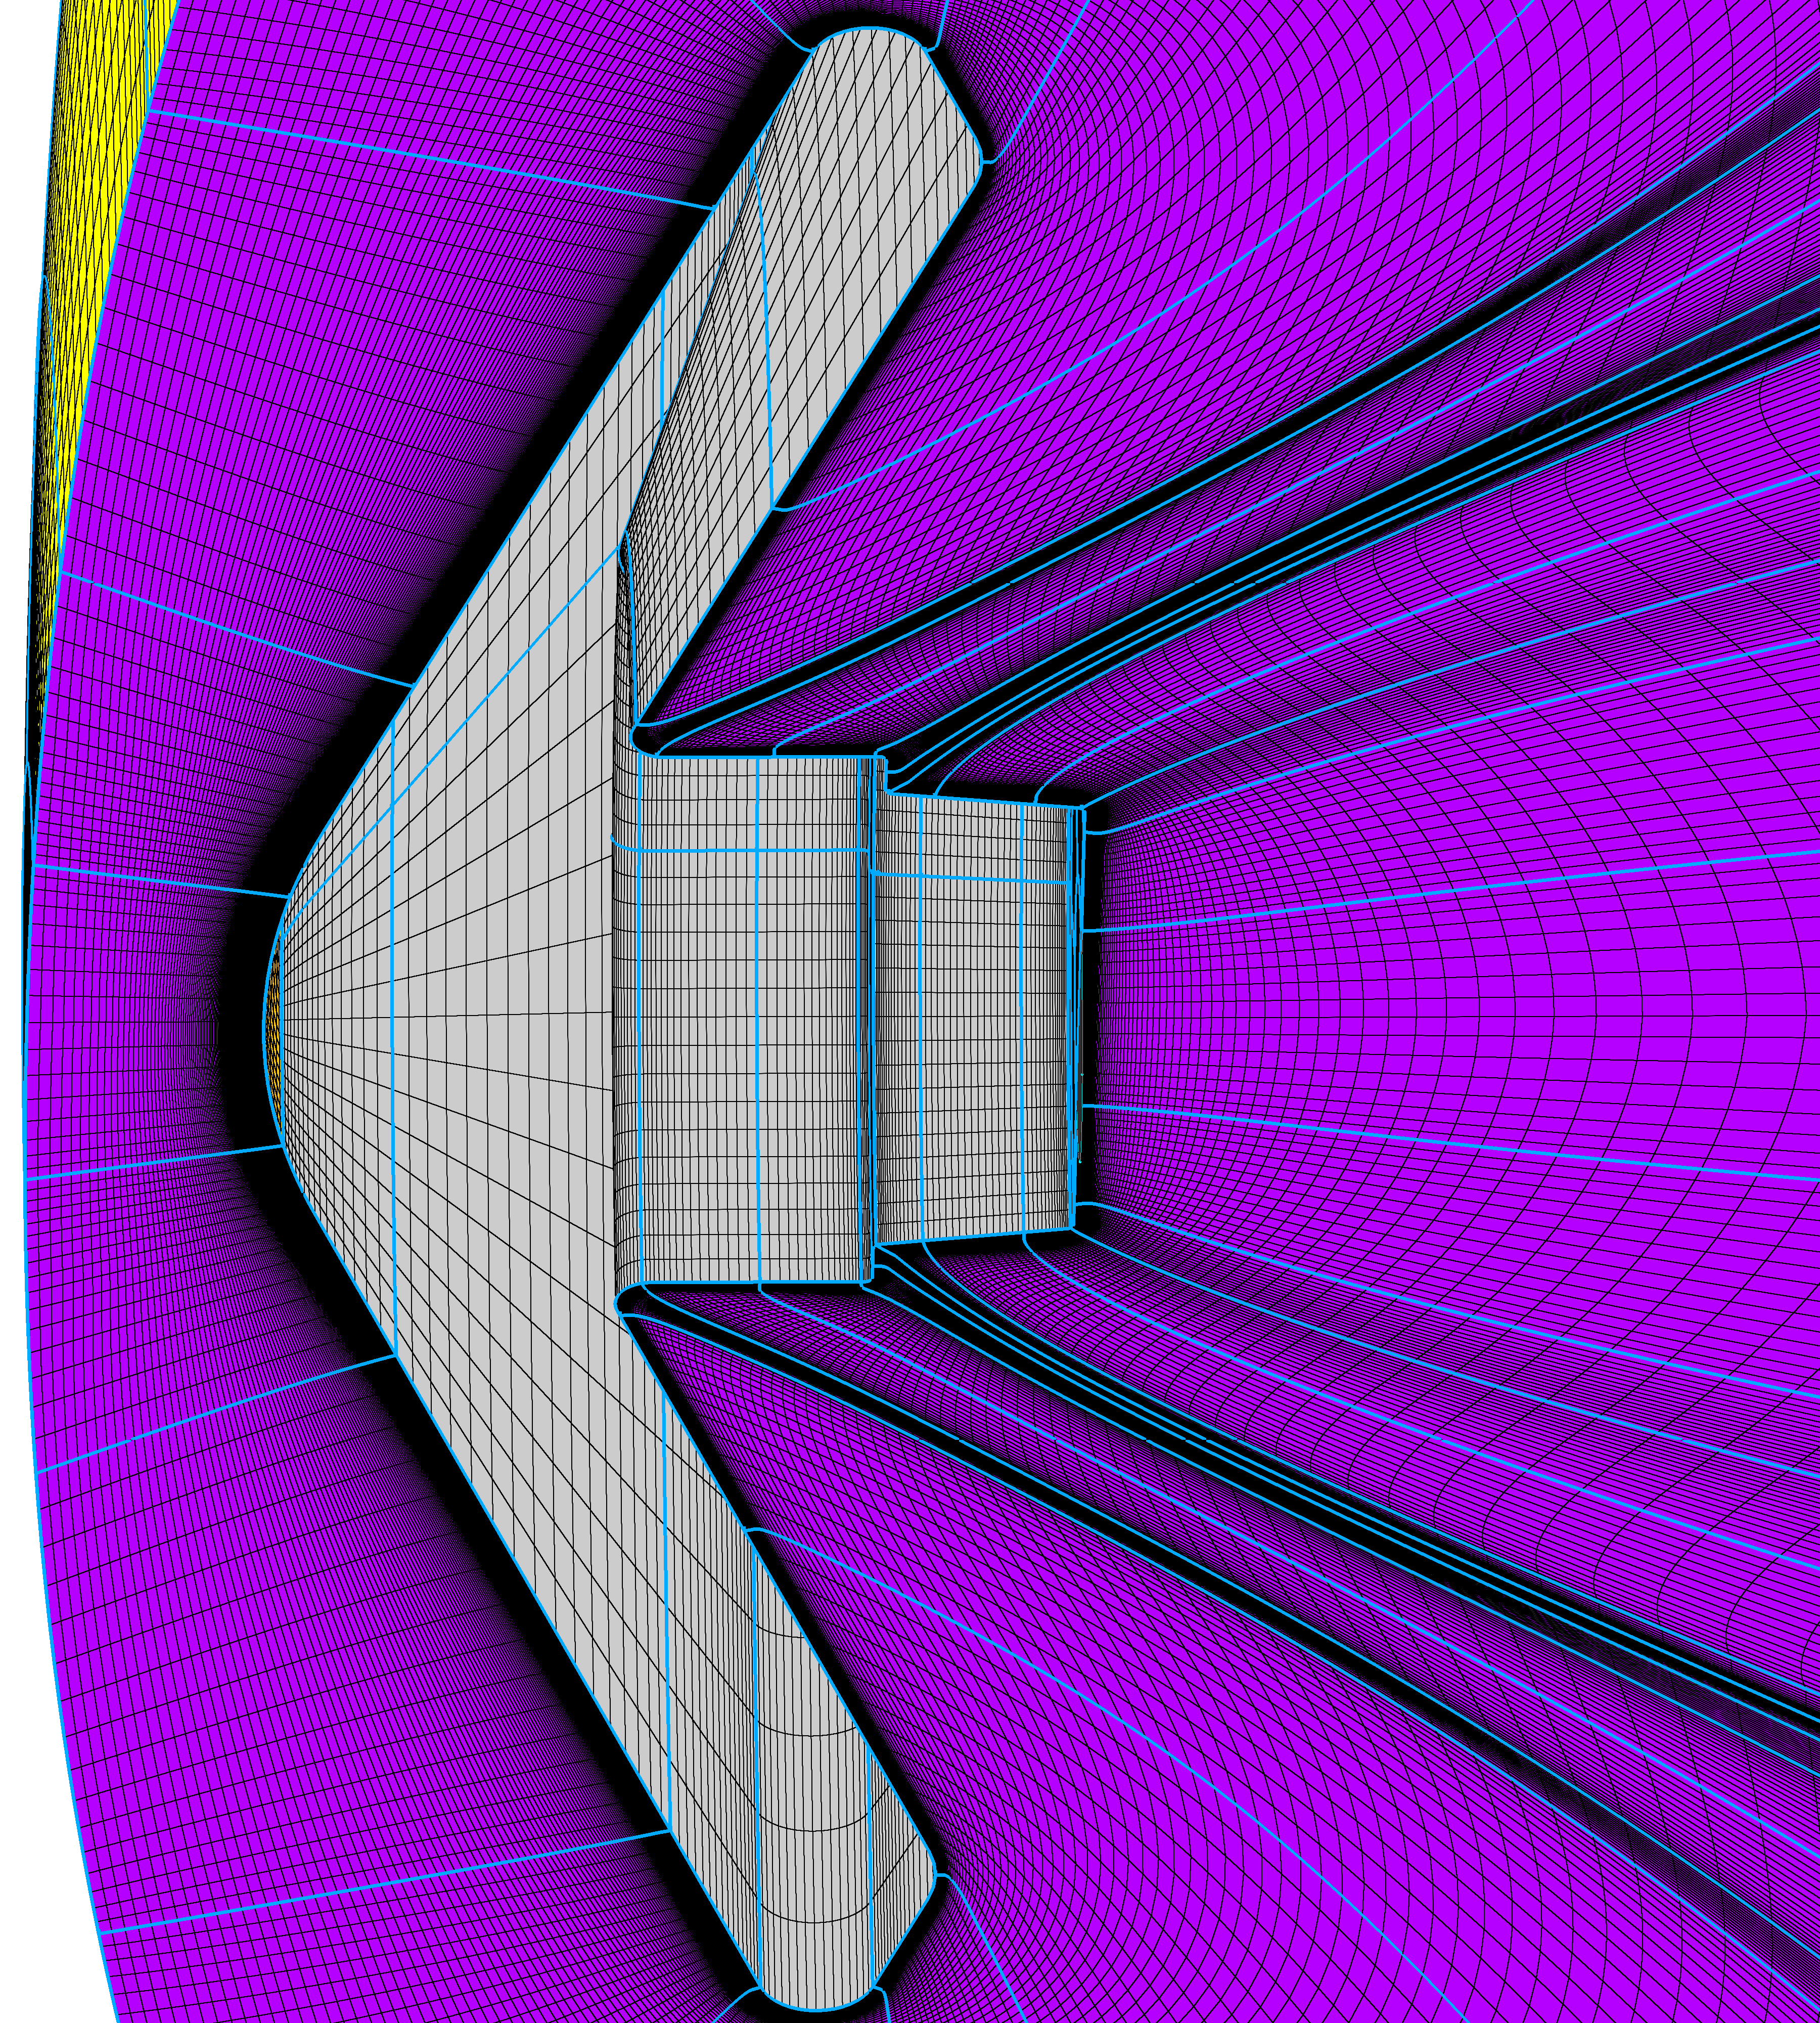
8. Define Boundary Conditions
Freestream
Outflow
Define boundary conditions
  Select ’LAURA’ as the flow solver in PointWise
  Define B.C. on outer control volume domains
  “Export -> CAE…” to write out grid and boundary condition file
Wall
Symmetry Plane

Slide 19
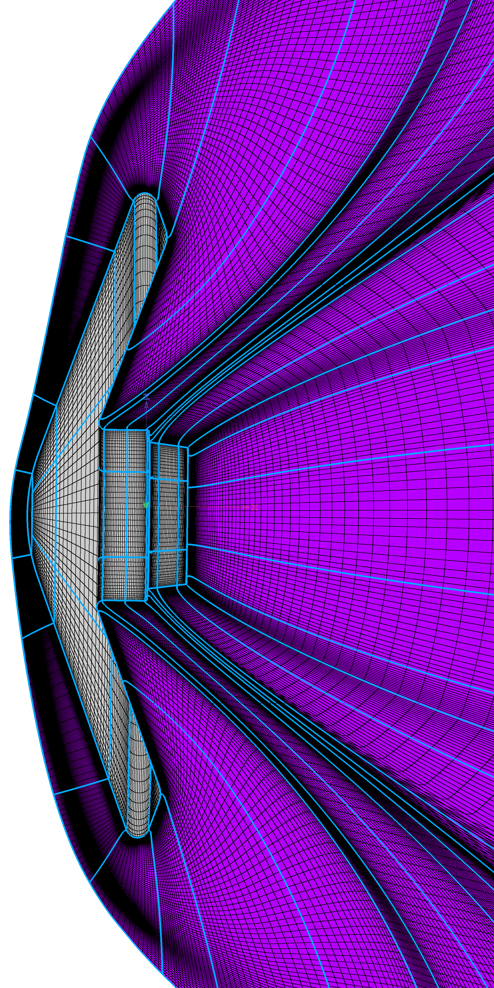
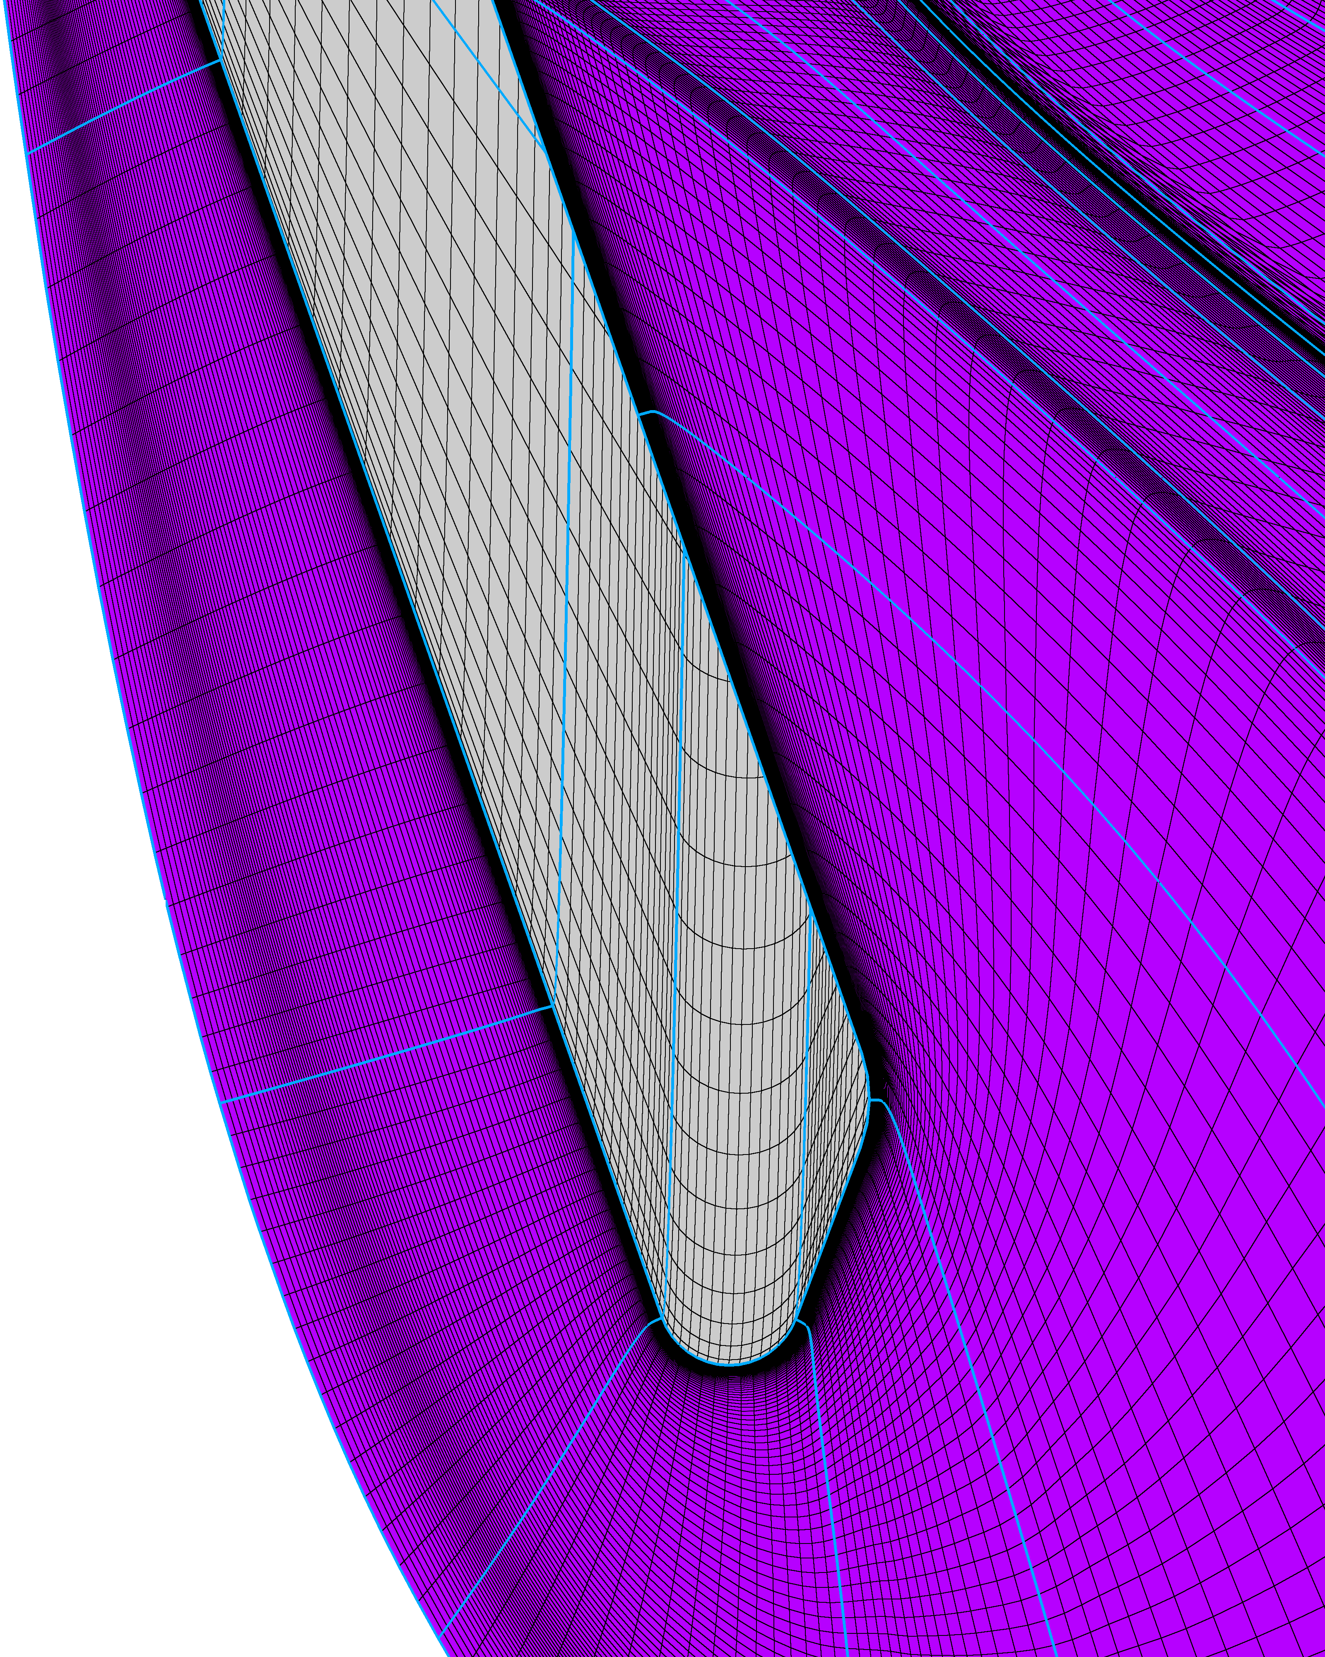
Adapt Grid to Bow Shock
Shock alignment and clustering
Cell Reynolds number
K distribution and stretching

Slide 20
Issues & Advancements

Slide 21
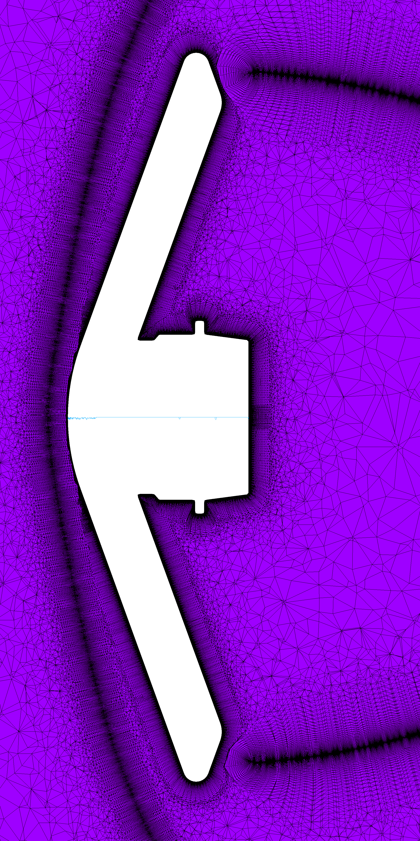
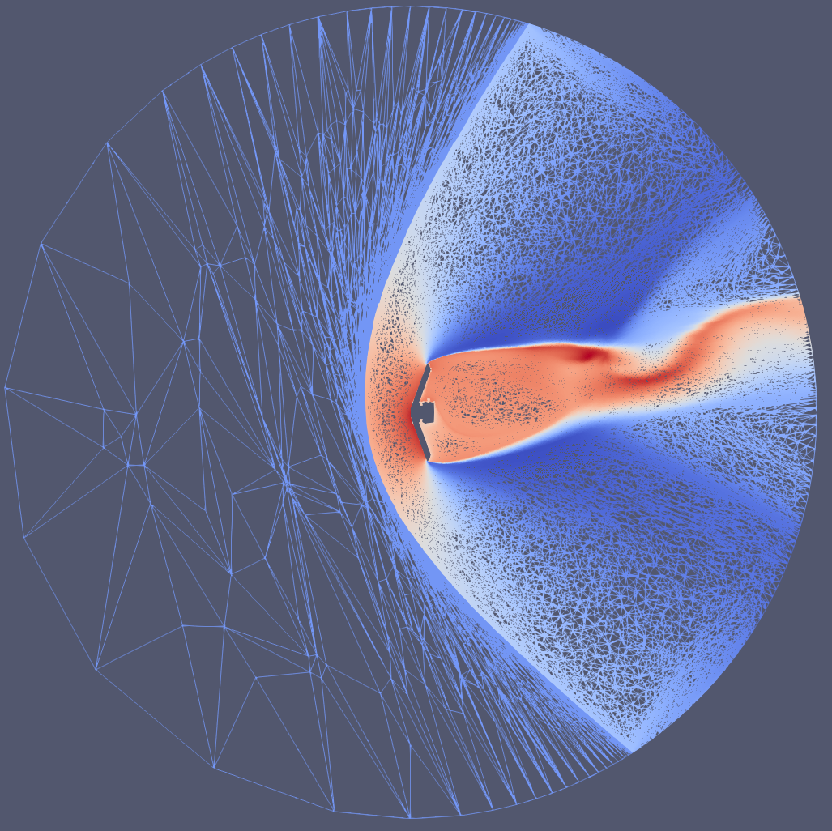
Unstructured Grids
As these problems get complicated, unstructured grids could be a solution
  Much more flexible and their generation can be automated
    Ex. Sketch-to-Solution
  Grid is only part of the “equation”
    Solver and Discretization
  We don’t know what makes a good unstructured grid
  Structured grids are the only robust ways we know of
Hybrid Tet/Prism Grid with local advancing front isosurfaces
Sketch to Solution - Refine

Slide 22
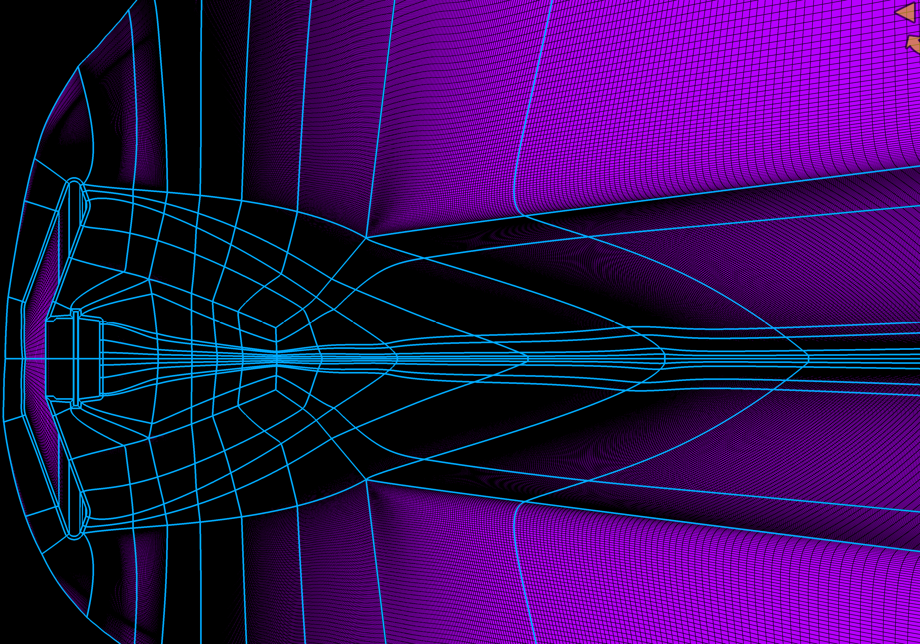
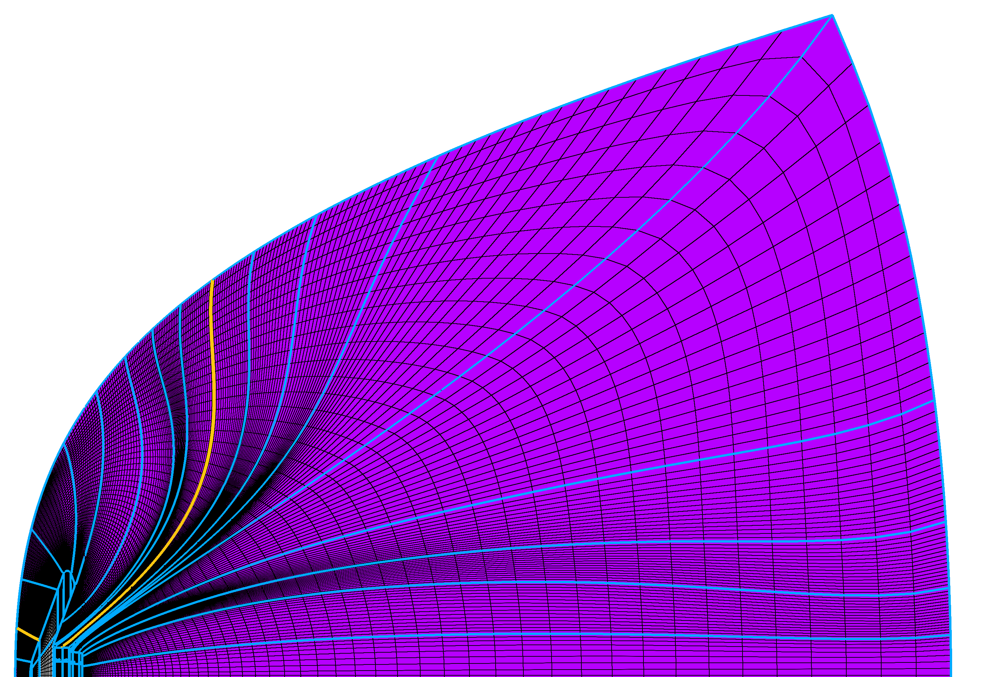
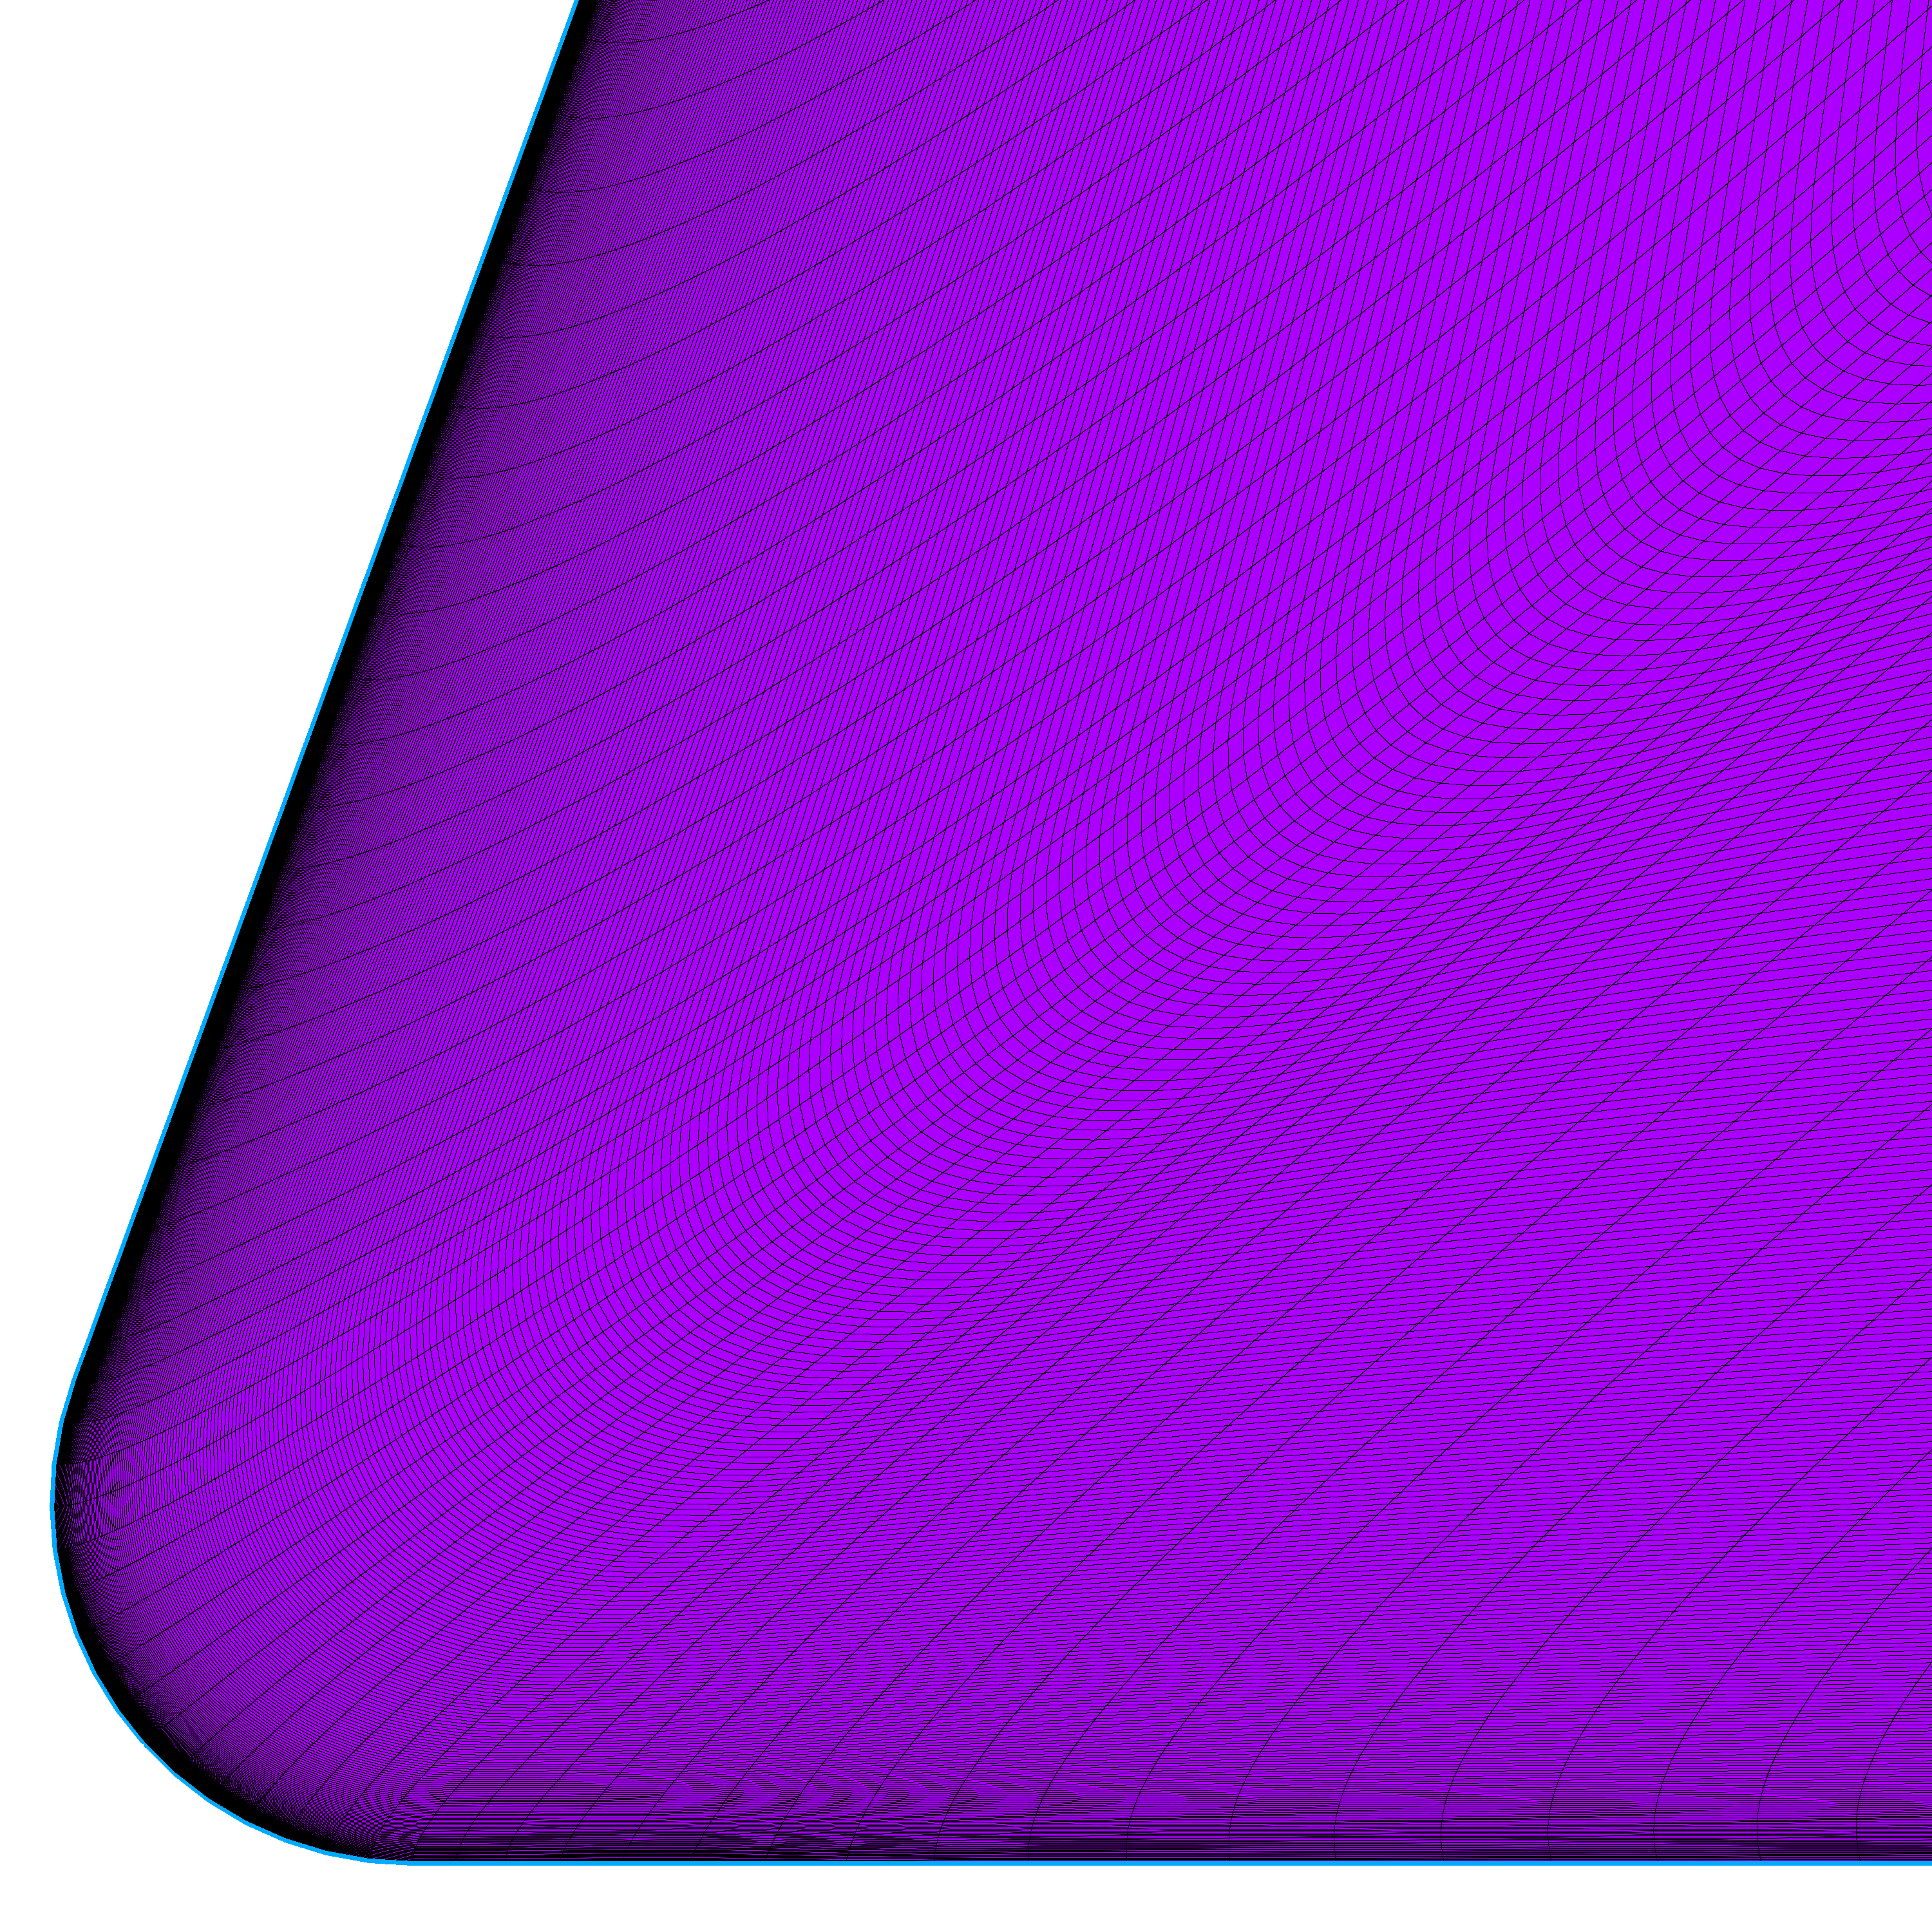
Structured Grid Difficulty
Stacked block topology
Arc Length
Throw more points at it!?
Arc Length

Slide 23
Questions?

